Slide 1
DICTIONARIES
CS1910
Computer Science I

Slide 2
JUPYTER Notebook
https://colab.research.google.com/github/cdspower-upei/2026W-CS1910-Students/blob/main/Lectures/L13/CS1910-Dictionary-Examples.ipynb

Slide 3
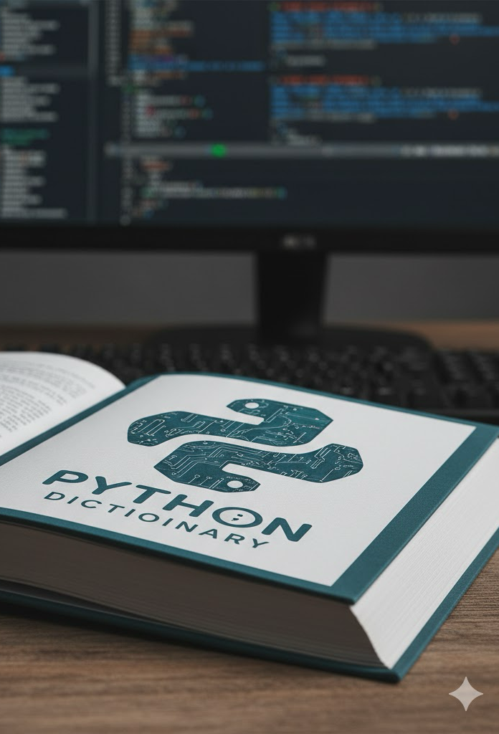
Dictionary
A collection of data (a list is also a collection of data)
Does not use numbered indices
Uses keys to access values
Similar to a real-world dictionary
A word is associated with its definition
Key-value pairs: information stored as pairs, a unique key and its associated value
Mutable
You can add, change or remove items after creating a dictionary

Slide 4
Dictionary
The key in a python dictionary can be any immutable type (int, string, tuple, etc)
The value can be anything (another string, a list, an int, another dictionary)
Example:
Key: student id as a string; Value: a list of strings representing enrolled course codes
Key: course code as a string; Value: the number of students in the class
1 # Students and courses 2 student_courses = {"00100" : ["CS1910", "MATH1910", "STAT1910"]} 3 print(student_courses) # {'00100': ['CS1910', 'MATH1910', 'STAT1910']} 4 course_students = {"CS1910" : 20, 5 "MATH1910" : 30, 6 "STAT1910" : 40 7 } 8 print(course_students) #{'CS1910': 20, 'MATH1910': 30, 'STAT1910': 40}

Slide 5
Creating a Dictionary
1 #empty dictionary 2 my_dict = { } 3 #empty dictionary 4 my_dict2 = dict() 5 #populated dictionary associating names with email addresses 6 contacts = { "Clark Kent" : "ckent@dailyplanet.com", 7 "Superman" : "ckent@dailyplanet.com"}
Values can be any data type and duplicates are allowed
Must be unique and immutable

Slide 6
Dictionary Example
Values can be of different types:
1 contact = {"name" : "Clark Kent", 2 "age" : 33, 3 "address" : "Metropolis" }
{'name': 'Clark Kent', 'age': 33, 'address': 'Metropolis’}
When creating the key always takes the last value it was set to even with type change
1 contacts = {"name" : "Clark Kent", 2 "age" : 33, 3 "address" : "Metropolis", 4 "name" : "Bruce Wayne", 5 "age" : "Unknown", 6 "address" : "Gotham" }
{'name': 'Bruce Wayne', 'age': 'Unknown', 'address': 'Gotham'}

Slide 7
Accessing Values
01 # Using Dictionaries 02 contact = {"name" : "Clark Kent", 03 "age" : 33, 04 "address" : "Metropolis" } 05 print(contact) # {'name': 'Clark Kent', 'age': 33, 'address': 'Metropolis'} 06 # Get value associated with key "age" 07 print(contact["age"]) # 33 08 print(contacts["secret_identity"]) # Produces KeyError 09 # Update key 10 contact["name"] = "Superman" 11 print(contact) #{'name': 'Superman', 'age': 33, 'address': 'Metropolis'} 12 # Add a new Key 13 contact["secret_identity"] = "Clark Kent" 14 print(contact["secret_identity"]) # Clark Kent

Slide 8
REUSING Keys
01 # Duplicate Keys - Results in Overwrite 02 contacts = {"name" : "Clark Kent", 03 "age" : 33, 04 "address" : "Metropolis", 05 "name" : "Bruce Wayne", 06 "age" : "Unknown", 07 "address" : "Gotham" } 08 09 # Reusing keys in creation results in overwriting values 10 print(contacts)
#{'name': 'Bruce Wayne', 'age': 'Unknown', 'address': 'Gotham'}
If you accidentally reuse keys during creation (or later in a program) the value will simply be overwritten

Slide 9
List of Dictionaries
01 #List of Dictionaries 02 contacts = [ { "name" : "Clark Kent", 03 "age" : 33, 04 "address" : "Metropolis" }, 05 { "name" : "Bruce Wayne", 06 "age" : "Unknown", 07 "address" : "Gotham" } 08 ] 09 print(len(contacts)) # Length of list contacts 10 print(len(contacts[0])) # Number of items in dictionary 11 print(contacts[0]) # dictionary at 0 12 print(contacts[1]) # dictionary at 1
In the above case, we are storing repeated dictionaries within a list – that allows us to store sets of values in a predictable way
Output:
2
3
{'name': 'Clark Kent', 'age': 33, 'address': 'Metropolis'}
{'name': 'Bruce Wayne', 'age': 'Unknown', 'address': 'Gotham'}

Slide 10
NESTED Dictionaries
01 # Nested Dictionaries 02 contact = {"Batman": { 03 "name" : "Bruce Wayne", 04 "age" : "Unknown", 05 "address" : "Gotham", 06 "sidekick": {"Robin" : { 07 "name" : "Richard Grayson", 08 "age" : 16, 09 "address" :"Bludhaven" 10 } 11 } 12 } 13 } 14 # Resolve each key in precedence from left to right like lists 15 print(contact["Batman"]["sidekick"]) # {'Robin': {'name': 'Richard Grayson', 'age': 16, 'address': 'Bludhaven'}} 16 print(contact["Batman"]["sidekick"]["Robin"]["name"]) #Richard Grayson

Slide 11
Adding or Modifying Elements
1 # .pop method on dictionary 2 hero_1 = {"name" : "Clark Kent", 3 "age" : 33, 4 "address" : "Metropolis", 5 "email" : "ckent@dailyplanet.com"} 6 age = hero_1.pop("age") #get the value for age and remove key:value pair 7 print(age) # 33 8 del hero_1["address"] 9 print(hero_1) # {'name': 'Clark Kent', 'email': 'ckent@dailyplanet.com'}
Change the value associated with a particular key
Use the [ ] square brackets
Add a new key-value pair by assigning a value to a new key
Use the square brackets [ ] with existing key
Removing a key-value pair
Use del or .pop

Slide 12
A Note on .Pop
It returns the value associated with the provided key (it also removes the key-value pair)
You can provide an optional default which is returned in the case the key does not exist
If no default is provided then None is returned
1 hero_2 = { "name" : "Bruce Wayne", 2 "age" : "Unknown", 3 "address" : "Gotham" } 4 email = hero_2.pop("email", "Unknown") 5 print(email) #Unknown 6 print(hero_2) #{'name': 'Bruce Wayne', 'age': 'Unknown', 'address': 'Gotham'}

Slide 13
Self-check
01 # Self check 02 # nested dictionary 03 films = {"Superman Movies" : { "Superman: The Movie" : 04 {"genre" : "Action", 05 "release" : 1971, 06 "income" : 300500000 }, 07 "Superman II" : 08 {"genre" : "Action", 09 "release" : 1980, 10 "income" : 216000000 }, 11 "Superman III" : 12 {"genre" : "Comedy", 13 "release" : 1983, 14 "income" : 80250000 }, 15 "Superman IV" : 16 {"genre" : "Tragedy", 17 "release" : 1987, 18 "income" : 36700000}} 19 }
As you are likely aware: Superman: The Movie with Chris Reeves and Margot Kidder was released in 1978
Update 1971 to 1978
Change the release date for Superman: The Movie from 1971 to 1978

Slide 14
Self-check
01 # Self check 02 # nested dictionary 03 films = {"Superman Movies" : { "Superman: The Movie" : 04 {"genre" : "Action", 05 "release" : 1971, 06 "income" : 300500000 }, 07 "Superman II" : 08 {"genre" : "Action", 09 "release" : 1980, 10 "income" : 216000000 }, 11 "Superman III" : 12 {"genre" : "Comedy", 13 "release" : 1983, 14 "income" : 80250000 }, 15 "Superman IV" : 16 {"genre" : "Tragedy", 17 "release" : 1987, 18 "income" : 36700000}} 19 }
films["Superman Movies"]["Superman: The Movie"]["release"] = 1978
As you are likely aware: Superman: The Movie with Chris Reeves and Margot Kidder was released in 1978
Update 1971 to 1978
Change the release date for Superman: The Movie from 1971 to 1978

Slide 15
Dictionary Methods
.keys() returns a view object of all keys in the dictionary
.values() returns a view object of all values in the dictionary
.items() returns a view object of tuples of (key, value) pairs
View objects are similar to lists but they are read-only
i.e., they cannot be modified
But they are objects and so they reference the actual underlying data (not a copy)
Support iteration, membership checks, etc

Slide 16
Keys
01 my_dict = {'a': 1, 'b': 2, 'c': 3} 02 # Create a view object for keys 03 keys_view = my_dict.keys() 04 # keys_view can "see" all of the keys 05 print(keys_view) #dict_keys(['a', 'b', 'c']) 06 print(f"Initial keys view: {keys_view}") 07 # Initial keys view: dict_keys(['a', 'b', 'c']) 08 # Modify the dictionary 09 my_dict['d'] = 4 10 # After modifying the dictionary, the keys_view variable 11 print(f"Keys view after dictionary modification: {keys_view}") 12 # Keys view after dictionary modification: dict_keys(['a', 'b', 'c', 'd'])

Slide 17
Values
1 # Same thing with .values() 2 values_view = my_dict.values() 3 print(values_view) 4 my_dict['e'] = 5 5 print(f"Values view after dictionary modification: {values_view}")
Values work pretty much the same as keys – you have a view over them, not accessing the actual values:
“Values view after dictionary modification: dict_values([1, 2, 3, 4, 5])”

Slide 18
items
1 # .items() returns an 'iterable' 2 # Iterable - means it is a data structure that can be iterated over 3 items_view = my_dict.items() 4 print(f"Items view (tuples)): {items_view}")
Lists and dictionaries are both objects that are iterable
That means that they have been defined in a way where you can process them in an order that makes sense
You can provide a method (named anything but usually items()) that can return an iterable even if your data structure is very complicated
Particularly important down the road for trees

Slide 19
Common Iteration Patterns
01 # Iterating over dictionaries 02 my_dict = {'a': 1, 'c': 3, 'b': 2} 03 my_dict['d'] = 4 04 #Iterates over the keys 05 #(in the order they were inserted) 06 for k in my_dict: 07 print(k, end=" ") 08 print() # a c b d 09 #Iterates over the keys 10 #Retrieve keys view 11 for k in my_dict.keys(): 12 print(k, end=" ") 13 print() # a c b d 14 #Iterates over the values 15 for v in my_dict.values(): 16 print(v, end=" ") 17 print() # 1 3 2 4 18 # iterable - data structure that can be iterated over 19 # .items() - returns an iterable of tuples 20 # Iterates over tuples 21 for k,v in my_dict.items(): 22 print(k,v, end= " ") 23 print() # a 1 c 3 b 2 d 4 24 for item in my_dict.items(): 25 print(item[0], item[1], end= " ") 26 print() # a 1 c 3 b 2 d 4 27 #Iterate over the keys but access the values 28 for k in my_dict: 29 print(k, my_dict[k], end= " ") 30 print() # a 1 c 3 b 2 d 4
Iterating over lists comes in many common patterns that you can use in your code:
Iterate over keys
Iterate over values
Iterate over tuples
Iterate over keys but access values

Slide 20
Avoiding a Key Error: .get
.get(key, default=None) returns the value associated with a key (or default) if the key doesn’t exist
.get is useful because of the ability to supply a default. The [ ] operator does not have a default
Therefore extra care is required when using [] to avoid a KeyError which may crash your program

Slide 21
When to Use Dictionaries
Need to create an association
Need fast lookups based on a specific identifier (key)
Order of items doesn’t matter
Examples:
Configuration settings
Counting frequencies
Representing objects or records

Slide 22
FIND A Partner: Ciphers
You are given a list that represents a cipher.
Even positions contain symbols
Odd positions contain meanings
Assume one UNICODE symbol for each ASCII capital letter character
Task: Your task is to translate this list into a dictionary so it can be used to decode messages.
Task: Create a function called transform_cipher that takes in a list and returns a dictionary

Slide 23
FIND A PARTNER: Generalization
Assume that we do not want anyone to know how we have implemented the cipher – it could be a list, or it could be a dictionary
Write two functions:
One named encode which takes in a unencoded string, and returns an encoded string of symbols – but it should use a list inside for doing the encoding
One named decode which takes in an encoded string of symbols and returns the decoded string – but it should use a dictionary inside for doing the decoding

Slide 24
Dictionary Comprehensions
Convert a sequence into a dictionary
new_dict = {key_expression : value_expression for item in iterable}
Key : Value Pair
Example:
numbers = [1, 2, 3, 4] squared_dict = {num: num ** 2 for num in numbers} # Result: {1: 1, 2: 4, 3: 9, 4: 16}

Slide 25
Examples
#optional condition original_dict = {'a': 10, 'b': 25, 'c': 5, 'd': 30} filtered_and_doubled = {k: v * 2 for k, v in original_dict.items() if v > 15} # Result: {'b': 50, 'd': 60}
# dictionary from list of tuples data = [('apple', 1), ('banana', 2), ('cherry', 3)] fruit_counts = {fruit: count for fruit, count in data} # Result: {'apple': 1, 'banana': 2, 'cherry': 3} print(fruit_counts)

Slide 26
Conditional Expression
Can be used anywhere an expression is expected
value_if_true if condition else value_if_false
Examples:
# conditional expression time = 13 print( "good morning" if time < 12 else "good afternoon")
#if-else condition data = {'A': 10, 'B': 5, 'C': 12} transformed_values = {k: "High" if v > 10 else "Low" for k, v in data.items()} # Result: {'A': 'High', 'B': 'Low', 'C': 'High'}

Slide 27
Self-check
What is stored in status?
# Self-check age = 20 status = "Adult" if age >= 18 else "Minor"

Slide 28
Self-check
realnames = { "Marilyn Monroe" : "Norma Mortenson", "Nicolas Cage" : "Nicolas Coppola", "Albert Brooks" : "Albert Einstein", "Elton John" : "Reginald Dwight"} #What is stored in rev? rev = { realnames[k]:k for k in realnames} print(rev)
Notes:
Reversed dictionary

Slide 29
Extra Practice with Mutable Objects
mt1 = [99, 98, 97, 90, 82, 55] mt2 = [96, 94, 90, 81, 47] grades = { "MT1" : mt1, "MT2" : mt2 } #also alters the mt1 list grades["MT1"].append(46) #changes what grades["MT1"] refers to grades["MT1"] = grades["MT1"][0:2] print(grades) print(mt1)

Slide 30




Find a Partner
You have a 2-dimensional image where there is a boundary of some kind.
Example:
An outline of your favourite character
A map with a coastline boundary
You have 3 characters that can represent inside the boundary, outside the boundary, and the boundary itself:
@ - Boundary
# - outside the boundary
. – Inside the boundary
Encoded message: @ = 1, # = 0, . = 2
How would you store the picture?
How would you store the translation?
How would you store the mapping between characters?
Sketch the algorithm you would use to create the encoding
Translate that into Python

Slide 31
Encoding Example
0 0 0 0 0
0 1 1 1 0
0 1 2 1 0
0 1 2 1 0
0 1 1 1 0
0 0 0 0 0
# # # # #
# @ @ @ #
# @ . @ #
# @ . @ #
# @ @ @ #
# # # # #

Slide 32
Try At Home: Character Frequency
Consider that we want to count the number of times a letter appears in any text
Example: "the quick brown fox jumps over the lazy dog"
{'b':1, 'r':1, 'o':2, 'w':1, 'n':1, 'd':1, 'g’:1}
Write an algorithm that creates this dictionary from any text
What questions do you need to ask about the design?
Now, assume that we want to reuse this algorithm again and again – what is the function that you would define?

Slide 33
Try at home
Create a dictionary to store information about your favorite book
Author, title, year, pages, etc
Create a dictionary where the keys are book titles and the values are a dictionary like the one you created above
Add 3 books to this dictionary
update the pages for each entry to increase it by 1
For a given string create a dictionary to count the occurrences of each letter in the string

Slide 34
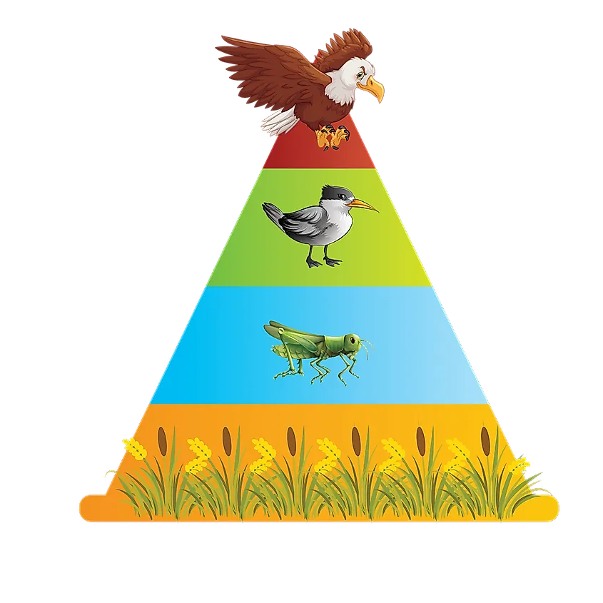
Try At Home: Food chain (Challenging)
Find a Partner: Food Chain
Some creatures producers, meaning they do not eat anyone other creature. Others are apex predators meaning they are eaten by no one else. Some creatures only eat producers, meaning they are vegetarian.
Assume that we have food systems that are stored in lists.
The first in the list is the predator and the remaining is a list of prey that they eat.
Example: Birds eat Prawn, Mussels, Crab, Limpets and Whelk
Bird,Prawn,Mussels,Crab,Limpets,Whelk
Consider:
How would we transform these into a dictionary that would help us manage our data better?
What is the design of your dictionary? Do you need to know anything else?
How do we do it as a loop? How do we do it as a comprehension?
After creating that dictionary, answer each of the following questions?
Determine the apex predators
Determine the producers
Determine the tastiest organisms (most eaten)
Determine the omnivores who eat both producers and non-producers?
At each step consider - can you use parts of your previous solution?

Slide 35
Try At Home
Consider the predator-prey relationship: predators eat prey
Bird,Prawn,Mussels,Crab,Limpets,Whelk
Crab,Mussels,Limpets
Fish,Prawn
Limpets,Seaweed
Lobster,Crab,Mussels,Limpets,Whelk
Mussels,Phytoplankton,Zooplankton
Prawn,Zooplankton
Whelk,Limpets,Mussels
Zooplankton,Phytoplankton

Slide 36
Conclusion
Dictionaries are a data structure capable of storing key and value pairs
They offer fast lookup capabilities given a key
They are a mutable object
But the keys must be comprised of an immutable type
Combined with Lists they offer mechanism to represent many data storage options

