Slide 1
Files and Folders Reading from Files Writing to Files
CS1910
Computer Science I

Slide 2
Types of Storage
Program data when running is in memory only when power is running
Programs themselves need to be stored for long term use even when power is turned off
Internal Storage Devices:
Hard drive
Originally tape, then spinning platters of discs, increasingly are solid state drives (SSD)
External Storage Devices
External drives that are connected via USB or other connector
USB sticks – smaller versions of SSD that can be removed
Increasingly – cloud services
Can hold: text, images, videos, programs, binary information

Slide 3
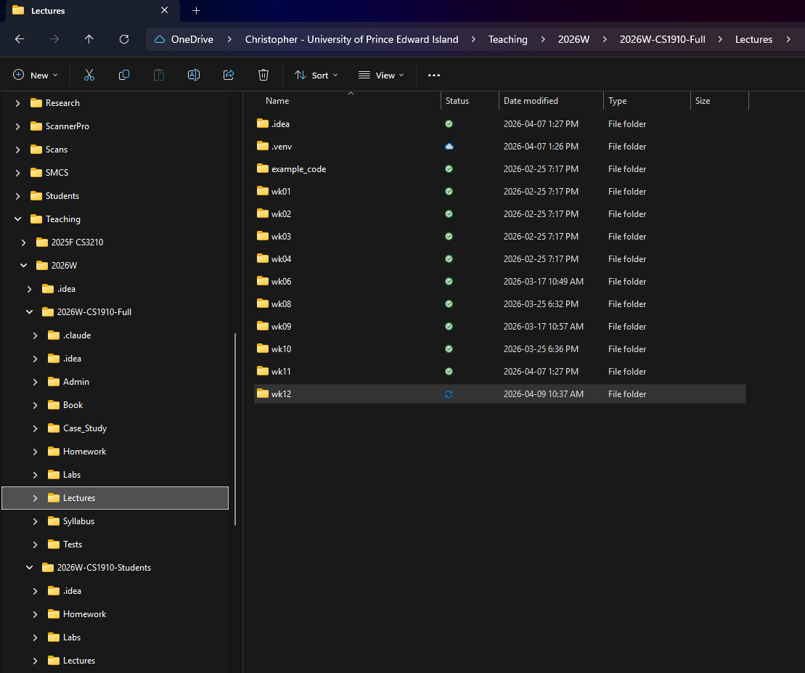
File Systems
File – a structured collection of data that is grouped under an abstraction of a name with an “extension” that tells you the type of data that is stored within
Folder – an abstraction that gives a name that collects files together that are related to one another (previously called “directory”)
The metaphor is that of folders in an office drawer that hold files of paper – like a case file in a lawyer’s office
Where it breaks down as a metaphor is:
Files can be put in folders
Folders can be put in other folders creating hierarchies
A unique location of a file is defined by it’s path:
\Teaching\2026W\2026W-CS1910-Full\Lectures\wk12\Lecture-FileIO.pptx (Windows)
\Teaching\2026W\2026W-CS1910-Student\Lectures\wk12\Lecture-FileIO.pptx (Windows)
/Teaching/2026W/2026W-CS1910-Student/Lectures/wk12/Lecture-FileIO.pptx (Mac, Linux)

Slide 4
DatA File Formats
Two main file formats:
Text
Readable by humans
Everything is a string (even numbers)
Binary
Generally not readable by humans
The data is binary encoded stored in groups of bytes (8 bits)
Binary is 0-1 encoding where each 0 or 1 is called a bit
Offer some efficiencies in storage
Not the focus in this course (aside from understanding they exist)
Examples: images, songs, programs

Slide 5

Text Files
Some common Text files:
Plain text: .txt, .md
Source code: .py,
Structured Data: .csv, .ipynb
hypertext: .html
You can open any of these files with a “text editing” program and read the contents

Slide 6
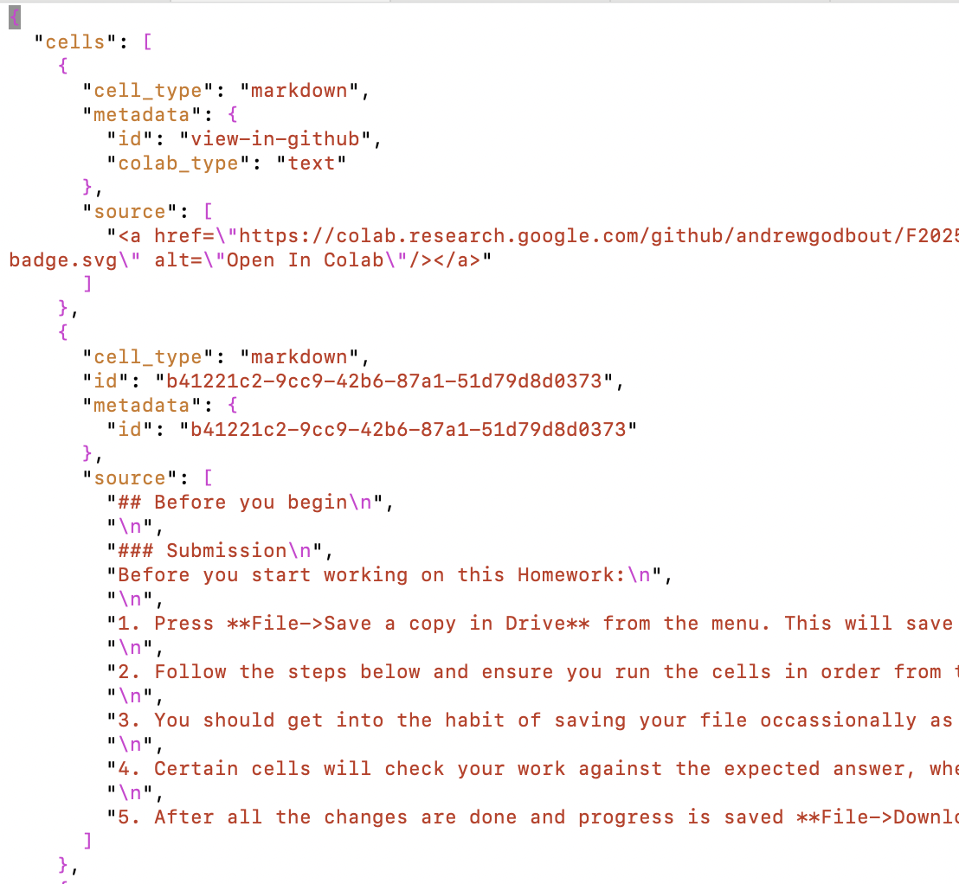
.ipynb
Opening HW7.ipynb with a text editor reveals:
Even our Notebook files are plain text
That is JSON (the syntax is similar to a python dictionary)

Slide 7
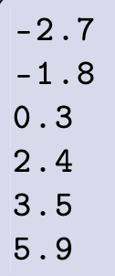

Opening and closing a File in Python
f can be used to read the file
Filename to open
Flag to indicate read
temperatures.txt
contains one temperature listed on each line of the file
Always close a file when you are done
(releases the resource)
f can no longer be used to read the file

Slide 8
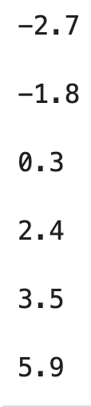
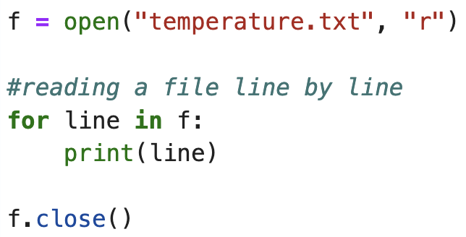
Reading Files
Read a file line by line
temperatures.txt
output

Slide 9
Reading Files
Read a file line by line
temperatures.txt
output
Why the extra space
after each line?

Slide 10
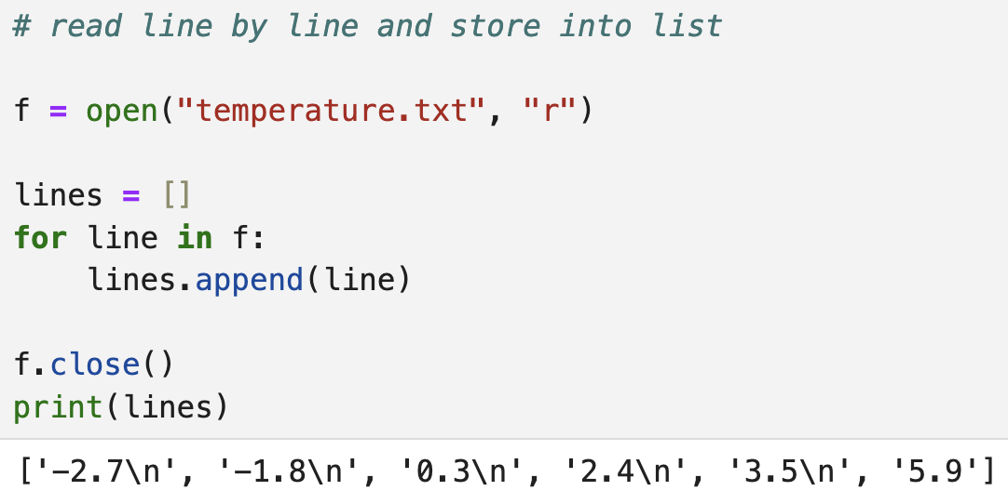
Reading Files
The file ends abruptly
The newline character is read with each line as well

Slide 11
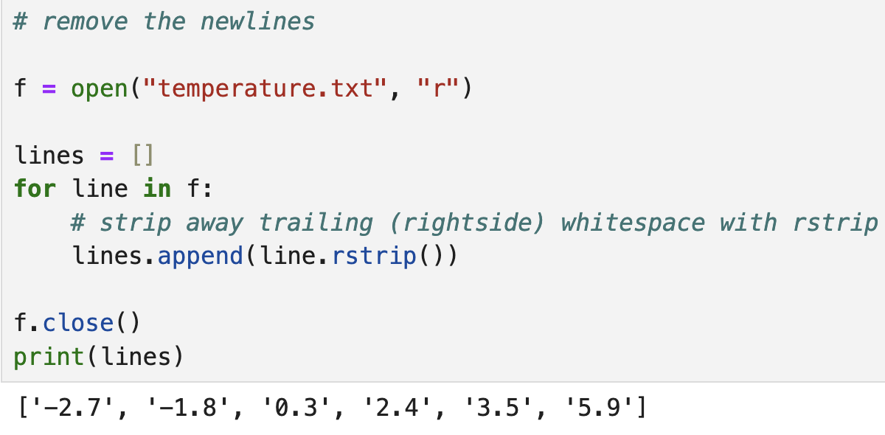
Reading Files

Slide 12
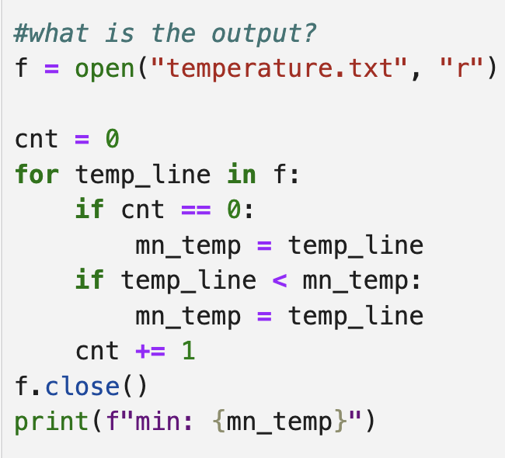
Self-Check
temperatures.txt

Slide 13
Self-Check
The lexicographically ordered smallest line of text from the file
i.e.,: “-1.8”

Slide 14
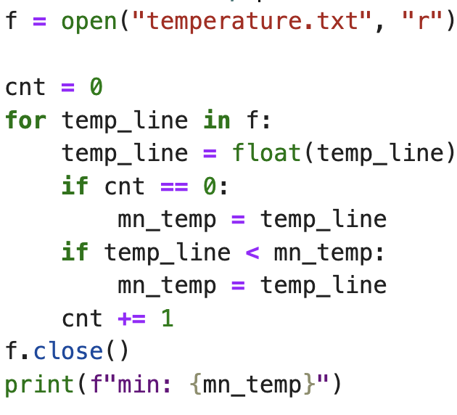
Converting Text

Slide 15
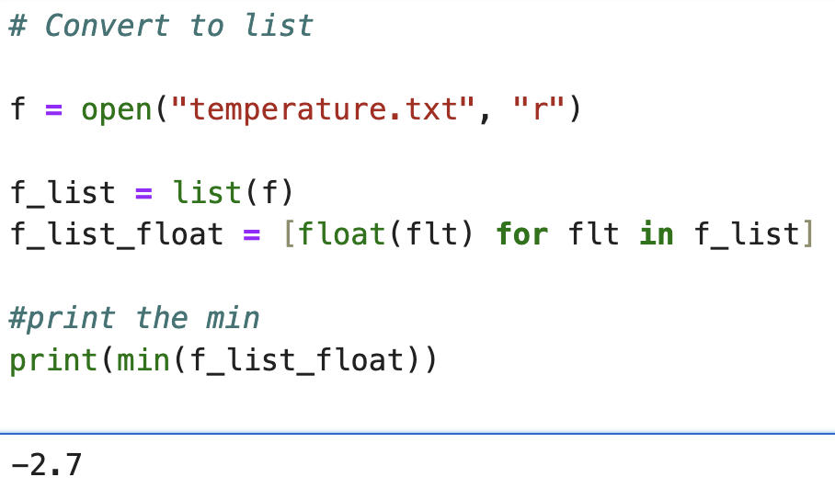
READING FiLES
An alternative to the repetition-based line reading

Slide 16
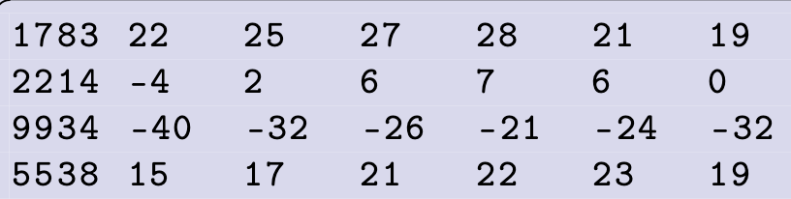
Consider a Tabular File
temptable.txt
Weatherstation ID
Temperatures from that weatherstation

Slide 17
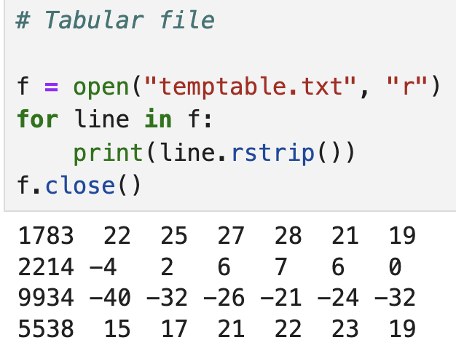
Tabular File
How to access this 6?

Slide 18
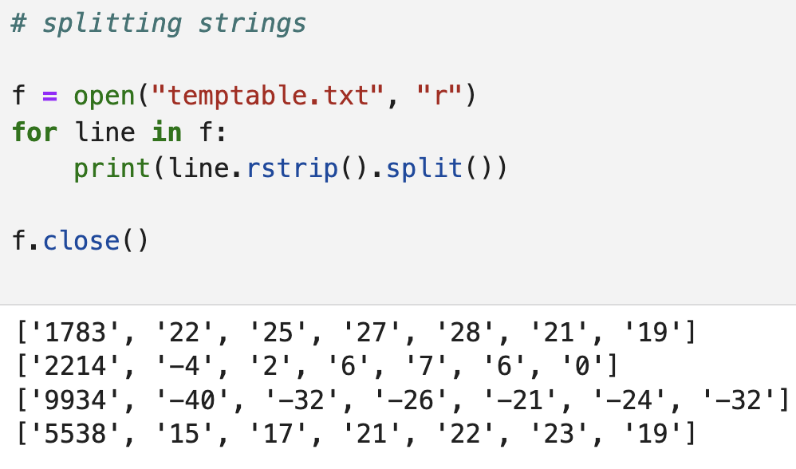
Split Strings
split() accepts a delimiter (whitespace by default)

Slide 19
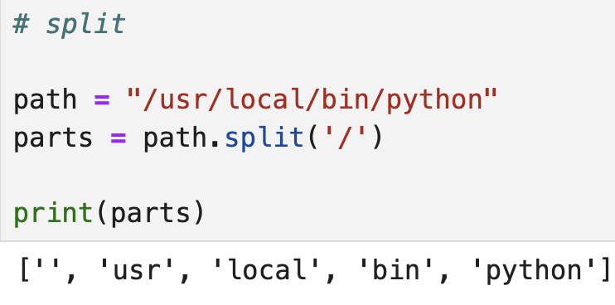
Self-check
What is the output?
Delimiter to determine split points

Slide 20
Self-check

Slide 21
Writing Text Files
Write: creates or overwrites the contents of a file
Append: creates or appends to the contents of an existing file

Slide 22
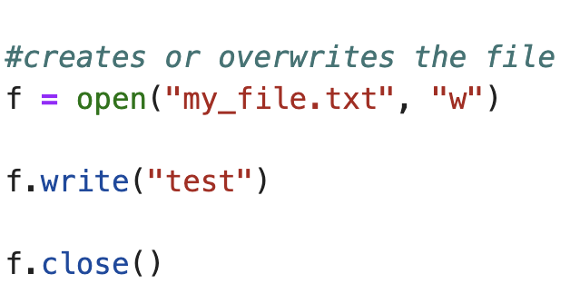
Write examples
Does not automatically add a ‘\n’

Slide 23
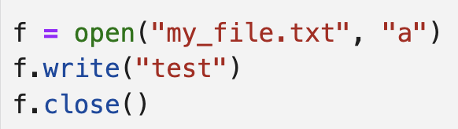
Write examples
If you ran this code over and over it would append ”test” to the file over and over

Slide 24
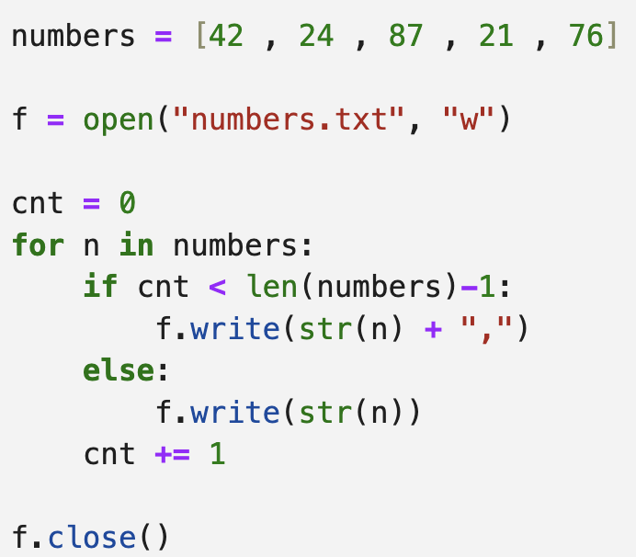
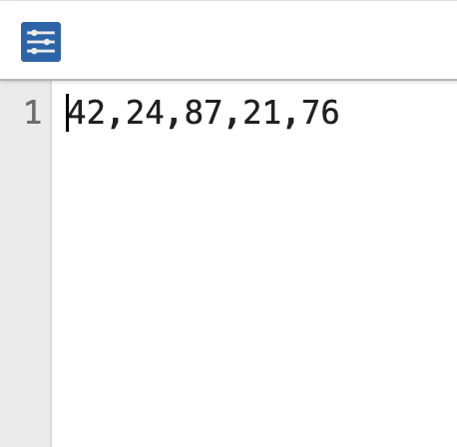
writing
Consider we want to write a list of numbers out to file
numbers.txt

Slide 25
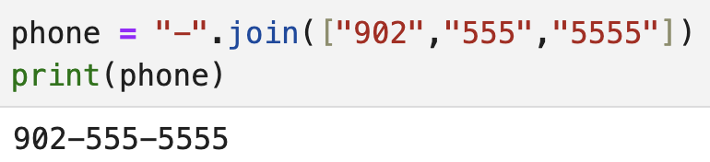
String .join
.join concatenates a sequence of strings together with a specified separator
the separator is the string on which .join is called
Example:
separator
Sequence of strings

Slide 26
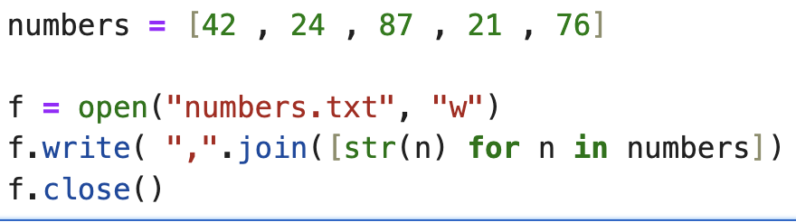
Writing to file
numbers.txt
.join with list comprehension to convert the ints to strings

Slide 27

Paths
Absolute paths: specify the entire path from the beginning of the file system to a particular file
Windows example:
macOS example:
At the start of the file system in the folder home then chris then Documents there is a file awesomedata.csv

Slide 28

Paths
Relative paths: specify the path from a current working directory (example where your program is running
.. Is a special name that refers to the parent directory
. Is a special name that refers to the current directory
Parent directory
From our current directory go up to the parent, go up to the parent again, then enter a directory called experiment then data and find a file specialdata.txt

Slide 29
OS Differences
On windows paths are separated using a backward slash “\”
On macOS and Linux paths are separated by a forward slash
To avoid writing code that only works on windows or linux for example
Use the os module and path.join

Slide 30
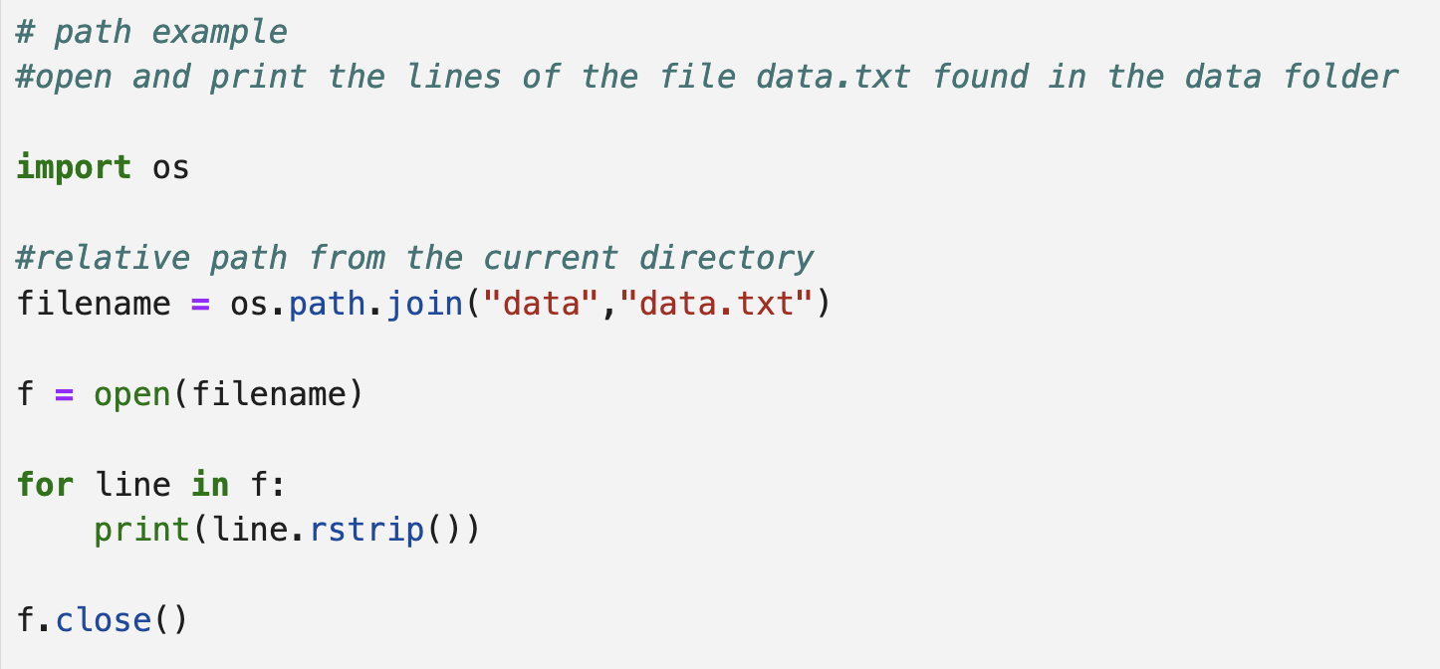
Path .join
Do not need to worry if it is “data/data.txt” or “data\data.txt”

Slide 31
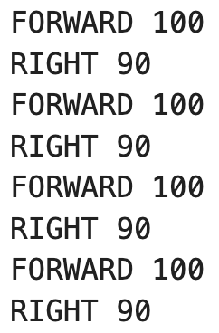
Find a Partner
Read each line of the instructions into a tuple containing the command and the integer value e.g.:
instructions.txt
[('FORWARD', 100), ('RIGHT', 90), ('FORWARD', 100), ('RIGHT', 90), ('FORWARD', 100), ('RIGHT', 90), ('FORWARD', 100), ('RIGHT', 90)]
command
Integer value

Slide 32
Try At Home
Count the words in the file gentle.txt found in the directory poem
Print out the number of words in the file
Read the text file game_board.txt into a 2D list where each position in the 2D list is a single character
print out the location of the “P” (index position in the 2D list)
Ask the user to enter their first name and then create a file called their name and the extension .txt
Add the length of their name to the file

