Slide 1
Lecture Objectives
Students will be introduced to:
The course, the instructors, and how lectures, labs, and homework fit together [—]
The syllabus, grading breakdown, and the "pass the tests" requirement [—]
Academic integrity expectations, including appropriate and inappropriate use of GenAI [—]
The culture of the course: valuing the problem-solving process over "getting the answer" [CI01]
Student resources and supports (accessibility services, office hours, the help centre) [—]
Computational thinking as the organizing idea of the course (a preview of Lecture 2) [CI01, CI07]
What Computer Science is, using examples (e.g. gaming, 3D animation) to challenge preconceptions [CI07]
The tools and environment used in the course (Google Colab / Jupyter, Python 3, Moodle) [—]
What it means to be a "good" programmer: problem solving, abstraction, logical reasoning, creativity [CI01, CI06]

Slide 2
Lecture Preparation
Technical setup
Have the syllabus, grading table, and academic-integrity regulation link ready to display.
Bring an internet-capable device and confirm the room projector shows external links.
Content to review
Skim the "pass the tests" worked examples so you can answer grade-scenario questions confidently.
Refresh the two "Is this Computer Science?" examples (gaming, 3D animation) and be ready to prompt discussion.
Classroom flow
Plan the ~3-minute "Is this CS?" group brainstorm (groups of 3–5) and leave time to share out.
Reserve ~2 minutes for the first participation check so students practice the routine early.
Gotchas to anticipate
Students fixate on the "pass the tests" rule — have the FAQ examples ready to defuse anxiety.
Set expectations now that photographing code off the board correlates with lower success; emphasize the process.
Clarify the appropriate-vs-inappropriate GenAI boundary early; it recurs in Lecture 2.
Notebook ↔ slides
No example notebook for this lecture (intro/admin only) — nothing to reconcile.

Slide 3
Course Introduction
CS1910
Computer Science I
Introduction and Orientation

Slide 4
Instructors
2026F-CS1910-01
Instructor: Christopher Power
Office: Cass Science Hall 208 (Just inside the main SMCS Office)
Email: cdspower@upei.ca
Lectures: T/Th 8:30 AM - 9:45 PM
Office Hours: Wednesdays 10:30 AM-11:30 AM or email to schedule a meeting
2026F-CS1910-02
Instructor: Dania Tamayo-Vera
Office: Cass Science Hall 203F
Email: dtamayovera@upei.ca
Lectures: T/Th 8:30 AM - 9:45 PM
Office Hours: Wednesdays 12:45 PM -2:15 PM or email to schedule a meeting
Labs:
Instructor: Chris Vessey
Office: Cass Science Hall 308
Email: cvessey@upei.ca
Lab Times: 3 sections Most weeks starting in week 2; CSH 104

Slide 5
Course Description
From the Academic Calendar:
Students will be introduced to computational thinking. They will learn how abstraction and decomposition can be used to solve problems and how to create, analyse and trace their own algorithmic solutions. They will iterate and improve their solutions through pseudocode and through implementation in a procedural programming paradigm.
They will learn the following programming constructs:
built-in types and user defined types,
decision structures,
repetition structures,
functions, and
ways to represent data.
They will learn to test their code through unit testing to ensure correctness of their programs.

Slide 6
Learning Objectives
Solve problems using computational thinking
Decomposing problems into smaller tasks
Recognizing patterns
Forming pseudo-code to outline solutions
Ability to create procedural programs in python
Competency using repetition, decisions, functions and data types in python
Ability to interpret and read procedural programs in python
Validating and debugging programs
Familiarity with computational thinking and programming terminology

Slide 7
Syllabus Overview
Grading
Lectures
Homework
Environment
Google Colab / Jupyter Notebook / Textbook / Moodle
Tests / Final Exam
Academic Honesty
Accessibility
How to be successful

Slide 8
Grading
Assessment | Value
Class Participation | 5%
Homework | 18%
Labs | 12%
Midterm Test 1 | 15%
Midterm Test 2 | 15%
Final Exam | 35%
Date: October 6, 2026
Date: November 3, 2026
Date: During final exam period
Dec 11-23, 2026
You must pass the combined Tests (midterm 1, midterm 2 and final exam) to pass the course. 50% of your final grade is Tests, you must achieve at least 30% of your final grade from tests to pass the course. Otherwise your final grade is at most 45%.

Slide 9
Pass the Tests
The pass the tests stipulation exists to ensure students moving beyond CS 1910 have demonstrated a basic level of understanding in the course content.
It also allows us to allocate a large number of points (35%) towards non-test grades so that students who struggle in testing environments can significantly boost their grade by performing well in other areas.
Example:
Student A : Midterm 1 (40%), Midterm 2 (50%), Final Exam (55%), Labs (80%), Homework (80%), Participation (80%)
Final Grade: 65%
Student B: Midterm 1 (40%), Midterm 2 (60%), Final Exam (40%), Labs(100%), Homework (100%), Participation (100%)
Final Grade 45% (student did not pass the tests portion of the course)

Slide 10
FAQ
I did not pass Test 2, does that mean I have failed the course?
The Pass the tests stipulation considers the tests on aggregate; you must achieve 30% (or more) of your final grade from tests.
I did not get 30% or more of my final grade points from tests, but if I add up all of my other grades it averages out to 60%, therefore I pass the course, right?
Regardless of your other grades, if you do not “pass the tests”, you receive a maximum grade of 45.
Can I do a make-up test?
There are no make-up tests. Once a test is complete it is complete.
What happens if I miss a test?
The points for that assessment are rolled equally onto other as yet unwritten tests.
If you miss the final exam you should notify the Registrar’s Office immediately
Please do not plan to travel during the exam period in case there are cancellations

Slide 11
Midterm Tests
Written on paper during regular class time
Dates are posted in the syllabus
May consist of multiple choice, short answer, long answer or coding
Try at home questions, homework, labs, lectures and textbook materials are all considered as potential question materials

Slide 12
Academic DISHonesty
This course adheres to section 20 of the UPEI Academic Calendar section 13: Undergraduate Academic Regulations regarding Academic Integrity
https://calendar.upei.ca/current/chapter/undergraduate-and-professional-programs-academic-regulations/
You should read and be familiar with this regulation (and all other undergraduate regulations!)
Penalties for Academic Dishonesty
All penalties will be determined on a case-by-case basis
Normally, a first violation is loss of all marks on the component.
Normally, a second violation can lead to a 0 in the course.

Slide 13
Academic Dishonesty
Examples of academic dishonesty (a non-exhaustive list)
Copying the work of others on individual assessments (homework or test for example)
Use of Generative AI to answer exam questions
Sharing your solutions to individual assessment questions with others
Impersonating others
Unauthorized use of electronic or smart devices

Slide 14
Accessibility
For those students who may require accommodations for portions of the course, it is your responsibility to register with student services
Accessibility services will contact the professor to communicate appropriate accommodations
https://www.upei.ca/accessibility
For any aspects of the course – lecture, labs, assignments and tests - please come have a discussion accommodations with us to identify what alternatives will work best for you
Both midterms are already in the accommodate system already, and you can register for them right now!

Slide 15
Lectures
Attendance and Participation are expected
Participation is part of final grade
Slides posted to Moodle
Even if you miss a lecture you are expected to learn the material by consulting colleagues and reading slides
Last slides typically contain try at home suggestions
Not graded but often similar to exam questions
Come prepared to ask about them during the next class
Solutions are not pre-emptively posted
Designed to help you keep pace not as a cram session for midterms

Slide 16
Participation
Most classes will have a brief pause to fill out a participation link. Please ensure you have an internet capable device in class.
These are as much about you checking your own knowledge as me knowing where the class is in their knowledge of a topic
5% of final grade is in-class participation
If you participate in 75% of the opportunities you receive full marks for participation, otherwise your grade is the amount you participated in divided by 75% of the total opportunities (then scaled out of 4)
Example: There are 20 opportunities, 15 would mean full marks. If you participated in 12 of those opportunities. your participation grade would be 3.2/4.

Slide 17
Participation FAQ
Do I have to be present in the classroom to participate?
No, anyone completing the interaction from their Moodle account will receive credit
Can I participate multiple times for a single interaction opportunity
It will only count as participating in one class
Why have class participation if I can sit at home and refresh my browser for hours waiting for the link to become live and never actually be present in class thus winning the course?
One of the goals of the course is to help build a network of colleagues, and have engaging lectures, most people will show up and participate thus contributing to everyone’s experience
It helps me know what content needs more explanation or examples to help the class fill in the gaps.
What if I miss a class, can I be excused from participation?
Everyone is excused from 25% of the participation grades, if you miss more than 25% of the participation opportunities you will not receive a100% grade for participating
If you have an issue that precludes you from more than 25% of the course please speak to the me

Slide 18
Labs
Mandatory Attendance starting the week of September 14, 2026
Google Colab notebook – workbook style
Bottom up learning of coding practices
Answer questions together with a partner
Pair coding to develop skills and help each other out
Practice our skills in a safe environment that has low risk
Labs are worth 12% of total grade
8-9 Labs starting in Week 2
Attend and participate in the lab = 2 point
Lab grade is out of 12
Grading is based on participation
Attend and participate in 6 labs = earn 12/12 = 12% of final grade

Slide 19
Homework
Many weeks there will be a homework assignment that is intended to be independent work
Completed through Google Colab
Submitted on Moodle
Save your completed notebook to drive and then upload to Moodle
Due before Friday of the next week before 5pm
These assignments help you integrate the top-down knowledge you are gaining in lecture with the bottom-up skills you gain in your lab and personal practice.
A first homework will be released this week to help you get used to the way we do these assignments and help you through any issues.

Slide 20
Environment
Programming Tools
Google Colab / Jupyter Notebook
Browser based coding environment
Python 3
Google Drive
Moodle
Please bring an internet capable device to class
No installs or special computer equipment required
Textbook
CS1910 — Computer Science 1 2nd Edition
Course topics roughly align with the textbook
Course has evolved since the book was written and so we will not go entirely in the same order

Slide 21
Moodle
Course Notes Posted to Moodle
Announcements made via Moodle
Homework submitted via Moodle
Class participation facilitated via Moodle
Grades posted to Moodle
Class Participation is currently open at moodle31.upei.ca under CS 1910
2 minute break to participate in today’s class by answering a couple of questions

Slide 22
How to be successful
A portion of the assessment for the course will involve programming
You will be asked to implement solutions to questions you have never seen before
Start today – keep pace with the course
Decompose a problem, write some code, recognize patterns in problem solving, abstract details
Practice daily ~ 20 minutes of coding
Don’t bypass the learning
GenAI can assist with many aspects of the course (or help you bypass the learning)
Don’t put yourself on the stress treadmill by bypassing learning
Very hard to unsee solutions and subsequently focus on the process
Everyone can score a high mark in CS 1910
It comes down to approach, attitude and practice

Slide 23
IS CS 1910 Easy or Hard?
- Communicating with a computer
- Interpreting error messages
- Analyzing/creating programs with strange tools
(so) Many ways to solve a problem
Operating System environment
Neither?!?!
Computer Programming has several hurdles
This can de-motivate students
Students in upper years point out “how easy” the 1910 work is
Towards the end of the term you too will look back at the early topics and believe them to be simple
All of us have faced similar challenges when we first encountered computer programming
Practice makes progress
Focus on the journey
If you practice your skills regularly you should find success in this course
Hard to make up time in CS 1910 – cramming isn’t as effective as in courses where memorization or common sense make up large portions of the grade
Time management and consistency are challenges
Ignoring the effort, they put forth to master the subject

Slide 24
Being a ”Good” Programmer
The same Computer Science Educators were asked skills and qualities are consistent with a “Good” Programmer:
Problem solving
Ability to abstract and decompose
Structure and create readable code
Reason and work logically
Creativity
No mention of writing instructions for computers!
Same group as prior slide
Less tangible skills are most important in being a “good” programmer
Added benefit: more impervious to AI
https://cacm.acm.org/opinion/what-is-programming/

Slide 25
Course Goals
Develop computational thinking skills as problem solvers to become “good” programmers
Abstraction and decomposition
Problem solving
Logical thinking
Creativity
Learn the basic programming skills
Reading and writing python instructions
Planning programs
Validating solutions
A little more challenging to test and assess
Be mindful not to bypass the learning by having someone else do the work (AI or other)

Slide 26
Extra Comment on AI
While we do not know exactly what the future of programming holds we do know that AI is currently capable of solving most basic programming tasks
In some instances, in the course (e.g., next lecture) we will be asked to use AI to help solve a task, but in most instances the default for this course is to do the work and learning without AI assistance.
If you use AI to provide an answer you lose out on the opportunity to learn the skills (you bypass the learning opportunity)
It is very difficult to un-see a solution once you have seen it
If you trust the process, you should be successful in the course, if you bypass the learning and focus on the solution you may have trouble with aspects of the course
When we look to the future, very likely the computational thinking skills you will learn through the process is more important than the specific programming language

Slide 27
Expectations
Attend 2 Lectures per week (2.5 hours)
Attend 1 Lab per week (1.25 hours)
Complete 1 Homework each week (1 hour)
Try at Home practice problems (1 hour + 1 hour = 2 hours)
Study / Reading (1 hour)
Total expectation is approximately 8+ hours per week
If you are taking 5 courses you should expect 40 hours of work per week

Slide 28
Big Picture Course Assessment
35% of grading is Labs, Participation and Homework
Take advantage of this learning opportunity
Time management is critical to ensuring the learning happens in this 40%
65% of grading is traditional tests
Written on paper
Tests will be made up of theory, practical, problem solving and coding questions
Expected to be able to read and write code
Expected to be able to build solutions to new problems
But if you do the first part, you will succeed on the tests – the first prepares you for the second

Slide 29
Success Anecdotes
Student who hated CS and then changed their approach
Studied the textbook inside and out … barely passed CS 1910
Changed to a practice makes progress approach (20 mins per day) scored A+ in CS 1920, went to graduate school
“If you know what you are being asked to do, then you have already solved the problem”
Student focused on memorizing solutions – took photos of code written on the board – failed 2 midterms
Changed approach to focusing on the process – What am I being asked to do?
One of highest marks on final exam (A) (4 weeks after failing midterm 2)

Slide 30
FAQ: What should I practice?
Each lecture has some practice suggestions near the last slides
If examples were done in class, see if you can remember the plain English description of what was done
Can you reproduce a solution from the description
Focus on the process – what did we try to accomplish in class as opposed to what syntax did the professor write on the board
Generally, students who take photos of code on the board do not do well in the course
Ask GenAI to give you some sample problems
Visit Office hours

Slide 31
Programming
Computer Science Educators were asked “What is programming?”
Reading Code
Composing Code
Planning Structure
Solving Problems
Validating Solutions
Large focus on ability to instruct the computer
Minor Themes
algorithms
importance of the computer
automation
programming languages
execution of code
https://www.tandfonline.com/doi/pdf/10.1076/csed.13.2.137.14200
https://cacm.acm.org/opinion/what-is-programming/

Slide 32

Questions

Slide 33

Is this Computer Science?

Slide 34
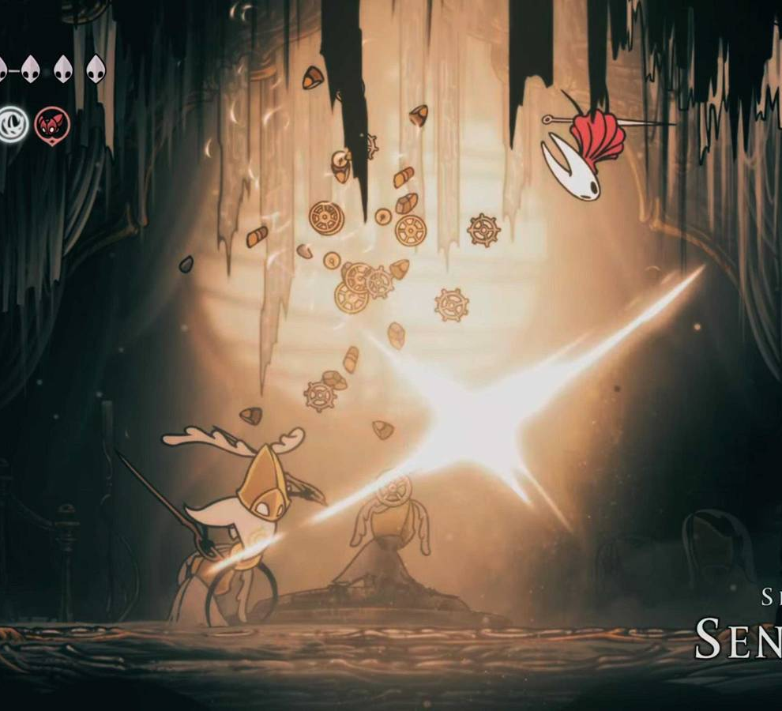
Gaming as Computer Science
Rendering screens and backgrounds
Moving sprites (characters) with predictable physics
Responses and patterns for enemies and bosses for players to react to actions
Pathfinding algorithms for the various targeting weapons
Creating an interface for players to translate what they want to do to the character

Slide 35

Is this Computer Science?

Slide 36
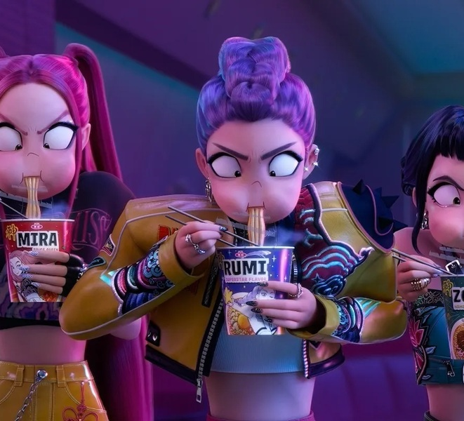
3D Animation
Application of Computer Graphics
Rendering millions of triangles together to make complex shapes
Movement of triangles throughout coordinate systems to create animation
3D modelling mapping mathematical coordinates to represent objects
Mapping textures onto the models
Motion capture mapping hundreds of dots onto the models

Slide 37
Group Work ~3 minutes
Break into groups of 3 – 5 people
1
Introduce yourself
2
Place a piece of paper in the middle of the group
3
Brainstorm a “Is this Computer Science” example that might spark discussion within the class
4

Slide 38
Discussion

