Slide 1
Input/Output
Built-in Functions
CS1910
Computer Science 1

Slide 2
FIND a PARTNER:
Input and Output
Let’s simulate a program that reads numbers from the user (forever … but we will do 6) and after each number report out the largest number seen to that point.
Example set of numbers: 5, 6, 3, 2, 6, 8
How would you do this in partners?

Slide 3
Computational Thinking: Algorithm
Let’s try an example with a partner – what is the overall algorithm?
In pairs: One person is a sender, and one is a receiver
  Sender write a set of 6 numbers.
  One number at a time, Receiver asks “Can I have the next number?”, and the Sender gives it.
  Repeat the above line 6 times
  Sender asks “What was the highest number I gave you?”
  The Receiver reports what the highest number was.

Slide 4
Questions to Ask
What are we trying to achieve?
What do we know?
What information is missing?
Can we break it down into smaller parts?
What are the patterns?
Can we represent it differently?
Have we solved it before?

Slide 5
Questions to Ask
What are we trying to achieve?
  We are taking in numbers and printing the largest seen so far
  Do we need to track all of the numbers?
What do we know?
  That the user can stop after the first or the millionth (or higher)
What information is missing?
  How do we stop it? What does forever really mean?
  We only have to report the highest!
Can we break it down into smaller parts?
  In the slide above, I gave you an initial algorithm – what can you give a name the steps if they were on a computer?

Slide 6
Computational Thinking: Algorithm
Decomposing the algorithm
  Sender create a set of 6 numbers.
    Create by Sender
  One number at a time, Receiver asks “Can I have the next number?”
    Output: (prompt) from Receiver to Sender
  Sender says the next number
    Input from Sender to Receiver.
  Receiver records the number
    Input by Receiver
  Sender asks “What was the highest number I gave you?”
    Output: Sender to Receiver
  The Receiver reports what the highest number was.
    Receiver compares new number to all other numbers
    Output: Receiver to Sender
  Repeat forever …

Slide 7
What are we really doing here?
How to build a program to read numbers from the user (forever) and after each number print out the largest number seen yet
  We are not yet looking for python code – we are instead looking to use these skills
Decomposition
Abstraction
Pattern Recognition
Algorithm Design
Validation

Slide 8
Computational Thinking
Group Exercise
How to build a program to read numbers from the user (forever) and after each number print out the largest number seen yet
  We are not yet looking for python code
Decomposition
Abstraction
Pattern Recognition
Algorithm Design
Validation
What are the essential tasks?
Get input
Convert input to int
Keep track of largest
Printing
Require a variable to store the largest
and the most recent (current)
A loop that runs forever
each time ask for input
potentially update the largest seen
Initialize a variable
Loop forever
  Ask for input
  Update the variable
  Print the variable
simple cases
negative numbers
Invalid inputs?

Slide 9
Computational Thinking: Algorithm Refinement
Decomposing the algorithm
  Sender create a set of 6 numbers.
    Create by Sender
  One number at a time, Receiver asks “Can I have the next number?”
    Output: (prompt) from Receiver to Sender
  Sender says the next number
    Input from Sender to Receiver.
  Receiver records the number
    Input by Receiver
  Sender asks “What was the highest number I gave you?”
    Output: Sender to Receiver
  The Receiver reports what the highest number was.
    Receiver compares new number to all other numbers
    Output: Receiver to Sender
  Repeat forever …
Now the next questions …
What are the patterns?
    Questions are output asking for input
    Statements are the input themselves
  There is a second pattern:
    We are constantly comparing different numbers - do we need to do that?
Can we represent it differently?
  The answer to the above question actually informs this – how do we avoid comparing different numbers?
Have we solved it before?
  Have you seen anything that lets you compare maximum values?

Slide 10
Keeping track of the largest?
2 Variables
  Most recently entered value
  Max ever seen (so far)
How to update highest_value so it contains the maximum between itself and latest_value?
  Can you come up with a single expression?
Give them names:
latest_value
highest_value
Given the problem do we need any other variables? i.e., do we need to keep track of anything else?

Slide 11
Translate to Pseudocode
Create a pseudocode algorithm for the above problem
  Remember that you have seen some looping before
  When you want some output you can write “PRINT” as your pseudocode
  When you want some input from the user write “INPUT” and in <angle brackets> write what input you are waiting for

Slide 12
PseudoCode
START
  highest_number = minus infinity #so my first number is always higher
  Repeat until INPUT is ‘Quit”
    PRINT “Please enter the next number:”
    INPUT <Wait for next number>
    SET latest_number to INPUT
    Highest_number = maximum of highest_number and latest_number
      #Remember from last time we had a built-in called max
  END

Slide 13
Code Examples
https://colab.research.google.com/github/UPEI-CS/CS1910-Students/blob/main/lectures/06-Decisions/CS1910_Decisions_Workbook.ipynb

Slide 14
Printing
In Python the built-in print method can be used to print values to the console
Print automatically converts an int to string
print(“hello”)
print(3)
hello = “Hi!”
print(hello)
Convert the integer 3 to a string and then print it
print(str(3))
print(“hello” + 3)
print(“hello” + str(3))
Error can’t add string and int
“hello3”

Slide 15
Escape Sequences
Certain characters are challenging to represent in a string
For these we can represent the character using an escape sequence.
  A special character combo that stands in for the challenging character
  In Python we use a backslash \ followed by a character to indicate an escape sequence
Example: How to represent a newline within a string?
\n represents a newline “Hello\nWorld” translates to
Hello
World

Slide 16
Example Escape Sequences
Cursor positioning escape sequences:
  \b = Backspace
  \t = Tab
  \n = Newline
  \r = Carriage return
Character used in syntax escape sequences
  \” – produces a double quote
  \’ – produces a single quote
  \\ - produces a \

Slide 17
Self Check
What is the output for the following?
print("\"\\Hello\n\tWorld!\\\"")

Slide 18
Self
Check
What is the output for the following?
print("\"\\Hello\n\tWorld!\\\"")
"\Hello
World!\"

Slide 19
Class Participation
On Moodle you will find:
Class Participation – Review – Expressions

Slide 20
Formatted Strings
F-StRings
Allow you to embed variables and expressions into strings
Preface the string with an f and then use curly braces { } to indicate an expression or variable that should be inserted into the string
Example
x = 10
y = 5
result_str = f"The sum of {x} and {y} is {x+y} or what is stored in z which is {z}"

Slide 21
Format Specifiers
Control the presentation of values such as number of decimal places for floating point values or alignment
price = 123.4567
formatted_price = f"Price: ${price:.2f}" # Two decimal places
print(formatted_price)
number = 7
padded_number = f"Number: {number:03d}" # Pad with leading zeros to 3 digits
print(padded_number)

Slide 22
Self-Check
Consider you have files named as follows:
file001.txt, file002.txt, … file999.txt
Given an integer variable file_num (between 1 and 999) construct the appropriate file name (string) as per above.

Slide 23
Self-Check
Consider you have files named as follows:
file001.txt, file002.txt, … file999.txt
Given an integer variable file_num (between 1 and 999) construct the appropriate file name (string) as per above.
file_name = f“file{file_num:03d}.txt”

Slide 24
input
User input from the keyboard can be accepted using the input() function
The function accepts a prompt that is displayed to the console
  name = input(“Enter your name:”)
All input is returned as a string
If numbers are intended as input they will have to be converted to integers or floats explicitly
  age = input(“Enter your age”)
  age_int = int(age)
  print(f”On your next birthday you will turn {age_int + 1}”)
Convert to int
string

Slide 25
Self Check
What is the output?
  age = input(“Enter your age”)
  print(f”On your next birthday you will turn {age + 1}”
Notes:
This is an important self-check to do in class – most will say that it prints the sentence with the number. But it actually errors out because the input pulls in a str that needs to be converted.

Slide 26
Converting input to Int
Recall that input is read in as a String.
We have to convert it to an integer.
  “3” is not 3
current_value_str = input(“Enter a value”)
current_value = int (current_value_str)

Slide 27
Find a Partner
Write a program to ask the user to enter 3 floating point numbers and then print the average.
The user should enter them one after the other (not all on the same input)
Make use of the += (add and assign operator) as part of your solution.

Slide 28
Volunteers
Some volunteers to share their solutions to the average of 3 numbers problem
  On the board or with a share to google colab

Slide 29

Readability Pause
It is important to write code that is easy to understand, interpret and read

Slide 30
Variable Names
We have mentioned a few rules about python names w.r.t variables
But there are also best practices
1. Choose meaningful descriptive names
  Avoid single letters most of the time,
  Use pot_hole_case (aka snake_case)when using multiple word variable names
2. Be consistent – choose a style and stick to it

Slide 31
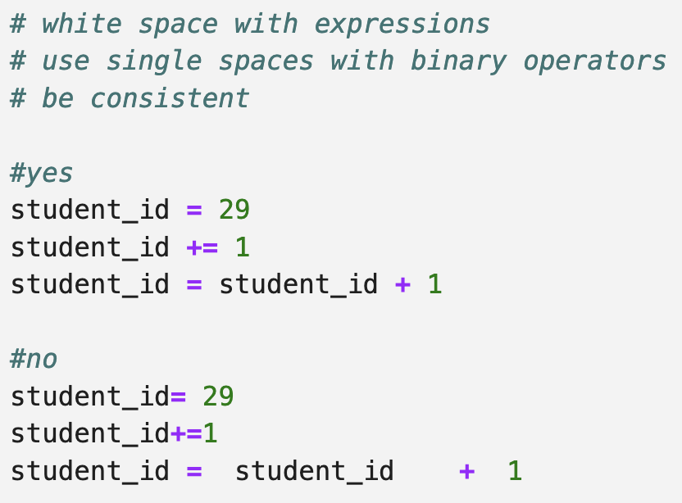
White Space
Surround binary operators with a single white space character

Slide 32
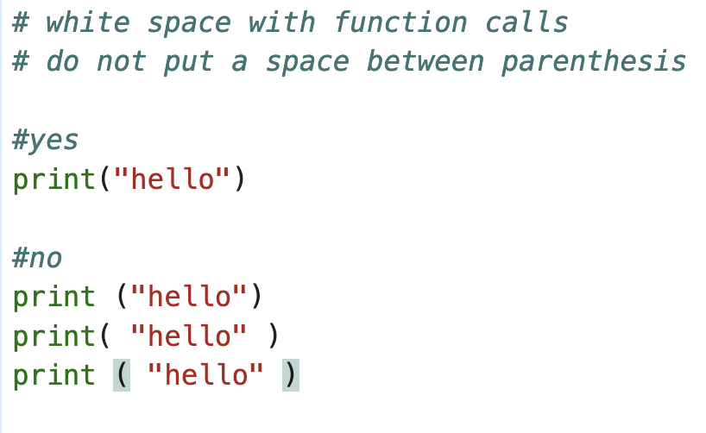
White Space
Avoid spaces with function call expressions

Slide 33
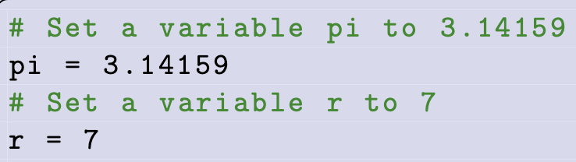
Comments
Avoid using comments to support poorly written code
The comments provides no added benefit
Document the context of the program
Help other programs understanding programming choices
  Not a commentary on what lines of code do
  Well written code should be self-documenting (good choice of variables, consistent naming and whitespace clear and concise

Slide 34
Functions
Last day we introduced function expressions
A function call returns a value in the place of the call
  It might be None (a special value representing nothing)
Functions are a form of abstraction
  Generalize a program or procedure based on inputs (called arguments)
In terms of program flow so far we have programs that ”flow” from the first statement (top) to the bottom
When a function is called the program executes the code belonging to the function before continuing “down” to the next code in the program
Some functions accept arguments that are passed to them
E.g max(5, 10)
Arguments passed to the max function

Slide 35
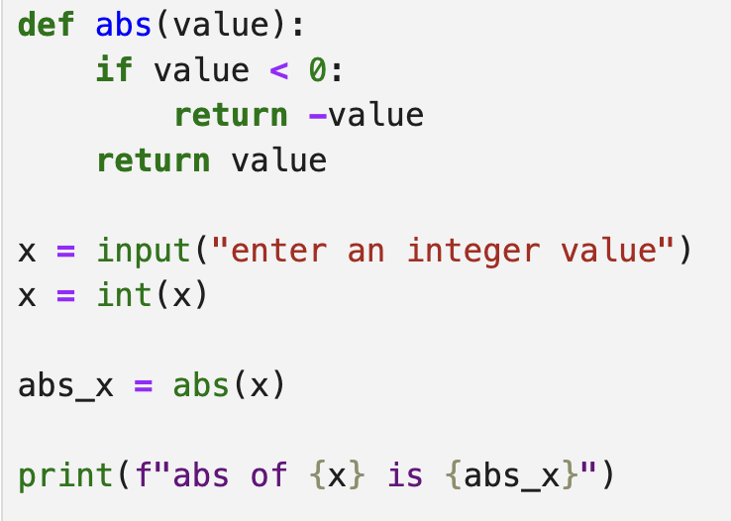
Program Flow Example
This is our own version of the built-in abs
We’ll write our own
Functions later in the course
A function must be defined before it is used
This is why we import math to use math functions
Built-in functions (like abs) do not need to be imported (they are already visible)
First line of program execution
Direction of program flow
Each line in this program calls a method. The program flow will jump to that method and execute its code before continuing

Slide 36
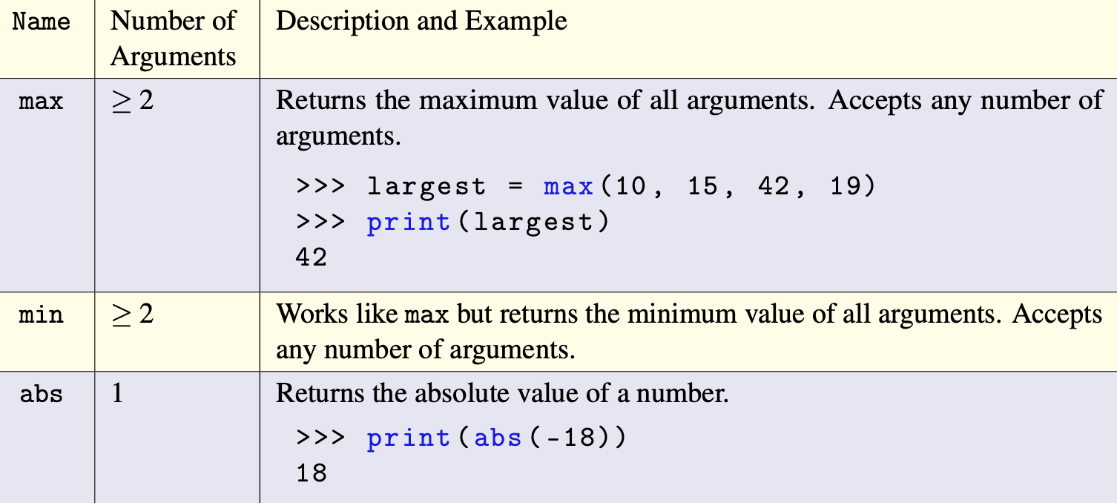
More Built-ins

Slide 37
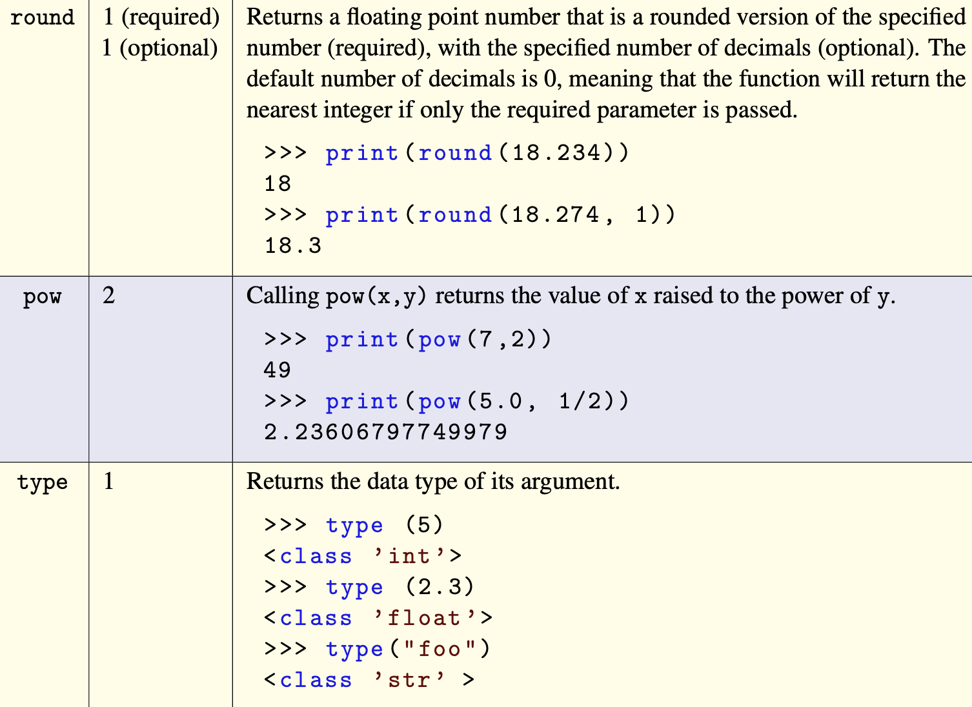
More Built-ins

Slide 38
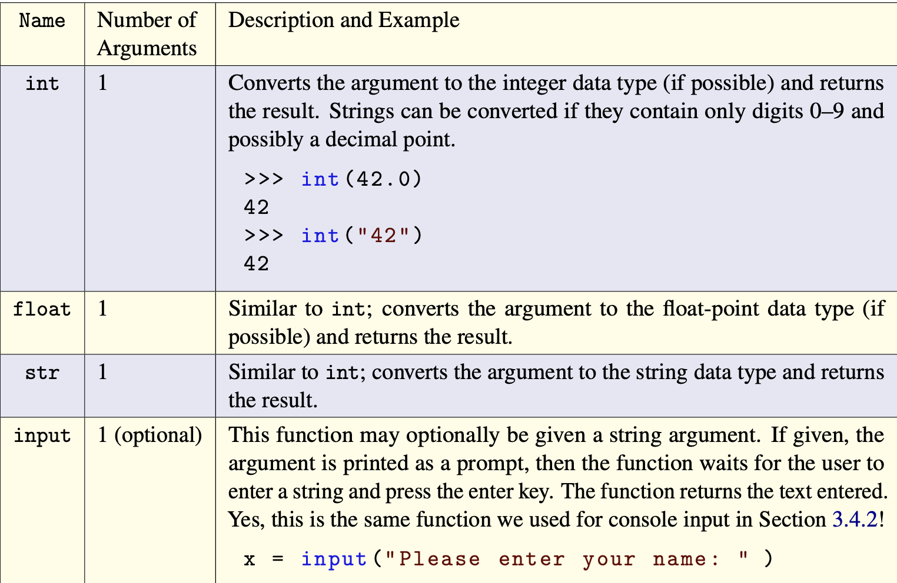
More Built-ins

Slide 39
SELF-CHECK
What is the result?
float(str(f"{max(5,min(5,max(5,1)))}.25")) + int(5.25)

Slide 40
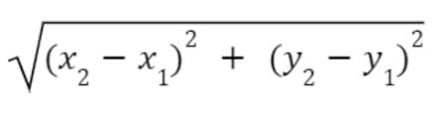
Euclidean Distance
Suppose we have 2 points (x1, y1) (x2, y2) we want to output the distance between the 2 points where distance is given by the below formula:
d =

Slide 41
Try at Home
Prompt the user to enter their first name and then last name, output whichever has more letters in it. Hint use the len built-in function
Create an adding machine to read 2 numbers from the user and then output their sum
Change the Euclidean distance program to instead use Manhattan Distance
  https://simple.wikipedia.org/wiki/Manhattan_distance

Slide 42
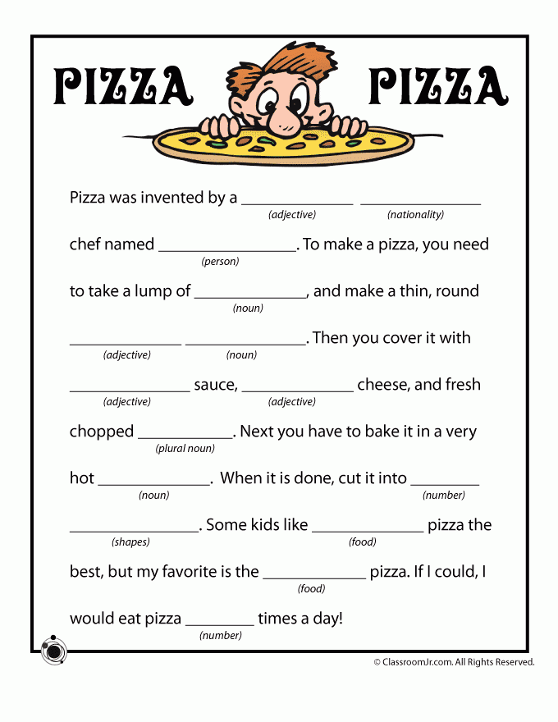
Try at Home
Build a Mad-Libs program, Prompt the user to input each of the blanks in the story to the right. After they have entered all the blanks output the story with the blanks filled in with their answers.
Read the output, hilarity ensues.

Slide 43
From last try at home:
Hotel Room Question Hints
Sum of the individual digits in a 3 digit number
How to get the first digit (ones digit)?
How to access the second digit?

