Slide 1

Organization name: Pinkishe Foundation
Problem Statement Title: Create an AI Chatbot to help females specially girls of young age to understand menstruation cycle better .

Slide 2
Team Name: M.A.N.I.A.C.S
Team member:
Vikash kumar
Shudhanshu shoritya
Vedant arora
Arpita kumari

Slide 3
Abstract
Our AI chatbot is an initiative through which we want to build a women health platform, which track women specific health issues and help raise awareness for its treatment and management. With a lot of fear of the stigma associated with reproductive health services, women often avoid making use of such services.
This stigma imposes a great deal of mental stress, fear, and depression on patients and causes delays in the diagnosis and treatment of their conditions. Through Our AI chatbot, we aim at solving this barrier for women to connect with doctor and try to reduce the errors and hassle in the diagnosis of the ailments.

Slide 4
Introduction of Protoype
Intuitive AI-based Chatbot capable to interact to answer any doubt related to reproductive health.
It track the user’s periods regularly, send them reminders and also have a feature to inform the user’s parents/guardians if complications requiring immediate attention arise
Tracking of previous Medical History
Menstrual Cycle Tracker
Booking Lab/Appointment
Medical consultation from expert 24/7.

Slide 5
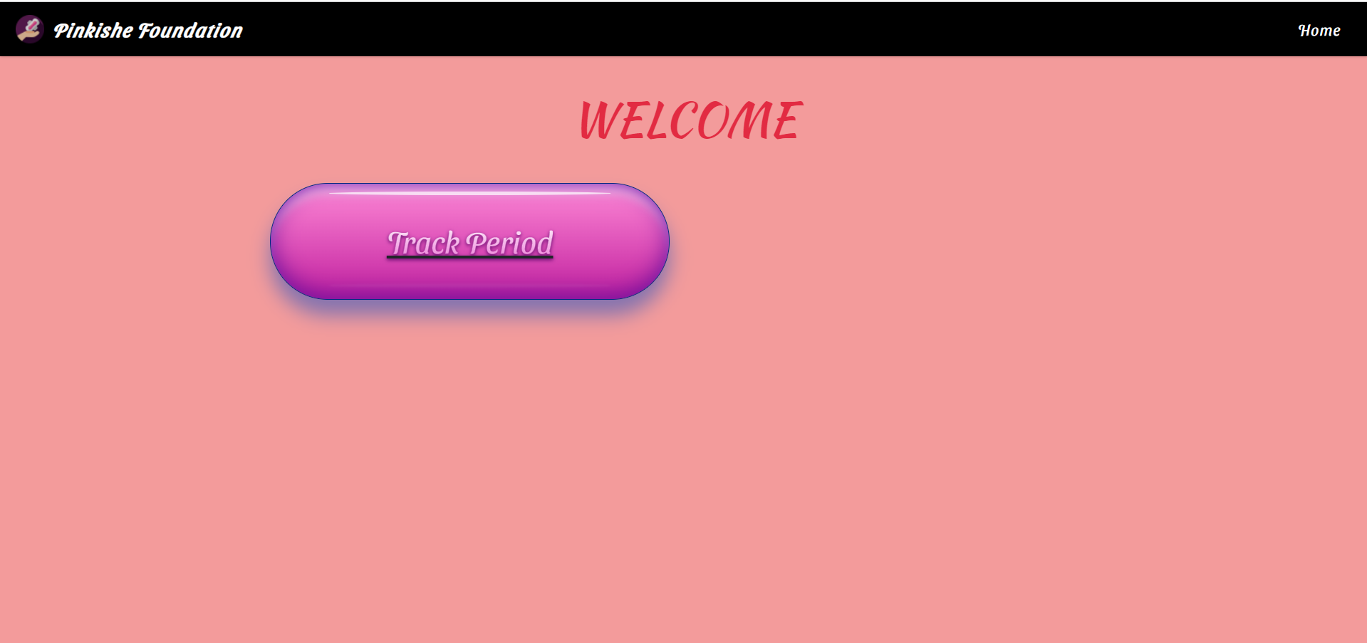
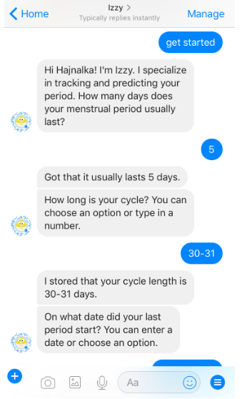
Idea/Approach Details
Development of web based Dashboard.
features on the chatbot:
Generic information on women's health
Remedial solutions Vast range of symptom and cause repository
Doctor/treatment/hospital/medicinal recommendations
Articles and exercises on health betterment
When they are unsure of a medicine, test, process. Updated information on banned medicines / medical practices / validity etc.

Slide 6
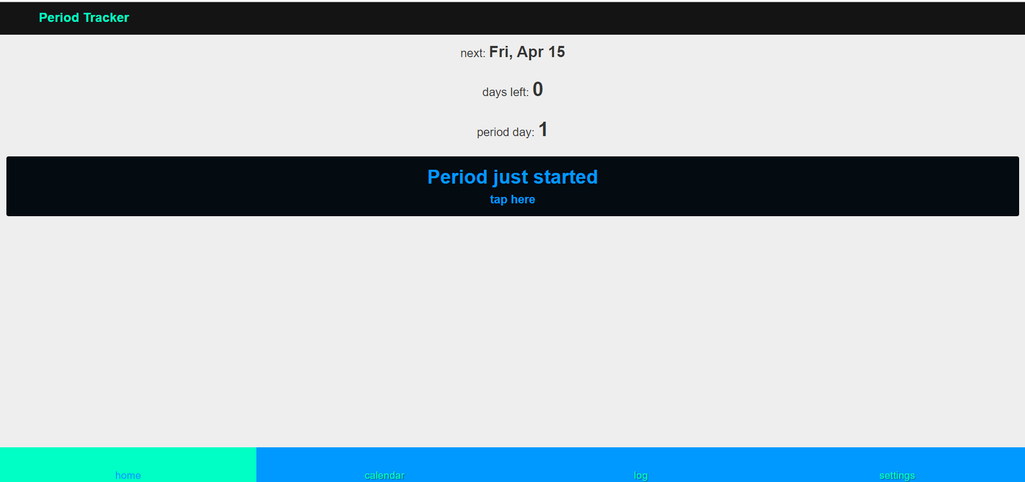
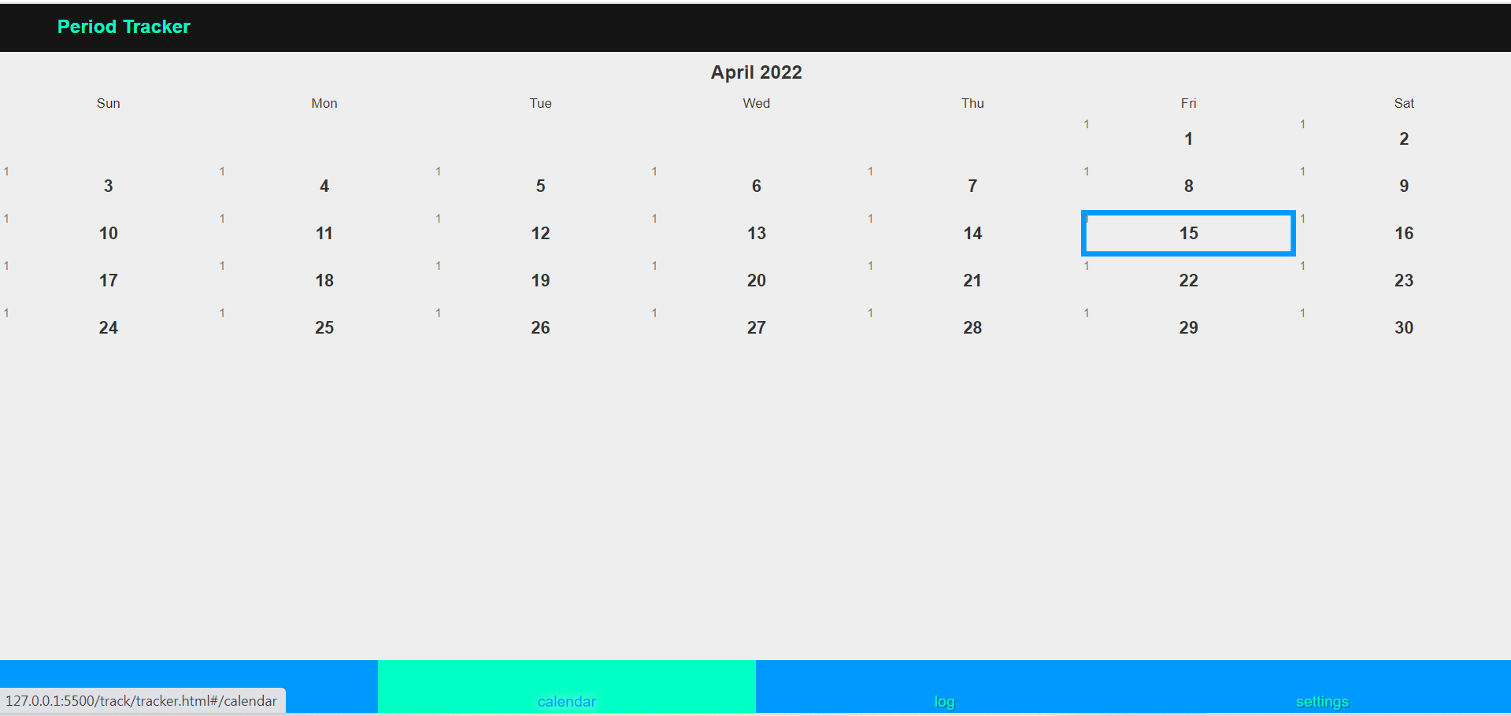
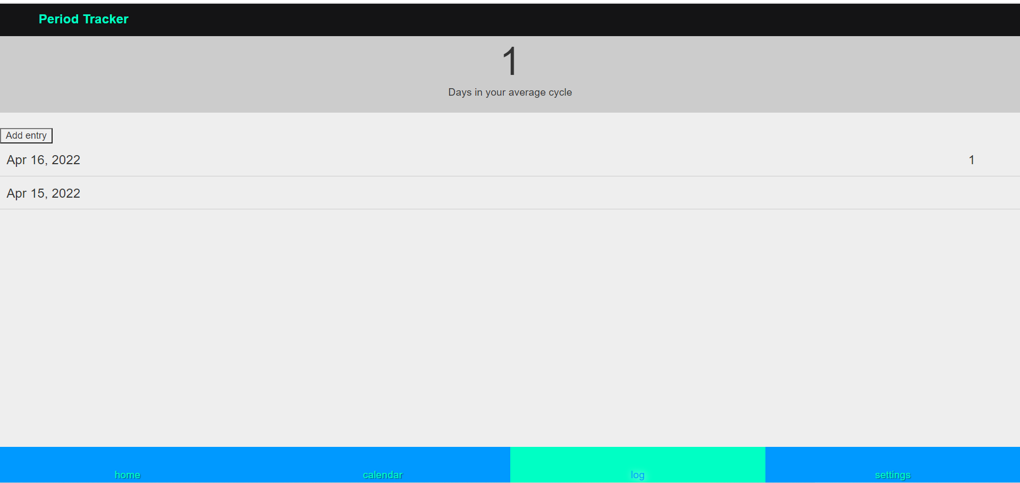
Menstrual cycle tracker
It can help user to get to know their body and cycle and observe any symptoms that occur during a particular phase of their cycle. it also help identify any changes to the menstrual cycle that may indicate potential health issues.
Another feature is that it can usually predict when a person is ovulating and fertile. This means they are helpful for user who are avoiding pregenancy or trying to conceive.

Slide 7
Technology stack
Artificial Intelligence & Web Technology
Machine Learning
Python - Sklearn, Keras, Tensorflow etc. for the ML Model(s)
Django REST Framework (for Model Endpoints)
Frontend
HTML
CSS
Bootstrap
Backend
PHP
MySQL (Database)

Slide 8
Future Asspects
• Localisation
• Addition of different regional languages for. interaction.
•Voice Search
•PCOD/PCOS Tracker.

