Slide 1
CENGEOMETRY
Predicting how centriole
architecture responds to perturbation
A geometric and mechanical model of the centriole cross-section, built from cryo-ET measurements
A hypothesis-generating model — not a physics simulation. See the final slide for what it is not.

Slide 2
MOTIVATION
The question
A centriole is a ring of microtubule triplets held around a central cartwheel. Every part is connected to every other part, so nothing can change alone.
SAS-6 mutation
changes cartwheel symmetry from 9-fold to 8-fold. What happens to the triplets?
1
Longer coiled-coil
pushes the ring outward. Does the structure still close, and at what cost?
2
C-tubule lost
leaves doublets instead of triplets. Is that geometrically viable?
3
Answering these by intuition is unreliable — the constraints are geometric and they interact.

Slide 3
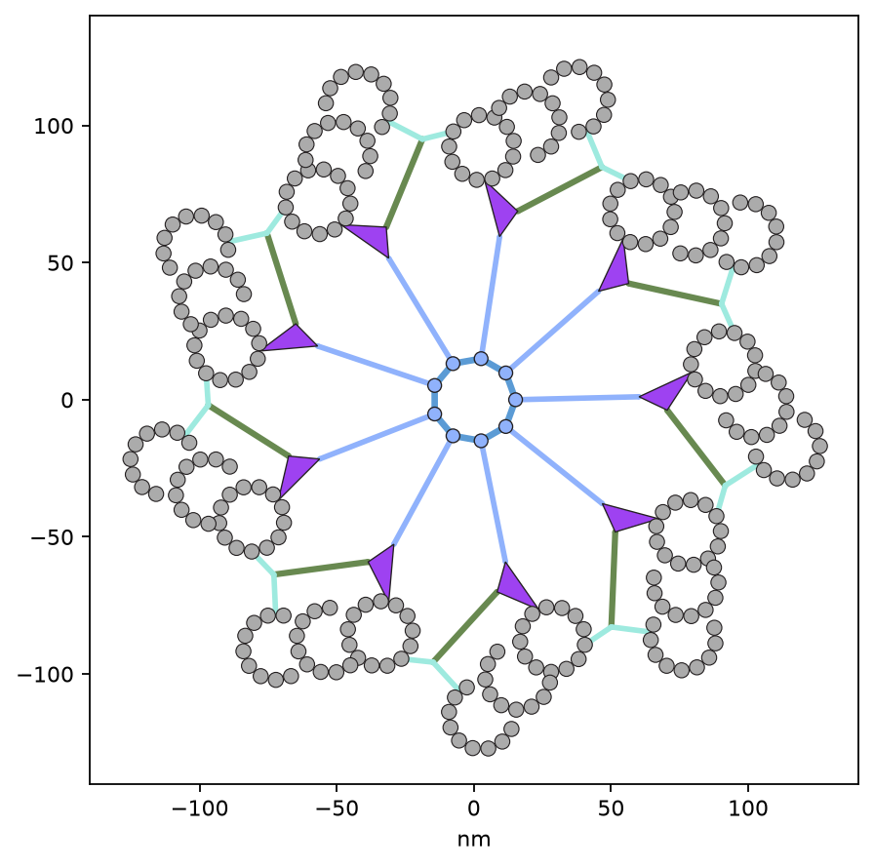
HOW IT WORKS
The idea: a linkage, not a drawing
One repeating unit is a set of rigid bodies joined by connections that can rotate:
SAS-6 head
sits on the hub ring
Coiled-coil spoke
radial at rest
Pinhead
grips A-tubule protofilaments 3 & 4
MT triplet
A + B + C, one rigid body
Triplet base
branches to the linker
A-C linker
reaches the next triplet
Because the units must close into a ring, changing one part forces the others to adapt. The model finds the least-strained arrangement that still fits together.

Slide 4
PROVENANCE
Every dimension is measured, not estimated
Read off a cryo-ET-derived schematic by a re-runnable script, calibrated against its 500 Å scale bar (4.132 Å per unit).
Element | Measured value | Element | Measured value
SAS-6 dimer (total) | 50.0 nm | Tubule radius | 11.9 nm
· head | 4.98 nm | A→B spacing | 18.8 nm
· coiled coil | 45.0 nm | B→C spacing | 19.6 nm
Pinhead span | 21.3 nm | Triplet axis vs spoke | −56.9°
Triplet base | 34.7 nm | Protofilament pitch | 27.7°
A-C linker arms | 14.6 / 11.6 nm | Linker vertex angle | 138.7°
One exception, stated plainly: the SAS-6 head-head spacing cannot be read off the drawing (its centre is ambiguous), so it is fitted as the value that lets the measured unit close with least strain.

Slide 5
FINDINGS FROM CALIBRATION
Two things the measurement revealed
1
B and C tubules share the A-tubule's lattice
They carry 9 protofilaments each — but at the same ~27.7° pitch as A's 13, i.e. 360/13, not 360/9. All three tubules sit on one lattice; B and C simply stop short, leaving ~138° open where each fuses inward.
2
The A-C linker is bent, not straight
Two arms of 14.6 nm (to the C-tubule) and 11.6 nm (to the neighbouring A-tubule), meeting at 138.7°. The triplet base attaches at that vertex. A straight linker would not reproduce the geometry.
Neither was assumed — both fell out of measuring the schematic properly.

Slide 6
HOW IT DECIDES
The mechanical rules
✓
Nothing stretches
✓
Bonds have strengths
Segments have fixed length. Under compression they may buckle — bow so the ends come closer — but never extend.
Each connection is a spring stiffened by its bond strength, so weak bonds yield first and load distribution is a result, not an assumption.
✓
Joints have individual limits
✓
Connections cannot separate
A rotation means different things at a 45 nm spoke and a 13 nm linker arm. Each is graded against its own thresholds.
Each body is built onto the one that feeds it, so a connection point holds exactly — by construction, not by penalty.
Grades: OK · HARD · SEVERE — assumed tolerances, not feasibility verdicts

Slide 7
THE FORMALISM
What the script actually solves
Six slides of formalism. Nothing biological is lost by skipping to the results — but if you want to know what “least-strained arrangement” means precisely, it means this.

Slide 8
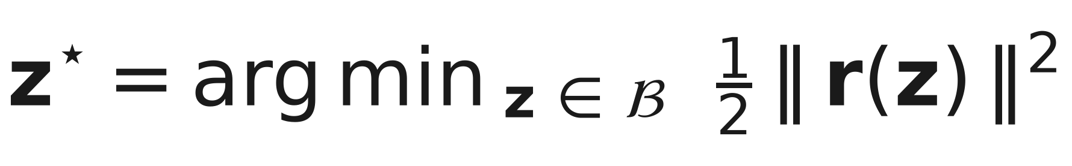
THE FORMALISM · 1 / 6
It is one constrained least-squares problem
Generalised coordinates z: one angle per body, plus a buckling fraction per compressible segment. B bounds the buckling variables.
The residual stacks six independent blocks:
gₑ
loop closure
Φⱼ(δⱼ)
joint strain
Δφᵢ
even spacing
vector gap at the two connections that close a ring
banded penalty on each joint's rotation from rest
triplets held at equal angular pitch — the scaffold
βₛ
buckling
oᵢⱼ
MT vs MT
h(−dₛₜ)
strand vs MT
penalises bowing, so segments shorten only when they must
tubule overlap between different units
a strand inside a tubule wall, its own width counted
The k weights set the exchange rate between blocks. k_b = 600 makes closure dominate, so strain is pushed into the angles where it can be read — not traded against a visible gap.

Slide 9
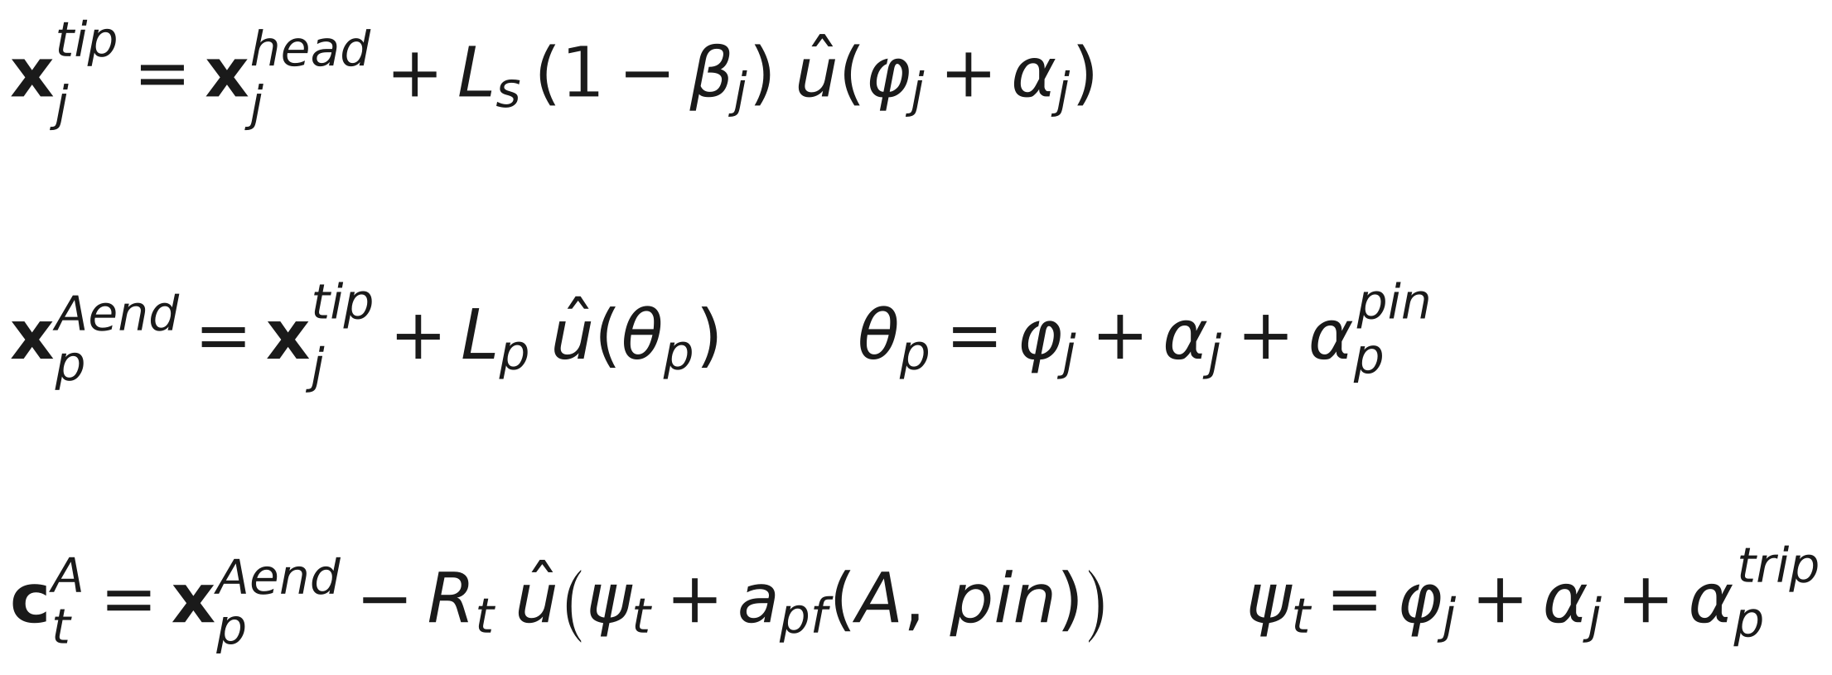
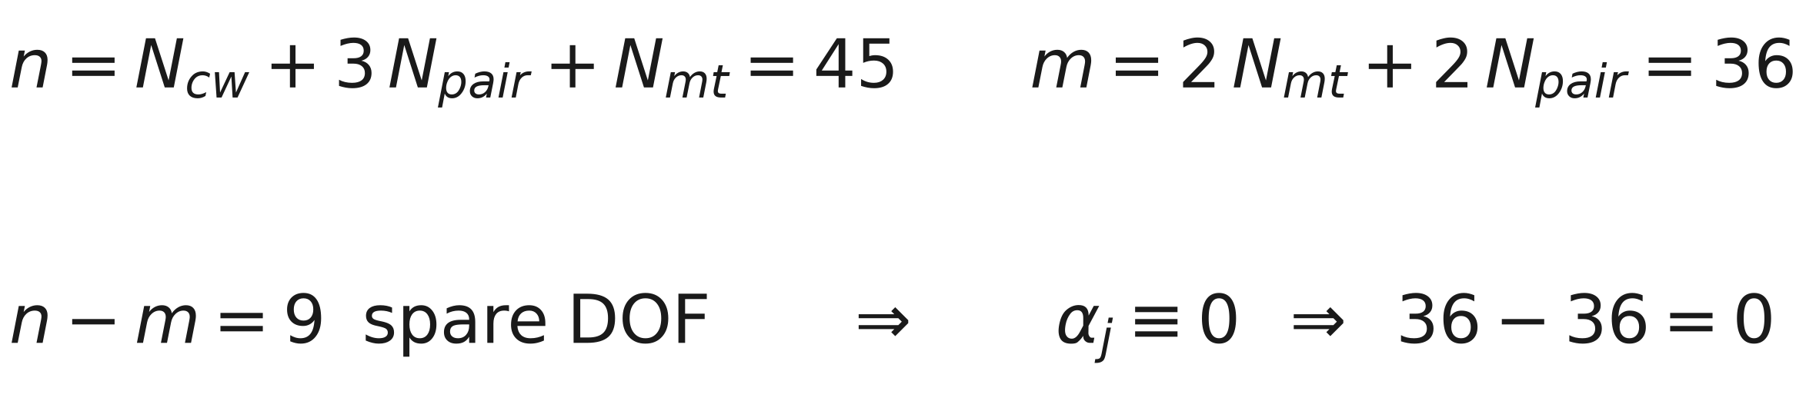
THE FORMALISM · 2 / 6
Forward kinematics: a chain, not a soup
Every body is built onto the one that feeds it, so its pose is one angle, not three:
Why it matters
Four of the six connections are satisfied identically — a shared point, not a penalised one. They cannot separate at any load, however hard the structure is pushed. Giving every body a free pose and tying it with springs instead let the spoke visibly detach from the pinhead under a large perturbation.
Only two connections close a loop, and only these can open:
Counting the freedom left, for a 9-fold centriole:
162 unknowns in the old spring formulation; 45 here. Same structure, a quarter of the coordinates, and no redundancy for the solver to fight.

Slide 10
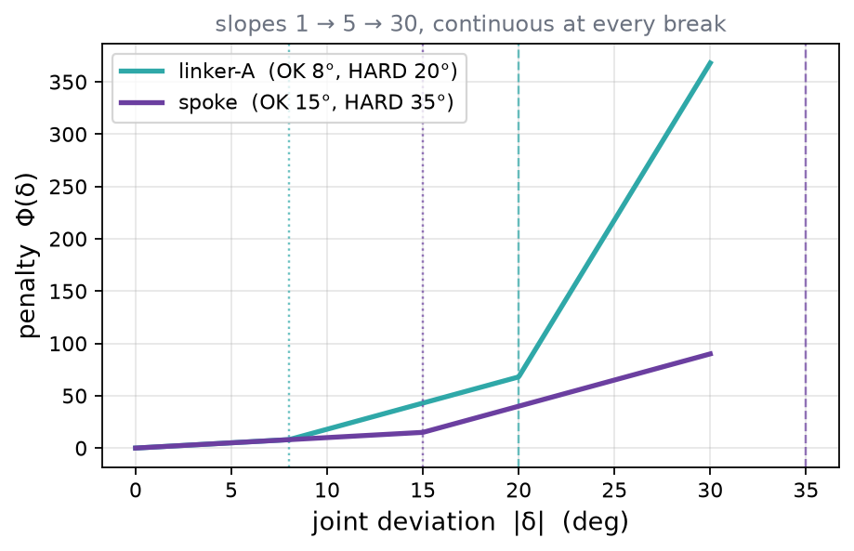
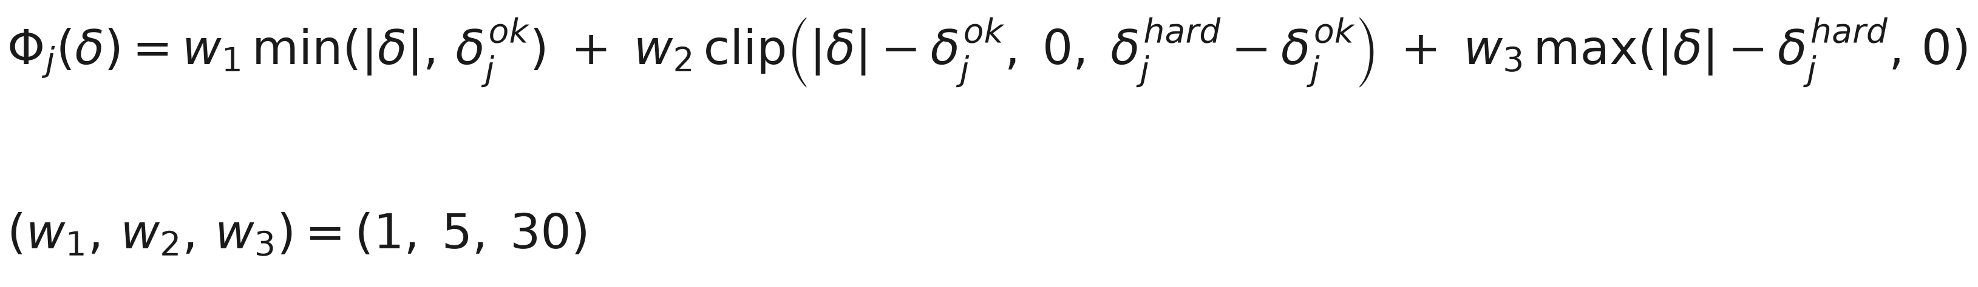
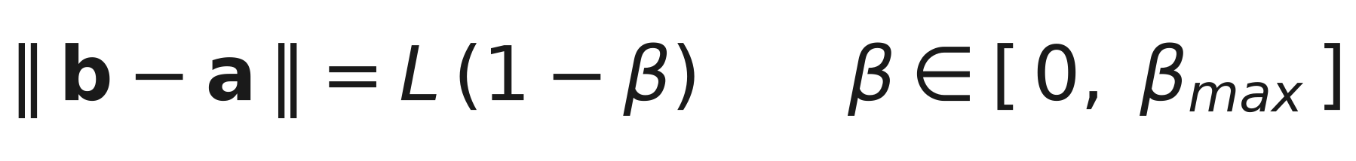
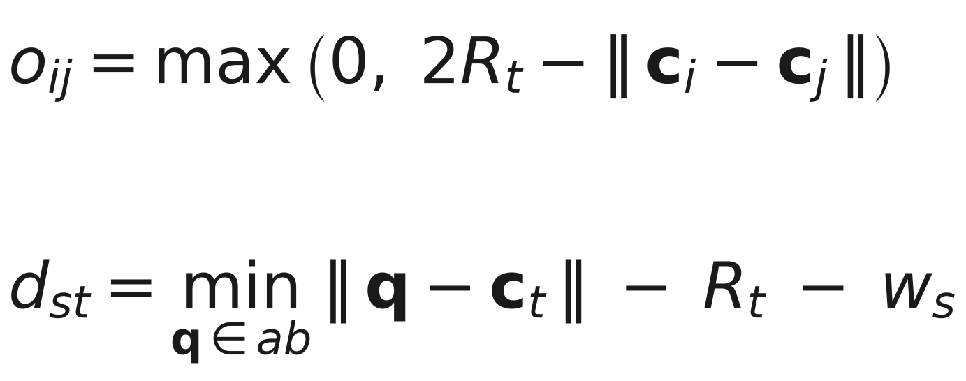
THE FORMALISM · 3 / 6
What is being minimised
Joint strain is piecewise-linear in three bands, continuous everywhere so the optimiser stays well behaved, but with the slope stepping up at each threshold:
Nothing stretches — a segment's contour length is fixed and only its chord shortens:
Sterics: tubules cannot overlap, and a strand cannot lie inside a tubule wall.
wₛ is the one assumed number here
The strand half-width, 1 nm — half a two-stranded coiled coil. It was never fitted to any measurement. Without it a strand lying flat along a tubule wall measures zero clearance and passes; with it, grazing counts as overlap.
The hinge h is rounded over its first 0.1 nm. A hard corner is only C⁰, and with a finite-difference Jacobian that made the solver chatter — 1522 iterations instead of 36, for the same answer to five figures.

Slide 11
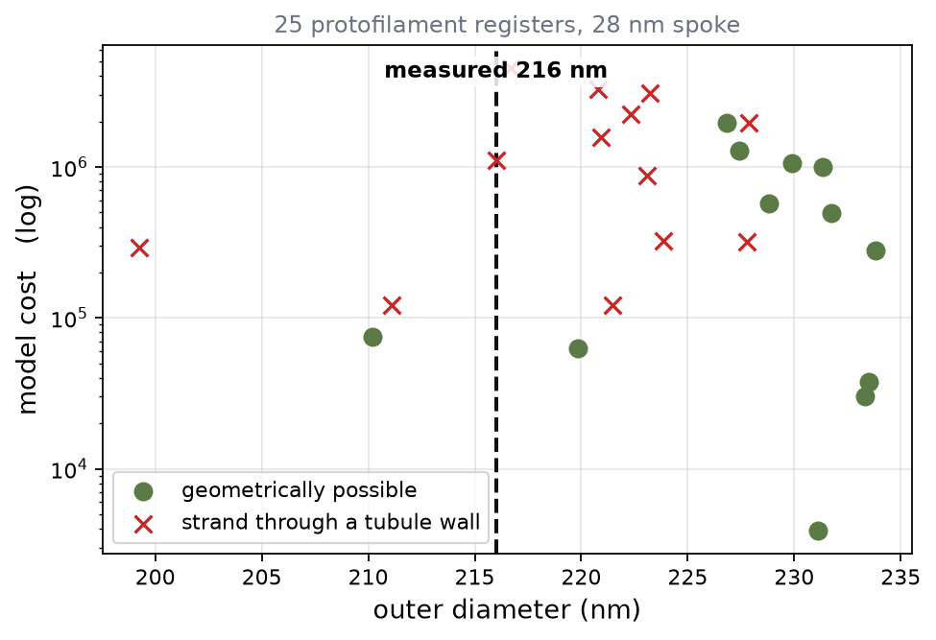
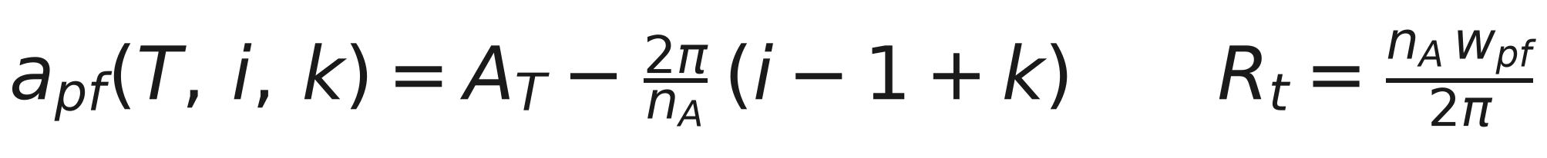
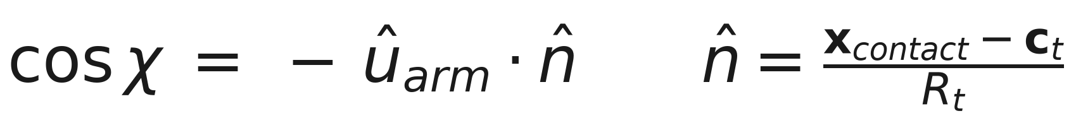
THE FORMALISM · 4 / 6
The protofilament register is a discrete variable
Contacts sit on named protofilaments, so a contact can slide only in whole steps of the lattice pitch. That makes the register an integer axis alongside the continuous solve:
The rest angle must slide with the site
This was missing. Every shifted register was charged 27.7° of strain that was never there — past the 20° HARD limit before the structure had moved at all — so the search ranked bookkeeping, not mechanics.
And a site must be reachable from outside its own tubule:
Assumption-free
cosχ asks only which side of the wall the strand arrives from. It does not depend on the assumed strand width, on the steric weight, or on any tolerance — which is why a register ruled out on reachability is ruled out more firmly than one ruled out on clearance.

Slide 12
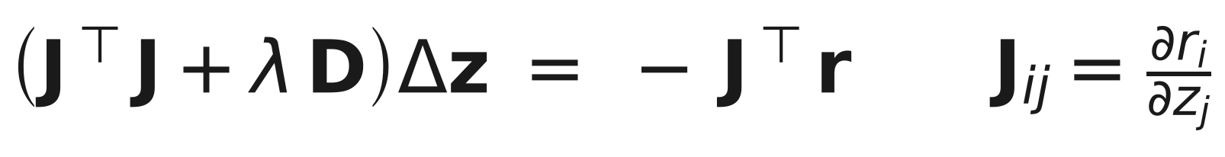
THE FORMALISM · 5 / 6
Solving it
Trust-region reflective Gauss–Newton on the bounded problem, with the Hessian approximated from the Jacobian and no analytic derivatives:
Continuation past the barrier
The rest-angle starting guess sits up to 7 nm inside a tubule wall at a short spoke. Solved cold that costs ~1500 iterations; solved first without the steric term it costs ~30 and lands already clear, so the full problem starts inside the feasible set.
A fallback when the factorisation fails
The dense SVD in the trust-region step occasionally will not converge on a badly conditioned geometry. That is linear algebra, not biology, so it retries with an iterative solver rather than taking down a 25-register scan for one bad cell.
Cost is a model quantity, not evidence
½‖r‖² is built from tolerances and bond strengths that were reasoned, never measured. It ranks candidates. It does not tell you which one nature picked.
Wild type solves in 0.4 s; a 25-register search takes about 4 minutes.

Slide 13
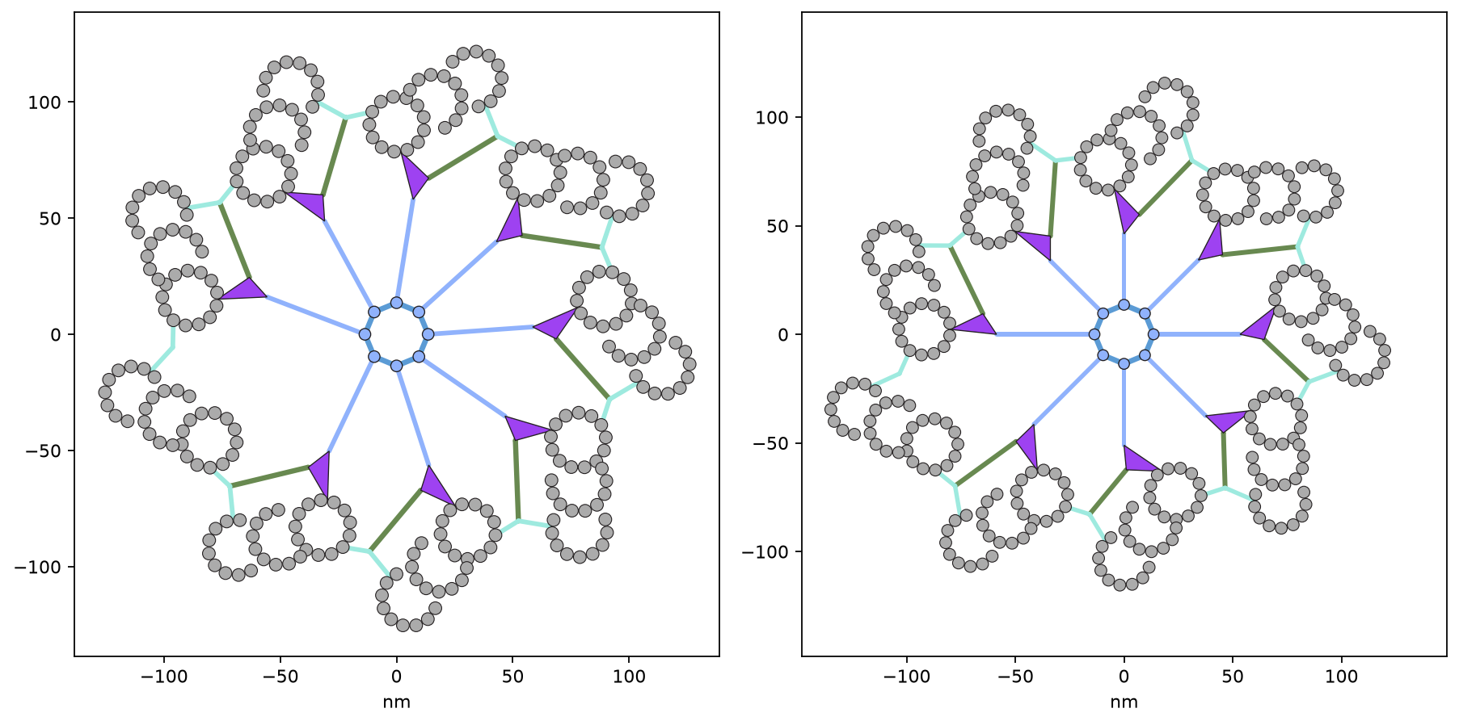
THE FORMALISM · 6 / 6
An assumption you can switch off
Most treatments of the cartwheel assume the spoke strains outwards without hinging where it meets its SAS-6 head. Setting αⱼ ≡ 0 imposes exactly that — and removes N_cw degrees of freedom, leaving 36 unknowns against 36 constraints: exactly determined, with no slack left to absorb a mismatch.
8 cw / 9 mt | free | locked
Outer diameter | 256.4 nm | 279.0 nm
Spoke rotation | -20.9° | 0° (imposed)
Spoke buckling | 1.1 % | 27.5 %
Joint strain, RMS | 7.1° | 19.2°
Worst loop gap | 0.002 nm | 0.186 nm
Wild type barely notices: 255.0 nm either way, strain 1.4° → 1.6°. A wild-type spoke hardly pivots anyway.
Run both. A conclusion that survives the toggle does not depend on the assumption; one that flips is being carried by it. Note that with the spoke locked its grade reads 0° by construction, not by relaxation — read the other joints and the gaps for where the strain went.

Slide 14
HOW STRAIN IS GRADED
Every joint has its own tolerance
A rotation means different things at different connections. 15° at the base of the 45 nm spoke moves its tip 11.6 nm — a whole tubule radius — while the same angle at a 13 nm linker arm moves it 3.4 nm. So each is graded against its own limits.
Joint / contact | OK | HARD | SEVERE | Why
Linker to A-tubule | 8° | 8–20° | > 20° | grips a rigid, ordered lattice
Linker to C-tubule | 8° | 8–20° | > 20° | same lattice, slightly weaker bond
Pinhead to A-tubule | 10° | 10–22° | > 22° | lattice contact, larger footprint
Spoke vs radial | 15° | 15–35° | > 35° | many SAS-6 rings stack axially
Pinhead vs spoke | 15° | 15–30° | > 30° | multi-protein, three contacts
Triplet axis vs spoke | 20° | 20–40° | > 40° | a composite, not one interface
Base vs spoke | 20° | 20–40° | > 40° | designed to reorient
These are assumed tolerances, NOT verdicts on feasibility. The values were reasoned, not measured. A SAS-6 spoke shortened by 17 nm builds real centrioles, yet the model grades its linker contacts SEVERE while reporting zero clashes and a perfectly buildable geometry. Read them as “how far from wild type” and judge from the geometry itself.

Slide 15
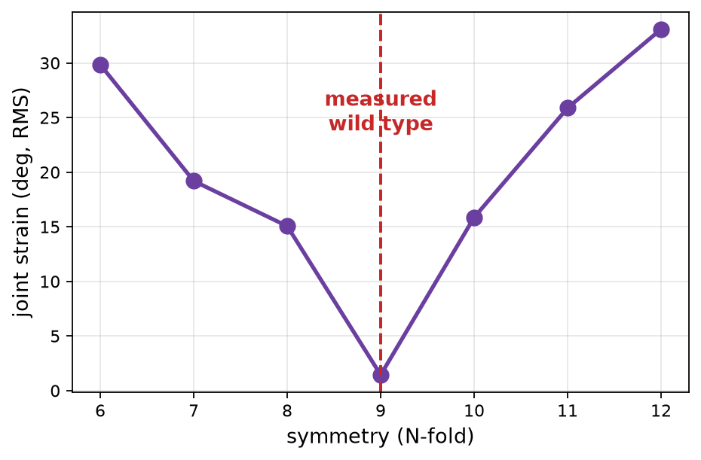
VALIDATION
The model was never told 9-fold is special
Sweeping each parameter independently, the measured wild-type value sits at a strain minimum every time:
Parameter | Measured | Best
Symmetry | 9 | 9
SAS-6 coiled coil | 45.0 nm | 45 nm
Triplet base | 34.7 nm | 34.7 nm
A-tubule protofilaments | 13 | 13
Tubules per blade | 3 | 3
Wild-type diameter comes out at 255 nm, against roughly 250 nm measured in real centrioles — and diameter was never fitted.
Strain rises steeply either side of 9: 15.1° at 8-fold, 15.9° at 10-fold, against 1.4° at 9.

Slide 16
OUTPUTS
What it tells you
Readout | Biological meaning
Joint rotation | How far each connection had to turn, graded OK / HARD / SEVERE against its own limits (assumed tolerances, not feasibility)
Bond load | Which connection carries most strain — i.e. which would rupture first
Buckling | Which segments were forced to bow because space became tight
Clashes | Microtubules overlapping in space. Anything above zero is physically impossible
Clearance | How close the linker, base or spoke passes to a microtubule; negative means passing through one
Diameter | Outer, A-tubule ring, and lumen, in nm — directly comparable to EM measurements
Unattached triplets | Triplets the cartwheel could not reach — expected when the two symmetries differ
Read grades comparatively — mutant against wild type — rather than as absolute verdicts.

Slide 17
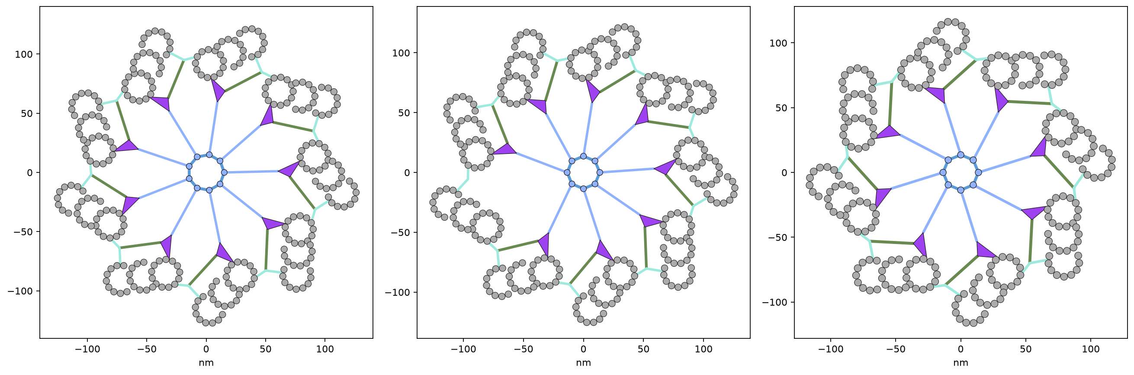
WHAT IT IS FOR
A worked prediction: symmetry mismatch
If SAS-6 makes an 8-fold cartwheel but nine triplets are still built, the model predicts the triplet ring keeps wild-type spacing and diameter (256 nm, against 255 at wild type) while the cartwheel absorbs the entire mismatch — the spoke swings -20.9° to reach, grading HARD, and 1 triplet is left with no pinhead at all. A fully 8-fold centriole instead shrinks to 233 nm.

Slide 18
PRACTICALITIES
Using it takes no coding
Double-click the launcher
Sets everything up the first time and opens in your browser.
1
Cross-section tab
Change any parameter; the geometry redraws with every metric.
2
Parameter scan tab
Vary one parameter; all metrics plotted, with cross-sections and a wild-type reference.
3
2-parameter scan tab
Cross any two — e.g. coiled-coil length against symmetry — as heatmaps or curves.
4
Sliders for symmetry, typed boxes for every distance, and CSV download on every scan.

Slide 19
What this model is not
It is not a physics simulation
It is a geometric and mechanical model for generating hypotheses. Bond strengths are a rank ordering, not measured energies.
The joint thresholds are reasoned, not measured
No sub-tomogram angular variance was available to calibrate OK / HARD / SEVERE. Their rank ordering is defensible; the absolute numbers are not.
It is a single 2D cross-section
The real centriole twists along its length. Anything longitudinal is outside its scope.
Grades are not feasibility verdicts
The tolerances were reasoned, not measured. Structures assemble in conditions graded SEVERE.
Calibration rests on one schematic
Protofilament positions carry about 2° (~0.4 nm) of reading noise, which sets the precision floor.
Used within those limits, it answers a question intuition cannot: given everything is connected, what has to give?

