Slide 1
EXPERT REVIEW
Where to take this model,
and what to ask it
Prioritised improvements, published knowledge worth building in, and six testable predictions
Citations below were drawn from the project's own literature notes. Each should be checked against the source before use in a manuscript.

Slide 2
STARTING POSITION
Assessment in one slide
A geometrically careful, honestly documented model whose main weakness is not its mechanics but its evidence base: one calibration source, invented thresholds, ordinal bond strengths, and a validation that is largely internal. The mechanics are ready for more than the calibration currently supports.
1
2
3
Ready to use now
Needs work first
The single highest-value fix
Comparative predictions, feasibility screening, hypothesis generation
Absolute forces, fluctuation amplitudes, anything longitudinal
External validation against data not used in calibration
The tool's own documentation already identifies most of these. The recommendation is to act on them in order of leverage.

Slide 3
ROADMAP
Part A — Improvements, by value for effort
# | Improvement | What it unlocks | Effort
1 | Hold-out validation | Breaks the circularity. Predict a system never used in calibration, then measure it. Without this, no result is independently supported. | High
2 | Bands from sub-tomogram variance | Turns OK / HARD / SEVERE from reasoned guesses into measured tolerances. The observed particle-to-particle spread IS the OK band. | Medium
3 | Bond energies in kT | Enables forces, rupture predictions and fluctuation amplitudes. Explicitly the blocker that killed the soft-mode analysis. | High
4 | 2.5D stack of coupled slices | Several cross-sections at fixed axial spacing with a twist increment. Reaches longitudinal questions at a fraction of full-3D cost. | Medium
5 | Uncertainty propagation | Resample inputs within their ~0.4 nm noise and report output ranges instead of point estimates. | Low
5b | Report every conclusion both ways | The spoke-pivot switch already exists. Any result that flips when the spoke is held radial is being carried by that assumption, not by the data. Free to run. | Low
6 | Per-state geometries | Procentriole, distal cartwheel-free region, Chlamydomonas and Trichonympha as their own calibrations, not perturbations of one mature human slice. | Medium
Do 5 and 5b first — both are cheap and immediately make every other number more honest. Then 2, then 1.

Slide 4
GROUNDING
Part B — Published knowledge worth building in
Stage-resolved ring diameters
U-ExM measurements give PLK4 77, SAS-6 75, STIL 89, CPAP 120 and CEP135 85 nm. These are direct calibration targets for assembly-stage geometries, and CEP135 spanning 85→182 nm across assembly bounds how far the triplet base can reach.
Protein identity per element
Assigning real proteins to each modelled body — CEP135 to the triplet base, SAS-6 to hub and spoke — lets mutant data enter as constraints and makes every prediction addressable by a specific reagent.
A-C linker as an integrity determinant
The linker is reported to control centriole structural integrity and duplication. The model independently makes it the load-bearing element, so published linker mutants are a ready-made validation set.
Known mutant phenotypes
Any documented symmetry or length mutant with a measured diameter is a free hold-out test. This is the cheapest available route to non-circular validation.
Verify each source directly before citing — these were taken from the project's working notes, not from the papers.

Slide 5
PREDICTIONS
Part C — Six testable questions
Chosen for making non-obvious predictions that could plausibly be wrong. A prediction that restates a known fact is not a test.
Q1
Does the triplet ring or the cartwheel absorb a symmetry mismatch?
PREDICTION An 8-fold cartwheel with 9 triplets keeps wild-type diameter (256 nm, versus 233 nm if the whole centriole were 8-fold), leaves 1 triplet with no pinhead, and swings the spoke 20.9° while triplets turn 10.3°.
TEST A SAS-6 mutant with altered cartwheel symmetry; cryo-ET; measure diameter and count spoke-to-triplet attachments.
FALSIFIED IF diameter falls toward 233 nm, i.e. the triplet ring follows the cartwheel instead of resisting it.
Q2
Which connection fails first under stress?
PREDICTION The triplet-base-to-A-C-linker junction carries the highest load in every perturbation tested — the weakest bond yields first, ahead of the linker-to-tubule contacts.
TEST Graded depletion or point mutation of each junction; look for which linkage is lost first, or which is most disordered in sub-tomogram averages of stressed centrioles.
FALSIFIED IF a tubule contact fails before the base-linker junction.

Slide 6
PREDICTIONS
Testable questions, continued
Q3
Is a doublet centriole a shrunken triplet centriole?
PREDICTION Removing the C-tubule collapses diameter from 255 to 207 nm — a 48 nm drop — and raises joint strain from 1.4° to 21.2°, i.e. doublets are strongly disfavoured rather than merely smaller.
TEST Measure diameter in systems with native doublets, or after C-tubule loss. FALSIFIED IF doublet diameter is close to triplet diameter.
Q4
Does protofilament number set centriole diameter?
PREDICTION The viable window is narrow and 13 sits inside it. Diameter is NOT monotonic — 130 nm at 9, 255 at 13, 267 at 15, back to 253 at 18 — and only 13 and 15 give a geometry with no microtubule clashes AND every contact reachable. 9, 11 and 18 all fail sterically.
TEST Compare species or mutants with non-canonical protofilament numbers. FALSIFIED IF a clash-free centriole is found at 9 or 18 protofilaments, or diameter tracks protofilament count monotonically.
Q5
Does a longer SAS-6 coiled coil widen the centriole proportionally?
PREDICTION No — the response saturates. 40→45 nm adds 4.4 nm of diameter; 45→50 nm adds only 1.5 nm, while strain rises from 1.4° to 9.3°. Length buys progressively less width and progressively more strain.
TEST Engineered SAS-6 coiled-coil length variants; measure diameter. FALSIFIED IF diameter tracks coiled-coil length linearly.
Q1 is the strongest: the prediction is counter-intuitive, quantitative, and distinguishable by a single diameter measurement.

Slide 7
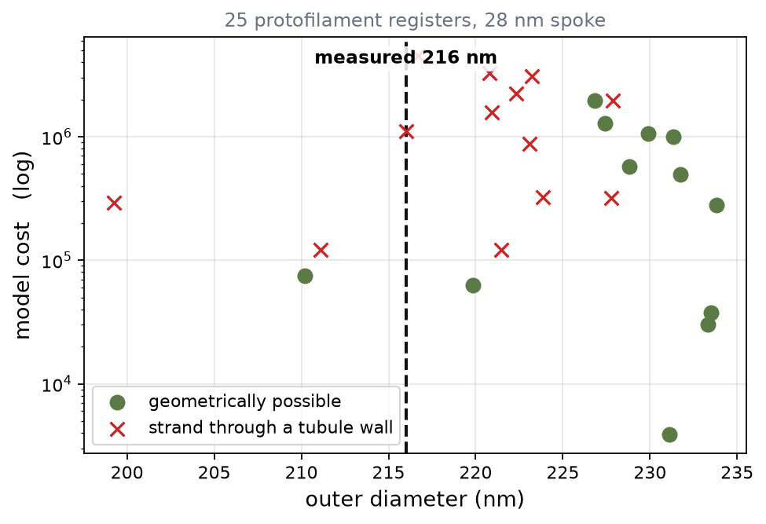
THE LIVE ONE
Q6 — Where does the A-C linker sit in a short-spoke mutant?
A SAS-6 spoke shortened by 17 nm narrows real centrioles from 250 to 216 nm. At wild-type register the model gives only −21 nm, because the blade rotates outward and buffers the loss. Something has to give, and re-registering the linker was the proposal.
Register (A / C) | Outer Ø | Tilt change | Reachable?
+0 / +0 wild type | 234 nm | +12.9° | yes
+1 / +1 model's pick | 231 nm | +10.2° | yes
+2 / +0 | 220 nm | +14.1° | yes, grazing
+1 / −2 the old answer | 221 nm | +4.4° | NO
+0 / −2 | 222 nm | +2.6° | NO
measured | 216 nm | — | —
The registers that reproduced the measurement by letting the blade keep its tilt — the C−2 family — are exactly the ones needing the linker's C-arm to arrive through the C-tubule wall. +0/−2 is ruled out robustly; +1/−2 crosses the reachability boundary at −2.5° of protofilament anchor shift, i.e. inside the ±2° calibration noise, so it is at the edge of the possible rather than refuted.
TEST cryo-ET the mutant: read the linker's protofilament and the blade tilt. Tilt unchanged + linker shifted on C → the old mechanism, and the reachability check is wrong. Tilt rotated ~+14° with the linker shifted +2 on A → the corrected model. Tilt ~+13° at wild-type register → re-registering is not the explanation at all.

Slide 8
Recommended order of work
Now
Run Q1 as a hold-out test. It needs no model changes and would be the first non-circular validation.
Next
Add uncertainty propagation, then calibrate the joint bands against whatever angular variance the data can give.
Then
Bond energies in kT, which unlocks force and fluctuation claims and revives the parked soft-mode analysis.
Later
The 2.5D stack, once there is a longitudinal question worth the cost of answering.
The mechanics are further ahead than the evidence. Closing that gap is worth more than any new feature.

