Slide 1

Rahul rathour
Akhil pratap singh
Intern at:-Indian Servers

Slide 2
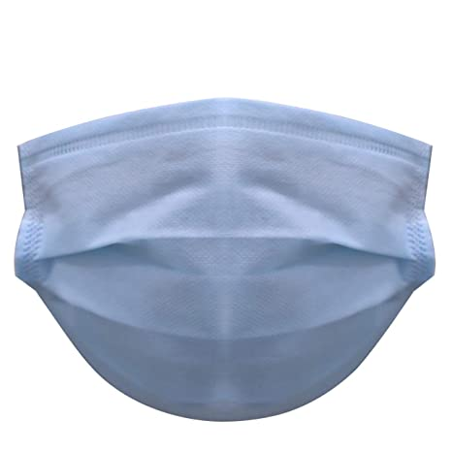
Final project on
FACE MASK DETECTION

Slide 3
Libraries that we used
NUMPY
PANDAS
MATPLOTLIB &
Detectron2: A PyTorch-based modular object detection library

Slide 4
PRETRAINED MODEL THAT WE USED
FASTER RCNN:-Faster-RCNN is one of the most well known object detection neural networks. It is also the basis for many derived networks for segmentation, 3D object detection, fusion of LIDAR point cloud with image ,etc. An intuitive deep understanding of how Faster-RCNN works can be very useful.

Slide 5
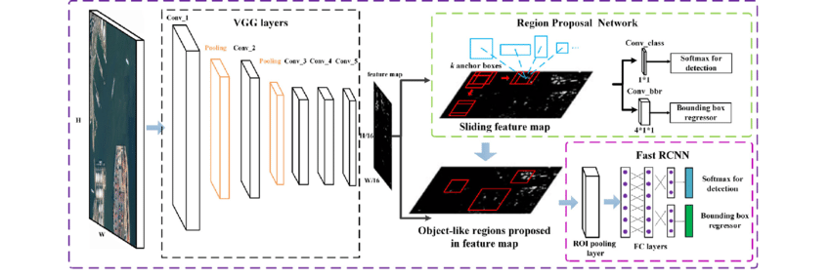
Architecture OF faster R-CNn

Slide 6
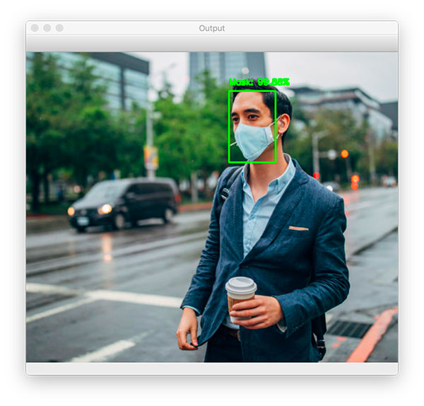
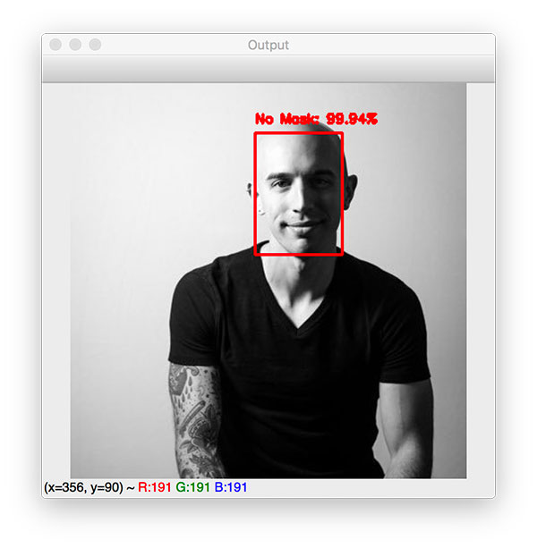
Sample outputs

