Slide 1
Quadratic Reciprocity:
History and Proofs
Geraud Campion
Michael O’Connor
Meng Tran
Lilly Yeh

Slide 2
History
Euler:
  Suppose p and q are distinct primes
  q is a quadratic residue of p
  Is p also a quadratic residue of q?
  Euler-found the answer by examining numerical evidence, but he was unalbe to prove that his answer was correct

Slide 3
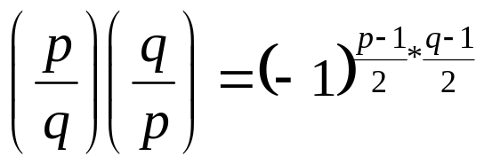
History
Legendre:
  1785: reformulated Euler’s answer into its modern, more elegant form:
  He published a few proofs, but all were incomplete

Slide 4
History
Gauss:
  1st to publish complete proof of quadratic qeciprocity – using induction
  Found proof in 1796 at the age of 18
  Went on to find at least 6 different proofs
In the year 2000 Lemmermeyer compiled a list of 192 proofs of quadratic reciprocity
There are now 214 proofs total
Last proof bye Duke and Spears in 2004 using Group Theory

Slide 5
153rd proof 1963:
Murray GerstenHaber (UPenn ☺)
This proof uses Gauss’s Lemma:
  Let p be an odd prime and a be an integer with (a,p) = 1. If s is the number of least positive residues of the integers a, 2a, 3a, …, ((p-1)/2)a that are greater than 2a then (a/p) = (-1)^{s}
Gerstenhaber’s proof uses a refinement of Eisenstein’s technique
Gerstenhaber’s proof is also an absraction of Kubota’s (152nd) proof

Slide 6
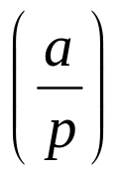
Key Points
Gauss’s Lemma – let p be an odd prime and a an integer with (a,p) = 1. If s is the number of least positive residues of the integers a, 2a, 3a, …, ((p-1)/2)a that are greater than 2a then
Make a complete set of residues mod m, using (half-system) of residues mod m (M)
If (n,m) = 1, then for any a in M that is an a’ s.t. na = a’ (mod m)
= 1

Slide 7

Key Points
If (n,m) = 1, then for any a in M that is an a’ s.t. na = a’ (mod m)
A complex number ζ be a primitive m^{th} root of unity, where m is a positive integer, if ζ⁻¹ = 1. If m is the least for which ζm = 1, then ζ is a called a primitive m^{th} root.

Slide 8
Sey Y. Kim
Proof # 212/214
Proved in 2004

Slide 9
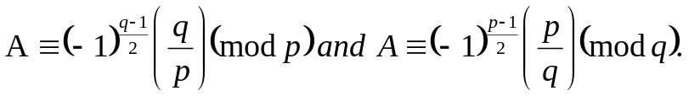






Lemma1:
Proof: Set
Plainly, T is a subset of S. Since
it follows easily that Φ = S-T. Hence, by Euler’s criterion,
On the other hand, because
we have
Where we have used Wilson’s theorem: (p-1)!≡-1(mod p). We infer that
Whence A≡(-1)^{(q-1)/2}(q/p)(mod p). The other statement in Lemma 1 follows by symmetry.

Slide 10



Lemma 2
Proof. We set d=pq. By the CRT, the congruence X²≡1(mod d) has precisely four solutions, say X≡1,-1,N,-N(mod d). The congruence X²≡-1(mod d) has a solution X≡I(mod d) iff p≡q≡1(mod4), in which case there are precisely four solutions, namely, X≡I,-I,NI,-NI(mod d).
Now for each a in Φ there exist unique a’ in Φ and δ_{a} in {-1,1} s.t. a*a’≡δ_{a}(mod d). (The correspondence a->a’ is a permutation of Φ.) Writing
we remark that
If p≡q≡1(mod4), we have
whereas otherwise it is the case that

Slide 11
Differences
S. Y. Kim’s Proof
  Elementary proof
    Using only real numbers
  Uses Permutations
  Uses Euler’s criterion
Gerstenhaber’s Proof
  Algebraic proof
  Based on Kubota’s proof (147, 148)
  Uses Gauss’s Lemma

Slide 12
Other Methods
Cyclotomy used by Mathieu (31), Teege(114) and many others
Induction used by Bang (78), Kronecker(39), and many others
Duke and Spears(214) were the only ones to use group theory to prove it

Slide 13
Importance of Variety
Allows for different techniques to be exposed
Other mathematicians can use these techniques to prove other theories and conjectures
Allows for a wide range of understanding

Slide 14
Application
Quadratic Reciprocity is mainly used to evaluate Legendre symbols
The formula is fast, but factoring prime numbers is still inefficient
One of the fastest prime factorization method is the quadratic sieve algorithm (Wednesday’s presentation)

Slide 15
Any Questions?
☺

