Slide 1
Patients

Slide 2
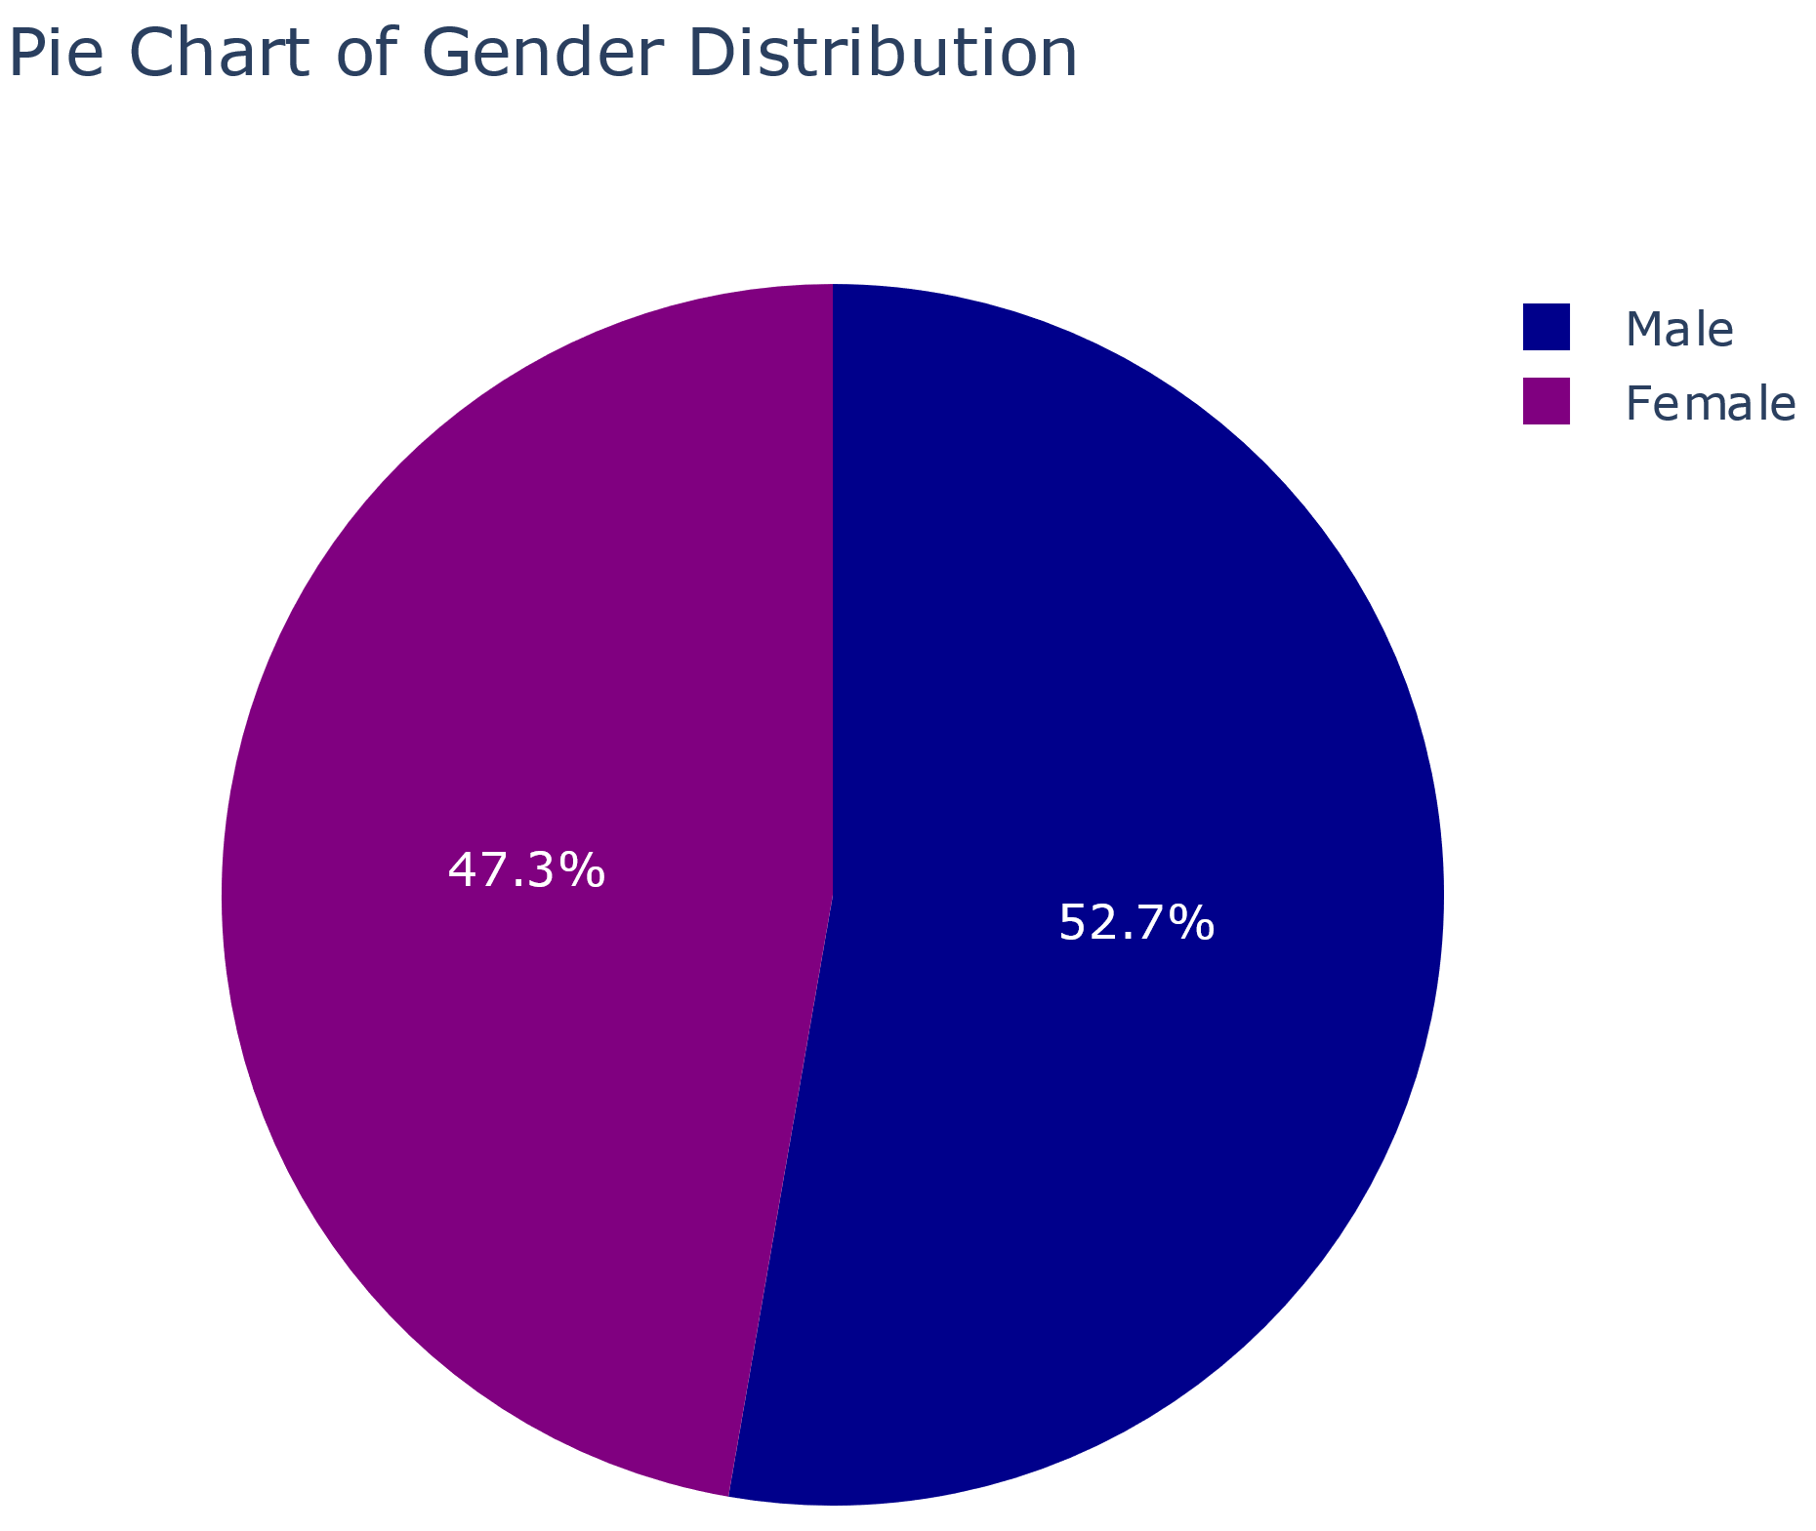
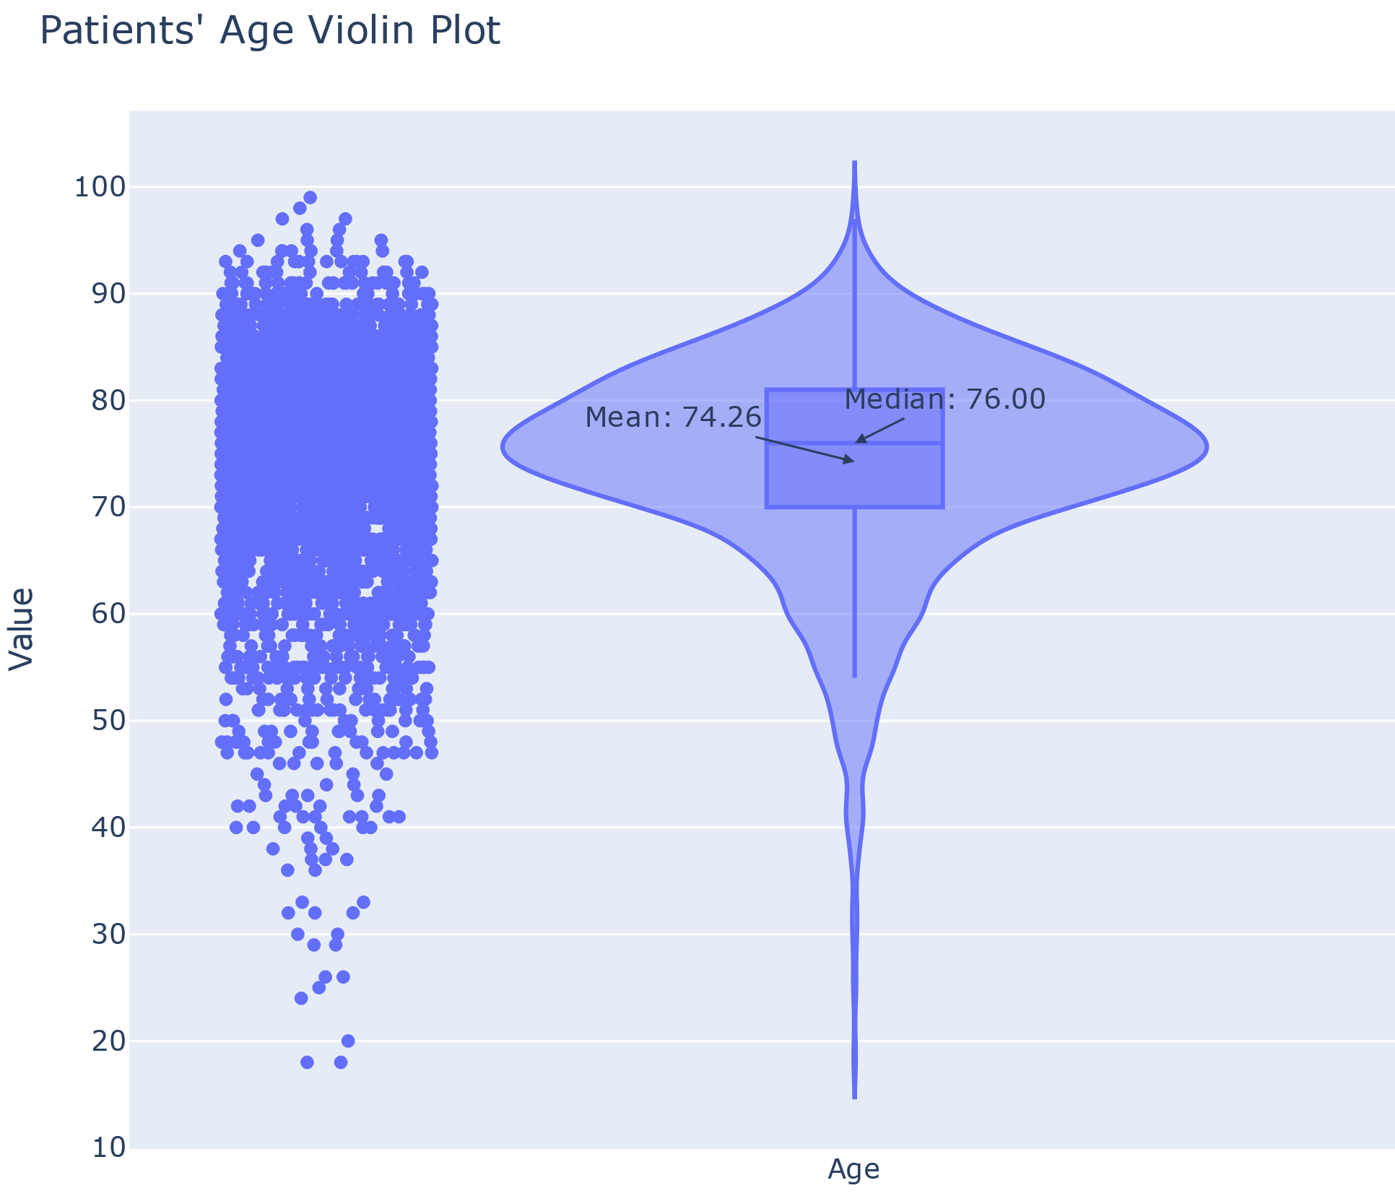
Patient ∩ Lab Meas

Slide 3
Afspraken

Slide 4
Appointment Code to be in the LHS
'NFFRAC’,'NFPOS’,'NFALG’,'NONCO’,'NFVPVAL', 'NFVAL+', 'NFOST', 'NFNEF', 'NFGEHPSO', 'NFPSO', 'NF', 'NPOSK', 'NFVPGEH', 'NTC', 'NFGEH', 'NFPSOVMI', 'NTCPOS', 'NFVMI+', 'NFVPVMI', 'NFSP', 'TCN', 'NSPOS', 'NFSOGEH', 'NS', 'STSN', 'NSCREEN'
CODE | OLD CODE
NALG | NFALG
NGEH | NFGEH
NVCMI+ | NFVMI+
NVAL+ | NFVAL+
4 out of 26 codes are for eligible patients
Inclusion doesn’t take into account haematochemicals
Inclusion doesn’t take into account the text
Better clusterize?

Slide 5
Lab Measurements

Slide 6
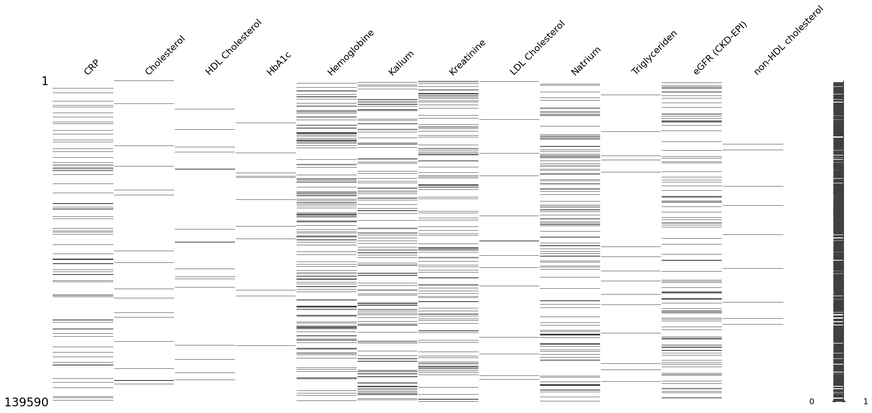
Missing Values

Slide 7
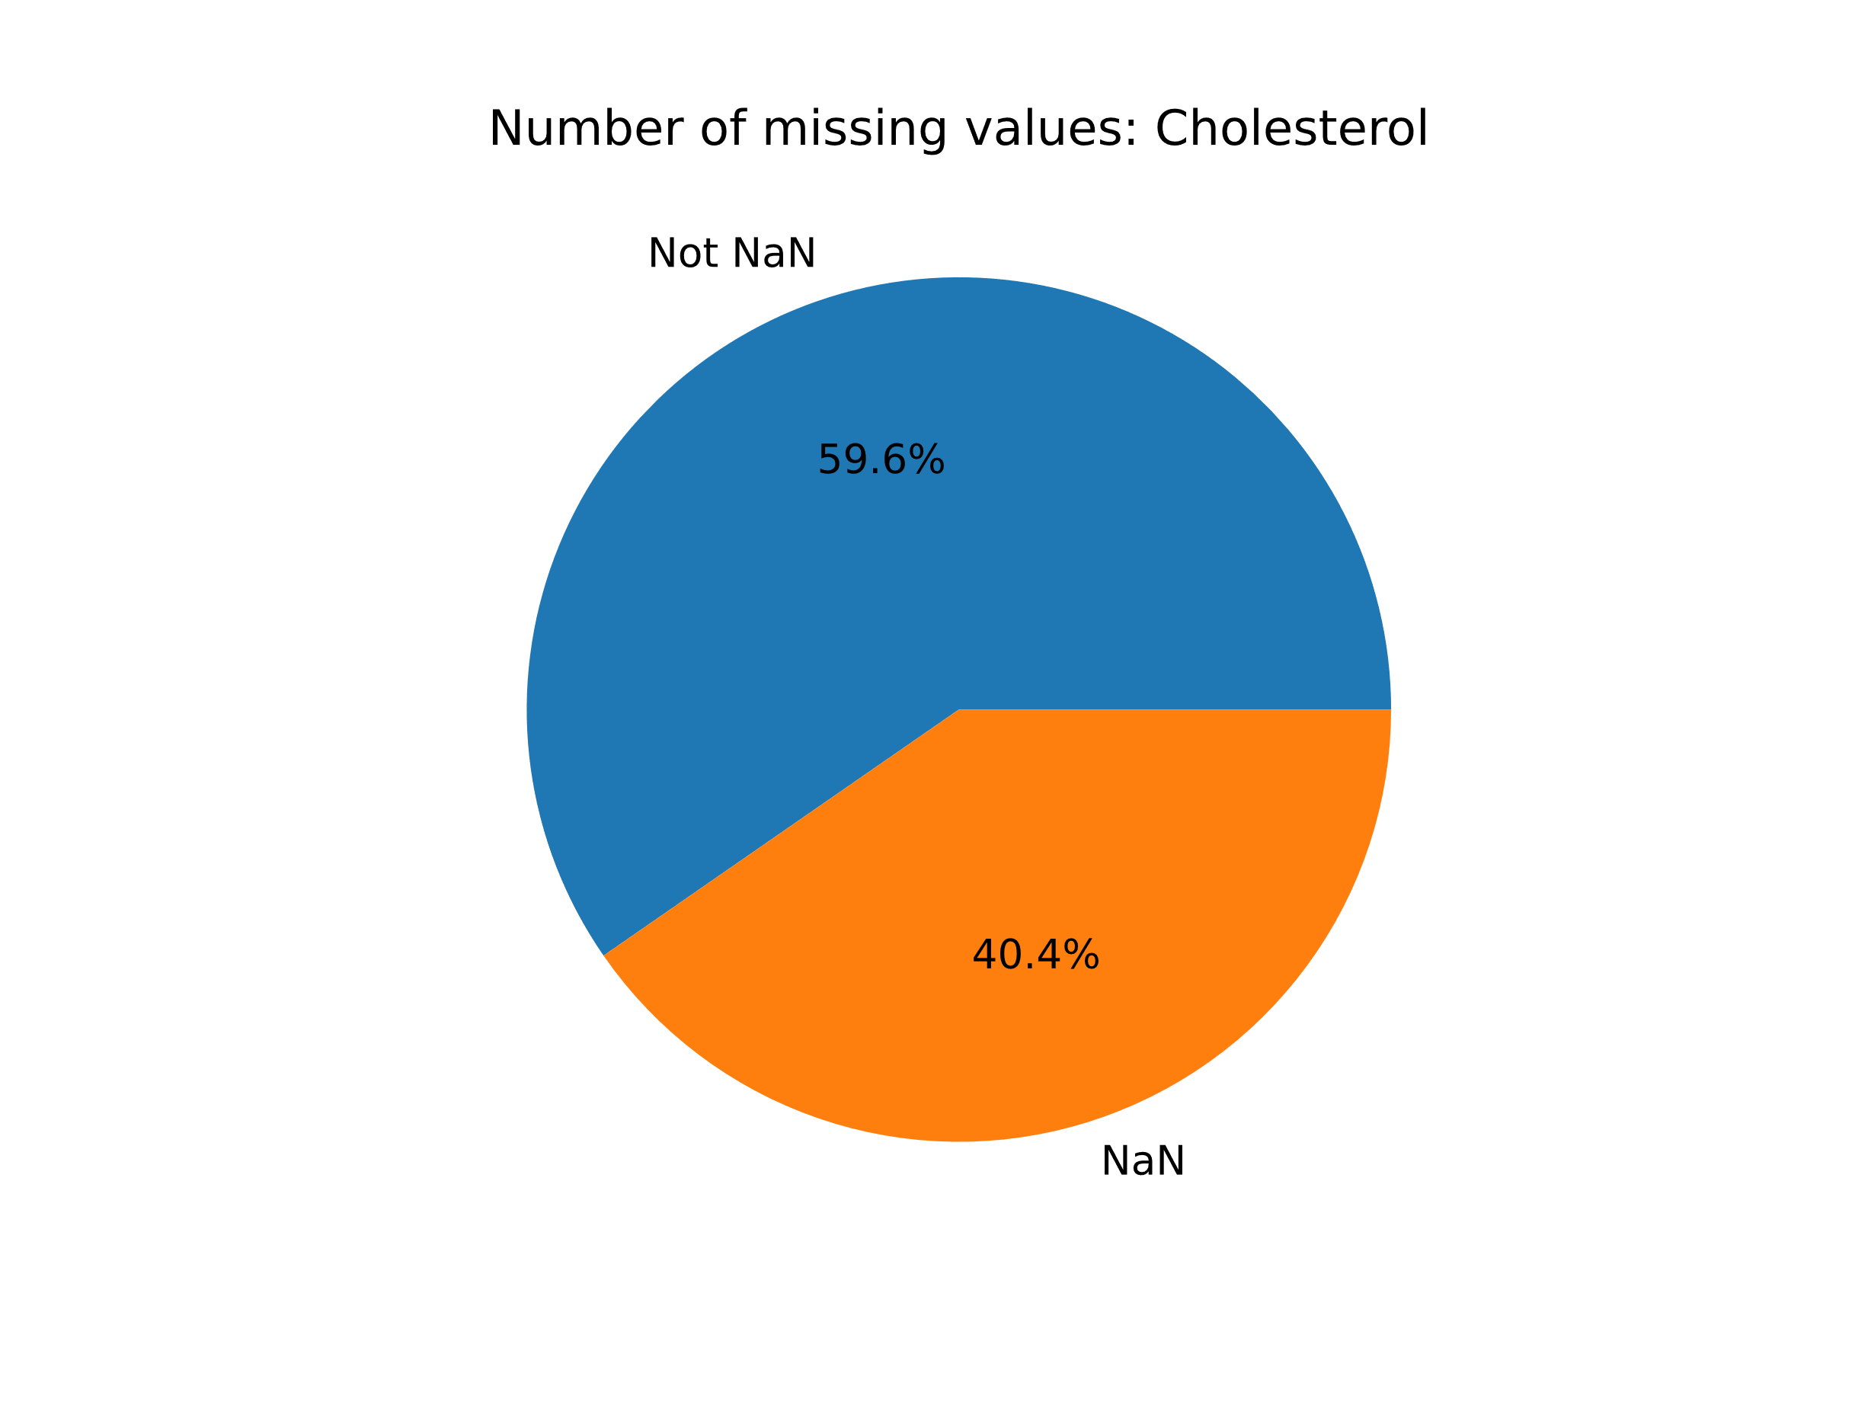
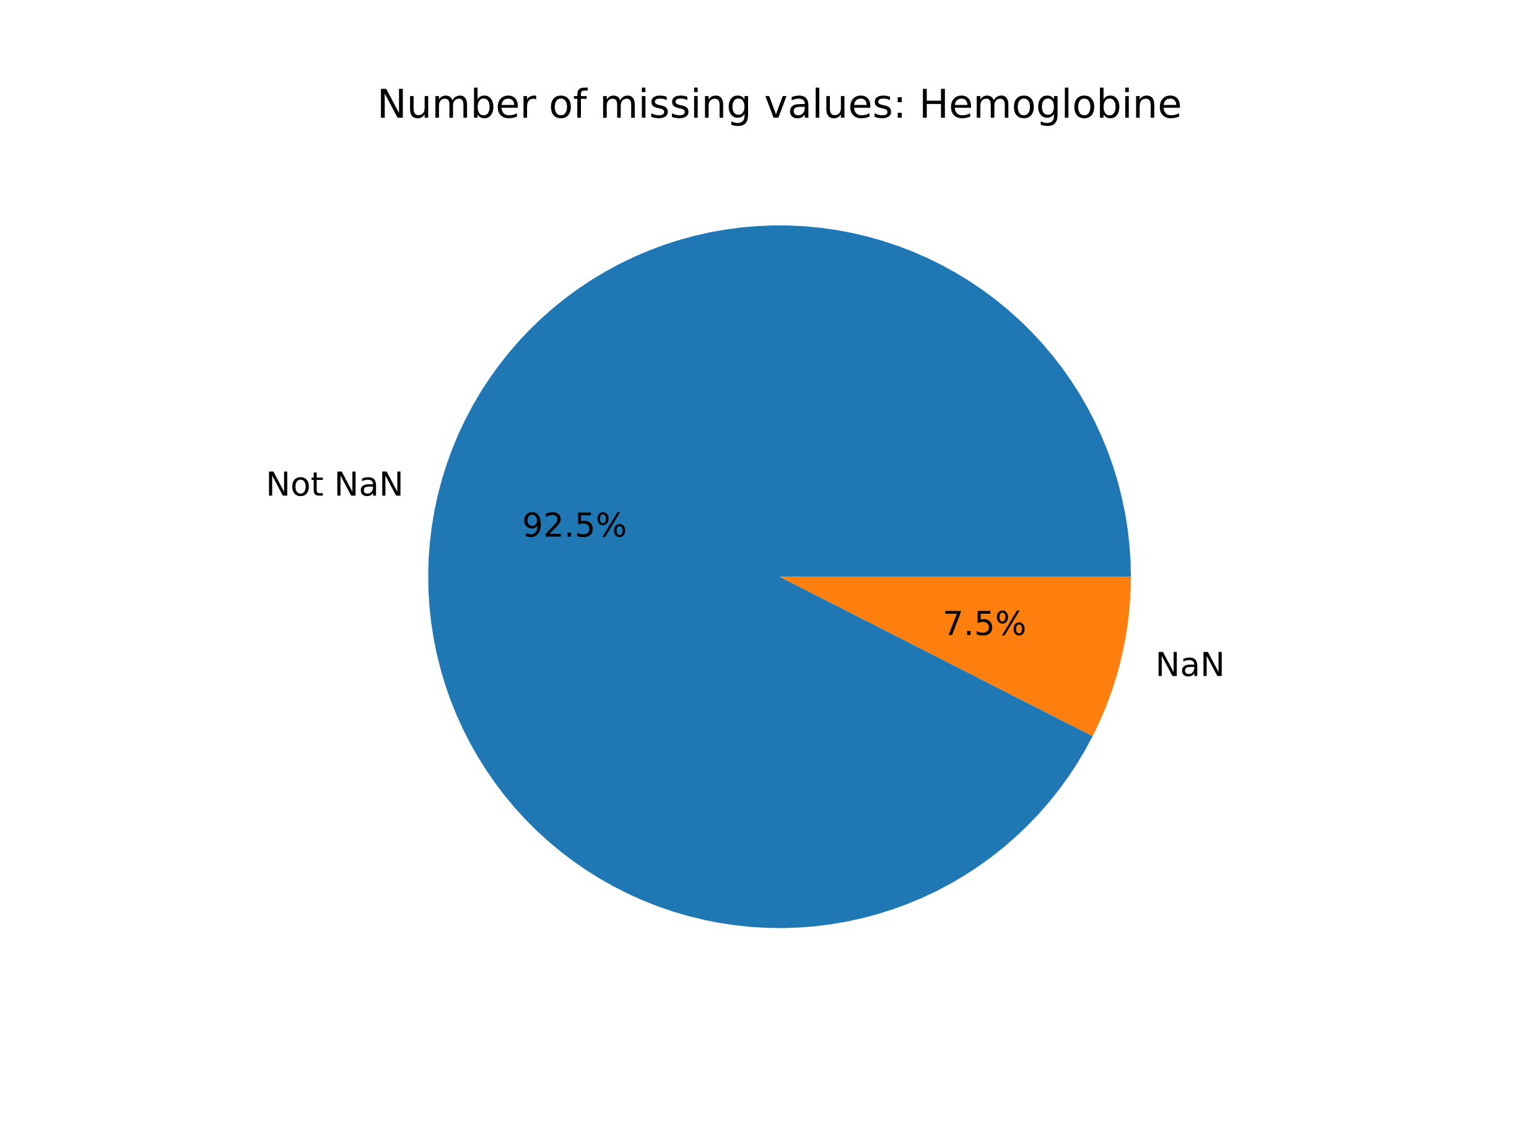
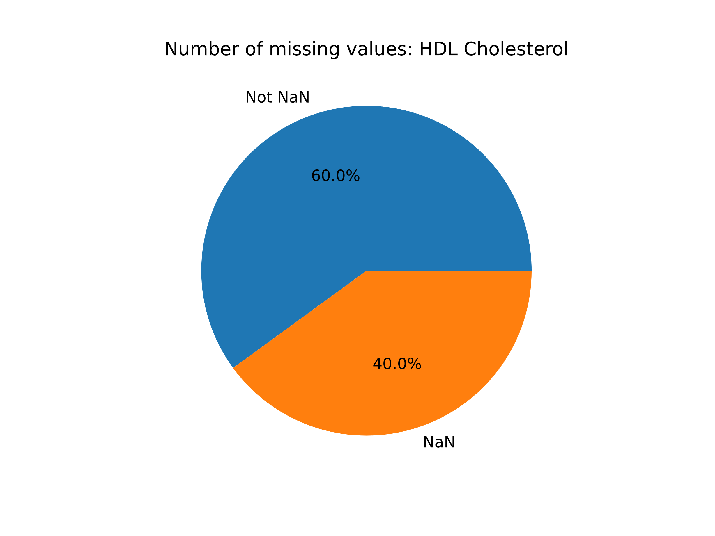
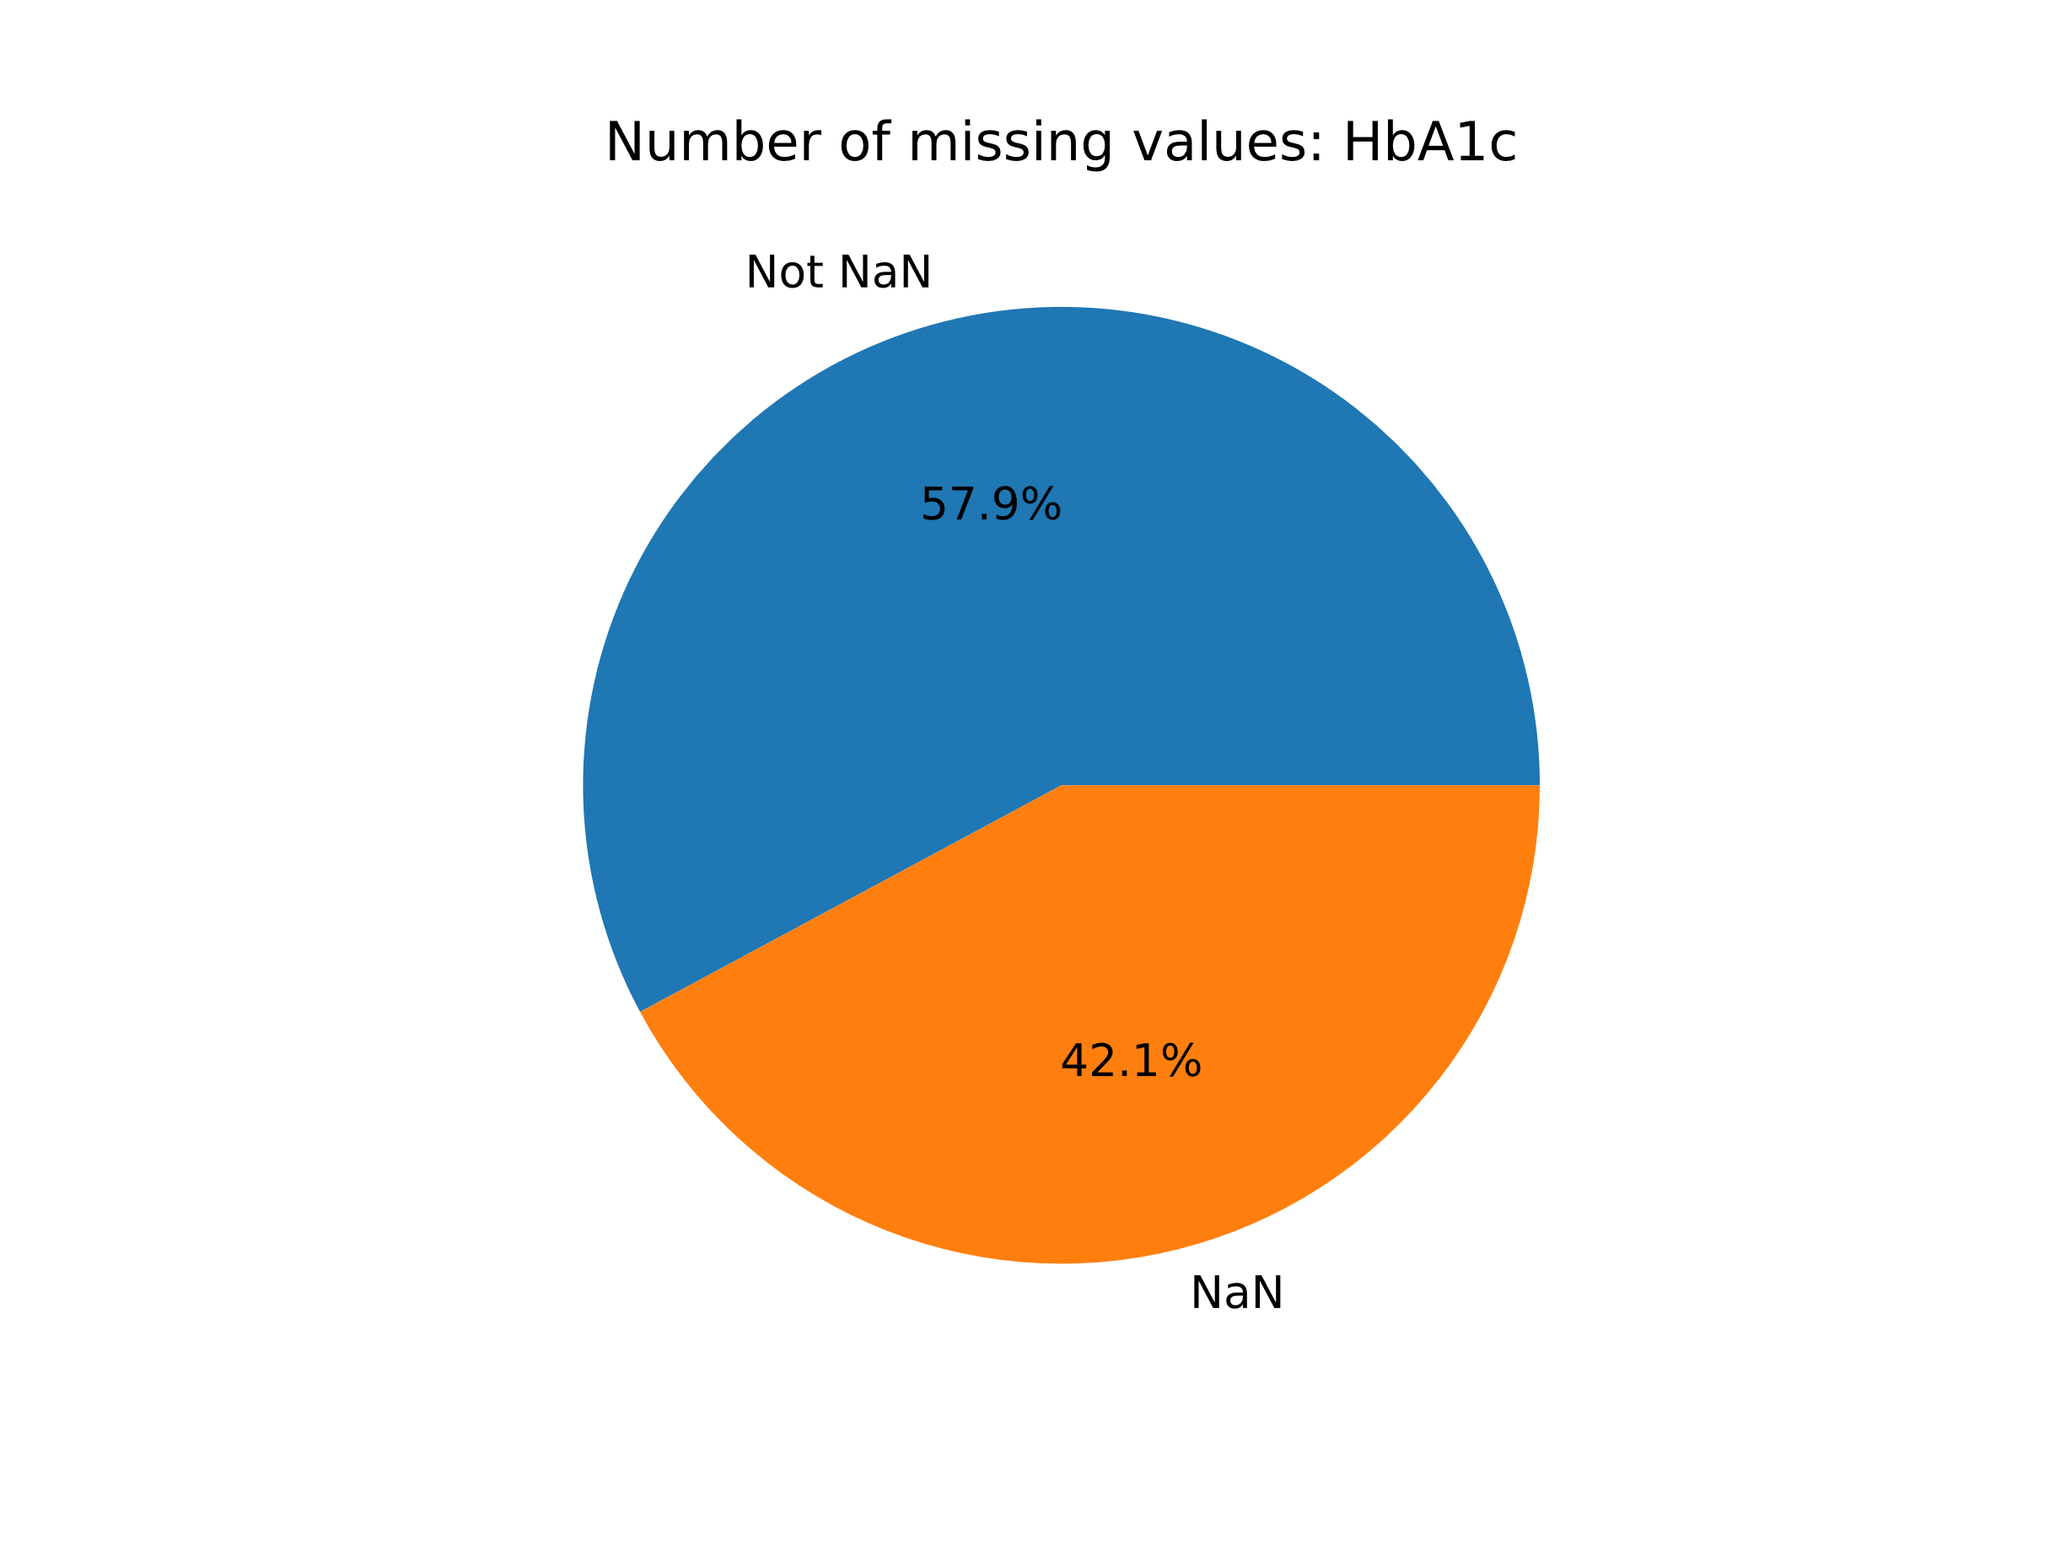
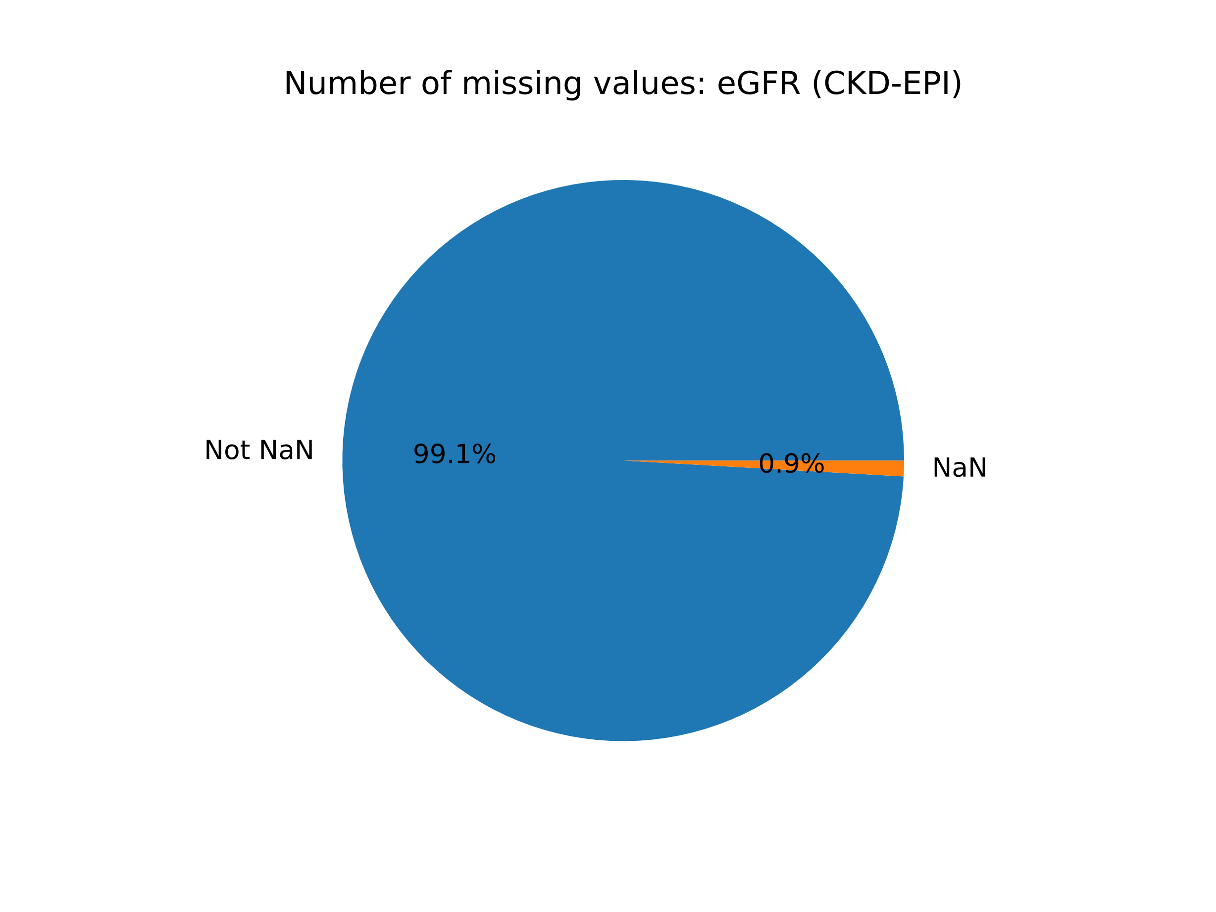
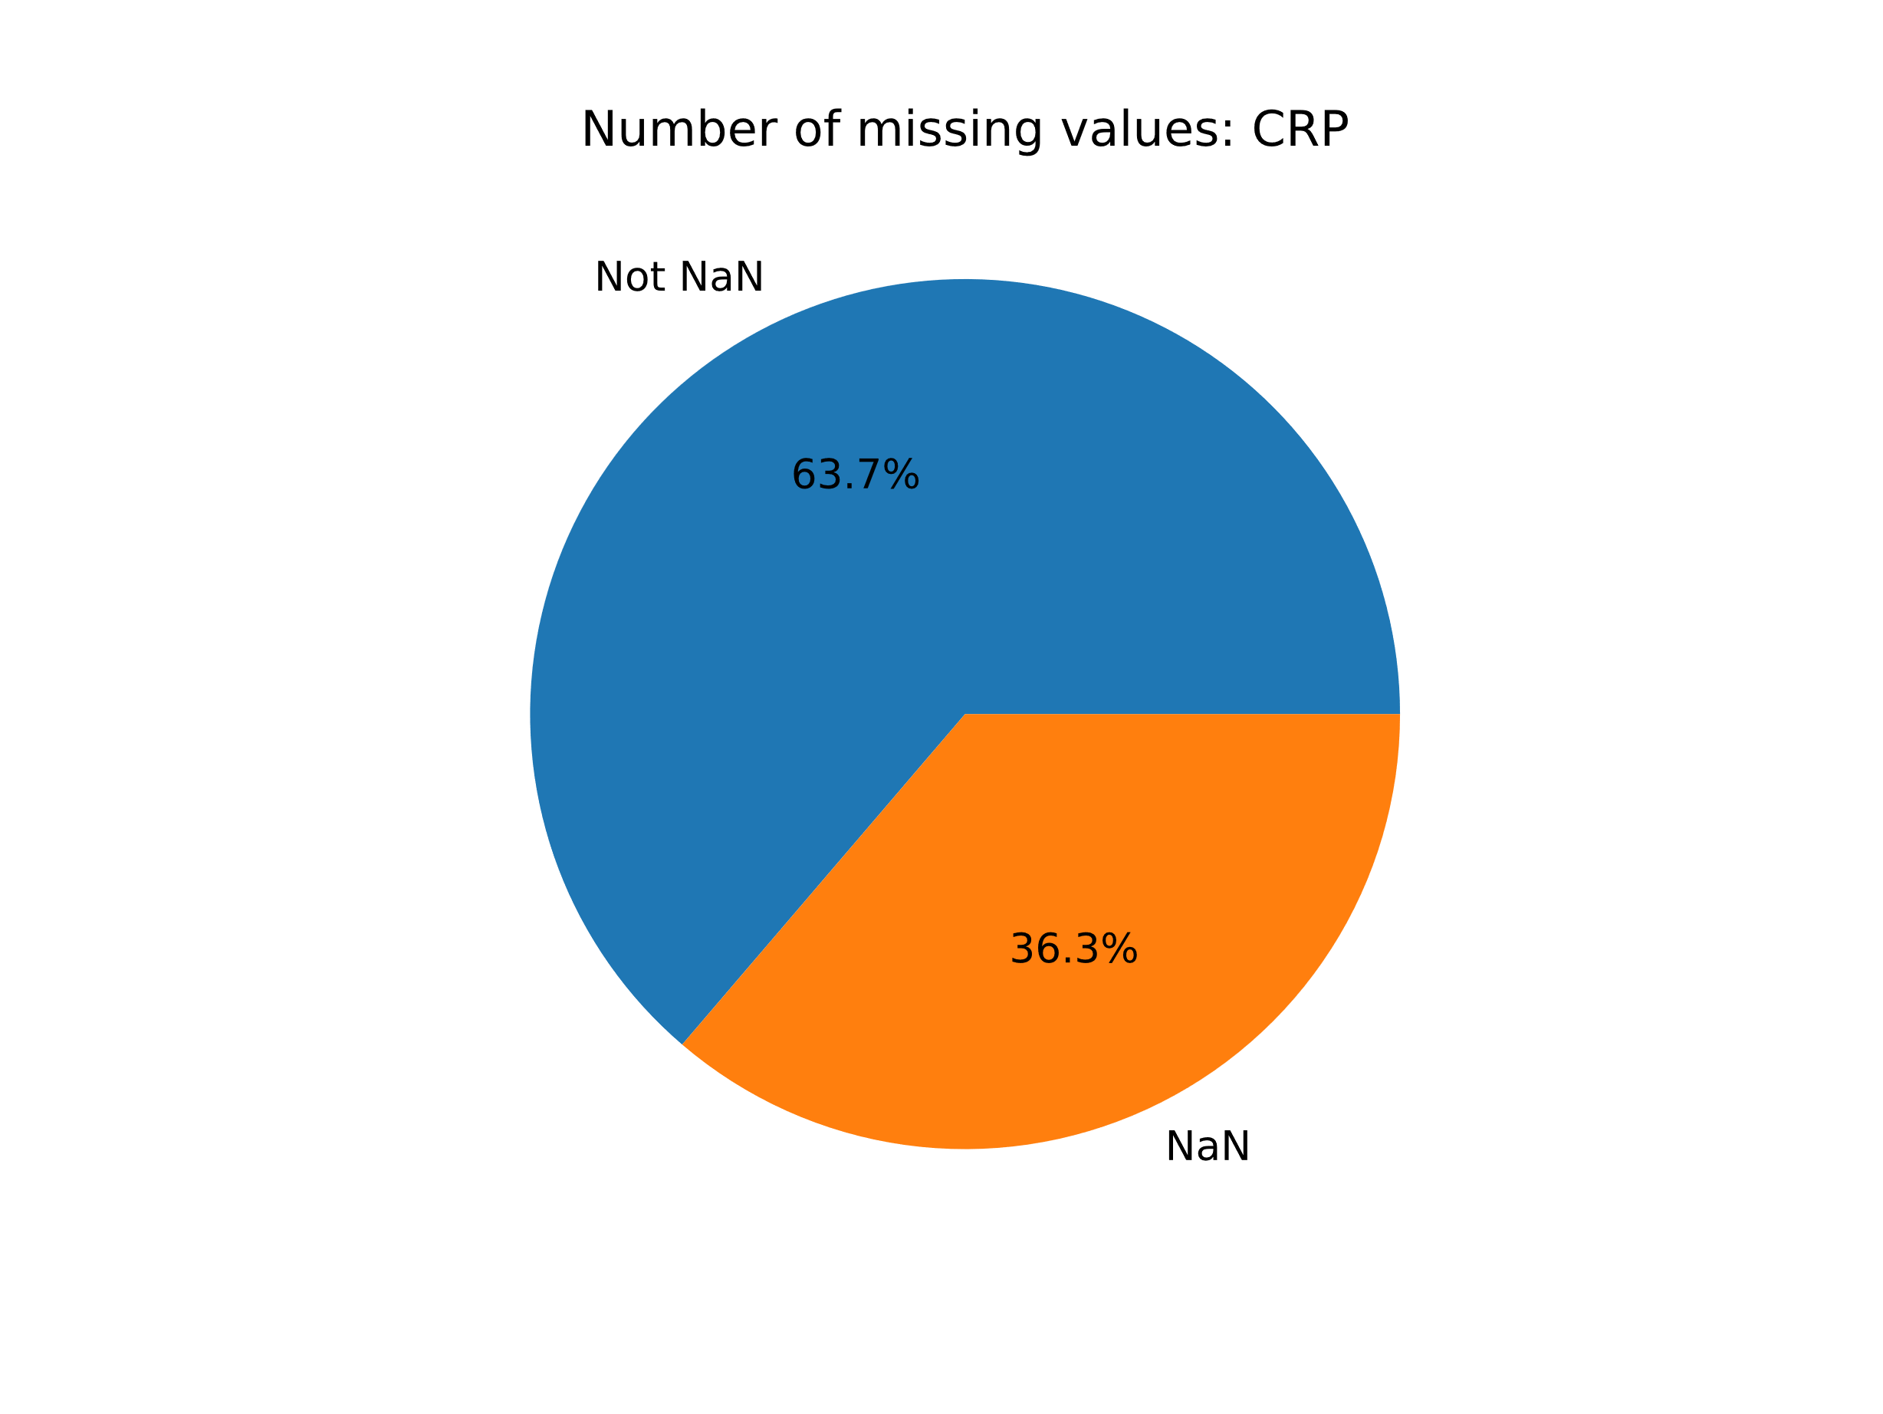

Slide 8

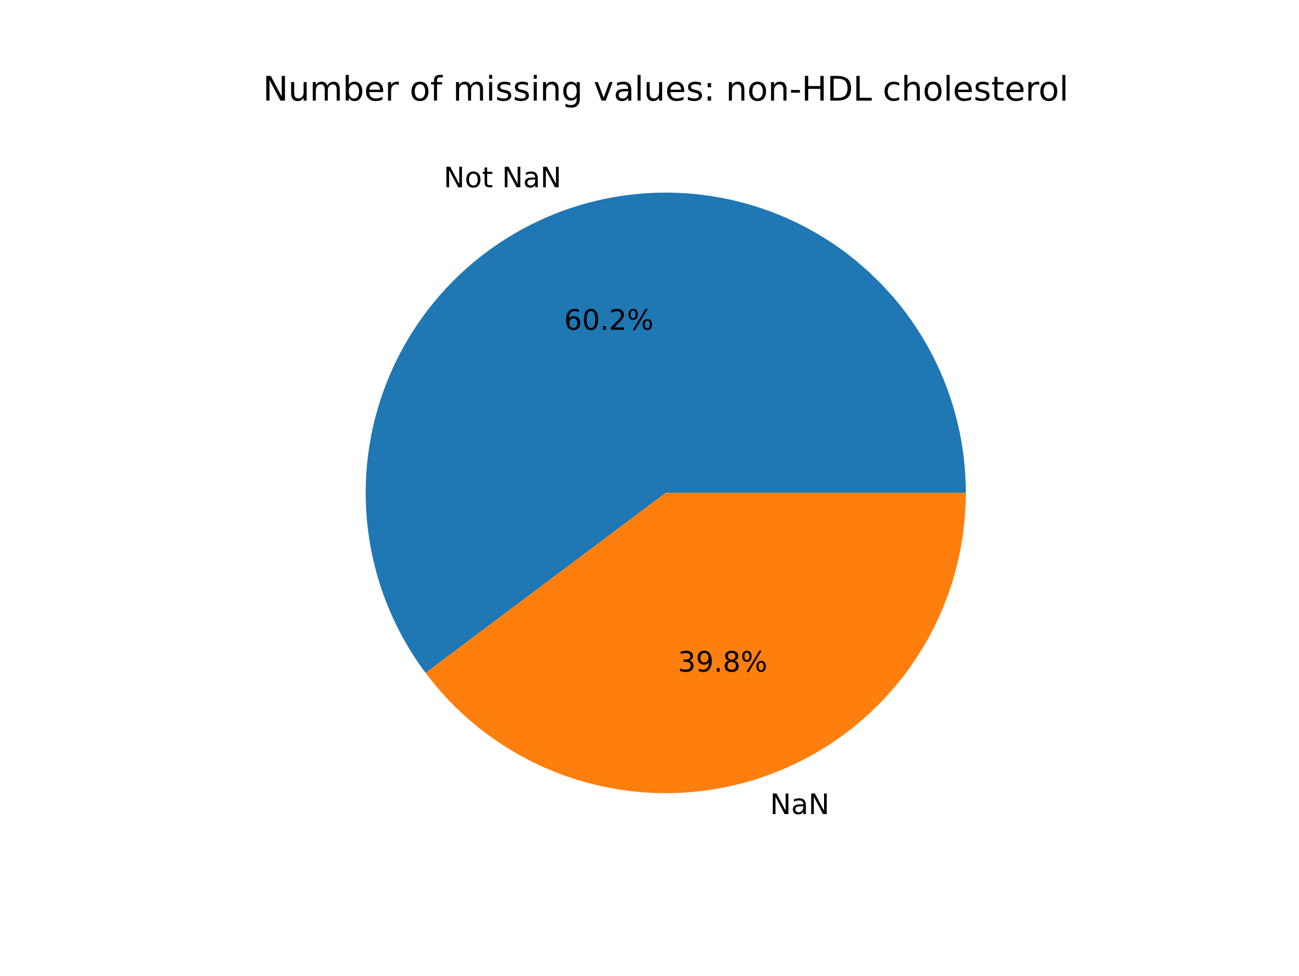
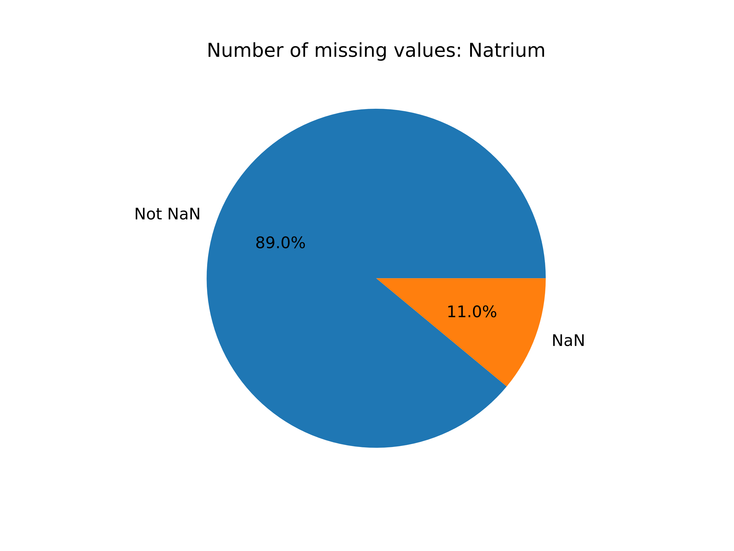
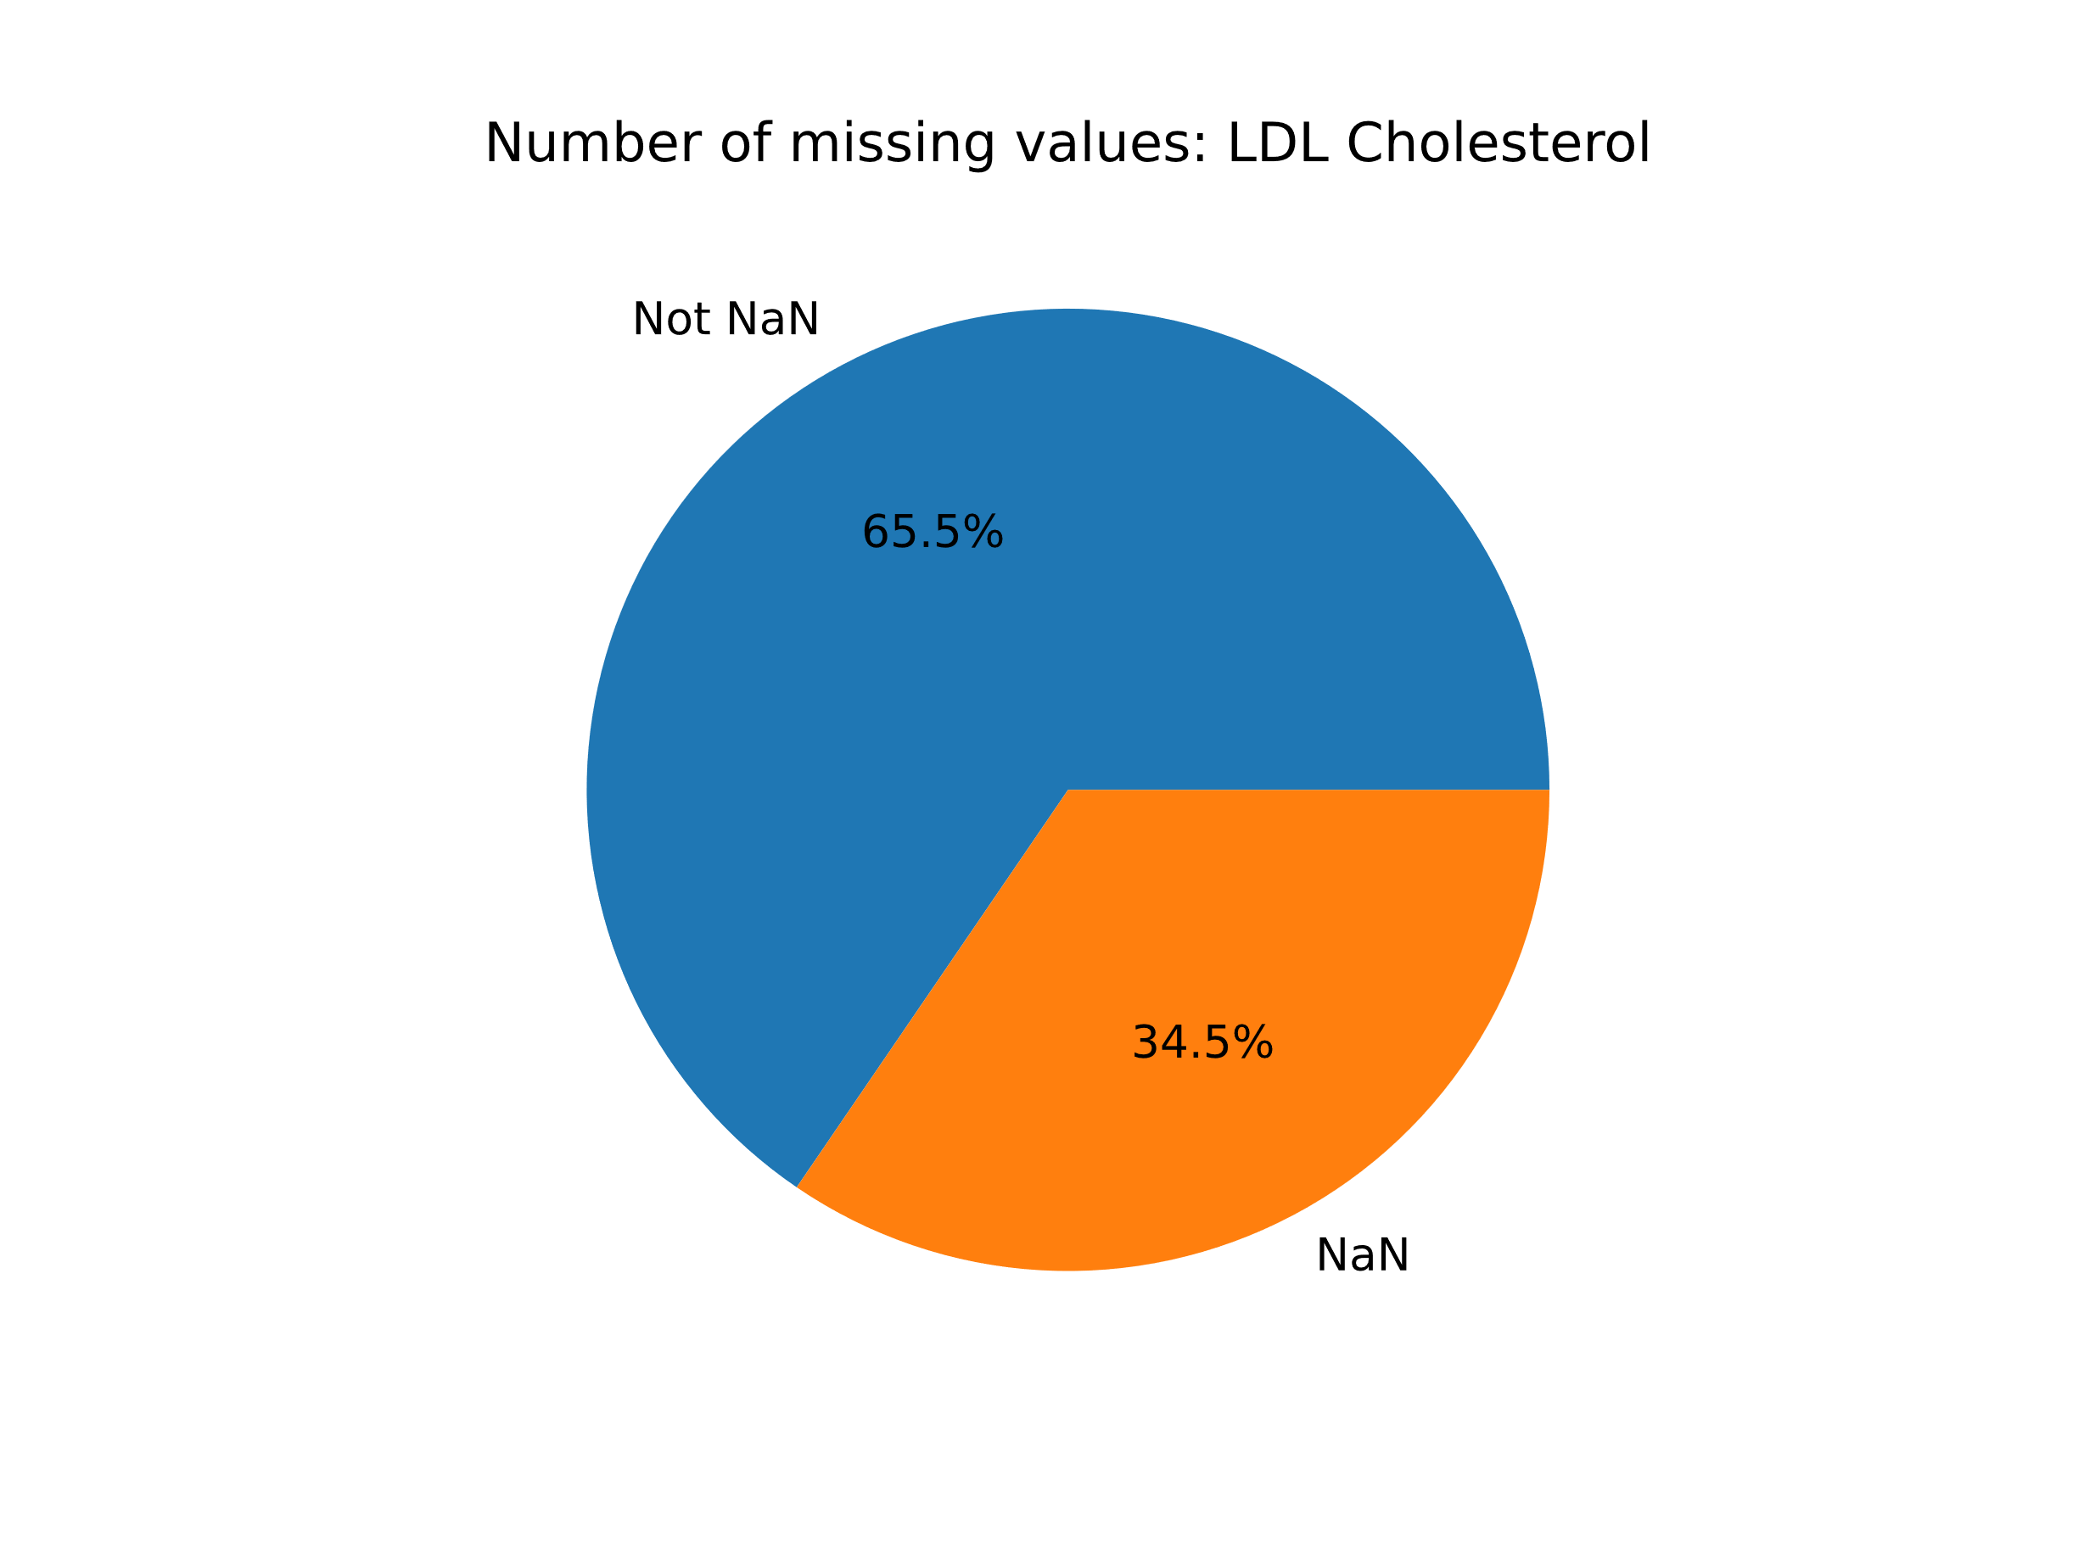
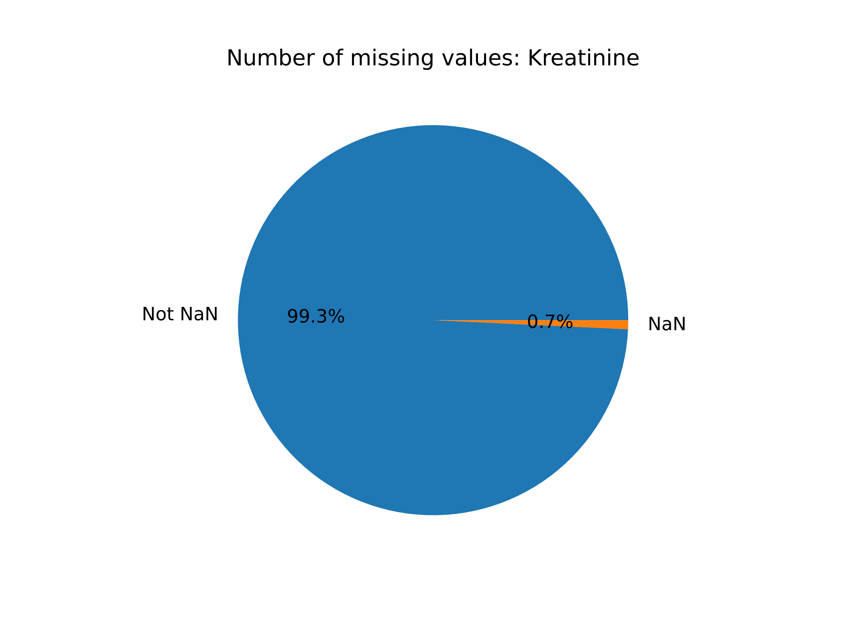


Slide 9
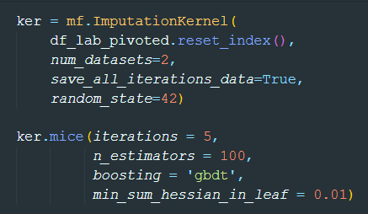
MICE Forest
Gradient Boosting
Decision Trees

Slide 10
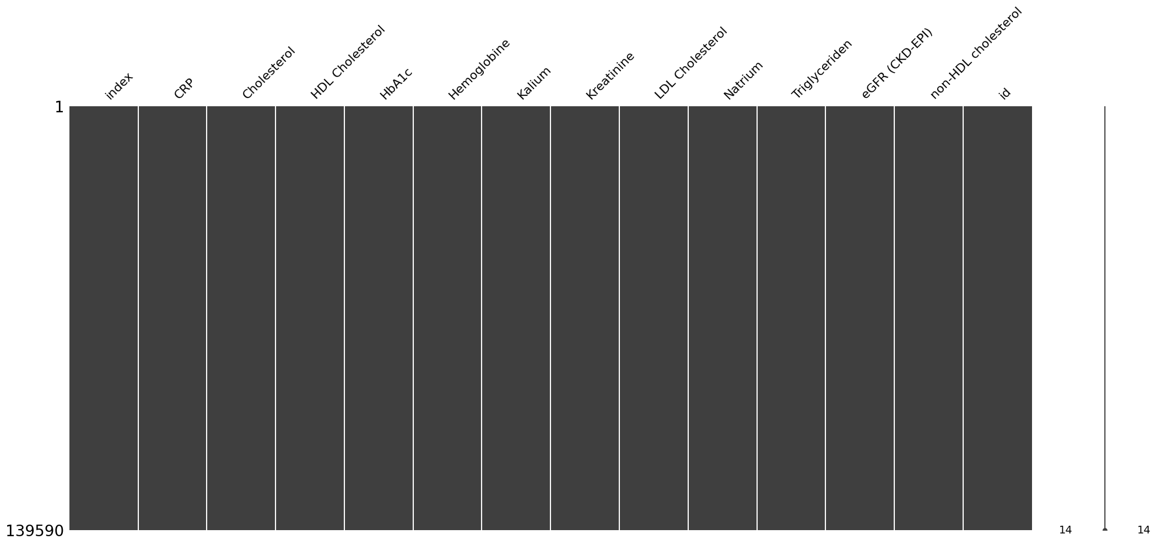
Imputed Values

Slide 11
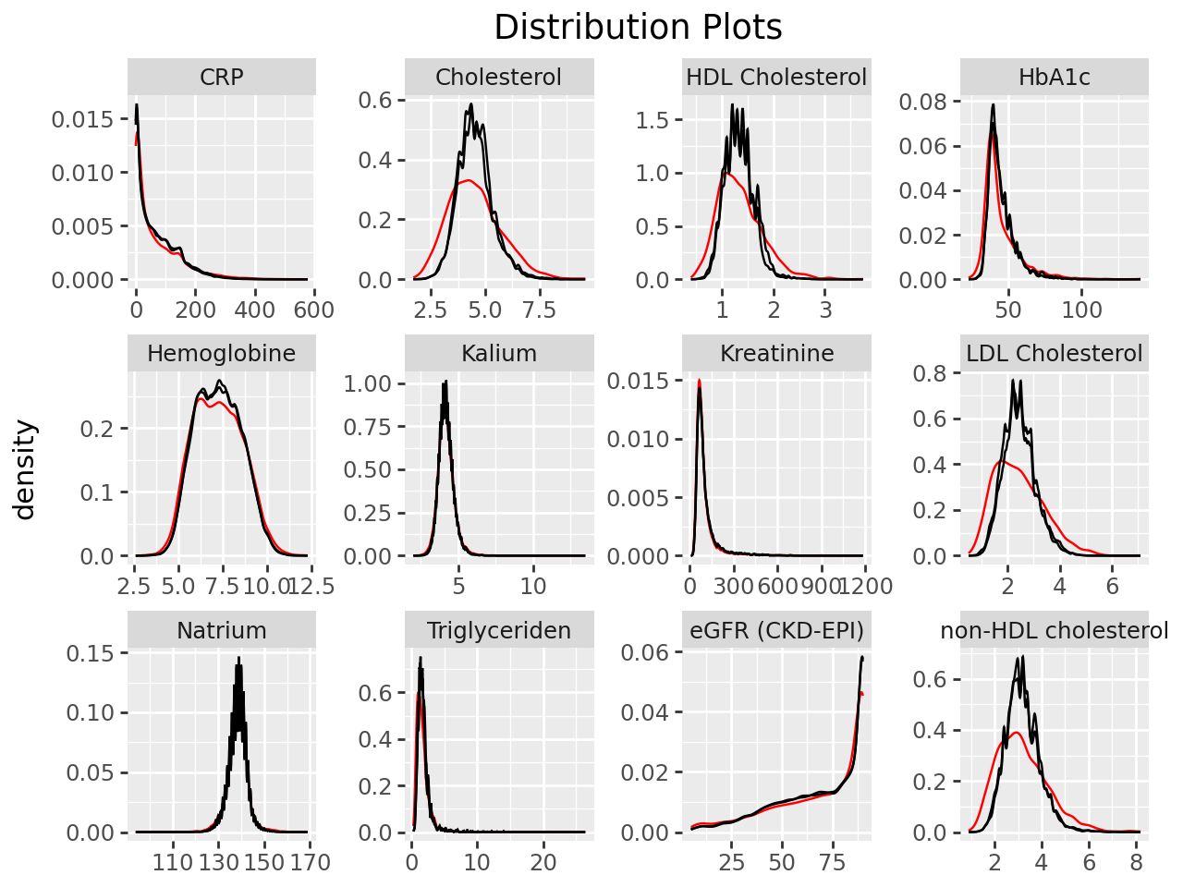
MICE Forest

Slide 12
Medications

Slide 14
Eligibility to LHS

Slide 15
Afspraken DB
Lab Measures DB
4435 patients records
4206 patients records

Slide 16
Afspraken DB
Lab Measures DB
Patient who has lab meas is kept
4206 Patients

Slide 17
Afspraken DB
Lab Measures DB
Patient who has appointment but no lab meas
229 Patients

Slide 18
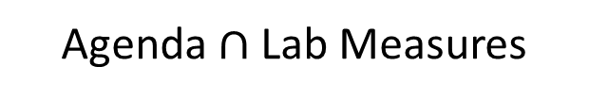
Eligibility based on agenda codes
Agenda $∩$ Lab Measures

