Slide 1
Project BI
Master 2 SIGLIS, 2023 - 2024
Clement Combier
Elie Pierrot
Chems Sakji
Notes:
Hello everyone, we will present you an analysis of a dataset.

Slide 2
Presentation of the datasets
➤ id - Unique ID for each home sold
➤ date - Date of the home sale
➤ price - Price of each home sold
➤ bedrooms - Number of bedrooms
➤ sqft_living - Square footage of the apartments interior living space
➤ floors - Number of floors
➤ lat - Lattitude
➤ long - Longitude
Notes:
The dataset we chose is the one on houses. Here is an example of the dataset, we can find an ID, the date the sale of the house, its price and several other variables. The objective is to analyze house prices among themselves. We will have to compare them according to different criteria and under different models. First, we visualize the raw data around the price.

Slide 3
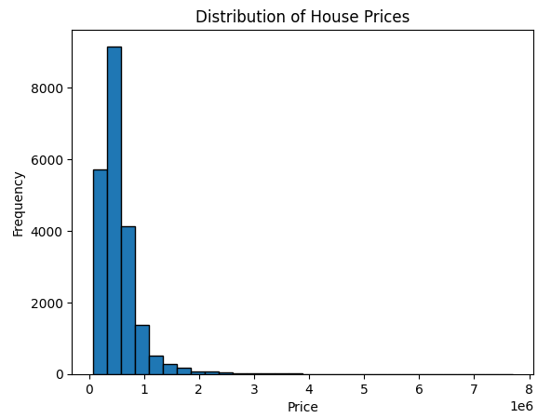
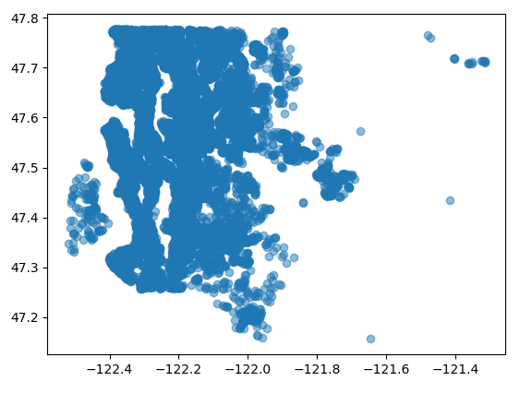
Visualize the raw data
Notes:
For this first analysis of our raw dataset, we can spot multiple outliers that we could easely fix by cleaning our dataset using simple filters. On the first graph, we can see the repartition is not good for our study and we could easely remove houses with a price more than 4 million without causing too much trouble on our dataset for our future machine.The second graph, we have an interesting figure is a plot of houses depending on their location (we graphed out the lattitude and longitude of each house to see the grouping which result)

Slide 4
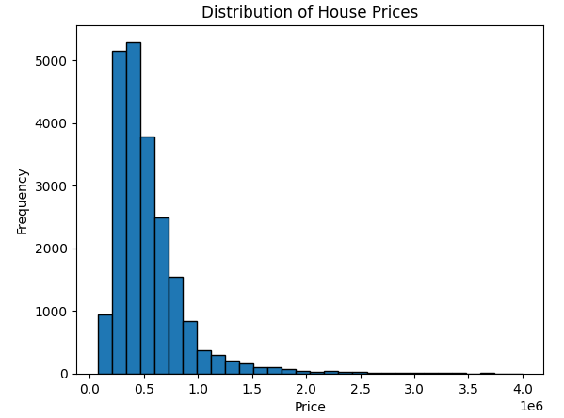
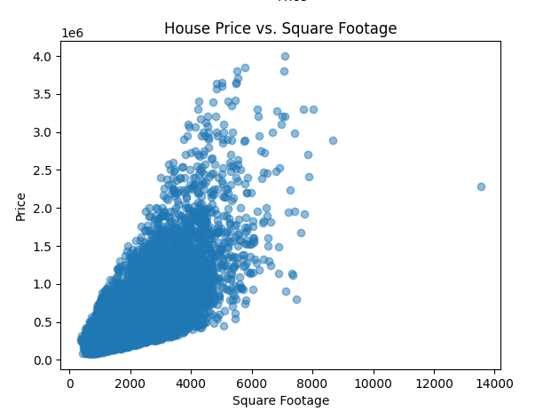
Cleaning the data
Notes:
By only removing houses with a price more than 4 million, we already have cleaned a good portion of our dataset. Most of the outliers are now gone and the repartition is much better than the original one.

Slide 5
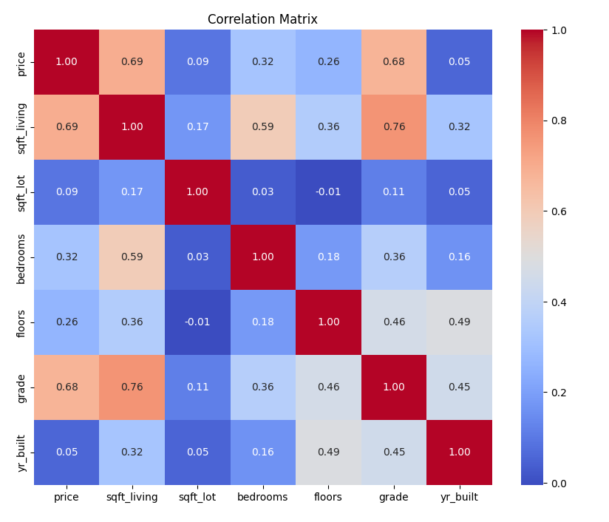
Select the independent variables
Notes:
After cleaning the dataset most outliers have now disappeared and the distribution is much better than the original one. After that we created a resolution matrix to see which variable in our dataset would affect our price. We found two variables that we can identify as independent for our machine, the living square foot (sqft_living) and the grade (grade). We will use these two climbs to power our machine.

Slide 6
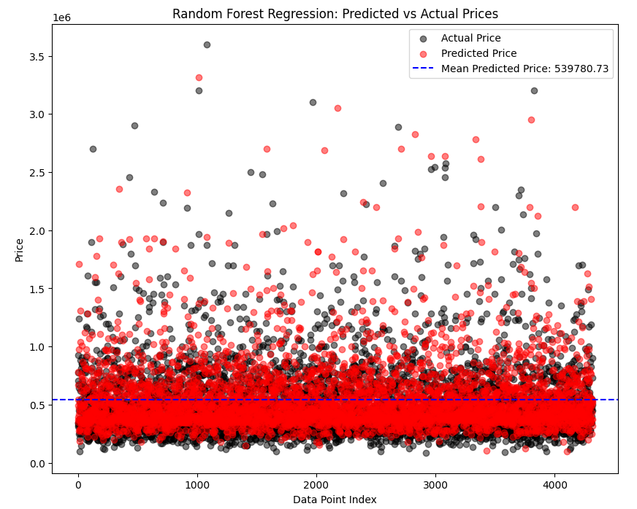
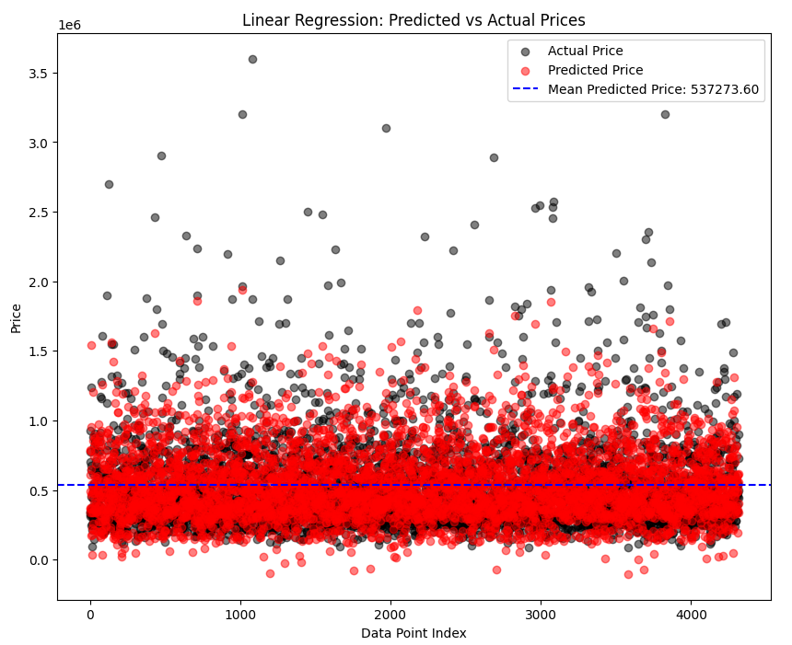


Compare Linear Regression with a Random Forest
Notes:
We made a random forest and a Linear Regression with the variables previously selected and here are two graphs we get. We can see in blue a line corresponding to the average price predicted by our model, this line is in the middle of all our data which proves the quality of our model. We can also see in red the predict price and in black the actual price.
So by comparing our two models visually we can see that predicted prices are a little more scattered with the Random Forest.
Moreover, if we look at the coefficients calculated by our models, we can see that the R2 of the linear model is higher than that for the random forest. Or the R2 score is higher as the model is performing.
So we can conclude that Linear Regression is a better model here.

Slide 7
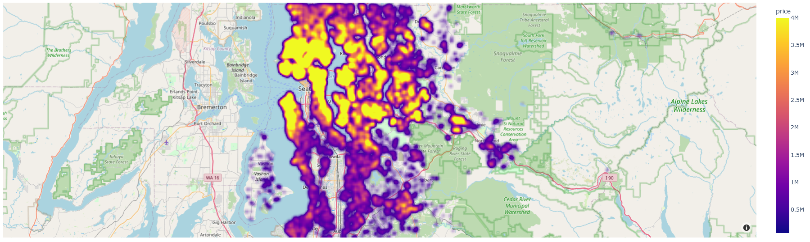
House position and price

Slide 8
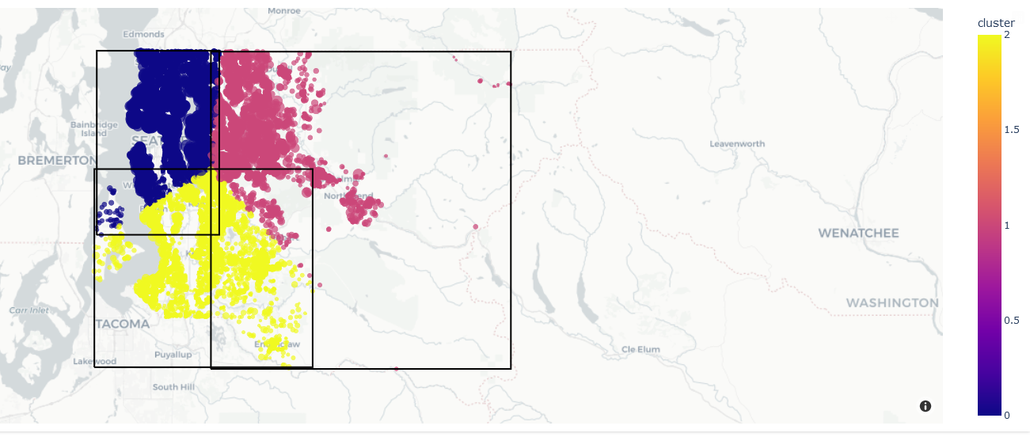
Clustering the data

Slide 9
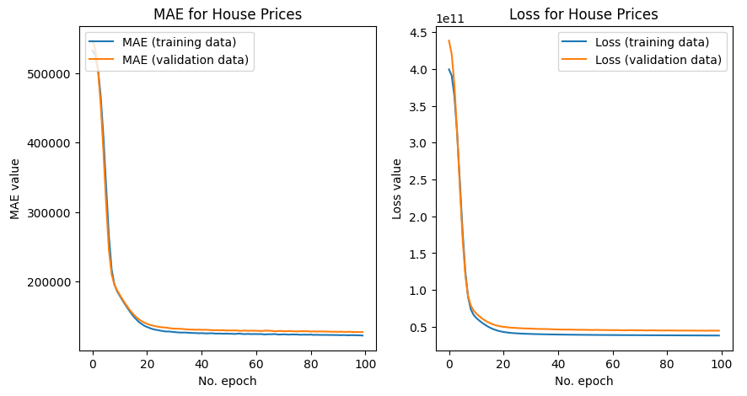
Neural network to the data

Slide 10

Thank’s you for listening !

