Slide 1


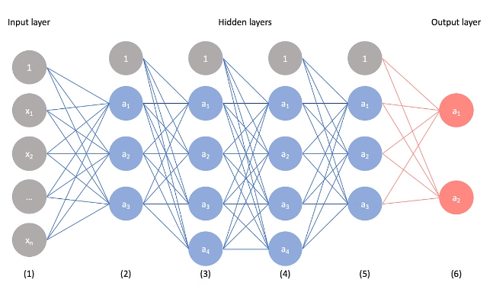
Convolutional Neural Networks

Slide 2

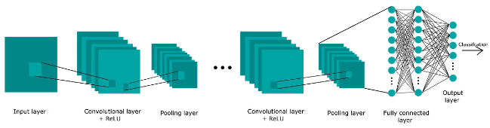
Layer Types
Convolutional Layer
Applies convolution operation to input
Pooling Layer
Downsamples spatial dimensions
Fully-Connected Layer
Connects all neurons to previous layer

Slide 3
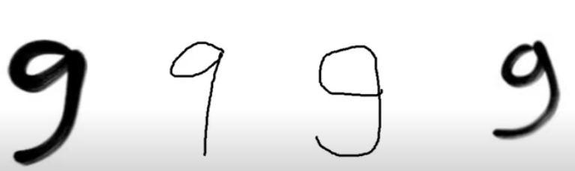
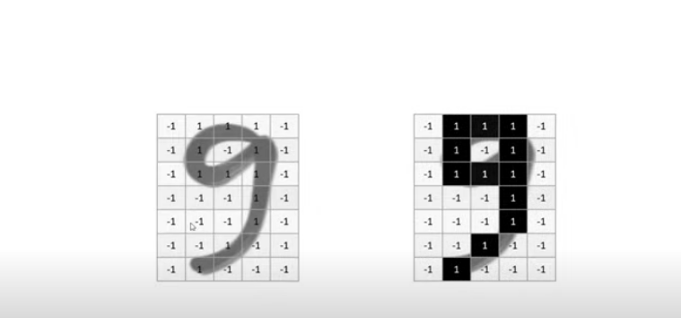
Image Storage

Slide 4
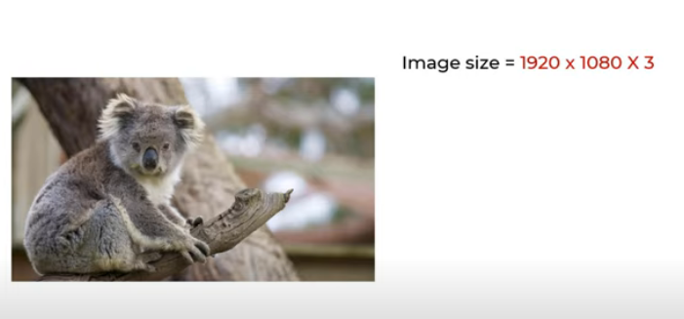
Image Storage

Slide 5
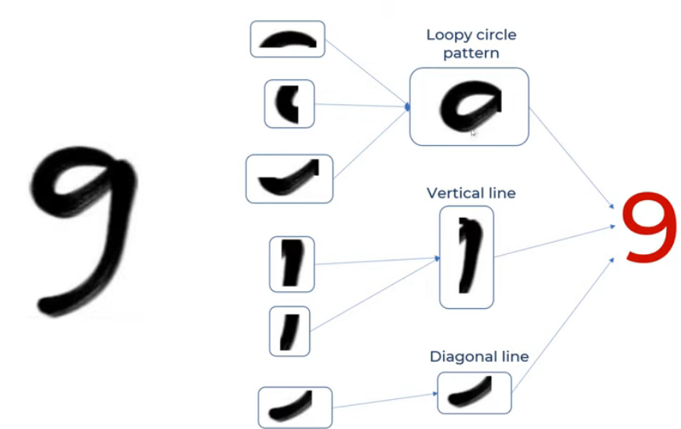
How does human recognize Numbers/Alphabets

Slide 6
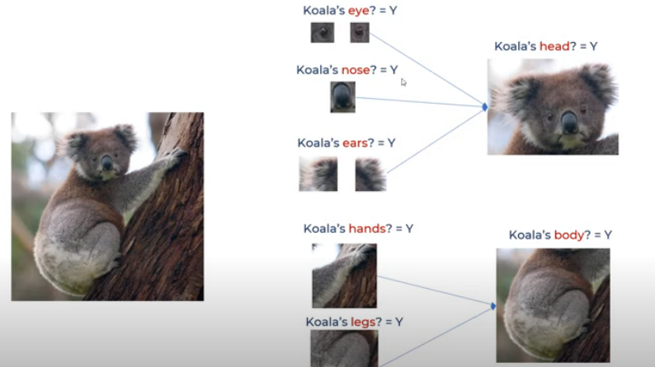
How does human recognize images

Slide 7
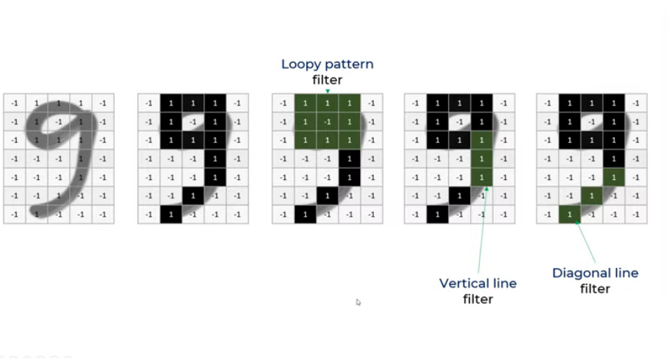
How to make computers to learn?
Filters

Slide 8
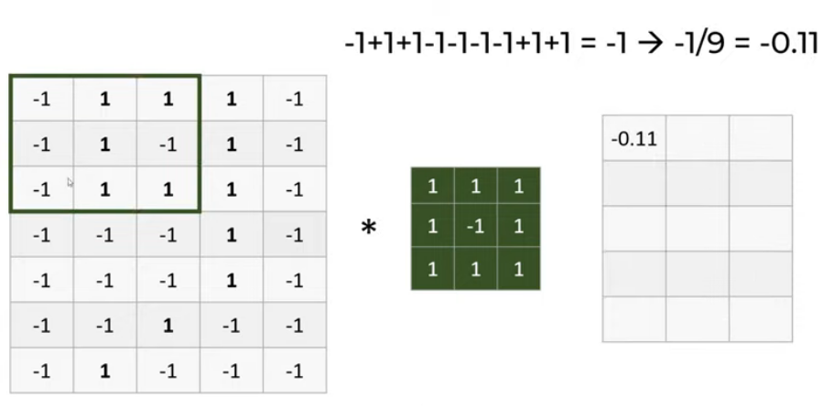
Feature map
3 x 5
32 x32

Slide 9
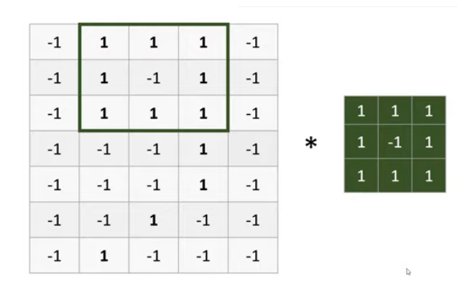
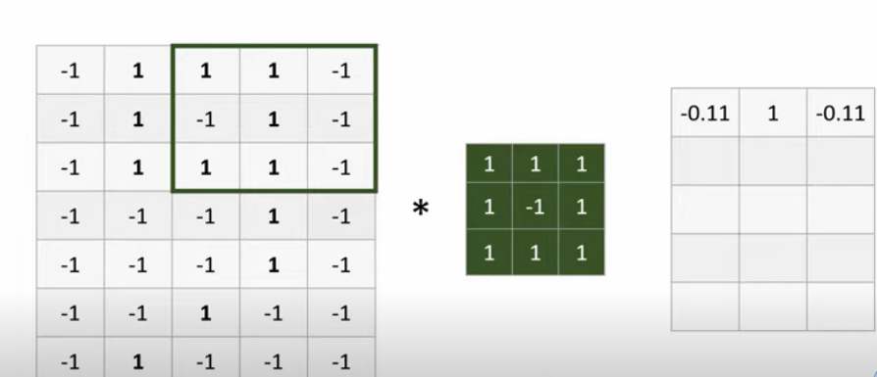
Stride of 1
1+1+1+1+1+1+1+1+1

Slide 10
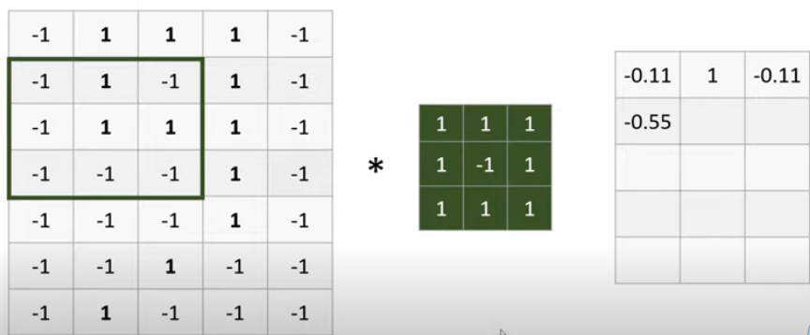
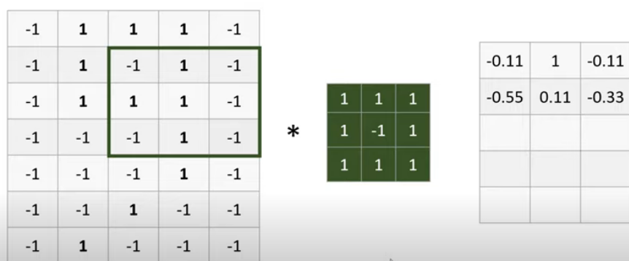

Slide 11
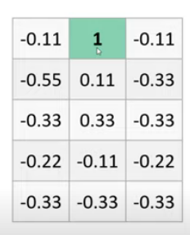
Final one is Feature map

Slide 12
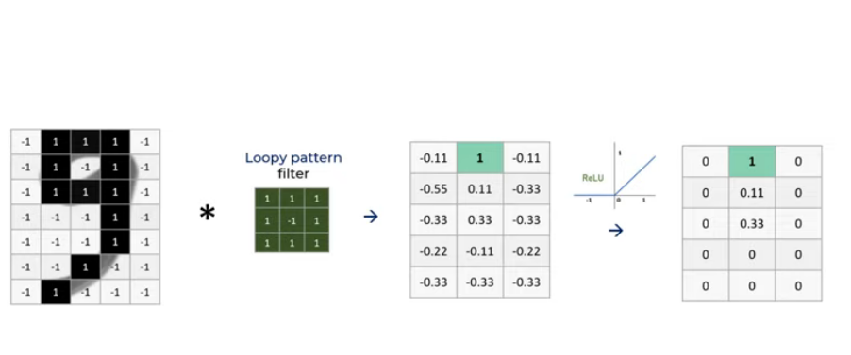
ReLU

Slide 13
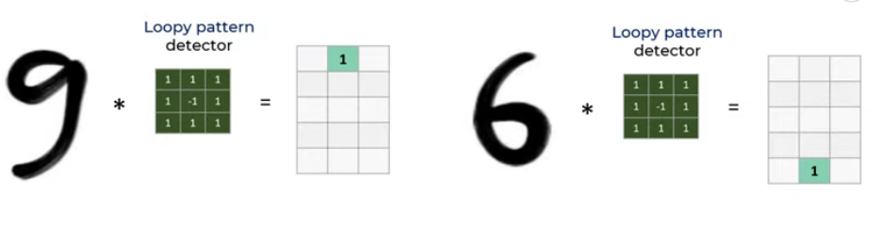
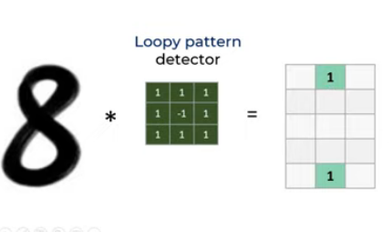

Slide 14


Slide 15
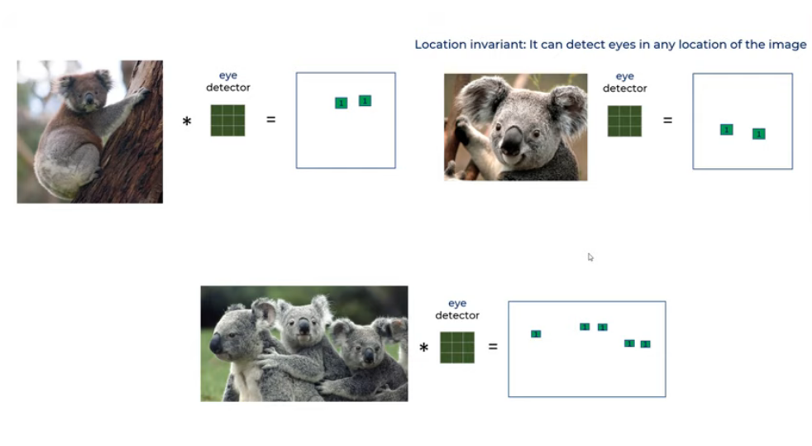
Feature Map

Slide 16
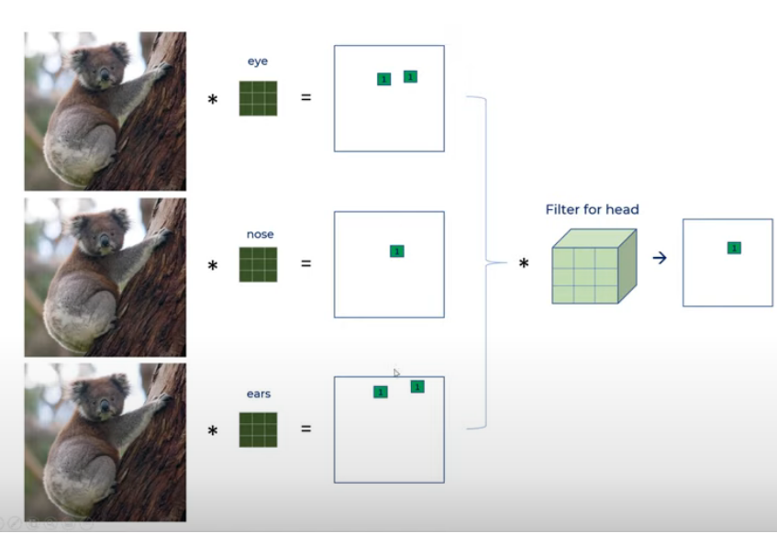
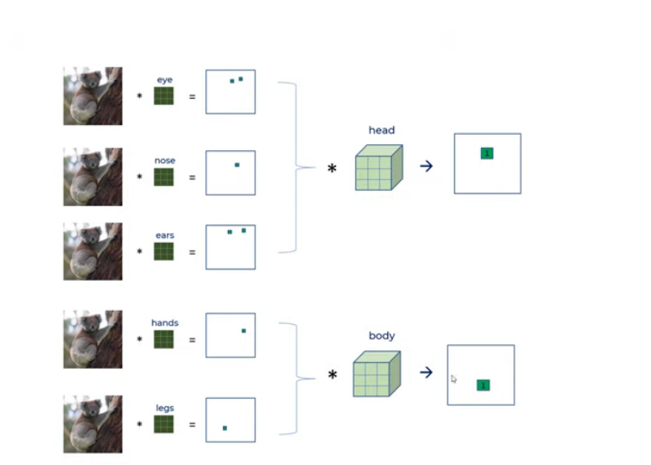
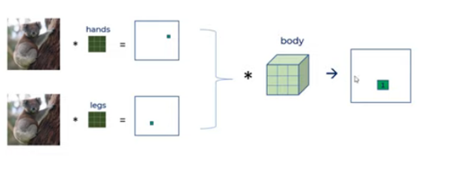
Feature Map

Slide 17
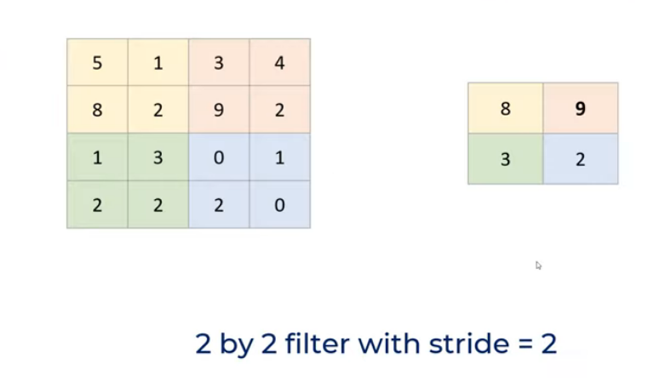
Pooling Layer

Slide 18
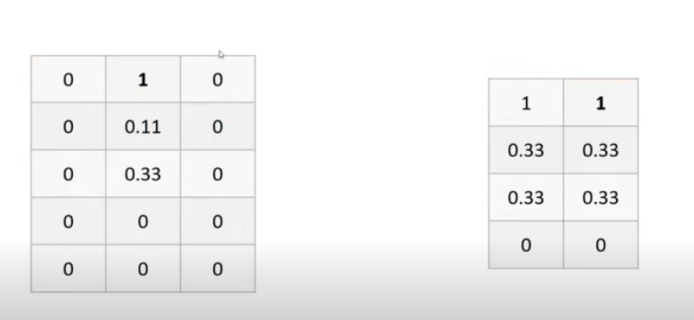
For Number 9
2x2 with 1

Slide 19
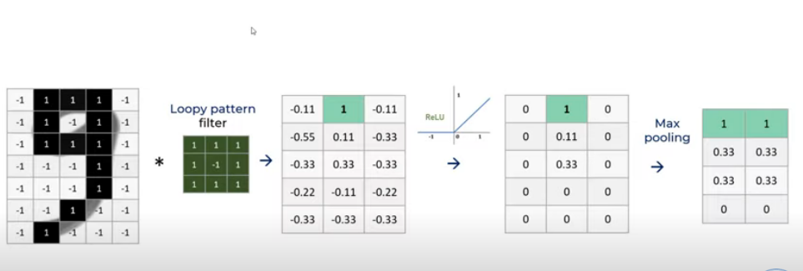
All put Together

Slide 20
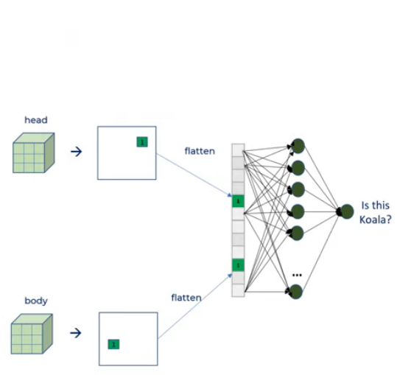
Flatten

Slide 21
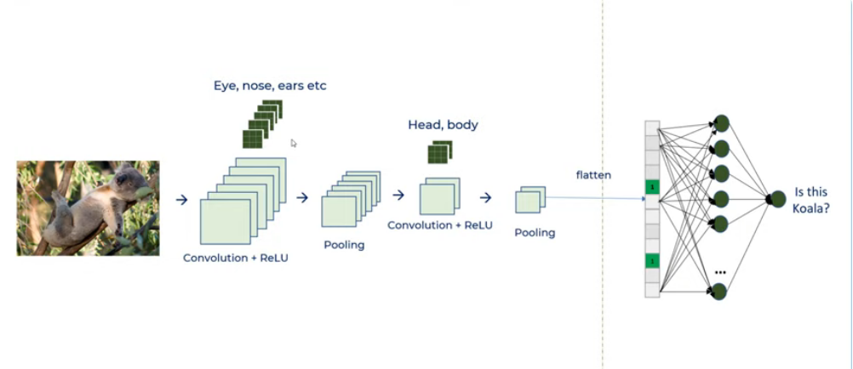
CNN
Feature Mapping
Classification

Slide 22
Input: A 28×28grayscale image.
Convolution: Apply multiple filters (e.g., 3×3) to extract features → Get feature maps.
Pooling: Downsample the feature maps using max pooling → Smaller feature maps with key patterns.
Repeat the process as needed (Conv → Pool → Conv → Pool).

Slide 23

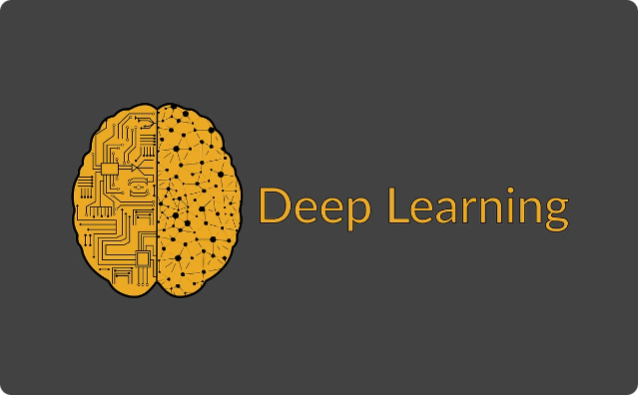
CNN Implementations
TensorFlow
Open-source library developed by Google. It is one of the most
widely used libraries for building and deploying machine learning models.
PyTorch
Facebook's AI Research lab (FAIR), which is particularly useful
for research and development in deep learning.
Keras
Keras was developed by François Chollet, a researcher at Google. Keras is an open-source neural network library written in Python that acts as an interface for the TensorFlow library (among others).

