Slide 1
Foundational Topics in Natural Language Processing (NLP)
Comprehensive Overview and Techniques

Slide 2
Introduction to NLP
It enables computers to understand, interpret, and generate human language in a way that is both meaningful and useful. It bridges the gap between human communication (in the form of text or speech) and machine understanding.
Understanding Language: Enabling computers to understand the semantics (meaning) and syntax (structure) of text or speech.
Generating Language: Allowing systems to produce human-like text or speech.
Interacting with Humans: Facilitating communication between humans and machines in natural language, e.g., chatbots or voice assistants.

Slide 3
similar word should be in same vector value range :word -vec

Slide 4
Applications of NLP in Various Industries
Healthcare:
Predicting patient outcomes using EHRs.
Chatbots for mental health support.
E-commerce:
Personalized product recommendations.
Customer sentiment analysis through reviews.
Finance:
Automating customer support with chatbots.
Education
Customer Service:
Virtual assistants like Siri, Alexa, and Google Assistant.
Intelligent chatbots for handling customer queries.

Slide 5
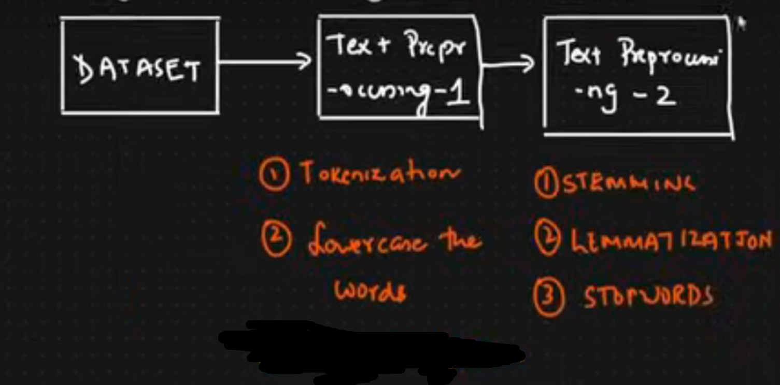

Slide 6
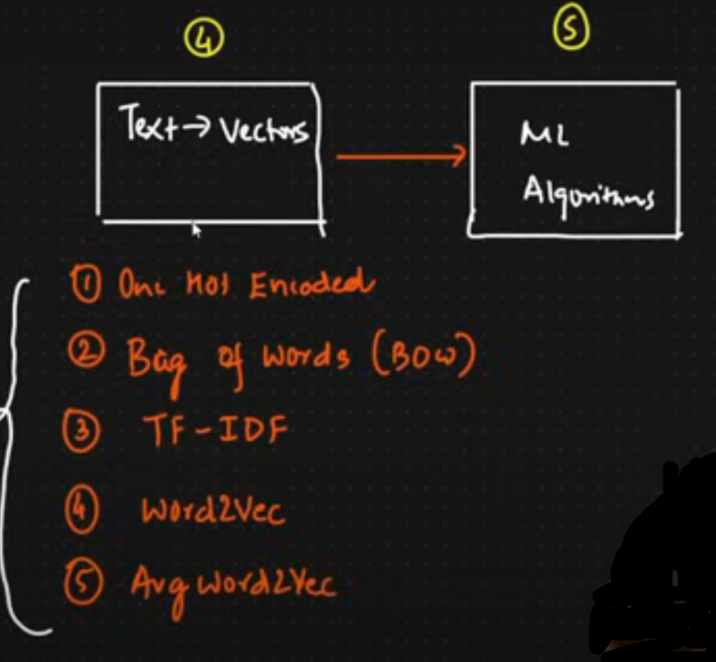
similar word should be in same vector value range

Slide 8
Key Concepts Supporting NLP
Corpus: A corpus is a collection of text data used for analysis or training NLP models.
Document: A document is a single unit of text within the corpus.
Tokens: Tokens are the smallest units of text resulting from the tokenization process.
Vocabulary: The vocabulary is the set of unique tokens (words or phrases) that appear in a corpus or document.

Slide 9
Tokenization
Tokenization is the process of breaking down a larger piece of text into smaller units called tokens.
Why Tokenization Matters:
Tokenization is the first step in most NLP tasks It transforms raw text into a structured format that machines can process.

Slide 10
Types of Tokenization:
Word Tokenization:
Example: "I love NLP." → ["I", "love", "NLP"]
Sentence Tokenization:
Example: "I love NLP. It is fascinating." → ["I love NLP.", "It is fascinating."]
Subword Tokenization:
Splitting words into smaller units.
Useful in languages with complex morphology or for handling unknown words.
Example: "playing" → ["play", "ing"]
Character Tokenization:
Splitting text into individual characters.
Example: "NLP" → ["N", "L", "P"]

Slide 11
Steps in Tokenization
Identify the corpus or document to tokenize. Example: "The quick brown fox jumps over the lazy dog."
Choose the type of tokenization:
Sentence-level
Word-level
Subword-level
Apply rules:
Split by spaces for words.
Split by punctuation for sentences.
Handle special characters or cases.
Produce tokens:
For word tokenization: ["The", "quick", "brown", "fox", "jumps", "over", "the", "lazy", "dog"]

Slide 12
Stemming
Stemming is a process of reducing a word to its base or root form. The root form may not always be a linguistically valid word. It relies on simple rules or algorithms, often removing suffixes or prefixes without considering the word's meaning.
How it Works: Stemming uses a heuristic process (rule-based stripping of prefixes or suffixes) to cut off derivational and inflectional endings of words.
Purpose: To group similar words with the same base meaning together for text analysis.

Slide 13
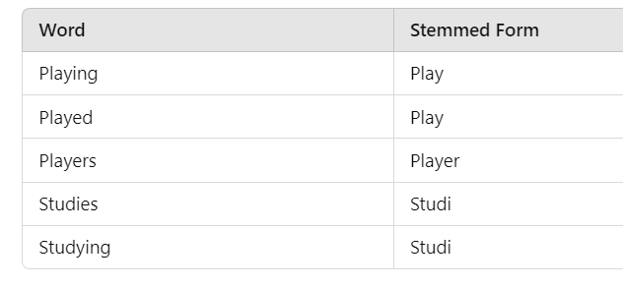
Example

Slide 14
Common Algorithms:
Porter Stemmer: Widely used and based on a set of rules to strip word endings.
Snowball Stemmer: A refined version of Porter Stemmer.
Pros: Fast and computationally efficient.
Works well when the context or linguistically valid root isn't a priority.
Cons: Produces non-linguistic root words
(e.g., "studying" → "studi").
Can lead to over-stemming or under-stemming, where the root form doesn't preserve the original word's meaning.

Slide 15
Lemmatization
Lemmatization reduces a word to its dictionary form, called a lemma, while considering its meaning and context. Lemmatization is more sophisticated than stemming and uses vocabulary and morphological analysis.
How it Works: Lemmatization uses a part-of-speech (POS) tag to understand the context of a word and return the linguistically correct lemma.
Purpose: To ensure that words are normalized in a way that retains their meaning.

Slide 16
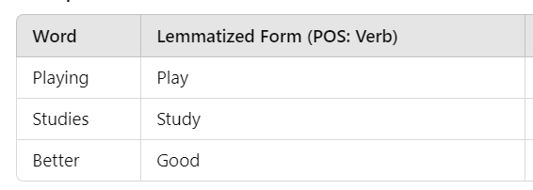
Example

Slide 17
Lemmatization
Pros:
Produces linguistically valid words.
Cons:
Computationally more expensive than stemming.
Requires additional information like part-of-speech tags for better accuracy.

Slide 18
Common POS Tags
Tag | Meaning | Example
NN | Noun (Singular) | dog, car, tree
NNS | Noun (Plural) | dogs, cars, trees
NNP | Proper Noun (Singular) | India, John, Tesla
NNPS | Proper Noun (Plural) | Americans, Germans
PRP | Personal Pronoun | he, she, they
VB | Verb (Base) | run, eat, jump
VBD | Verb (Past) | ran, ate, jumped
VBG | Verb (Gerund) | running, eating
VBN | Verb (Past Participle) | eaten, given
VBZ | Verb (3rd person singular) | runs, eats
JJ | Adjective | quick, lazy, beautiful
JJR | Adjective (Comparative) | quicker, better
JJS | Adjective (Superlative) | quickest, best
RB | Adverb | quickly, silently
IN | Preposition | in, on, over, with
DT | Determiner | the, a, an
CD | Cardinal Number | one, two, 100
CC | Coordinating Conjunction | and, but, or

Slide 19
General NER Table
NER Tag | Entity Type | Example
PERSON | People (real or fictional) | Barack Obama, Elon Musk, Harry Potter
GPE | Geopolitical Entities | India, New York, Germany
ORG | Organizations | Google, United Nations, Tesla
DATE | Dates & time periods | January 1, 2024, 1990s, Monday
TIME | Specific time expressions | 5:30 PM, midnight, noon
MONEY | Monetary values | $10 million, 500 euros
QUANTITY | Measurement values | 5kg, 10 liters, 100 miles
LOC | Non-GPE locations (mountains, rivers, etc.) | Mount Everest, Amazon River
PRODUCT | Products or objects | iPhone, Tesla Model S, MacBook Pro
EVENT | Named events | World War II, Olympics 2024
FAC | Buildings, highways, bridges | Eiffel Tower, Golden Gate Bridge
NORP | Nationalities, religious, political groups | American, Hindu, Communist
WORK OF ART | Books, movies, songs | Inception, The Catcher in the Rye
LAW | Legal documents, treaties | The Constitution, GDPR
PERCENT | Percentages | 50%, 10% increase

Slide 20
Basic NLP Libraries
NLTK:
- Comprehensive text processing library.
spaCy:
- Industrial-strength NLP library.
TextBlob:
- Simple library for text analysis.

Slide 21
NLP Tasks
Building a Vocabulary: Tokenization is used to generate the vocabulary, which consists of unique tokens from the corpus.
Applications:
Bag of Words (BoW): Represent text based on token counts.
TF-IDF: Use token frequency to measure importance.
Word Embeddings: Learn vector representations of tokens for downstream tasks.

Slide 22
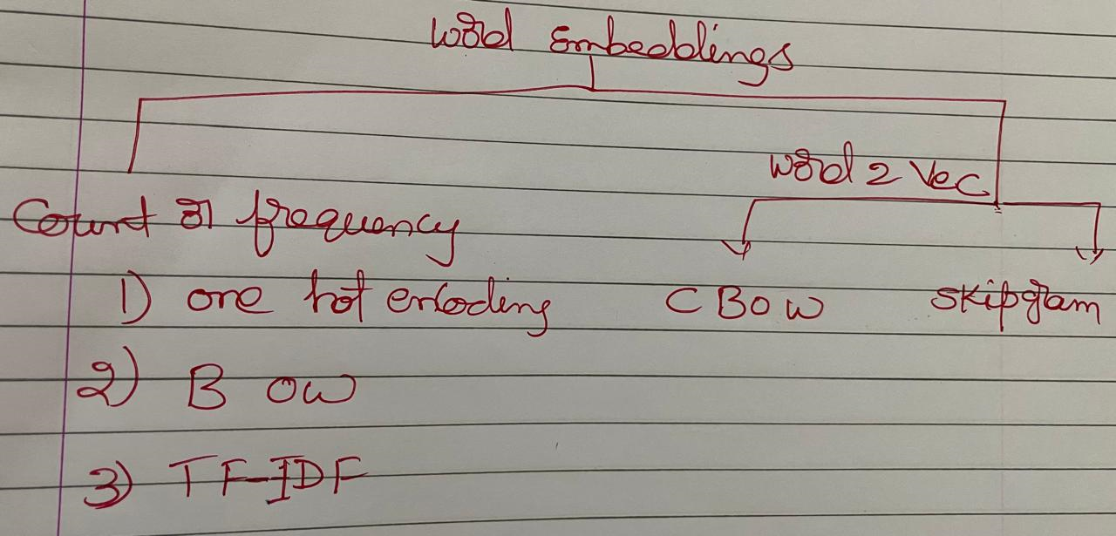

Slide 23
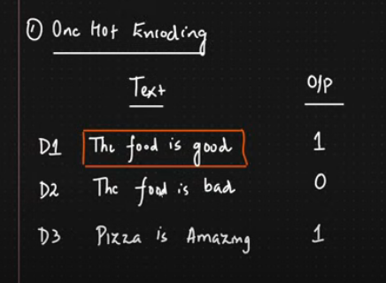
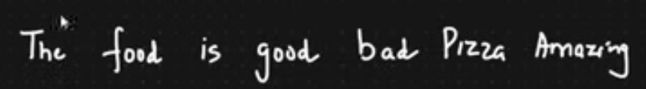

Slide 24
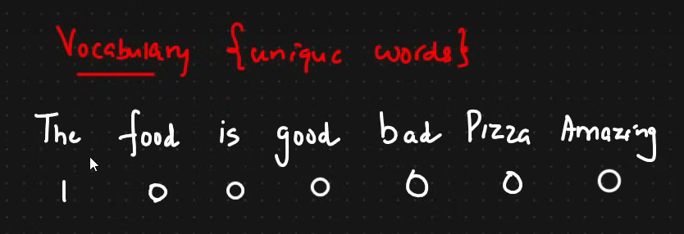

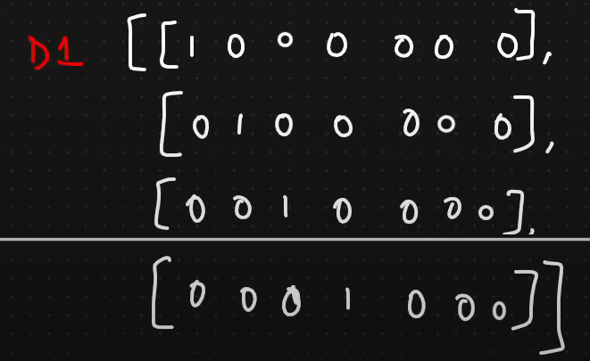
THE
Food

Slide 25
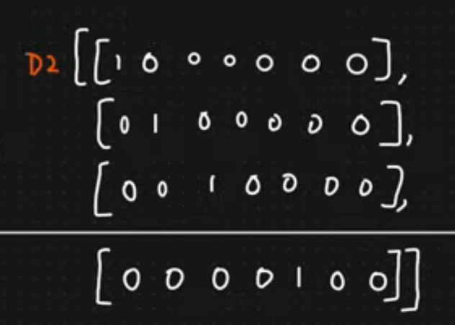

Slide 26
High Dimensionality:
One-hot encoding creates a new dimension for each unique category in the dataset. For datasets with many unique categories, this can lead to a very large feature space, making computations inefficient and increasing memory usage.
Sparsity:
The resulting vectors are sparse, with most values being zero. Sparse matrices require more storage and computational resources, especially when dealing with high-dimensional data.
Loss of Semantic Information:
One-hot encoding does not capture semantic similarity between categories. For example, "cat" and "dog" are encoded as completely independent entities, even though they might have a closer relationship compared to "cat" and "car."

Slide 27
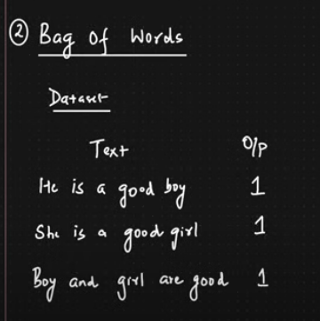
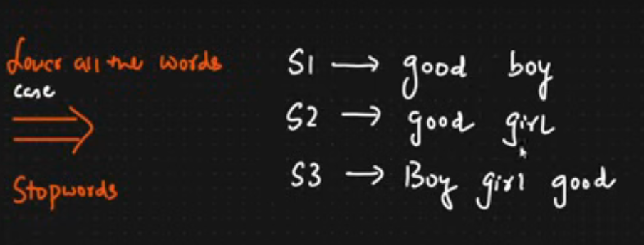

Slide 28
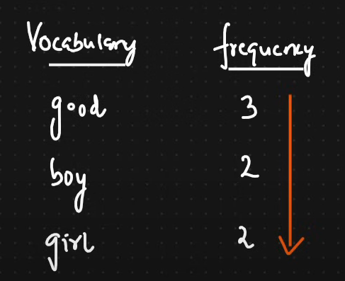



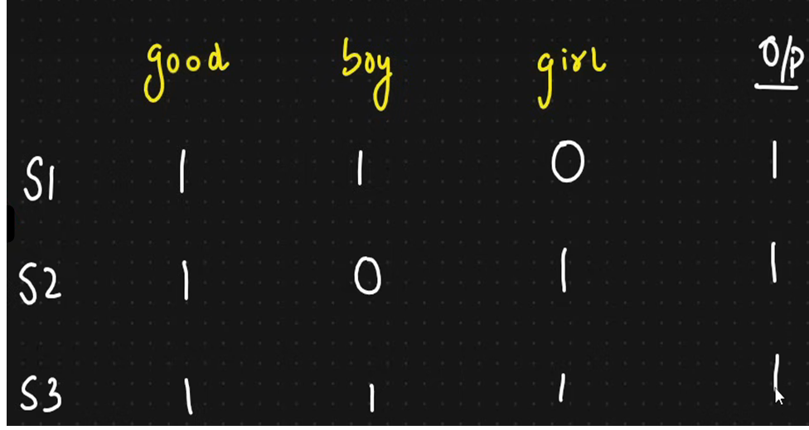

Slide 29
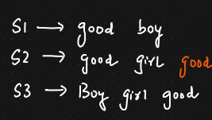
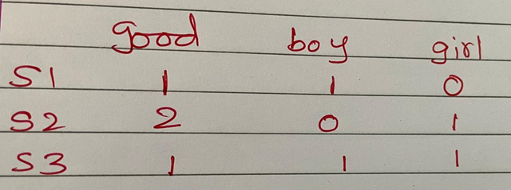

Slide 30
BOW Disadvantages
Loss of Context and Order: BoW ignores the sequence of words, losing important contextual and syntactic information. For instance, "I love dogs" and "Dogs love me" would have the same representation, despite having different meanings.
High Dimensionality: For large vocabularies, BoW generates a feature vector with as many dimensions as the number of unique words in the corpus, which can lead to scalability and computational challenges.
Sparsity: Most entries in the BoW vector are zero, especially for large vocabularies, resulting in sparse vectors that are computationally expensive to process and store.

Slide 31
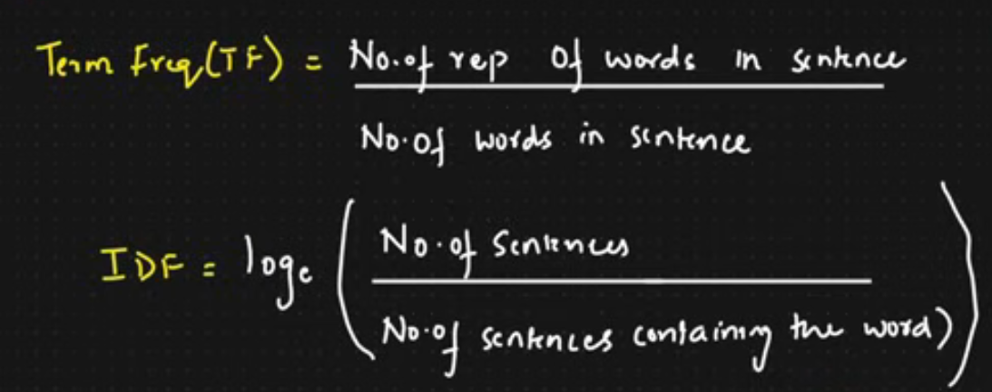
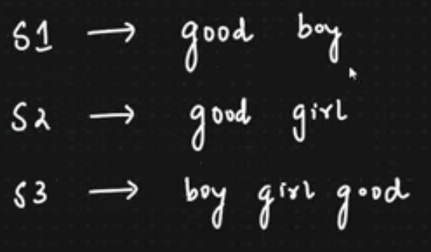
Term Frequency (TF) and Inverse Document Frequency (IDF)

Slide 32
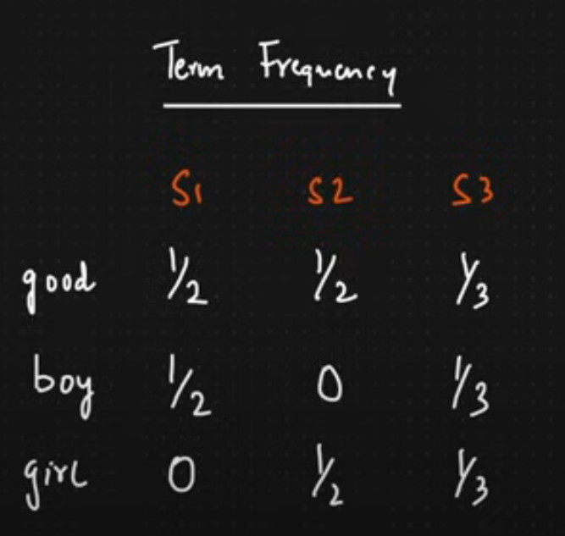
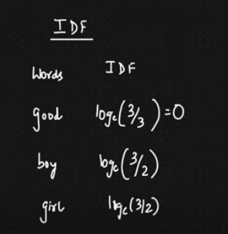
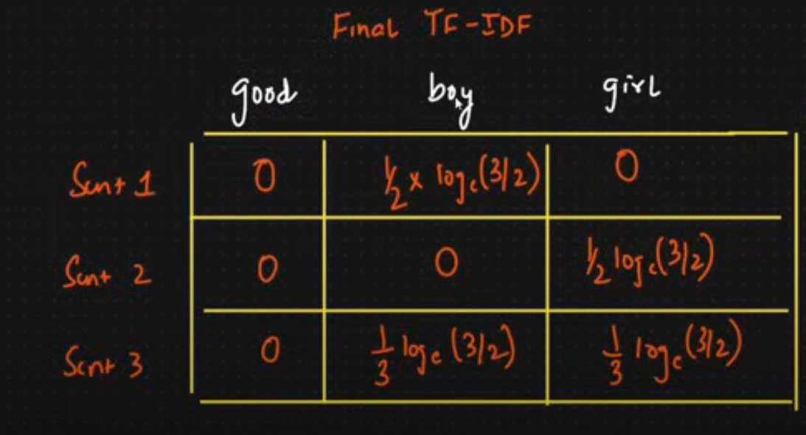

Slide 34
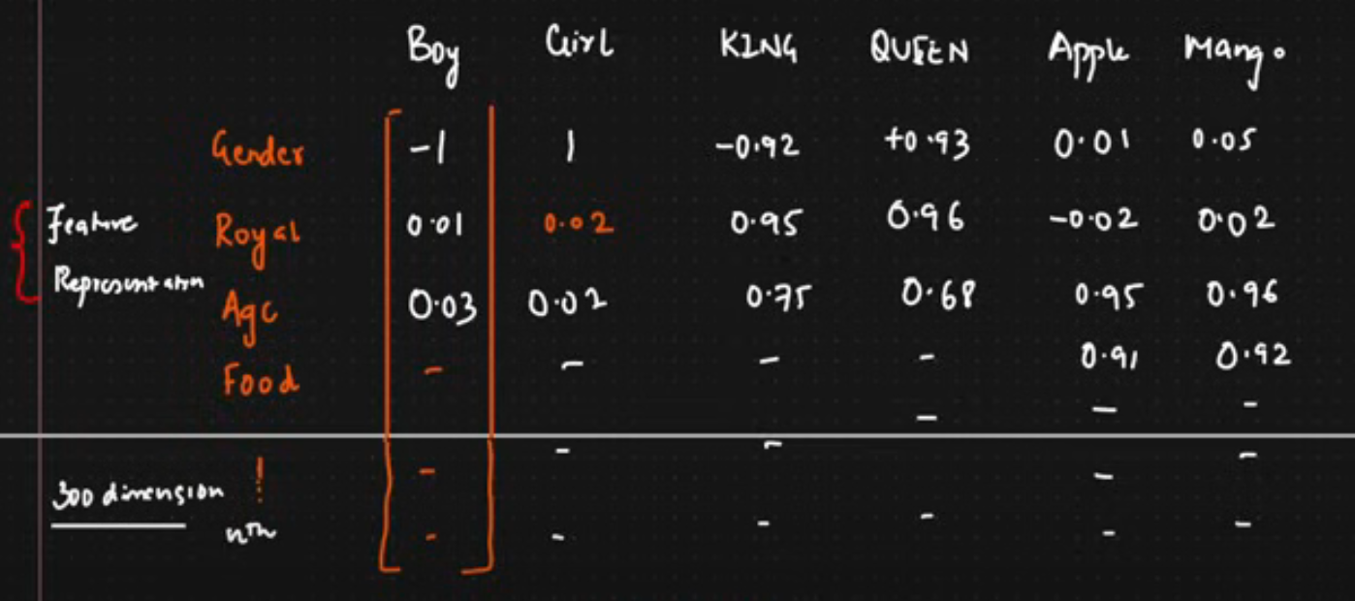
Word 2 vec Expected O/P

Slide 35
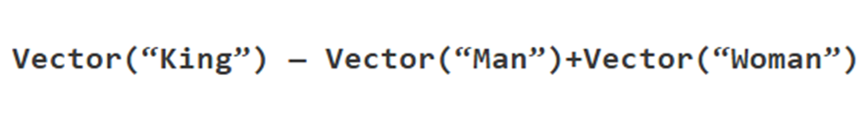
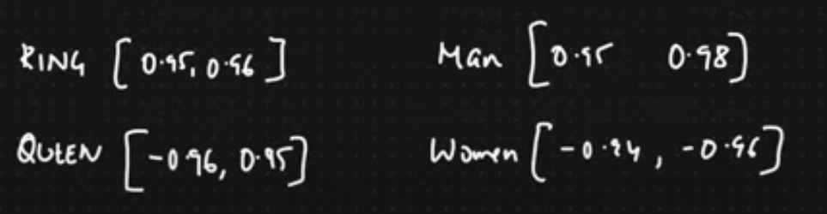


Slide 36
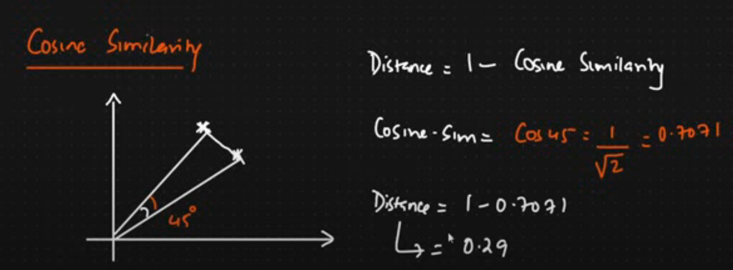
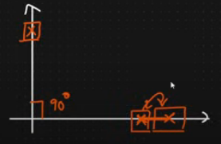
King
Man
1-0=1 for 90. as cos 90 =0. SO there are not similar

Slide 37
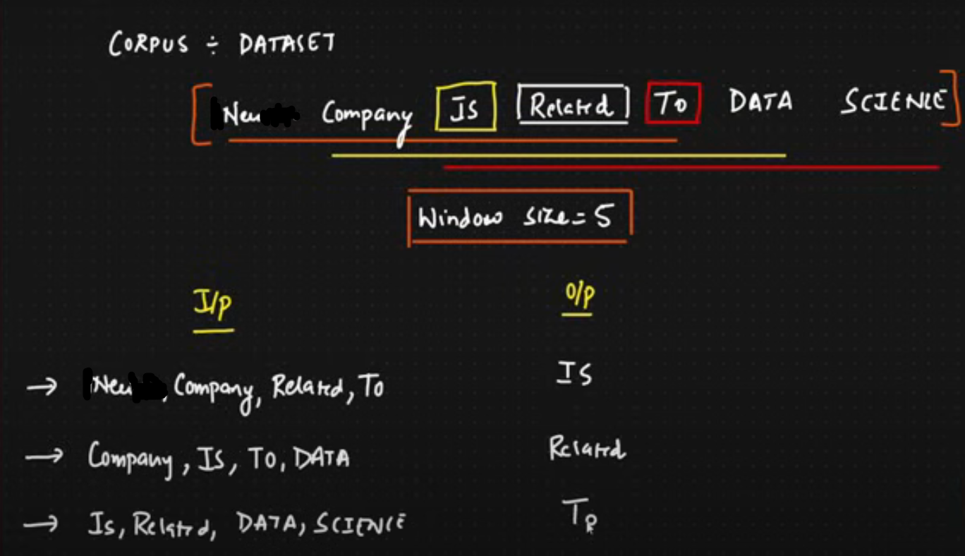

Slide 38
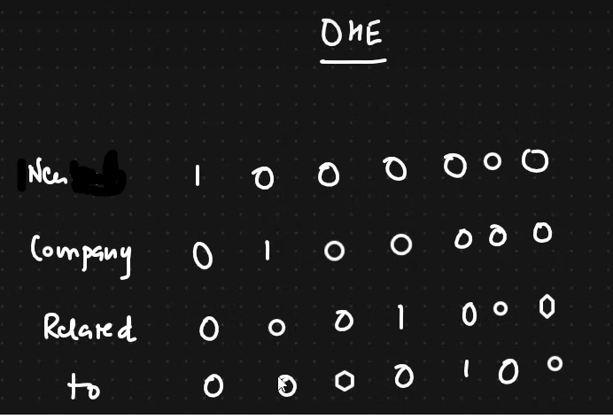
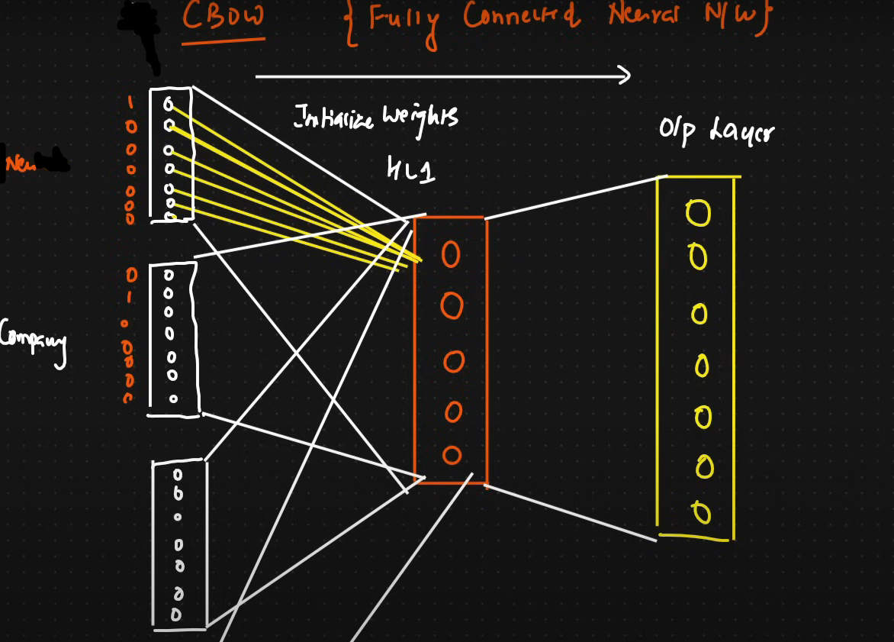

Slide 39
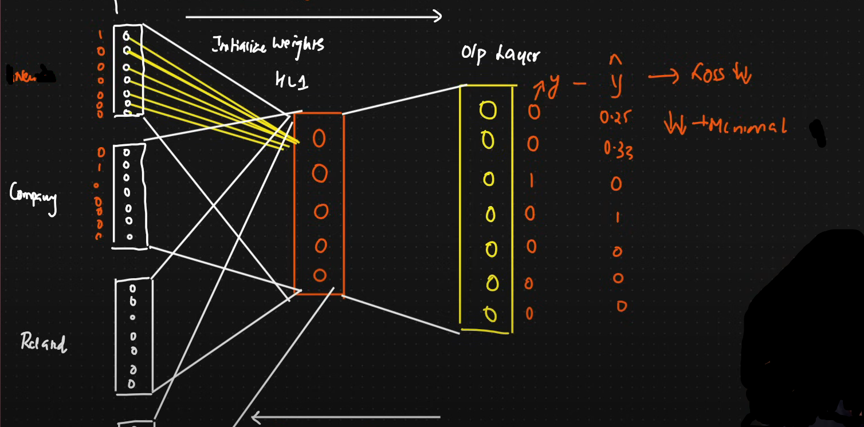

Slide 40
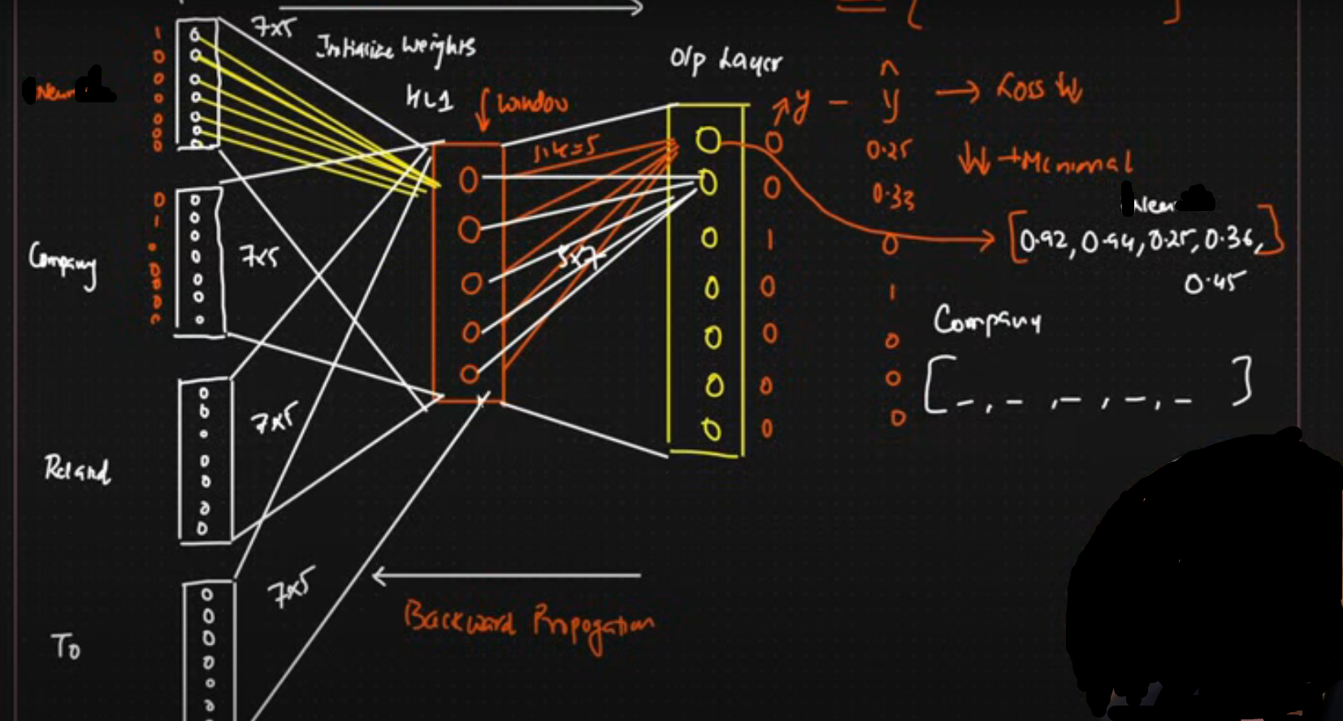

Slide 41
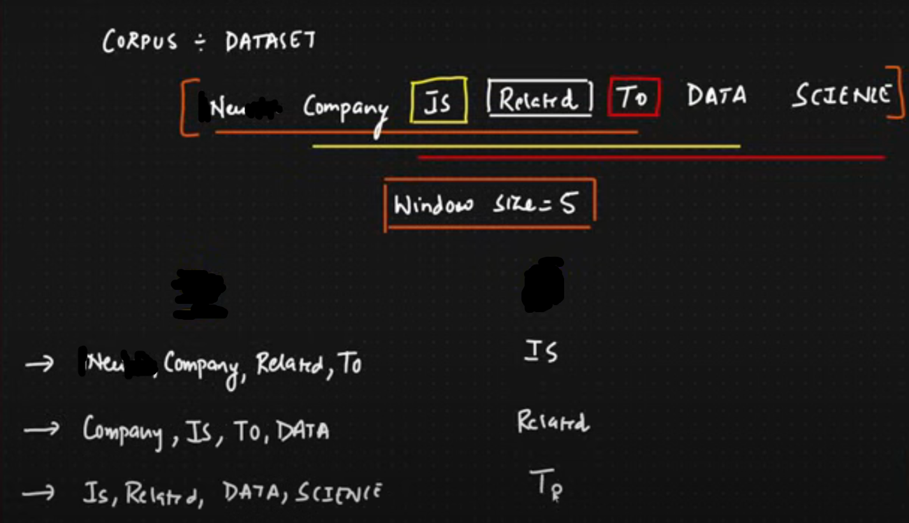
Output
Input

Slide 42
