Slide 1
Machine Learning for DATA SCIENCE

Slide 2
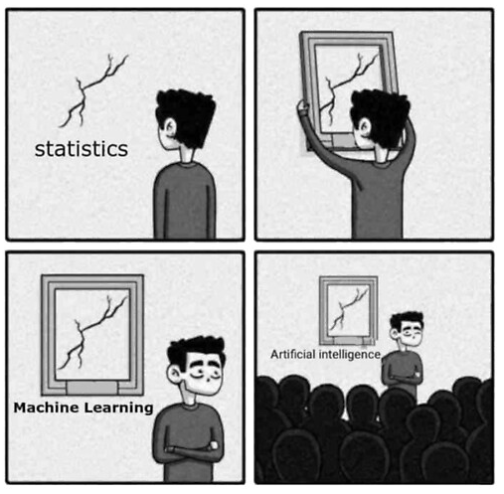
Learning Objectives
Today you will learn:
What is Machine Learning
Linear Regression
Logistic Regression
https://www.redbubble.com/i/ipad-case/Funny-design-comparing-artificial-intelligence-machine-learning-and-statistics-by-omolog/43039603.MNKGF

Slide 3

Machine Learning
Machine learning is a field of data science that employs statistical techniques to enhance performance based on prior knowledge or find novel patterns in vast amounts of data.
While working at IBM in 1959, Arthur Samuel invented the phrase "Machine Learning”.

Slide 4
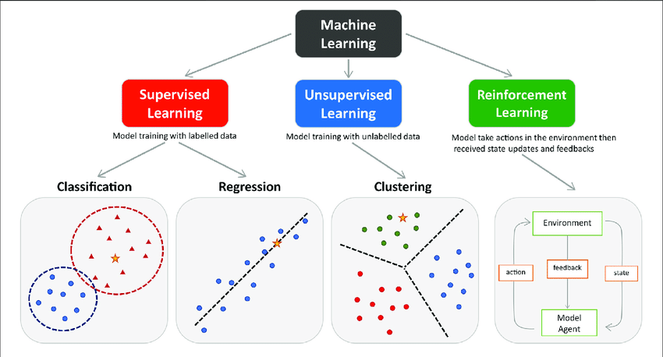
Types Machine Learning
https://www.researchgate.net/figure/The-main-types-of-machine-learning-Main-approaches-include-classification-and_fig1_354960266

Slide 5
Linear Regression

Slide 6
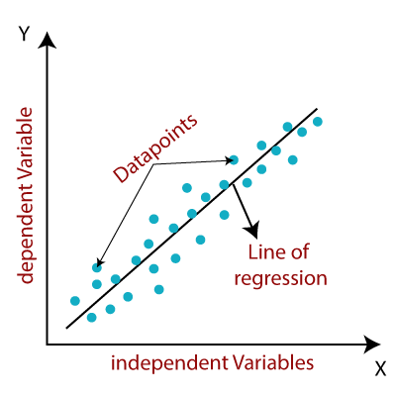
Linear Regression
Linear regression helps answer the question, if and how a change in X influences a change in Y.
Here Y is dependent/label data and X is independent/feature variable.
It is used to model quantitative dependency (continuous variable).
We model change in Y = f(X)
https://www.javatpoint.com/linear-regression-in-machine-learning

Slide 7
Simple Linear Regression
Relationship between a dependent variable with ‘ONE’ independent variable.
Y = a + b1X1 + ε
a = intercept
b1 = slope of the line
ε = error or residuals
https://www.javatpoint.com/linear-regression-in-machine-learning

Slide 8
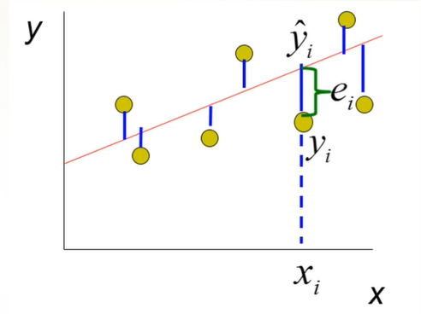
Error
Error/Residual (e) = Observed value (Y) – Predicted Value (Ŷ)

Slide 9
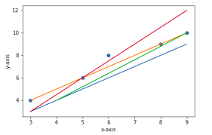
Which line is the best line?
https://www.quora.com/Which-method-is-used-to-find-the-best-fit-line-linear-regression

Slide 10
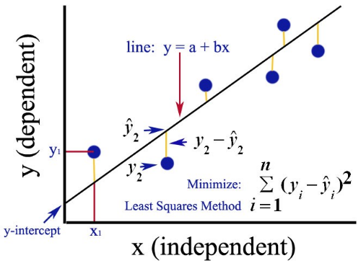
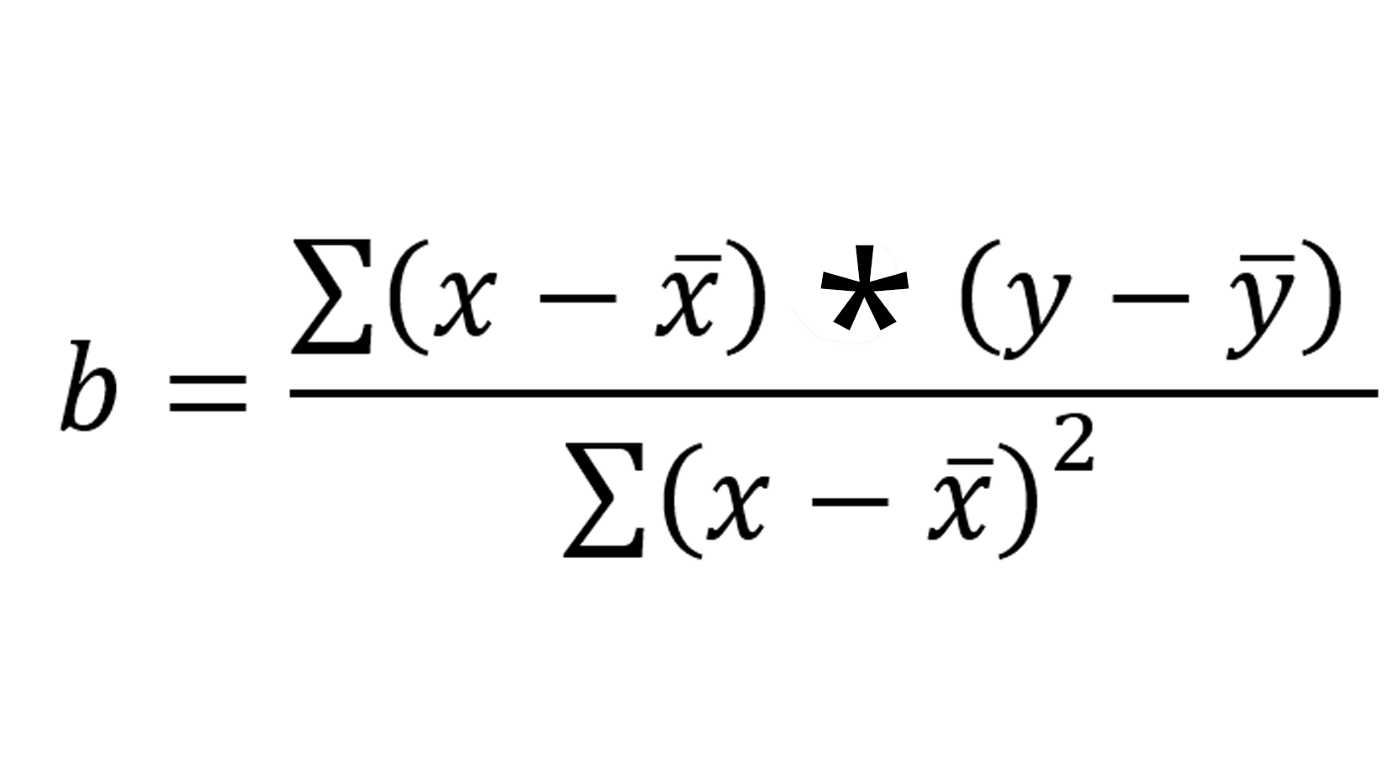
Ordinary Least Square (OLS)
Linear regression model tries to fit a best fitting straight line to describe the relationship between X and Y.
Line fitting is done on the basis of ordinary least square.
Regression line fits best line through the data by minimizing the sum of squared errors.
a = y̅-b x̅

Slide 11
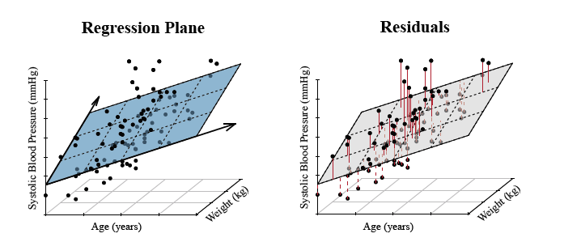
Multiple Linear Regression
Relationship between a dependent variable with ‘multiple’ independent variables.
When one independent variable, its line, more than one its plane.
Y = a + b1X1 + b2X2 + … + b_{k}X_{k} + ε

Slide 12
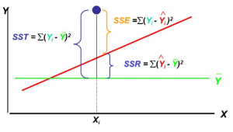
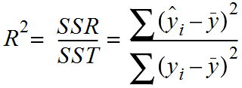
Model Evaluation (R² value)
Regression will best line.
R-squared (R²), also known as coefficient of determination, is used for model evaluation.
Ranges between 0 and 1. Higher the value higher the variability predicted.
It tells how much the variability in Y explained by taking in X into account.
ONLY used for simple linear regression.

Slide 13
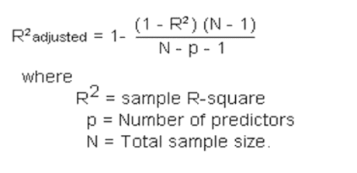
Adjusted R² value
Adding more independent variable increase the R² value, even if it by chance or variable is unnecessary.
Hence, we modify the R² value by penalizing it by adding additional independent variable.
A model with higher adjusted R2 value is preferred in ML.
ONLY used for multiple linear regression.

Slide 14
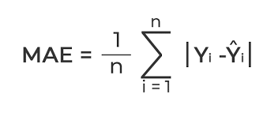
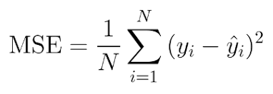
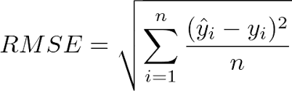
Cost functions for Regression
Three common evaluation matrix for regression models:
Mean Absolute Error
Mean Squared Error
Root Mean Squared Error

Slide 15
Comparing Matrix
MAE is the easiest to understand, because it's the average error.
MSE is more popular than MAE, because MSE "punishes" larger errors, which tends to be useful in the real world.
RMSE is even more popular than MSE, because RMSE is interpretable in the "y" units.
All of these are cost/loss functions, because we want to minimize them.

Slide 16
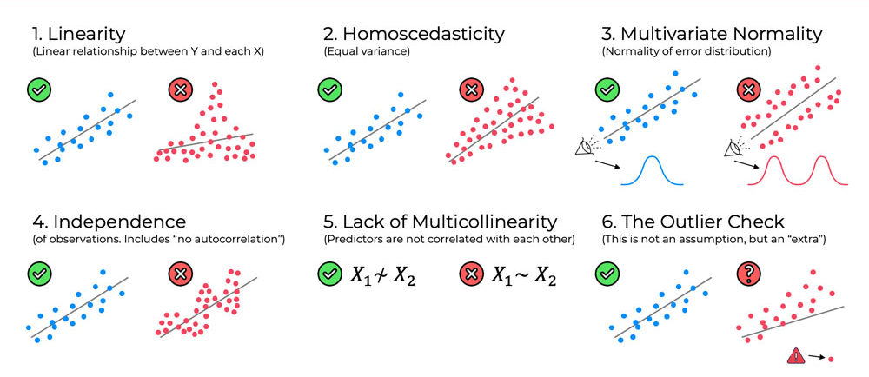
Assumptions of Linear Regression
https://www.superdatascience.com/blogs/assumptions-of-linear-regression

Slide 17
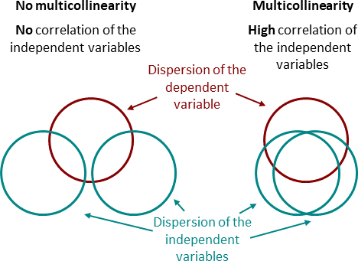
Multicollinearity
Dealing with multicollinearity
Variance Inflation Factor (VIF) a way to check for multicollinearity
Higher the value, higher the multicollinearity, above 10 is critical
Correlation matrix
https://datatab.net/tutorial/multicollinearity

Slide 18
Python implementation

Slide 19
Logistic Regression

Slide 20
Regression vs Classification
Regression | Classification
Dependent variable is numeric | Dependent variable is categorical
Techniques - Linear Regression, Regression Tree etc. | Techniques - Logistic Regression, Decision Tree etc.
Evaluation Metric - RMSE, Rsq etc. | Evaluation Metric - Accuracy, F1 score etc.
Example - Predicting salary of employees | Example - Spam filtering

Slide 21
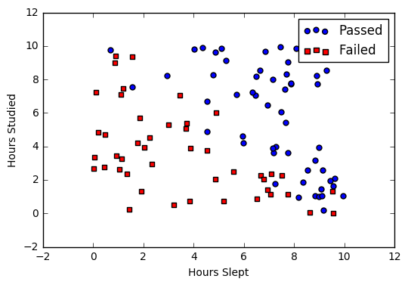
Logistic Regression
Also known as logit model.
With the exception of how they are applied, logistic regression and linear regression are very similar.
Studied | Slept | Passed
4.85 | 9.63 | 1
8.62 | 3.23 | 0
5.43 | 8.23 | 1
9.21 | 6.34 | 0
Reference - https://ml-cheatsheet.readthedocs.io/

Slide 22
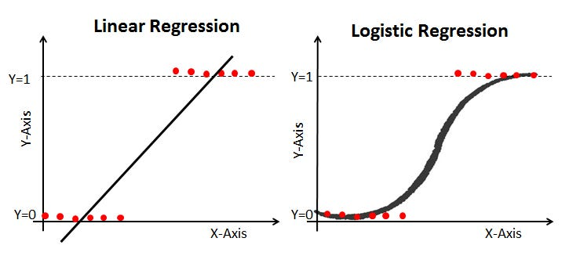
Logistic Regression
Reference - https://ml-cheatsheet.readthedocs.io/

Slide 23
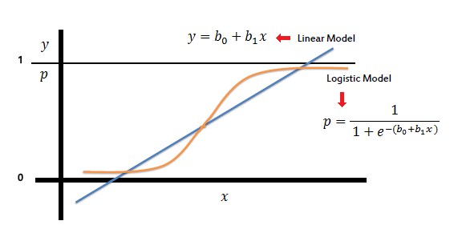
Sigmoid Function
Instead of fitting a regression line, we fit an ‘S' shaped logistic function that predicts the outcome (0 or 1) in logistic regression.
The sigmoid function is a mathematical function used to map the predicted values to probabilities.
https://www.saedsayad.com/logistic_regression.htm

Slide 24
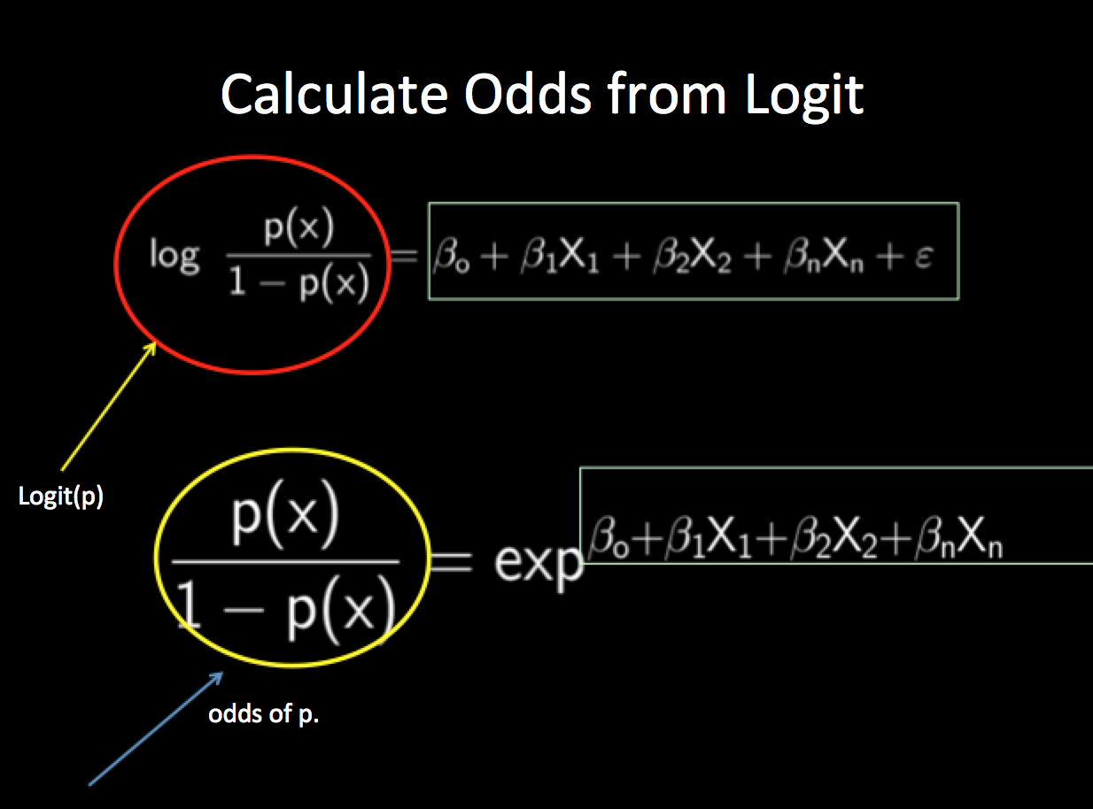
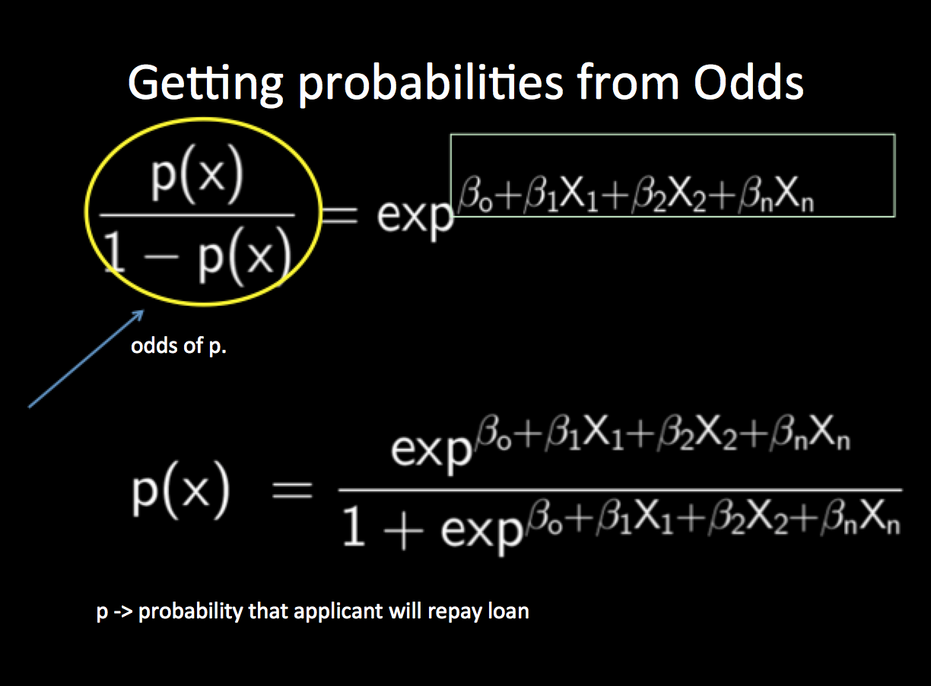
Sigmoid Function

Slide 25
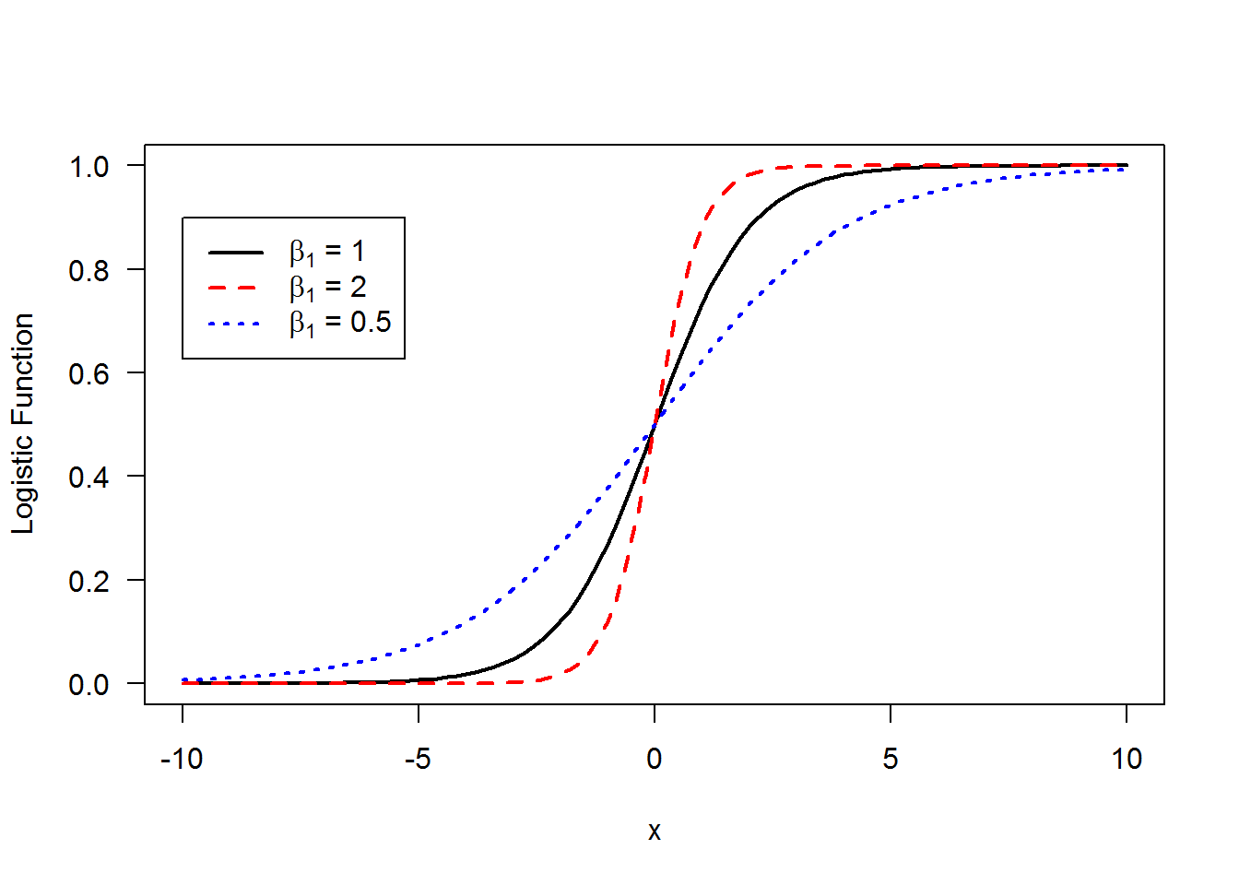
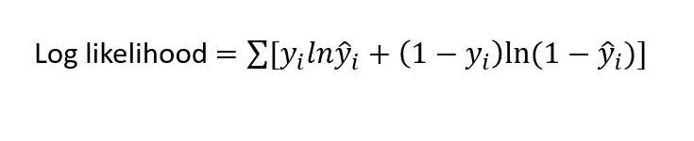
Maximum Likelihood Estimation
Maximum likelihood estimation (MLE) is a statistical method used to find the best set of parameters that explain the observed data. The goal is to find the set of parameters that make the observed data the most likely, given the statistical model that we have assumed.
https://ashutoshtripathi.com/2019/06/17/logistic-regression-with-an-example-in-r/
http://courses.atlas.illinois.edu/spring2016/STAT/STAT200/RProgramming/Maximum_Likelihood.html

Slide 26
Day 2

Slide 27
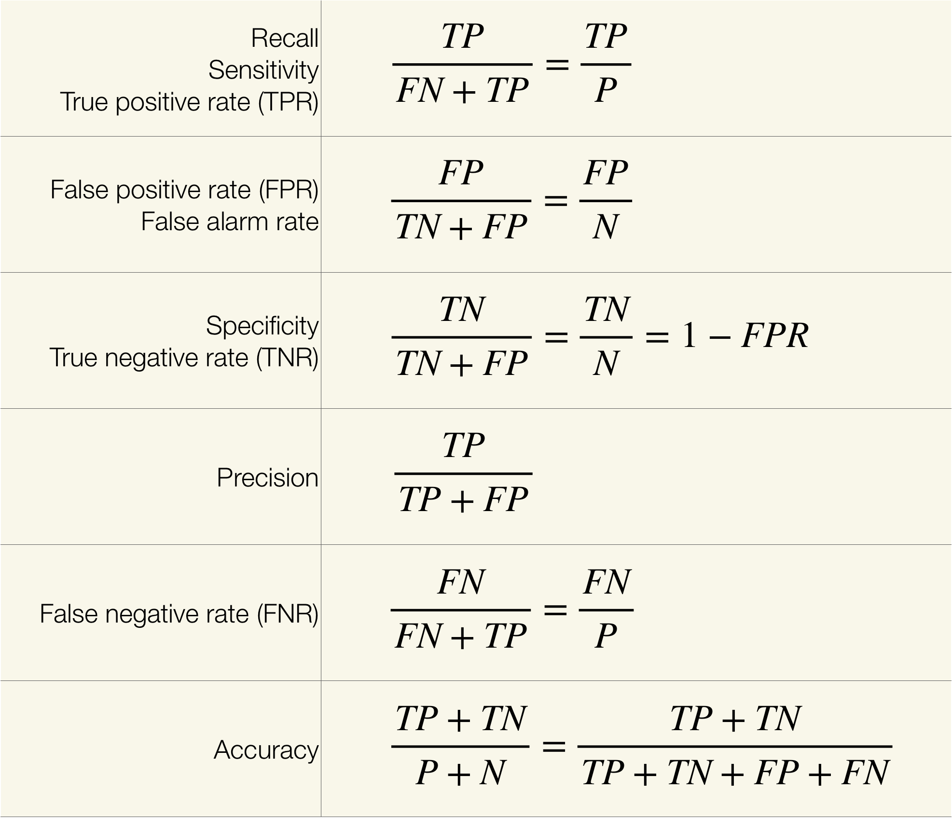
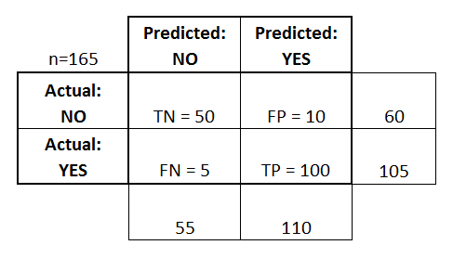
Confusion Matrix

Slide 28
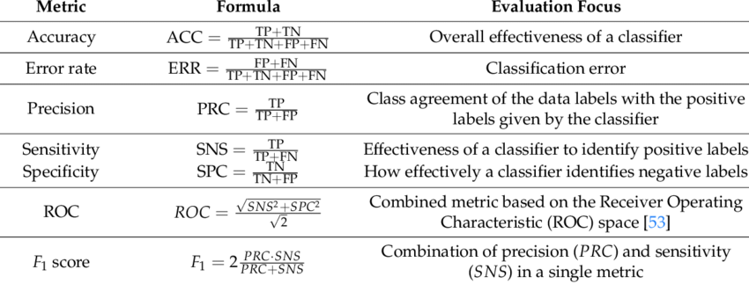
Evaluation Matrix
Reference -https://www.researchgate.net/

Slide 29
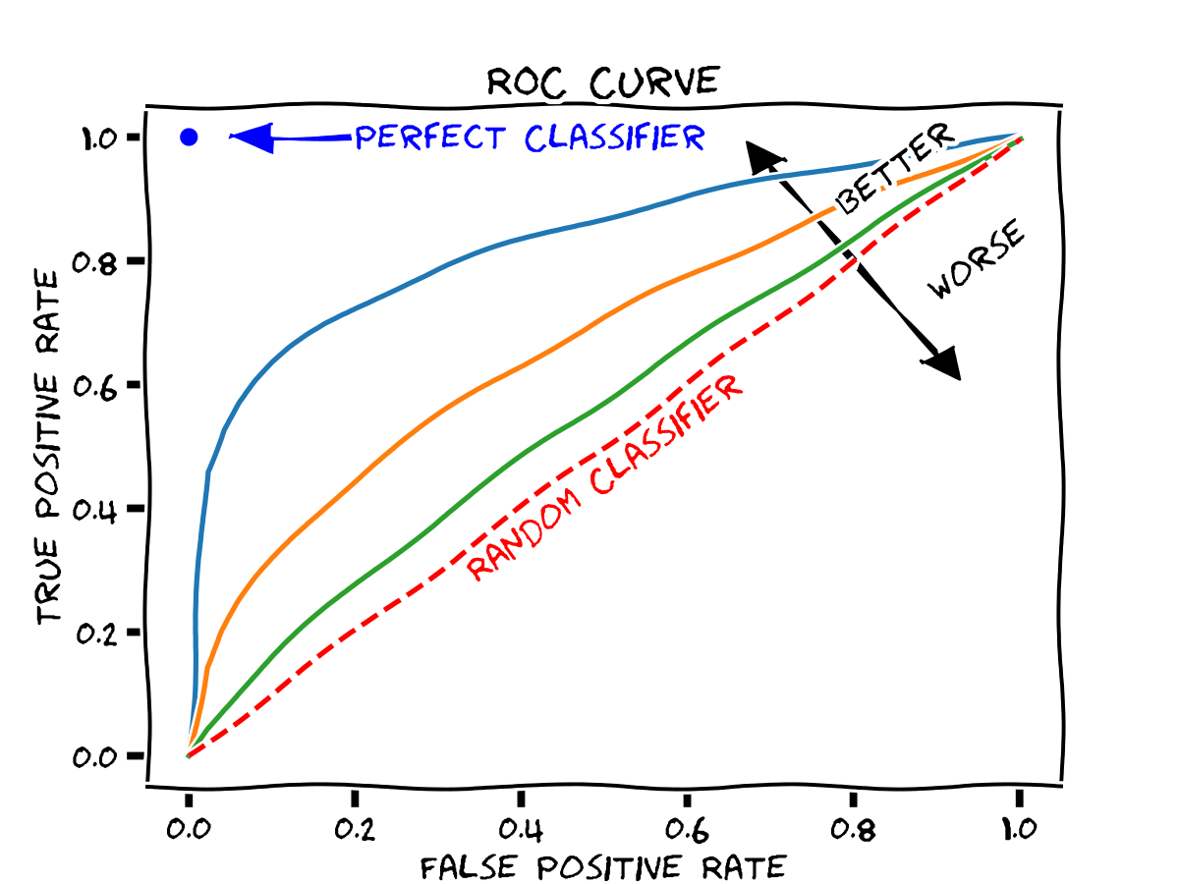
Receiver Operating Characteristics curve

Slide 30
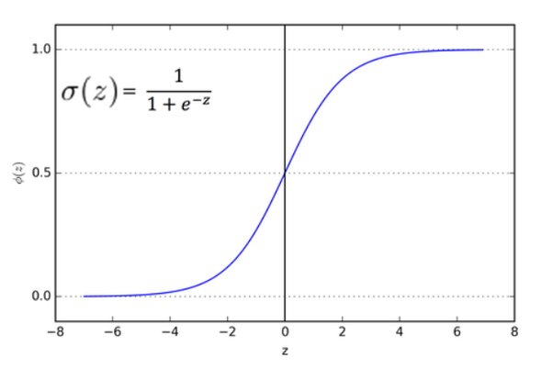
Assumptions of Logistics Regression
Dependent variable is categorical
Observations are independent of each other
Little/no multicollinearity between features
Linearity of features and log odds

Slide 31
Cross Validation

Slide 32
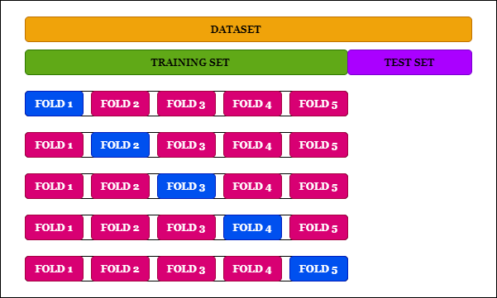
Cross Validation
A resampling method
K fold cross validation
https://medium.com/the-owl/k-fold-cross-validation-in-keras-3ec4a3a00538

Slide 33
Cross Validation
A resampling method
K fold cross validation
https://medium.com/the-owl/k-fold-cross-validation-in-keras-3ec4a3a00538

Slide 34
Cross Validation
A resampling method
K fold cross validation
https://medium.com/the-owl/k-fold-cross-validation-in-keras-3ec4a3a00538

Slide 35
Cross Validation
A resampling method
K fold cross validation
https://medium.com/the-owl/k-fold-cross-validation-in-keras-3ec4a3a00538

Slide 36
Cross Validation
A resampling method
K fold cross validation
https://medium.com/the-owl/k-fold-cross-validation-in-keras-3ec4a3a00538

Slide 37
Cross Validation
A resampling method
K fold cross validation
https://medium.com/the-owl/k-fold-cross-validation-in-keras-3ec4a3a00538

Slide 38
Decision Tree

Slide 39
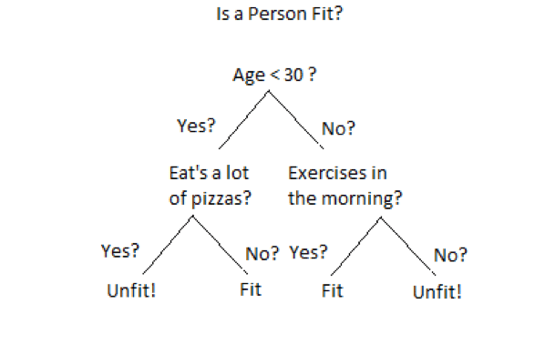
Decision Tree
Machine Learning model used for classification and regression analysis.
Popular in decision making because they are easy to interpret.
Consider the whole training set as the root, to start with
Feature values are preferred to be categorical. If the values are continuous then they are bucketed prior to building the model
Non-parametric model
https://dimensionless.in/building-blocks-of-decision-tree/

Slide 40
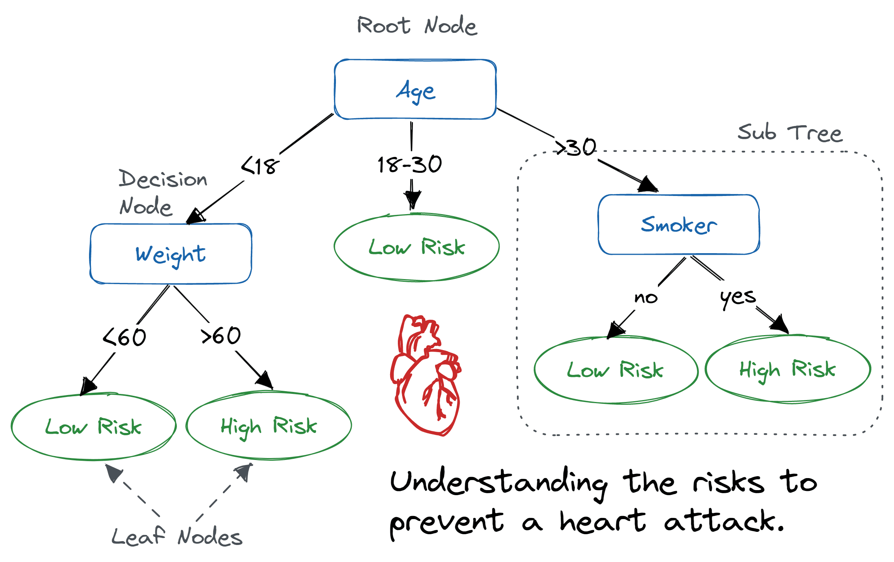
Different Nodes
Root node
Decision node
Leaf node
https://www.datacamp.com/tutorial/decision-tree-classification-python

Slide 41
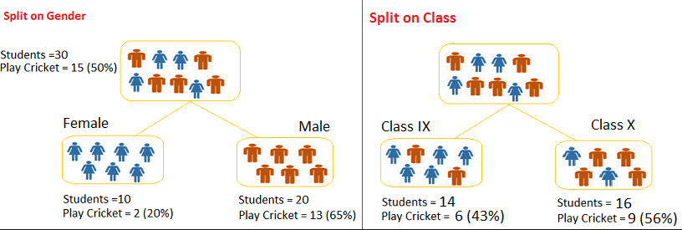
Splitting
It is the splitting of data sets into subgroups.
As demonstrated in the figure below, splitting can be done depending on a variety of factors, including class, height, and gender.
But which one is best
https://www.analyticsvidhya.com/

Slide 42
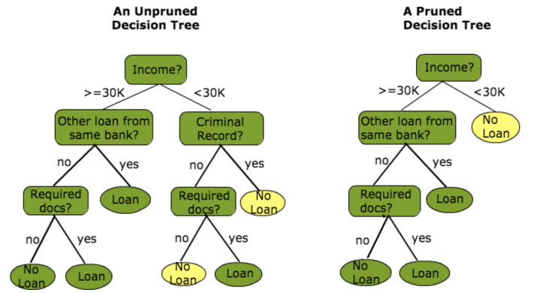
Pruning
It limits the tree depth by reducing the branches of decision tree
Pre-pruning (bigger dataset)
Post-pruning (smaller dataset)
https://www.analyticsvidhya.com/

Slide 43
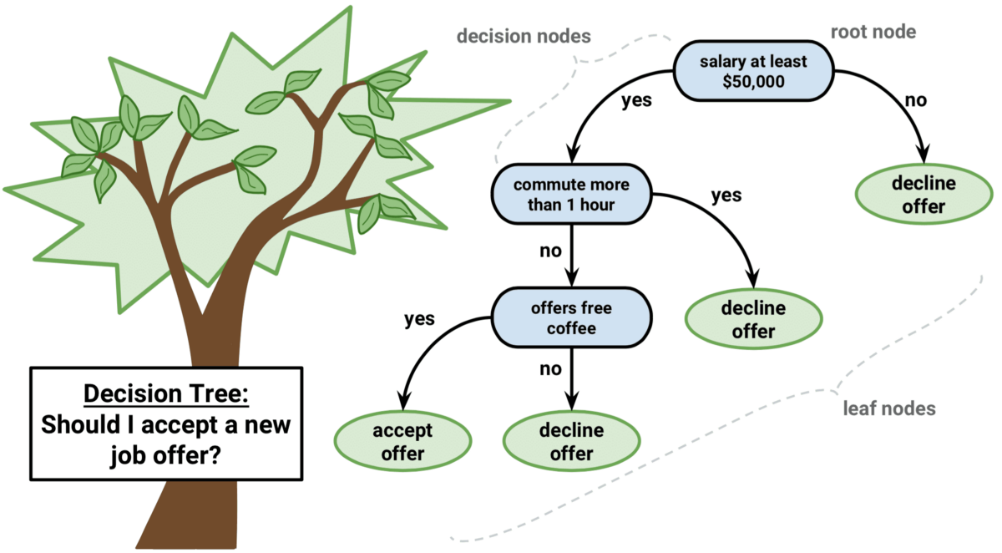
Algorithm used in Decision Tree
ID3
C4.5
CART
CHAID
https://regenerativetoday.com/simple-explanation-on-how-decision-tree-algorithm-makes-decisions/

Slide 44
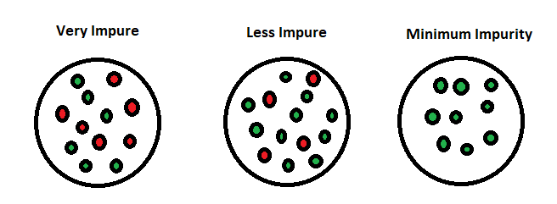
Impurity
https://www.section.io/engineering-education/entropy-information-gain-machine-learning/

Slide 45
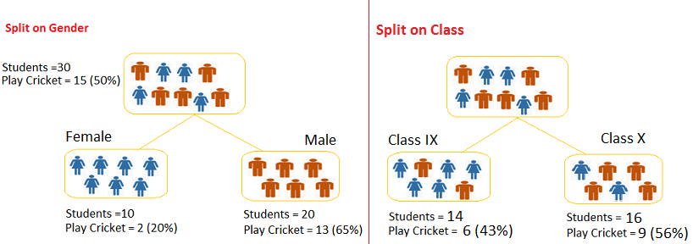
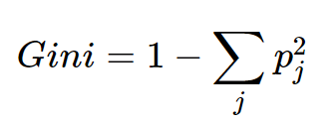
Gini Index
Gini for sub-node Female = (0.2)*(0.2)+(0.8)*(0.8)=0.68
Gini for sub-node Male = (0.65)*(0.65)+(0.35)*(0.35)=0.55
Weighted Gini for Split Gender = (10/30)*0.68+(20/30)*0.55 = 0.59
Gini for sub-node Class IX = (0.43)*(0.43)+(0.57)*(0.57)=0.51
Gini for sub-node Class X = (0.56)*(0.56)+(0.44)*(0.44)=0.51
Weighted Gini for Split Class = (14/30)*0.51+(16/30)*0.51 = 0.5
Split on Gender is higher than Split on Class, hence, the node split will take place on Gender
https://stats.stackexchange.com/questions/477063/how-to-derive-equation-of-gini-index-used-in-decision-trees
https://www.analyticsvidhya.com/

Slide 46
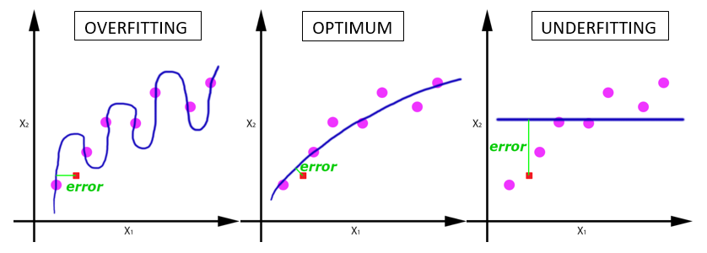
Overfitting vs Underfitting
https://machine-learning.paperspace.com/wiki/overfitting-vs-underfitting

Slide 47
Advantage and Disadvantage
Advantages - Explainable, Few hyper parameters
Disadvantages - Prone to overfitting, Low accuracy
Overfitting - Pruning helps in reducing overfitting

Slide 48
Hyperparameter Tuning

Slide 49
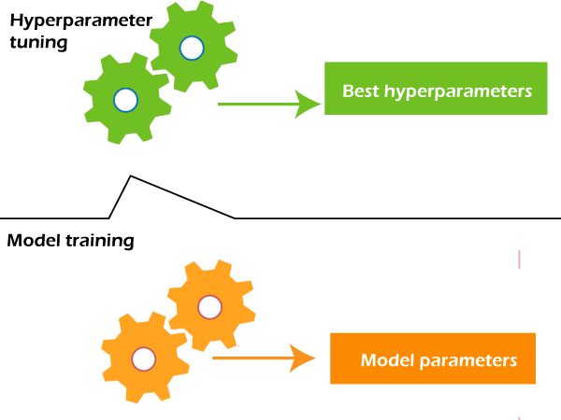
Hyperparameter Tuning
https://www.javatpoint.com/hyperparameters-in-machine-learning

