Slide 1
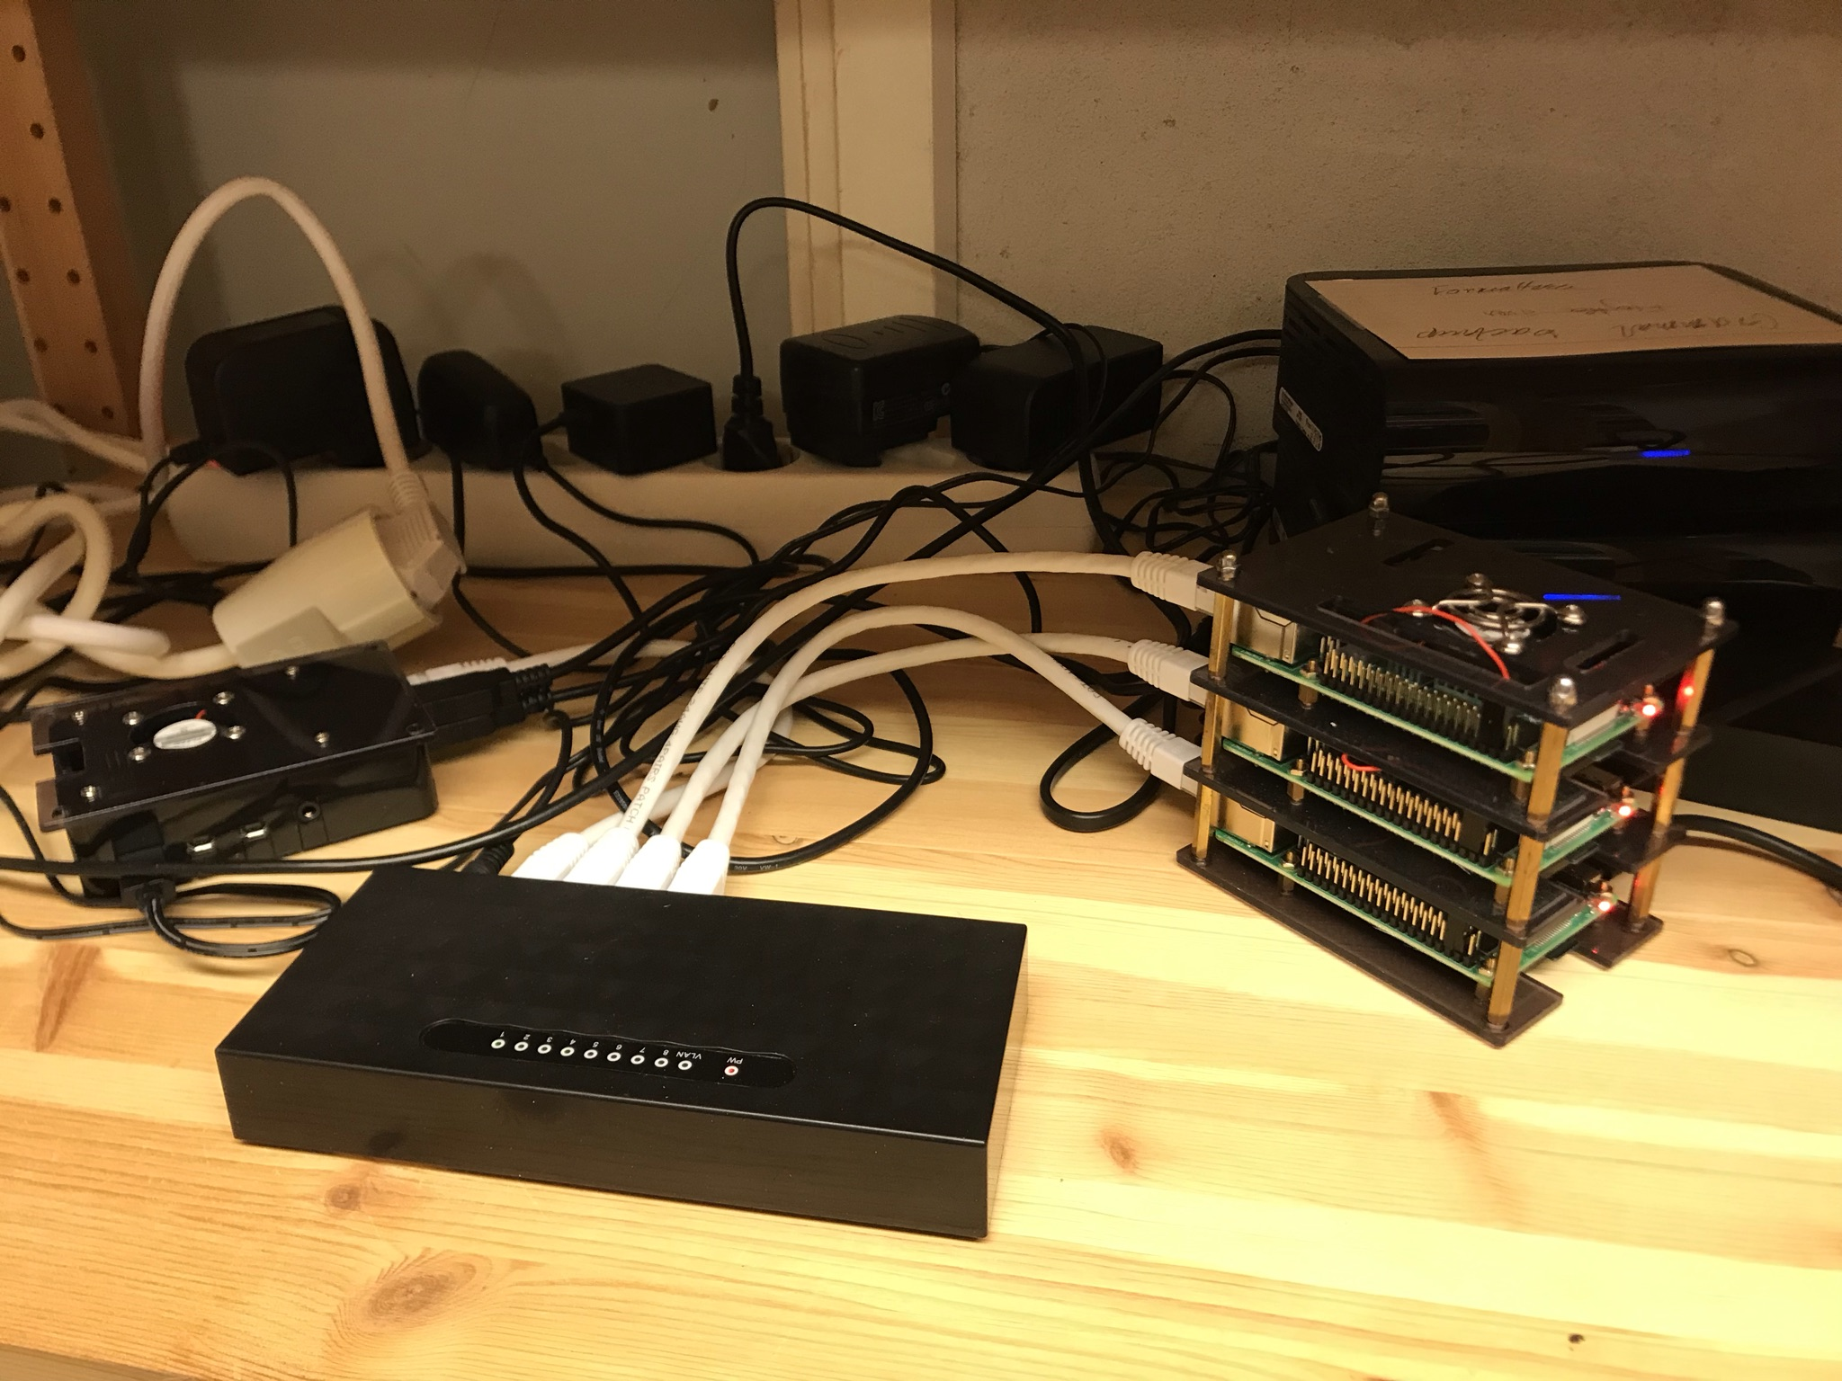
Storage
Login node
Calculation nodes
4 cores each
Switch

