Slide 1
UPPMAX Basics
What even is UPPMAX?
What about SNIC?
How do I submit jobs to the queue?

Slide 2
UPPMAX Basics
Organisation
  What is what
  What does UPPMAX do
How a cluster works
How to use UPPMAX clusters

Slide 3
Organisational orienteering
VR/SRC and a consortium of universities funds SNIC — Swedish National Infrastructure for Computing
SNIC and Uppsala University funds UPPMAX — UU’s supercomputing centre
NBIS, a part of SciLifeLab, has a facility called Compute and Storage, which is hosted by UPPMAX

Slide 4
UPPMAX
Mission for SNIC: to provide a quality high-performance computing environment nationally
  General purpose
  Data intensive
  Sensitive data (human sequences)
Mission for UU: to provide relevant services to the university
Mission for NBIS/SciLifeLab: to provide the best possible resources for data-driven life science, especially bioinformatics

Slide 5
UPPMAX (more concretely)
Computer infrastructure
  Clusters
  Storage
  Cloud
Support staff
  System administrators
  Application experts

Slide 6
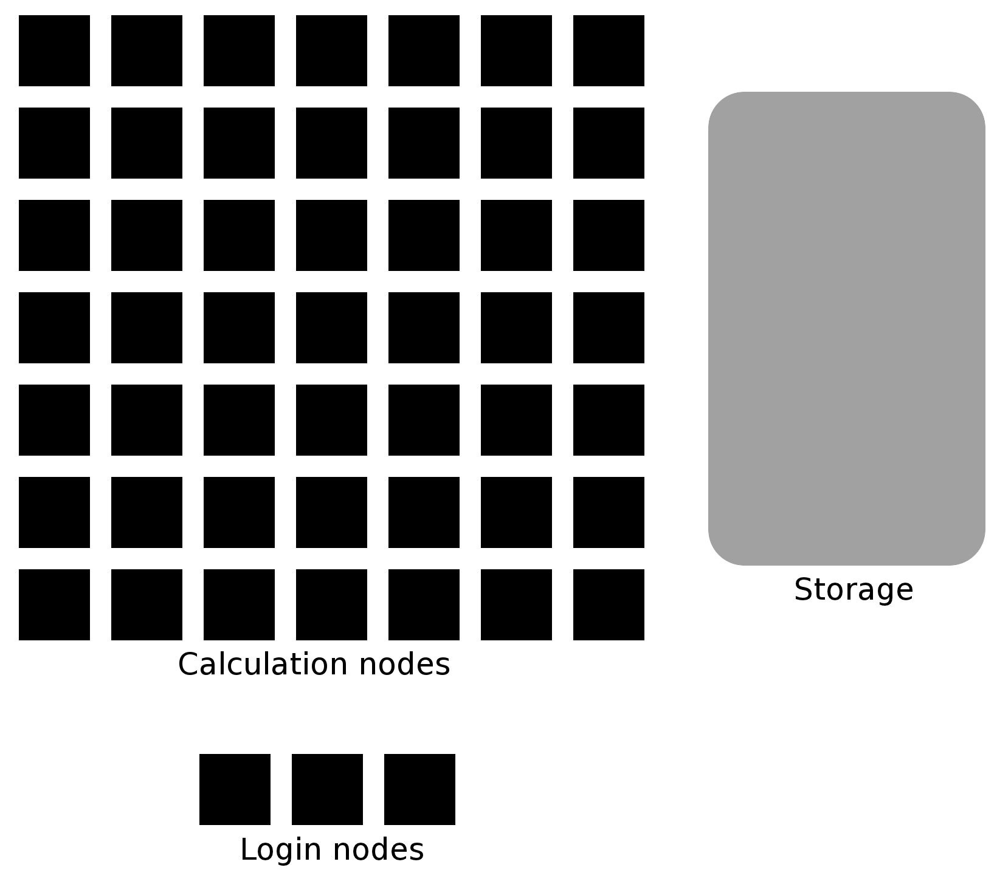
High Performance Computing

Slide 7
High Performance Computing
Local Disk
core
Other nodes
Network storage
Internet
RAM

Slide 8
UPPMAX Clusters
 | Rackham | Snowy | Bianca
Purpose | General-purpose | General-purpose | Sensitive
# Nodes | 486 | 228-ish | 200
Memory/node | 128 GB | 128 GB | 128 GB
Fat nodes | 512 GB - 1 TB | 512 GB – 4 TB | 256 GB
Local disk (scratch) | 2 TB | 4 TB | 4 TB
Login nodes | Yes | No | Yes
Storage | Crex, Lutra | Crex, Lutra | Castor, Cygnus

Slide 9
Storage systems
Domus — Home directories for Rackham/Snowy
Crex — Project storage for Rackham/Snowy
Castor — Project storage for Bianca
Cygnus — “New” project storage for Bianca
Lutra — Paid-for storage on Rackham/Snowy

Slide 10
Exercise
Open a web browser to http://uppmax.uu.se.
Find articles about how to best use the storage systems and good data practices.
Look at Support -> User Guides and Support -> FAQ
Find and discuss articles in Breakout Rooms

Slide 11
Solution
Disk Storage Guide
How to use a node’s own disk
How does automatic backup of project areas work at UPPMAX?
File compression guide
How can I compress my files as quickly and efficiently as possible?
How should I compress FastQ-format files?
Which compression format should I use for NGS-related files (FastQ, Fasta, VCF, GFF, etc.)?

Slide 12
Storage Basics
All nodes can access:
your home directory on Domus or Castor
a project directory on Crex or Castor
Its own local disk (2-3 TB)
If you’re reading/writing a file once, use a directory on Crex or Castor
If you’re reading/writing a file many times...
copy to the file to ”scratch”, the node local disk
”cp myFile $SNIC_TMP”

Slide 13
Other systems
Dis — part of the SNIC Science Cloud
Grus — NGI data delivery
Da Vinci — GPU resource

Slide 14
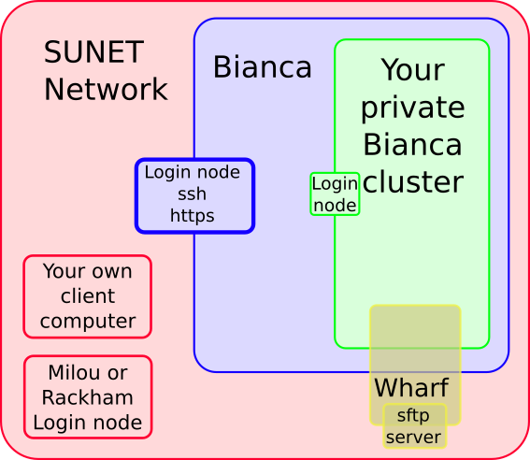
Bianca
Login:
  First 2FA login to Bianca portal
  Second regular login to private cluster
Data import/export:
  SFTP from “outside”
    Data in non-backed up “wharf” directory
  NGI delivery via SUPR

Slide 15
Bianca Has No Internet
We have “solutions”
  Data transfers:
    NGI Deliver through SUPR
    Transit server (transit.uppmax.uu.se)
  Software
    Almost the same software library as Rackham
    Local Conda repository
    Local Perl modules
    Local R packages

Slide 16
ThinLinc
Both Rackham and Bianca offer graphical login
On web: https://rackham-gui.uppmax.uu.se
Or use the client (only for Rackham)
Try it now!

Slide 17

Slurm, sbatch, the job queue
Problem: 1000 users, 500 nodes, 10k cores
  Need a queue:
Time ↑

Slide 18
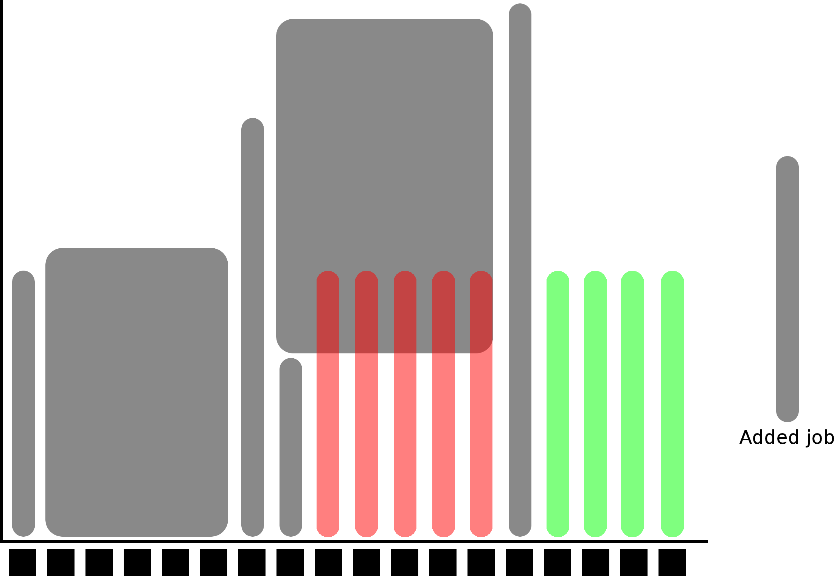

Slurm, sbatch, the job queue
Easiest to schedule single-threaded, short jobs

Slide 19
Jobs
Job = what happens during booked time
Described in a Bash script file
Slurm parameters
Load software modules
Move around file system
Run programs
Collect output
...and more

Slide 20
Slurm parameters
1 mandatory setting for jobs:
Which compute project? (-A)
3 settings you really should set:
Less than one node? (-p)
How many cores? (-n)
How long at most? (-t)
If in doubt:
-p core
-n 1
-t 10-00:00:00

Slide 21
Slurm parameters
Where should it run? (-p node or -p core)
Use a whole node or just part of it?
1 node = 20 cores (16 on Bianca & Snowy)
1 hour walltime = 20 core hours = expensive
Waste of resources unless you have a parallel program or need all the memory
Default value: core

Slide 22
How long is the job
How long is it? (-t)
Always overestimate with ~50%
Jobs killed when timelimit reached
Only charged for time used
-t = time (hh:mm:ss)
78:00:00 or 3-6:00:00
Default value: 7-00:00:00

Slide 23
Efficient jobs
Use your booked cores or memory
  (at least 50%)
Runtime longer than 1 hour
  Combine shorter jobs
Ask UPPMAX support for help!

Slide 24
Interactive jobs
Most work is most effective as submitted jobs, but e.g. development needs responsivity
Interactive jobs are high-priority but limited in -n and -t
Quickly give you a job and logs you in to the compute node
Require same Slurm parameters as other jobs
Try it:
  $ interactive -A g2020018 -p core -n 1 -t 10:00
  Which node are you on?
  Logout with Ctrl-D or logout

Slide 25
A simple job script template
#! /bin/bash -l # Tells Bash to run this like a Bash script
#SBATCH -A g2020018 # Project name
#SBATCH -p core # Asking for cores (as opposed to multiple nodes)
#SBATCH -n 1 # Number of cores
#SBATCH -t 00:10:00 # Ten minutes
#SBATCH -J Template_script # Name of the job
# go to some directory
cd /proj/g2020018/marcusl
# load software modules
module load bioinfo-tools
# do something
echo Hello world!

Slide 26
Exercise (1)
Copy the template from the previous slide
Put it into a file named “jobtemplate.sh”
Make the file executable (chmod)

Slide 27
Exercise (2)
Submit the job:
  $ sbatch jobtemplate.sh
Note the job id!
Check the queue:
  $ jobinfo -u yourusername
When it’s done, look for the output:
  $ ls
Check the output file to see if it ran correctly

Slide 28
Other Slurm tools
Squeue — quick info about jobs in queue
Jobinfo — detailed info about jobs
Finishedjobinfo — summary of finished jobs
Jobstats — efficiency of booked resources

Slide 29
Software at UPPMAX
800+ programs and packages installed
Managed by a 'module system'
Everything already installed, but hidden
Manually loaded before use
Bioinformatics tools require loading the “bioinfo-tools” module first
module spider <name> — search for modules
module load <module name> — Loads the module
module unload <module name> — Unloads the module
module list — Lists loaded modules

Slide 30
Software exercise
Use module spider to find a software you like to use.
Try to run the software, e.g. “$ samtools”
Load the latest version of the module
  load bioinfo-tools first if necessary
  You can write “module load samtools” and then TAB-complete to see the available modules
Now try to run the software again

Slide 31
Wrap-up
In breakout rooms, ask for help:
  Finding software
  Writing job scripts
  Basic Linux

