Slide 1


Robot Cale Assembly
Nicolas Miranda
Capstone Project - Industry 4.0
2025-2026

Slide 2
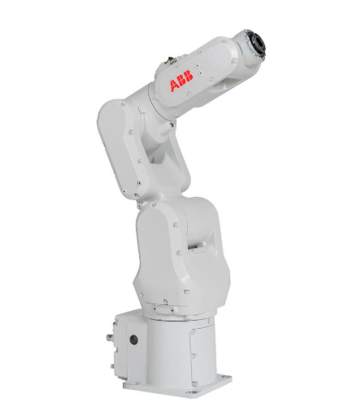
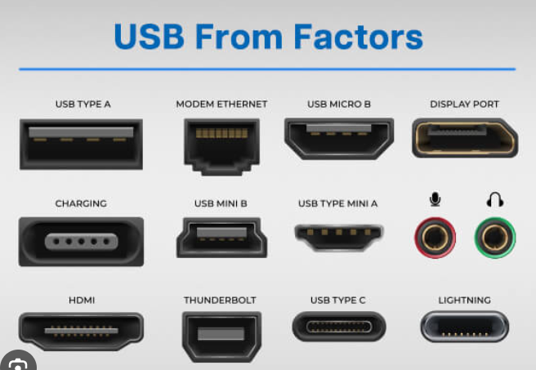
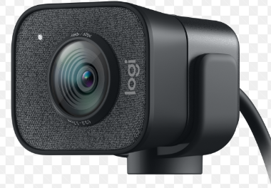
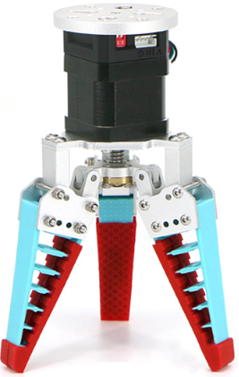
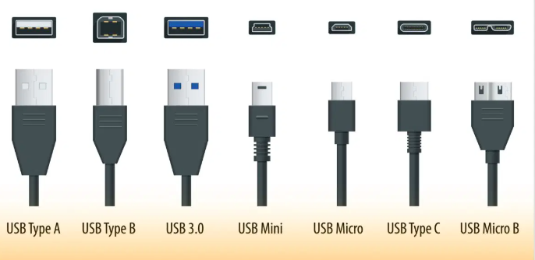
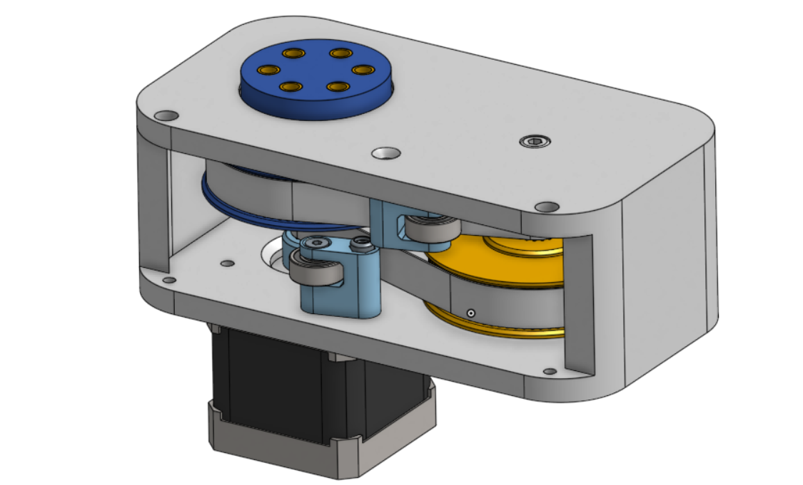
Reference Design #1

Slide 3
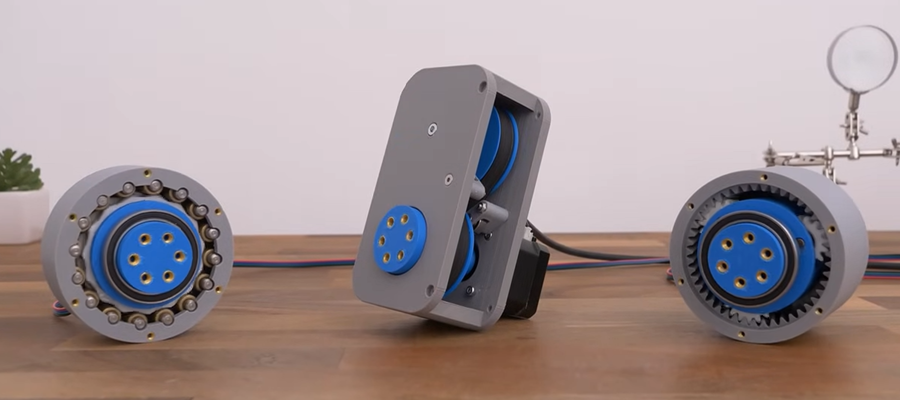
Gearbox Types
Belt Drive
Cycloidal
Gearbox

Slide 4
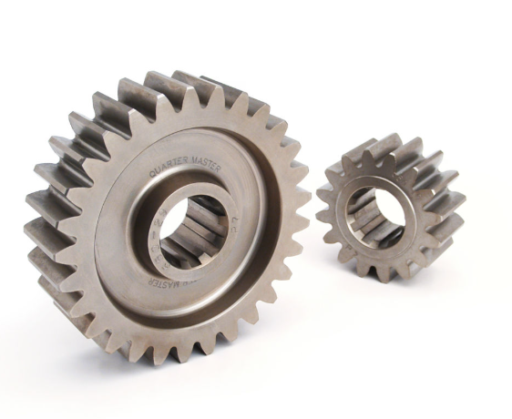
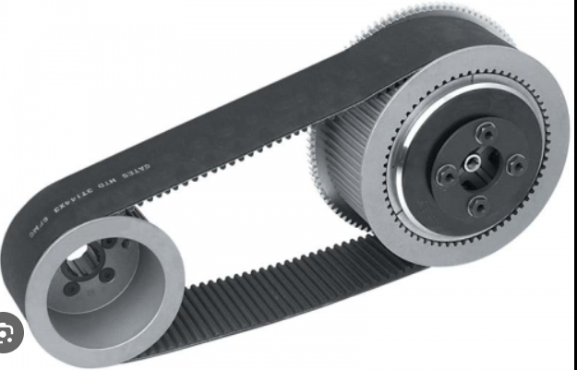
Gears Vs Belt Drive
Gearbox Types

Slide 5
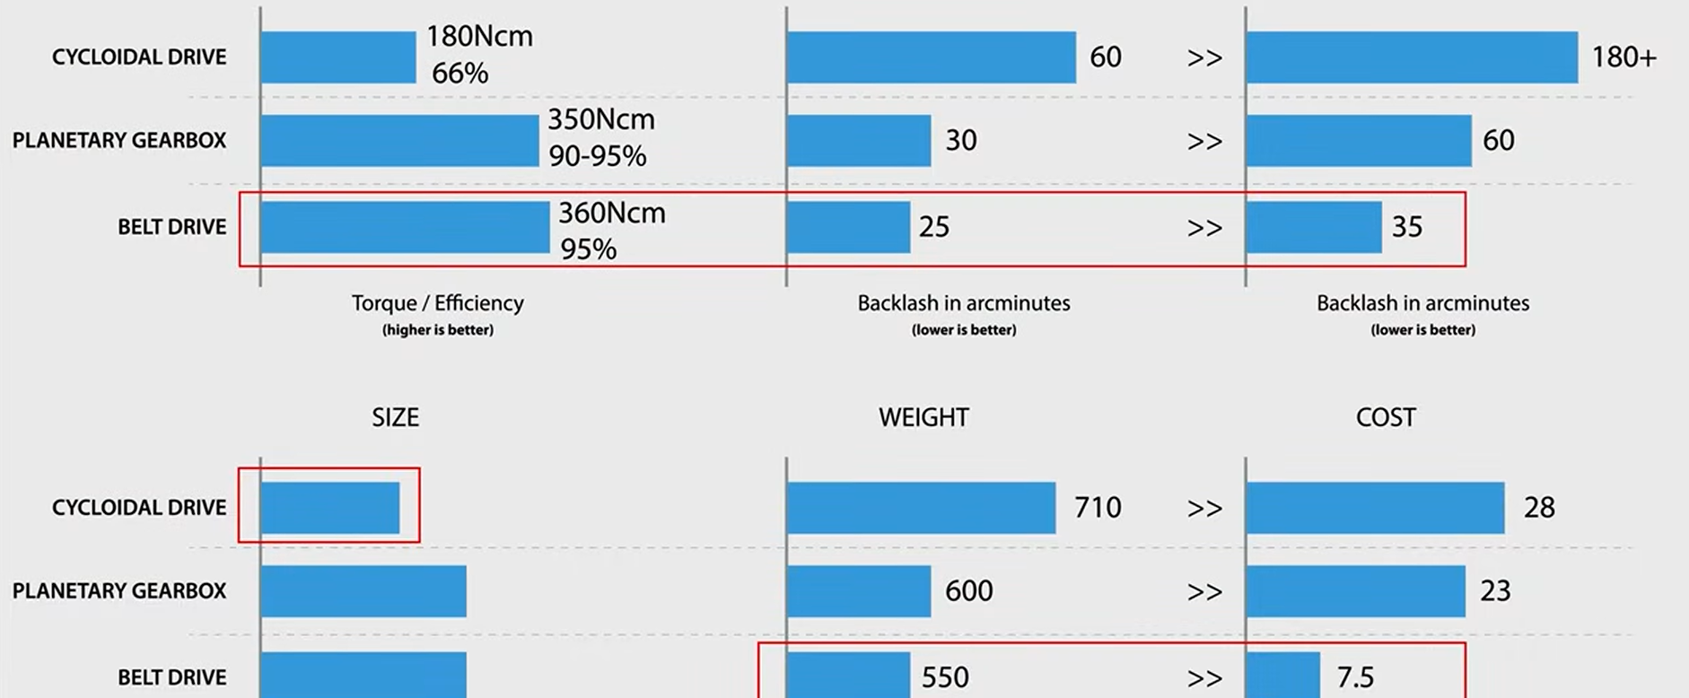
Gearbox Types

Slide 6
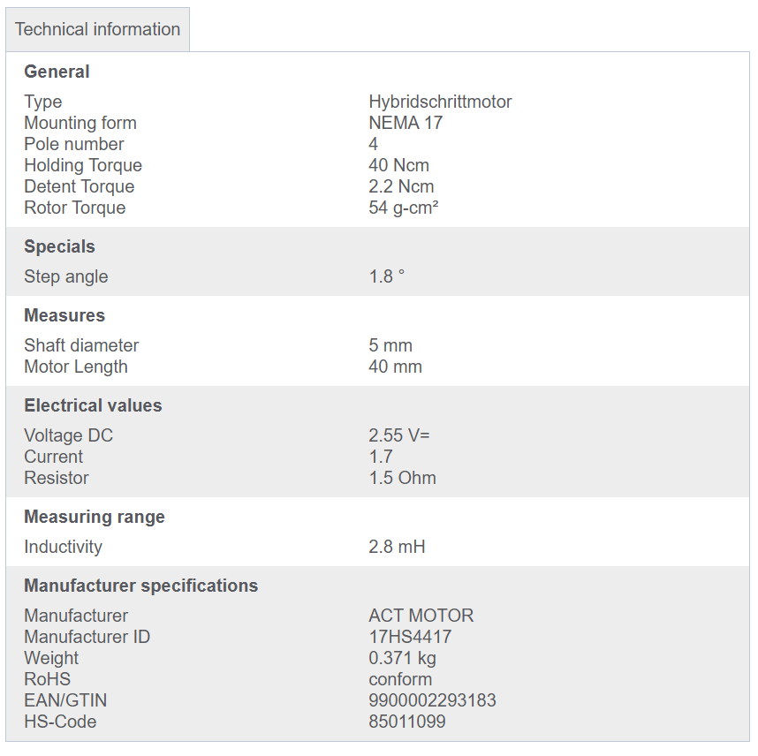
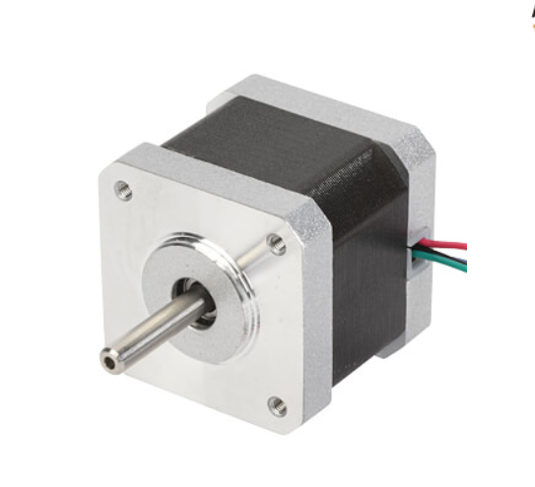
Stepper Motor: 17HS4417
https://www.reichelt.com/de/en/shop/product/stepper_motor_4_pole_1_8_2_55_v_dc-229318?country=de&CCTYPE=private&LANGUAGE=en

Slide 7
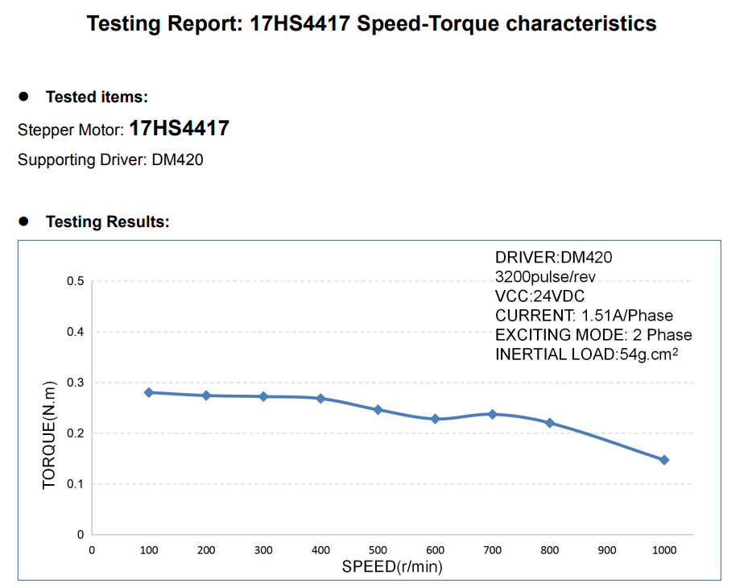
Stepper Motor: 17HS4417
https://www.reichelt.com/de/en/shop/product/stepper_motor_4_pole_1_8_2_55_v_dc-229318?country=de&CCTYPE=private&LANGUAGE=en

Slide 8
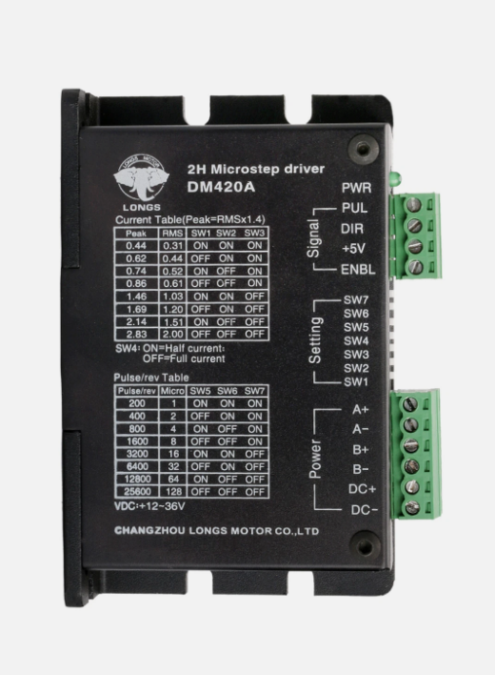
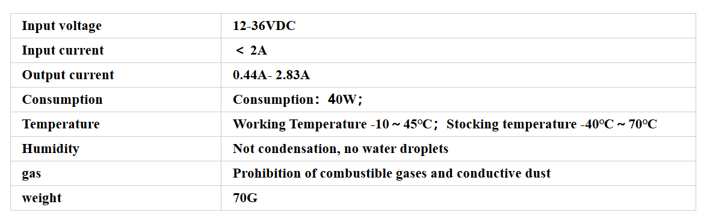
Two-Phase, Four-Phase Hybrid Stepper Motor Driver DM420

Slide 9
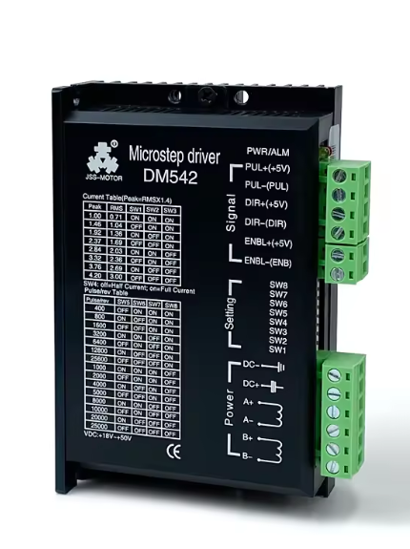
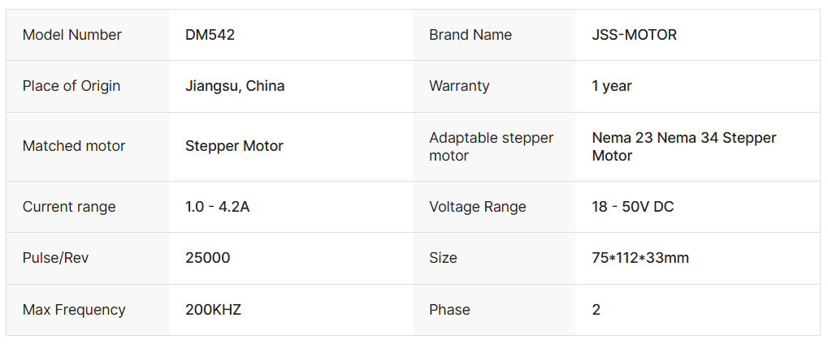
DM542 4.2A 24V/48V Digital Stepper Motor Driver Controller 2-Phase
https://www.alibaba.com/product-detail/DM542-4-2A-24V-48V-dc_1600480457901.html

Slide 10


Stepper Motor: 17HS4417
https://www.reichelt.com/de/en/shop/product/stepper_motor_4_pole_1_8_2_55_v_dc-229318?country=de&CCTYPE=private&LANGUAGE=en

Slide 11
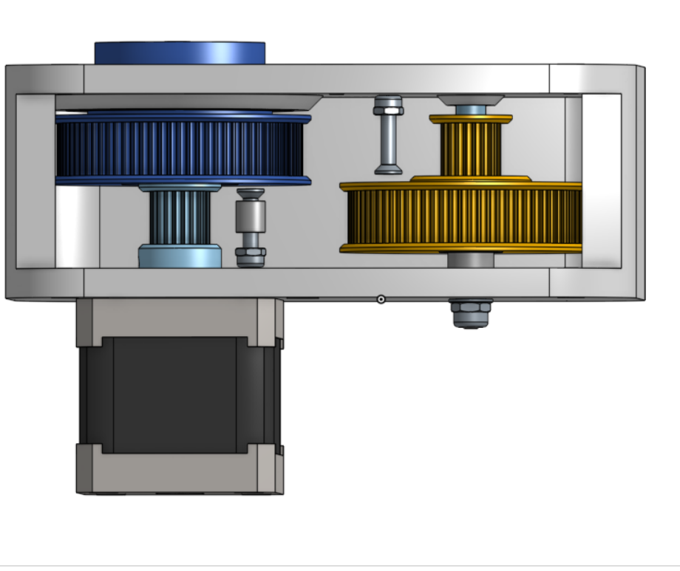

80 Teeth
20 Teeth
Gearbox
Gear Ratio = 1/16
Input Torque = 0.275Nm
Output Torque = 4.4Nm
Input Speed = 400 rev/min
Output Speed = 25 rev/min
80 Teeth
20 Teeth

Slide 12
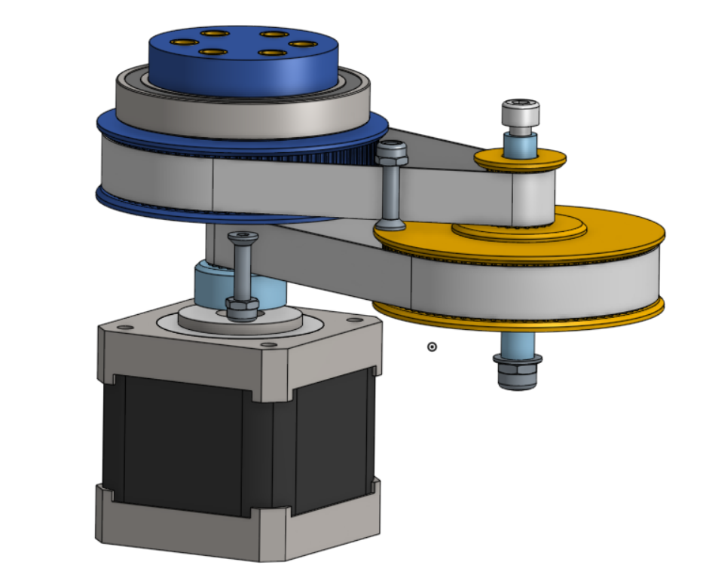
80 Teeth
20 Teeth
Gearbox
80 Teeth
20 Teeth

Slide 13
80 Teeth
20 Teeth
Gearbox
80 Teeth
20 Teeth

Slide 14
Gearbox

Slide 15
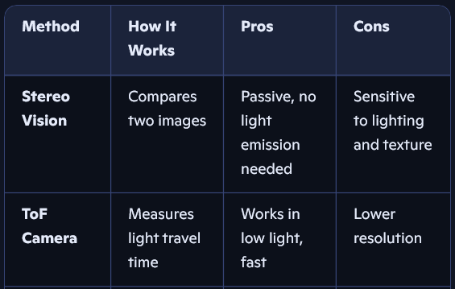

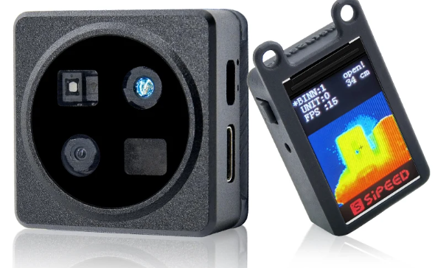
Camera

Slide 16
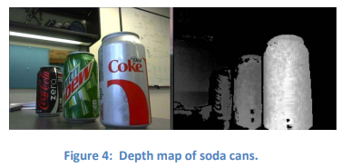
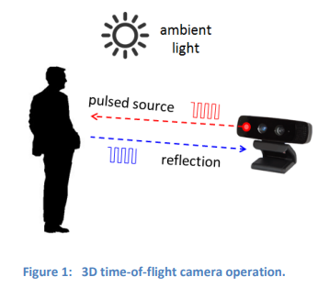
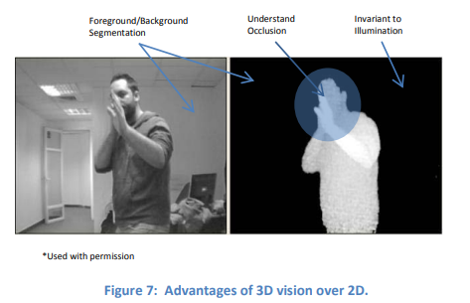
Camera
https://www.ti.com/lit/wp/sloa190b/sloa190b.pdf?ts=1761726029116&ref_url=https%253A%252F%252Fwww.google.com%252F

Slide 17
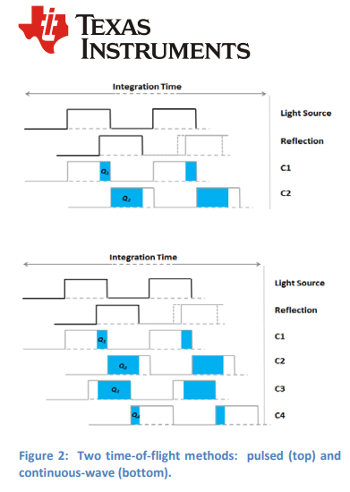

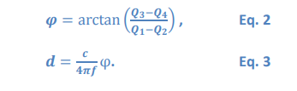
Camera
https://www.ti.com/lit/wp/sloa190b/sloa190b.pdf?ts=1761726029116&ref_url=https%253A%252F%252Fwww.google.com%252F

Slide 18
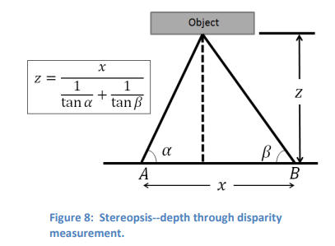
Camera
https://www.ti.com/lit/wp/sloa190b/sloa190b.pdf?ts=1761726029116&ref_url=https%253A%252F%252Fwww.google.com%252F

Slide 19
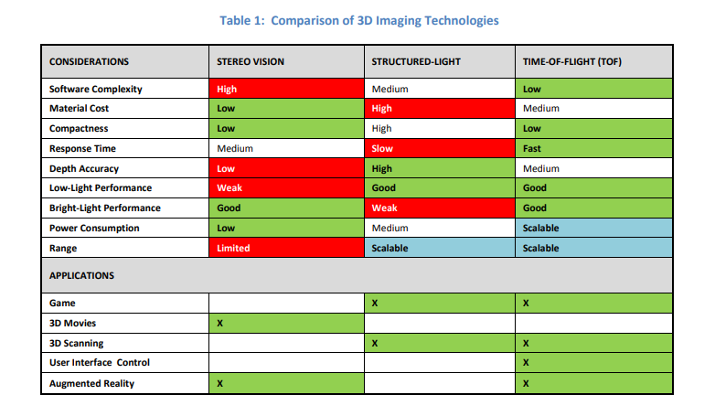
Camera
https://www.ti.com/lit/wp/sloa190b/sloa190b.pdf?ts=1761726029116&ref_url=https%253A%252F%252Fwww.google.com%252F

Slide 20
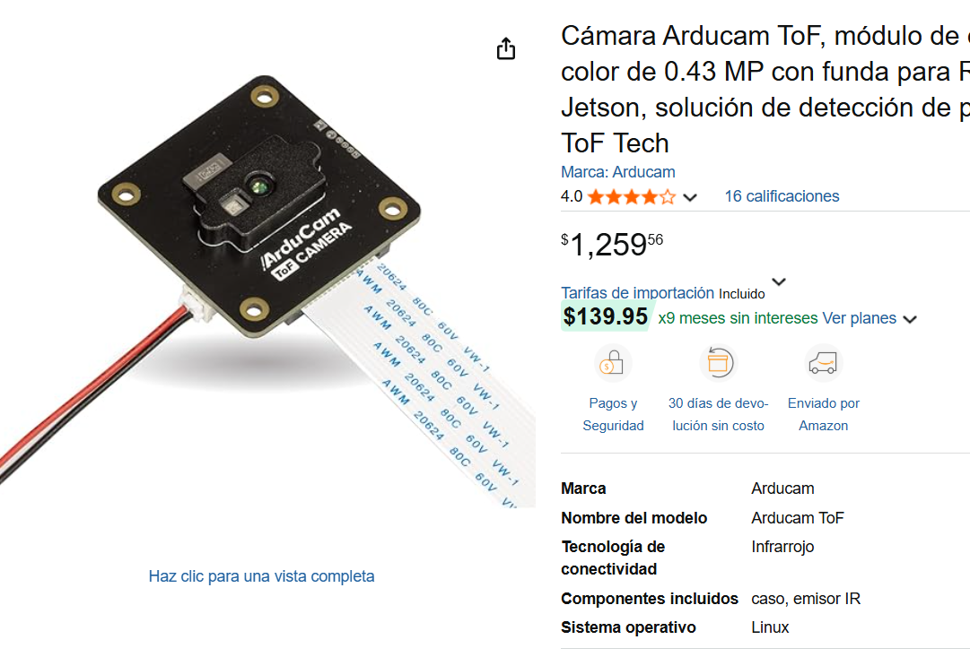
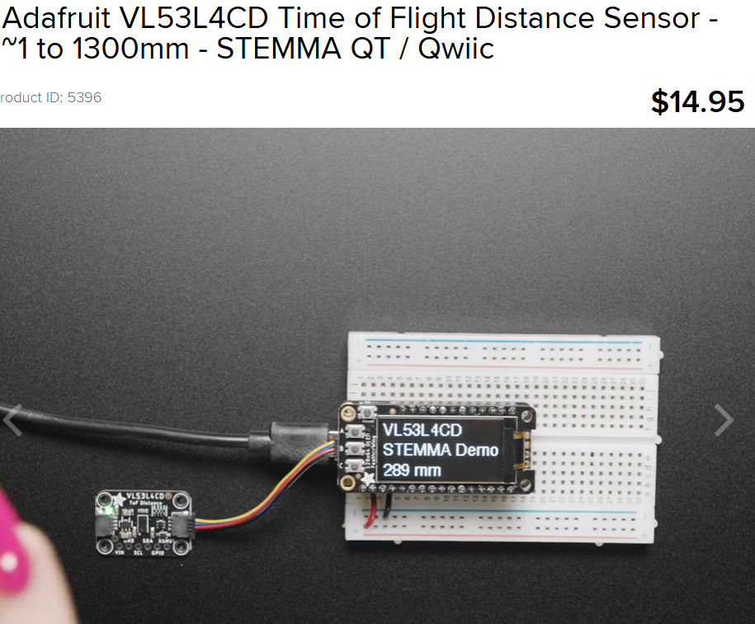
Camera

Slide 21
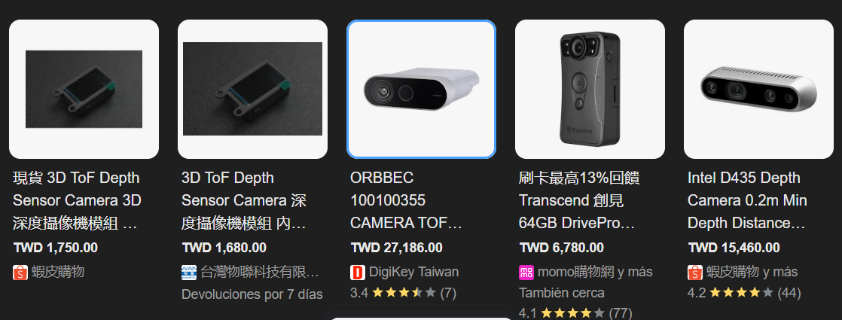
Camera

Slide 22
Reference Design #1

Slide 23
Reference Design #2

