Slide 1


Robot Cale Assembly
Nicolas Miranda
Capstone Project - Industry 4.0
2025-2026

Slide 2
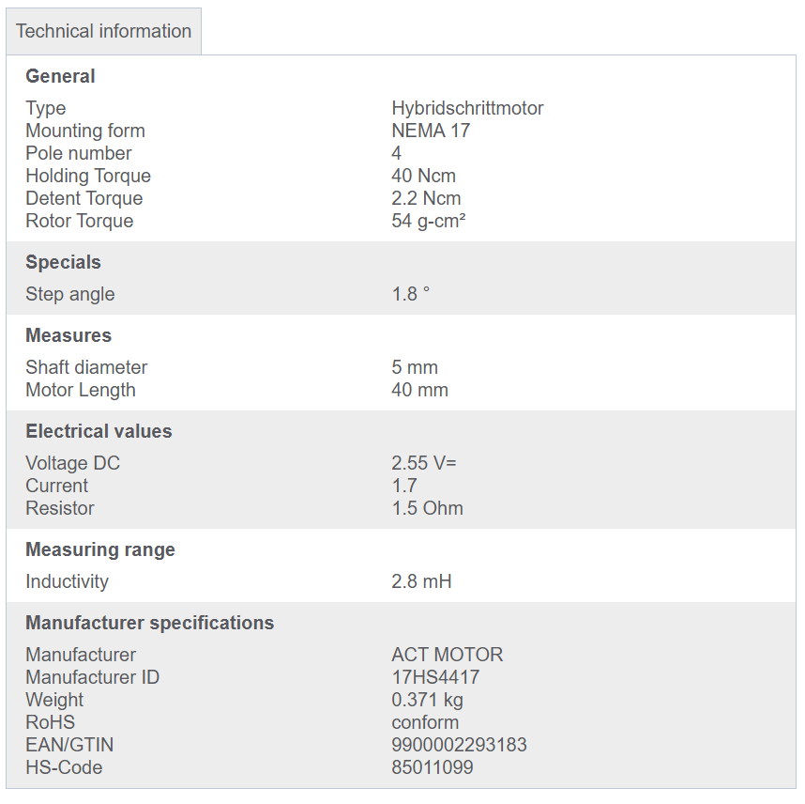
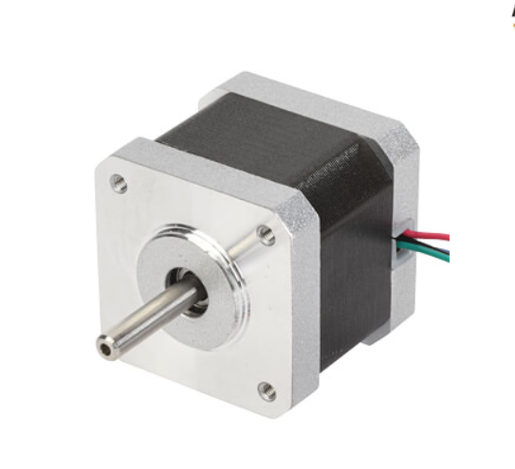
Stepper Motor: 17HS4417
https://www.reichelt.com/de/en/shop/product/stepper_motor_4_pole_1_8_2_55_v_dc-229318?country=de&CCTYPE=private&LANGUAGE=en

Slide 3
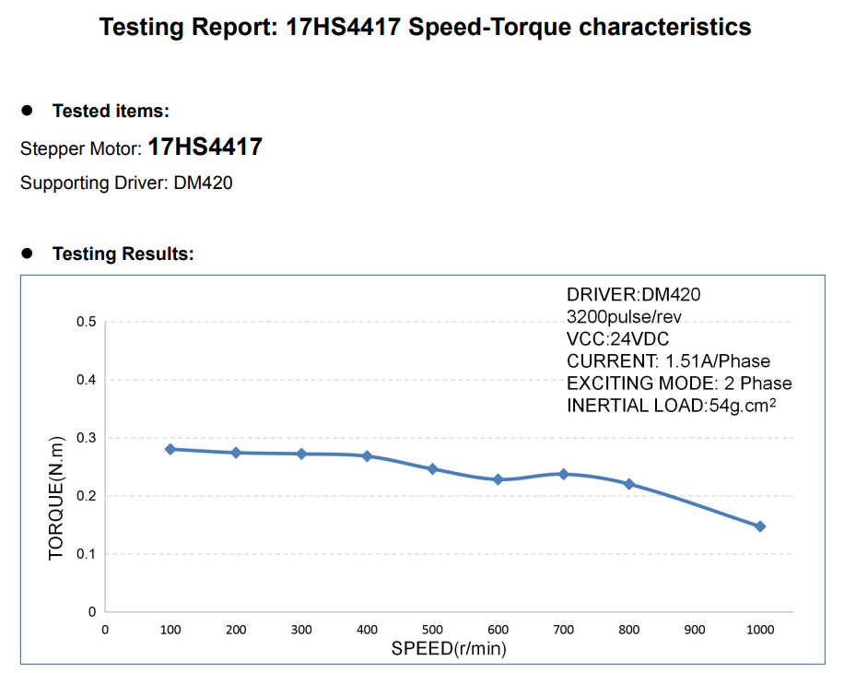
Stepper Motor: 17HS4417
https://www.reichelt.com/de/en/shop/product/stepper_motor_4_pole_1_8_2_55_v_dc-229318?country=de&CCTYPE=private&LANGUAGE=en

Slide 4
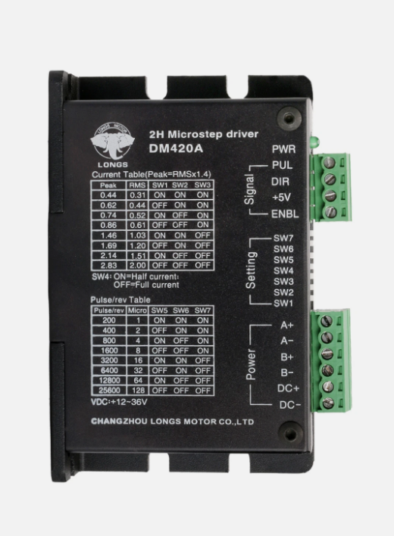
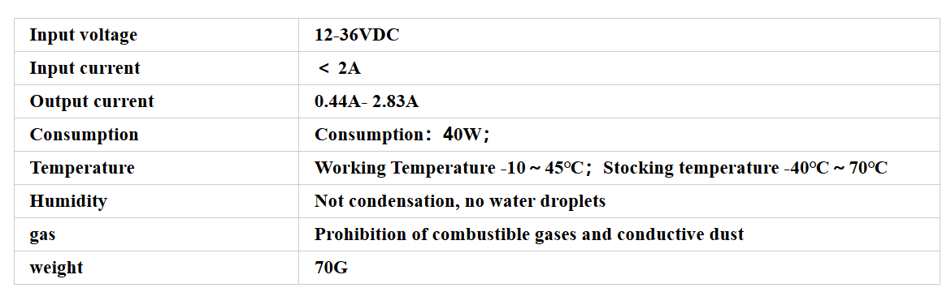
Two-Phase, Four-Phase Hybrid Stepper Motor Driver DM420

Slide 5
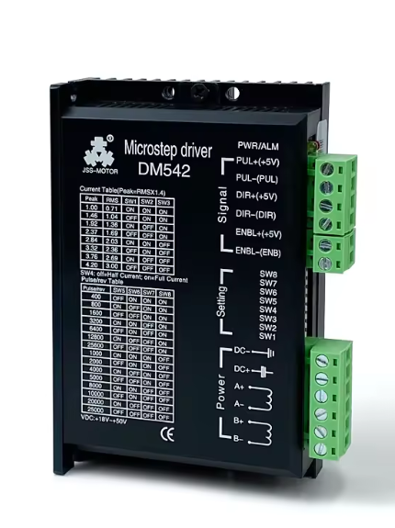
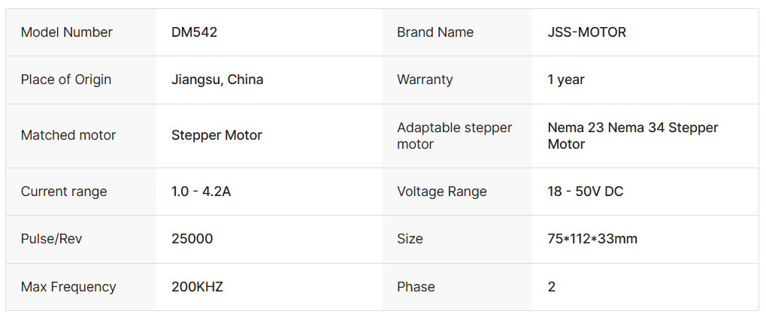
DM542 4.2A 24V/48V Digital Stepper Motor Driver Controller 2-Phase
https://www.alibaba.com/product-detail/DM542-4-2A-24V-48V-dc_1600480457901.html

Slide 6


Stepper Motor: 17HS4417
https://www.reichelt.com/de/en/shop/product/stepper_motor_4_pole_1_8_2_55_v_dc-229318?country=de&CCTYPE=private&LANGUAGE=en

Slide 7
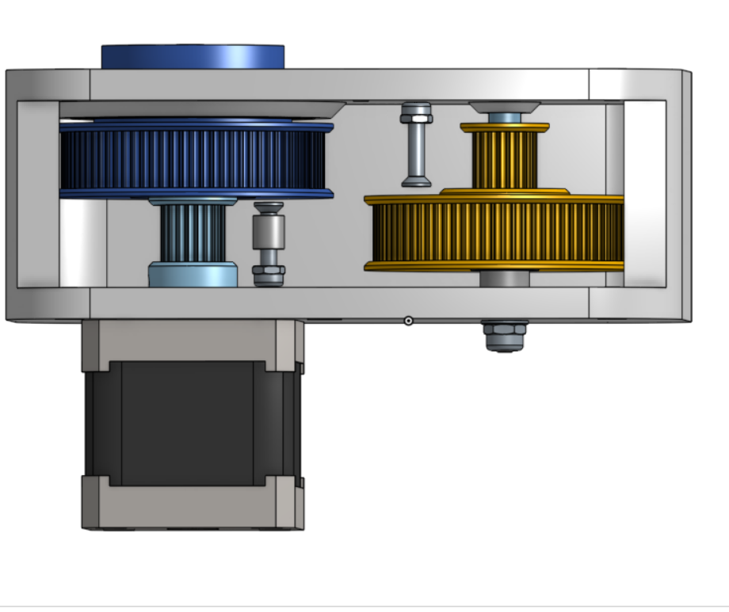

80 Teeth
20 Teeth
Gearbox
Gear Ratio = 1/16
Input Torque = 0.275Nm
Output Torque = 4.4Nm
Input Speed = 400 rev/min
Output Speed = 25 rev/min
80 Teeth
20 Teeth

Slide 8
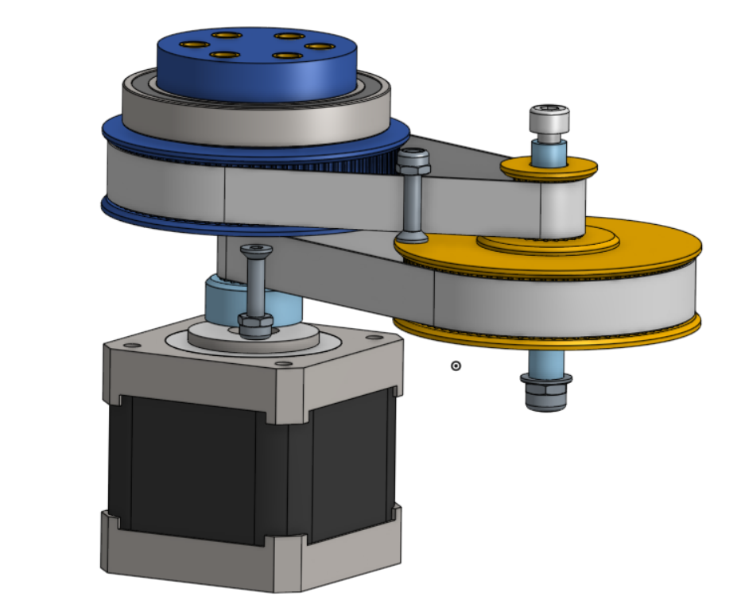

80 Teeth
20 Teeth
Gearbox
80 Teeth
20 Teeth

Slide 9
80 Teeth
20 Teeth
Gearbox
80 Teeth
20 Teeth

Slide 10
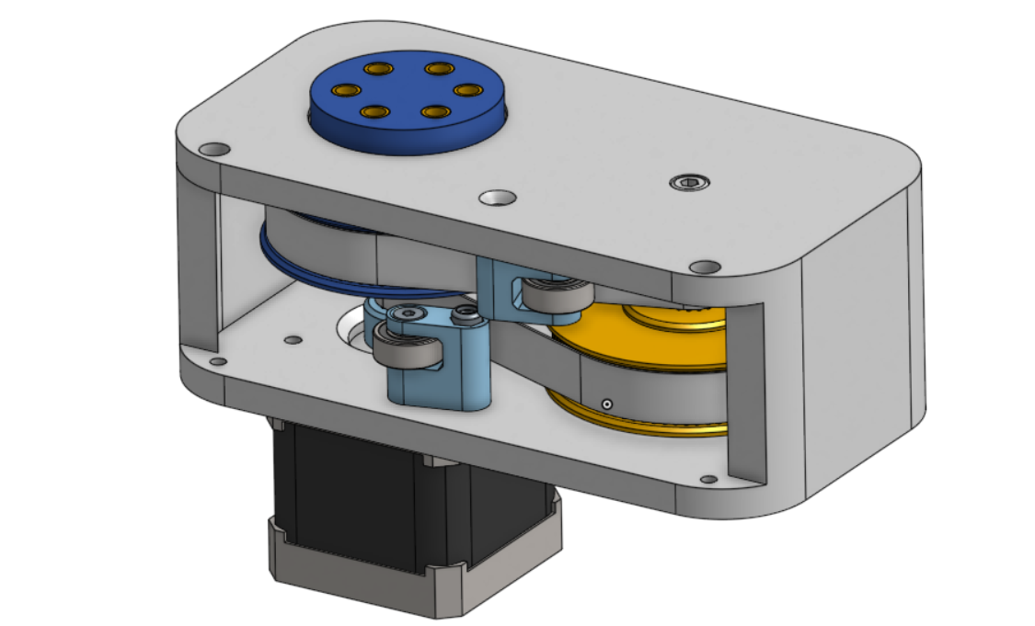
Gearbox

Slide 11
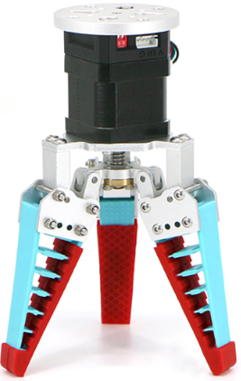
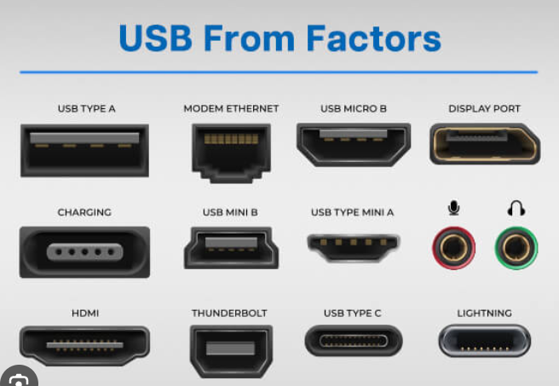
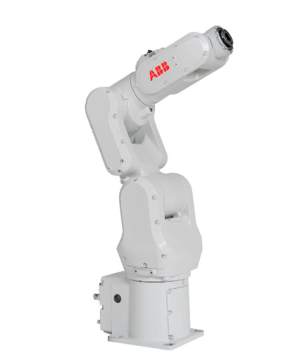
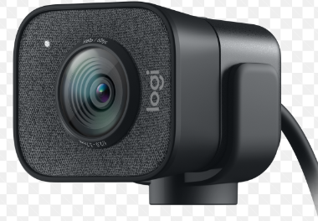
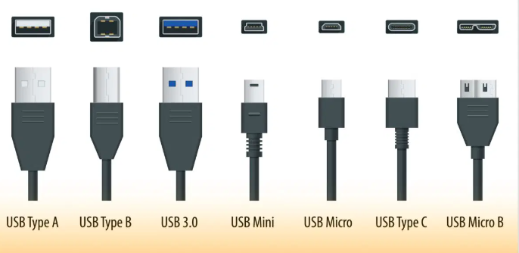
Reference Design #1

Slide 12
Reference Design #2

