Slide 1
Equity Trading System
Team 59: Wenting Yang, Mengqi(Sara) Liu
Design Milestone of Final Project
MCIT 591
April 6, 2020

Slide 2
Scope of Design
Develop an equity trading system including reading market data, generating and executing orders, booking and adding trades, and then publishing the data.
Submitted documents
Design work flow diagram
A table of main function modulus, main classes and class interactions
Codes and javadocs of main classes and help classes
Finished main classes: EquityMarketDataConnector, EquityMarketDataService
Unit test testMarketDataService to test methods of EquityMarketDataService

Slide 3
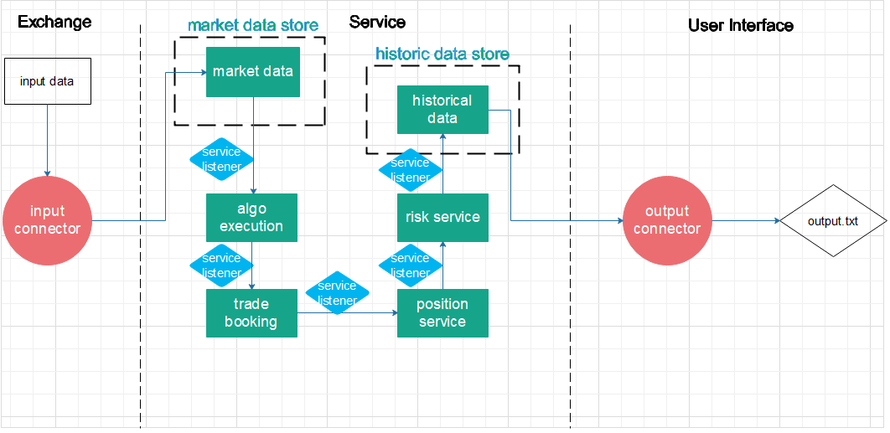
Design Work Flow Diagram

Slide 4
Table of Main Function Modulus, Classes and Class Interactions
Function Modulus
Main classes
Interaction with main classes & help classes
Function descriptions
EquityMarketDataService;
OrderBook, Order;
read from the marketdate.txt, construct orderbook, call onMessage method to transmit data to market data service
Input connector
EquityMarketDataConnector
EquityMarketDataConnector,
EquityAlgoExecutionService;
EquityAlgoExecutionServiceListener
Create orderbook with imported data, send it to the EquityAlgoExecutionService via a service listener and onMessage() method
Market data service
EquityMarketDataService
EquityMarketDataService,
EquityTradeBookingService;
EquityTradeBookingServiceListener, executionOrder
Process and execute order, send it to the EquityTradeBookingService via a service listener
Algo execution service
EquityAlgoExecutionService
Trade booking service
EquityTradeBookingService
EquityAlgoExecutionService
EquityPositionService
EquityPositionServiceListener, Trade
Book trade, send it to the PositionService via a service listener
Position service
EquityTradeBookingService,
EquityRiskService, Position,
EquityRiskServiceListener
Add trade, send it to the RiskService via a service listener
EquityPositionService
Risk service
EquityRiskService
EquityPositionService, EquityHistoricalDataService, Risk EquityHistoricalDataServiceListener
Assess risk, send it to the HistoricalDataService via a service listener
Historical data Service
EquityHistoricalDataService
EquityRiskService, EquityHistoricalDataServiceConnector
Send it to the output connector via EquityHistoricalDataServiceConnector
.publish() method
Output connector
EquityHistoricalDataServiceConnector
EquityHistoricalDataService
Publish trade

