Slide 1
Docker (software)
Technology2
Uros Pocek

Slide 2
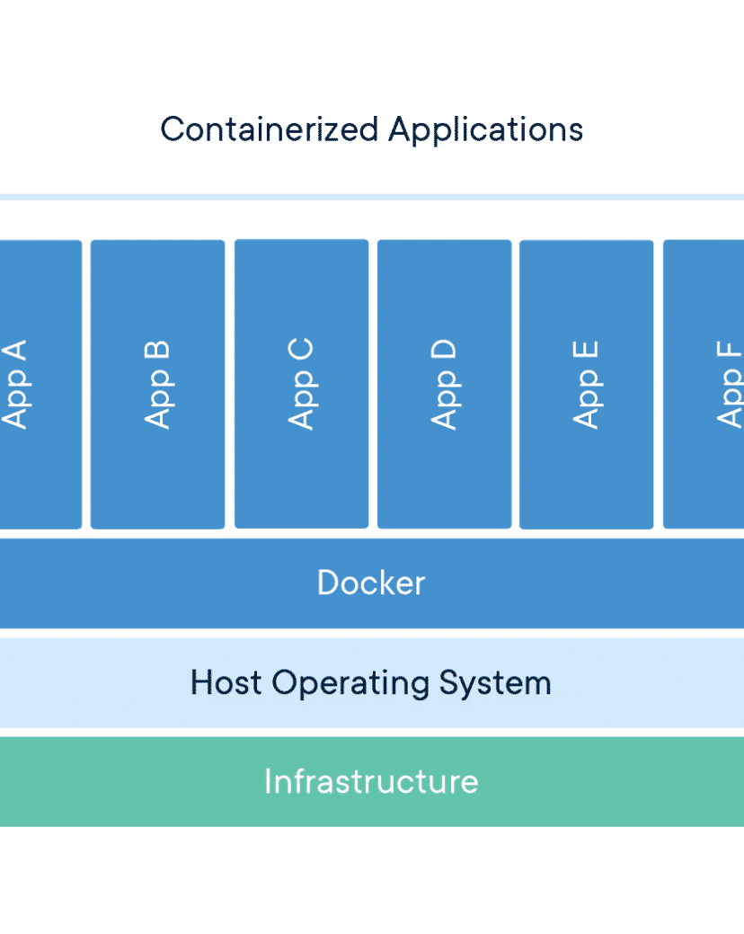
major subject
About the Docker (software)
Docker is a set of platform as a service products that use OS-level virtualization to deliver software in packages called containers. The service has both free and premium tiers. The software that hosts the containers is called Docker Engine. It was first started in 2013 and is developed by Docker, Inc.

Slide 3
major subject
Background
Containers are isolated from one another and bundle their own software, libraries and configuration files; they can communicate with each other through well-defined channels. Because all of the containers share the services of a single operating system kernel, they use fewer resources than virtual machines.

Slide 4
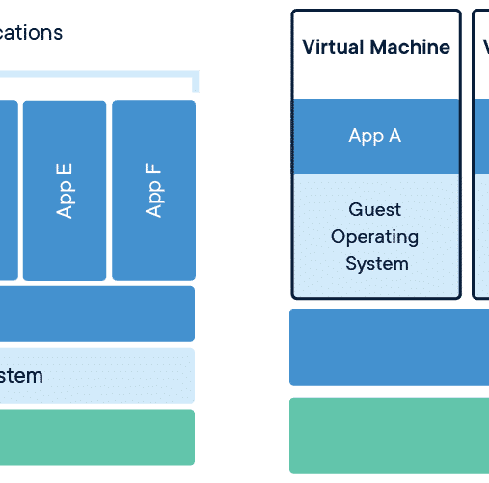
major subject
Operation
Docker can package an application and its dependencies in a virtual container that can run on any Linux, Windows, or macOS computer. This enables the application to run in a variety of locations, such as on-premises, in public or private cloud. When running on Linux, Docker uses the resource isolation features of the Linux kernel to use virtualization facilities provided directly by the Linux kernel, in addition to using abstracted virtualization interfaces via libvirt, LXC and systemd-nspawn.Docker implements a high-level API to provide lightweight containers that run processes in isolation. Docker containers are standard processes, so it is possible to use kernel features to monitor their execution—including for example the use of tools like strace to observe and intercede with system calls.

Slide 5
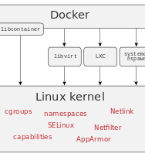
Components
Operation
The Docker software as a service offering consists of three components: Software: The Docker daemon, called dockerd, is a persistent process that manages Docker containers and handles container objects. The daemon listens for requests sent via the Docker Engine API. The Docker client program, called docker, provides a command-line interface images that they have built. Registries can be public or private. Two main public registries are Docker Hub and Docker Cloud. Docker Hub is the default registry where Docker looks for images. Docker registries also allow the creation of notifications based on events.

Slide 6
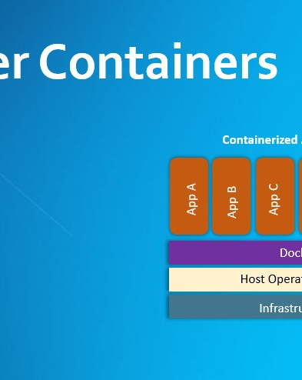
Tools
Operation
Docker Compose is a tool for defining and running multi-container Docker applications . It uses YAML files to configure the application's services and performs the creation and start-up process of all the containers with a single command . The docker-compose tool allows users to run commands on multiple containers at once, for example, building images, scaling containers, running containers that were stopped, and more . Docker Swarm provides native clustering functionality for Docker containers, which turns a group of Docker engines into a single virtual Docker engine .

Slide 7
major subject
History
Docker Inc. was founded by Kamel Founadi, Solomon Hykes, and Sebastien Pahl during the Y Combinator Summer 2010 startup incubator group and launched in 2011. The startup was also one of the 12 startups in Founder's Den first cohort. Hykes started the Docker project in France as an internal project within dotCloud, a platform-as-a-service company.Docker debuted to the public in Santa Clara at PyCon in 2013. It was released as open-source in March 2013. At the time, it used LXC as its default execution environment. One year later, with the release of version 0.9, Docker replaced LXC with its own component, libcontainer, which was written in the Go programming language.In 2017, Docker created the Moby project for open research and development. Subsections

Slide 8
Thank you for your attention

