Slide 1
Identifying target market and the location for restaurant business based out of Bangalore

Slide 2
Restaurant business in Bangalore
Bangalore is a cosmopolitan city in India with ethnically diverse population. Residents of the city are not only from India – There are also sizeable population from other countries who live in Bangalore
It is often said that the number of migrants from outside (outside of Karnataka, an Indian state for which Bangalore is the capital) outweigh the locals in Bangalore
With such a diverse population and most of them office goers, restaurant business has become thriving industry – albeit a difficult one
This project attempts to address some of the key questions for aspiring restaurant owners in the city of Bangalore:
Is there an opportunity in restaurant business in Bangalore that is not adequately addressed?
If such an opportunity does exist, what would be the ideal location in the city to start our venture so that the competition is minimized?
From available data, can we identify potential customers for our new venture?

Slide 3
Identifying target market is valuable
One of the difficulties in restaurant business arise from catering to the multitude of tastes that cuisines from different parts of India has to offer
Also, with globalization and establishment of multinational food chains, dwellers of Bangalore has found their taste in cuisine from all over the world
Since it is difficult for a restaurant business to offer all possible cuisines, it is valuable to identify if there is a demand supply shortage for a particular cuisine category and then cater to that market

Slide 4
Identifying the location to open restaurant business is important
Bangalore is one of the largest cities in India with the end to end diameter of about 50 kms.
Bangalore’s notorious traffic jams are a topic often discussed in offices across the country
Given this, it is less likely for customers living far from restaurant to visit, leave alone repeated or frequent visits
Therefore, it is important to find a location that has less number of restaurants addressing the target market that we identify so that the competition is reasonable to cater to the population living in and around that location

Slide 5
Data acquision
In order to identify the target market, we use the foursquare data
Data on currently available restaurants in Bangalore can be obtained using foursquare search API to search for category ‘Food’.
From the response, we extract the venue ID, Name, location (latitude-longitude pair) and the sub category to indicate what type of restaurant it is – Indian, South Indian, Karnataka, Burger Joint, American, Italian to name a few
Similarly, to get data on user preference for a particular category of cuisine, we could use the like count for a venue id. Though may not exactly indicate the number of visitors, the like count does have a high correlation to the number of visitors who liked a particular food category
Using the foursquare likes API, we could extract the like count for each venue and aggregate over the category to get like count for each category of food

Slide 6
Data acquisition (Contd)
To identify the location, we use the Bangalore municipality geo division data from the following location
https://raw.githubusercontent.com/datameet/Municipal_Spatial_Data/master/Bangalore/BBMP.GeoJSON
We use the four square search API and pass in the IDs for high demand category to find number of restaurants of high demand category in each municipal division
From the likes API, we can extract information on different cuisine categories that a particular user liked and use that to cluster users and identify potential customers for our new venture

Slide 7
Methodology
Firstly, we find the different restaurant categories that are available in and around Bangalore and the number of restaurants available for each
Using four square APIs, find details of venues that fall under the food category within the radius of 50km. We collect information on venue ID, name, location co-ordinates and the type of restaurant
We plot a bar chart for number of restaurants per restaurant type to understand the market dominance based on restaurant type
Secondly, we would like to understand if population with preference for any particular restaurant category are concentrated in specific localities of Bangalore
For each restaurant category, we plot locality of restaurants in that category with unique colour coding
For now, we only plot categories which has sufficient sample points

Slide 8
Methodology (Contd.)
Thirdly, we analyse the demand for different categories and identify the high demand category
Using four square APIs, we find the number of likes for the restaurant and aggregate them over categories to find the number of likes for a particular type of category
For each category, we plot the number of restaurant and number of likes to understand if the demand for a particular category outweighs the currently available restaurant count
As the two features differ by order of magnitude in our data set (restaurant counts are of the order of tens, while the like counts are of the order of hundreds), we do linear normalization of both features so that the graph remains comparable
Once the high demand category is identified, find the locality where the high demand category of restaurants does not have intense competition
In order to define the localities, we use the Bangalore municipal division geoJSON file. For each locality, we find the number of target high demand category restaurants available within a specified radius.
We visualize the target high demand category restaurants available in the localities using choropleth map to understand where our new restaurant could be located so that the competition is minimized

Slide 9
Methodology (Contd.)
Finally, we identify our potential customers for whom we want to extend the opening invitation with discounts and rewards. Our aim is to maximize the likelihood of turnout for the invitations sent. To identify our potential customers, we perform segmentation of customers based on the cuisine category they have liked in the past
Using four square APIs, we find the users and the cuisine category they have liked
We perform K means clustering on the users and for each cluster we look at the most common category of cuisine liked by the users of that cluster
This gives us an idea of cluster of users whose likelihood of turnout is high

Slide 10
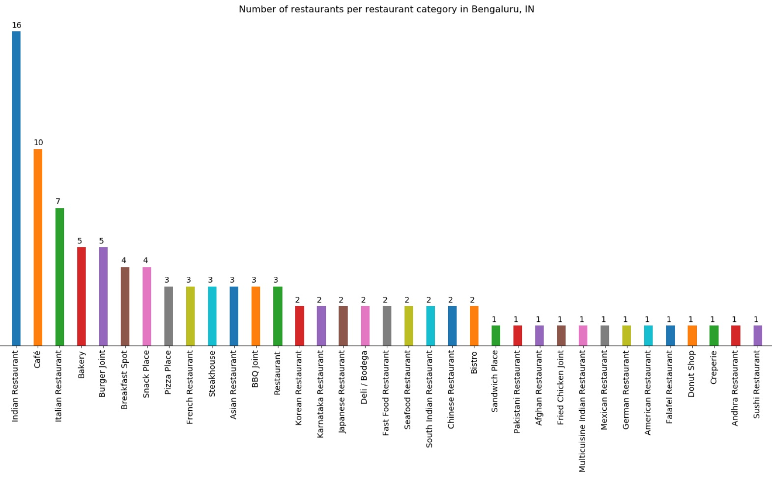
Results
Plot to understand the market dominance (from step 1 in Methodology section)
From the plot we understand that café’s and restaurants serving Indian and Italian food have high market dominance. It might be difficult to penetrate this market unless there is an overwhelming demand for this market

Slide 11
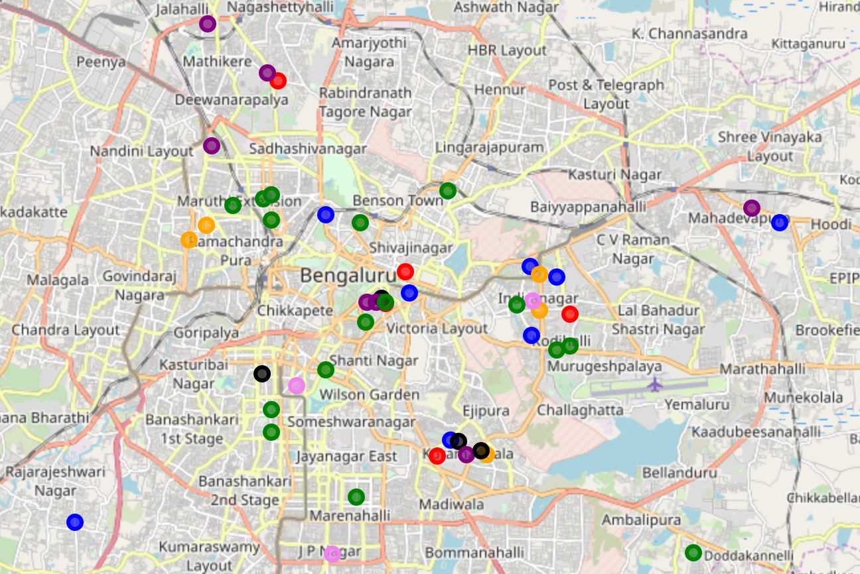
Results (Contd.)
Plot of spread of different restaurant categories (From step 2 in Methodology section)
From the plot we observe that each high occurrence restaurant category has moderate spread all over Bangalore
Though limited data, it is reasonable to conclude no particular restaurant category is concentrated in specific locality
It seems, Bangalore is truly a cosmopolitan city as far as its taste buds are concerned!

Slide 12
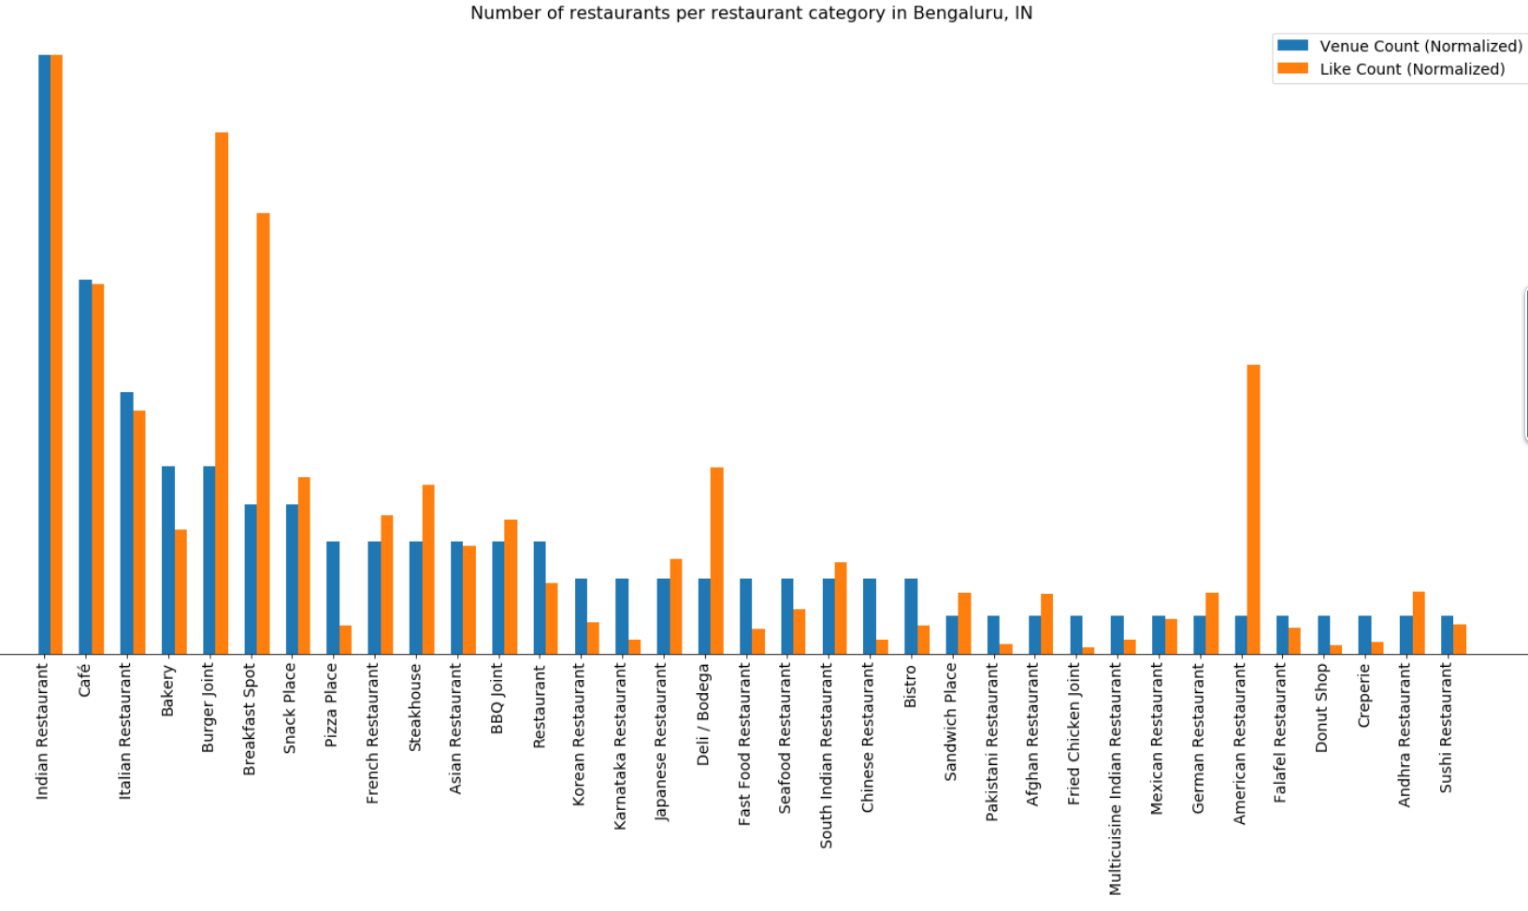
Results (Contd.)
Plot to understand the demand (from step 3 in Methodology section)
From the plot, we spot two market opportunity where the demand exceeds the supply
American restaurants and burger joints
Breakfast spots
For the rest of the discussion, we focus on American and burger restaurants, but similar analysis can be done for breakfast spots

Slide 13
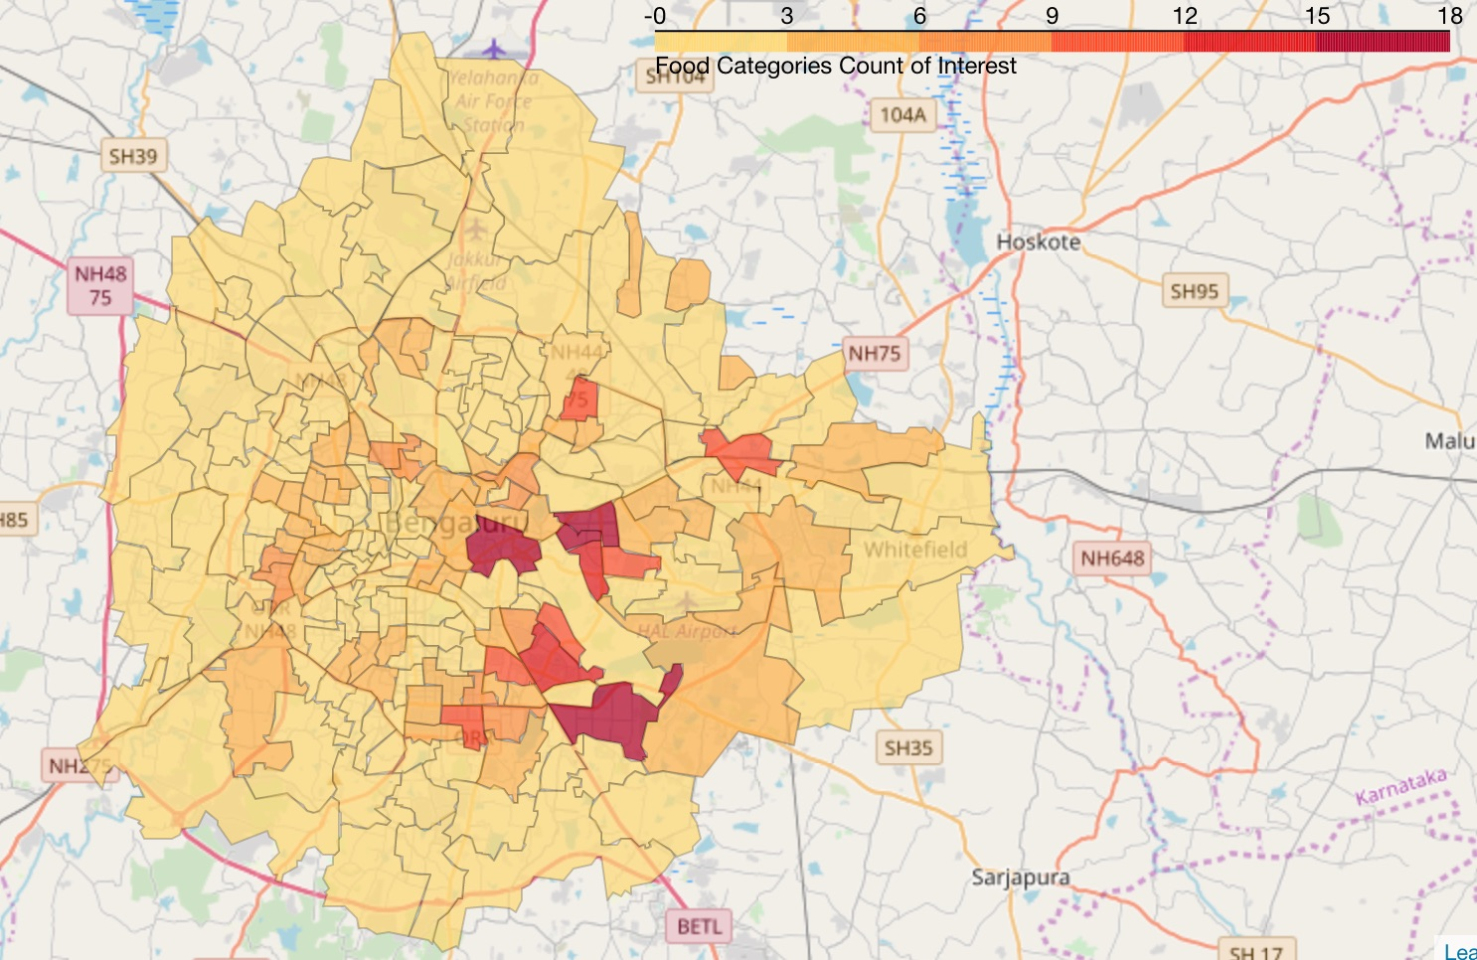
Results (Contd.)
Chorpleth map depicting spread of target category – American and Burger joints (from step 4)
From the map, we observe that the restaurants catering to target category of American cuisine and burgers are more prominent in central, south and south western parts of Bangalore
As such northern Bangalore (extending from north east to north west) is a probable location candidate where we expect the competition to be minimum

Slide 14
Results (Contd.)
Finally, we perform clustering of users based on the likes they had for different category of cuisine in the past. This gives us an idea of our target customers who has a high likelihood of turnout
Analyzing the clustering of users based on their likes for different category of cuisine, we infer the following:
Cluster zero users are interested in multi-cuisine
Cluster one users have special taste bud for coffees
Cluster two users like to eat out for breakfast
Cluster three users like Indian food
Cluster four users predominantly like Italian food, but also have an inclination for other foreign cuisines
From the inference, we conclude that users of cluster zero and cluster three have high chances of turnouts

Slide 15
Discussion
For the initial analysis, we have limited data. Four square API’s return only limited number of results for search APIs. While the current analysis does give us some insights, for a more meaningful analysis, we need to get search results with close-by locations (say a search per municipal division) and then merge those results weeding out the duplicates. An analysis based on such consolidated data can throw more insights. With the limited queries per day for foursquare APIs, we found this difficult to implement – but future work could consider this enhancement
To understand if population with specific taste buds are concentrated in a particular locality, we have marked the specific restaurant type in the map and have looked for spread. But for such an analysis, the data we had is insufficient as many restaurant categories had minimal sample points. Enhancing the data collection through mechanism mentioned above may provide better analysis
To understand demand, we count the likes per category. But since the counts are based on venues if our search returned more ‘good’ restaurants for a category and more ‘bad’ restaurants for a different category, then our demand inference may be biased. For the analysis discussed in this presentation, we pretend such a bias does not exist. This problem will also be alleviated to a great extend with the data collection enhancement discussed earlier
We have based our analysis on the existing data available to us from four square and as such no inference can be made on data that is not available from this data set. For example, how do residents of Bangalore like ‘Hawaiian food’ for which our search did not return a result, possibly because one does not exist in Bangalore?. Data need to be augmented from reviews of food festival etc. rather than basing it only on foursquare location data to alleviate this short coming

Slide 16
Conclusion
From the analysis we performed, we identify two market opportunities for opening a restaurant in Bangalore
Restaurants that serves American food and Burgers
Breakfast spots
We also observe that the northern (extending from northeast to northwest) Bangalore is less competitively intense for American cuisine and burgers - Therefore ideal candidate for opening our new venture
Based on the cluster analysis of segmentation of users, we find that users who have a liking for multi-cuisine and Italian cuisine has higher chances of visiting our restaurant and generating business for our new venture. Therefore, we must target and lure these customers with discounts and rewards

