Slide 1
Online Booksellers
Deep-Dive into ML Classification
Zain Raza
May 13, 2020

Slide 2
Project Summary
Objective
Goals
Solution
Project Outline

Slide 3


Objective
Flipkart vs. Amazon:
Flipkart: widely successful e-commerce startup
Main category: books
acquired for $18B USD in 2018
BEAT out Amazon for #1 e-commerce in India
What was so different about books sold on Flipkart?
Would a machine be able to tell the difference?
📚📚🤖📚📚

Slide 4
Goals
The goal of this experiment is to uncover differences on how books are sold between Amazon and Flipkart.
This insight can inform the way smart products work, such as recommender-systems that direct consumers to one platform or another.
How does Flipkart differentiate?

Slide 5
Solution
Using Logistic Regression, a classification model was built, with an F1-Score of approximately 0.7034.
Input:
Book listed online for sale
Output:
Classification of who the bookseller was - Flipkart or Amazon?

Slide 6
Project Outline
The experiment was divided into performing the following tasks:
Exploration of the Dataset
Data Preprocessing
Implementation of Classification Models
Comparison of Models

Slide 7
Technologies and Tools
The Environment

Slide 8
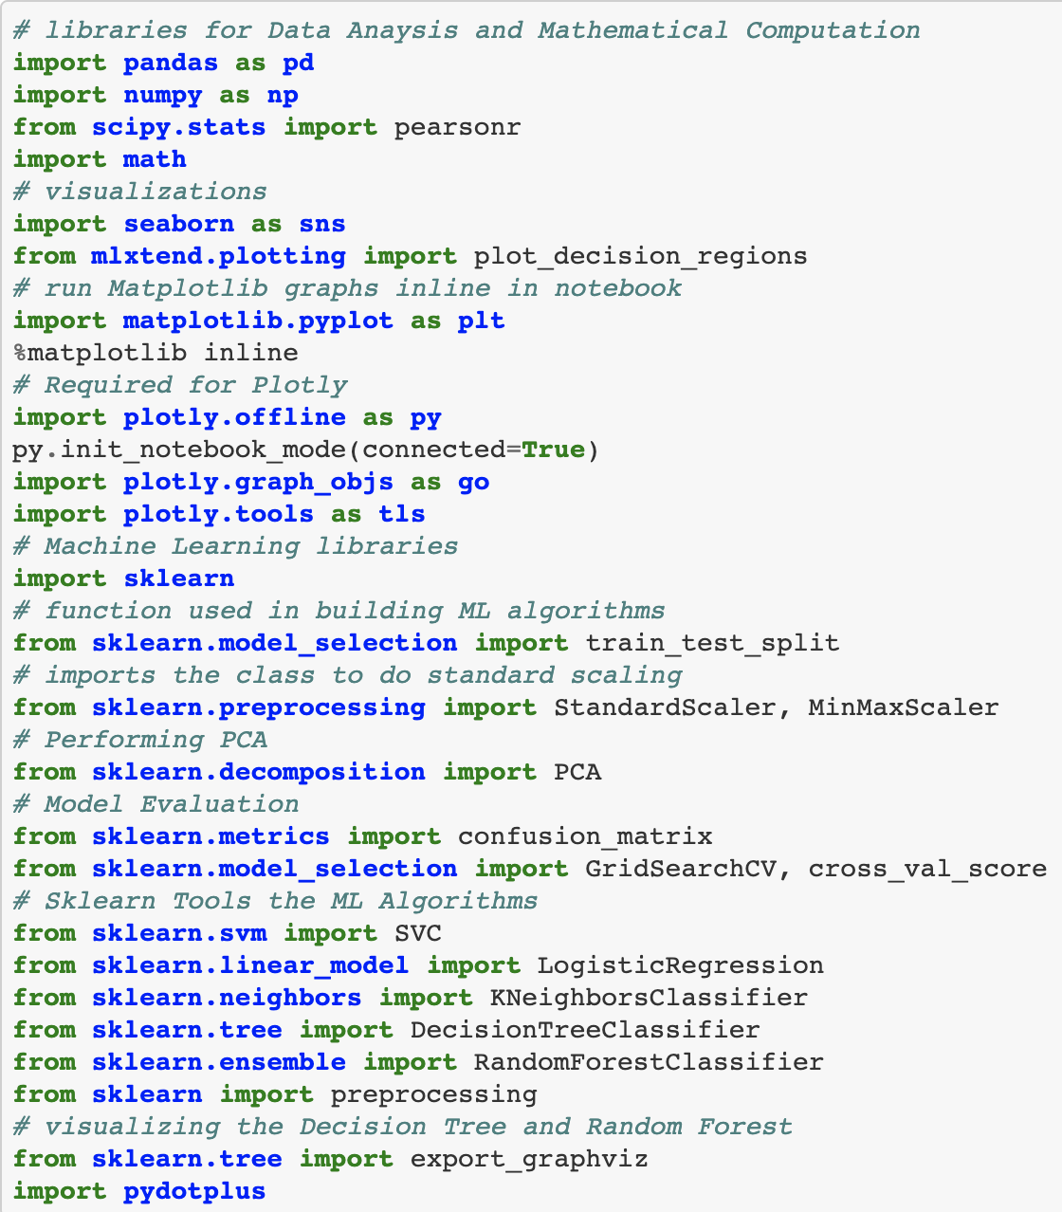
The Environment
This experiment was made possible using the following software tools:
Python 3.7.6: programming language
Jupyter Notebook: executes Python commands in the browser
SciKit-Learn: framework for implementing Machine Learning algorithms
Full list of imported dependencies

Slide 9
Exploratory Data Analysis
The Dataset
Scatter Plots
Feature Distributions
Correlation Heatmap

Slide 10
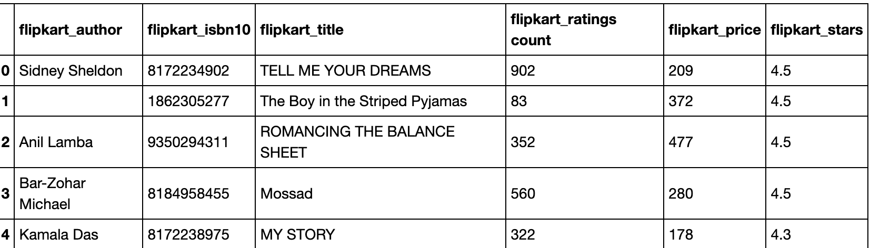
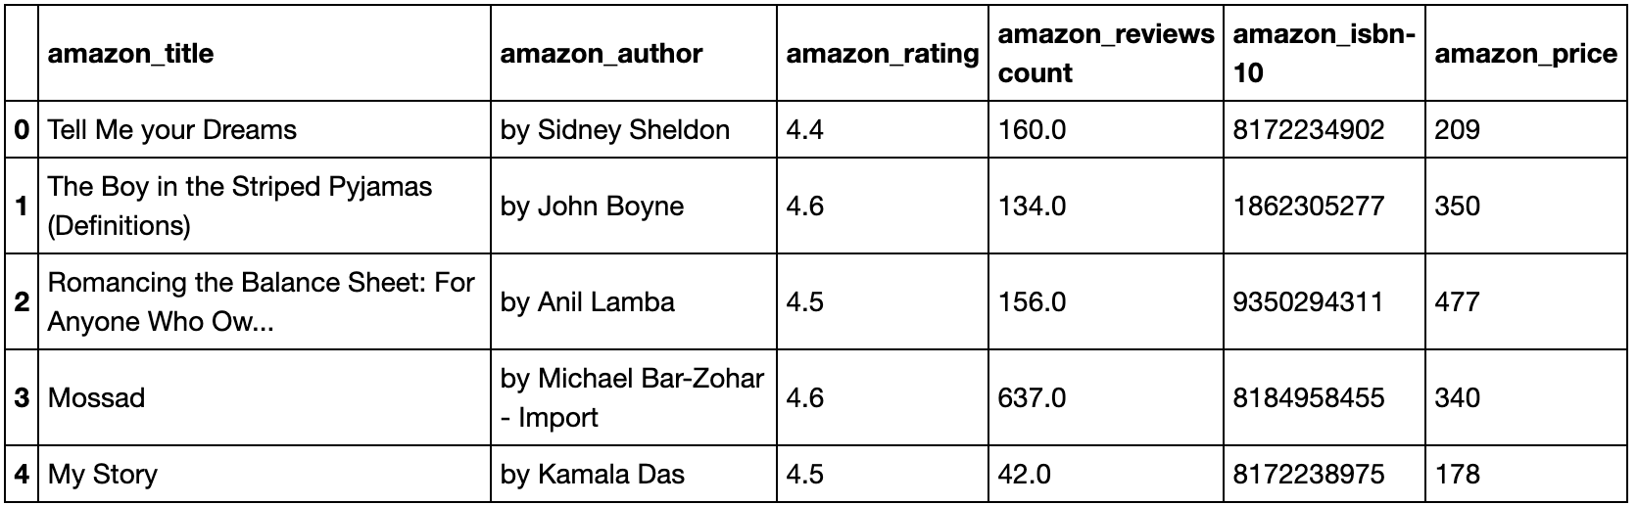
The Dataset
“Amazon Vs. Flipkart Book Prices” on Kaggle
Compares 1,382 of the same books sold differently on Flipkart and Amazon
Continuous, numerical features analyzed:
Price of book (USD)
Average Rating
Number of Reviews
Dataset posted by: mandan

Slide 11
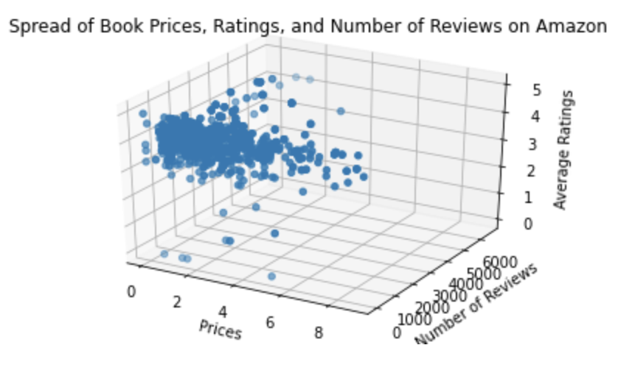
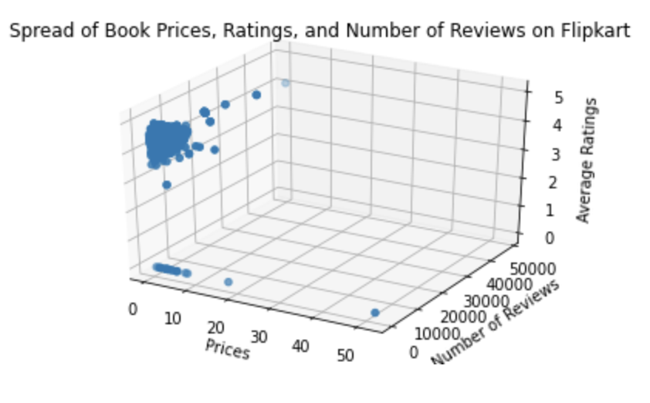
Scatter Plots of Book Features, by Company
Books on Amazon
Books on Flipkart

Slide 12
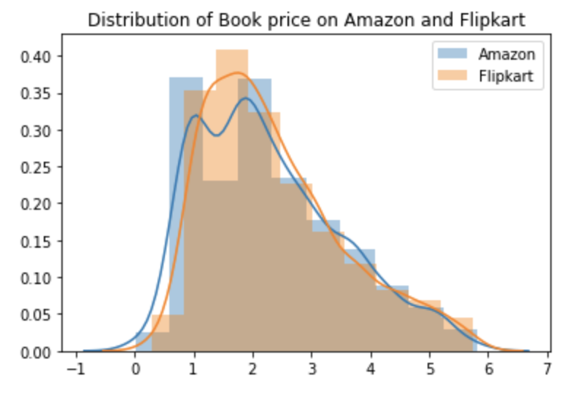
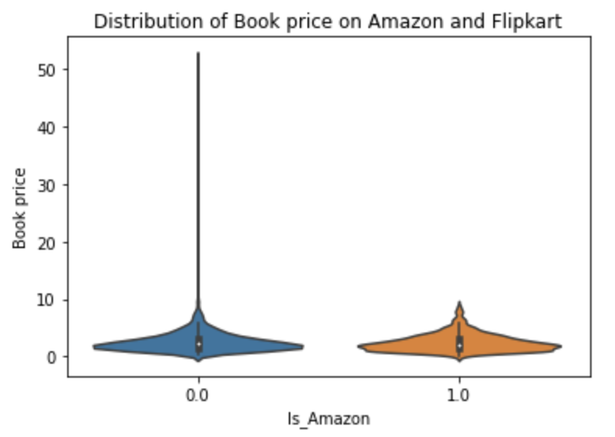
Distribution of Book Price

Slide 13
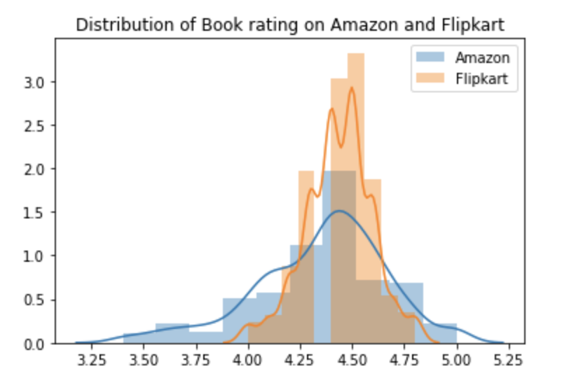
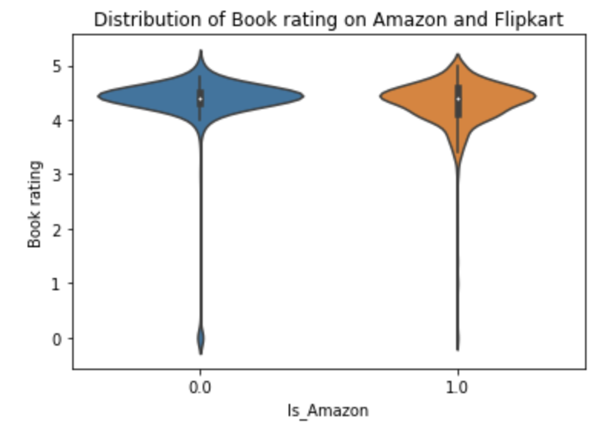
Distribution of Book Rating

Slide 14
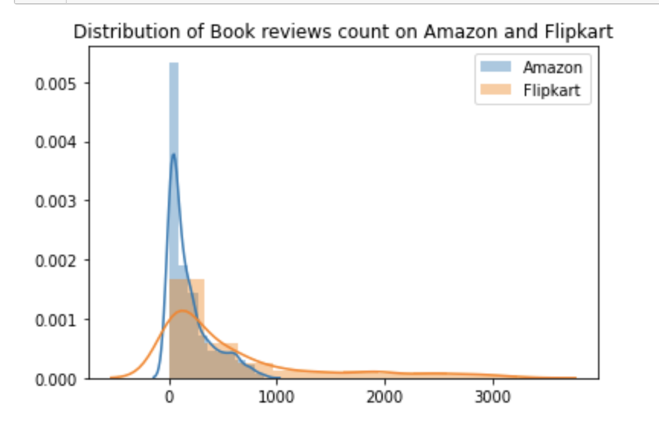
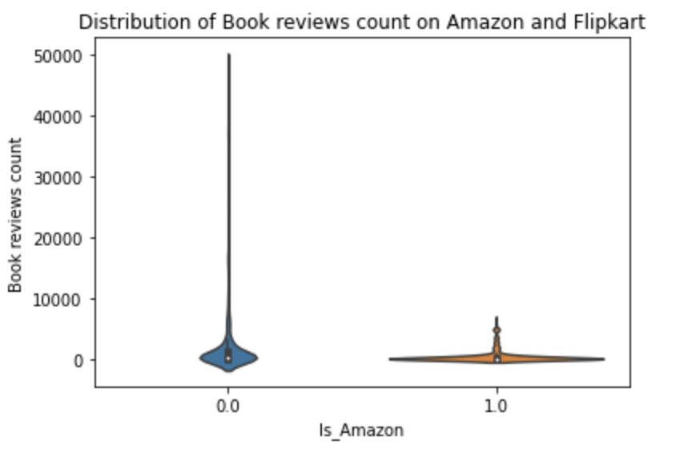
Distribution of Book Reviews Count

Slide 15
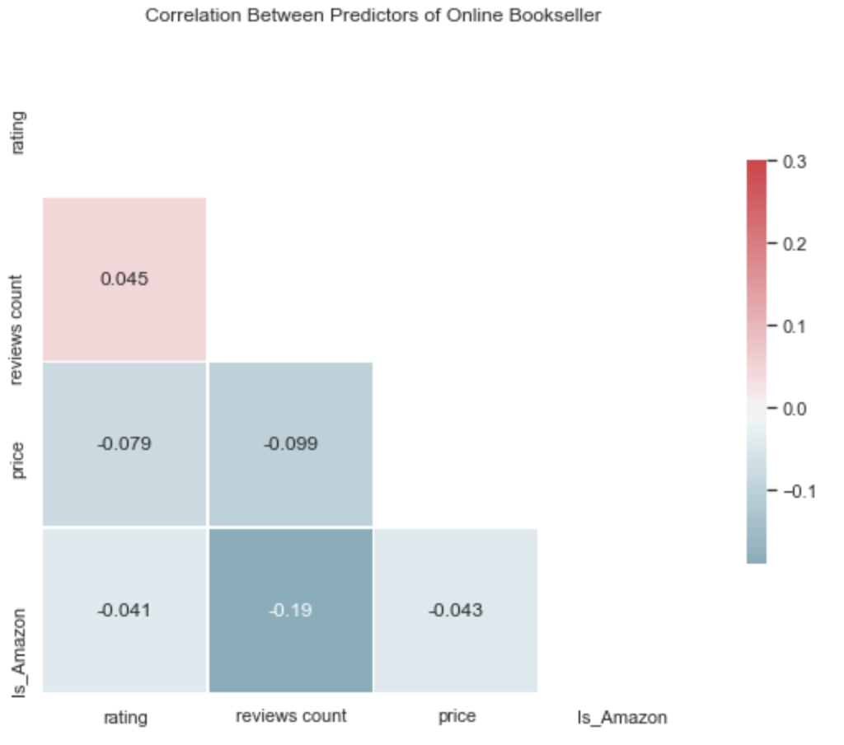
Correlation
Heatmap

Slide 16
Methodology
Modification of the Dataset

Slide 17
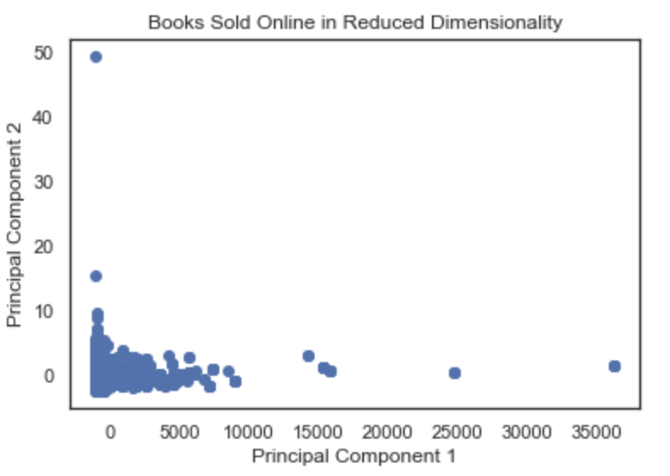
Modification of the Dataset
Dimensionality
Features clearly low in variance, so I decided to compare PCA vs. all 3 features in ML models
Data Preprocessing
Comparing data normalized vs data scaled to a distribution 0 - 1
Outliers removed using IQR
Classes equally weighted
Train-Testing Split
75%/25%
Model Evaluation
Emphasis on F1-Score
5 Fold Cross Validation to Compare Different Models Types

Slide 18
The Classifier Models
K-Nearest Neighbors
Support Vector Machine
Logistic Regression
Decision Tree
Random Forest

Slide 19
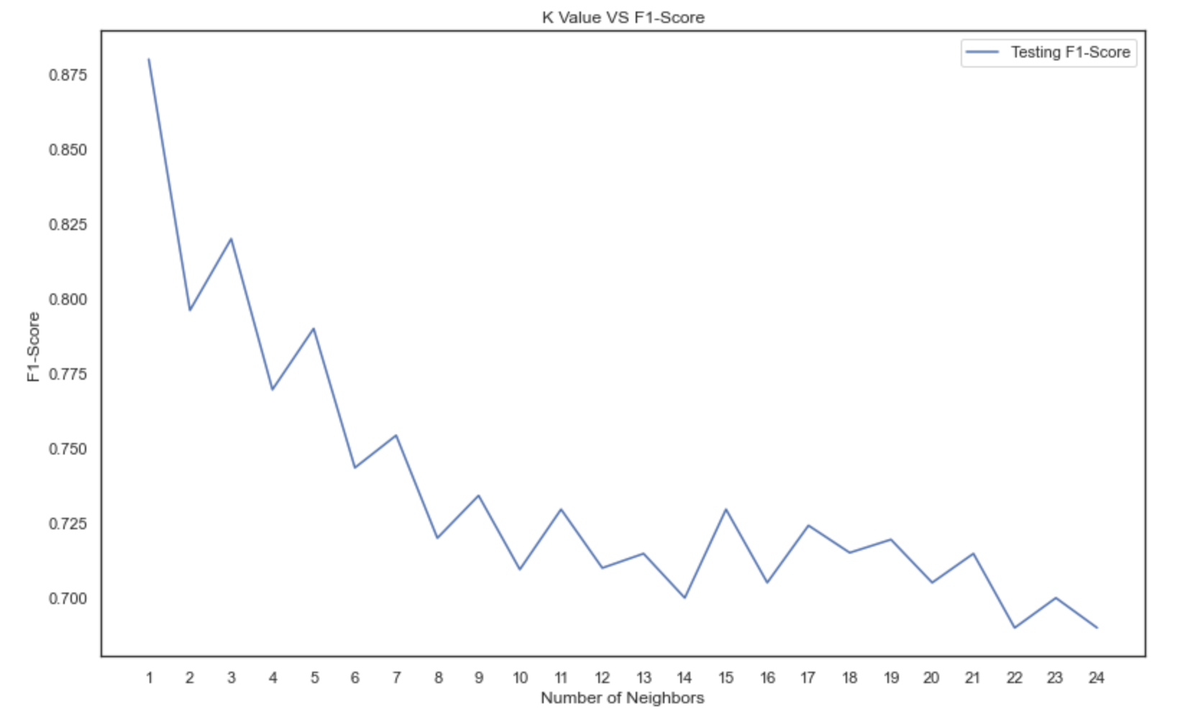
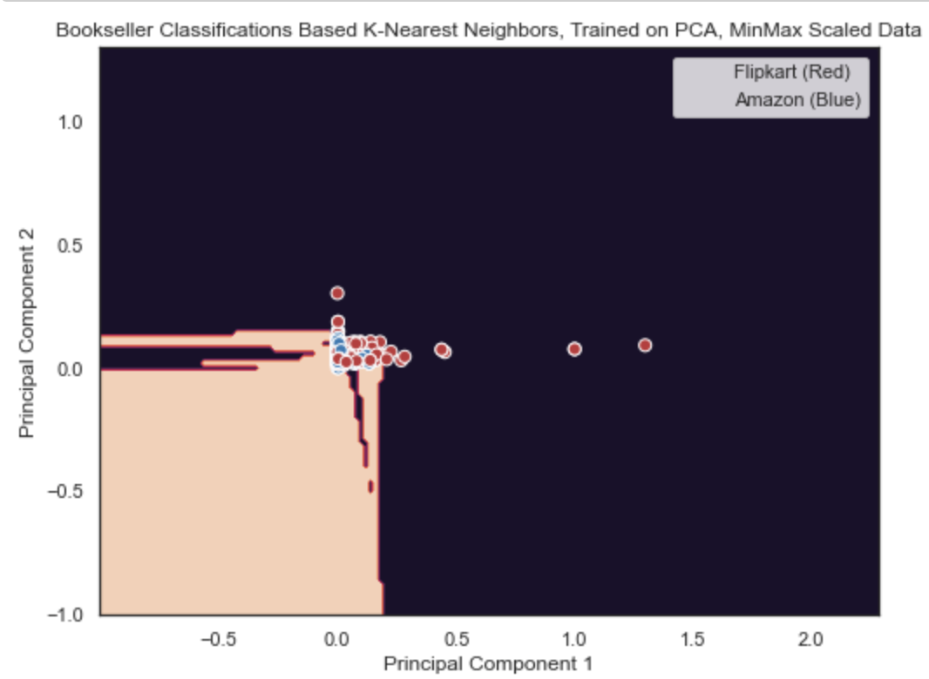
K-Nearest Neighbors
The best results of the KNN models --->
F1-Score: 0.8799
K = 1
non-reduced data (3 dimensions)
Normalized to a Standard Distribution
Probably overfitted, based on visualization of model trained on principal components (F1-Score: only 0.865) ------------------------>

Slide 20
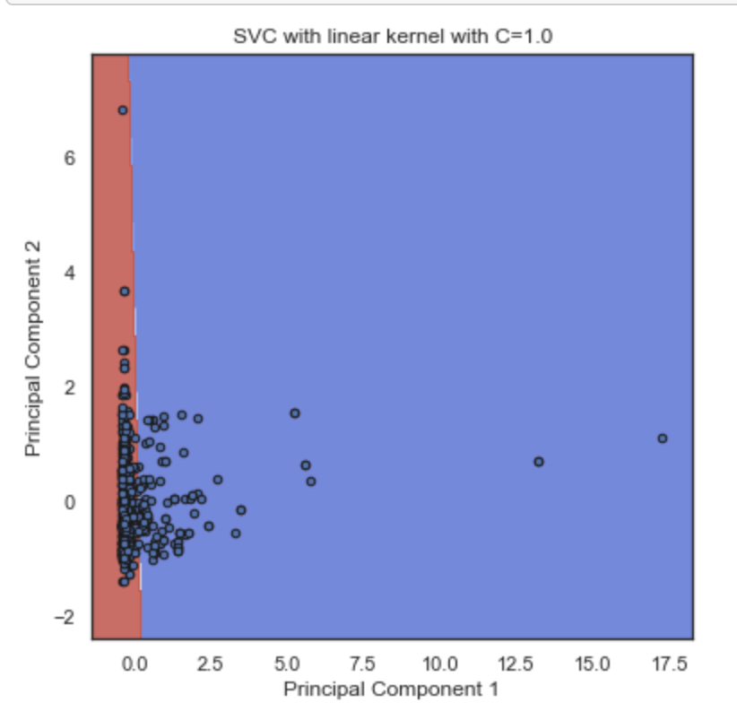
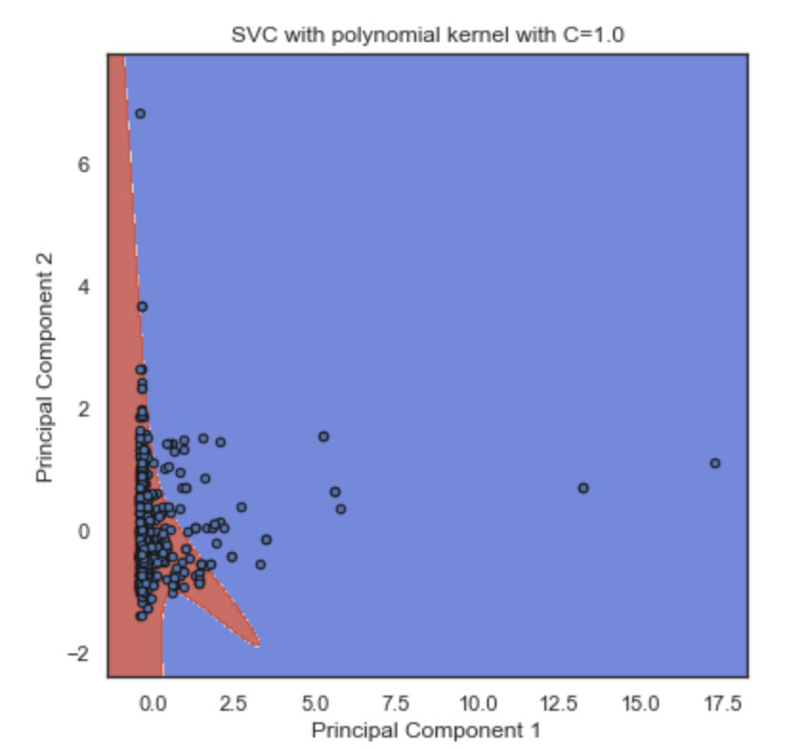
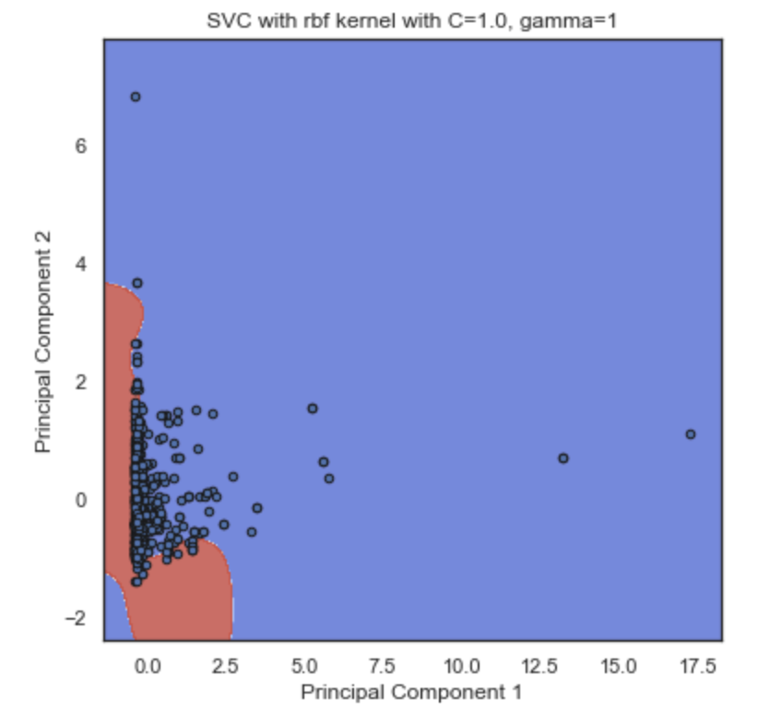
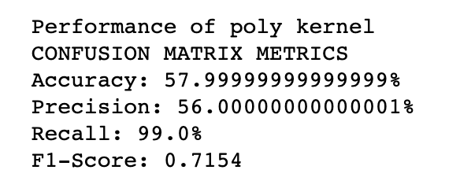
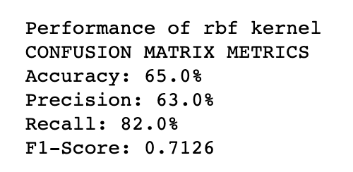
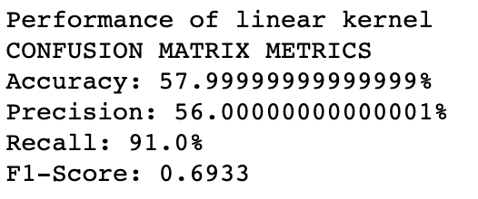
Support Vector Machine
Hyperparameters tuned using grid search: C = 1; gamma = 1 (RBF kernel) Data normalized to a Z-distribution
(least overfitted)
Notes:
Best was linear kernel
Takes into account overfitting.
Reminder: for RBF kernel the GAMMA param defines how “constrained” the decision the decision boundary becomes

Slide 21
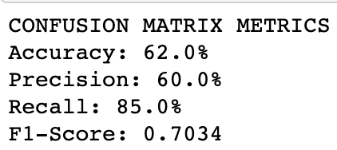
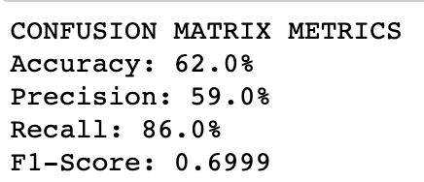
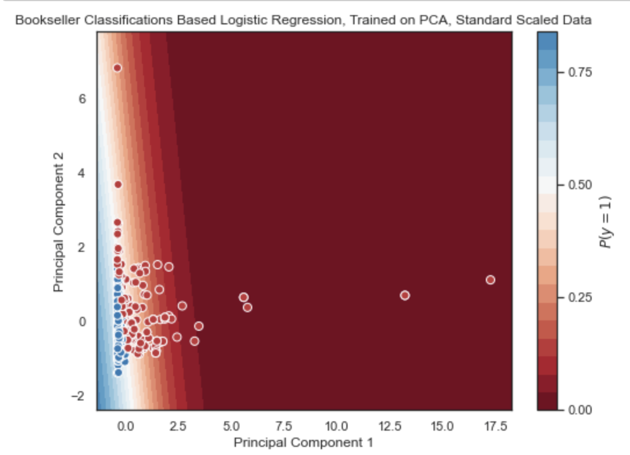
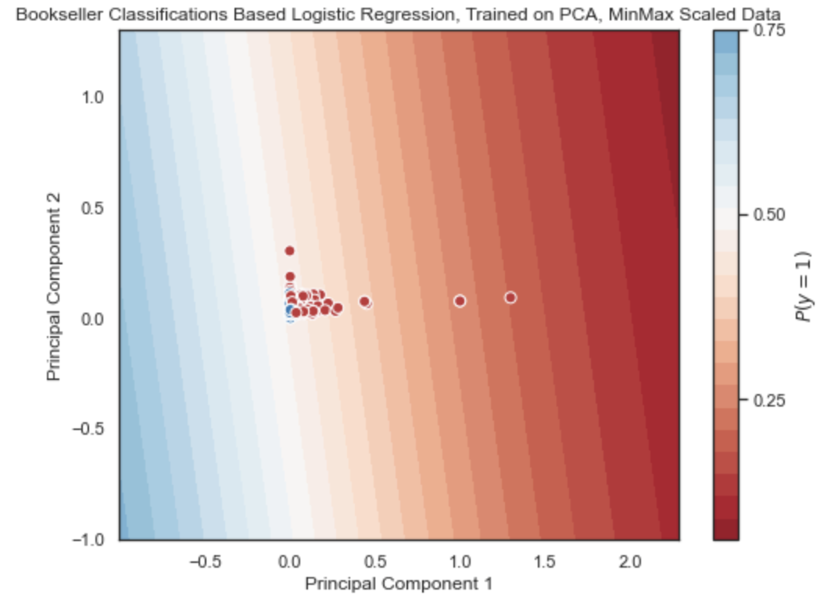
Logistic Regression
Conclusions: - Best results on PCA components, normal distribution - Slight decrease in Recall, increase in F1-score from MinMax
Notes:
Takes into account overfitting.
Log Reg did better than the SVM, possibly because the probabilities are CRUCIAL to making a decision in a dataset like this
On the same note, the model performed better on Standard Scaled data than on MinMax for most models, possibly because SS does a better job at preserving the little variance in our dataset, whereas MinMax is more like just trying to shove the entire distribution between 0 and 1, as much as possible (loses information about outlier, loses variance, etc.)

Slide 22
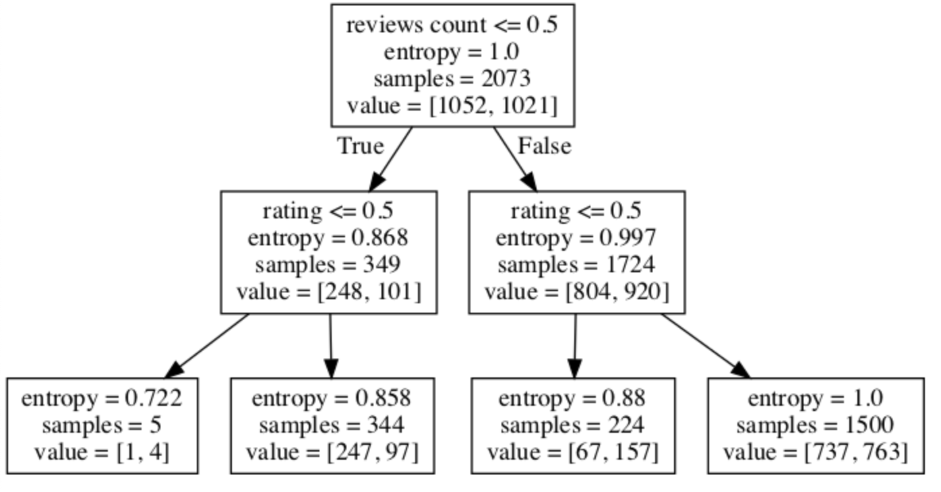
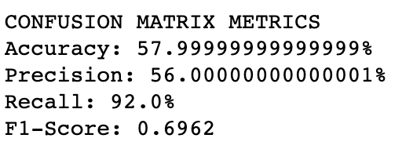
Decision Tree
Problems in binarizing the data, because the ranges were very similar (lack of variance to begin with)
No Scaling Applied, all categorical values
Feature Importance:
Review Count
Rating
Price
Notes:
Takes into account overfitting.

Slide 23
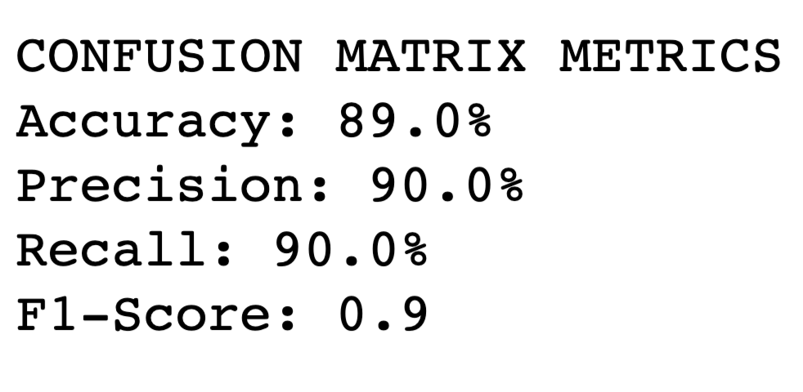
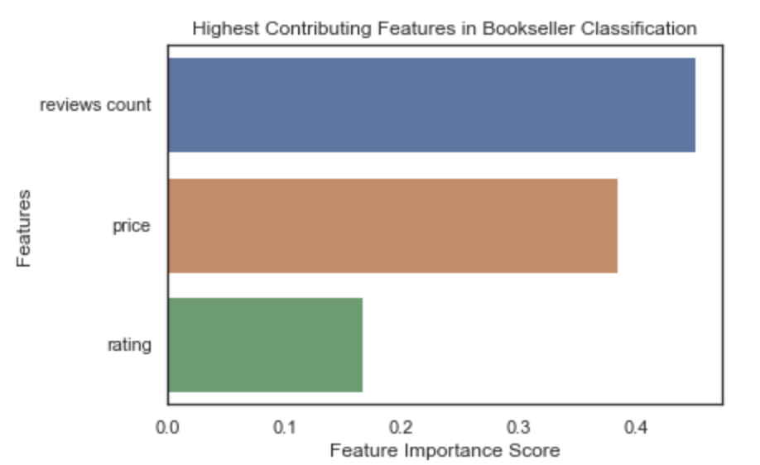
Random Forest
NO modification applied to dataset
Scaling, binarizing, PCA, etc.
100 Estimators
Feature Ranking Differences from 1 decision tree
Better results than 1 decision tree!

Slide 24
Final Conclusions
Cross Validation
Conclusions/Future Improvements

Slide 25
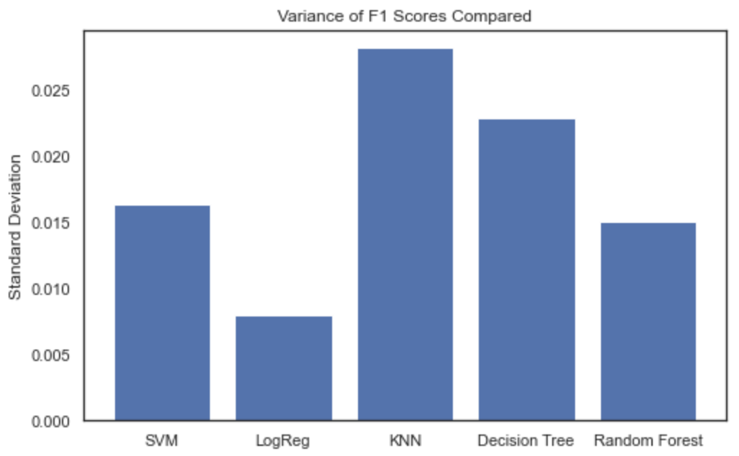
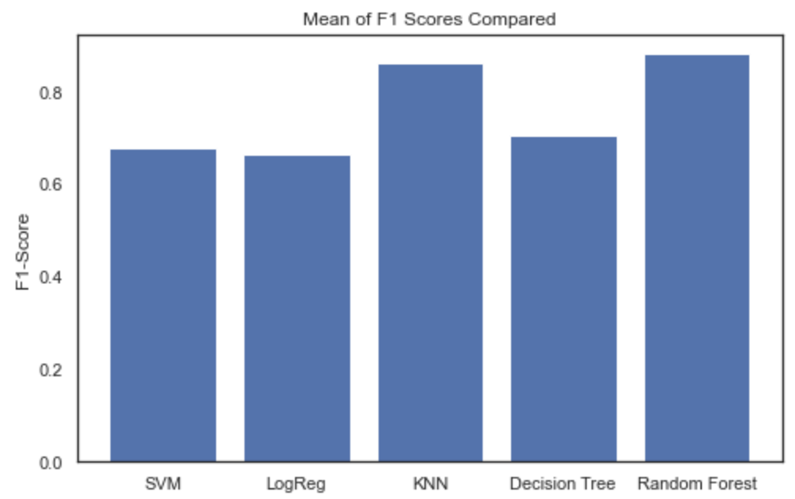
Cross Validation
Using 5 fold cross validation, the Logistic Regression model showed the least variance in its F1-Score.
The K-Nearest Neighbors classifier showed the highest mean F1-Score.
Notes:
Takes into account overfitting.

Slide 26
Final Conclusion/Future Improvements
Most Accurate: Logistic Regression (F1-Score: .7034; Accuracy: 62%)
i.e. Approx. 62% of a random guess for the bookseller being correct
Highest Contributing Feature:
Number of reviews, based upon Random Forest
May be attributed to difference in size of user base
Future Improvements
Experiment on a dataset of books exclusively sold on Amazon/Flipkart
Feature engineering to improve Random Forest

