Slide 1


UQCS Competitive Programming Group Week 4

Slide 2
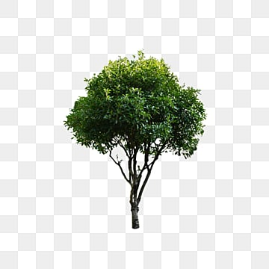
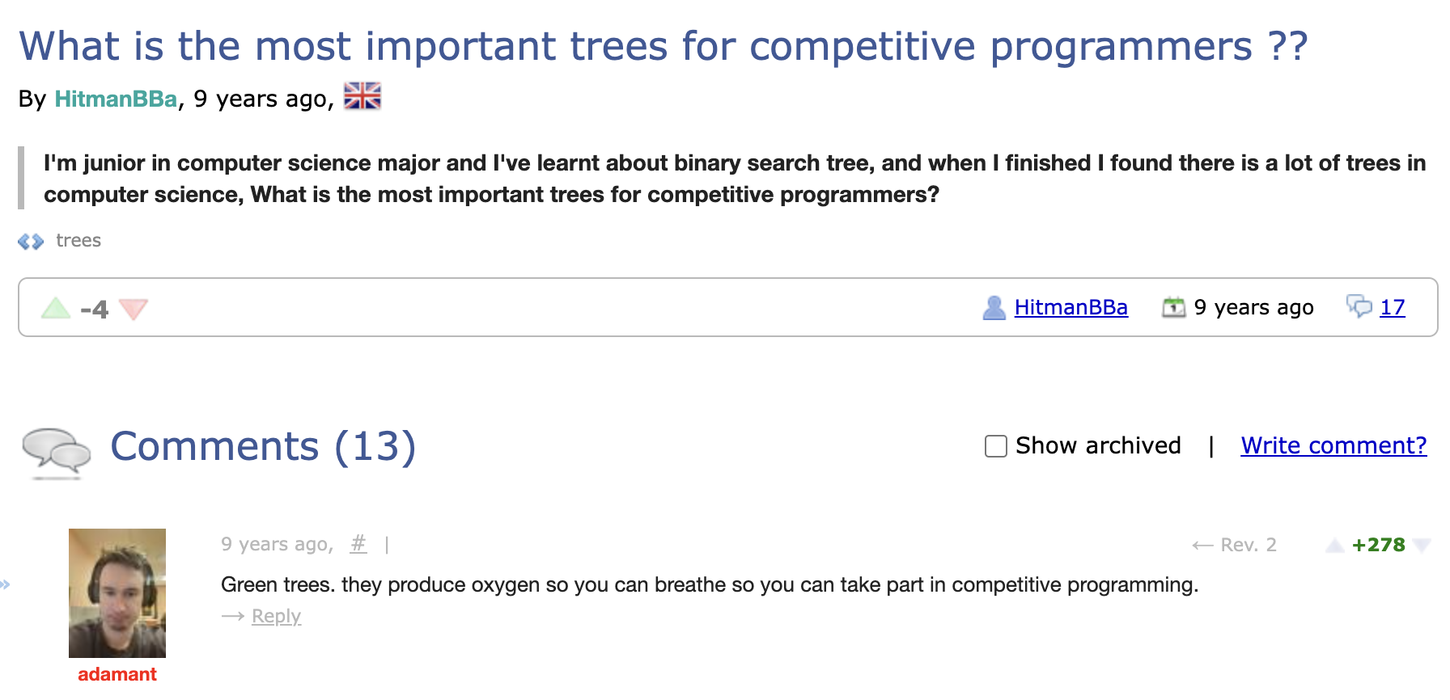
Today’s topic: Trees
https://codeforces.com/blog/entry/17679

Slide 3
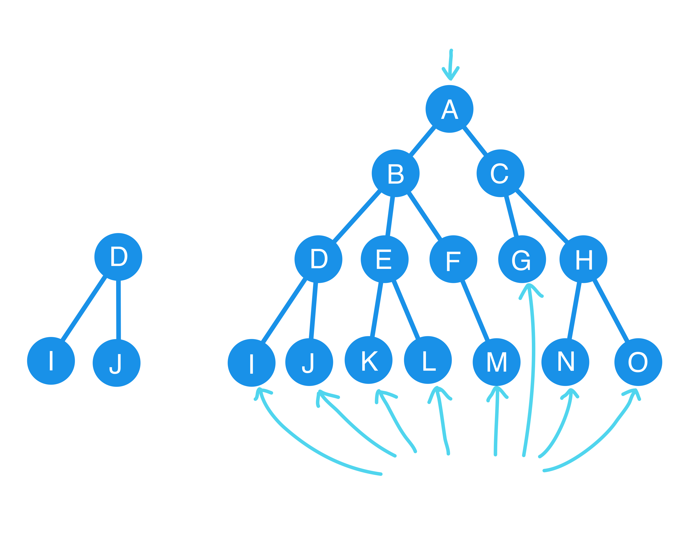
Tree Terminology
Keys
Level 0
Edges
Level 1
Parent
Level 2
Level 3
Children
Left subtree of B

Slide 4
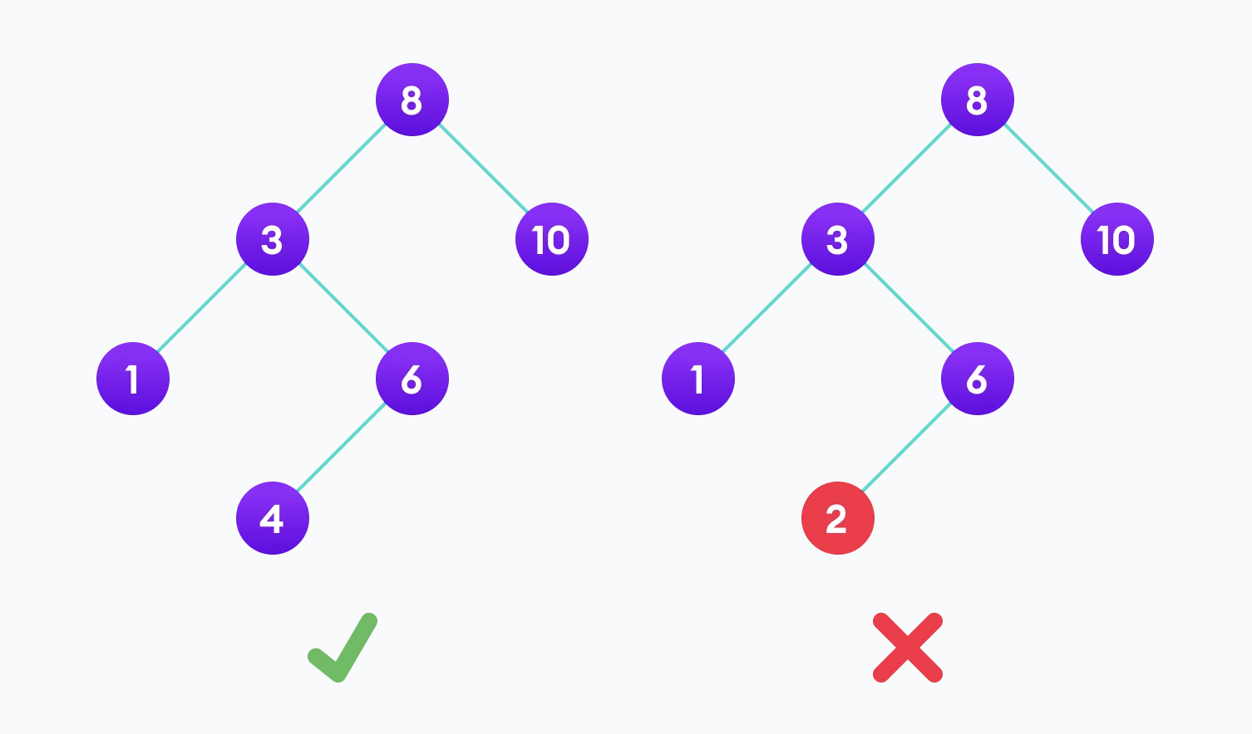
Binary Search Trees
Each node can have at most 2 children
All descendants from a node’s left edge must contain a value less than the node
All descendants from a node’s right edge must contain a value greater than the node
search space is reduced by half each step
Time complexity: O(log(n))
Image from: https://www.programiz.com/dsa/binary-search-tree
Notes:
Jokes aside, tree are some of the most important data structure in competitive programming

Slide 5
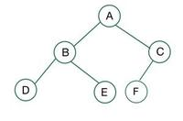
Complete tree
a special type of binary tree where all the levels of the tree are filled completely except the lowest level nodes which are filled from as left as possible.
Image from: https://www.geeksforgeeks.org/complete-binary-tree/

Slide 6
Array Representation of Binary Tree

