Slide 1
Rainfall Prediction System
Ubaid Qayyum FA22-BCE-015
Muhammad Hamza FA22-BCE-044

Slide 2
Outline
Introduction
Literature Review
Proposed Solution
Results
Teamwork / Tasks Division
Conclusion

Slide 3
Introduction
Rainfall prediction is essential for agriculture, water management, and disaster preparedness. Traditional methods rely on complex atmospheric models. This project, "Rainfall Prediction System," uses AI and Machine Learning to predict rainfall based on historical weather data, offering a simple yet effective tool for decision-making.
Aims and Objectives:
To develop a reliable rainfall prediction system using Machine Learning techniques.
To preprocess and utilize historical weather data effectively for model training.
To compare the performance of Logistic Regression and Random Forest Classifier models.
To provide an easy-to-use interface for users to predict rainfall based on input parameters.
To enhance accessibility by designing a lightweight system suitable for low-resource environments.

Slide 4
Literature Review/ breakdown of the problem
Rainfall prediction has been approached using various methods, each with its own strengths and limitations:
Traditional Meteorological Models: Utilize atmospheric physics and large-scale simulations but require substantial computational resources.
Time-Series Analysis: Techniques like ARIMA (Auto-Regressive Integrated Moving Average) focus on historical data patterns but may lack robustness for multi-variable datasets.
Machine Learning Approaches:
Logistic Regression: Offers a straightforward method to model relationships between variables but struggles with complex, non-linear interactions.
Random Forest Classifier: Provides superior accuracy by combining multiple decision trees, making it well-suited for handling imbalanced and categorical data.
Deep Learning Models: Advanced methods like RNNs (Recurrent Neural Networks) and LSTMs (Long Short-Term Memory networks) excel in capturing temporal dependencies but are computationally expensive and require large datasets.

Slide 5
Proposed Solution/Methodology
The system uses Logistic Regression and Random Forest Classifier for accurate rainfall prediction. Key steps include:
Data Preprocessing: Handling missing values with imputation and encoding categorical variables.
Feature Scaling: Standardizing variables for consistent model performance.
Model Training: Employing Linear Regression as a baseline and Random Forest for improved accuracy and handling imbalanced data.
Prediction Interface: Users input weather parameters to receive rainfall predictions.

Slide 6
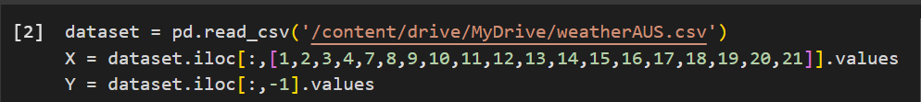
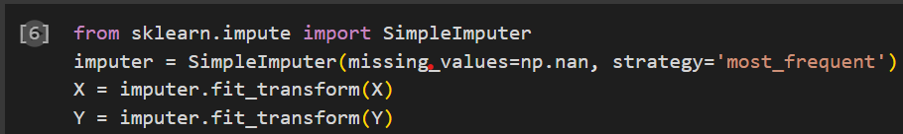
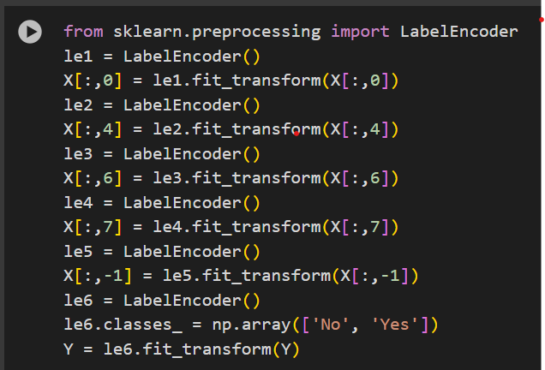
Code:
Importing Dataset:
Dealing with Invalid Data:
Encoding Dataset:

Slide 7
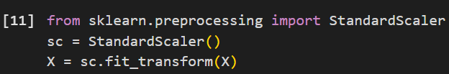
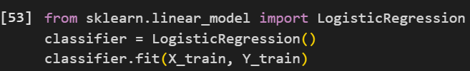
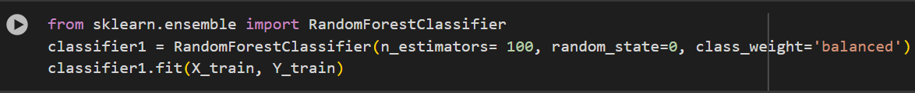
Feature Scaling:
Splitting Dataset into training and testing sets
Training MODEL using Logistic Regression and Random-forest Classifier

Slide 8
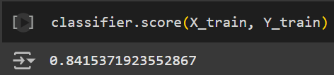
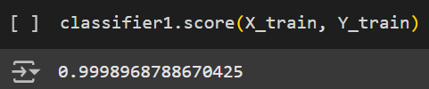
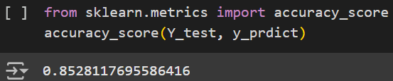
Results
Data used = weatherAUS.csv and downloaded from Kaggle website.
Random Forest Accuracy: Achieved over 96% on training data and robust performance on test data.
Logistic Regression Accuracy: Achieved 84.15% on training data.
Simulation results:
Training results:% of data is trained successfully
Accuracy score:(Random forest classifier)

Slide 9
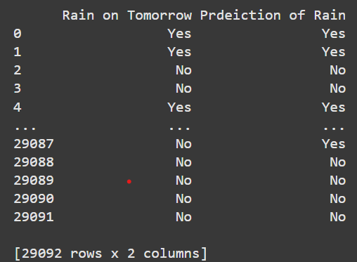
Comparison b/w Actual and Predicted data

Slide 10
Teamwork/Tasks Division
Interface Design: [Team Member D]
Data Preprocessing: Muhammad Hamza(provided the dataset)
Model Development: Ubaid Qayyum
Evaluation: Ubaid Qayyum
Interface Design: Ubaid Qayyum
Documentation: Muhammad Hamza
Regular coordination ensured project milestones were met.

Slide 11
Conclusion
This system demonstrates the utility of AI in rainfall prediction with a focus on simplicity and accuracy. Future work could include advanced algorithms, broader weather predictions, and real-time updates, further enhancing its impact in meteorology.

