Slide 1
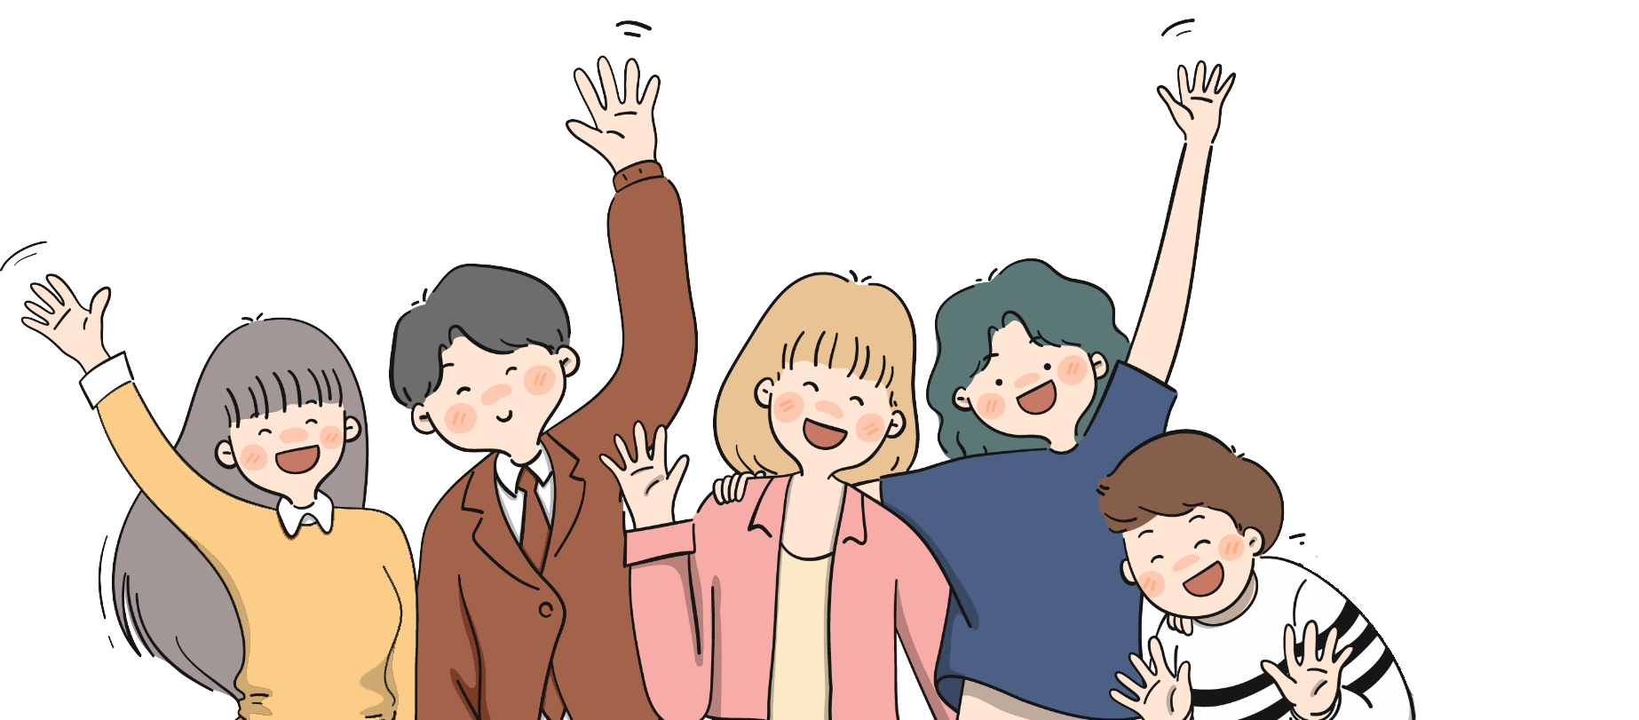
01
Team Profile
Boyu Peng
Shuo Zheng
Wenxin Dong
Wenrui Jiang
Pinduan Zhou

Slide 2
02
Domain and Problem
Better balanced nutrition for people
Domain
Aim
Urging people to adopt healthier eating habits
Domain Introduction
Problem
Setting nutritional goals for various types of daily needs for users based on different user information through calculations and other means. The application intelligently calculates the nutrient content of each type of food and reminds and urges users to consume the missing nutrients. Provide food recommendations and preparation methods for different users. This will help users to develop healthier eating habits.
Dietary habits lead to nutrient deficiencies
Unaware of the amount of nutrients needed on a daily basis
Lack of clarity about which foods provide needed nutrients
Lack of guidance on how to cook

Slide 3
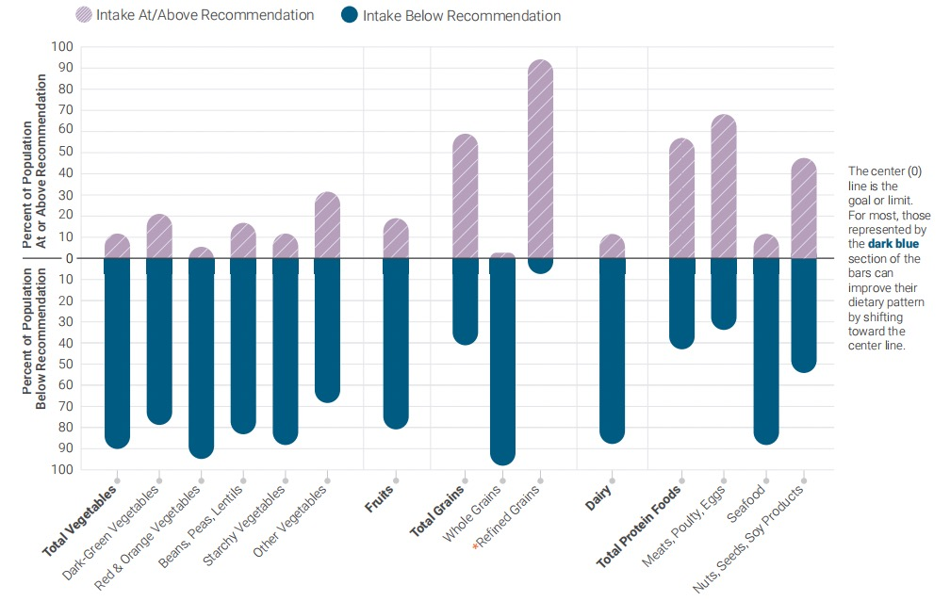
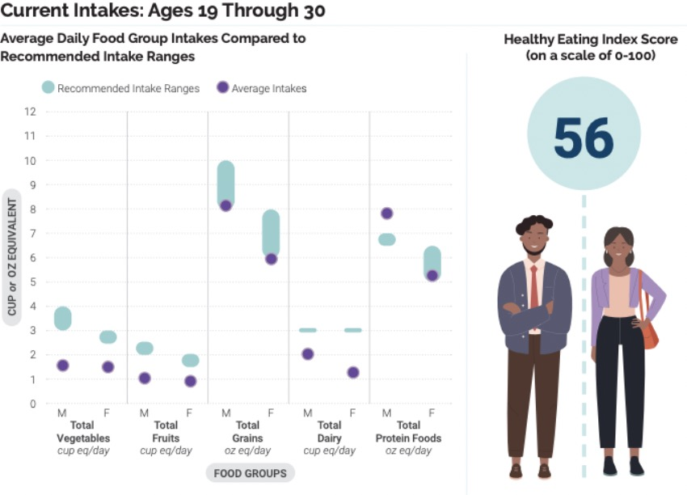
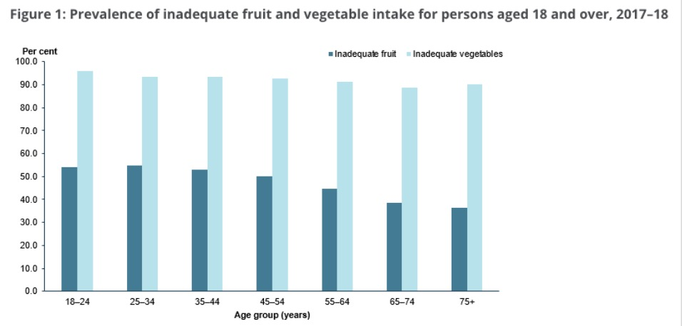
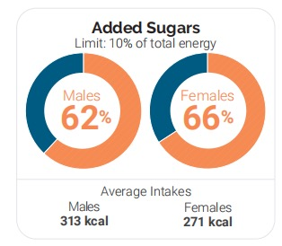
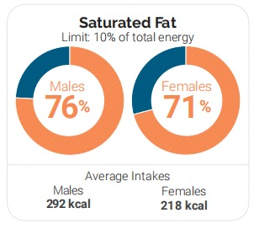
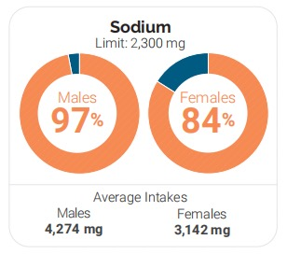
Evidence of design
More than 80 percent have dietary patterns that are low in vegetables, fruits, and dairy.
More than half of the population is meeting or exceeding total grain and total protein foods recommendations,
but are not meeting the recommendations for the subgroups within each of these food groups.
Based on self-reported data from the Australian Bureau of Statistics (ABS) 2017–18 National Health Survey (NHS), 1 in 2 people aged 18 and ove (49%) did not eat the recommended 2 serves of fruit, while over 9 in 10 (92%) did not eat the recommended 5–6 serves of vegetables (ABS 2018).
Poor diet, Poor diet in adults. (2019, July 19). Australian Institute of Health and Welfare. https://www.aihw.gov.au/reports/food-nutrition/poor-diet/contents/poor-diet-in-adults

Slide 4
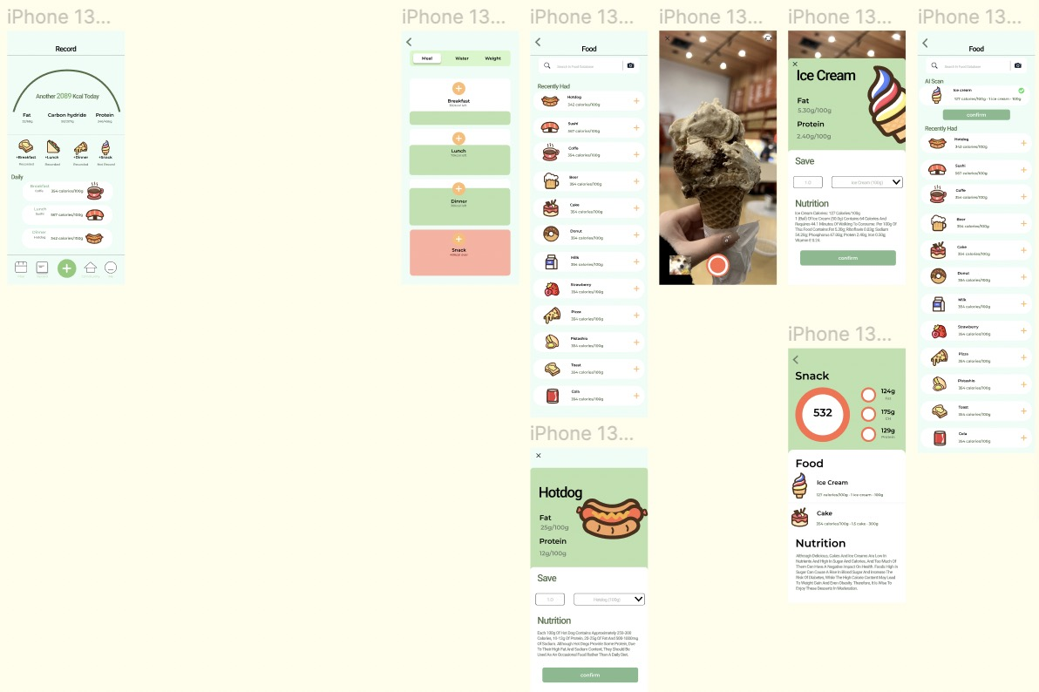
Design Opportunities
Shopwell
z
Personalised Nutritional Advice
ShopWell is designed to help users make healthier food choices by providing targeted food ratings and recommendations.
Users enter personal information (e.g. age, gender, weight, activity level, etc.) and the app provides them with customised nutritional intake recommendations.
Previous attempts in this area
Food diary and automated nutritional analysis
Users can record their daily food intake, which the app automatically analyses and provides detailed nutritional information. Visual charts and statistics are provided to show the user's intake trends.
Smart Recipe Recommendations
Recommend healthy recipes for users based on their dietary preferences, food allergies and nutritional needs.
Friends/Community
Inspire others by adding like-minded friends or sharing photos of your achievements in the community.

Slide 5
04
Work plan
vv
Design Opportunities
User research
v
vv
Competitive Analysis
Conducting a literature study/ background research
v
vv
Conceptualisation
User Research
v
vv
Situational analysis
Competitive Analysis
vv
vv
Prototyping
Prototype Testing
vv
User testing
vv
Iterative design

Slide 6
THANKS FOR YOUR WATCHING

