Slide 1

FITNESS
MOVEMENT
Team Introduction
Yuqing Zhang: Project manager
Our team consists of three undergraduate students and two graduate students. We come from the same major, which allows us to have more common words.
Our team has experienced interaction designers as well as all of us have a good foundation in computers, which makes us design products that will have a better future.
Anqi Zhang: UI/UX designer
Kang Liang: Front-end prototype engineer
Xinyu Qiu : Interaction Designer
Wenyu Wang: Back-end development
Notes:
Introduce the team and combined team strengths
Good morning everyone, let me introduce out team members first. Our team members are Zhang Yuqing, Zhang Anqi, Liang Kang, Qiu Xinyu and Wang Wenyu. Our team consists of three undergraduate students and two graduate students. We came from the same major, which allows us to have more common words. Our team has experienced interaction designers as well as all of us have a good foundation in computers, which makes us more efficient when designing products and communicating with each other.

Slide 2
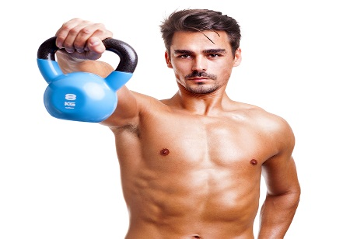
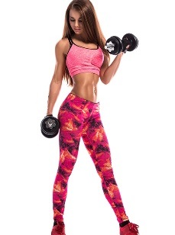
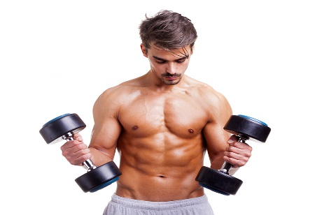
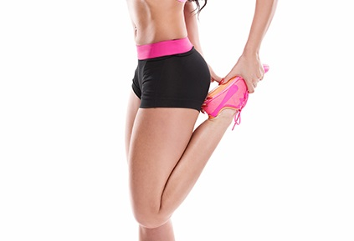
FITNESS
MOVEMENT
Domain/Problem Space
Aim
The main direction of this design is to provide people with a comprehensive health management solution to help them better manage their health and exercise programs. Based on this need, we plan to design a system consisting of software and hardware to motivate and monitor users' health.
Problem Space
Some people are having difficult problems in the gym. These problems include
A lack of user motivation
Difficulty maintaining a regular exercise routine
Uncertainty about goal setting and planning
The importance of controlling eating habits cannot be underestimated in health management. This requires users to engage in regular exercise and diet control.
Notes:
Our domain is about healthy management of exercise plans。
In modern life, more and more people begin to pay attention to health and exercise. However, busy schedules and life stresses make health programs complicated and difficult to manage. The goal of our project is to address these challenges through a user-friendly application.
The main direction of this design is to provide people with a comprehensive health management solution to help them better manage their health and exercise programs. Based on this need, we plan to design a system consisting of software and hardware to motivate and monitor users' health.
Some people are having difficult problems in the gym. These problems include a lack of user motivation, difficulty maintaining a regular exercise routine, and uncertainty about goal setting and planning. Also, the importance of controlling eating habits cannot be underestimated in health management. This requires users to engage in regular exercise and diet control.

Slide 3

FITNESS
MOVEMENT
Design Opportunity & Audience
Healthy exercise management platform specialized for users of different age groups
Audience
Help them better manage their health needs.
People who need to exercise
Assist users in more effectively managing their health conditions, improving their health outcomes, and enhancing their quality of life.
Integrating customized workout plans.
Notes:
Design opportunity:
The design opportunity lies in creating a specialized health and exercise management platform application tailored for users of different age groups. This can help them better manage their health needs. By integrating customized workout plans, the platform can assist users in more effectively managing their health conditions, improving their health outcomes, and enhancing their quality of life.
Target users:
People who need to exercise

Slide 4


FITNESS
MOVEMENT
Concepts
& Previous attempts
Concepts
In this application, users can record fitness data. And share. Users have personality settings in fitness and eating due to different requests having different exercise programs and dietary advice. In the social part, users can choose which part they want to share and which part
They want to hide. With this application, people can fit together to increase motivation.
Today, numerous fitness apps assist users in health management and workouts. Yet, many quit due to low motivation. Thus, adding social features is vital. These foster connections, share progress, and encourage competition. Users gain support, advice, reminders, and motivation within the community, sustaining their commitment. In short, such features enhance app dimensions, boost motivation, and retain users, creating a supportive fitness environment.
Previous attempts
Notes:
Concept
In this application, users can record fitness data. And share. Users have personality settings in fitness and eating due to different requests having different exercise programs and dietary advice. In the social part, users can choose which part they want to share and which part
They want to hide. With this application, people can fit together to increase motivation. And have a better body.
Previous Attempts:
Today, a plethora of fitness apps have emerged on the market, aimed at assisting users in managing their health and creating workout plans. However, many people abandon their efforts early on due to a lack of motivation. Therefore, incorporating social features into health management apps has become particularly crucial. Such social features not only establish close connections and a collaborative atmosphere among users but also allow them to share their progress, mutually boost their sense of achievement, and inspire friendly competition. Additionally, users can gain support, receive advice, and be regularly reminded and motivated within the community, thereby maintaining their commitment to their workout plans. In summary, the introduction of social features adds multiple dimensions to health management apps, enhances user motivation, and increases user retention. It creates a positive and mutually supportive fitness environment for users.

Slide 5
FITNESS
MOVEMENT
Plan of Work
User testing is crucial as a practical means to validate the usability and effectiveness of the product. By observing real users interacting with our product, we can discover any usability issues, glitches, or points of confusion that may arise during their usage.
Adopt a comprehensive approach to enhance the quality of our product, which includes interviews and user testing.
Directly interact with our target audience, gaining their valuable insights to understand their thoughts, expectations, and areas of concern. Through open dialogue, we can delve deeply into their experiences, comprehend their motivations, and identify areas that need improvement and innovation.
First hand feedback provides us with invaluable guidance that can be used to optimise the user interface, simplify processes, and enhance overall user satisfaction.
Notes:
Plan of Work & Methods for Discovery:
In the future, we will adopt a comprehensive approach to enhance the quality of our product, which includes interviews and user testing. These methods are key steps in refining and optimising our product to ensure a precise match with user needs and preferences. Conducting interviews will enable us to directly interact with our target audience, access their valuable perspectives to understand their thoughts, expectations, and areas of concern. Through open communication, we can gain insight into their experiences and understand their motivations to identify areas for improvement and innovation.
On the other hand, user testing plays a crucial role as a practical approach to confirm the product's usability and effectiveness. By observing real users interacting with our product, we can identify any usability issues, problems, or areas of confusion that may occur during their experience. This first-hand feedback provides us with valuable guidance to optimize the user interface, simplify processes, and enhance overall user satisfaction.
Summary
The Healthy Management of Exercise Plans Applications project aims to provide users with an integrated health management solution to enable them to better manage their health and exercise goals. Through these efforts, we hope to create a supportive, convenient and customized health experience solution. Thank you.

Slide 6
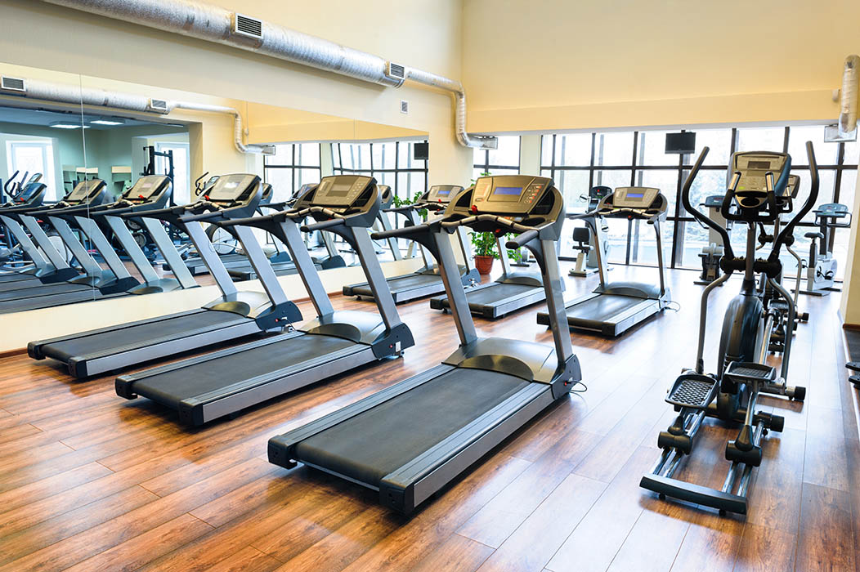
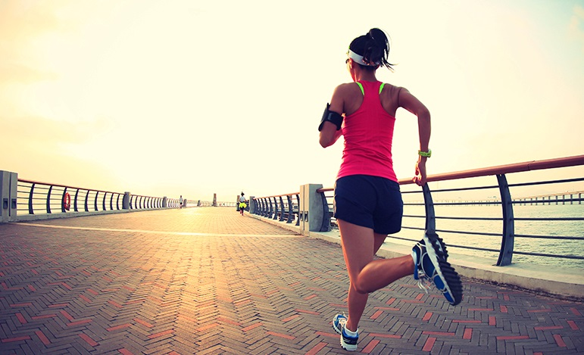
Reference
Weight Loss Exercise Fitness Theme PPT Templates. (n.d.). https://www.ypppt.com/article/2016/3067.html

