Slide 1
Part II: Communication Tools and Cloud Services Available in UTokyo
Information Session on ICT Systems and Tools for UTokyo Members (Conducted in English)
Presenter: SATO Hiroya
Senior Staff,
Digital Transformation Promotion Group, Information Systems Department
Send us questions via slido !
Access via this link or https://sli.do/ and following event code:
utelecon20240913
Please ask questions at any time
before or during the explanation.
Ver 2.50 Last updated on 2024/09/11

Slide 2

Outline
Part II: ICT Systems and Tools Available in UTokyo
Zoom and Tools for Online Meeting
UTokyo Slack
ECCS Cloud Email (Google)
UTokyo Microsoft License
Generative AI
How to Get Supported
Send us questions via slido !
Access via this link or https://sli.do/ and following event code:
utelecon20240913
Please ask questions at any time
before or during the explanation.

Slide 3
Zoom
Zoom and Tools for Online Meeting
UTokyo Slack
ECCS Cloud Email (Google)
UTokyo Microsoft License
Generative AI
How to Get Supported
Send us questions via slido !
Access via this link or https://sli.do/ and following event code:
utelecon20240913
Please ask questions at any time
before or during the explanation.

Slide 4
Zoom
Tools for online meetings, most popular in UTokyo.
Various functions are available during meetings.
screen sharing
internet chat
breakout room
Divide the meeting into several small rooms during the meeting (e.g., for group work)
voting
For simple surveys, quizzes, etc.
When you simply join an informed Zoom meeting, no licensed account required.

Slide 5
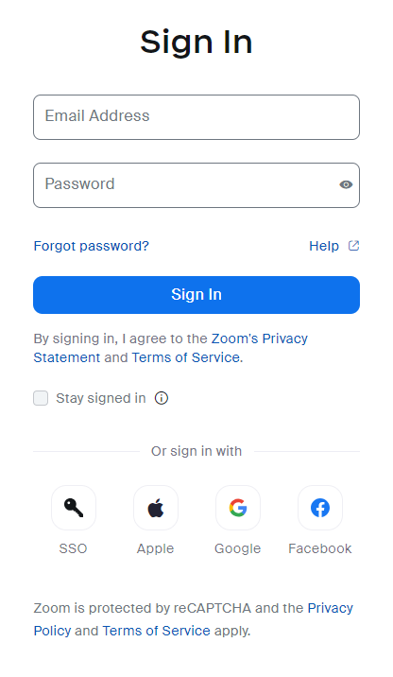
Sign in Your Licensed Zoom Account
Do not use fields on the sign-in screen.
Go directly to this URL: https://u-tokyo-ac-jp.zoom.us/profile (Bookmark this URL!)
Recommended
Unless you have already signed in to your UTokyo Account, the sign-in page will be displayed. Please sign in.

Slide 6
Sign in Your Licensed Zoom Account
Do not use fields on the sign-in screen.
Go directly to this URL: https://u-tokyo-ac-jp.zoom.us/profile (Bookmark this URL!)
Or access via SSO (Single Sign-On) button on the sign-in screen.
Recommended

Slide 7
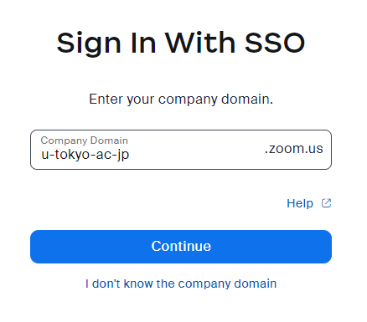
Sign in Your Licensed Zoom Account
Go directly to this URL: https://u-tokyo-ac-jp.zoom.us/profile (Bookmark this URL!)
Or access via SSO (Single Sign-On) button on the sign-in screen.
Input u-tokyo-ac-jp as Company Domain and continue.
Recommended
↑
↑
Not periods(.), but hyphens(-)
Unless you have already signed in to your UTokyo Account, the sign-in page will be displayed. Please sign in.

Slide 8
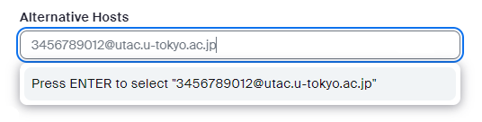
Zoom Use Cases and Tips
The basic usage is the same as for Zoom in general public.
When you assign alternative hosts, use their UTokyo Account.
Meetings that only members can attend is not common in UTokyo.
Sometime students attend online classes without signing in.
So please keep in mind not to spread information carelessly.
10-digit number and “@utac.u-tokyo.ac.jp”

Slide 9
Zoom Use Cases and Tips
You need to be licensed exclusively in advance when you…
Host meetings with more than 300 participants.
Host webinars.
→ Please submit the application form in advance.
Please delete your recordings that you no longer need!
UTokyo’s overall storage capacity is strained.

Slide 10
Webex
Zoom and Tools for Online Meeting
UTokyo Slack
ECCS Cloud Email (Google)
UTokyo Microsoft License
Generative AI
How to Get Supported
Send us questions via slido !
Access via this link or https://sli.do/ and following event code:
utelecon20240913
Please ask questions at any time
before or during the explanation.

Slide 11
Webex
Tools for online meetings
Particularly suitable for large-scale online conferences or webinars.
e.g., customizable registration screens
You can host webinars without application in advance.

Slide 12
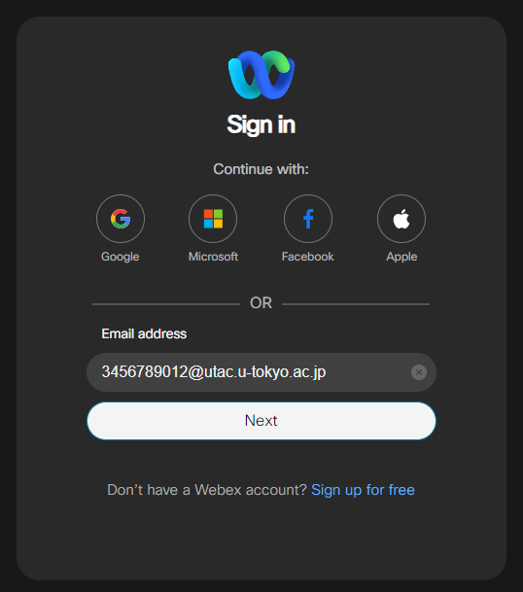
Sign in Your Licensed Webex Account
Enter your UTokyo Account to the Email Address field and go Next.
10-digit number and “@utac.u-tokyo.ac.jp”
Unless you have already signed in to your UTokyo Account, the sign-in page will be displayed. Please sign in.
https://signin.webex.com/signin

Slide 13
Slido
Zoom and Tools for Online Meeting
UTokyo Slack
ECCS Cloud Email (Google)
UTokyo Microsoft License
Generative AI
How to Get Supported
Send us questions via slido !
Access via this link or https://sli.do/ and following event code:
utelecon20240913
Please ask questions at any time
before or during the explanation.

Slide 14
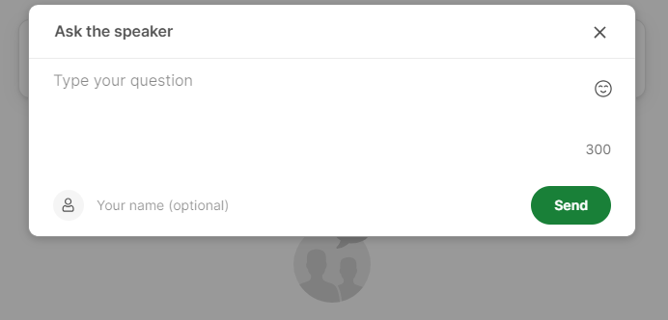
Slido
Q&A and polling platform for meetings and events
Create a page like a bulletin board for each event
Allows anonymous questions to be asked and answered by moderators
Also being used in today’s session!
Send us questions via slido !
Access via this link or https://sli.do/ and following event code:
utelecon20240913
Please ask questions at any time
before or during the explanation.

Slide 15
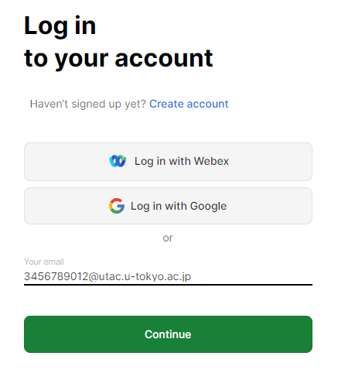
Log in Your Licensed Slido Account
zoom
Enter your UTokyo Account to the Your email field and Continue.
10-digit number and “@utac.u-tokyo.ac.jp”
You can also log in from here
Unless you have already signed in to your UTokyo Account, the sign-in page will be displayed. Please sign in.
https://admin.sli.do/events

Slide 16

UTokyo Slack
Zoom and Tools for Online Meeting
UTokyo Slack
ECCS Cloud Email (Google)
UTokyo Microsoft License
Generative AI
How to Get Supported
Send us questions via slido !
Access via this link or https://sli.do/ and following event code:
utelecon20240913
Please ask questions at any time
before or during the explanation.

Slide 17
Slack and its Environment in UTokyo
Slack: platform for messaging and collaboration
Collaboration within a team called “workspace”
UTokyo provides an enterprise environment under the name “UTokyo Slack.”
Functionality for paid workspaces is available to UTokyo members.
Some differences between the standard Slack workspaces.

Slide 18
Join UTokyo Slack Workspace
Access UTokyo Slack
“Sign in with UTokyo Account”
Review the Terms of Service
Open Workspaces in UTokyo Slack
Choose a workspace you will join
https://utokyo.enterprise.slack.com/
Unless you have already signed in to your UTokyo Account, the sign-in page will be displayed. Please sign in.
CAUTION
You must have completed Information Security education
You must have activated Multi-Mactor Authentication (MFA)
(Only when you first activate UTokyo Slack)
About these, see also:
PART I

Slide 19
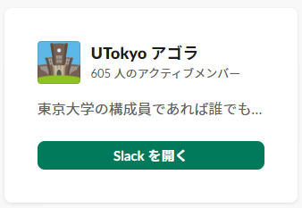
Join UTokyo Slack Workspace
Access UTokyo Slack
“Sign in with UTokyo Account”
Review the Terms of Service
Open Workspaces in UTokyo Slack
Choose a workspace you will join
You can view workspaces you can join directly or send request to join.
(Hidden workspace that you are invited to by the workspace manager will also be listed.)
(Only when you first activate UTokyo Slack)
About these, see also:
PART I
For example, “UTokyo Agora” Workspace is open to all UTokyo Students, Faculy and Staff. Feel free to join us!

Slide 20
Join UTokyo Slack Workspace
Change profiles when you first activate UTokyo Slack.
The “Display Name”, displayed as your name in messages, is initially set as the 10-digit number of your UTokyo Account.
It is recommended that you set a name appropriately that others can recognize.
Profiles are universal across all UTokyo Slack workspaces and cannot be customized differently for each workspace.
The procedure for changing your profile is as follows (if you are using a PC).
Press the icon in the lower left corner of the workspace screen
Select “Profile” from the menu that appears
Click on the “Edit” button to the right of your name
Make changes and press the “Save Changes”

Slide 21

Features of UTokyo Slack Workspaces
Standard Slack Workspaces
Enterprise Grid Workspaces
WS
#channel_a
#channel_b
Direct Messages
UTokyo Slack
(Enterprise Grid)
Workspace A
Workspace A
#channel_a
#channel_b
Workspace B
#channel_a
#channel_b
Wordspace C
#channel_a
#channel_b
Direct Messages (unified)
WS
#channel_a
#channel_b
Direct Messages
Workspace B
WS
#channel_a
#channel_b
Direct Messages
Workspace C

Slide 22
Create Workspaces
Faculty and staff can create workspaces (Students cannot)
See the guidance page for more information and to follow the instructions.
Types of workspaces
After create workspace, invite members with UTokyo Account.
You must know the 10-digit number of UTokyo Account of the member you are inviting to the workspace.
 | Shown on the Workspaces List | Users can join by themselves | Users can send request to join | Owner can send invitation to users
Open | 〇 | 〇 | ― | 〇
By Request | 〇 | × | 〇 | 〇
Invite Only | 〇 | × | × | 〇
Hidden | × | × | × | 〇

Slide 23

Intermediate Tips on UTokyo Slack
Slack Connect
Collaboration on UTokyo Slack with people who are not UTokyo members.
Slack “Guest” feature is not available on UTokyo Slack.
Create a channel to be shared between a UTokyo Slack workspace and another external Slack workspaces.
UTokyo Slack workspaces can connect to workspaces using a free Slack license.
Details: https://utelecon.adm.u-tokyo.ac.jp/slack/workspace/connect (* Currently only in Japanese)
UTokyo Slack
(Enterprise Grid)
Shared
WS
#channel_c
#sample_connected
Direct Messages
Workspace A
#channel_a
#sample_connected
Workspace A

Slide 24
Intermediate Tips on UTokyo Slack
Multi-workspace Channel
Create a channel to be shared across multiple UTokyo Slack workspaces.
Slack Connect is not available across multiple UTokyo Slack workspaces.
Please refer to the article on utelecon for more details.
UTokyo Slack
(Enterprise Grid)
#channel_a – Workspace A
#channel_b – Workspace A
#channel_c – Workspace B
#sample_mwsc
↑ Shared across Workspace A and B

Slide 25
Microsoft Teams
Zoom and Tools for Online Meeting
UTokyo Slack
ECCS Cloud Email (Google)
UTokyo Microsoft License
Generative AI
How to Get Supported
Teams
Send us questions via slido !
Access via this link or https://sli.do/ and following event code:
utelecon20240913
Please ask questions at any time
before or during the explanation.

Slide 26
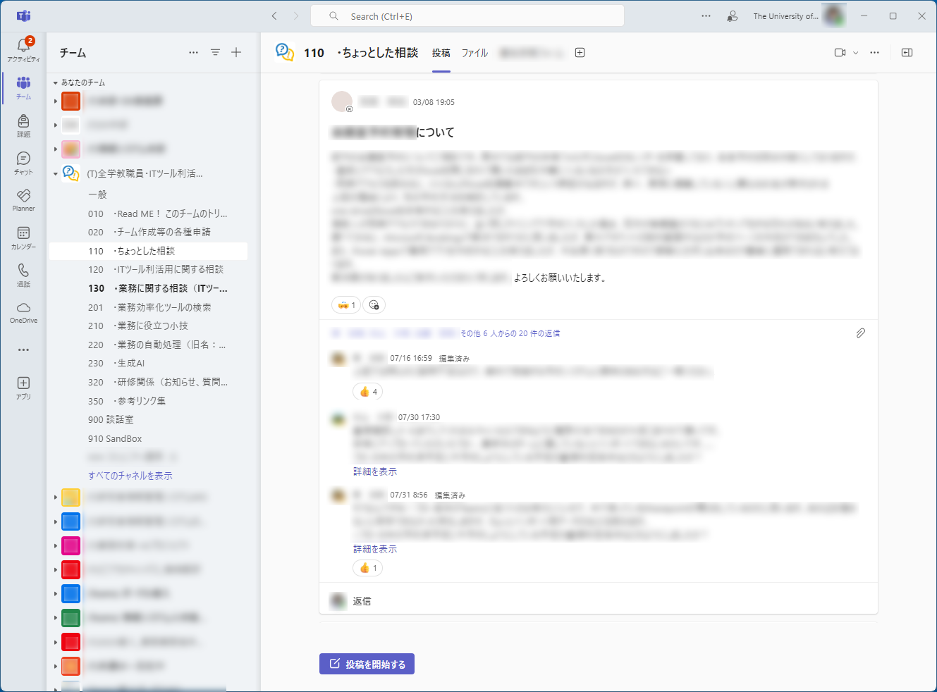
Microsoft Teams
Faculty and staff can also use Microsoft Teams (Students cannot).
Microsoft Teams is widely used by administrative staff.
The administrative department has teams for each section.
Faculty and staff can apply to create their own new teams.

Slide 27
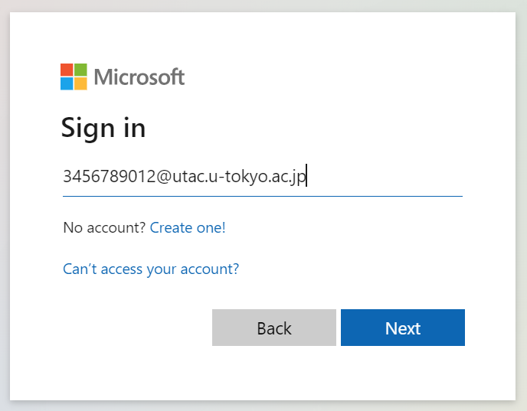
Sign in Your Microsoft Teams Account
Enter your UTokyo Account to the Email, phone or Skype field and go Next.
10-digit number and “@utac.u-tokyo.ac.jp”
Unless you have already signed in to your UTokyo Account, the sign-in page will be displayed. Please sign in.
https://teams.microsoft.com/

Slide 28
ECCS Cloud Email (Google)
Zoom and Tools for Online Meeting
UTokyo Slack
ECCS Cloud Email (Google)
UTokyo Microsoft License
Generative AI
How to Get Supported
Send us questions via slido !
Access via this link or https://sli.do/ and following event code:
utelecon20240913
Please ask questions at any time
before or during the explanation.

Slide 29


What is ECCS?
ECCS: Educational Campuswide Computing System
Name of the comprehensive educational system provided by the Information Technology Center
ECCS Cloud Email
Google Workspace for Education as a component of ECCS services

Slide 30


ECCS Cloud Email (@g.ecc.u-tokyo.ac.jp)
Same ease of use as Gmail; the domain is unique to ECCS Cloud Email.
The default email address is 10-digit number + @g.ecc.u-tokyo.ac.jp
You may use this as the default email address, but it is recommended to change your email address to your preferred one in advance.
After you change your email address, emails sent to your default email address will still be delivered to your mailbox.
To: Your Changed Address (the current latest)
To: Your Default Address (with 10-digit number)
Your ECCS Cloud Email Inbox
(Your Changed Address)

Slide 31
ECCS Cloud Email (@g.ecc.u-tokyo.ac.jp)
Even if you do not intend to use this email address regularly, it is recommended to set it up initially.
There are some emails from the system/services that can only be delivered to this email address, such as Zoom, Slack, etc.
You can also set up forwarding to your usual email address.
Forwarding
Email to your ECCS Cloud Email
Your Daily Inbox
(Your another email address)
Your ECCS Cloud Email Inbox

Slide 32
Change ECCS Cloud Email Adresss
Access the UTokyo Account User Menu.
Please note that the username is only a 10-digit number here.
Click “ECCS Cloud Email (mail address)” on the left.
Enter your preferred username (string before @) and click “SAVE.”
Wait for more than 40 minutes.
Username (string before @) Requirements
The characters that can be used lowercase letters, numbers and hyphen: abcdefghijklmnopqrstuvwxyz0123456789-
It cannot be the same as one that is already being used (or has been used in the past) by another user.
There are certain strings that cannot be use due to administrative reasons.
You can change your username as many times as you like, but once your username is changed, you cannot change it again for 30 days.

Slide 33
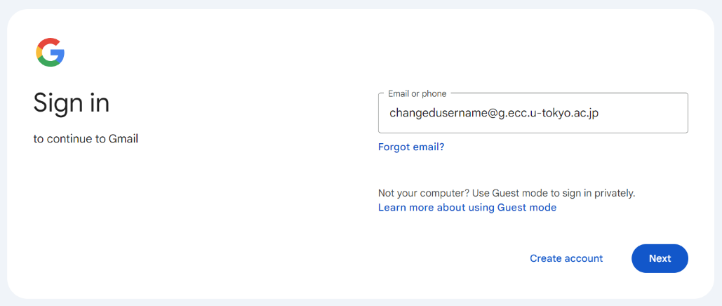
Sign in ECCS Cloud Email (@g.acc.u-tokyo.ac.jp)
Enter your changed email address to the Email or phone field and go Next.
Once you sign in, you can use it with the same ease of use as Gmail.
Unless you have already signed in to your UTokyo Account, the sign-in page will be displayed. Please sign in.
https://mail.google.com/

Slide 34
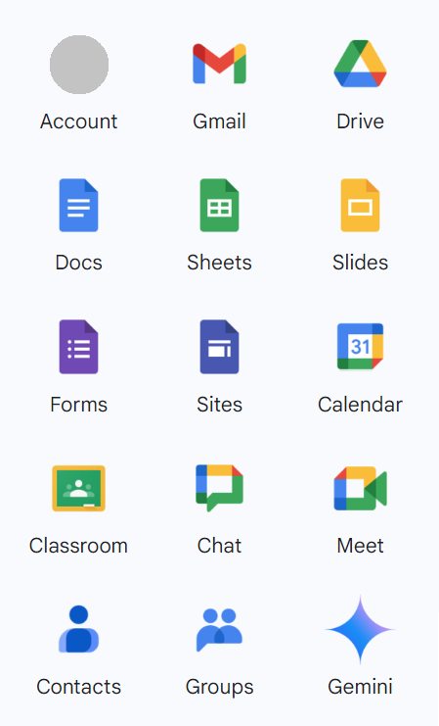
Various Google Services
Gmail – send and receive emails
Calendar – manage and share schedule
Drive – store and share documents on cloud storage
Docs/Sheets/Slides – create and share documents
Forms – create forms and collect answers
Sites – create and publish website
Classroom – Learning Management System
* In principle, it is recommended to use UTOL (c.f. Part III)
Gemini – Generative AI
etc.

Slide 35
Difference with Personal Google Account (@gmail.com)
Gmail
The domain of email address is @g.ecc.u-tokyo.ac.jp
You can change your email address (username)
Google Drive
Document sharing settings can be limited to UTokyo members (ECCS Cloud Email users).

Slide 36
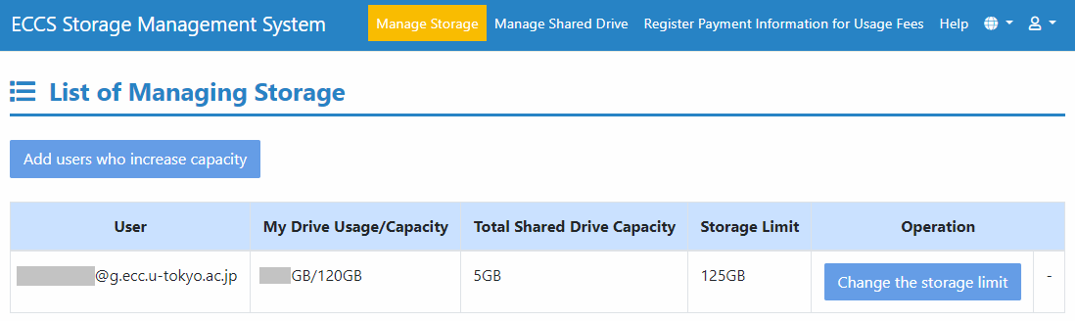
Difference with Personal Google Account (@gmail.com)
You can use up to 125 GB storage as your “My Drive” by default.
You can expand your storage capacity for a fee, using your budget processed through the university’s account (not your private funds).
ECCS Storage Management System
For more information, please check the following page: https://www-old.ecc.u-tokyo.ac.jp/storage_mgt/
* Currently only in Japanese. The URL will be changed shortly, and an English version will be provided.

Slide 37
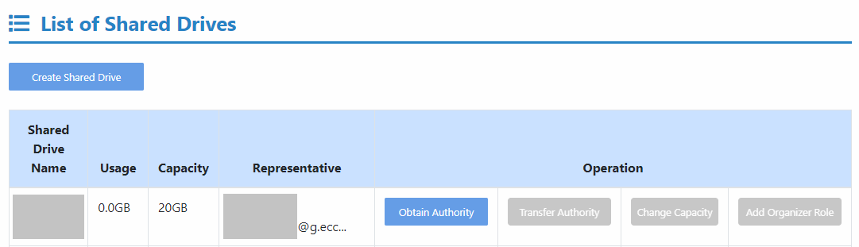
Difference with Personal Google Account (@gmail.com)
Google Drive – How to create and use shared drives
You cannot create a shared drive in the usual way due to the need to manage storage capacity.
Please refer to the article on utelecon for more about Google Shared Drives
If you are an owner of shared drives, the storage allocated to your shared drives will be reduced from your personal drive.
For more information, please check the following page: https://www-old.ecc.u-tokyo.ac.jp/storage_mgt/
* Currently only in Japanese. The URL will be changed shortly, and an English version will be provided.

Slide 38
Possibly Another Google Workspace
Some departments may have their own Google Workspaces apart from ECCS Cloud Email and provide accounts to their members.
If you use more than one Gmail or Google workspace account in addition to ECCS Cloud Email Google Workspace, please switch accounts depending on the situation.
The description here refers to the ECCS Cloud Email Google Workspace, and your department’s workspace may not be the same.
Please contact the person in charge of your department for more information.

Slide 39
UTokyo Microsoft License
Zoom and Tools for Online Meeting
UTokyo Slack
ECCS Cloud Email (Google)
UTokyo Microsoft License
Generative AI
How to Get Supported
Send us questions via slido !
Access via this link or https://sli.do/ and following event code:
utelecon20240913
Please ask questions at any time
before or during the explanation.

Slide 40
Sign in Your Microsoft 365 Account
UTokyo Members are provided Microsoft 365 accounts
Enter your UTokyo Account to the Email, phone or Skype field and go Next.
10-digit number and “@utac.u-tokyo.ac.jp”
Unless you have already signed in to your UTokyo Account, the sign-in page will be displayed. Please sign in.
https://www.office.com/login

Slide 41
Microsoft 365 Services
For Faculty and Staff
(not for Students)
Teams – text chat communication and collaboration
Outlook
Email – UTokyo Staff Email and notices from Microsoft 365 services
Calendar – manage and share schedule
Word/Excel/PowerPoint – create and share documents
OneDrive/ SharePoint – store and share documents on cloud storage
Power Platform – build automate workflows or original applications
Copilot – Generative AI
etc.

Slide 42


Teams and Outlook
(already described about Teams in pp. 25-27)
Outlook (only for faculty and staff)
You can issue a UTokyo Staff Email address for Outlook.
[last name].[first name] @mail.u-tokyo.ac.jp (in principle)
To issue,
access the button below in UTokyo Account User Menu,
log in again with your UTokyo Acccout,
select “ 申請書作成 and ” 職員メール利用申請書.”
For more information, please check the page about the service in UTokyo Portal. (* Currently only in Japanese)
(Submit Applications)
(Staff Email Issuance Application)

Slide 43
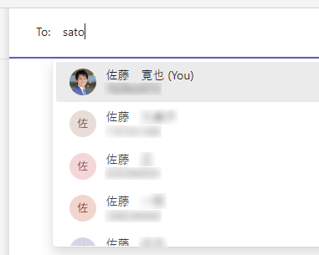
UTokyo Staff Email
Once UTokyo Staff Email address is issued, UTokyo members can search and find your name and contact in Teams and outlook.
Faculty and staff
who have been issued a UTokyo Staff Email

Slide 44
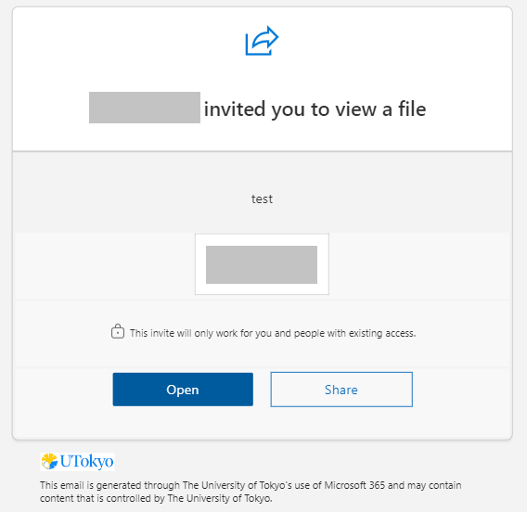
UTokyo Staff Email
Even if you do not issue this, all email notifications from Microsoft 365 services will be delivered to your Outlook inbox.
e.g., documents sharing notifications in OneDrive or mention notifications in Teams
If you have not issued a staff email address,
your temporary email address is one of the following.
10-digit number + @utac.u-tokyo.ac.jp
10-digit number + @univtokyo.onmicrosoft.com

Slide 45



Microsoft Word/Excel/PowerPoint
Word: word processing application (.docx)
Excel: spreadsheet application (.xlsx)
PowerPoint: presentation application (.pptx)
In UTokyo, these applications are often used to edit documents.
Even if you do not use these on a daily use, please have them available in case you are asked to submit documents in these formats.
If you are employed by or a student at UTokyo, you can install the applications on your devices.
Otherwise, use the web app versions of them.

Slide 46
OneDrive/SharePoint
Cloud Storage for personal use (Precisely “OneDrive for business”).
50 GB storage of personal OneDrive storage at no cost
Currently, capacity cannot be expanded. You will soon be able to expand your storage capacity for a fee, using your budget processed through the university’s account (not your private funds).

Slide 47
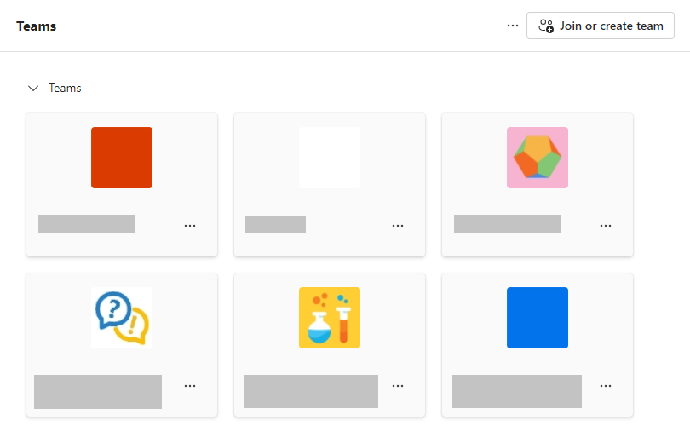
OneDrive/SharePoint
Each Microsoft Teams Team has shared cloud storage called "SharePoint” for collaboration.
You can expand your storage capacity for a fee, using your budget processed through the university’s account (not your private funds).

Slide 48



Take Advantage of Cloud Storage
Share documents and edit together at the same time.
Send and receive documents by issuing shared links.
Don’t “PPAP.”
PPAP means sending (ZIP) files with a password and sending the password later in a separate email.

Slide 49
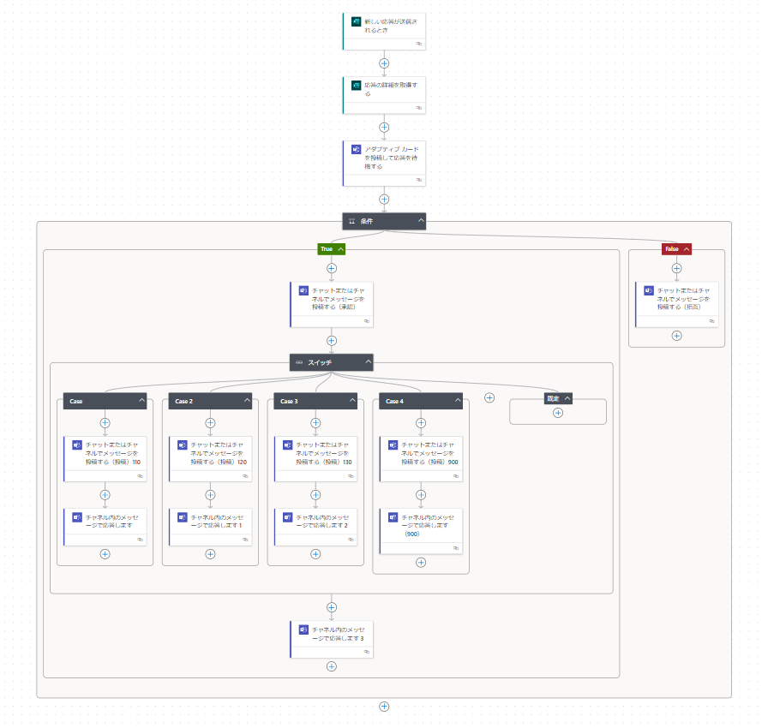

Power Platform
Power Platform
No-code/low-code development tools
Power Automate and Power Apps are available for faculty and staff.
Power Automate can be combined with Microsoft Forms and other application to automate business processes easily.

Slide 50
Generative AI
Zoom and Tools for Online Meeting
UTokyo Slack
ECCS Cloud Email (Google)
UTokyo Microsoft License
Generative AI
How to Get Supported
Send us questions via slido !
Access via this link or https://sli.do/ and following event code:
utelecon20240913
Please ask questions at any time
before or during the explanation.

Slide 51

Generative AI in UTokyo
Generative AI is a type of artificial intelligence that can create new content, such as text, images, or music, based on patterns it learns from large datasets.
Generated by Google Gemini
Generative AI Services Provided for UTokyo Members
Google Gemini for Education
Microsoft Copilot with Commercial Data Protection
Chatbot UI with Azure OpenAI API
Trial service started earlier
and will be terminated soon. Details are on this article. (Only in Japanese)
Generated by Microsoft Copilot

Slide 52
Generative AI in UTokyo
Messages and Guidelines about Generative AI
Message from Prof. OHTA Kunihiro, Executive Vice President of UTokyo, at that time (Only in Japanese)
For Faculty: Policy on the use of AI tools in Classes
For Student: Notification to Students on the Use of AI Tools in Classes
For All: UTokyo Security Guidelines for the Use of Generative AI

Slide 53
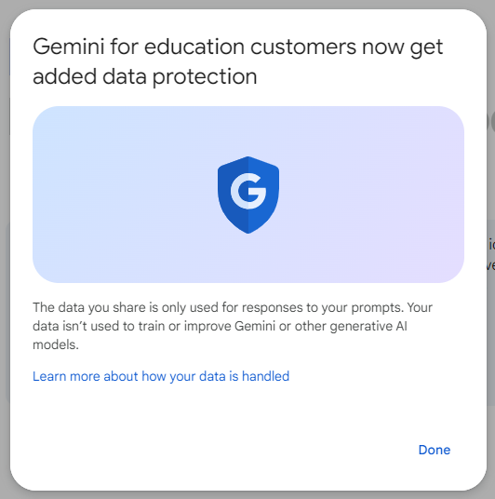
Google Gemini
Google Gemini for Education
with ECCS Cloud Email Google Workspace
https://gemini.google.com/app
A generative AI provided by Google.
The data you share isn’t used to train or improve generative AI models.

Slide 54
Microsoft Copilot
Microsoft Copilot with Commercial Data Protection
https://copilot.microsoft.com/
A cloud service provided by Microsoft that combines generative AI equivalent of OpenAI’s GPT-4 chat with Internet search (Bing search).
Input and output data are not used for model training.
See the utelecon article for more information (currently only in Japanese).
c.f. Copilot for Microsoft 365
An AI assistant integrated into Microsoft 365 applications to help users with tasks such as drafting documents. Currently being used on a trial basis by a small number of staff due to individual license fees.

Slide 55
Summary
Part II: ICT Systems and Tools Available in UTokyo
Zoom and Tools for Online Meeting
UTokyo Slack
ECCS Cloud Email (Google)
UTokyo Microsoft License
Generative AI
How to Get Supported
Send us questions via slido !
Access via this link or https://sli.do/ and following event code:
utelecon20240913
Please ask questions at any time
before or during the explanation.

Slide 56
Summary of This Part
Zoom
UTokyo Slack
ECCS Cloud Email
(Google)
Microsoft
UTokyo provides various service licenses to the members.
Some of them may have different sign in procedures or usability compared to general consumer licenses.
You can find information on how to use these tools (same as those with general consumer licenses) in various resources available in public.
Use a variety of tools to your full advantage!

Slide 57
How to Get Supported
(Common throughout All Parts of the Session)
Zoom and Tools for Online Meeting
UTokyo Slack
ECCS Cloud Email (Google)
UTokyo Microsoft License
Generative AI
How to Get Supported
Send us questions via slido !
Access via this link or https://sli.do/ and following event code:
utelecon20240913
Please ask questions at any time
before or during the explanation.

Slide 58



How to get supported
When you need support
Get Information
Inquiry for Support
Portal Site
Support Desk
Portal Site in your department
Office in charge of ICT in your department
Other resources available in public
ICT Tools Utilization Community Team

Slide 59


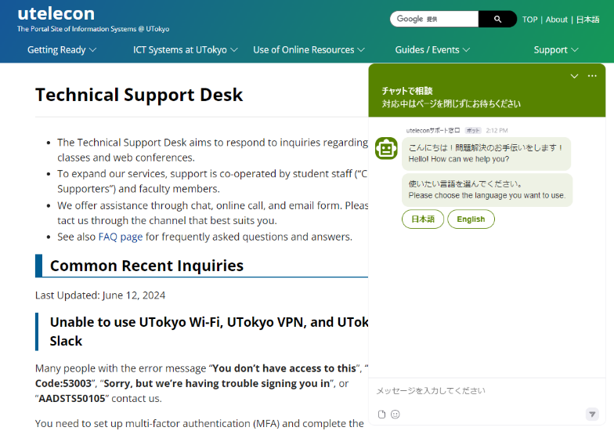
utelecon Portal Site and Support Desk
When you have questions, you can use .
Search by Google
In most cases, you can get the information you need by searching with “utelecon.”
Support desk
via Chat
via Online Call
via Email Form
https://utelecon.adm.u-tokyo.ac.jp/en/
utelecon zoom

Slide 60
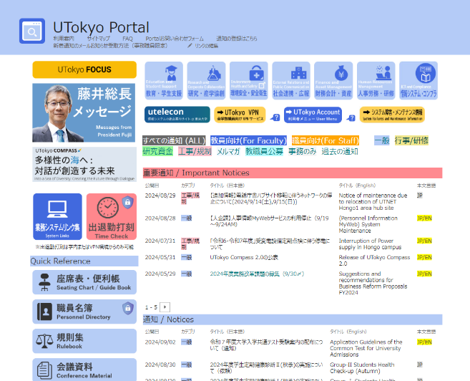
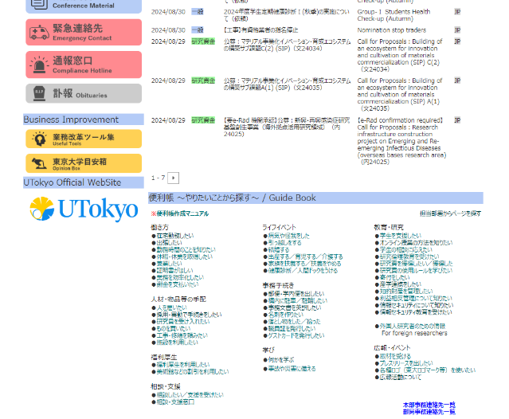
UTokyo Portal
Please also see
https://univtokyo.sharepoint.com/sites/utokyoportal/
* Available only for faculty and staff (not for students)
Notices (to be posted daily)
Please check here regularly for daily updates.
Important notices are also prvided in English.
Manuals and guide articles (“ 便利帳”)
Details on ICT services only for faculty and staff.
University-wide information are also available.
(However, many articles are only in Japanese……)
Benri-Cho

Slide 61

Office in Charge of ICT in your Department
For department-specific ICT services, please contact the office in charge of ICT in your department.
The departments may provide their own portal sites for information.

Slide 62
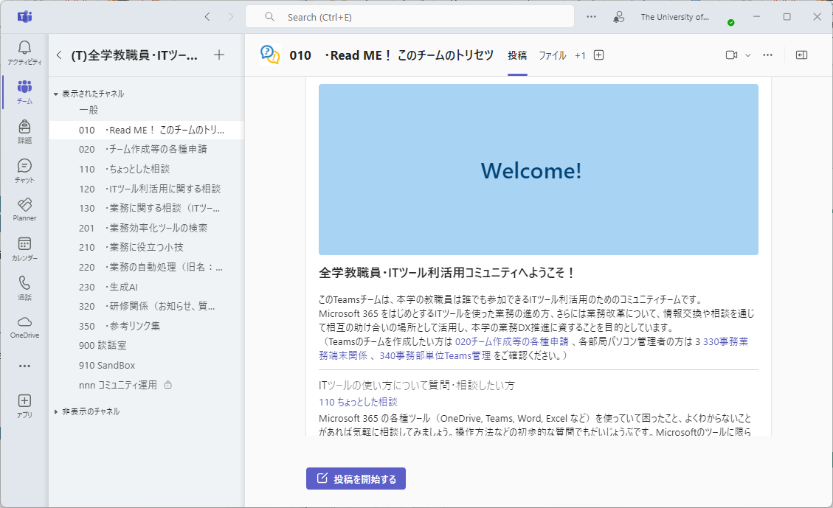
ICT Tools Utilization Community Team
All faculty and staff are welcome to join this Microsoft Teams community!
Consultations on how to use ICT tools
Exchange of ideas on RPAs and BPR
Discussions about daily work and life
More than 1,700 members have participated!
Please join us from the UTokyo Portal “Utilization of IT Tools” page!
The guidance pages and most internal communications are currently only available in Japanese, but posting topics in English is also WELCOME!

Slide 63

Future Information Updates
What we have explained is current as of today.
Updates will be made daily, and the environment will be subject to change.
We will keep you up-to-date with the latest information on the utelecon portal site and others.

