Slide 1
Part I: Basics of the ICT Systems in UTokyo
Information Session on ICT Systems and Tools for UTokyo Members (Conducted in English)
Presenter: TAURA Kenjiro
Executive Director and Vice President
Send us questions via slido !
Access via this link or https://sli.do/ and following event code:
utelecon20240913
Please ask questions at any time
before or during the explanation.
Ver 2.20 Last updated on 2024/09/09

Slide 2



ICT Systems and Tools in UTokyo
You can jump to the sign-in page from the logo.
You can jump to the utelecon description page from icon.
UTokyo Wi-Fi, eduroam
zoom
slack
Google
Microsoft
Account for UTokyo Wi-Fi
UTokyo Account (utac)

Slide 3
Main uses of each system and tool
LMS
(Handouts, Assignments, Announcements, ...)
Academic Affairs
(Syllabus, Grading, …)
Online Classes,
Meetings, Seminars
Email, Documents (share and co-edit),
and many kinds of cloud services
Wi-Fi on Campus
Communication
UTokyo Wi-Fi, eduroam
zoom
slack
Google
Microsoft
Account for UTokyo Wi-Fi
UTokyo Account (utac)
Common Account for ICT Systems and Tools

Slide 4
Outline
Part I: Basics of the ICT Systems in UTokyo
About utelecon
UTokyo Account
Initial Setup and MFA
Information Security Education
UTokyo Wi-Fi
Send us questions via slido !
Access via this link or https://sli.do/ and following event code:
utelecon20240913
Please ask questions at any time
before or during the explanation.

Slide 5
About utelecon
About utelecon
UTokyo Account
Initial Setup and MFA
Information Security Education
UTokyo Wi-Fi
Send us questions via slido !
Access via this link or https://sli.do/ and following event code:
utelecon20240913
Please ask questions at any time
before or during the explanation.

Slide 6
About utelecon
The portal site aims to be a one-stop source of information for ICT systems and tools.
https://utelecon.adm.u-tokyo.ac.jp/en/
Support desk via chat, email and online calls.
Faculty, staff and students are involved in operational activities.
See also utelecon introduction and Principles and Objectives.

Slide 7


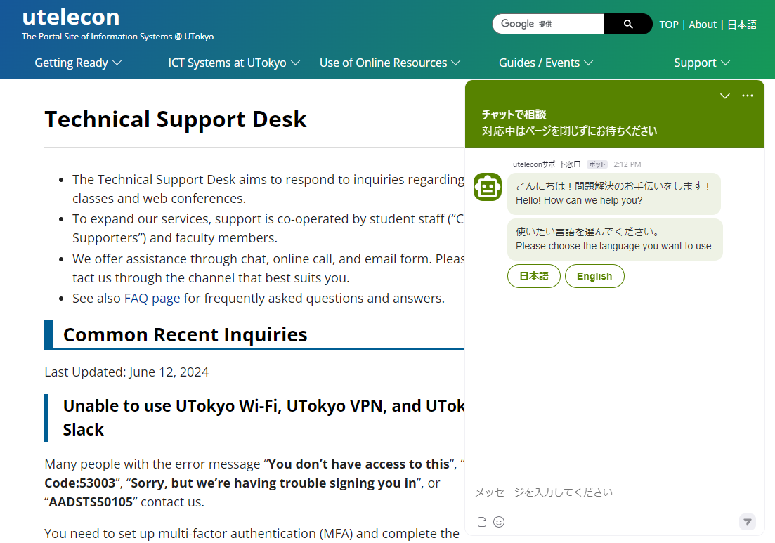
About utelecon
When you have questions, you can use .
Search by Google
In most cases, you can get the information you need by searching with “utelecon.”
Support desk
via Chat
via Online Call
via Email Form
utelecon zoom

Slide 8
UTokyo Account
About utelecon
UTokyo Account
Initial Setup and MFA
Information Security Education
UTokyo Wi-Fi
Send us questions via slido !
Access via this link or https://sli.do/ and following event code:
utelecon20240913
Please ask questions at any time
before or during the explanation.

Slide 9
UTokyo Account
What is UTokyo Account (utac)?
A common account for using the ICT systems and Tools in Utokyo.
In the beginning was the utac.
The same username and password can be used for many systems. As known as single sign-on (SSO).

Slide 10
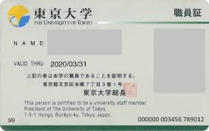
Your UTokyo Account
xxxxxxxxxx@utac.u-tokyo.ac.jp
The 10-digit number is on your ID card
The rightmost 10 digits of the number written in the right-bottom of the card.
You can also find it on the Notification Regarding Password (p. 14)
10-digit number
000000 003456 789012
Your UTokyo Account is
3456789012@utac.u-tokyo.ac.jp

Slide 11

Another way to call UTokyo Account
UTokyo Account may also be referred to by various names.
10-digit (number) “ 10桁”
“What’s your 10-digit number?”
Common ID “ 共通ID”
“Please let me know your common ID.”
utac [ju takku] or [ju: ti: ei si:]
This is the official abbreviation, but not widely used.
jikketa
Kyotsu

Slide 12
Initial Setup and MFA
(Multi-Factor Authentication)
About utelecon
UTokyo Account
Initial Setup and MFA
Information Security Education
UTokyo Wi-Fi
Send us questions via slido !
Access via this link or https://sli.do/ and following event code:
utelecon20240913
Please ask questions at any time
before or during the explanation.

Slide 13

Initial Setup
Preparing to use UTokyo Account
Get your UTokyo Account (10-digit number) and initial password.
You receive notification when you become a UTokyo member.
Change your password.
The initial password cannot be used as is.
Access UTokyo Account User Manu and change your password.
Set up Multi-Factor Authentication.
This will give you access to all ICT systems and tools.
utelecon utokyo account

Slide 14
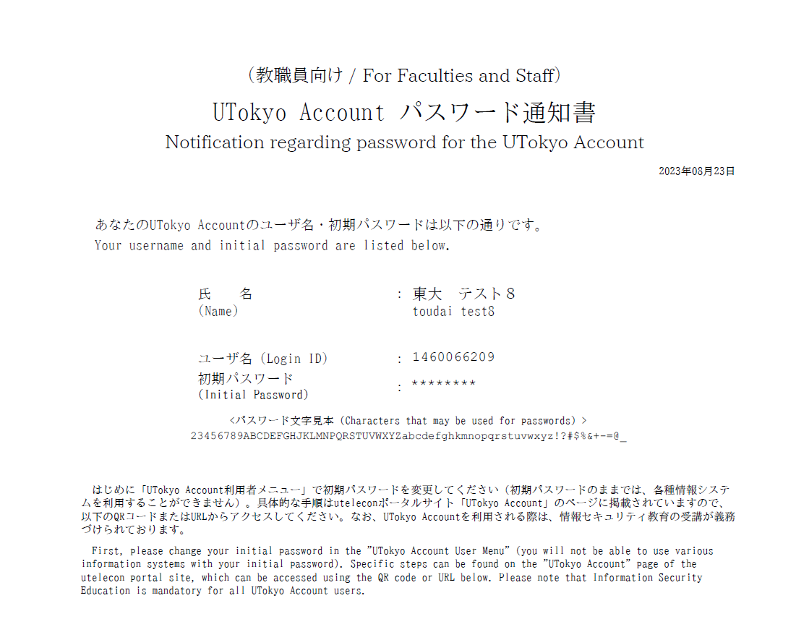
Notification Regarding Password for the UTokyo Account
10-digit number and Initial password
For faculty/staff, personnel affairs section in your department will distribute this to you.
For student, the academic affairs section in your faculty/school will distribute this to you.

Slide 15
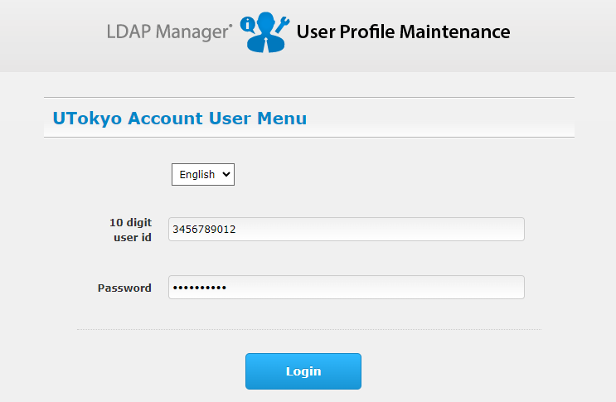
Change your UTokyo Account Password
Only 10-digit number
without “@utac.u-tokyo.ac.jp”
Initial password

Slide 16
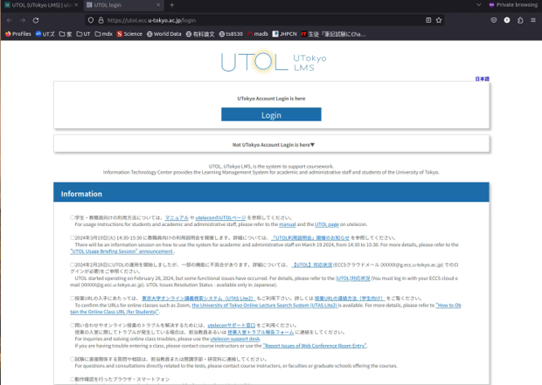
Let’s log in to UTOL to try it out
* This demonstration is with multi-factor authentication already set up.
If you cannot play the embedded movie, please watch the YouTube video from the following link.
https://youtu.be/IWKAHZCFsIs

Slide 17
Multi-Factor Authentication (MFA)
What is MFA?
Generally, to check two or more pieces of information that only legitimate users should know (or have) and allow them to sign in.
Password, phonecall, smartphone, specialized device, biometric, etc.
Pattern 1: Password + something else
Password + smartphone, etc.
Pattern 2: Passwordless Authentication
smartphone + biometric, specialized device + biometric data, etc.
utelecon MFA

Slide 18
Why MFA?
Setting up MFA makes your account significantly more secure than passwords alone.
Especially, protection against targeted email and phishing(*).
(*) A method in which a link embedded in an e-mail leads the user to an attacker’s website and forces the user to enter a password.
Single sign-on (SSO) integrates many accounts into one. It must be robustly protected.
Multi-factor authentication is both secure and convenient.

Slide 19
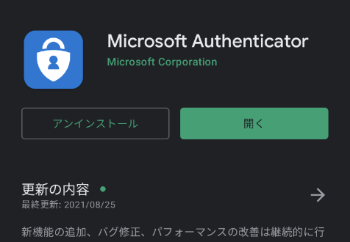
Isn’t it a hassle?
It depends on the method, but the method using the smartphone authentication app (Microsoft Authenticator) is less cumbersome.
Android (Google Play Store)
iOS (App Store)
If you always have a smartphone with you, it only takes to open your smartphone + a few seconds.

Slide 20
Various methods (Password + Something else)
Microsoft Authenticator (Recommended)
Open your smartphone app and enter the 2-digit number.
Short Message (SMS)
Enter the 6-digit number that is texted to your mobile phone.
Voice Phone (Mobile phone, (Fixed) Phone)
Just take the call and press the # key.
If you don't have a smart phone, we would recommend this, surprisingly.
Google Authentication System
Open your smartphone app and enter the 6-digit number.

Slide 21
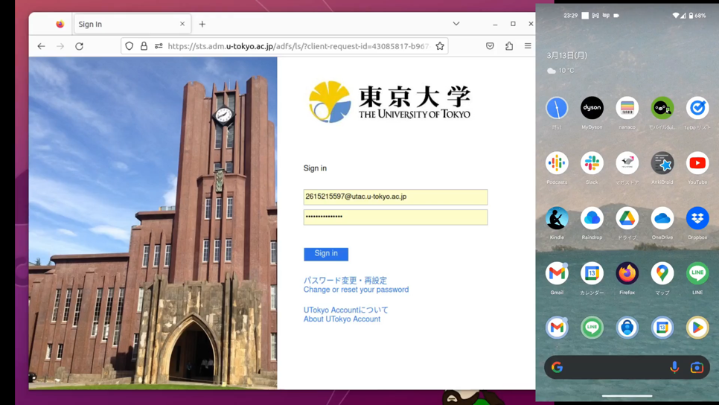
MFA - Microsoft Authenticator
If you cannot play the embedded movie, please watch the YouTube video from the following link.
https://youtu.be/205_cKXClps

Slide 22
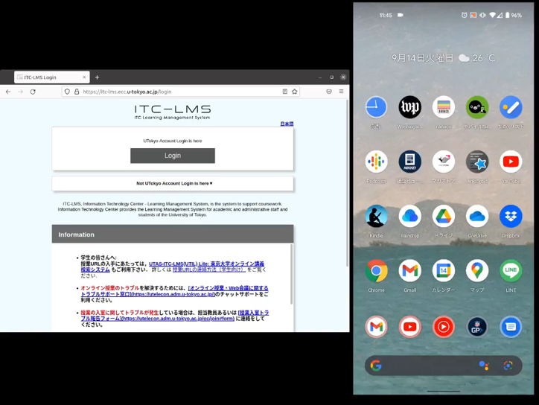
MFA – Short Message (SMS)
If you cannot play the embedded movie, please watch the YouTube video from the following link.
https://youtu.be/qR5TKZG650I

Slide 23
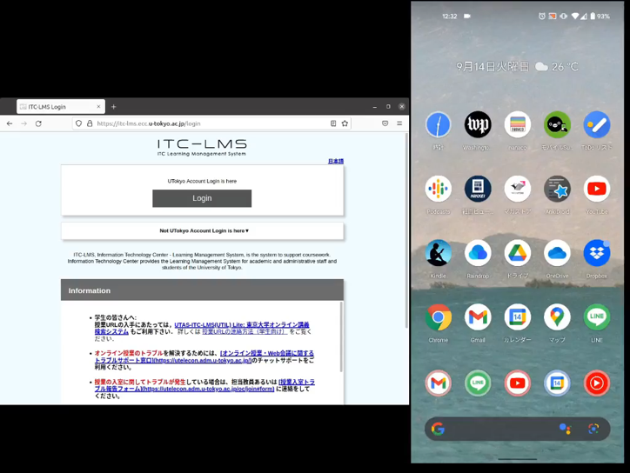
MFA - Voice Phone
If you cannot play the embedded movie, please watch the YouTube video from the following link.
https://youtu.be/W82tOKou7tE

Slide 24
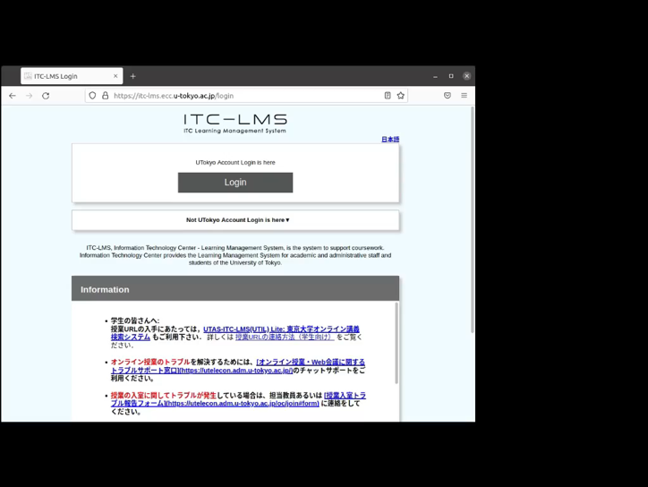
MFA - Google Authenticator
If you cannot play the embedded movie, please watch the YouTube video from the following link.
https://youtu.be/wody2hu1tC8

Slide 25
How to set up MFA
The Initial Setup Guide in utelecon
You must do ALL the following.
Step 1-3: Choose and set your identification method (App? SMS? Phone?)
Step 4: Apply for MFA Use
Wait for a maximum of 40 minutes
Try in advance with plenty of time to spare, not just before you need to use the system.
Many people forget step 4 after completing Step 1-3.
If you have not completed all the steps, you will get an error message when using a service that requires MFA (e.g. UTokyo Slack).
Please follow the initial setup guide and complete all the step.

Slide 26
Learn more about MFA
More advanced topics on MFA:
Passwordless sign-in (Highly Recommended)
When you buy a new smartphone
When you do not have a smartphone or mobile phone
When you are on an overseas business trip
When there is a communication failure with your mobile phone company
See utelecon for more information.
If you face difficulties, you have access to the support desk.
utelecon MFA

Slide 27
MFA is mandatory in UTokyo
Search UTokyo Portal for 100% Multi-Factor Authentication
Necessity of Multi-factor Authentication (only in Japanese) by NAKAYAMA Masaya, Assistant CISO, Information Technology Center
The MFA set-up percentage for each department is published on the portal.
The following services are not available without Multi-Factor Authentication.
UTokyo Wi-Fi
UTokyo Slack
UTokyo VPN
NOT a choice between setup MFA or not using the above services.

Slide 28
Information Security Education
About utelecon
UTokyo Account
Initial Setup and MFA
Information Security Education
UTokyo Wi-Fi
Send us questions via slido !
Access via this link or https://sli.do/ and following event code:
utelecon20240913
Please ask questions at any time
before or during the explanation.

Slide 29
Information Security Education
Simple e-learning + test (10 questions with 3 choices)
The following services will not be available until you pass the test.
UTokyo Wi-Fi
UTokyo Slack
UTokyo VPN
Required for all UTokyo members.
NOT a choice between taking the test or not using the above services.
UTokyo Information Security Education
or access via this link to the Information Security Portal.

Slide 30
UTokyo Wi-Fi
About utelecon
UTokyo Account
Initial Setup and MFA
Information Security Education
UTokyo Wi-Fi
Send us questions via slido !
Access via this link or https://sli.do/ and following event code:
utelecon20240913
Please ask questions at any time
before or during the explanation.

Slide 31
UTokyo Wi-Fi
UTokyo Wi-Fi
Campus Wi-Fi network access is available at most locations on campus.
You can connect by issuing an account for UTokyo Wi-Fi.
Accounts must be re-issued once a year.
You can also use eduroam with the same account.
utelecon wi-fi

Slide 32
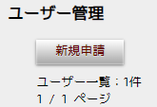
Account Issuance for UTokyo Wi-Fi
Access the UTokyo Wi-Fi Account Menu.
Press the “ 新規申請 (New Application)” button.
You will receive an email with your username and password for Wi-Fi.
The email will be sent to your ECCS mailbox and to your email address registered on the staff dictionary (or on UTAS if you are a student).
username: u24xxxxxx@wifi.u-tokyo.ac.jp
This is not an email address.
shinki shinsei
8-digit number beginning with the last 2 digits of the year

Slide 33
Connect to UTokyo Wi-Fi
Network Name (SSID): 0000UTokyo
Security: WPA2 Enterprise
You can connect with the username and password sent to you by email.
Details depend on the device and model. Please refer to utelecon for more information.
Windows, Mac, Android, iPhone, iPad, etc.
utelecon wi-fi

Slide 34
Connect to eduroam
eduroam is the world-wide roaming access service developed for the international research and education community.
Network Name (SSID): eduroam
You can connect with the same username, password, and settings as UTokyo Wi-Fi (0000UTokyo).
Available not only on UTokyo campuses, but also on campuses of many (almost all) universities and research institutes.
Even if you use it on UTokyo campuses, you cannot access to resources limited to on-campus network.
Connected as off-campus network.

Slide 35
Summary
Part I: Basics of the ICT Systems in UTokyo
About utelecon
UTokyo Account
Initial Setup and MFA
Information Security Education
UTokyo Wi-Fi
Send us questions via slido !
Access via this link or https://sli.do/ and following event code:
utelecon20240913
Please ask questions at any time
before or during the explanation.

Slide 36
Summary of This Part
In short, what should you do first?
Sign in to the UTokyo Account User Menu with your UTokyo. Account and initial password and change your password.
Your account and initial password is on the account notification letter.
Set up Multi-Factor Authentication.
Pass the Information Security Education Test.
Issue UTokyo Wi-Fi Account and try to connect.
Please set up Multi-Factor Authentication as soon as possible to use the system safely and comfortably.

