Slide 1
Information Session on ICT Systems and Tools for UTokyo Members (Conducted in English)
2024 Autumn Semester utelecon Information Session
Friday, September 13th, 2024
utelecon Project
TAURA Kenjiro, AMEMIYA Tomohito, SATO Hiroya
and utelecon supporters
Ver 2.22 Last updated on 2024/09/10

Slide 2
Purpose of the Information Session
Introduction to the basics of the ICT systems and Tools in UTokyo.
We provide an information session at the beginning of every semester on the ICT systems and tools for education, research and business activities.
You can find out…
how to use ICT systems and Tools in UTokyo, and what are these.
what systems and tools you must use to teach in UTokyo.
how you can get help if you have problems using ICT systems and tools.
This is the first information session we conduct in English.
We will also let you informed of recent changes to the system environment for those who have been in UTokyo.

Slide 3
Today’s Audience
Thanks also for your responses
to the pre-session questionnaire!
From Registration Information (as of September 6)

Slide 4
What We will Explain Today
Part I: Basics of the ICT systems in UTokyo
UTokyo Account, Security, UTokyo Wi-Fi
Part II: Communication Tools and Cloud Services Available in UTokyo
Zoom, Slack, Google and Microsoft Services, etc. and how to get supported
Part III: Systems for Educational Activities in Utokyo – UTAS and UTOL
UTAS: UTokyo Academic Affairs System
UTOL: UTokyo LMS
Q and A session
Send us questions via slido !
Access via this link or https://sli.do/ and following event code:
utelecon20240913
Please ask questions at any time
before or during the explanation.
(Questions are always welcome, even during the session)

Slide 5
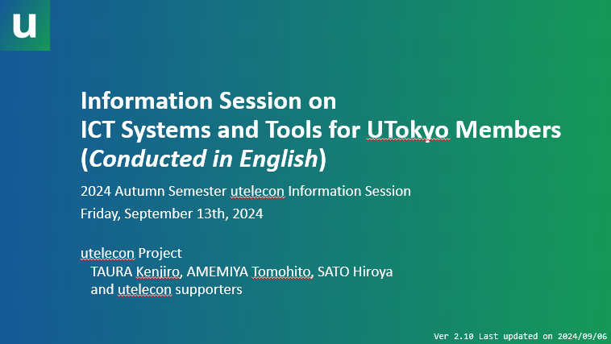
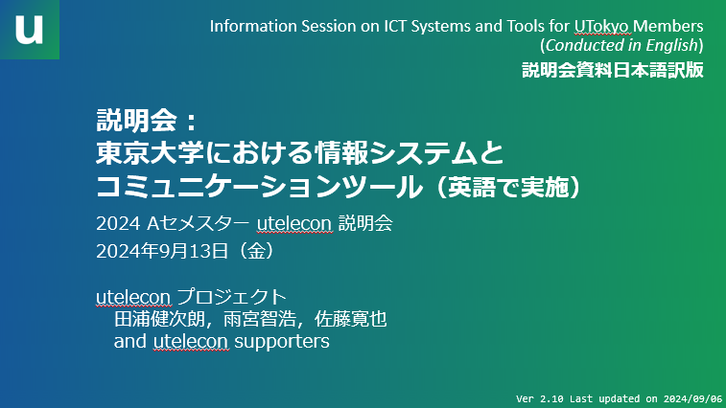
Session Materials and Recordings
Materials of this session is now provided on this page.
日本語訳版もあわせて公開しています Japanese translation is also available.
Recording of this session will be uploaded after the session on the page.

