Slide 1
Part III: Systems for Educational Activities in UTokyo – UTAS and UTOL
Information Session on ICT Systems and Tools for UTokyo Members (Conducted in English)
Presenter: AMEMIYA Tomohiro
Professor,
Information Technology Center
Send us questions via slido !
Access via this link or https://sli.do/ and following event code:
utelecon20240913
Please ask questions at any time
before or during the explanation.
Ver 2.20 Last updated on 2024/09/09

Slide 2

Outline
Part III: Systems for Educational Activities in Utokyo – UTAS and UTOL
(Introduction)
UTAS
UTOL
(Summary)
Send us questions via slido !
Access via this link or https://sli.do/ and following event code:
utelecon20240913
Please ask questions at any time
before or during the explanation.

Slide 3
Introduction
In this part, we will introduce you to UTAS and UTOL.
Before starting classes, we recommend that you become familiar with the following systems:
UTAS (UTokyo Academic Affairs System)
is used to register syllabuses and assign grades.
deals with information that should be officially recorded (syllabuses and grade).
UTOL (UTokyo LMS; Learning Management System)
is used to issue notices, distribute materials, record attendance, and accept assignments.
supports the exchange of information between faculty and students during class periods.
Zoom (online conferencing tool)
is the most widely used online conferencing tool in UTokyo
Part II

Slide 4

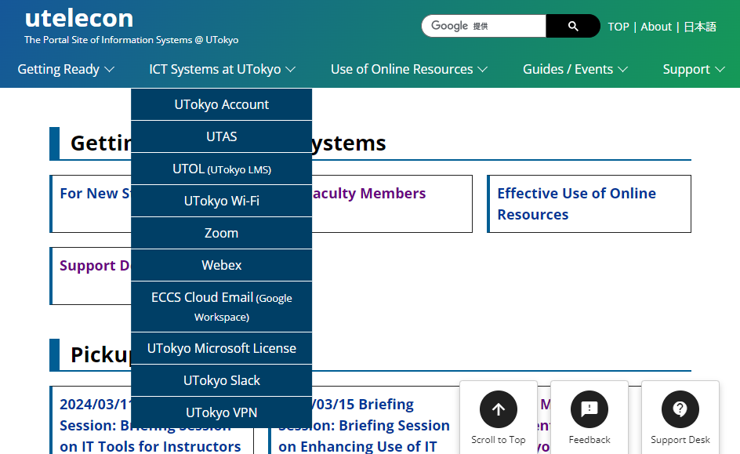
For More Details
If you have questions, you can visit .

Slide 5
Typical Flow of Classes
Even if your classes are not online,
many processes are common,
and you will use these systems.
UTAS
UTOL
Before class period
Writing the syllabus
During class period
Communication with students outside of class hours
Setting up online meetings and inform students about it
Distributing materials
Checking student attendance
Assigning assignments, collecting and grading assignments
Online testing
Notify students of class cancellations and supplementary classes
After class period
Assigning grades
Zoom

Slide 6


Link to the Systems
UTAS
https://utas.adm.u-tokyo.ac.jp/campusweb/
UTOL
https://utol.ecc.u-tokyo.ac.jp/
You should register these URLs in your browser's bookmark.

Slide 7
UTAS
UTokyo Academic Affairs System
(Introduction)
UTAS
UTOL
(Summary)
Send us questions via slido !
Access via this link or https://sli.do/ and following event code:
utelecon20240913
Please ask questions at any time
before or during the explanation.

Slide 8
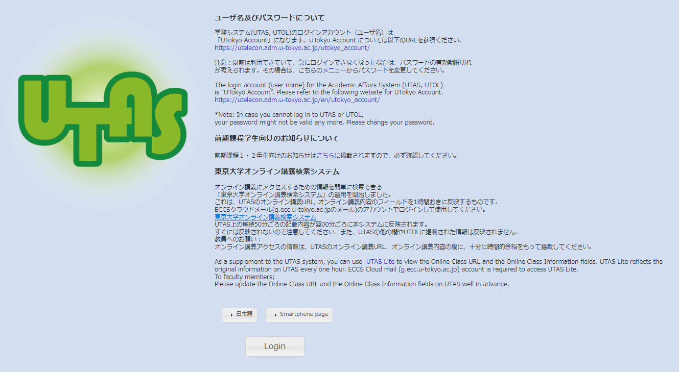

Login to UTAS
Unless you have already signed in to your UTokyo Account, the sign-in page will be displayed. Please sign in.
Click “Login”
Click “English ” here to switch to English mode.
If “Login” is displayed in English, you are in English mode.
https://utas.adm.u-tokyo.ac.jp/campusweb/

Slide 9
What class instructors must do on UTAS
For detail, please follow the requests and instructions of the faculty/graduate school offering the courses.
(When to enter, what to enter, how to enter, etc. )
Write the syllabus for the courses.
See also: Guidelines for Creating Syllabuses (English ver./Japanese ver.)
See also: UTAS manual for faculty (currently provided only in Japanese) pp. 32-47
Check students who have registered for the courses.
See also: UTAS manual for faculty (currently provided only in Japanese) pp. 7-12
Assign grades to students after the courses.
See also: UTAS manual for faculty (currently provided only in Japanese) pp. 13-31

Slide 10
What class instructors can do on UTAS
Register notices about classes
Register for information on class cancellations, classroom changes, and supplementary classes
Supervising Students
Browse information about the students you are supervising

Slide 11
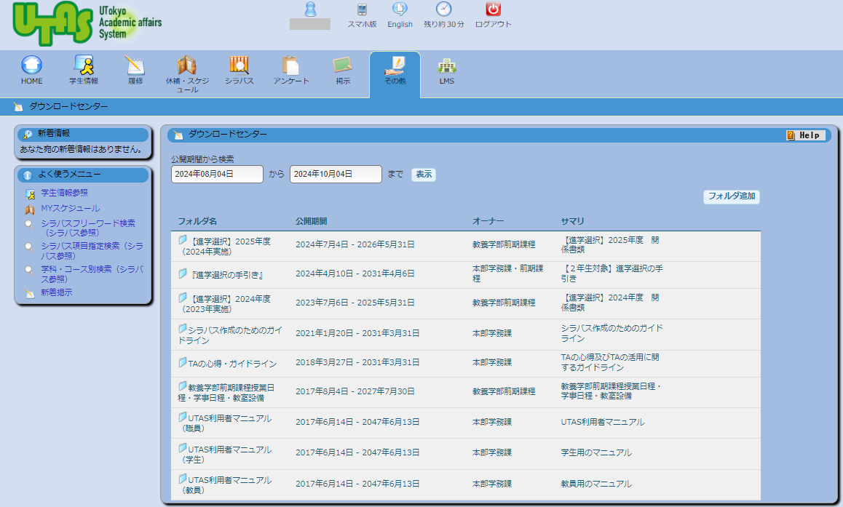
UTAS: Switch Languages (after login)
Switch language to English

Slide 12
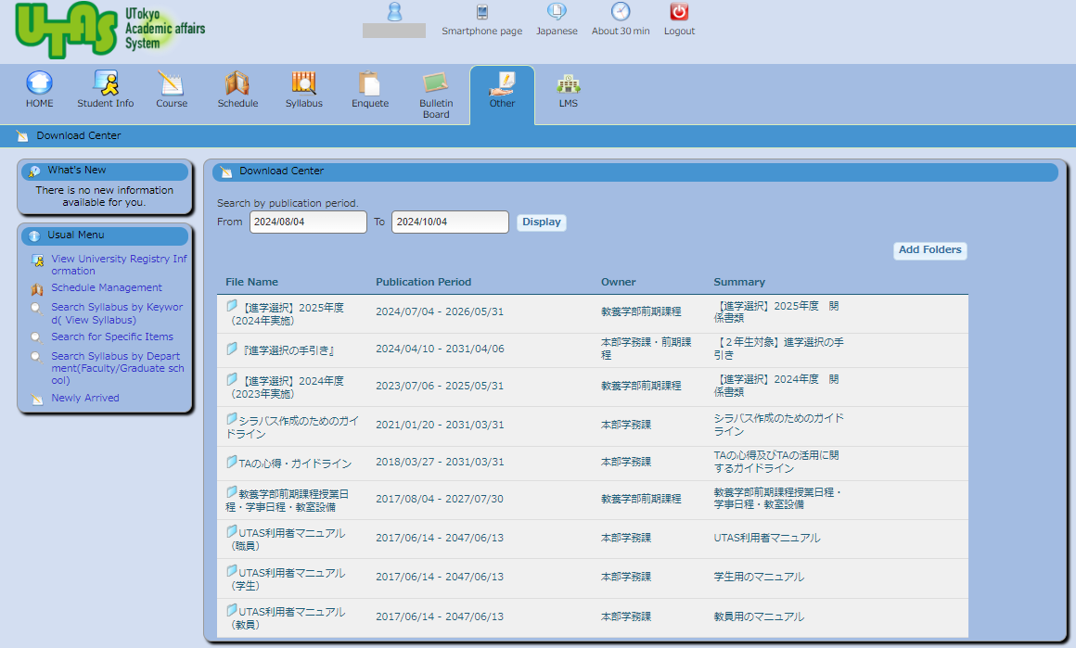
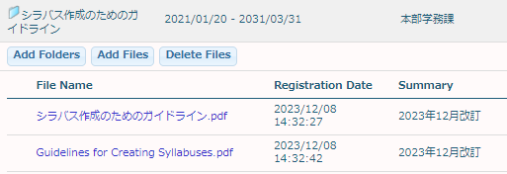
UTAS: Guidelines for Creating Syllabuses
Others
Detailed Manual
(For Faculty: only in Japanese)
(For Students: English/Japanese)
Guidelines for Creating Syllabuses (English ver.)

Slide 13
UTOL
UTokyo Learning Management System
(Introduction)
UTAS
UTOL
(Summary)
Send us questions via slido !
Access via this link or https://sli.do/ and following event code:
utelecon20240913
Please ask questions at any time
before or during the explanation.

Slide 14
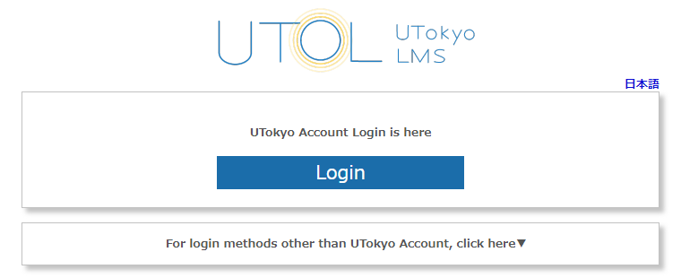

Login to UTOL
Click “Login”
Unless you have already signed in to your UTokyo Account, the sign-in page will be displayed. Please sign in.
Click “English ” here to
switch to English mode.
If “Login” is displayed in English,
you are in English mode.
https://utol.ecc.u-tokyo.ac.jp/

Slide 15
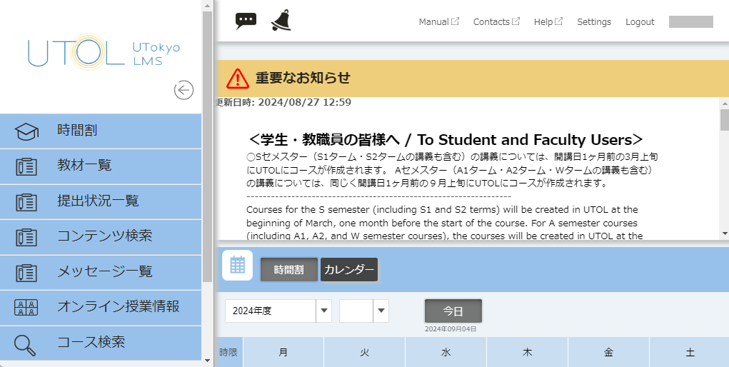
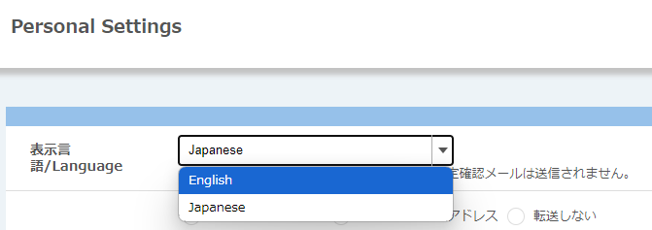
UTOL: Switch Languages (after login)
Switch language to English

Slide 16
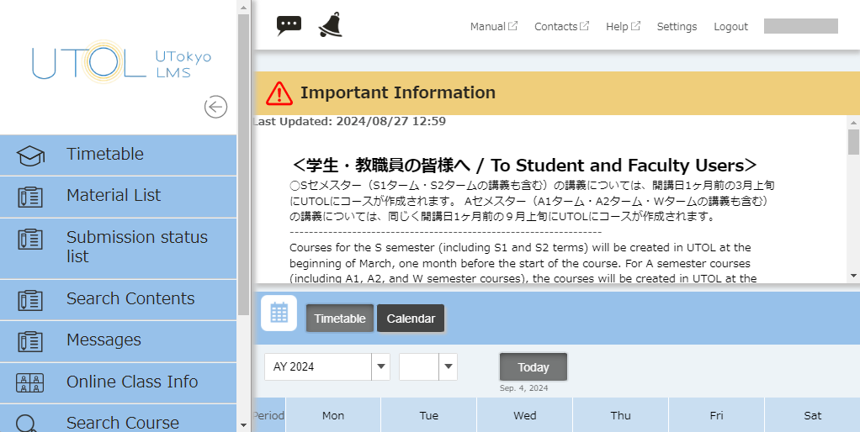
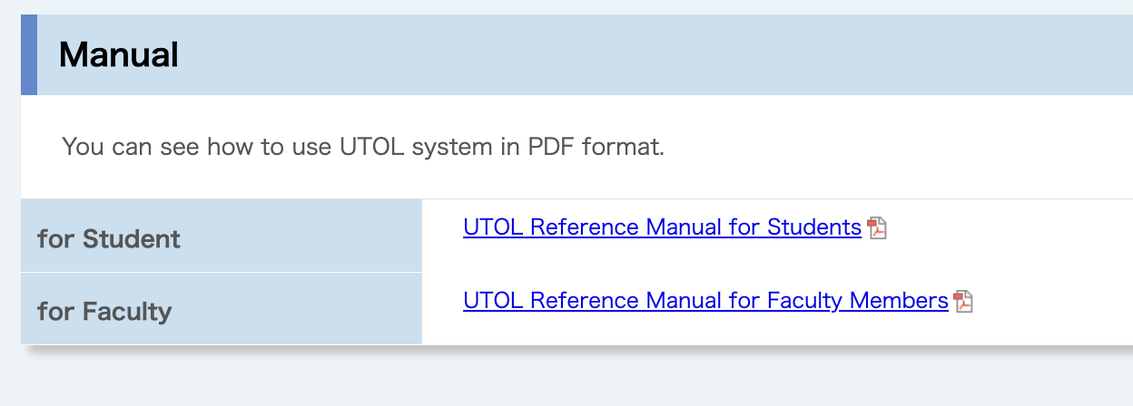
UTOL: Detailed Manual
Detailed Manual

Slide 17
UTOL: Your Go-To LMS
UTOL is available University-wide as UTokyo’s recommended LMS.
However, the choice of using an LMS is entirely up to each instructor.
Face-to-face classes can be conducted without an LMS.
Some instructors prefer Google Classroom available in ECCS Cloud Email.
We recommend using UTOL when using an LMS.
A unified system benefits students by reducing confusion across courses.
Instructors or TAs can contact enrolled students without needing their email addresses.

Slide 18
What class instructors must do about UTOL
Decide whether to use UTOL or not
If using UTOL
(Recommended)
If not
Set registration restrictions
set “Enrolled Student Range Setting” in UTOL
In the syllabus in UTAS, please enter which standard method of communication you will use

Slide 19
Registration Restriction on UTOL
UTAS
UTOL
Students who
want to earn credits
must register
automatically registered
(or originally registered)
Students who just
want to attend the classes
The class instructor
(1) allows students to self-register
or (2) registers students individually.
(settings need to be activated)
do not register
(Students who just
want to browse materials)
Because some courses may not be favorable to the situation where any student can access their materials.

Slide 20
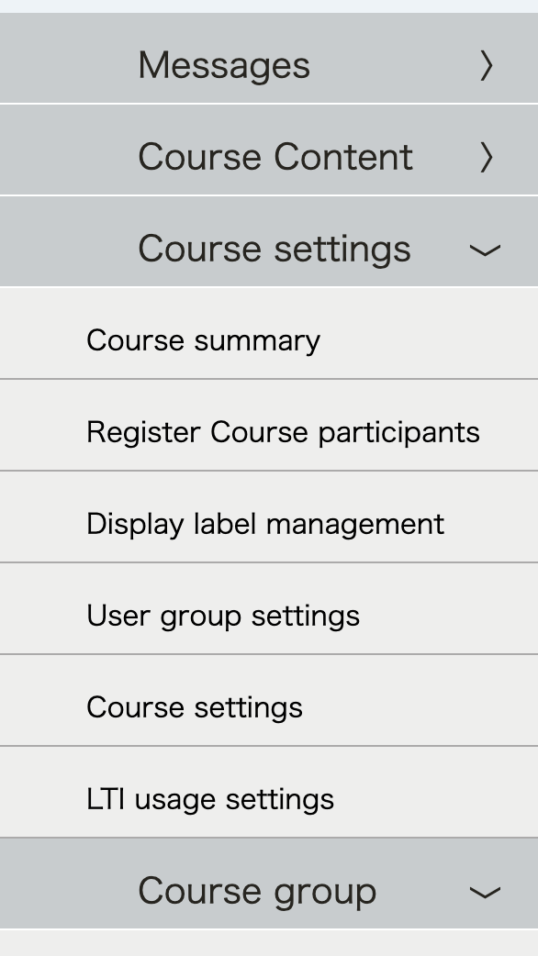
Details of Enrolled Student Range Setting
Course Settings Enrolled student range setting | Before the end of the registration period on UTAS | After the end of the registration period on UTAS
Always “All regardless of registration method” | Allow any students who wishes to attend the class to register on UTOL by themselves before or during the class period.
Automatically switch from “All regardless of registration method" to "Registration and instructor registration only” on the course confirmation date
Always “Registration and instructor registration only” | Allow only students registered on UTAS and students directly invited by the instructor to register on UTOL.
After the registration period, students who
do not apply will be forcibly unregistered.

Slide 21
What class instructors can do on UTOL
(Invite or register students to the courses)
Only if you allow only students registered on UTAS and there are students who must be manually invited by the instructor
Distribute class materials to students
Inform the online class information to students
Send/receive direct messages (or entire notice) to registered students and TAs
Create/share/submit/grade assignments
Take attendance
Exchange opinions on threads in a forum
Receive update notifications
Via email, LINE, UTokyo Slack

Slide 22
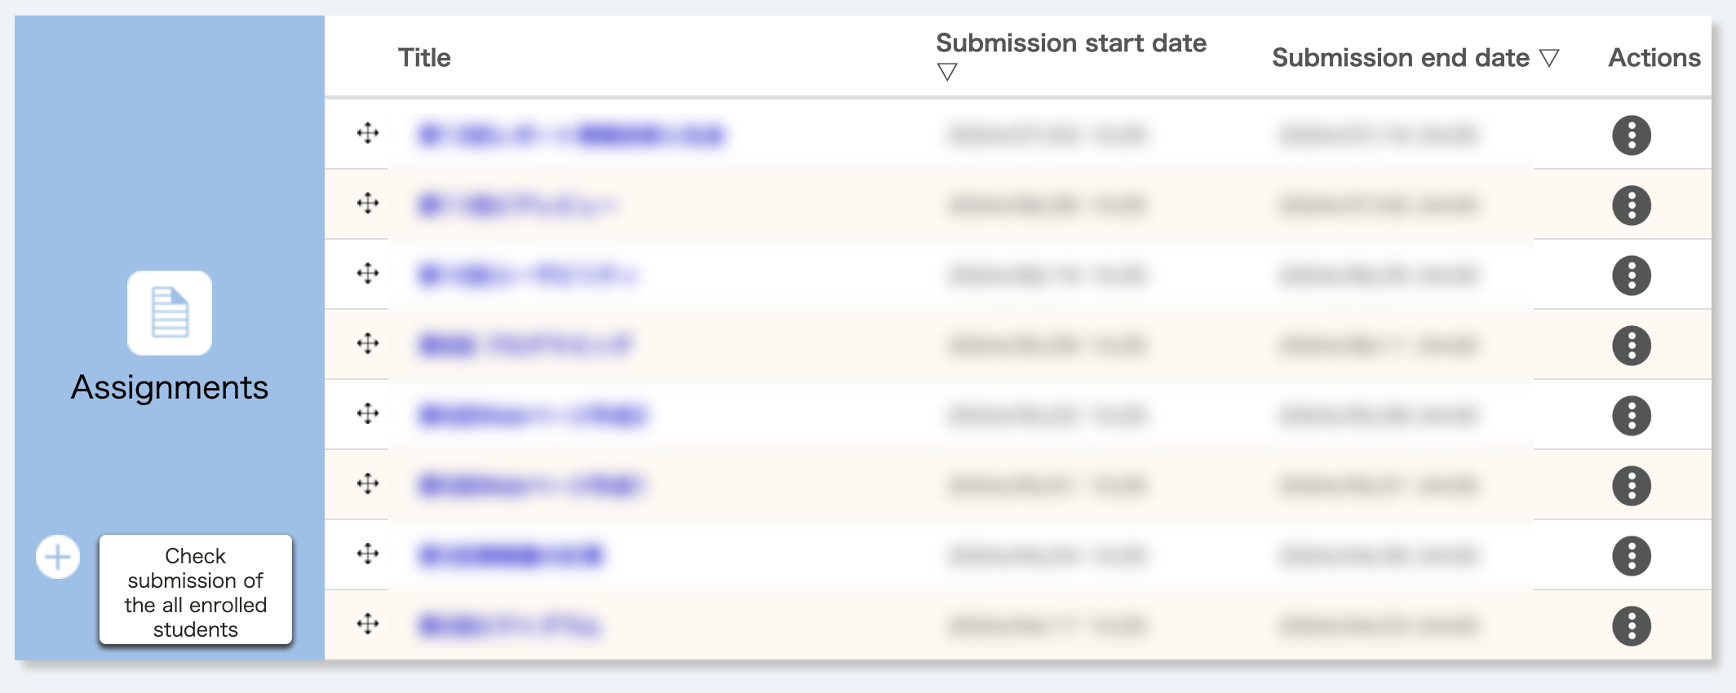
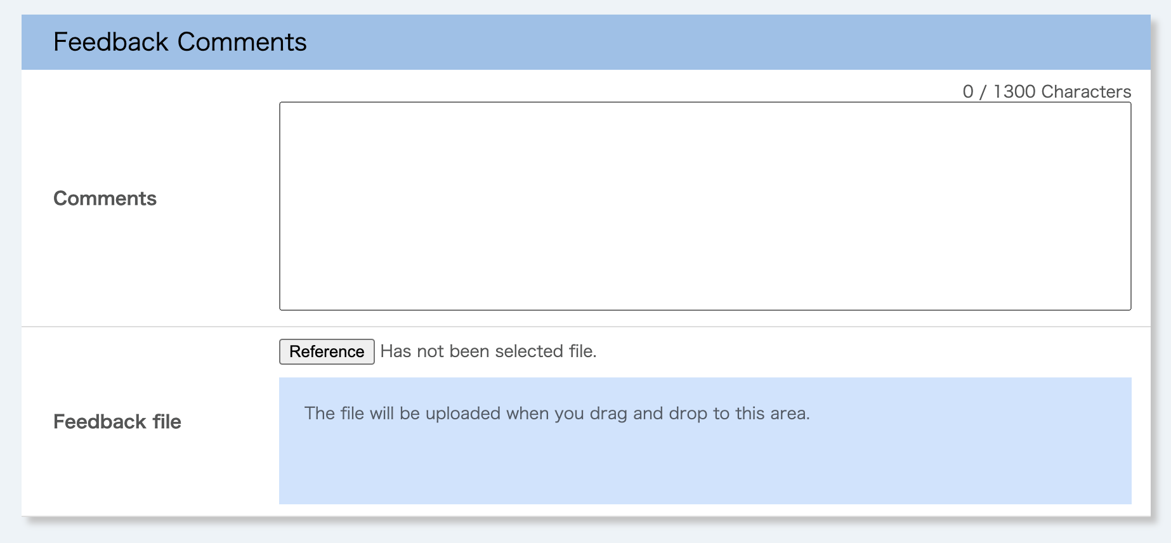
Pre-Submitted Q&A on UTOL
Q1. I teach a writing class. Is it easy to quickly comment on student papers?
Instructors can register feedback comments or upload a feedback file in UTOL. See also: UTOL manual pp. 75-78
Assignments > Actions > Check submission status

Slide 23
Pre-Submitted Q&A on UTOL
Q2. Can the students be split into groups within one course? I want to assign different tasks to each group.
Yes. Please click User group settings. See also: UTOL manual pp. 215-219
Q3. Is it possible to upload a document (e.g., a feedback sheet or a document) to only one student?
Yes. Please use Messages. See also: UTOL manual pp. 49-57

Slide 24
Further Information on UTOL
UTOL guidance article on utelecon (English version provided)
For Faculty https://utelecon.adm.u-tokyo.ac.jp/en/utol/lecturers/
For Students https://utelecon.adm.u-tokyo.ac.jp/en/utol/students/
UTOL guidance article on UTokyo Portal (only in Japanese)
For Administrative Staff https://univtokyo.sharepoint.com/sites/utokyoportal/wiki/d/UTOL.aspx
Appendix (English translation of the material of the Information session in March 2024)
* Coming soon

Slide 25
Summary
Part III: Systems for Educational Activities in Utokyo – UTAS and UTOL
(Introduction)
UTAS
UTOL
(Summary)
Send us questions via slido !
Access via this link or https://sli.do/ and following event code:
utelecon20240913
Please ask questions at any time
before or during the explanation.

Slide 26
Conclusion
UTokyo experienced a rapid increase in the use of ICT systems and tools in classes after fully online in 2020!
Since then, there has been a considerable return to face-to-face classes, but the use of ICT systems and tools in the classroom has increased significantly compared to before 2019.
Progress has also been made in developing an environment for the use of IT systems in the classroom.
Wi-Fi has been installed in classrooms, and students are now bringing their own laptops and other devices to class.
Please make effective use of ICT systems and tools, including face-to-face classes.

