Slide 1
ENSE 400 Bi-Weekly Scrum Report-Out
URStreamSight
Avery Cameron, Raymond Knorr, Noah Rowbotham
November 2, 2020

Slide 2
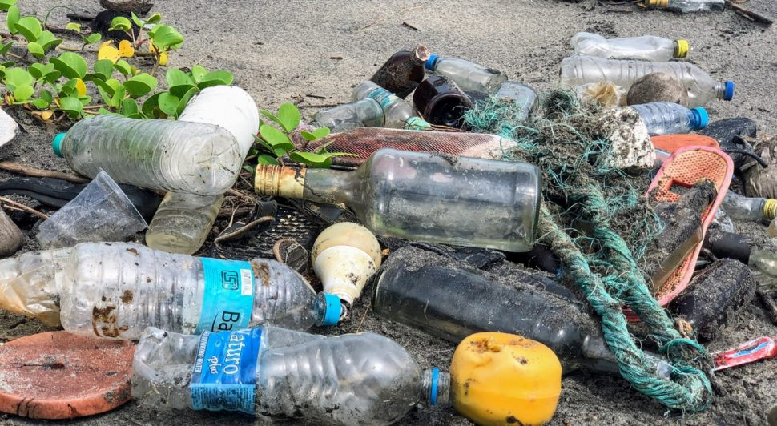
Project deats
Problem:
Citizens across Canada are confused regarding what proper recycling is.
Gap we are filling:
Giving data to municipalities to allow them to track/correct problem at its source. We are not actually sorting any recycling.
Innovation we are introducing:
Tool within waste trucks that scores recycling on an individual bin basis and keeps track of the data.

Slide 3
Project & Documentation review
What are you currently working on?
ML model Research and comparisons
Tech Stack options for ML Development
API Requirements and endpoint design
InProgress/Future work
Hifi Prototypes for UI
CI/CD Pipeline, style guides and linting, testing
“Show me what you got” (including but not limited to…)
Project initiating and planning
Updated documentation to be more accurate
GitHub/Version control “stamp of approval”
Is it readable, usable, “goodness” confirmed
Notes:
What are we currently working on:
We are currently working on researching machine learning models and comparing pros and cons of different implementations. We have a model built and are starting to train on it with a similar dataset to what we will end up using. We also have another model training that will help with comparison and checking performance.
We are researching ML development in AWS Sagemaker vs other AWS resources since this is the development environment provided for us. We have done some local work and finding resource limitation to be an issue.
We are developing our API requirements and beginning to set up our endpoints and calls. We are working with TypeScript, and Express to integrate with the current Prairie Robotics architecture.
We will work on Hi Fi prototypes and iterating through them to create positive user experiences and insightful
We are in the process of creating style-guides and implementing linters and tests that will be part of our CI/CD pipeline for the API and frontend.
What we currently have:
We updated our requirements documents to be more accurate, adding our mentors, and updated requirements and definitions

Slide 4
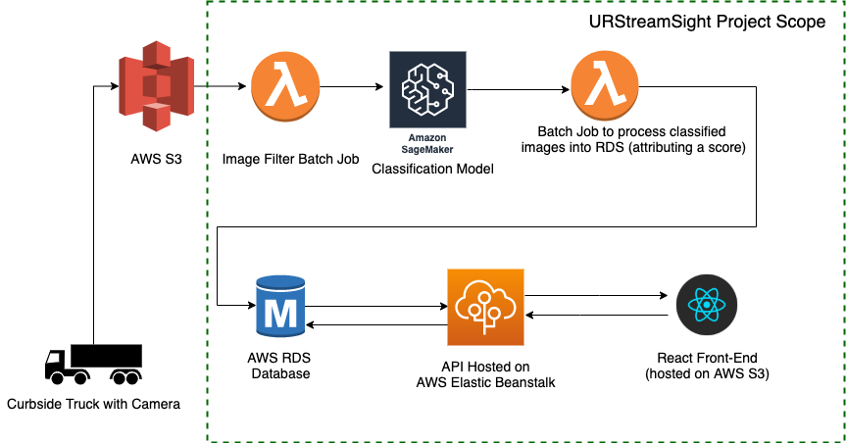
Initial Project Architecture
Notes:
Here is our pictured architecture:
Waste Truck cameras -> to S3 -> Image Cleaner -> Batch ML Classifier -> Database ->AWS API-> Front end

Slide 5
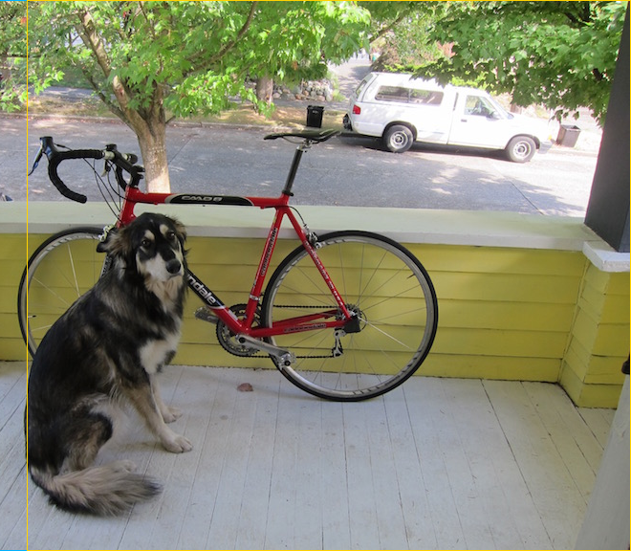
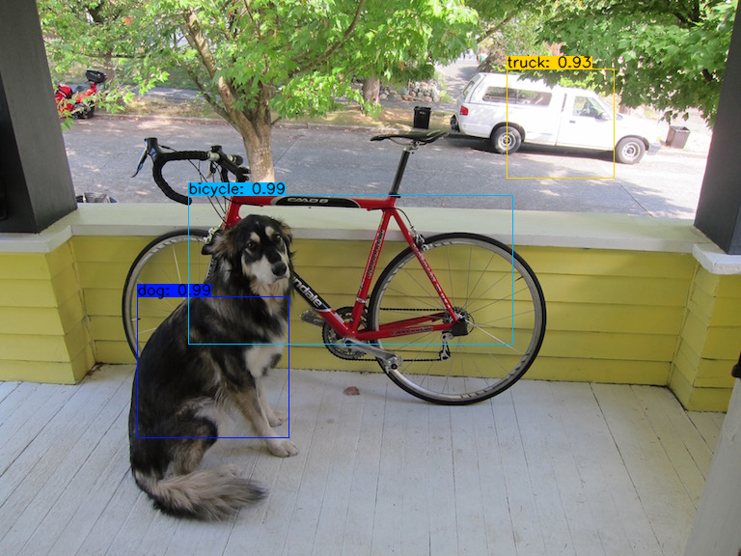
Initial ML Results using YOLOv3
Notes:
Here is our current ML model output for bounding boxes and classes that we are working on. and here is our envisioned output for the model

Slide 6
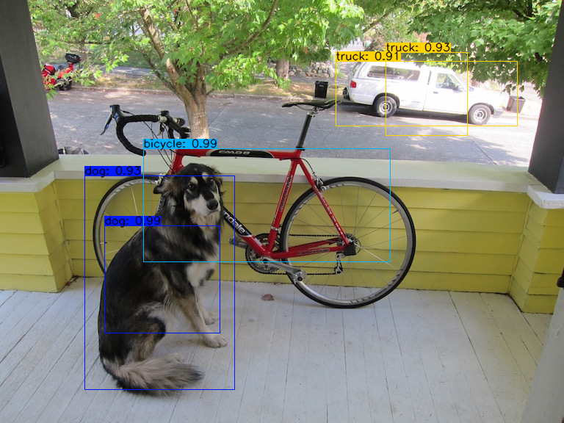
Initial ML Results Cont.
Current Results -->
Notes:
What we have now. Still not perfect, but better.

Slide 7
Group reflection
Do you feel you are on track?
We feel that we are on track, having the AI project keeps us researching and moving forward. Starting to realize how much time the ML portion will take
Do you feel there are barriers to your success (if any)?
Getting the real images to train on, and labelling them. Images probably won’t come in until the new year
Do you need any help going forward?
Just more discussions with mentors about project scope and documentation
Any other questions or concerns?
How should we be responding to Wiki comments made by mentors?
Notes:
EX:
For Tim:
We are not doing Gamification because we are creating for the municipality (on behalf of Prairie Robotics) and not individual users who would benefit from gamification. This could be a future project for Prairie Robotics through a website or app that users access to get their score, track trends and compare against community average.
For Yow:
We are working on software that classifies recycling as it is tipped out of the bin and into the truck. It currently just notes that there are contaminants but has not system to remove contaminants or separate them into streams or do any sorting. The ML model would be predicting on the contents of the bin that is poured into the truck and will contain a Camera subsystem (managed by Prairie Robotics) and outlined by our Project Architecture Diagram.

Slide 8
Image Refs
https://cleanriver.com/how-to-reduce-recycling-contamination/

