Slide 1
ENSE 477 March 4th Scrum
URStreamSight
Avery Cameron, Raymond Knorr, Noah Rowbotham
March 4, 2021
Notes:
AVERY

Slide 2
Team Members
Avery Cameron
Project Management/Flexible Developer
Help with Front-End and ML as needed
Raymond Knorr
Lead API and Front-End Developer
Manage collaboration with Prairie Robotics
Noah Rowbotham
Lead Machine Learning Technician
Lead development of classification model and documentation
Notes:
Avery Cameron: Project Manager/Flexible Developer
Manage our GitHub structure and CI/CD
Organize project meetings and milestones
Manage project documentation
Help with Front-End and ML as needed
Raymond Knorr: Lead UI/API Developer
Manage integration and documentation of our software with Prairie Robotics
Manage Trello board for workflow organization
Manage communications between URStreamSight & PrairieRobotics
Noah Rowbotham: Lead Machine Learning Technician
I lead development of machine learning training and implementation
I manage the integration of Amazon services with our ML workflow
I develop on the aaeon onboard computer which facilitates the collection of data from recycling collection vehicles

Slide 3
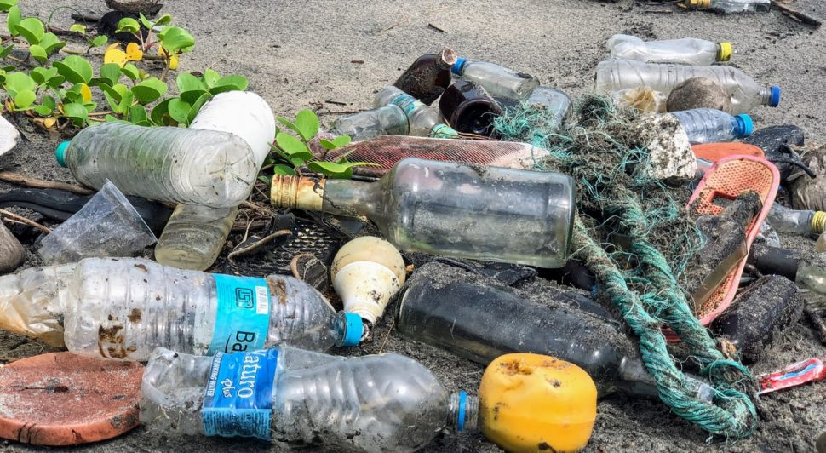
What is URStreamSight?
Problem:
Citizens across Canada are confused what proper recycling is
Sorting recycling is extremely costly
Gap we are filling:
Providing data to municipalities allowing them to track/correct problem at its source (the people recycling).
Innovation we are introducing:
Platform for municipalities that provides reporting for discovering contamination origins. Meant to provide data on specific areas or neighborhoods
Machine learning used to classify contaminants within a bin of recycling
Notes:
Avery
Web application for municipality workers that scores recycling data on a neighborhood basis and displays the data. Videos are captured from the bin of recycling trucks and ran through a waste classifier to determine whether the recycling is contaminated.
This is a web application for municipality workers to review contamination in recycling bins and display reports to help with decision making. Pictures are captured when a bin is tipped into the recycling truck and contamination is identified with machine learning, this is then displayed in our front end portal for users.

Slide 4
The Why
Contaminated recycling generates fines for municipalities
Fines increase costs for households
Clean recycling generates profits and lowers costs for households
Sorting recycling is complicated and expensive
Instead of reacting to recycling contamination by removing it or paying fines, being proactive through education will reduce contamination long term
This is all based on various studies on recycling contamination impacts such as a Study from the Region of Peel (in Ontario) showed that after education campaigns, 90% of people had less than 10% contamination compared to 60-70% of people before.
By educating, influencing, and reprimanding when required we can clean recycling at the source increasing revenues, lowering household expenses, and improving recycling effectiveness which in turn promotes a greener future.
Notes:
Contaminated recycling generates fines for municipalities which increases costs for households. If the recycling is clean, recycling can provide revenue for the municipality which will lower costs for households.
Instead of reacting to recycling contamination by removing it through sorting, this project is proactive. Being proactive is a more permanent solution, education campaigns then reduce contamination at the source instead of relying solely on sorting.
This is all based on various studies on recycling contamination impacts such as a Study from the Region of Peel showed that after education campaigns 90% of people had less than 10% contamination compared to 60-70% of people before the campaign.
To summarize: by educating, influencing, and reprimanding when required we can clean recycling at the source increasing revenues, lowering household expenses, and improving recycling effectiveness which in turn promotes a greener future. This is why we are developing URStreamSight.

Slide 5
Scrum Dates
Feb 26, 2021 - March 4, 2021
Notes:
This scrum ran from Feb 5, 2021 - Feb 25, 2021

Slide 6

Status Description
API - Yellow-Green
Testing - Yellow-Green
Front end - Green
Machine Learning - Yellow-Green
Image Pipeline - Green
Overall - Yellow-Green
Notes:
API Status: Yellow-Green
The last week was spent investigating CI/CD pipeline deployment of our apps to AWS. We are almost at the point where our API can be hosted via GitHub actions, but we are currently running into small issues. After this deployment, our API is MVP ready, the next steps are just to finish testing.
Testing Status: Yellow-Green
We have added additional tests for the endpoints but still have more to add. We are generating coverage report which are showing good progress but we are looking to add automated testing and coverage checks to our cicd pipeline.
Frontend Status: Green
We added several new pages to our front-end, including a sign-in flow, and implemented a means of generating a lot of mock data to display. Our front end is also hosted successfully on AWS via GitHub Actions. Altogether, our front-end is MVP ready.
Machine Learning: Yellow
Machine learning has been going well. We are behind on our contaminant classifier but we believe we can catch up. Regardless of progress on our own contaminant classifier, a functioning classifier is accessible to our API and so our app is functional.
Image Pipeline: Green
Our image pipelines are essentially complete. We intend to make small changes improvements with the remainder of our time.

Slide 7
Team Member Contribution
Avery
AWS Configuration
Front end deployment
Back end deployment
Ray
Front end pages / sign-in flow
API token validation
Generating mock data
Noah
Integration tools research
ML Action Plan
Notes:
Avery:
Over this scrum I worked on setting up our AWS services for deployment. I setup our frontend services and automatic deployment with Github Actions and set up our API configurations for deployment with serverless through github actions.
I set up S3, Cloudfront and Route53 for our frontend and have added deployment to our cicd pipeline. For the API, I set up a Virtual Private Cloud with proper Access Control List, subnets and security groups as well as an RDS instance with credentials in Secrets Manager.
Ray:
Over this scrum, I was creating the new pages in our front-end, implementing a sign-in flow, and implementing JSON Web Token validation on the API. I also created a utility function to generate a large amount of mock data to show in our front-end and API until our data pipeline is completed.
Noah:
I worked on some more integration analysis, following up on work I did last scrum. I also started working on an ML action plan to carry us to the end of the semester.

Slide 8
Project Issues and Changes
Dev device died
API Deployment issue
Notes:
My dev laptop died which delayed some progress we intended on making,
There is a minor issue with our API deployment that we encountered but we are working on this and making progress.

Slide 9
Project Demo
GitHub Actions | Front-end
Notes:
(AVERY GOES FIRST RAY)
CI/CD:
Github Actions
Front-end
Demo of sign-in flow and different pages within the hosted app.

Slide 10
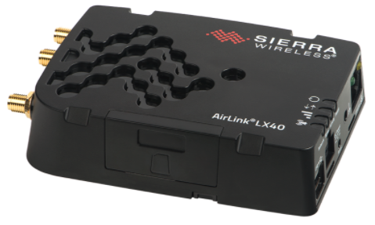
Data Pipeline Progress
Setting up a Sierra LX40 for cellular comm’s
Testing Mask R-CNN for real time inference vs. post-upload inferencing
Notes:
Other smaller tasks I have completed include setting up a cellular modem so that our Aaeon board has a more stable wireless connection than the current wireless modem in use.
I’ve also been working on testing a pre-trained mask r-cnn on single image inferencing to see if real time inferencing on the Aaeon board is a feature that could be implemented.

Slide 11
Plans For Next Scrum
Ray
Developing data pipeline to take data from ML model into our database
Finish API testing
Avery
Adding tests
CI/CD pipeline
Noah
Modifying GPS recording, if GPS fails during a service route, label bin tips with last known GPS reading
Notes:
Ray: I plan on developing the data pipeline to take messages stored in AWS Simple Queue Service coming from the trucks and putting entries into the AWS RDS Database. I also plan on writing tests to finish the API testing
Avery: I plan on testing the API and improving our cicd pipeline to have tests and test coverage in addition to the current deployment. I’m going to work with Ray to take messages from SQS into the RDS database.
Noah: I will be working on training a classifier for contaminants as well as modifying our current gps recording process

Slide 12
Group reflection
Do you feel you are on track?
Yes, we feel we are yellow-green overall, and are just about at MVP for all of our sub apps.
What progress does the team feel particularly great about?
We feel great about the work done on the front-end and the CI/CD pipeline for the front-end
Do you feel there are barriers to your success (if any)?
Pressures of other courses are possible barriers. The knowledge required for integrations and our model training could delay progress but at the moment things are going smoothly.
Do you need any help going forward?
We will continue to meet with Dr. El-Darieby and Sam for feedback.
Any other questions or concerns?
We realized since last scrum that our workflow looks more like waterfall than agile. This is due to our lack of understanding about what is necessary for an early MVP. Our work on CI/CD this scrum attempts to move us into our first, and quite large MVP.
Our previous scrum comments didn’t give us the impression that we weren’t on track
Notes:
Ray does first two,
Noah does next two,
Avery does last one
Was this level of description of our project understandable
Was this level of description of our project understandable

Slide 13
Image Refs
https://cleanriver.com/how-to-reduce-recycling-contamination/
https://i.pinimg.com/originals/e9/2c/79/e92c79bbf86dd1295f94bb279fe7152a.jpg

Slide 14
Questions or Comments?

