Slide 1
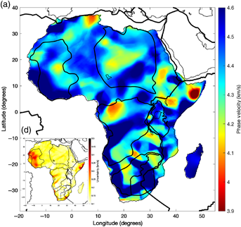
Presentation of Improving Ambient Noise Correlations with Multi-Taper Method
Sayan Kr Swar¹,
Advisor: Tolulope Olugboji^{1,2}
Planetary Sesimoacoustics, ESC 425
1 Electrical and Computer Engineering Department, UofR
2 Earth and Environmental Science Department, UofR
Figure taken from Tolulope Olugboji, Siyu Xue; A Short‐Period Surface‐Wave Dispersion Dataset for Model Assessment of Africa’s Crust: ADAMA. Seismological Research Letters 2022;; 93 (3): 1943–1959;
FOB eruption, 13 Aug. 2021 by Japan Coast Guard

Slide 2

What are we covering?
Cross Correlation Theory
How Cross Correlation is Used in Seismic Phase Velocity
Challenges in Surface Wave (Especially Love Wave)
Multi-Taper Technique Introduction
Multi-Taper on Synthetic Dataset
Results: Frequency and Time Domain CCF Examples
Results: Time Domain Correlation Wavefield
Results: Frequency Domain Correlation Wavefield
Results: Phase Velocity Computations with SeisLib
Results: Zero Crossings Analysis
References

Slide 3
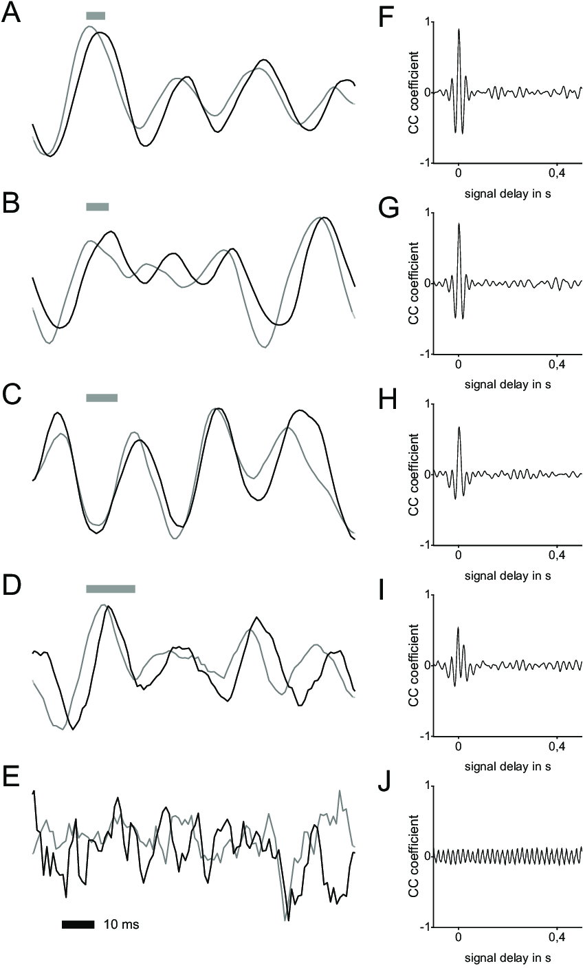
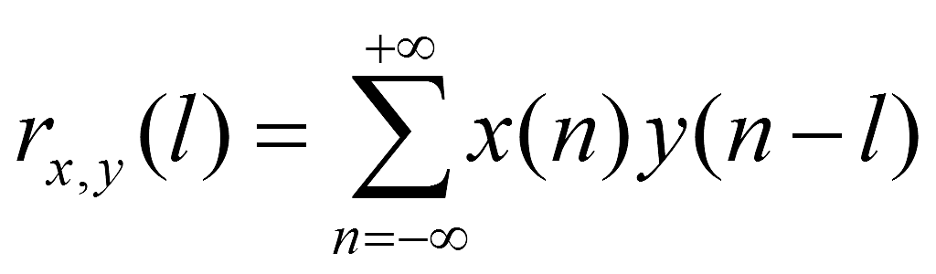
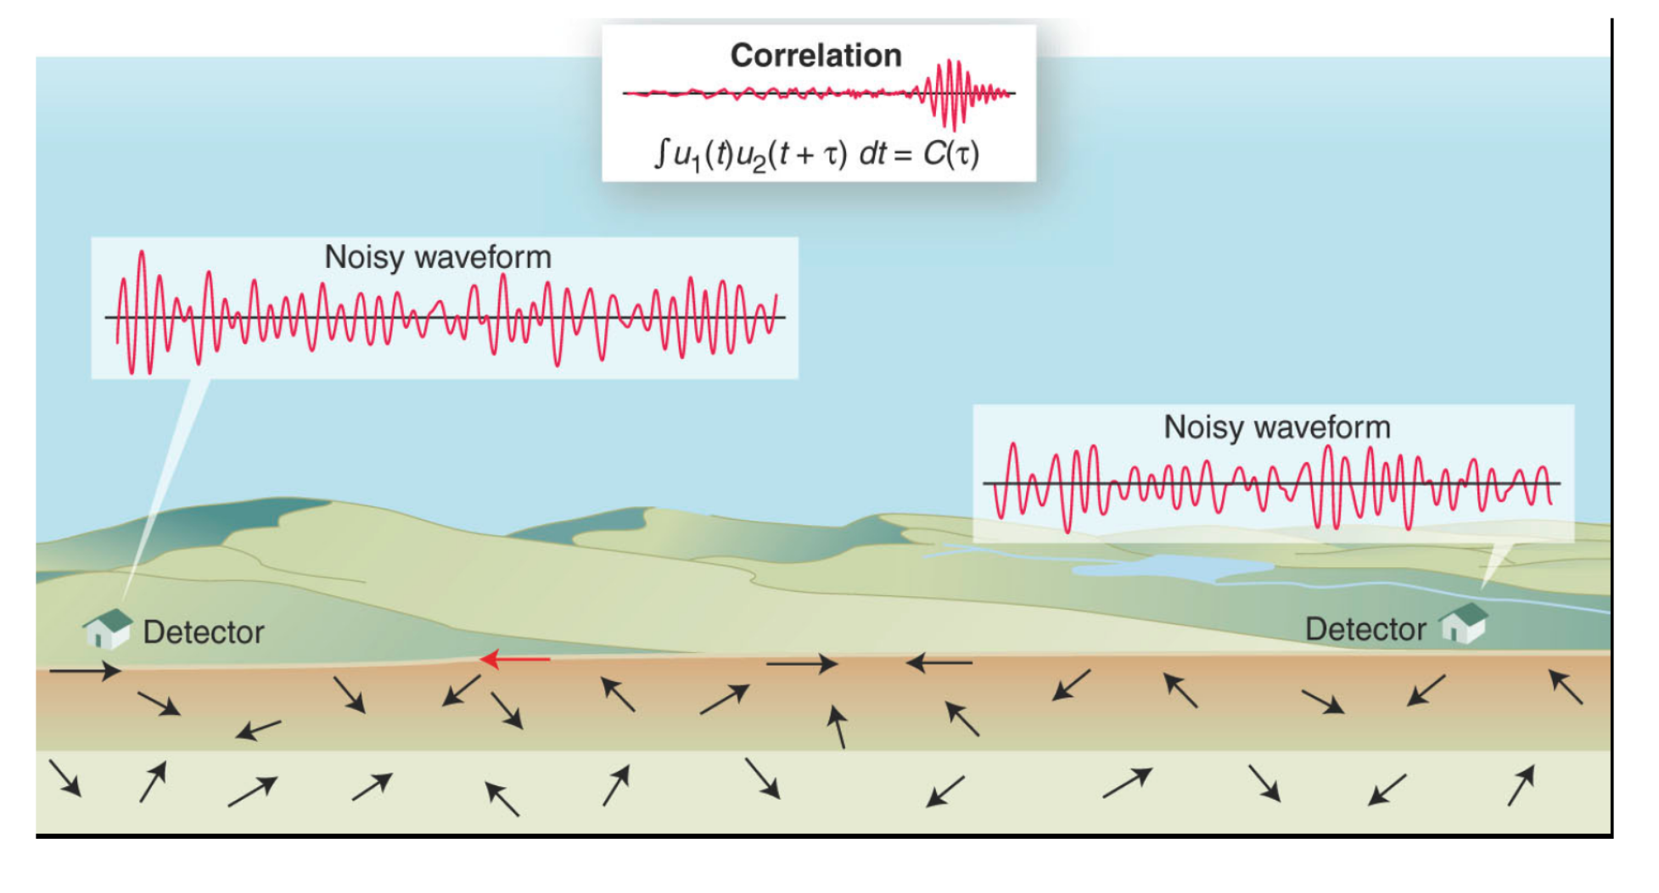
Cross Correlations Theory
Cross-correlation (CC) quantifies the similarity between two signals
When two real valued x(n) an y(n), CC can be signals represented by convolution:
Images taken Herzog, Hendrik & Klein, Adrian & Tätzner, Simon & Schulze, Elisabeth & Bleckmann, Horst. (2015). Micro-Machined Flow Sensors Mimicking Lateral Line Canal Neuromasts. Micromachines. 6. 1189. 10.3390/mi6081189;
Alongi, T., Schwartz, S. Y., Shaddox, H. R., & Small, D. T. (2021). Probing the southern Cascadia plate interface with the dense amphibious Cascadia initiative seismic array. Journal of Geophysical Research: Solid Earth, 126(7), e2021JB022180.

Slide 4


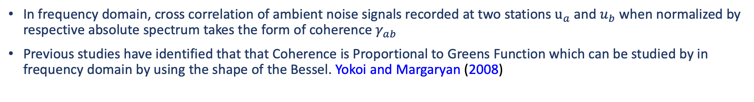
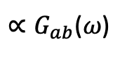
Using Cross Correlations To Compute Phase Velocity
In frequency domain, cross correlation of ambient noise signals recorded at two stations $u_{a}$ and $u_{b}$ when normalized by respective absolute spectrum takes the form of coherence $γ_{ab}$
Previous studies have identified that that Coherence is Proportional to Greens Function which can be studied by in frequency domain by using the shape of the Bessel. Yokoi and Margaryan (2008)
$∝G_{ab}$($ω$)
Further studies have established that Real part of the coherence is equal to the 0th order Bessel. Aki (1957)
By fitting coherence with Bessel function, through grid search and other waveform fitting techniques, phase velocity estimation and related dispersion curves are computed.
It is important to note that stronger coherence will lead to better Bessel function approximation and thus decreased uncertainty in the phase velocity estimation.

Slide 5
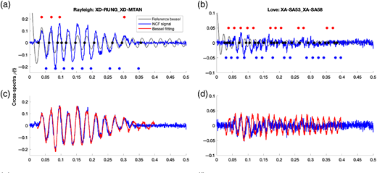
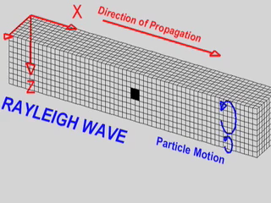
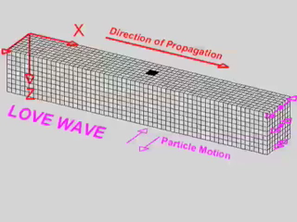
Challenges with Love Wave CCFs
Prior work shows that Coherence of Raleigh wave fits with the Bessel function strongly and coherently. Olugboji and Xue (2022)
Notable that Love waves lacks enough distinguishable peaks/troughs and zero-crossings.
Love wave being more noisier struggles to follow the Bessel function.
This calls for a more robust frequency domain coherence calculation for improved phase velocity estimation.
Estimation of Rayleigh and Love wave Bessel Function Estimation on two different stations
Figure taken from Tolulope Olugboji, Siyu Xue; A Short‐Period Surface‐Wave Dispersion Dataset for Model Assessment of Africa’s Crust: ADAMA. Seismological Research Letters 2022;; 93 (3): 1943–1959. doi: https://doi.org/10.1785/0220210355

Slide 6
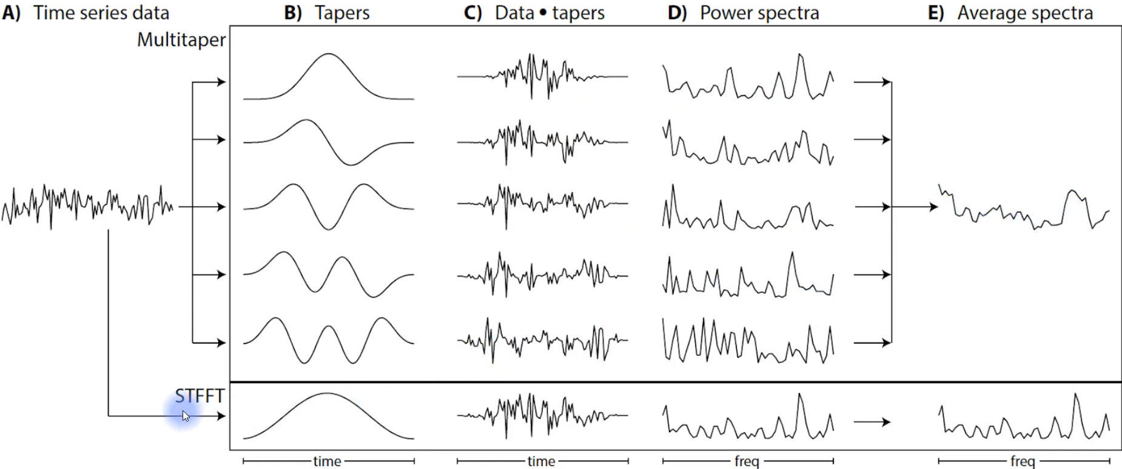
Introducing Multi-Taper Technique
It is a non-parametric technique that computes the Fast Fourier Transform (FFT) of a discretely sampled time series data after applying a set of tapers/windows Thomson (1982)
Employs multiple orthogonal tapers known as Discrete Prolate Spheroidal Sequences (DPSS).
These tapers are designed to minimize spectral leakage (bias) and spectral estimation variance while providing enhanced frequency resolution
Figure taken from https://www.youtube.com/watch?v=OBwnmiVT9TE

Slide 7
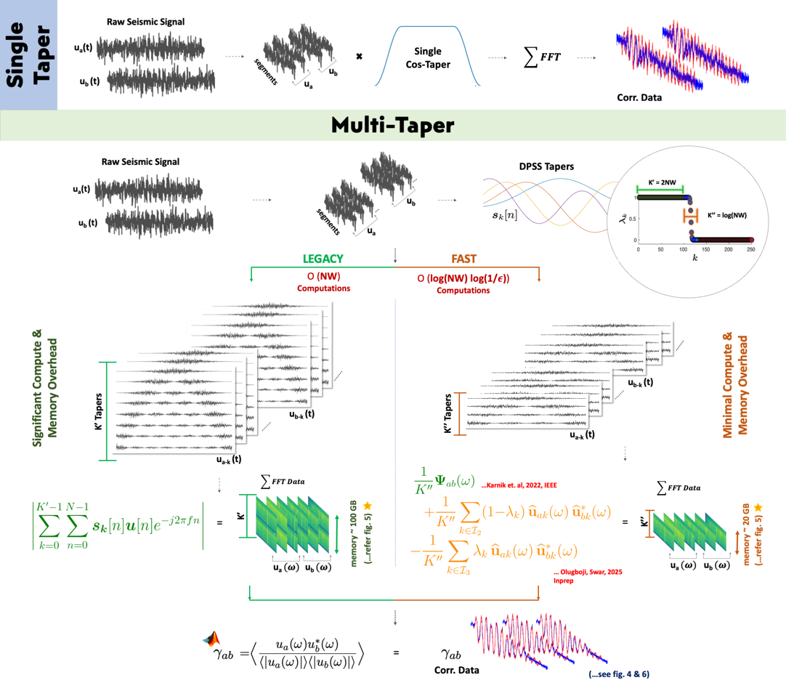
Multi-Taper Workflow

Slide 8
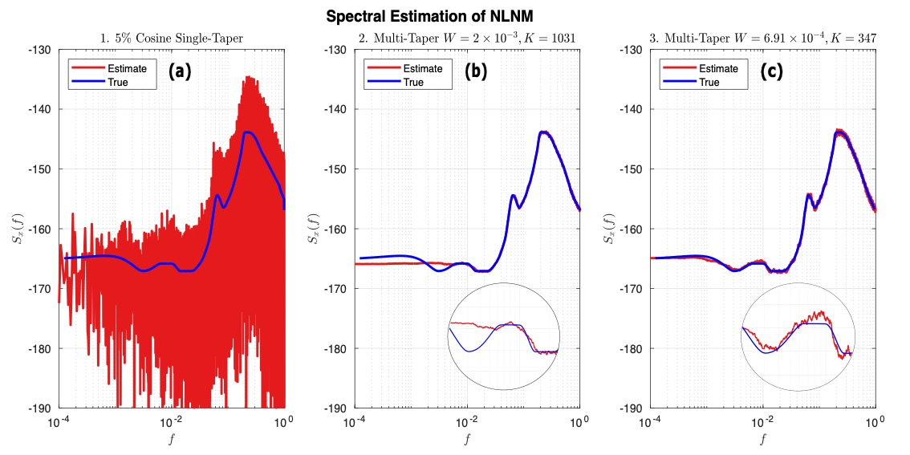
Does Multi-Taper Works on Synthetic Datasets
Baseline test: Synthetic ambient-noise waveform generated using NLNM spectrum (Peterson, 1993)
Methods compared: Conventional single-taper PSD vs. proposed multi-taper PSD.
Single-taper result (Fig. 2a): High variance and strong spectral fluctuations especially in high dynamic-range bands.
Multi-taper result (Fig. 2b): Smooth, stable PSD reconstruction with reduced variance and minimal bias.
Multi-taper approach demonstrates superior robustness, motivating its use for subsequent cross-correlation analysis.

Slide 9
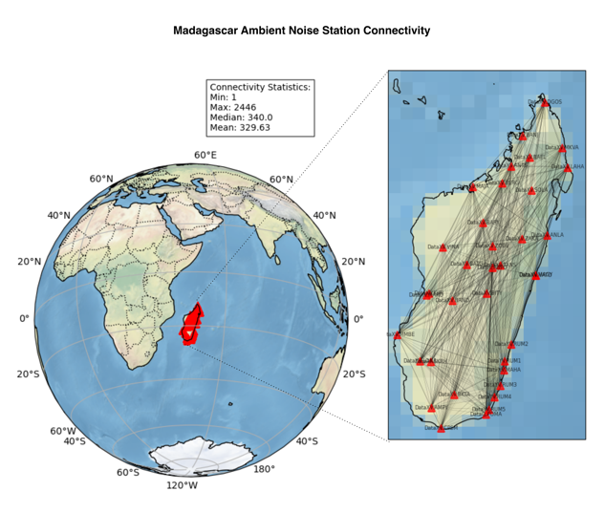
Real World Dataset
Seismic stations in Madagascar used in this study, along with station-pair connectivity statistics.
Edge widths between station pairs indicate the relative number of overlapping operational days.

Slide 10
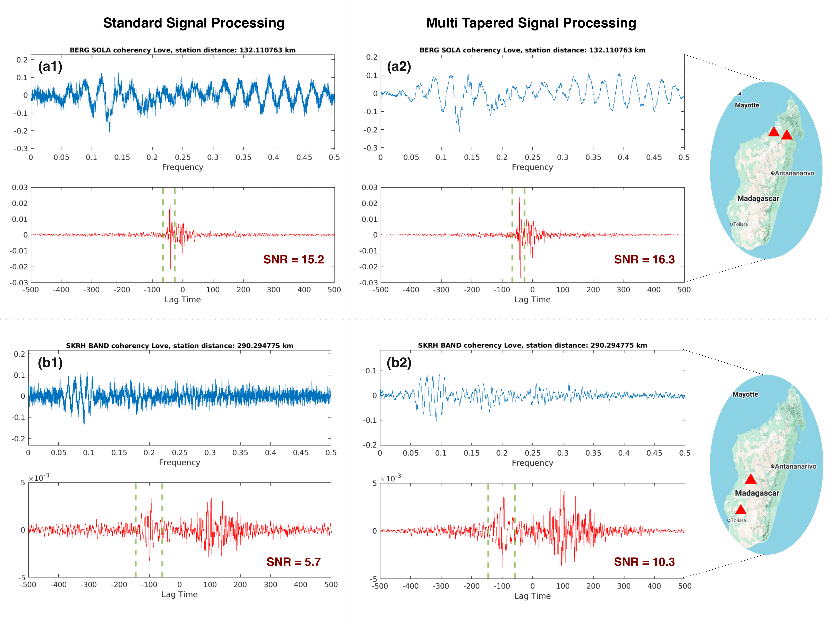
Results: Frequency and Time Domain CCFs
Frequency-domain results:
Single-taper method shows high stochastic variability in cross-spectra, especially in low-stability noise bands.
Fast-Mspec (multi-taper) yields smoother, more stable spectral correlation estimates.
Achieves improvements without phase distortion or filtering-induced delays.
Time-domain correlations:
Fast-Mspec consistently produces higher SNR across station pairs.
Indicates more reliable extraction of coherent ambient seismic energy.

Slide 11
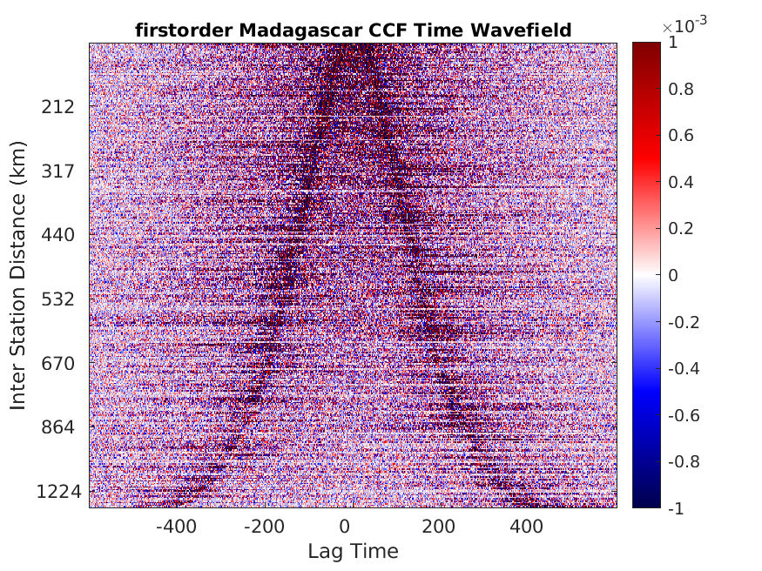
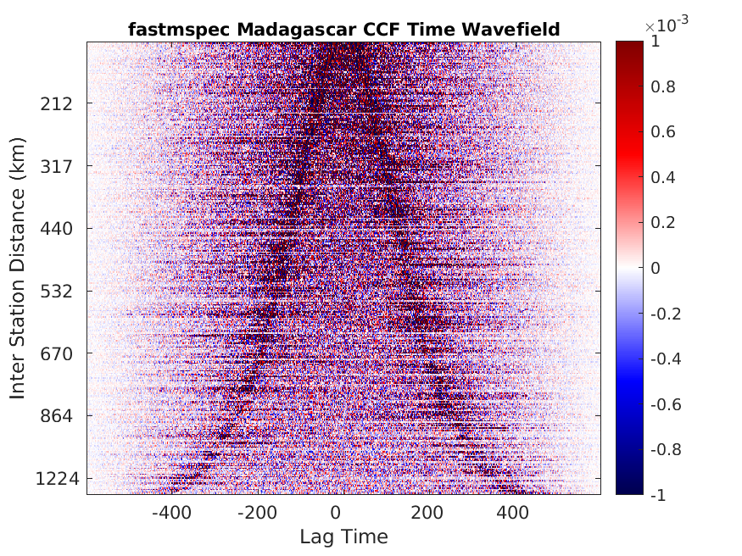
Results: Time Domain Correlation Wavefield Comparison
Fast-Mspec produces cleaner, more coherent stacked time-domain cross-correlations.
Clear phase arrivals are visible in Fast-Mspec results (right).
Classical first-order processing (left) shows higher residual noise, especially for short inter-station distances.
Indicates Fast-Mspec better suppresses incoherent local noise during wavefield stacking.

Slide 12
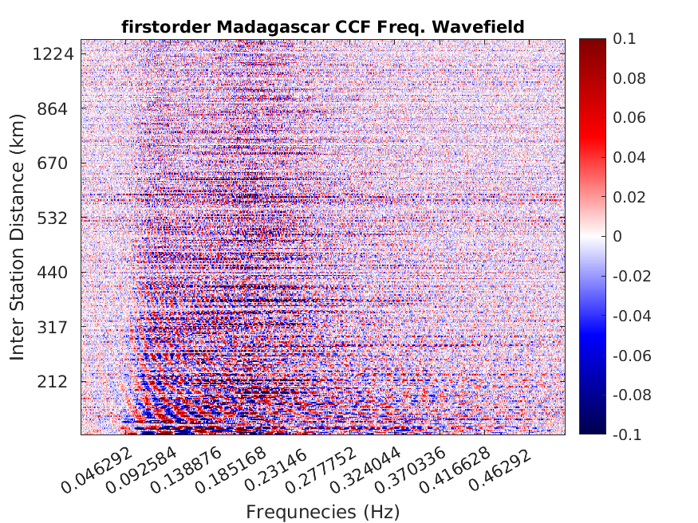
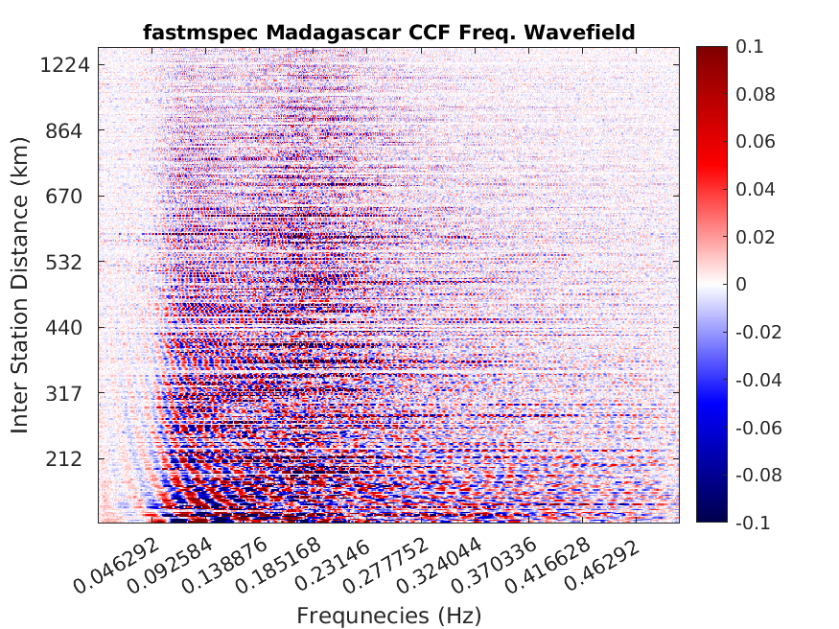
Results: Frequency Domain Correlation Wavefield Comparison
The frequency–distance diagram acts like a phase-velocity map, showing dispersive Love-wave trends.
Fast-Mspec (right) shows clear, coherent red–blue dispersive bands, especially at mid-to-high frequencies.
High-frequency energy attenuates faster, and Fast-Mspec captures this behavior accurately.
Compared to the classical approach (left), Fast-Mspec yields cleaner patterns with lower noise, especially in the 0.08-2.5 Hz band where SNR is typically poor.

Slide 13
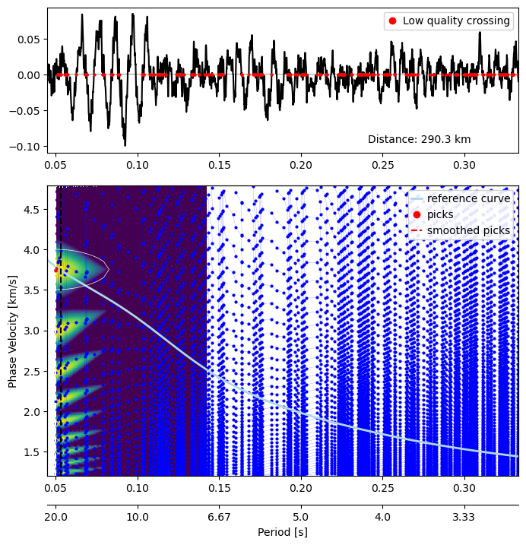
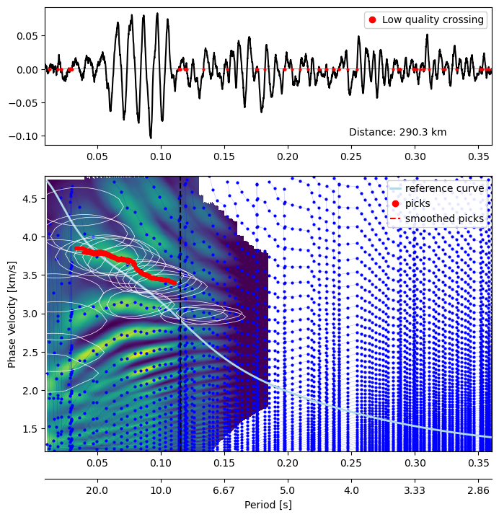
Results: SeisLib Phase Velocity Results
Phase velocities estimated using SeisLab (Magrini et al., 2022) via zero crossings of the cross spectrum
Moving Windowed CCFs unstable or non-convergent zero-crossing sequences.
Results in poor, unreliable phase-velocity estimates.
Produces low-variance, coherent CCFs stable and consistent zero-crossing identification.
Yields robust and reliable phase-velocity curves.

Slide 14
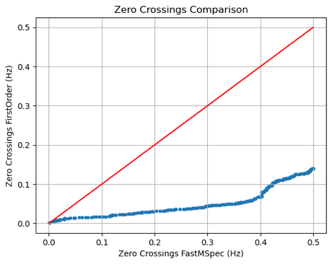
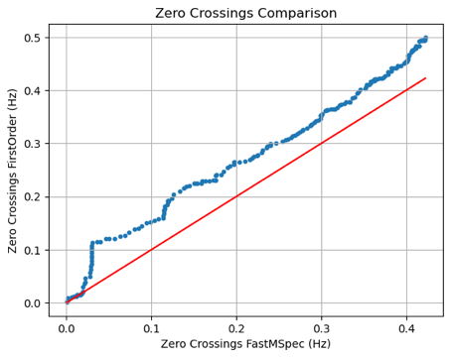
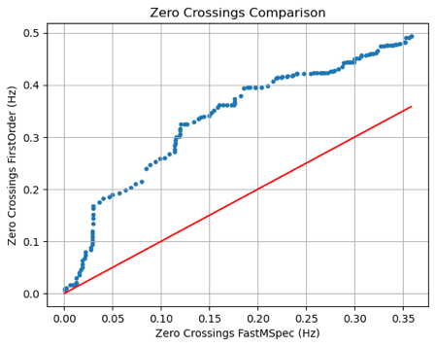
Results: Zero Crossings Variations
Problem with smoothing: Excessive spectral smoothing shifts zero-crossing positions, increasing uncertainty in dispersion estimates.
Window = 5: Zero-crossing structure largely preserved.
Window = 50: Noticeable drift in zero-crossing locations.
Window = 100: Significant shifts, unreliable phase-velocity retrievals.
Fast-Mspec avoids large smoothing windows, achieving variance reduction without distorting the zero-crossing structure thus more accurate dispersion measurements.

Slide 15

References
Olugboji, Tolulope, and Siyu Xue. "A Short‐Period Surface‐Wave Dispersion Dataset for Model Assessment of Africa’s Crust: ADAMA." Seismological Society of America 93.3 (2022): 1943-1959.
Karnik, Santhosh, Justin Romberg, and Mark A. Davenport. "Thomson’s multitaper method revisited." IEEE Transactions on Information Theory 68.7 (2022): 4864-4891
Tkalčić, H., Phạm, T.S. and Wang, S., 2020. The Earth's coda correlation wavefield: Rise of the new paradigm and recent advances. Earth-Science Reviews, 208, p.103285.
Peterson, Jon R. Observations and modeling of seismic background noise. No. 93-322. US Geological Survey, 1993.
Fabrizio Magrini, Sebastian Lauro, Emanuel Kästle, Lapo Boschi, Surface-wave tomography using SeisLib: a Python package for multiscale seismic imaging, Geophysical Journal International, Volume 231, Issue 2, November 2022, Pages 1011–1030, https://doi.org/10.1093/gji/ggac236
Aki, K. (1957). Space and time spectra of stationary stochastic waves, with special reference to microtremors. Bulletin of the Earthquake Research Institute, 35, 415–456.
Yokoi, T., & Margaryan, S. (2008). Consistency of the spatial autocorrelation methodwith seismic interferometry and its consequence
Thomson, D. J. (1982). Spectrum estimation and harmonic analysis. Proceedings of the IEEE, 70(9), 1055–1096.
Peterson, Jon R. Observations and modeling of seismic background noise. No. 93-322. US Geological Survey, 1993.
Notes:
Comments:
Implementation of something
Systematic evaluation of It
Make sure if we have metrics to show that if it works
If it doesn't work then come up with a reason and tell why? Go back, and tell what went wrong and if it can be improved with something? What all steps did I take to check why it different work and have a report for that. Have that report that has the analysis and decide.
Can I use my beamformer as a prior than the neural net.

