Slide 1
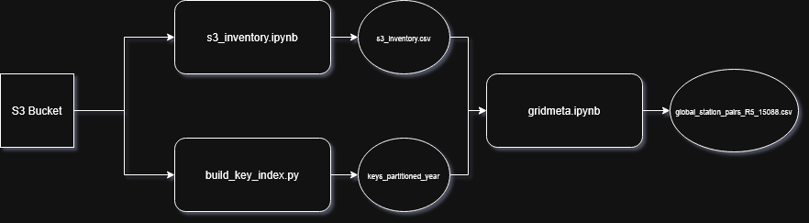
Metadata Pipeline

Slide 2
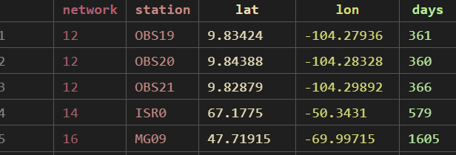
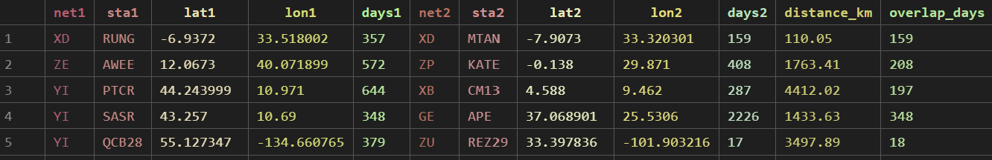
Metadata Pipeline
_{S3_inventory:}
Scan S3 bucket + populate metadata using FSDN earthscope client
_{build_key_index:}
Paginates through S3 bucket and saves to parquet
_{Gridmeta:}
Through immense filtering generates station pairs of which are used in the CC step
_{S3_inventory:}
_{Gridmeta pairs:}

Slide 3
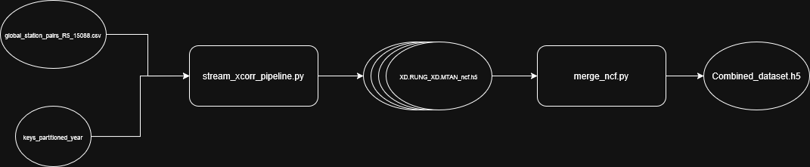
CC Pipeline
.\NCF_Output

Slide 4
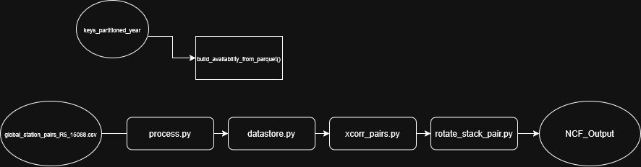
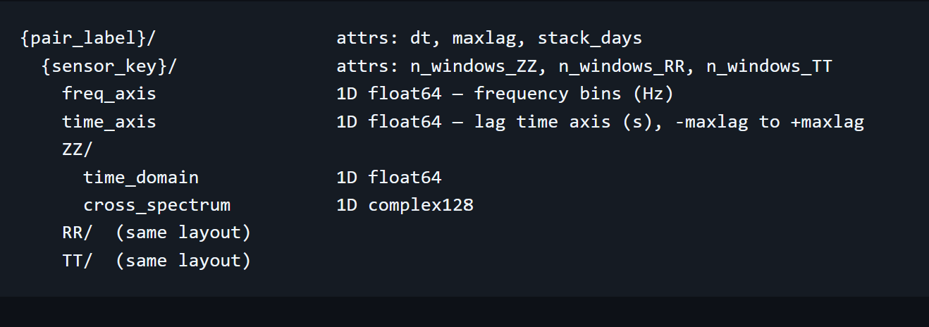
CC Pipeline

Slide 5
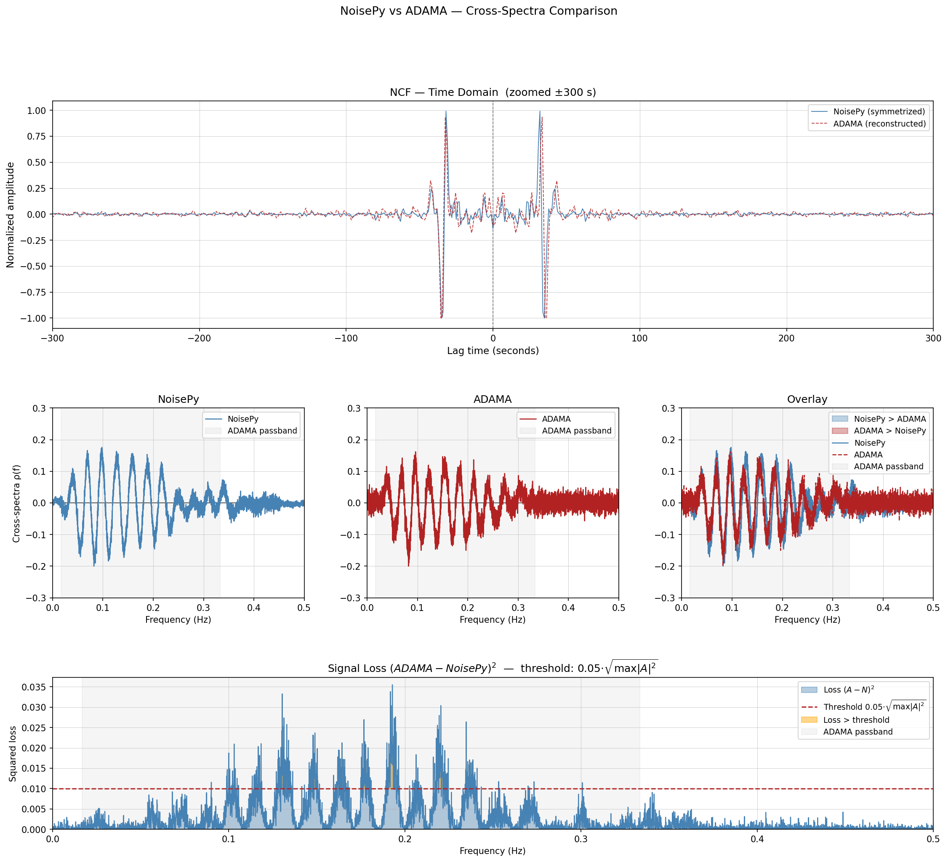
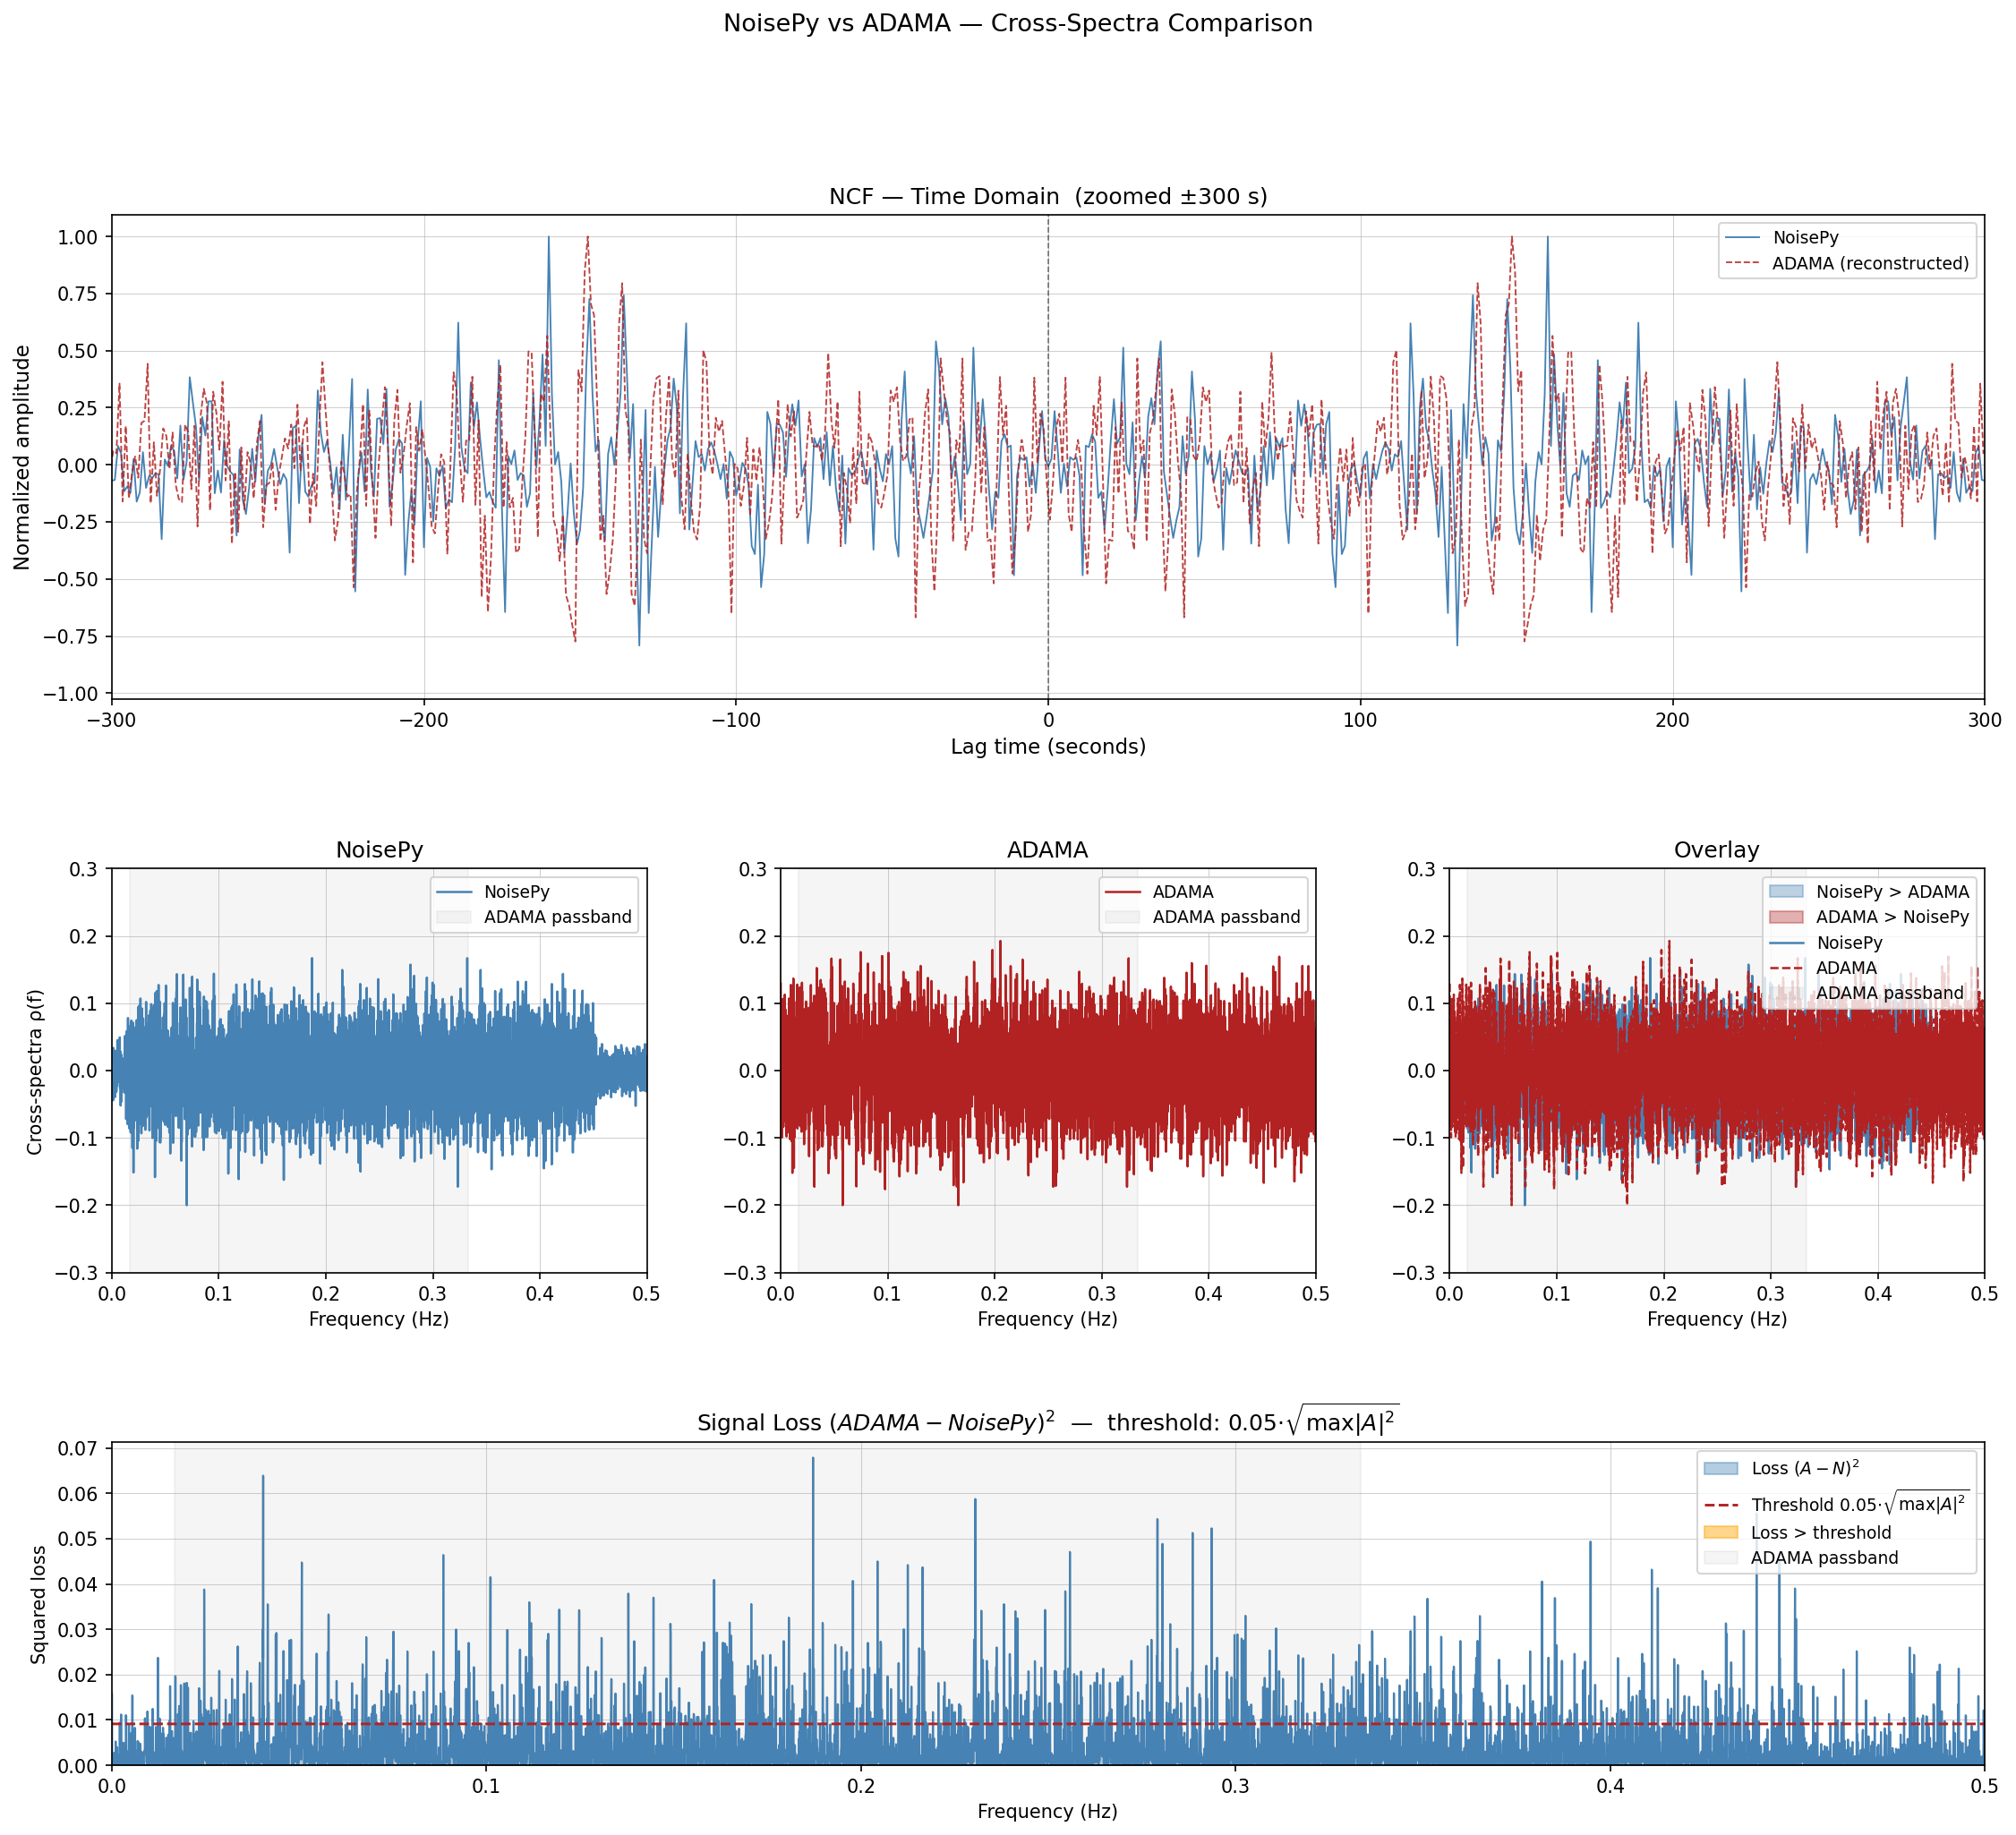

Slide 6
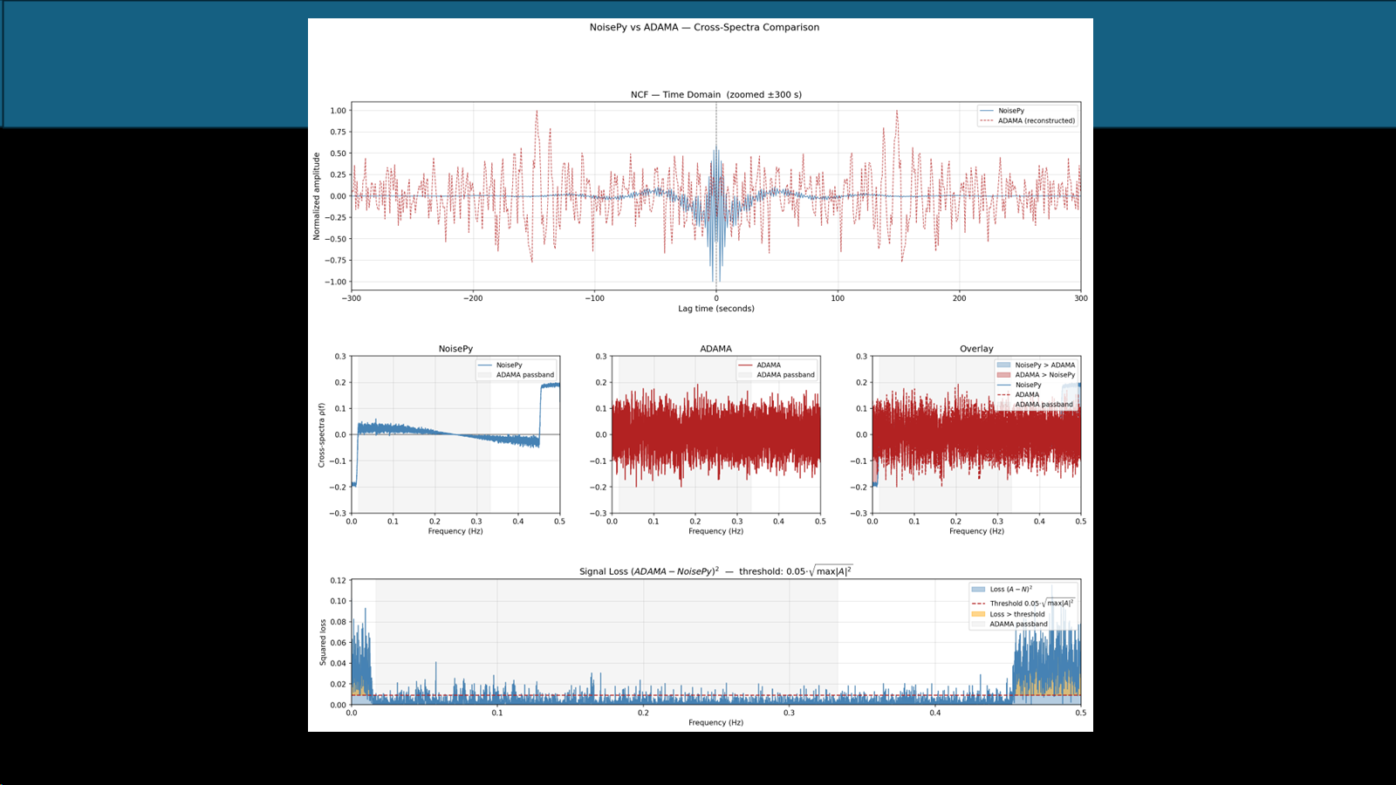
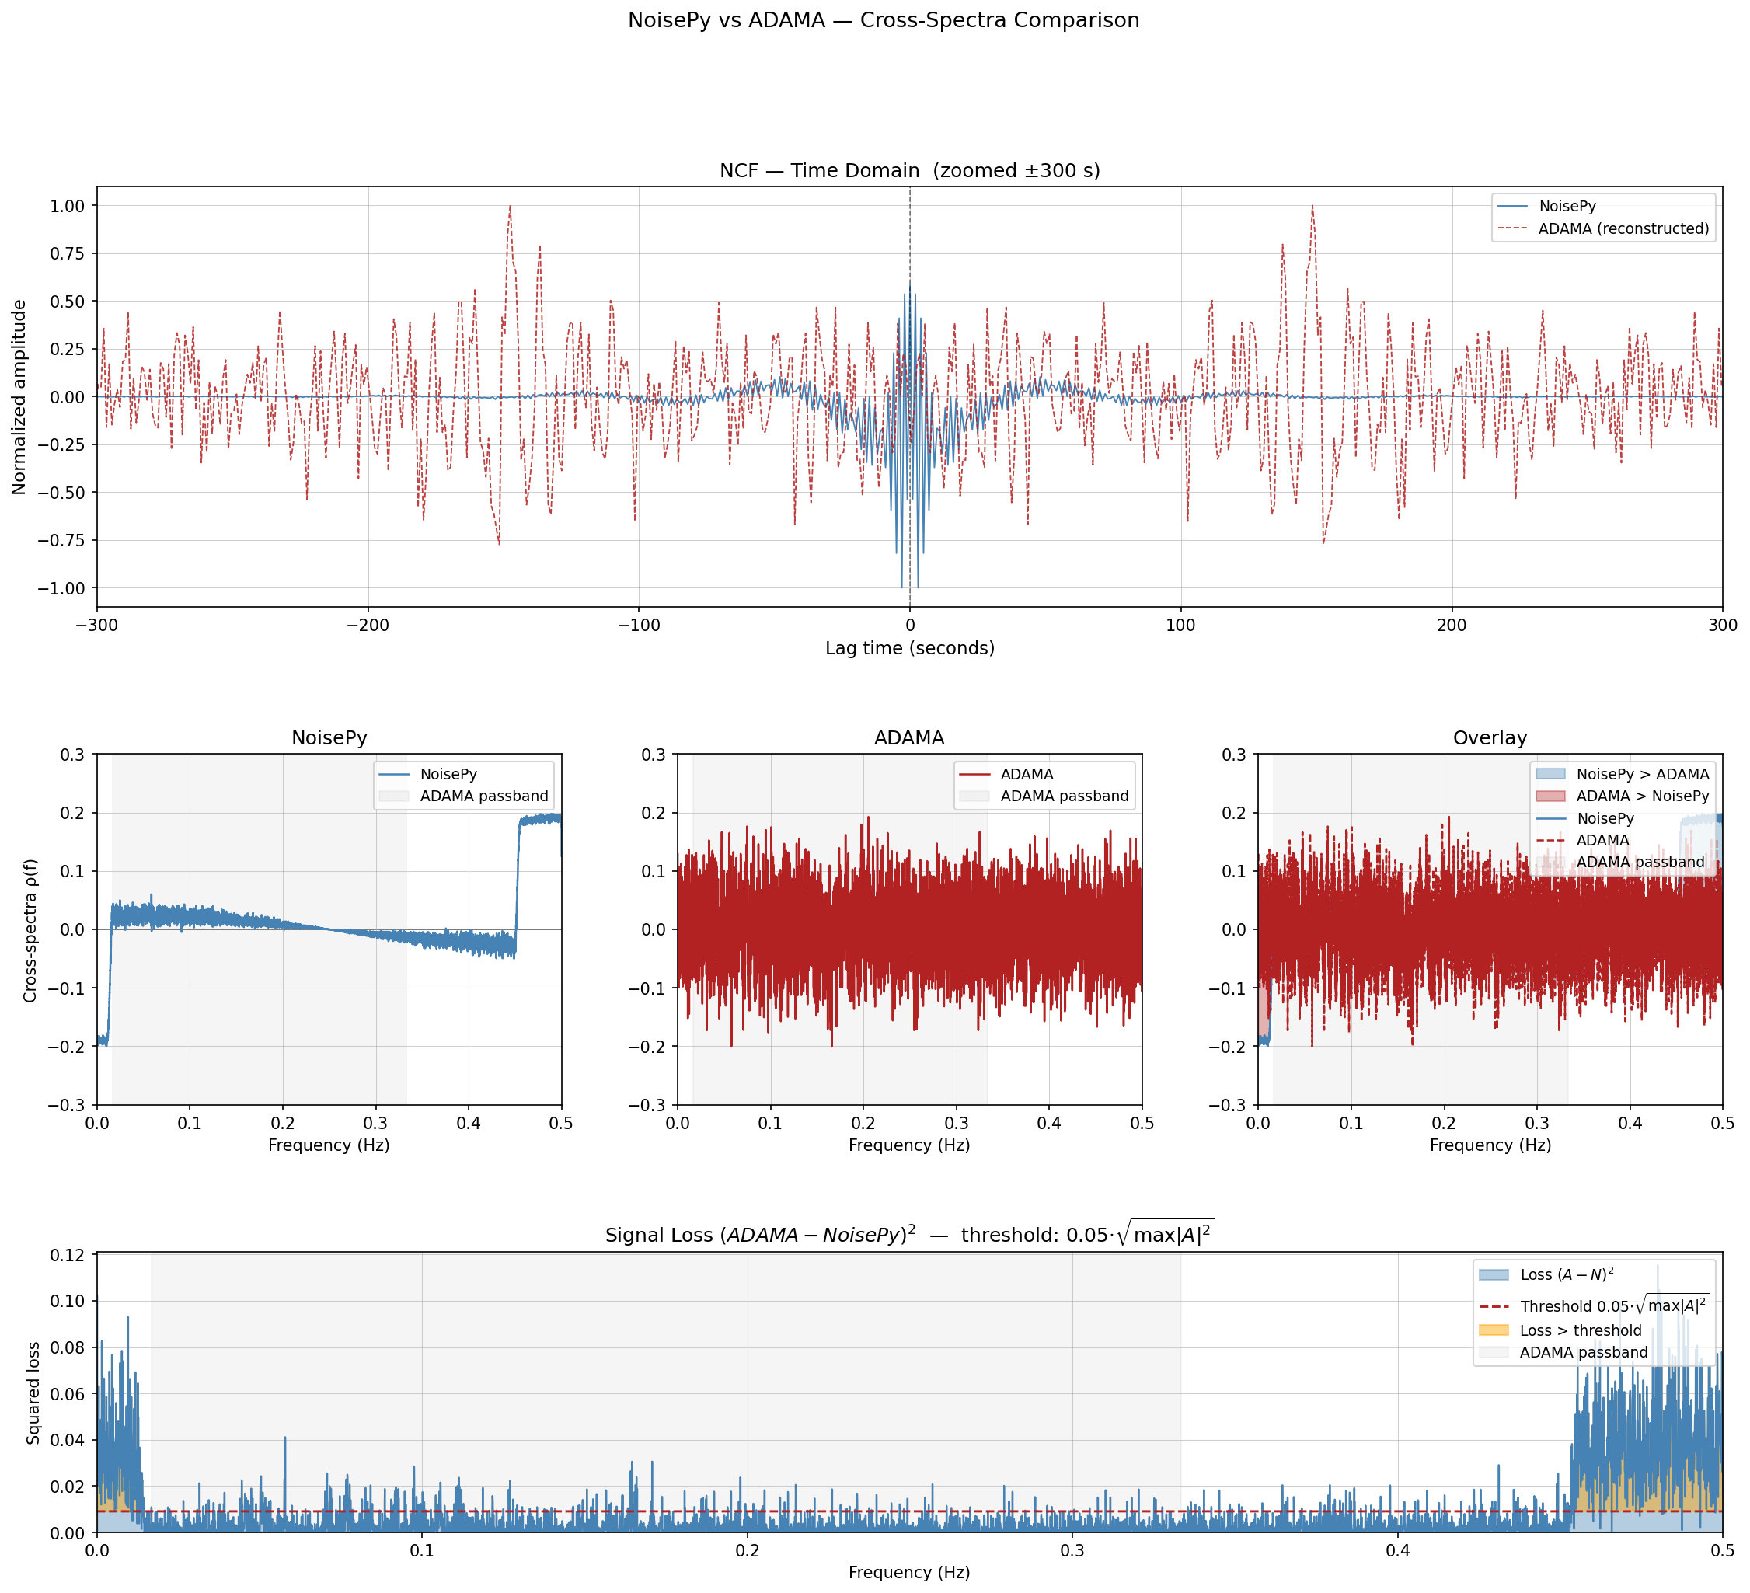

Slide 7
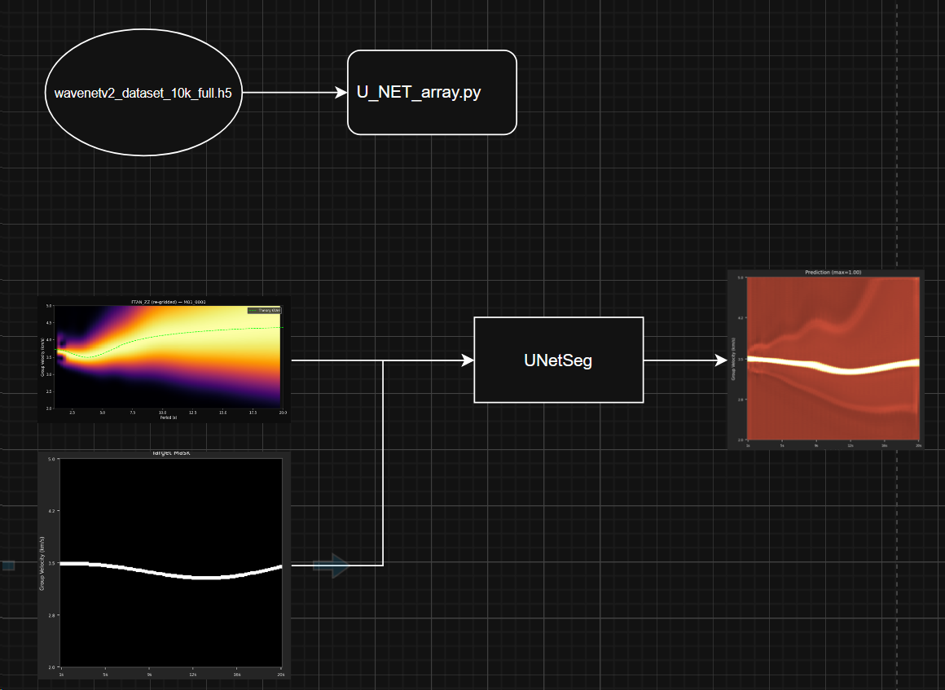
ML Pipeline

