Slide 1
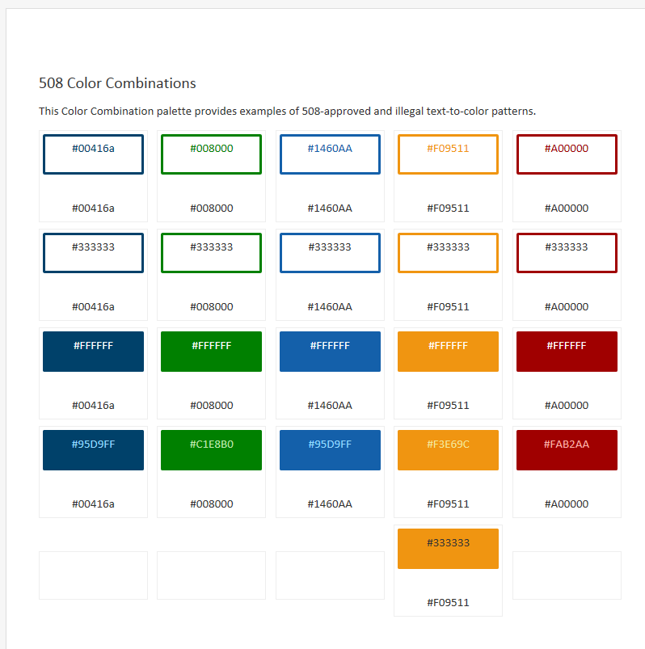
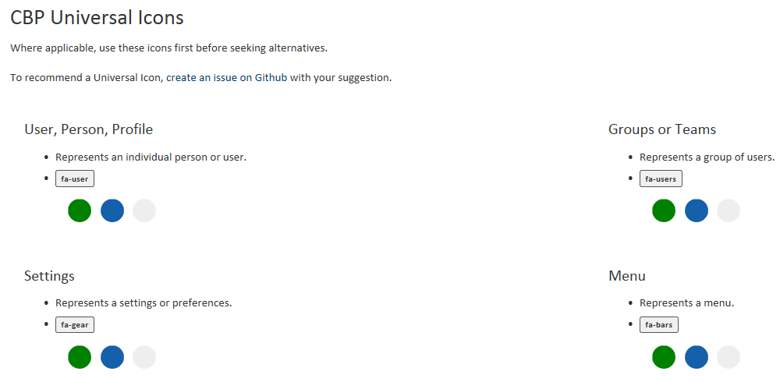
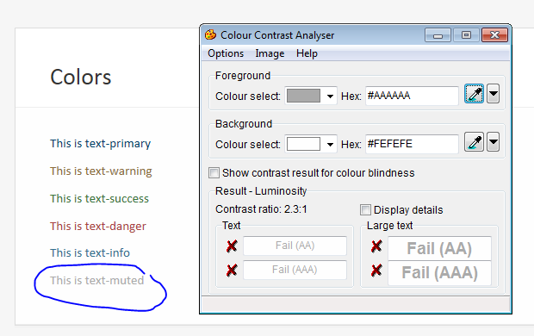
CBP Style Guide and Section 508 – 10-3-2016
#2. The examples show a light gray icon on white which is not compliant. Granted it is just an example, but by showing a non-compliant example, they will replicate it.
#1 – The note indicates that the chart includes “approved and illegal” color combos, will we be expanding that to indicate which is which?
#3. the muted text in typography is not compliant against the white background. Contrast ratio must be 4.5:1 or higher. All other colors shown here are compliant.

Slide 2
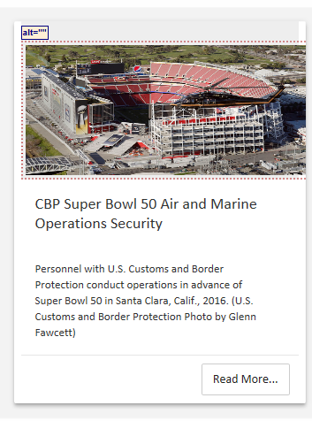
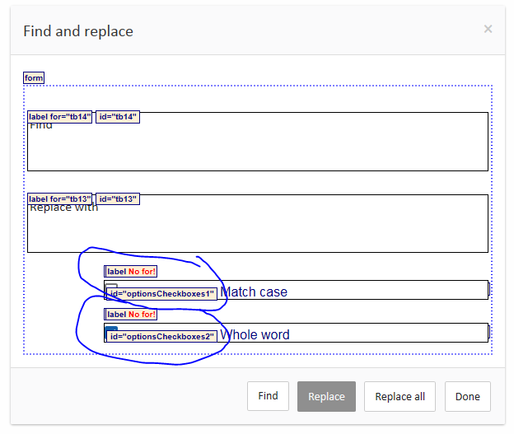
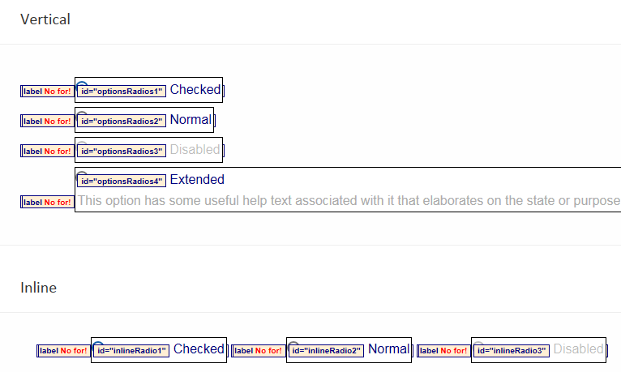
#4. Items in the style guide are not keyboard accessible. I can’t get focus to move out of the navigation pane and into the actual style guide. This prevents some of the functional 508 testing like ensuring all interactive elements (like Accordions) are keyboard accessible. Looks like we have removed any that use arrows as indicators? The key test for 508 on these is to ensure that when new content is revealed, focus moves to the new content. Currently not testable.
#5. Similar to the accordions, where an alert comes in, it is now considered revealed content and focus should go to the alert when it enters the page. This would cause a screen reader to recognize and announce the message.
#8. Probably good to add here that for a modal box, this prevention includes ensuring that keyboard functions (tabbing) also does not allow the user access to other areas of the application until the expected action in the modal is taken.
#9. All radio buttons and checkboxes need markup to associate them to their instructions. Label for and ID are the most commonly used form for this. Need exactly matching text in both the label for and ID for any given form control. Applies to radio buttons, checkboxes, and toggles (the toggles are currently correctly marked up).
#7. For the find and replace dialog box, the checkboxes need matching label for and ID. These can also use title for markup, but since you started with label for and ID, might as well just get those matching.
#6. Image needs alt text for the screen reader to tell a blind user “photo of football stadium” or similar text.

Slide 3
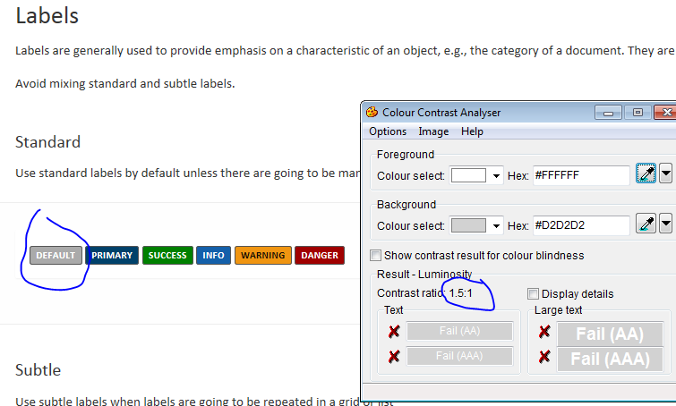
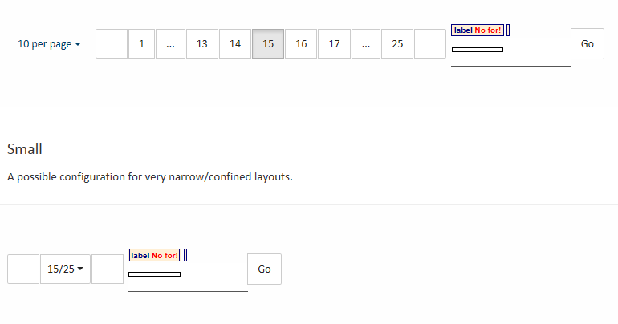
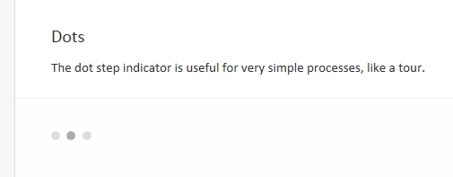
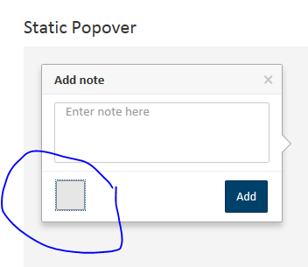
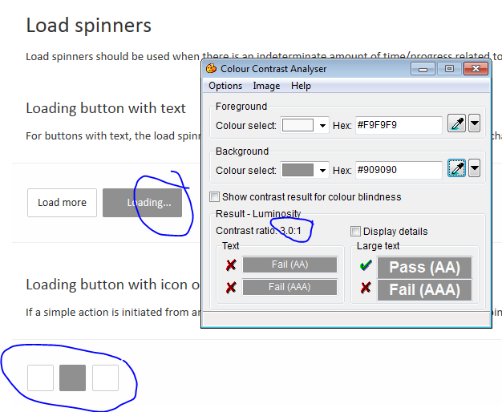
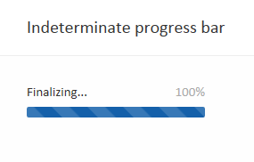
#11. The blanks where the user can input the page they want to jump to needs mark up. Label for and ID to tell them what the expected input would be.
#10. The Default button color combo above is not compliant for contrast.
#15. Color contrast too low and a colorblind or low vision user would likely only see the middle dot if any.
#16. Every table needs scope=col and scope=row mark-up. Even ones that are not “true” tables, but use a table style layout to present data.
#12. There are 2 stray focus elements between the input text box and the Add button. Need to ensure they are not in the sample code.
#13. A color blind user would not be able to detect the difference in these 2 blues, and would see this as a solid color. Needs higher contrast between the 2 colors and we will need to set the animation rate to avoid seizures.
#14. Need a darker gray to meet the contrast requirement here.

Slide 4
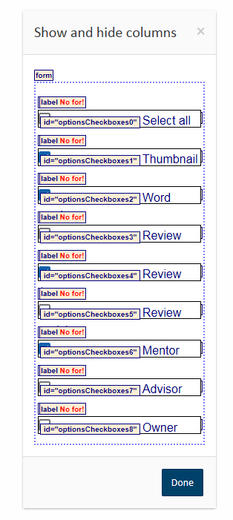
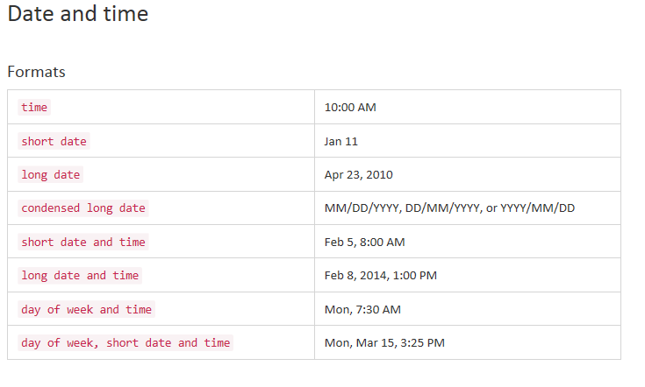
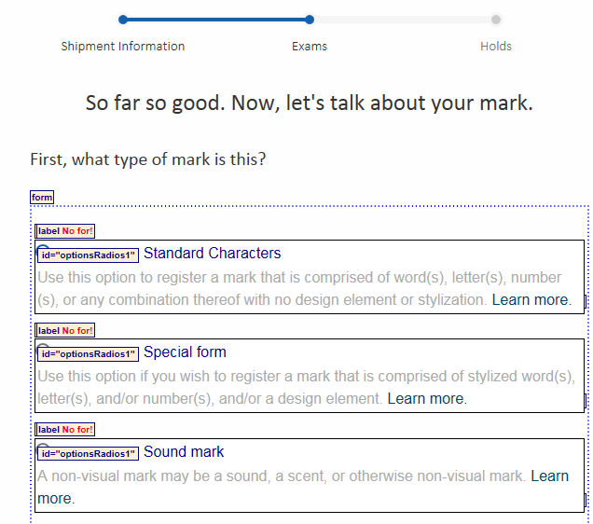
#21. And ensure that visible focus goes to the info icon so that a keyboard only user can access it .
#22. And ensure that the link has additional text to identify what the user will be learning more about, especially where there could be more than one “Learn more” on a page.
#23. Is the blue square meant to have a magnifying glass icon in it? I’m using IE 10, so if its supposed to be there, be aware that it is not showing.
#18. CSPD requires military times versus AM and PM. For CBP overall, that’s probably a better approach as well. I’m thinking enforcement and because our business runs 24/7.
#19. Label for and matching ID for file updoads.
#20. Label for and matching ID for MOT checkboxes in vertical filters.
#17. The show and hid columns checkboxes all require label for and id markup so a user knows which column they are showing or hiding.
#24. Need label for and matching ID mark up for radio buttons in Wizards area.

