Slide 1






Redis
Get / Post
http://localhost:8000/bindingname
{
"user":"johndoe"
}
Kafka
App
Event Hubs
Twitter
SQS

Slide 2



Redis
Event Hubs
App
“myApp”
DynamoDB
Post
http://localhost:3500/v1.0/bindings/bindingname
CosmosDB
{
"data":
{
"sku":"v100",
"quantity":"50"
}
}
Kafka
Twilio

Slide 3

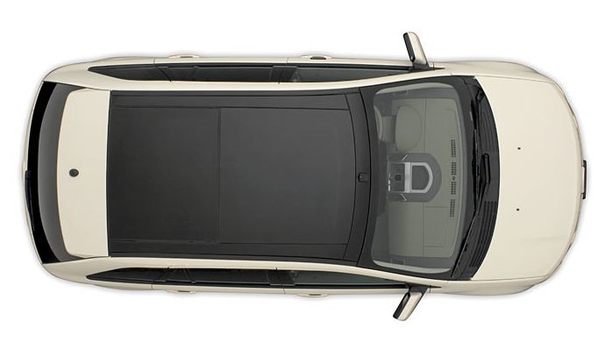
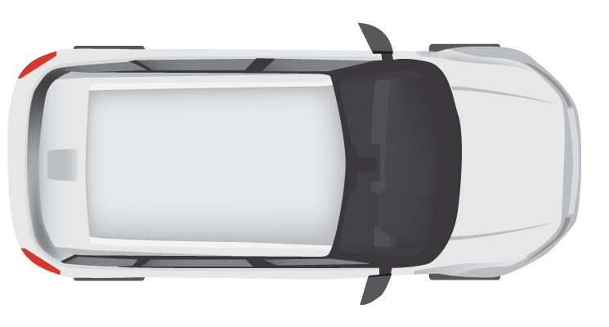
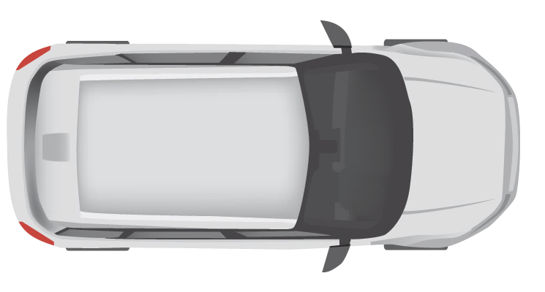
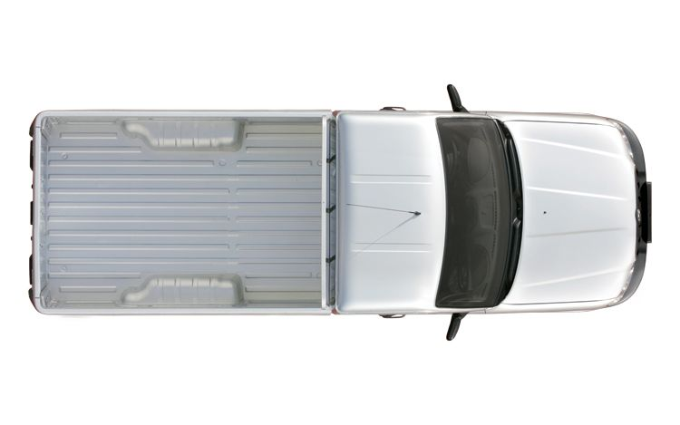



10 km
Entry Cam 1
Exit Cam 1
Entry Cam 2
Exit Cam 2
Entry Cam 3
Exit Cam 3
Department Of
Motor Vehicles (DMV)
Central Fine Collection Agency

Slide 4
Camera
Simulation
Traffic
Control
Service
Fine
Collection
Service
Vehicle
Registration
Service
/entrycam
/vehicleinfo/ {license-number}
/collectfine
/exitcam

Slide 5
Camera Simulation
Traffic Control
Service
Fine Collection Service
Vehicle Registration Service
Camera
Simulation
/entrycam
/exitcam
/collect fine
/vehicle
info
POST VehicleRegistered
Random
Interval
Store VehicleState
POST VehicleRegistered
Get VehicleState
Calculate Average Speed
[AvgSpeedOverLimit]
POST SpeedingViolation
Calculate Fine
GET /vehicleinfo/13-XK-46
Send Email

Slide 6






Camera
Simulation
MQTT
Sidecar
Traffic
Control
Service
5
5
5
/entrycam
7
5
/exitcam
2
3
Redis
3
RabbitMQ
2
Sidecar
Fine
Collection
Service
2
2
/collectfine
1
4
6
SMTP
4
1
Sidecar
Vehicle
Registration
Service
Secrets
1
/vehicleinfo/ {license-number}
6
1
Service invocation
3
State management
5
Input binding
7
Actors
2
Publish / subscribe
4
Output binding
6
Secrets management

Slide 7
Camera Simulation
Traffic Control
Service
Fine Collection Service
Vehicle Registration Service
Camera
Simulation
MQTT
/entrycam
/exitcam
Redis
RabitMQ
/collect fine
/vehicle info
SMTP
VehicleRegistered
VehicleRegistered
Random
Interval
Store VehicleState
VehicleRegistered
VehicleRegistered
Get VehicleState
Calculate Average Speed
[AvgSpeedOverLimit]
SpeedingViolation
SpeedingViolation
Calculate Fine
GET /vehicleinfo/13-XK-46
InvokeBinding
Send email

Slide 8





Camera
Simulation
Sidecar
Traffic
Control
Service
5
5
5
/entrycam
5
/exitcam
2
3
3
2
Sidecar
Fine
Collection
Service
2
2
/collectfine
1
4
6
4
1
Sidecar
Vehicle
Registration
Service
1
/vehicleinfo/ {license-number}
6
1
Service invocation
3
State management
5
Input binding
2
Publish / subscribe
4
Output binding
6
Secrets management

Slide 9




Camera Simulation
Traffic Control
Service
Fine Collection Service
Vehicle Registration Service
Camera
Simulation
/entrycam
/exitcam
/collect fine
/vehicle info
VehicleRegistered
VehicleRegistered
Random
Interval
Store VehicleState
VehicleRegistered
VehicleRegistered
Get VehicleState
Calculate Average Speed
[AvgSpeedOverLimit]
SpeedingViolation
SpeedingViolation
Calculate Fine
GET /vehicleinfo/13-XK-46
InvokeBinding
Send email

Slide 10
Assignment 2:
Camera
Simulation
Traffic
Control
Service
/entrycam
/exitcam
Sidecar
Fine
Collection
Service
/collectfine
1
1
Sidecar
Vehicle
Registration
Service
1
/vehicleinfo/ {license-number}
1
Service invocation

Slide 11
Assignment 3:
Camera
Simulation
Sidecar
Traffic
Control
Service
/entrycam
/exitcam
2
2
Sidecar
Fine
Collection
Service
2
2
/collectfine
1
1
Sidecar
Vehicle
Registration
Service
1
/vehicleinfo/ {license-number}
1
Service invocation
2
Publish / subscribe

Slide 12
Assignment 4:
Camera
Simulation
Sidecar
Traffic
Control
Service
/entrycam
/exitcam
2
3
3
2
Sidecar
Fine
Collection
Service
2
2
/collectfine
1
1
Sidecar
Vehicle
Registration
Service
1
/vehicleinfo/ {license-number}
1
Service invocation
3
State management
2
Publish / subscribe

