Slide 1
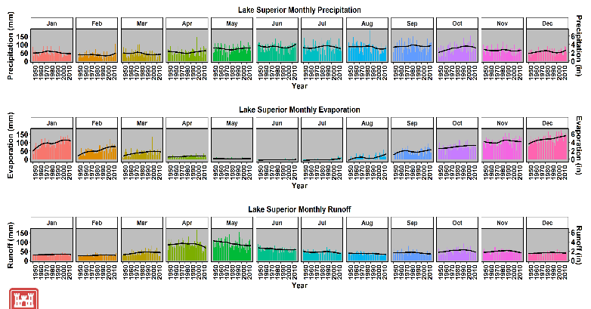
Using the ggplot2 package in r to create time-series plots
Deanna Apps
Great Lakes Hydrology and Hydraulics
Detroit District
September 23, 2019

Slide 2
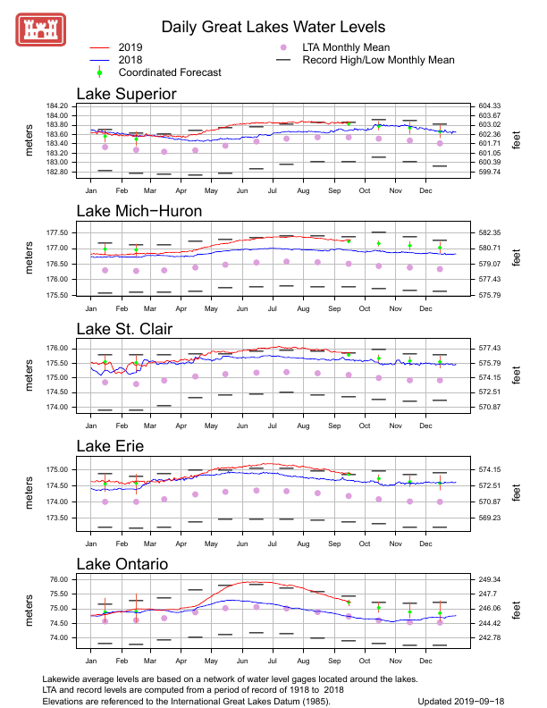
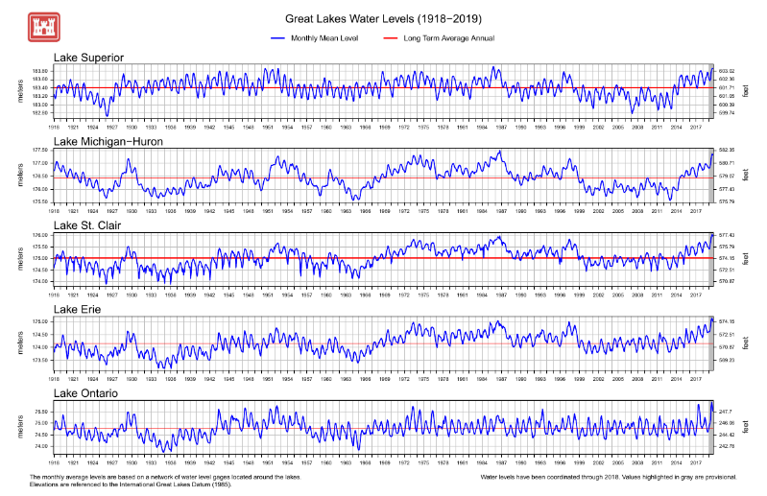
Mission: Great Lakes water levels Forecasting

Slide 3
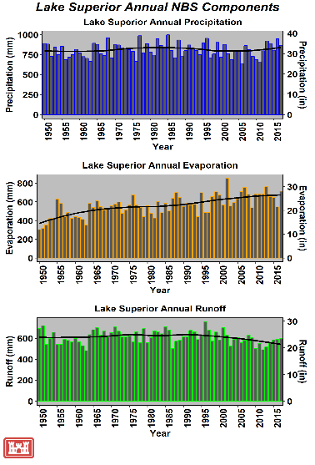
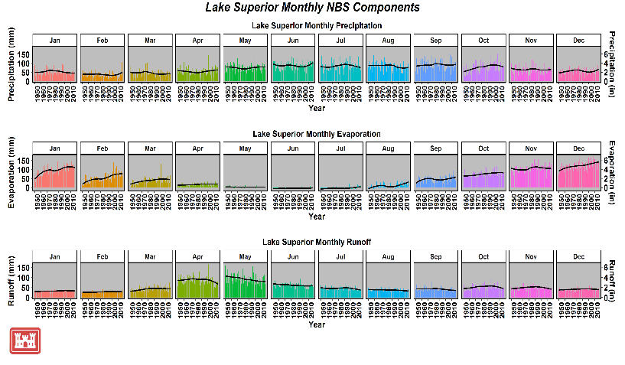
Basin conditions
https://www.lre.usace.army.mil/Missions/Great-Lakes-Information/Great-Lakes-Information-2/Basin-Conditions/

Slide 4
Creating plots with ggplot2 package
Walk through steps from importing data to manipulating data for creating graphics
Show example code to create graphics on previous slide
Point out tips that I’ve learned along the way (some of you may have others)
Talk about a couple packages in addition to ggplot2 that I have recently used to make better graphics
Main Resource I reference: https://www.rstudio.com/wp-content/uploads/2015/03/ggplot2-cheatsheet.pdf

Slide 5
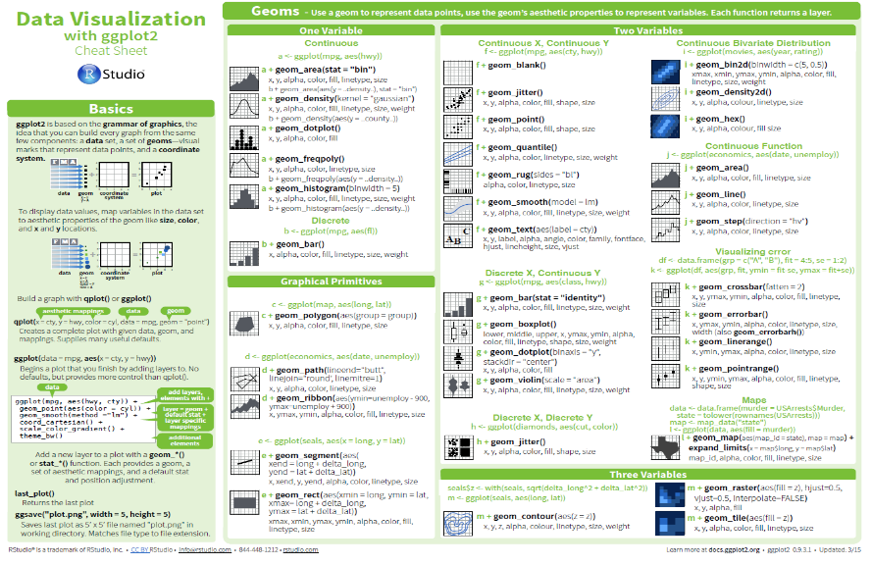
Creating plots with ggplot2 package
https://www.rstudio.com/wp-content/uploads/2015/03/ggplot2-cheatsheet.pdf

Slide 6
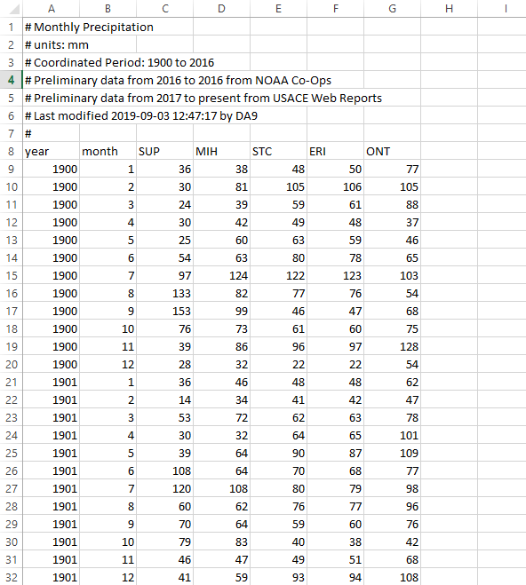
Setup workspace and loading data
Setup directories and load appropriate libraries. For this script, the following libraries were used: ggplot2, data.table, zoo, hydroTSM, stringr, gridExtra, grid, ggthemes, png
Read in the data (all of our data is formatted in csv format, example below)
precip.data<-read.csv(paste(wb.dir, precip.dir, 'precip.monthly.csv', sep='/'), skip=7)
3. To create annual time series use zoo package
precip.data2<-zoo(precip.data[,3:7], order.by=as.Date(paste(precip.data$year, precip.data$month, 15, sep='-')))
precip.sum<-monthly2annual(precip.data2, FUN=sum)
*allows the ability to take monthly data and quickly calculate an annual sum. (other variations exist: subdaily2daily, daily2monthly etc.)

Slide 7
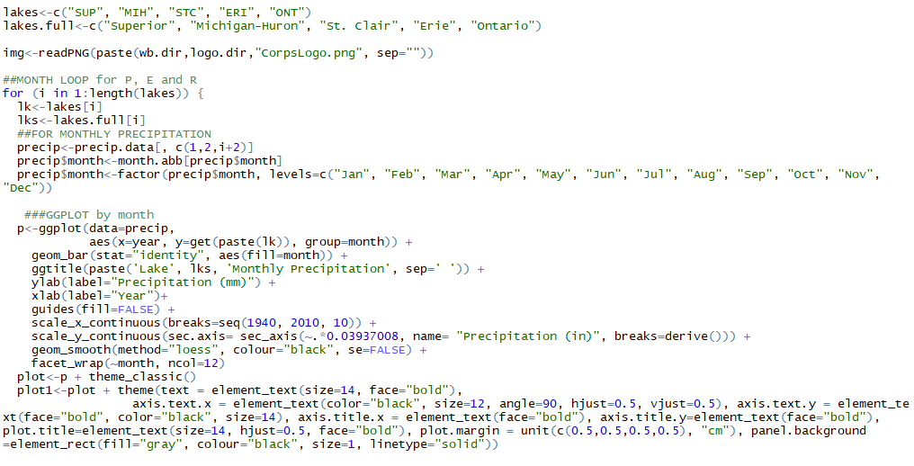
4. Making the Monthly plot
Looping by lake
Set the months as factors or else will plot months in alphabetical order
Data=dataframe name
X= data on x axis (date)
Y= data to be plotted (precip)
Group= partitions the data by this variable
Creates bar chart. stat=“identity” is for establishing heights of the bars as a value. aes(fill=month) establishes a different color for each month that is plotted.

Slide 8
4. Making the Monthly Plot
This is setting the scales for the x and y axis. On the y axis I am creating a secondary axis that converts mm to inch
Setting Axes Titles
Guides(fill=FALSE) means no legend will be plotted based on the fill varaible
Facet wrap tells the plot what to plot by or how you want the plot laid out. It’s typically your group variable.
This plots the trend line on the chart. This method is using a locally weighted regression (can choose other methods). Se is for confidence interval.

Slide 9
5. Making Aesthetic adjustments
Theme_classic() is one of four themes to choose from that has a white background and no gridlines. Other choices are noted on the reference cheat sheet.
These are justifications made to the layout of the plot: font size, font face, color, axis text justification, margins, and the last argument adjusts the panel background color.

Slide 10
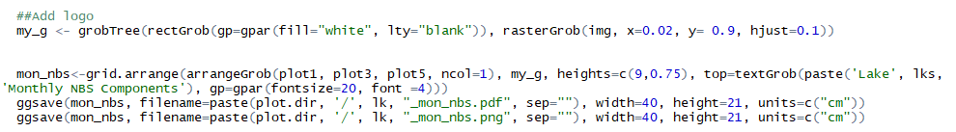
6. Constructing the entire plot
Do the same previous steps for precipitation, evaporation, and runoff to create 3 separate charts for each variable by month. Now we can construct the plot.
Create a graphical object out of the logo that can be added to the total plot with arrangeGrob and grid.arrange.
Using ggsave you can save as “png”, "eps", "ps", "tex" (pictex), "pdf", "jpeg", "tiff", "png", "bmp", "svg" or "wmf"

Slide 11
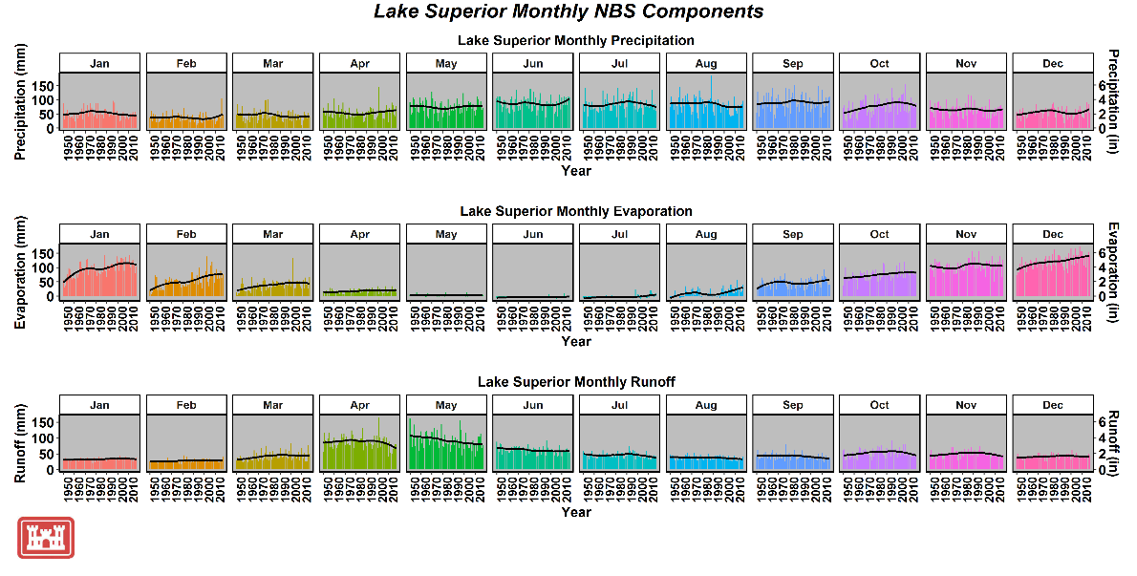

Slide 12
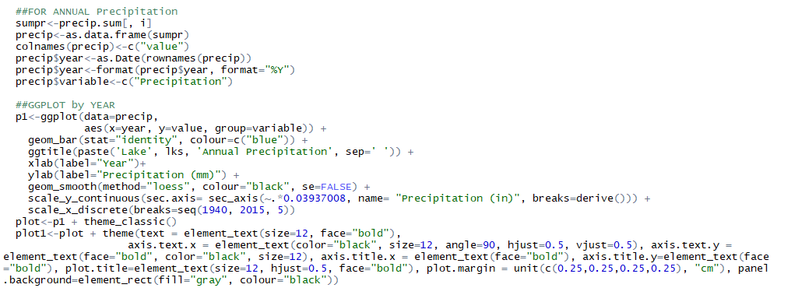
Making the annual plot
Converting the zoo object back to a dataframe for plotting and adding a year column based off the dates.
Very similar to last plot, no facet wrap because only plotting by year.
These are justifications made to the layout of the plot: font size, font face, color, axis text justification, margins, and the last argument adjusts the panel background color.

Slide 13
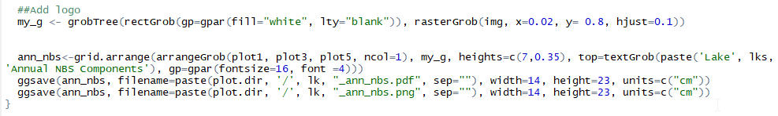
Constructing Annual plot
Do the same previous steps for precipitation, evaporation, and runoff to create 3 separate charts of a yearly time series. Now we can construct the plot.
Create a graphical object out of the logo that can be added to the total plot with arrangeGrob and grid.arrange.
Using ggsave you can save as “png”, "eps", "ps", "tex" (pictex), "pdf", "jpeg", "tiff", "png", "bmp", "svg" or "wmf"

Slide 14

Could I have created this differently?
Yes….

Slide 15
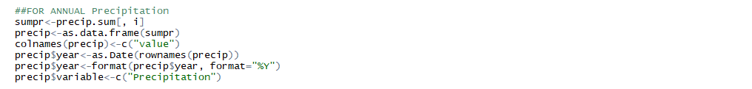
Alternate way to make annual plot
Instead of creating each plot for precipitation, runoff, and evaporation separately, could’ve merged the data into one data frame and plotted it using facet_wrap.
The variable column specifies which variable so when I merge them together will know the data source.

Slide 16
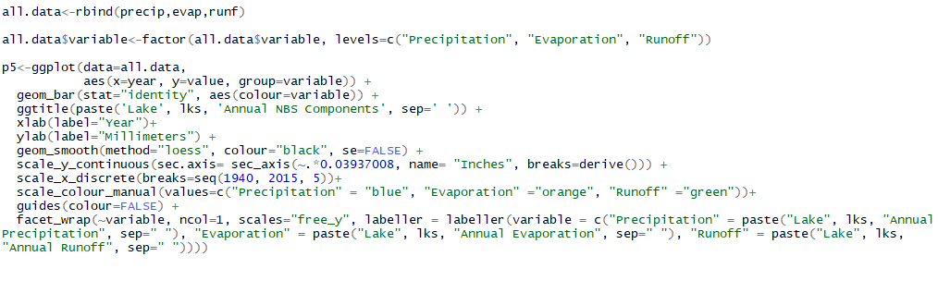
Alternate way to make annual plot
Will need to make adjustments within plotting structure to accommodate the use of one data frame.
Rbind all data into one data frame
Again, creating data variable as factors so the plots will be in the same order with precipitation first.
Adjust color of bars by variable name. Change title of entire plot here instead of each variable heading.
Making axes titles more general to just millimeters and inches.
Setting colors for each variable
Gets rid of legend
Facet_wrap parameters:
~variable: plot by variable column in data frame
Ncol= 1: want plots distributed in one column
Scales=“free_y”: allows the y axis to fluctuate for each plot or else all would be the same.
Labeller: allows you to designate the titles of each of the individual graphs. By default, they would take the name of variable (i.e. Precipitation)

Slide 17
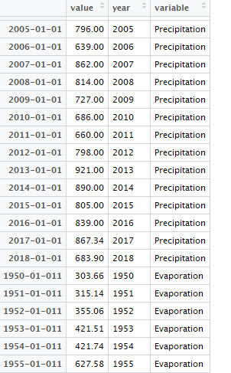
Alternate way to make annual plot
Example data frame

Slide 18
Alternate way to make annual plot
Will need to make adjustments within plotting structure to accommodate the use of one data frame.
Rbind all data into one data frame
Again, creating data variable as factors so the plots will be in the same order with precipitation first.
Adjust color of bars by variable name. Change title of entire plot here instead of each variable heading.
Making axes titles more general to just millimeters and inches.
Setting colors for each variable
Gets rid of legend
Facet_wrap parameters:
~variable: plot by variable column in data frame
Ncol= 1: want plots distributed in one column
Scales=“free_y”: allows the y axis to fluctuate for each plot or else all would be the same.
Labeller: allows you to designate the titles of each of the individual graphs. By default, they would take the name of variable (i.e. Precipitation)

Slide 19
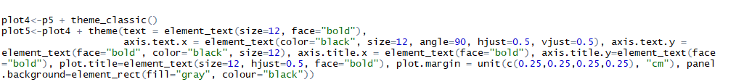
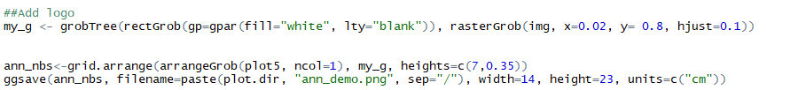
Alternate way to make annual plot
Switch to a classic theme and saving is the same as before.
Adjust for only one plot and logo at the bottom left

Slide 20
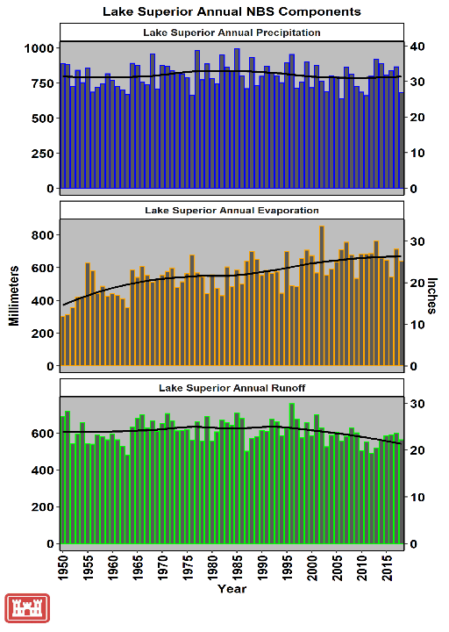
New annual plot

Slide 21
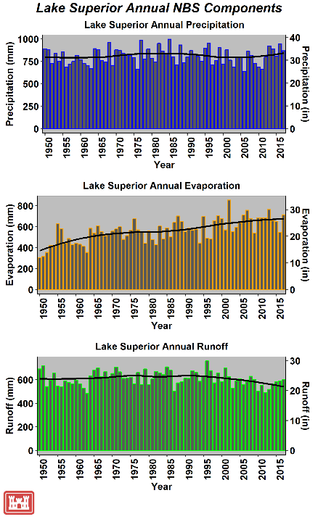
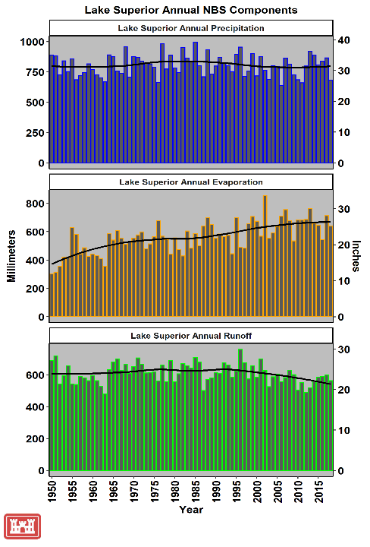
X-axis not plotted on each plot in new graphic.

Slide 22
Library(lemon)
A library called “lemon” has an alternate facet_wrap function that allows the x-axis to be plotted on all plots.
It is now facet_rep_wrap() and we have added to the argument: repeat.tick.labels=TRUE

Slide 23
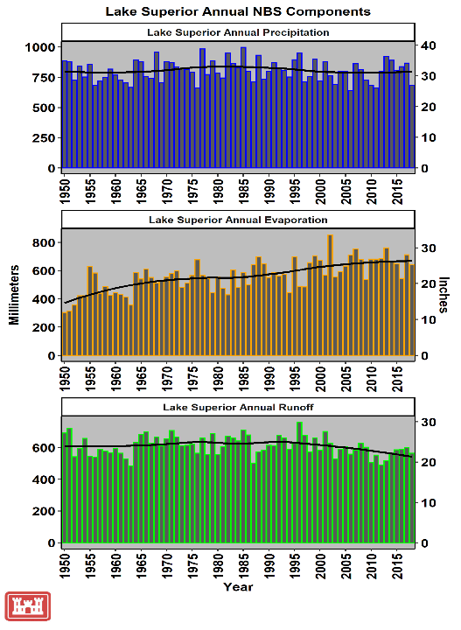
New faceted plot

Slide 24
Recently explored package plotly and htmlwidgets
This allows you to create an html version of your plot and work more interactively with the data.
More information here: https://plot.ly/ggplot2/

Slide 25
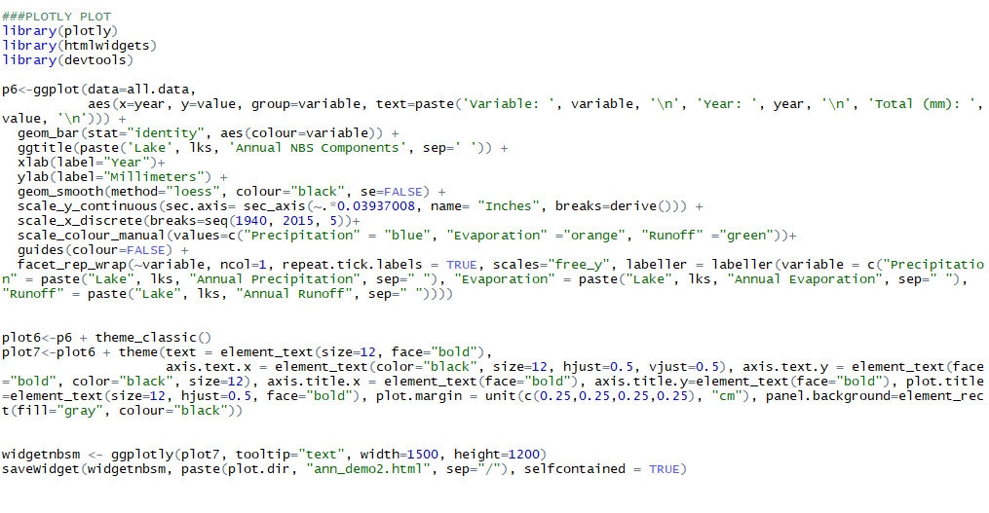
Recently explored package plotly and htmlwidgets
This allows you to create an html version of your plot and work more interactively with the data.
Additional packages needed
Add a text argument to ggplot to be incorporated in the html output
Creating a plotly graphic and saving it as html widget to view via the web.

Slide 26
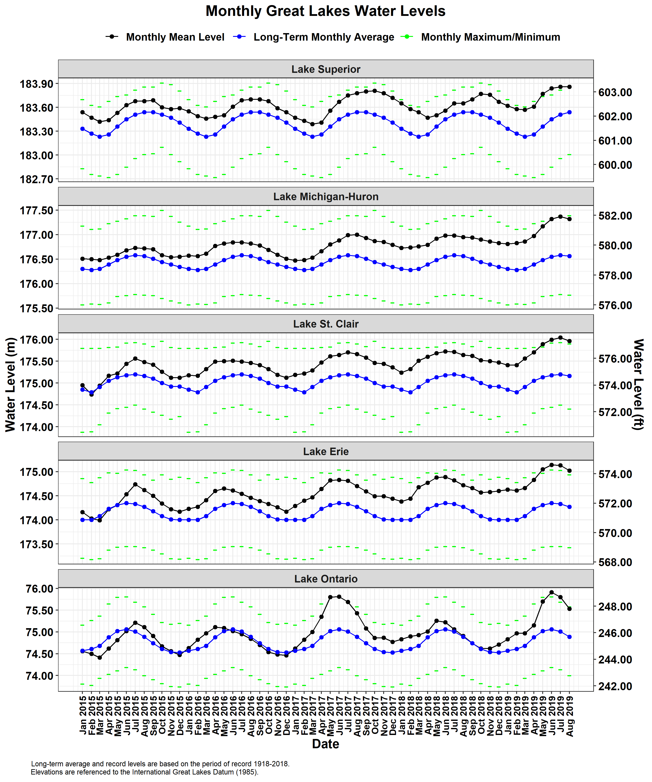
Questions?
Contact Information:
Deanna Apps
Deanna.apps@usace.army.mil
313-226-2979

