Slide 1
Let’s Talk About Unit Testing
Greg Karlovits
Team Lead, HEC-HMS

Slide 2
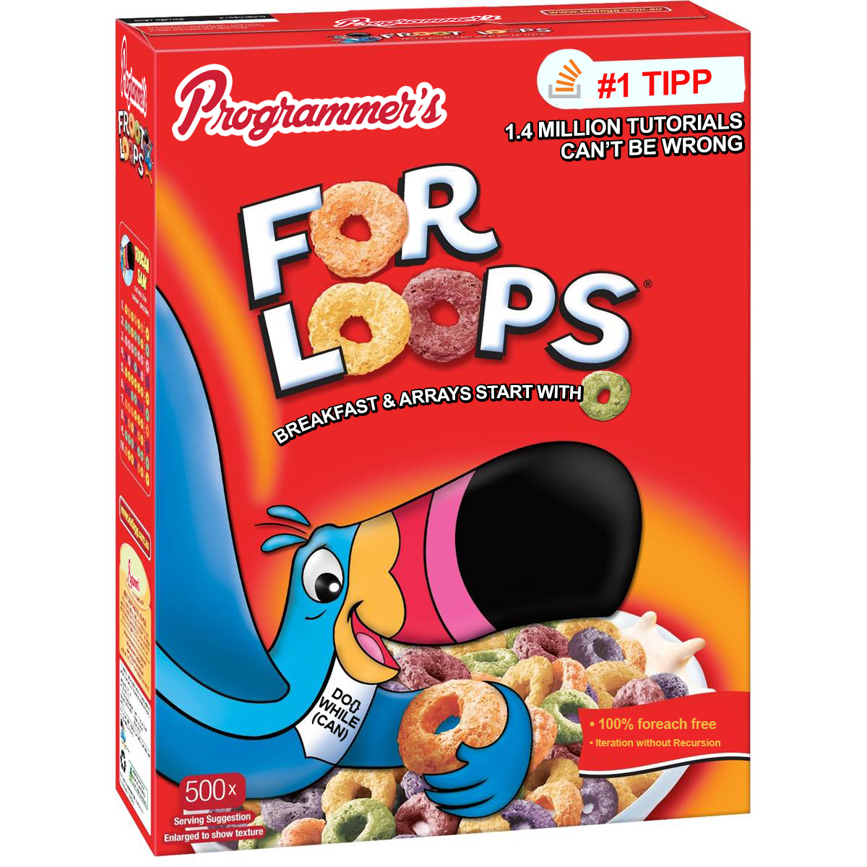
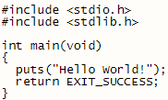
Programming is easy.

Slide 3
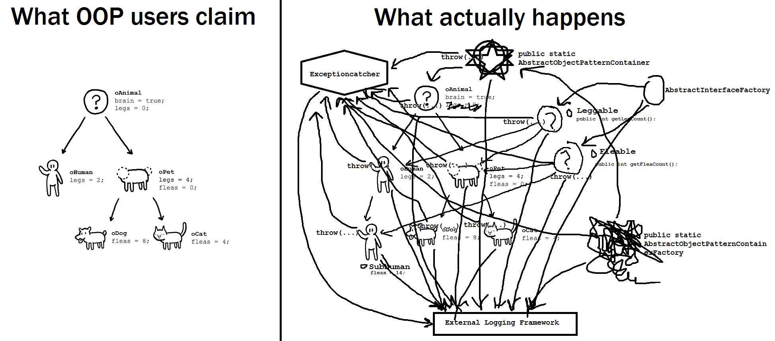
Programming well is hard.

Slide 4

Software integration is really hard.
CWMS
RAS
DSS
HMS

Slide 5
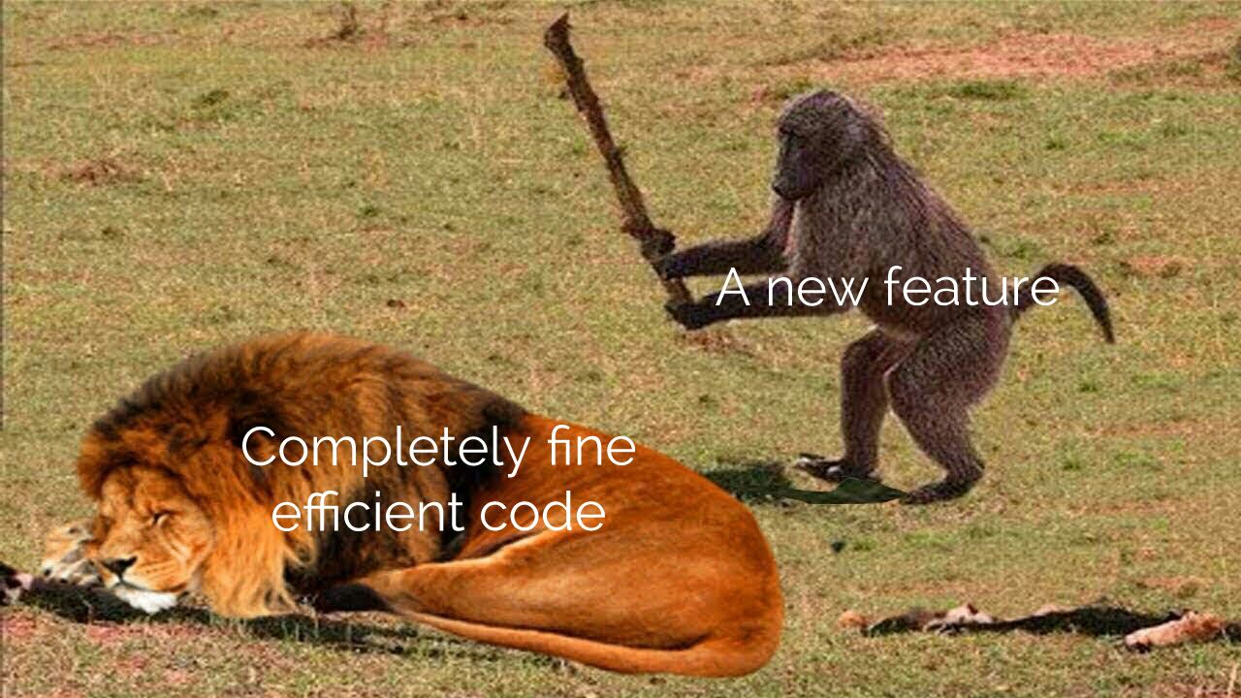
Changes have consequences.

Slide 6
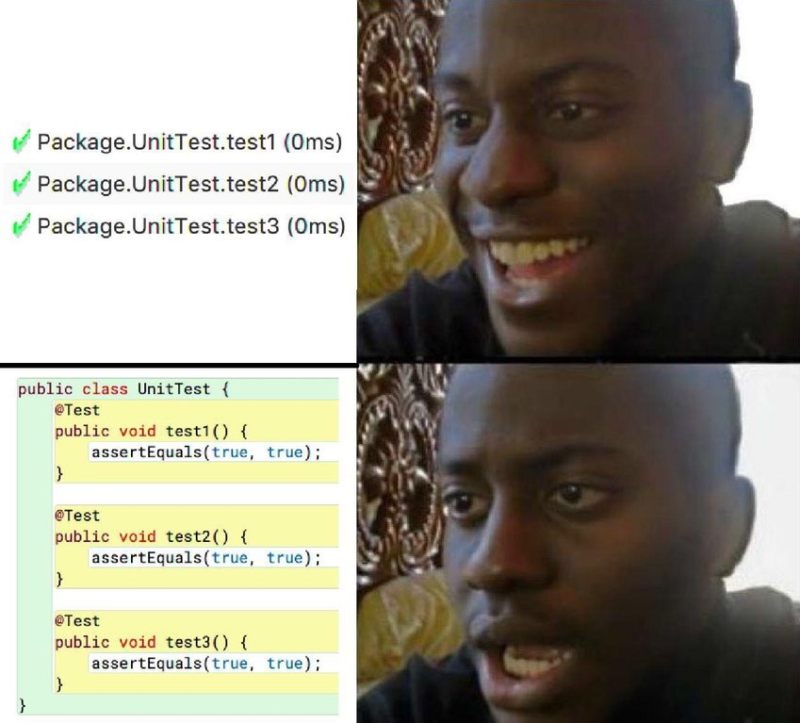
Writing tests is easy.

Slide 7
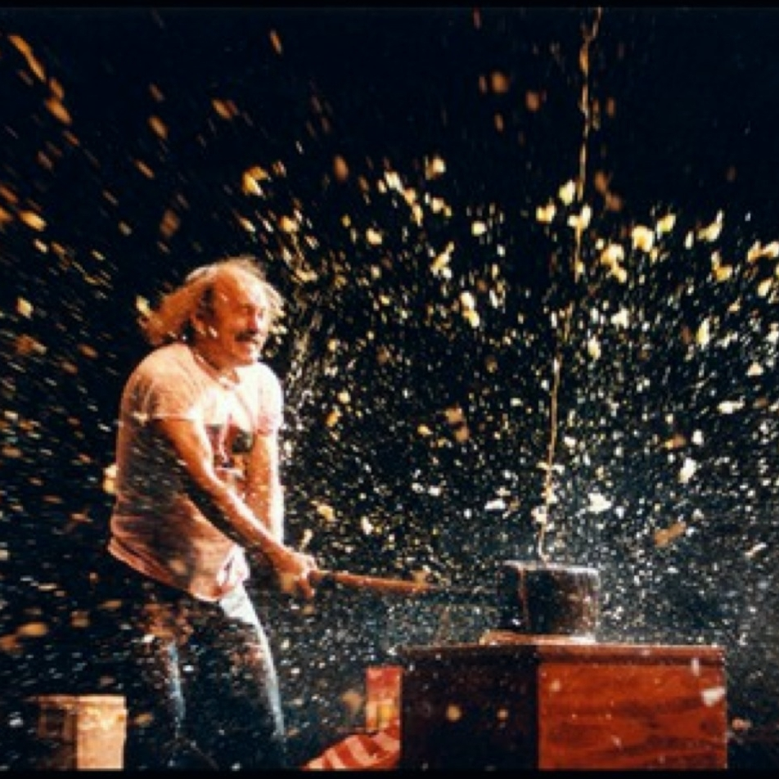
Writing good tests means breaking stuff.
PRECIOUS CODE
YOU
UNIT TEST

Slide 8
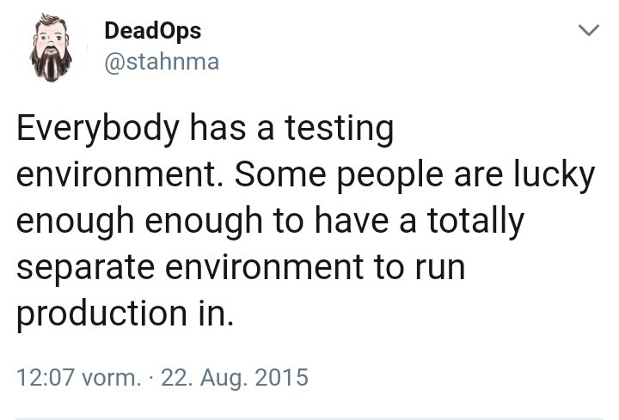
Break it now, or your users will.
Notes:
Matt noticed the typo in this dude’s tweet and I didn’t even see it. Dude has hawk eyes for detail.

Slide 9
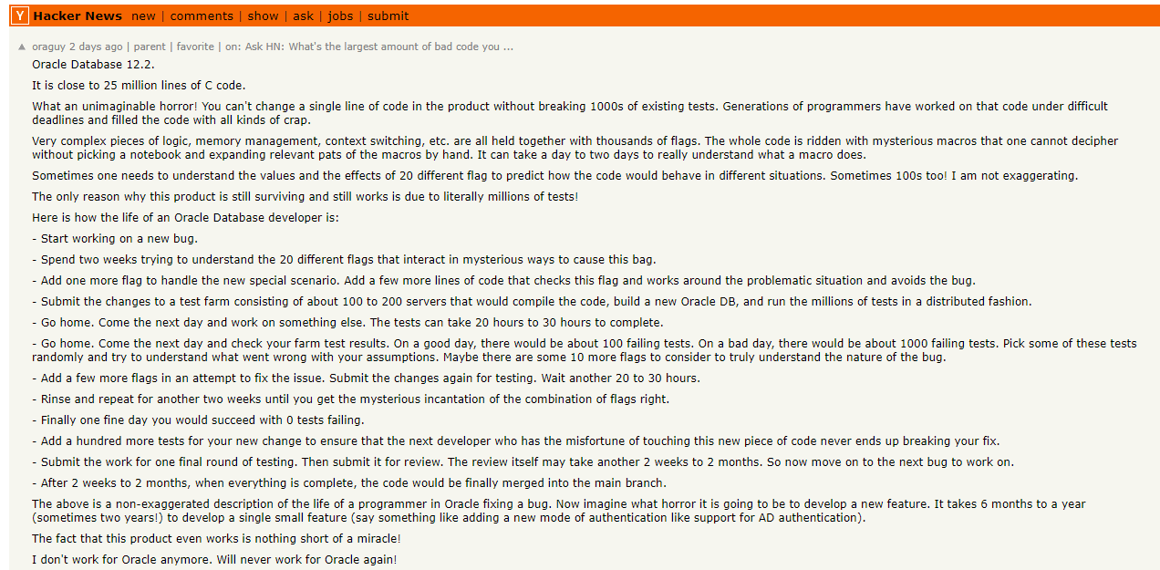
It doesn’t have to be this bad.

Slide 10
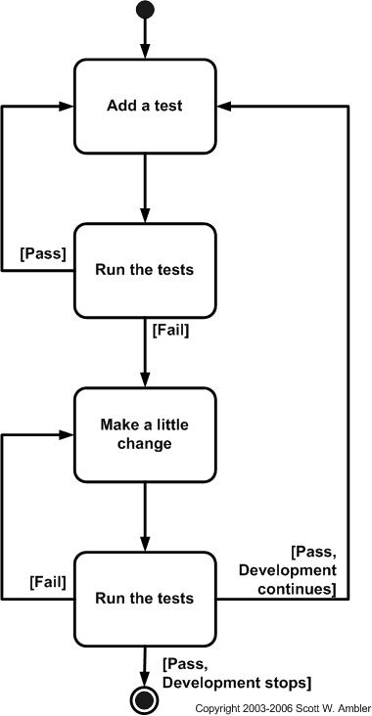
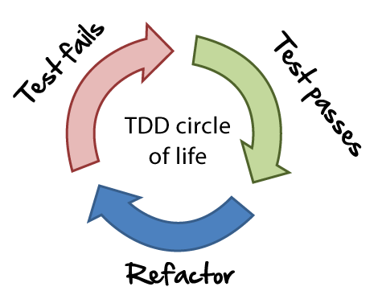
Tests can help you design a solution to a problem.
Notes:
TEST DRIVEN DEVELOPMENT
There are two levels of TDD:
Acceptance TDD (ATDD). With ATDD you write a single acceptance test, or behavioral specification depending on your preferred terminology, and then just enough production functionality/code to fulfill that test. The goal of ATDD is to specify detailed, executable requirements for your solution on a just in time (JIT) basis. ATDD is also called Behavior Driven Development (BDD).
Developer TDD. With developer TDD you write a single developer test, sometimes inaccurately referred to as a unit test, and then just enough production code to fulfill that test. The goal of developer TDD is to specify a detailed, executable design for your solution on a JIT basis. Developer TDD is often simply called TDD.

Slide 11
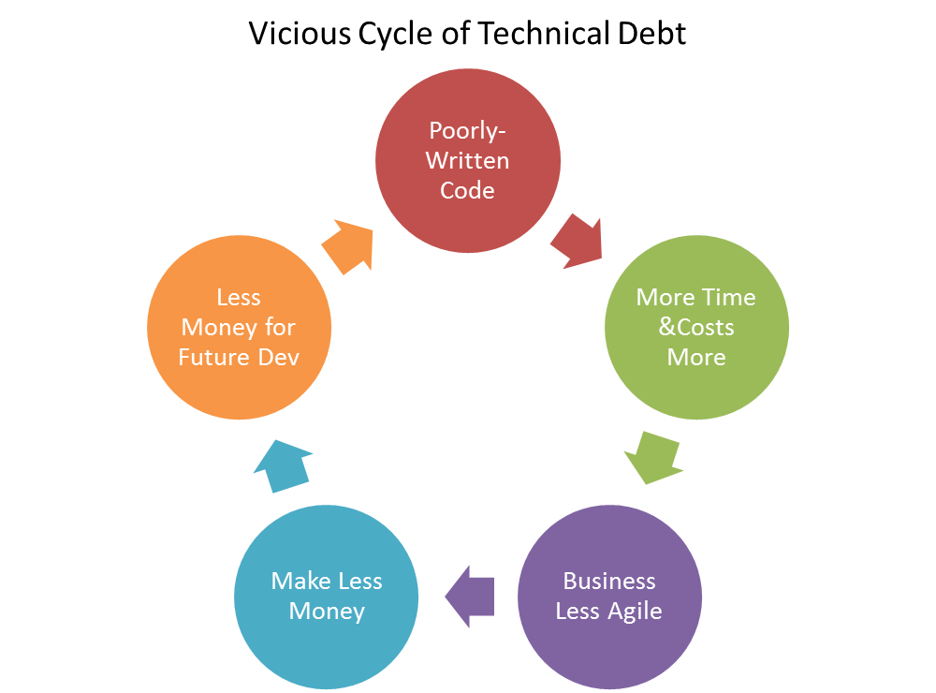
Tests prevent technical debt.

Slide 12
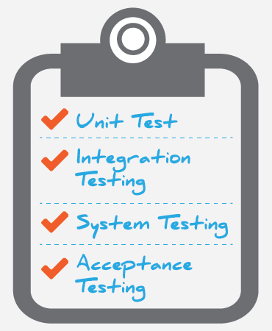
There are multiple views of software testing.
Unit Testing
Integration Testing
Black box
White box
Regression Testing
Smoke Testing

Slide 13
Most views share a common foundation.
Unit Testing
Integration Testing
Black box
White box
Regression Testing
Smoke Testing

Slide 14
Unit tests focus on the smallest units of design.
Examples:
Test if loop, method, function, etc. working ok
Arithmetic precedence/order of operations
Initialization is correct
Null checks

Slide 15

The assertion is the base of the unit test.
assertEquals(<expected>, <object>)
assertThrows(<exception>, <expression>)
assertArrayEquals(<expected>, <array>)
Unit tests fail if an assertion is false.
Notes:
assertThrows has a slightly different behavior and uses a lambda to make it work:
@Test
void testExpectedException() {
Assertions.assertThrows(NumberFormatException.class, () -> {
Integer.parseInt("One");
});
}

Slide 16

Don’t wait until build time to find out if your code works!

Slide 17

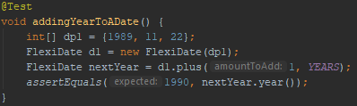

Unit tests have a simple structure.
Test Dependency
Testing Object
Annotation
Unit Test Method
Controlled Inputs
Assertion
Expected Output

Slide 18
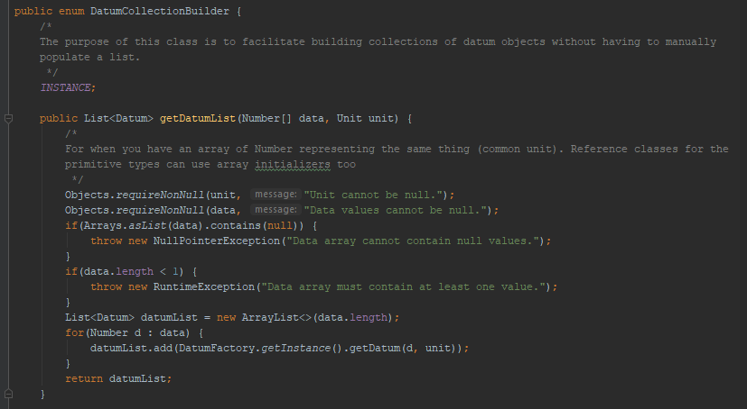
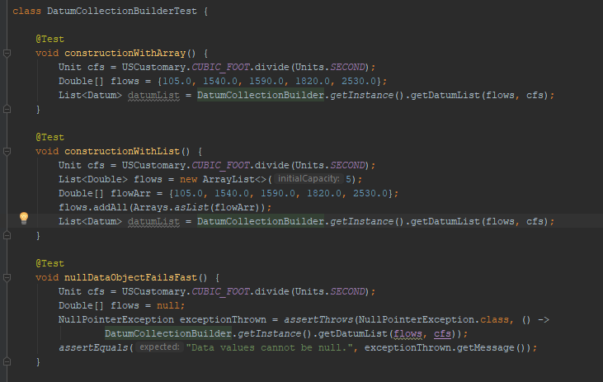
Unit tests give you code feedback in real time.

Slide 19
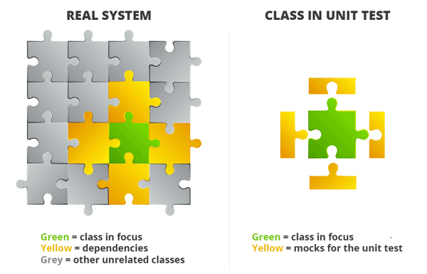
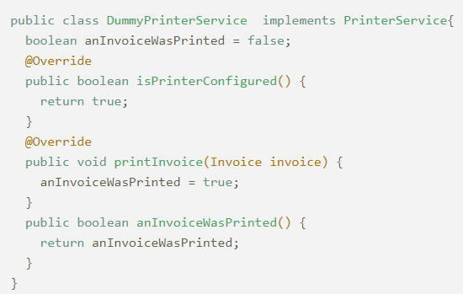
Use mockups to keep test scopes limited.
Notes:
Do you want your unit test to print a page to the office printer every time it runs? What do you mean no? Well, then do something that makes the code think it’s printing, without sending a job to the print spooler.

Slide 20
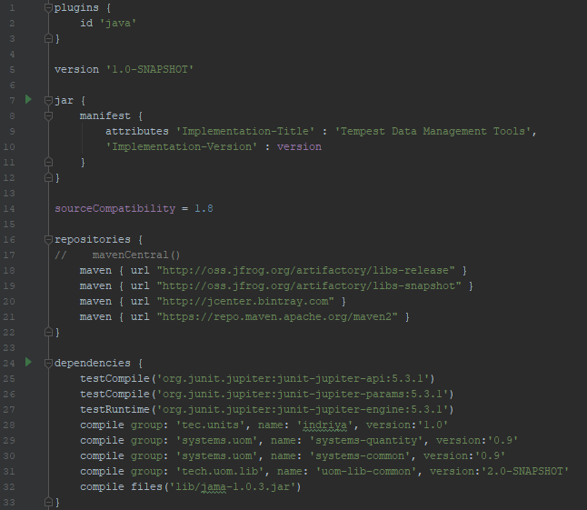

Including unit tests in a build process is easy.

Slide 21

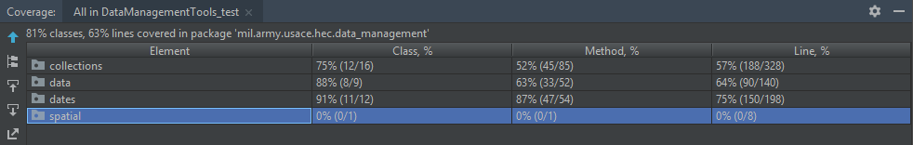
Code coverage measures how effective your tests are.

Slide 22
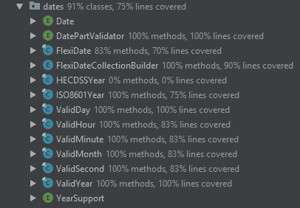
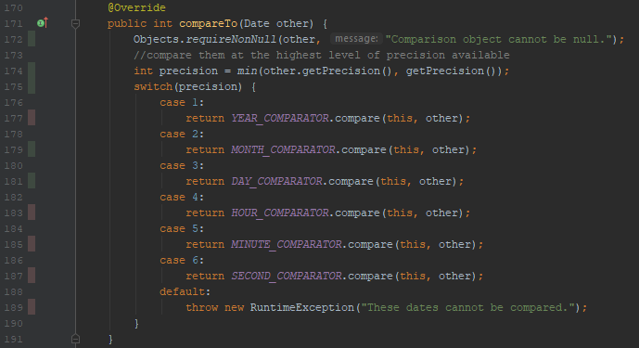
Code coverage measures how effective your tests are.

Slide 23
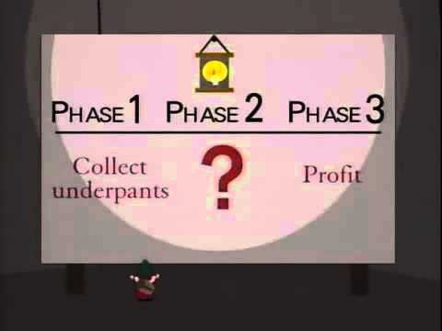
Demonstration
Create a simple class to test
Add JUnit dependencies to Gradle build script
Generate test class and methods using IntelliJ smart features
Fill out the test methods
???
Profit
Notes:
Create a new Gradle project in IntelliJ
Create a new AddingWidget class in the package mil.usace.army.hec.unittest (you’ll have to use the context to refactor it)
Add private final int fields a and b, create the constructor which takes int a and int b, perform their assignment in the constructor
Add methods add() (which returns a+b), getA() and getB()
Add in the JUnit5 dependencies to build.gradle
Use the alt+enter menu on the class name to get the CreateTest menu and create the test class (don’t generate the methods!)
Fill out the AddingWidget add() test verifying that AddingWidget(3, 5).add() results in 8
Fill out the AddingWidget getA() test verifying that AddingWidget(3, 5).getA() results in 3

Slide 24
Zealous Test-Driven Development Demo
Create skeleton class and test class
Write a test that defines behavior you want
Watch it fail, or succeed if you’re done!
Read what it tells you!
Go fix your code
GOTO 3.
Notes:
Create a new MultiplyingWidget class
Use the IntelliJ context menu to create the test class
In the test class, write a test for the multiply method, which creates a new widget using two doubles 3d and 5d, stores the result of multiply() to a double c, then asserts that 15d and c are equal.
Execute the test.

Slide 25
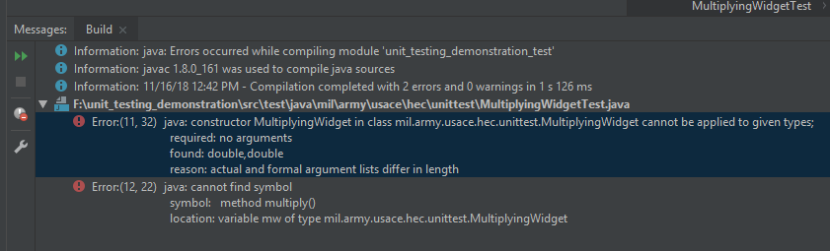
TFD Demo
test-first development
Notes:
See two issues 1) the constructor fails because the current empty constructor is incompatible with using 3 and 5 and 2) it can’t find the multiply() method.
Resolve the first one by making the constructor take two parameters (double a, double b)
Re-run the test.
Hooray! The first issue is gone. The issue about the multiply method is still there.
Add a multiply method returning a double, with an empty body.
Re-run the test.
Uh-oh, the compiler doesn’t like it. There’s no return statement.
Add a return statement. Can’t leave it blank, and doubles aren’t nullable so you can’t do that. I guess it’s time for the implementation.
Make multiply return a*b. Add pf double fields to the class. Add assignments in the constructor.
Re-run the test.
Success!
Write a test for getA().
Notice you’re repeating the object declaration. Banish the widget to a field of the test class, set the widget to an instance of MultiplyingWidget(3d, 5d).
Run the test.
It fails! Why? There’s no getA() method.
Write the getA() method. Or, make IntelliJ generate it.
Run the test.
Success!
Finish with the getB() method.

Slide 26
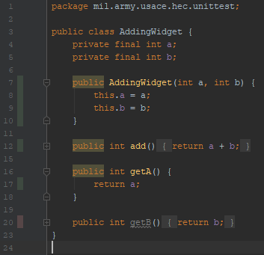
Code Coverage
Notes:
Run project tests with coverage.
Looks like we forgot to generate test methods for the getB() method.

Slide 27
Behavior-Driven Development
Story: Returns go to stock
As a store owner
In order to keep track of stock
I want to add items back to stock when they're returned.
Scenario 1: Refunded items should be returned to stock
Given that a customer previously bought a black sweater from me
And I have three black sweaters in stock.
When they return the black sweater for a refund
Then I should have four black sweaters in stock.
Scenario 2: Replaced items should be returned to stock
Given that a customer previously bought a blue garment from me
And I have two blue garments in stock
And three black garments in stock.
When they return the blue garment for a replacement in black
Then I should have three blue garments in stock
And two black garments in stock.
Notes:
BDD is a natural way of developing testing strategies and implementing TFD which has natural language at heart.

Slide 28
Discussion
Roses are red
Violets are blue
abstract class poem {
//TODO
}

Slide 29
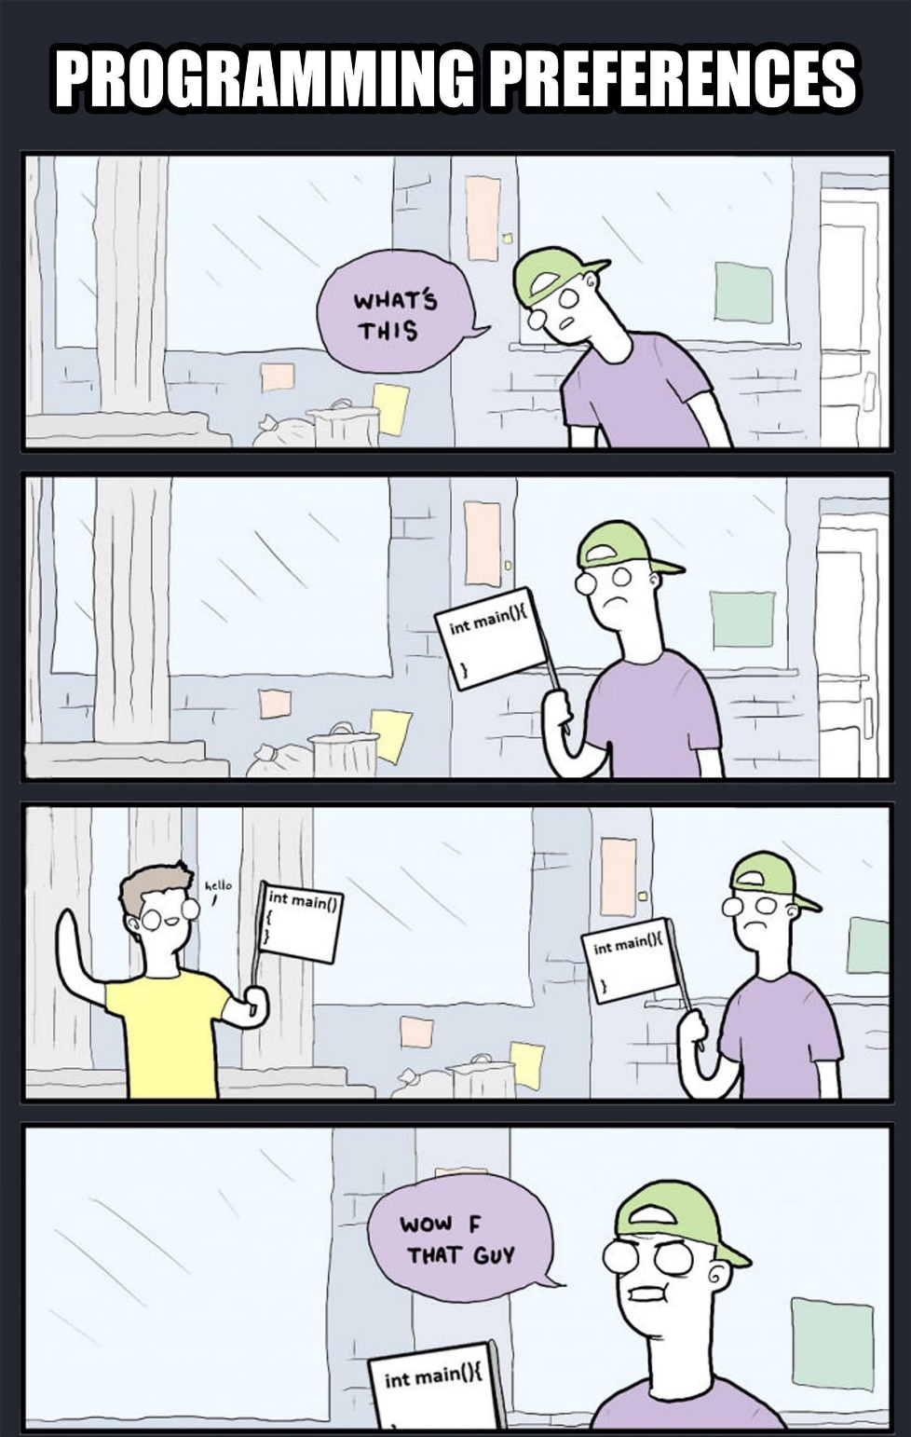
Notes:
In case someone decides to criticize my curly brace use

