Slide 1
Object Oriented Programming
“[Our] Primary Technical Imperative has to be managing complexity”
- Steve McConnel, Code Complete 2nd Addition

Slide 2
What is Object Oriented Programming?
OOP is a way to encapsulate methods/data into a single thing (object)
OOP is a deviation from functional or imperative programming
How do we determine what/how to encapsulate?

Slide 3
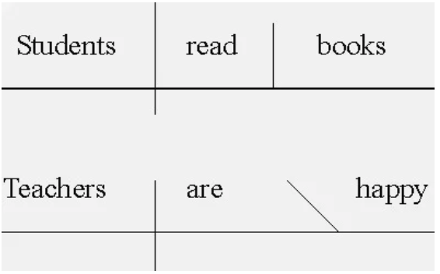
Objects are nouns
Everything is an object

Slide 4
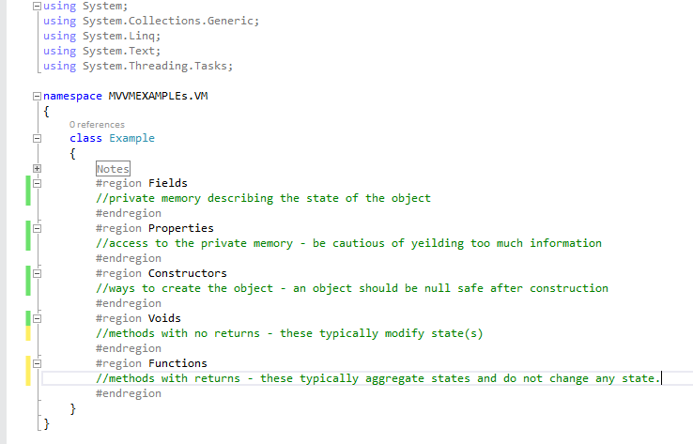
Anatomy of an object

Slide 5
Abstractions - Inheritance and Interfaces
Inheritance forms an (is - a) relationship – one per object
Interfaces create a (can – do) relationship – many per object
A dog is - a(n) animal, a cat is – a(n) animal. Cats and dogs inherit from animal.
We will talk about interfaces later but you can think of this example an animal or a human can - do “eatFood” - IConsumeFood.

Slide 6
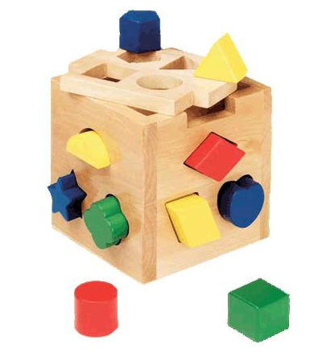
Polymorphism
Polymorphism can be thought of as shape identification.
If an object meets the shape requirement it can fit through the sorter
Shape is defined through inheritance or interfaces
A square can be any color
A shape can have multiple aspects

Slide 7
Cohesion and Coupling
Cohesion describes how closely related the operations in a method are related to one another
Coupling refers to the strength of the connection between two methods
We would prefer highly cohesive objects that are loosely coupled.

Slide 8
Perspectives – Martin Fowler
Use different perspectives in the software development process objects aren’t just nouns
Conceptual
Grouping of concepts – What am I responsible for?
Specification
The interfaces (not GUI) of the software – How am I used?
Implementation
The implemented code – How do I fulfill my responsibilities?

Slide 9
Application - perspectives
In managing a group of people to accomplish a task you could…
Give explicit directions to everyone
Assign a responsibility to each person who performs the tasks needed to fulfill their responsibility.
If the specification changes – we can change the order of the people remove or add people – otherwise we have to talk to each person and tell them all about the changes.

Slide 10
SOLID principles
Single Responsibility Principle
Objects should only have one reason to change
Open/Closed Principle
Objects should be open for extension but closed for modification
Liskov Substitution Principle
Subtypes must be substitutable for their base types – you must fulfill the contract
Interface Segregation Principle
Favor small interface specifications so that they can be tailored to the object
Dependency Inversion Principle
Use injection of abstractions to define the behavior at runtime

Slide 11
Summary
SOLID is a way of describing complex ideas in a loosely coupled highly cohesive way.
Key takeaway. Design to an interface, and use dependency injection of interfaces to mitigate the impacts of change.

Slide 12
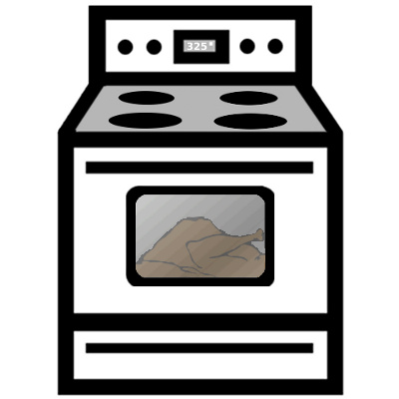
What does an oven do?
On
Off
Set Temperature
Set Timer
OpenDoor
CloseDoor

Slide 13
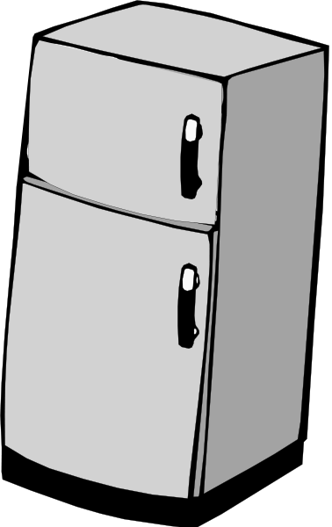
What does a Refrigerator do?
OpenDoor
CloseDoor
SetTemperature

Slide 14
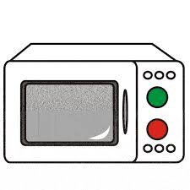
What does a Microwave do?
On
Off
OpenDoor
CloseDoor
SetTimer

Slide 15
Appliances
Action | Fridge | Oven | Microwave
On |  | X | X
Off |  | X | X
SetTemperature | X | X
SetTimer |  | X | X
OpenDoor | X | X | X
CloseDoor | x | x | X

Slide 16
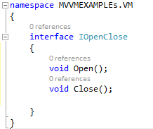
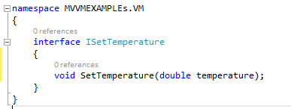
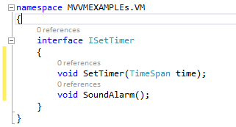
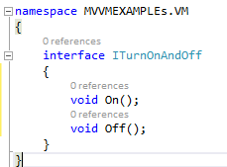
Interfaces
From the following four interfaces I can build all three appliances. By grouping cohesive ideas and defining their base behaviors through interfaces I can create any appliance but treat them in similar manners.
IOpenAndClose
ISetTemperature
ITurnOnAndOff
ISetTimer

Slide 17
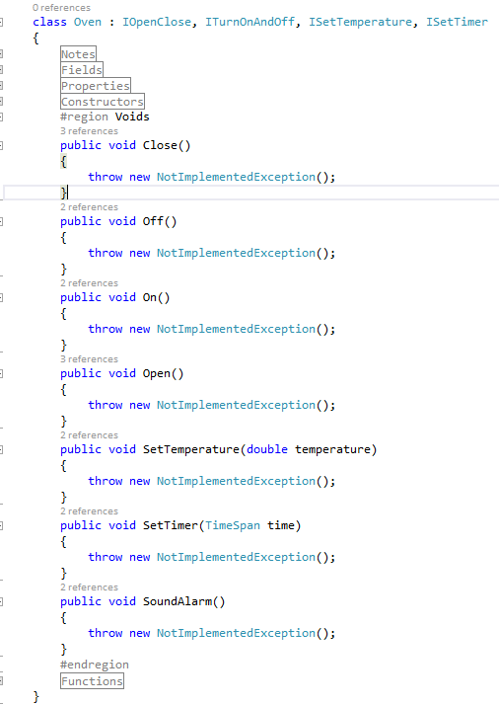
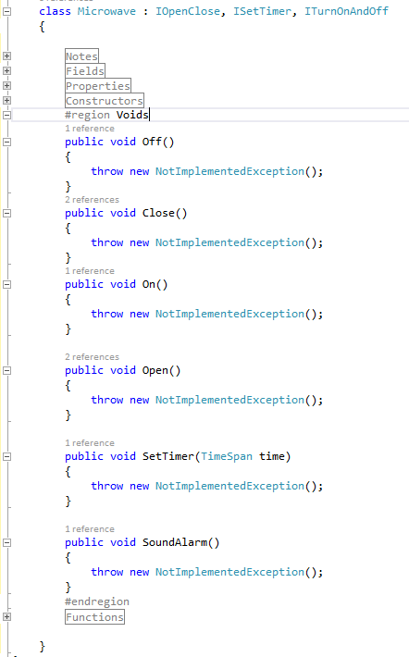
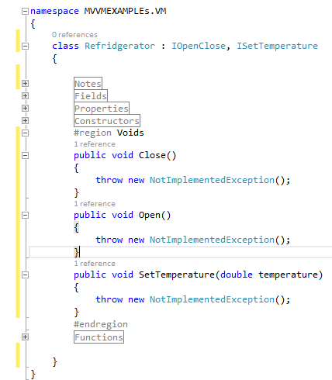
Examples

Slide 18
Inheritance vs. Composition
We could solve the problem of Appliance with inheritance by making an abstract class of Appliance and implementing the different appliances. It may take less keystrokes. It will be more tightly coupled.
Balance coupling and cohesion by carefully deciding between inheritance and composition.

