Slide 1
Tests
Nobody likes them, they make us testy.

Slide 2
Overarching principles
The DevOps Handbook “The three ways”
Principles of flow
Principles of feedback
Principles of continual learning

Slide 3
Testing Types
Unit tests
Method or class in isolation (a unit)
Integration tests
Integrates many units
Alternate definition: that the application integrates with other applications (if applicable)
Acceptance tests
That the application continues to work as a whole

Slide 4
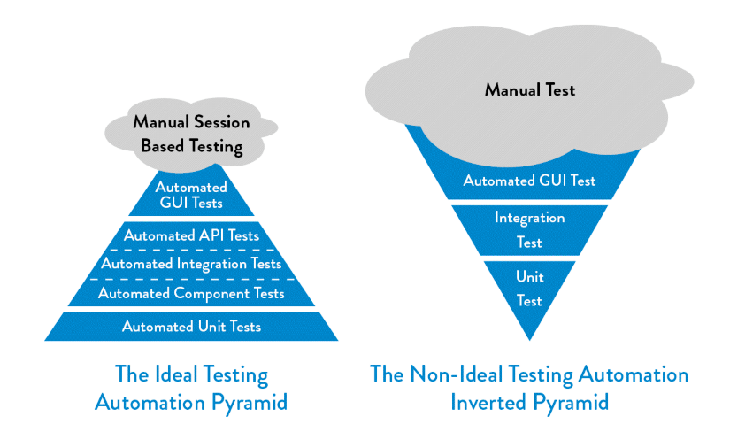
Principle of Faster flow
“If we find that unit tests or acceptance tests are too difficult or expensive to write or maintain; it’s likely that we have an architecture that is too highly coupled, where strong separation between our module boundaries no longer exist (or maybe never existed).” (Kim, G. et al. 2016, Pg.133

Slide 5
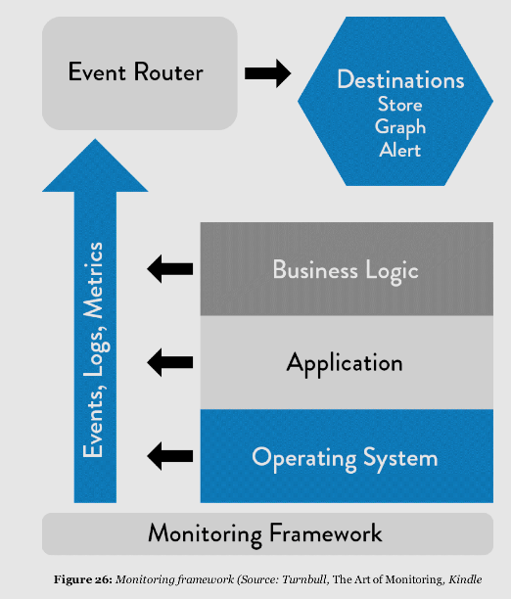
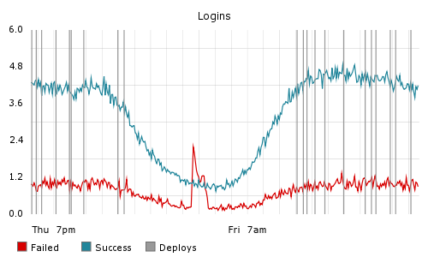
Principle of Faster Feedback
Faster feedback enables faster flow by decreasing the time between issue/bug detection and issue/bug generation.
Testing helps a programmer feel more confident their commit did not disrupt other code
Telemetry and monitoring helps an organization feel more confident that their system is healthy and functioning well.

Slide 6
Principles of Continual Learning
For major test failures or missed bugs
Conduct no blame post mortems
Encapsulate the example data into a new automated test
Constantly evaluate if the system is tightly coupled or loosely coupled and refactor – our tests should allow for easier refactoring!

