Slide 1

Agentic AI
Grounding Foundation Models
Committees of AI Agents

Slide 2
The Falcon AI Research Lab
Austin Weingart
Austin.w@ardentinc.com
Ryan Rabinow
Rrabinow@uccs.edu
Elijah Goodrich
Elijah.g@ardentinc.com
Dr. Chad Melo (Project Lead)
Chad.mello@afacademy.af.edu

Slide 3
Recap
LLMs predict, they don’t compute
Agents
LLMs + Tools + Memory + Planning
ReAct Loop:
Reason -> Act -> Observe
But... Agents still have limitations!

Slide 4
Agenda
Grounding LLMs
Multi-Agent systems

Slide 5
Critical Problems to Address
Complex Tasks
Hallucinations

Slide 6
What I'll show today
Librarian
Grounded with RAG
Never Hallucinates
Essay Grading Committee
Multi-agent collaboration

Slide 7
What are Hallucinations?
What would happen if I asked an LLM....
"What are the UCCS library hours?"

Slide 8
What are Hallucinations?
Definition:
When an LLM generates information that sounds plausible and confident but is completely fabricated or factually incorrect.

Slide 9
What causes Hallucinations?
LLMs are trained to predict the next most likely token
They don’t know facts, they predict patterns
When uncertain, they still generate something
No access to real-time data or specific documents

Slide 10

So how can we solve the Hallucinations problem?
Notes:
a) Train the model on more data
b) Tell it to say 'I don't know'
c) Give it access to documents
d) Use a bigger model

Slide 11
Grounding AI Agents
RAG!
Retrieval Augmented Generation

Slide 12
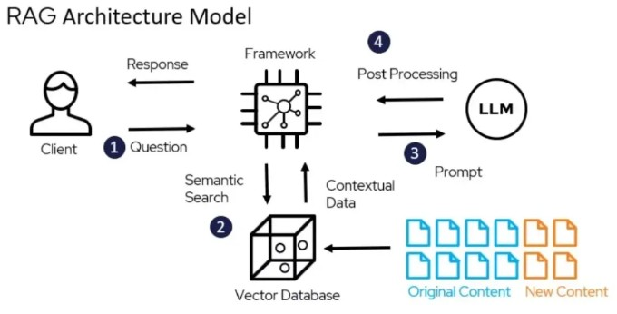
Notes:
PHOTO SOURCE: https://www.deepchecks.com/glossary/rag-architecture/

Slide 13

What is a Vector Database?

Slide 14
Vector Database
The Problem
Traditional databases search for exact matches
"library hours Friday" != "when does it close?"
Computers don't understand meaning, only exact words
The solution:
Vector Databases!
Definition: A database that stores text as numerical vectors that capture meanings

Slide 15
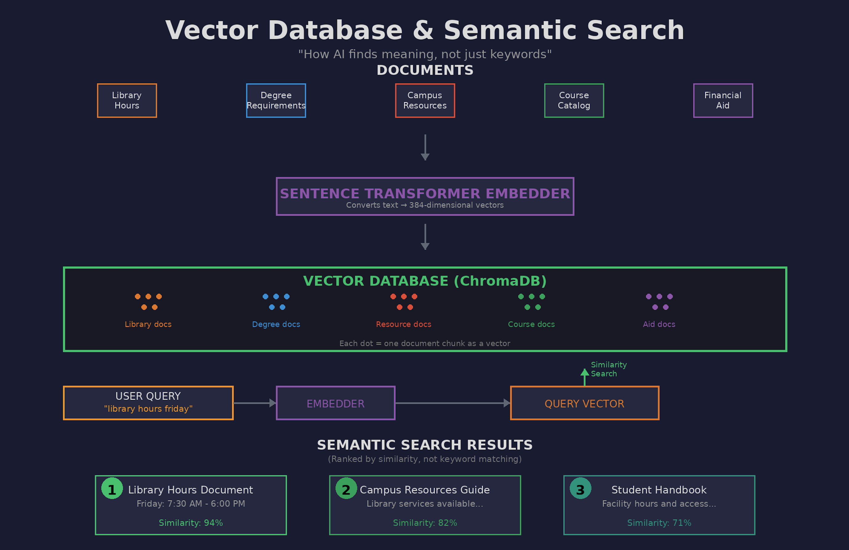

Slide 16
Let's look at in code!

Slide 17
What about solving complex tasks?
RAG is our solution to hallucinations, what solves complex tasks for us?
Single Grounded Agent:
Knows facts from your documents
Never hallucinates
Still STRUGGLES with multi-step reasoning
CAN'T handle tasks requiring different expertise

Slide 18
Complex Tasks
Code review system
Medical Diagnosis and Treatment Planning
Legal Contract Analysis and Compliance
Automated Academic Paper Review

Slide 19
Committees of Agents
The core Idea:
Single Agent Problem:
One agent trying to do everything = jack of all trades, master of none
Committee Solution:
Team of specialist agents working together, coordinated by a manager agent

Slide 20
Real World Committees
Building a house
BAD: One person does plumbing, electrical, framing, roofing...
GOOD: Electrician, plumber, carpenter, roofer -> general contractor coordinates
Software Projects
BAD: One developer writes frontend, backend, database, tests, docs...
GOOD: frontend dev, backend dev, QA engineer -> Scrum master
AI agents work the same way!

Slide 21
Single Agent Shortcomings
Why Single Agent Fails:
Must evaluate methodology, statistics, writing, ethics, citations
Each requires deep domain expertise
Needs to verify claims against literature
Different standards per field

Slide 22
Automated Academic Paper Reviewer
Let's think about a team that could solve this problem!

Slide 23
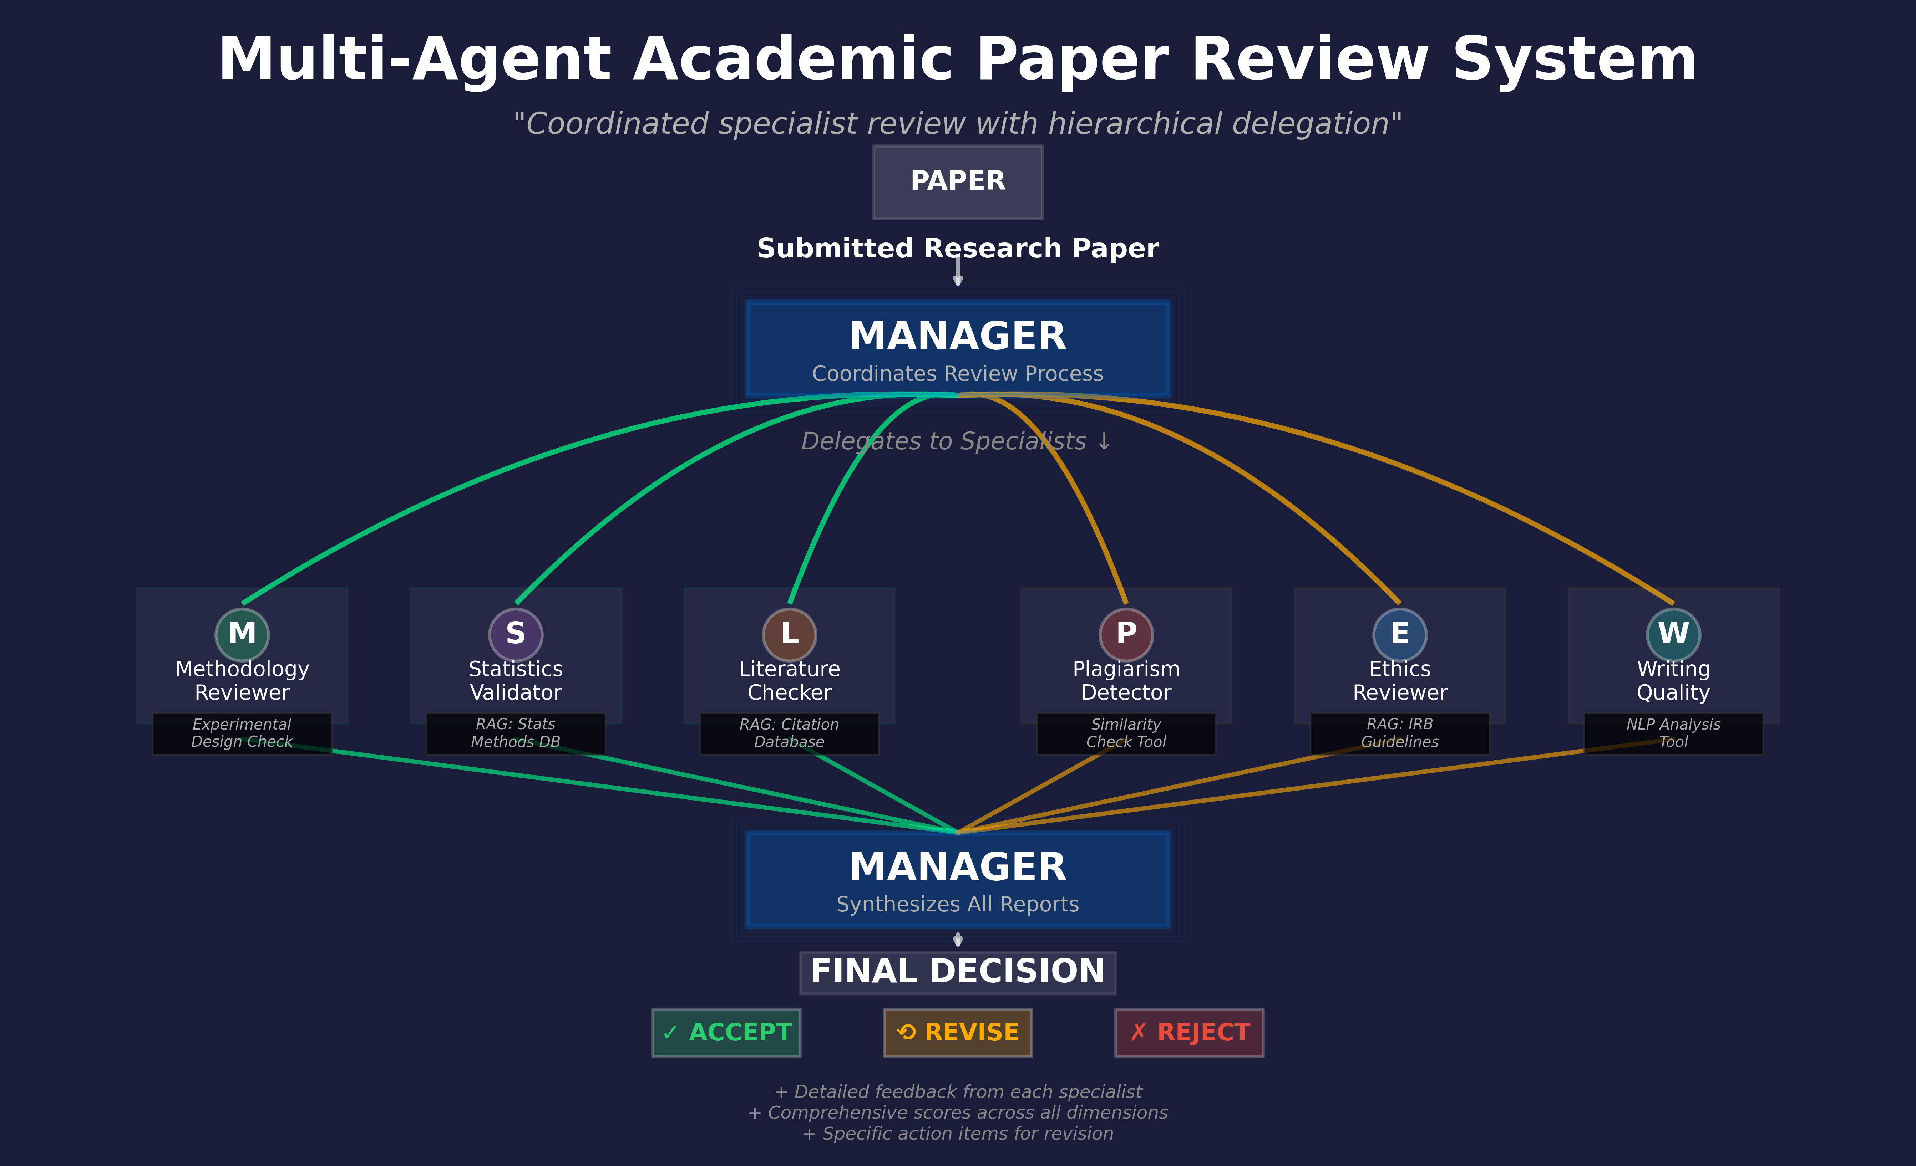

Slide 24
Committees Aren't Free
Single Agent
1 API call
~500 Tokens
Cost: $0.001
Time: 2 seconds
Quality: 6/10
Committee (5 agents)
5 API calls
~2500 Tokens
Cost: $0.005 (5x)
Time: 8 sec (4x)
Quality: 9/10

Slide 25
Thanks for listening!
Austin Weingart
Austin.w@ardentinc.com
Ryan Rabinow
Rrabinow@uccs.edu
Elijah Goodrich
Elijah.g@ardentinc.com
Dr. Chad Melo (Project Lead)
Chad.mello@afacademy.af.edu
https://github.com/USAFA-AI-Center/fair_llm

