Slide 1

Introduction to Agentic AI
The Fair LLM Framework
Transforming LLMs into Intelligent Agents

Slide 2
The Falcon AI Research Lab
Austin Weingart
Austin.w@ardentinc.com
Ryan Rabinow
Rrabinow@uccs.edu
Elijah Goodrich
Elijah.g@ardentinc.com
Dr. Chad Melo (Project Lead)
Chad.mello@afacademy.af.edu

Slide 3
Agenda
Environment setup
LLM Introduction
Limitations of LLMs
Jupyter Notebook (Part 1)
AI Agents
Jupyter Notebook (Part 2)

Slide 4
Environment Setup!
Navigate to the "teaching_fair_llm" GitHub repository
https://github.com/USAFA-AI-Center/teaching_fair_llm
Follow the README instructions until you run the following command:
"pip install –r requirements.txt"
REMEMBER: run the above install command from an active python virtual environment

Slide 5
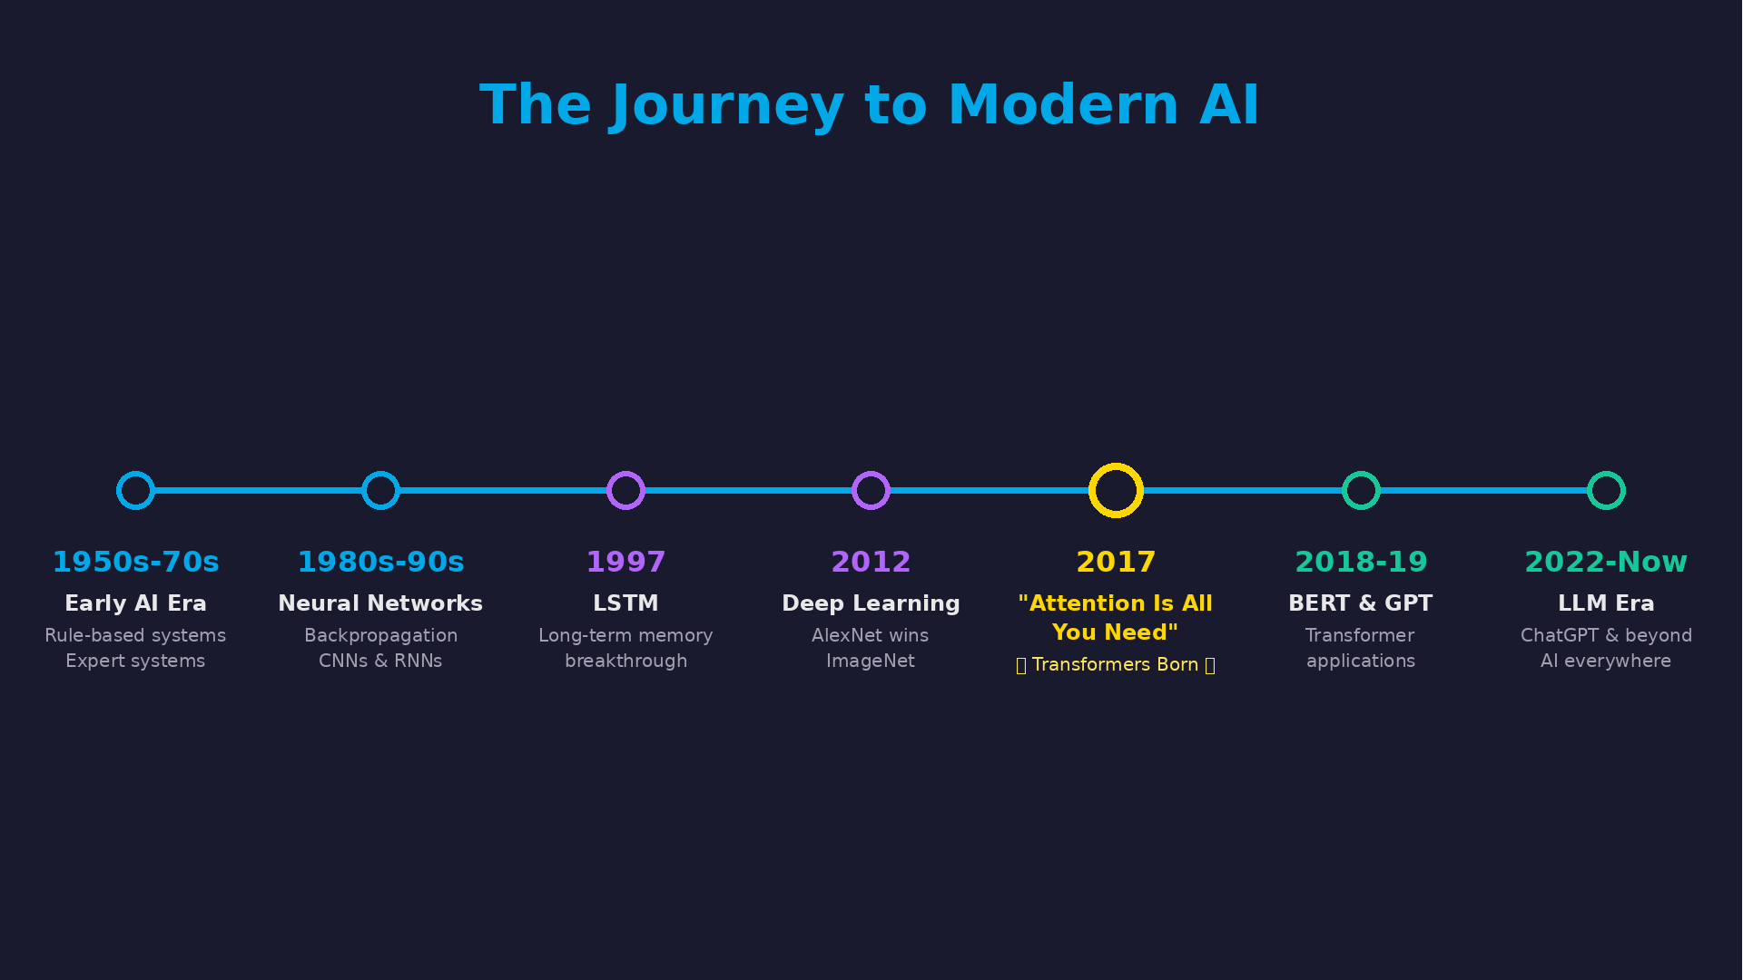

Slide 6
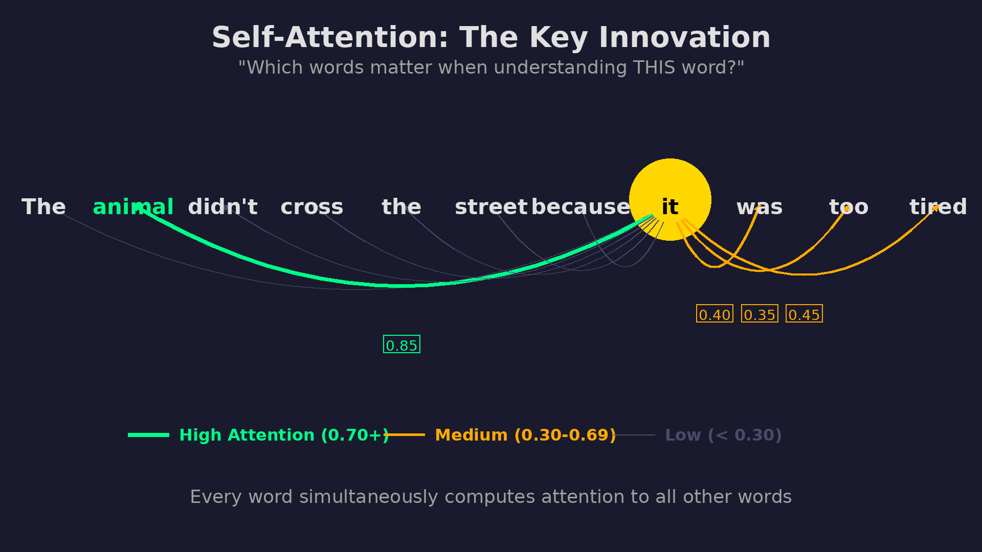

Slide 7
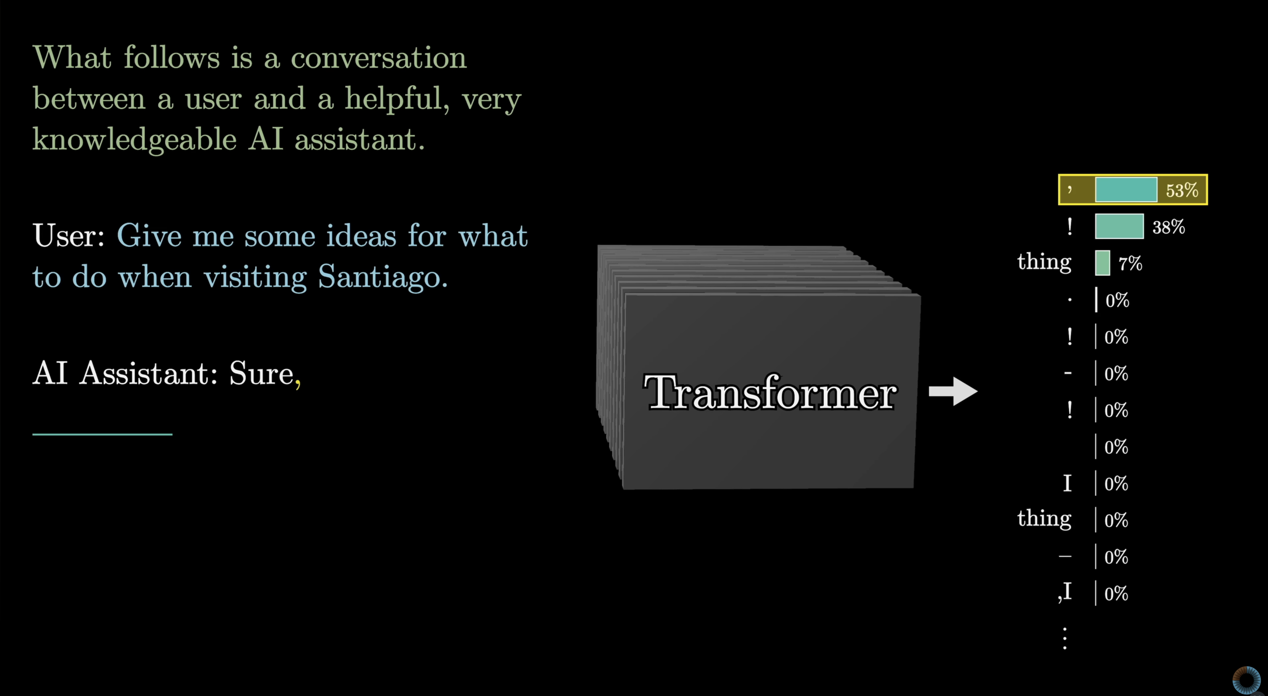
How LLMs Really Work
Notes:
IMAGE REFERENCE: https://www.youtube.com/watch?v=wjZofJX0v4M&t=947s

Slide 8
What LLMs Can Do
Language understanding & generation
Understand and generate human-like text
Translate languages
Summarize long documents
Answer questions based on training data
Reasoning and Analysis
Break down complex problems into steps
Explain concepts in multiple ways
Identify patterns in text
Make logical inferences from given information
Code generation and debugging

Slide 9
What LLMs Can't Do
No Real-Time Information
Can't access the internet
Don’t know current prices, events, weather
Can't check against current information for factual analysis
Knowledge cutoff = outdated information
No Actions in the Real World
Can't send emails, make purchases, book appointments
Can't click buttons or navigate websites
Can’t run code or access files
Cant' control physical devices

Slide 10
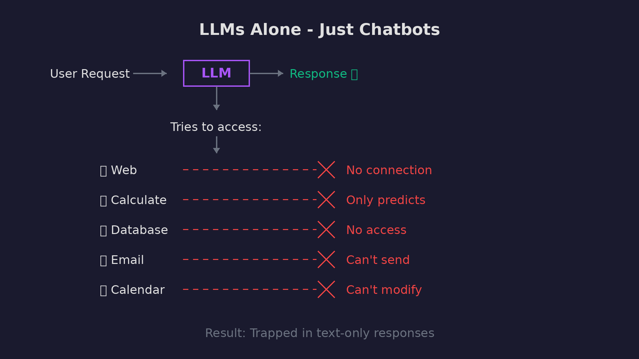

Slide 11
Question
Do you think an LLM could solve:
(112 + 203) * 6785

Slide 12

What is an AI Agent?
An AI Agent is an autonomous system that perceives its environment, reasons about what to do, and takes actions to achieve goals.

Slide 13
AI Agents – Key Characteristics
Autonomous
Makes its own decisions
Does not follow a script
Goal Oriented
Works towards a target objective
Plans in multiple steps
Interactive​
Perceives environment (reads input, context) ​
Acts on environment (uses tools, APIs) ​
Learns from feedback​
Uses tools and external systems

Slide 14
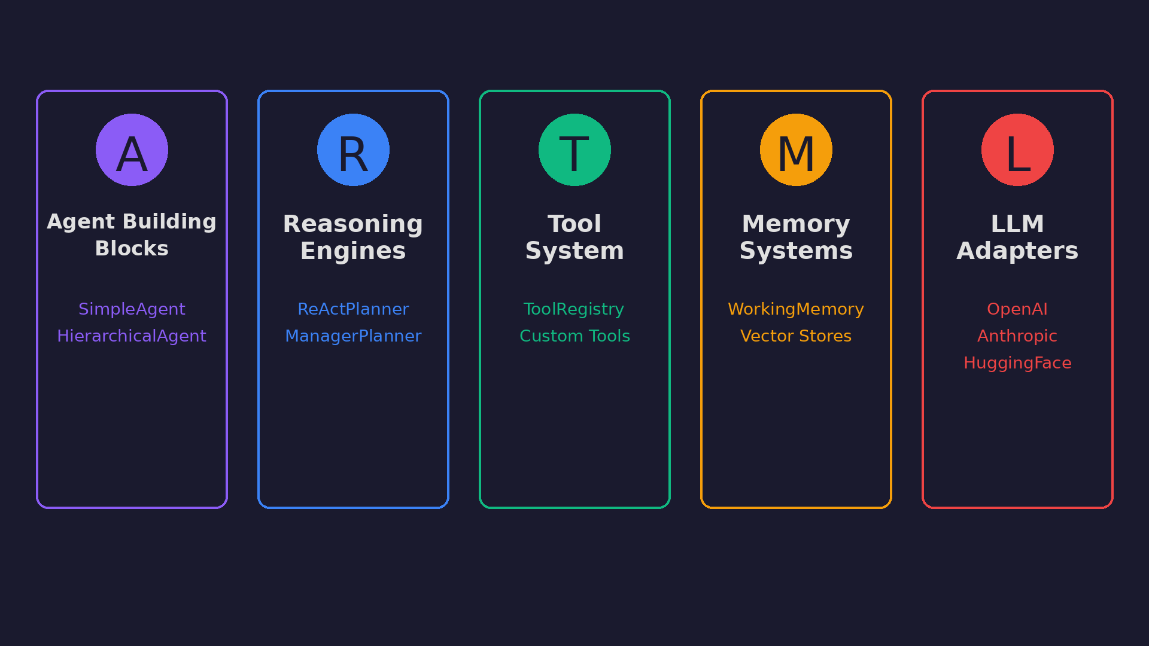
Fair LLM Building Intelligent Agents

Slide 15
Agent Component 1 – The Brain
The LLM Brain Provides
Language Understanding - Comprehends user requests
Reasoning - Thinks through problems step-by-step
Planning - Breaks complex tasks into steps
Decision Making - Chooses which tools to use and when
Communication - Generates natural responses

Slide 16
Fair LLM – Model Abstraction Layer
Fair LLM Provides three abstractions to invoke language models from the following providers
Hugging Face
OpenAI
Anthropic
Usage:
llm = HuggingFaceAdapter(model_name="dolphin3-qwen25-3b", auth_token=token)

Slide 17
Agent Component 2 - Tools
Tools are functions that agents can call to interact with the world
Tools give agents hands to do things the LLM brain cannot:
Calculate precisely
Access real-time information
Take actions
Process data
Interact with systems

Slide 18
Fair LLM – Tool Anatomy
Each Tool in Fair LLM has three key components
Name: str
Description: str
Use(tool_input: str) -> str

Slide 19
Defining a tool in Fair LLM
from fairlib import BaseTool
class WeatherTool(BaseTool):
name = "weather_checker"
description = "Gets current weather for any city. Input: city name"
def execute(self, tool_input: str):
# Your API call here
weather_data = weather_api(tool_input)
return weather_data

Slide 20
Agent Component 3 - Prompts
Prompts are the complete set of instructions that define who the agent is, what it can do, and how it should behave
In agentic systems, prompts are NOT just the user's questions, they define:
The agent's identity and role
Its capabilities (tools, workers)
Behavioral guidelines
Examples of correct behavior
The conversation context

Slide 21
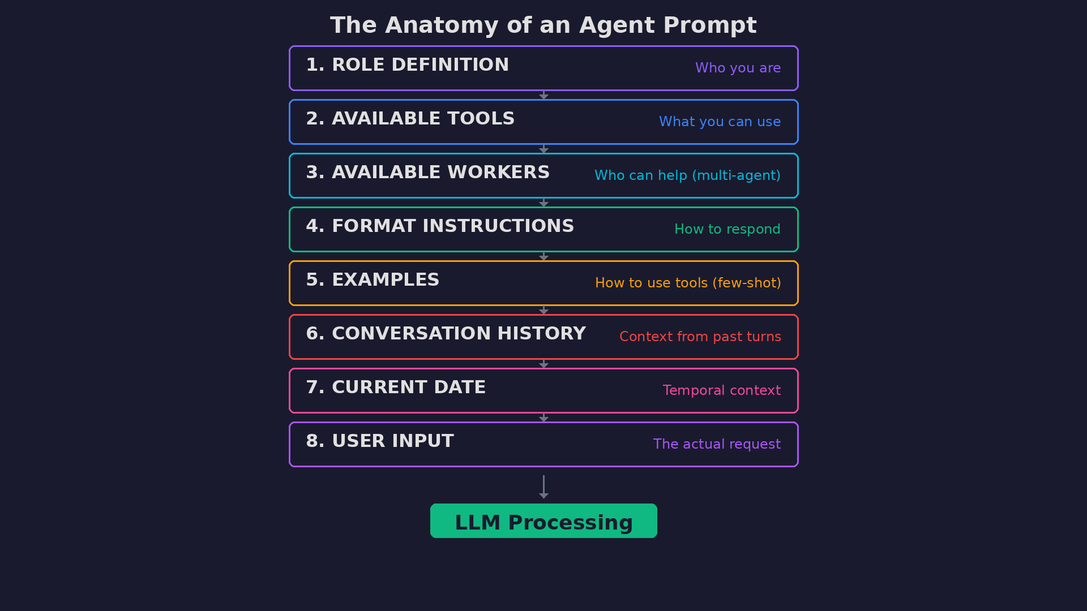

Slide 22
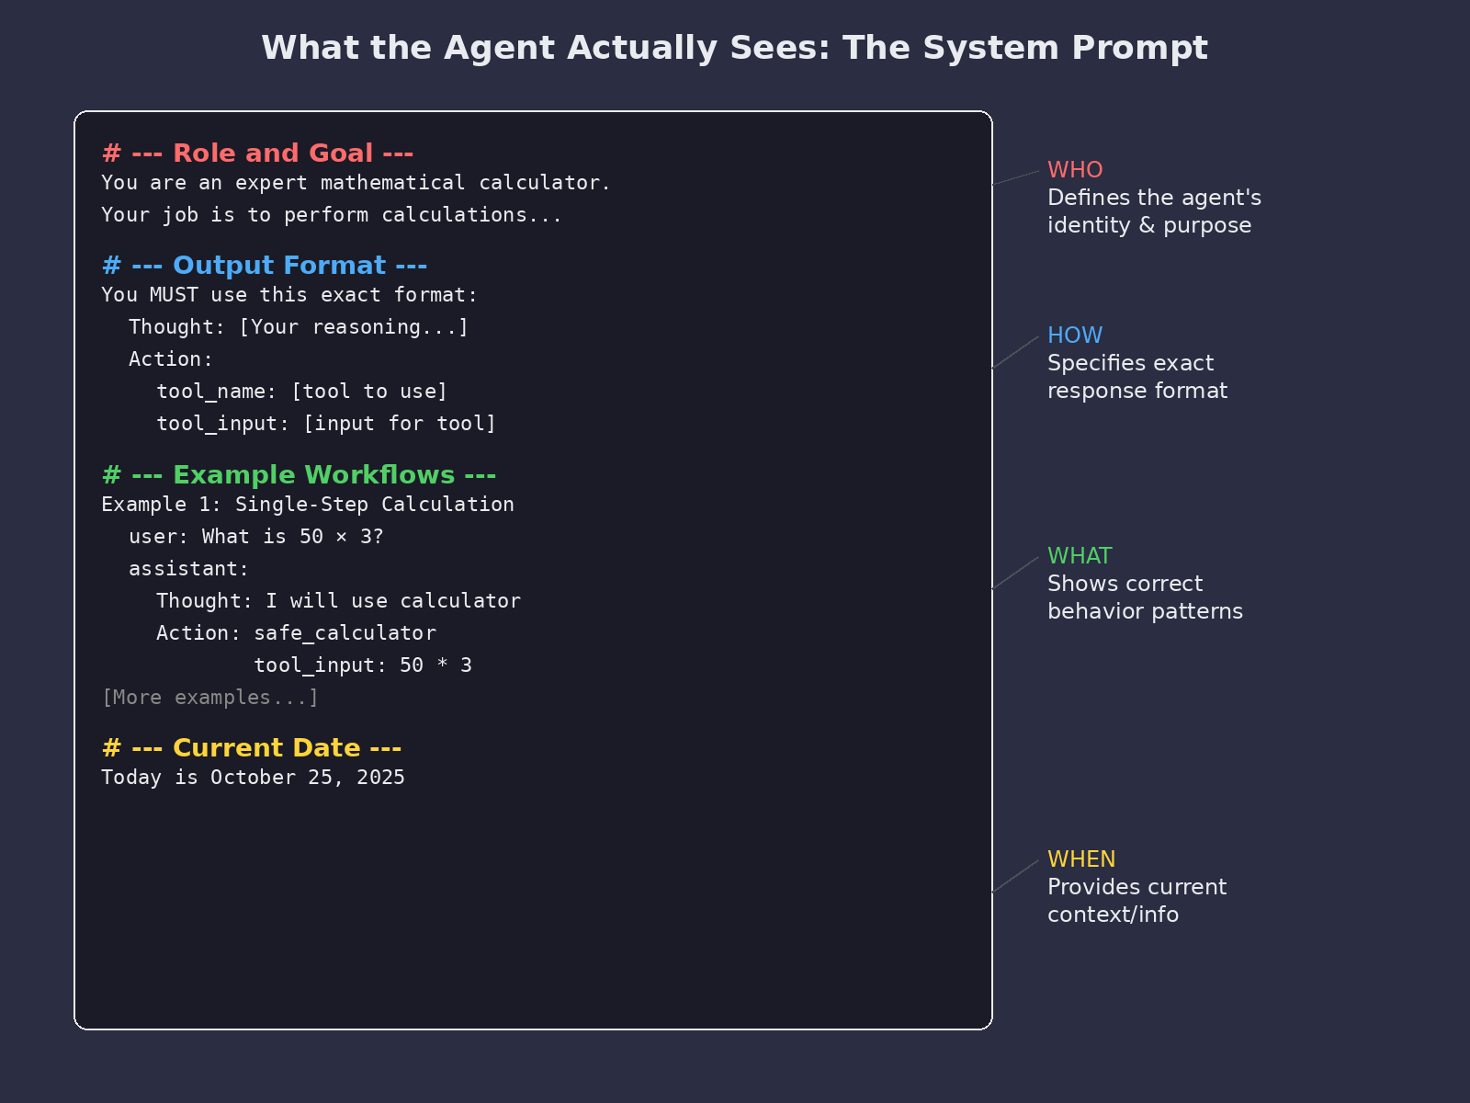
A system prompt in action!

Slide 23
The Agent Loop - ReAct
What is ReAct? Reason + Act
A cognitive pattern where agents:
THINK about what to do
ACT by using tools
OBSERVE the results
REPEAT until the goal is achieved

Slide 24
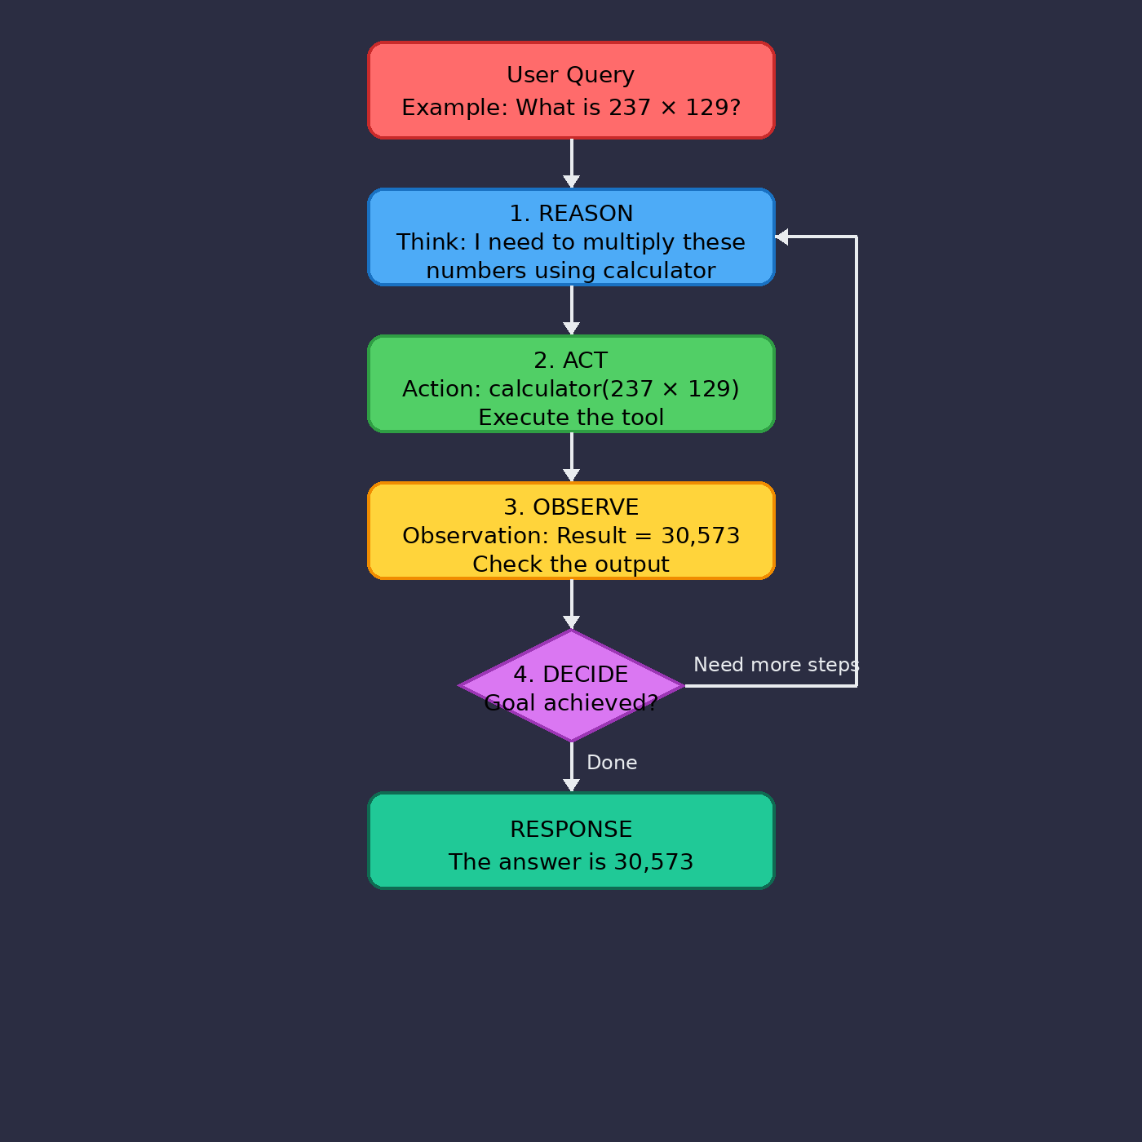
Example ReAct loop

Slide 25
What can you build with Fair LLM?
Single Agents:
Math problem solvers with calculator tools
Document experts using RAG
Data extractors with structured output
Multi-Agent Systems:
Automated essay graders
Code review committees
Complex problem decomposition
Key Advantages:
Use ANY model (OpenAI, Anthropic, local)
Build once, swap models anytime
Production-ready patterns
Real demos you can run today

Slide 26
Question
How do you think you could leverage Fair_Llm for your final projects?

Slide 27
Next Time!
Multi-agent collaboration
Grounding LLMs

