Slide 1
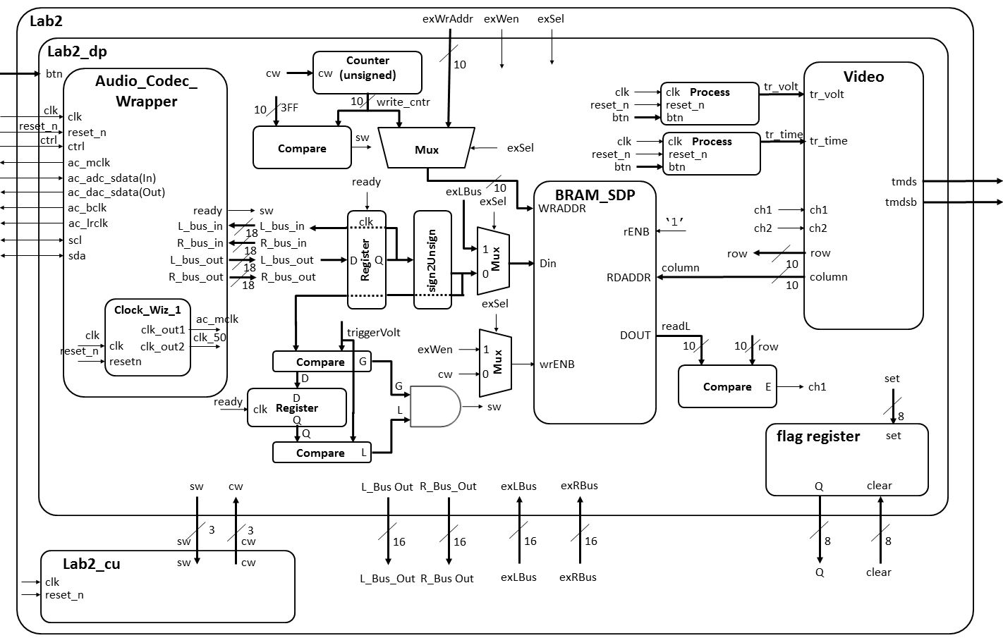
Lab 2 – Architecture

Slide 2
Lab 3 – Architecture
Artix 7 (design_1 for Lab 3)
AA19
V18
axi_uartlite_0 @ 40600000
RX
RX
TX
TX
my_oscope_ip_v2_0.vhd @ 0x44a00000
MicroBlaze
Design_1.xdc
axi_lite
my_oscope_ip_v2_0_S00_AXI.vhd
Lab3.c
R4
G4
S_AXI_ACLK
Lab2_dp.vhd
clk
clk
reset_n
S_AXI_ARESETN
reset_n
32x32
main()
slv_reg0 → 31
To/From Microblaze
Lab2 Signals
myISR()
Interrupt
ready
Lab2.xdc
cw
sw
Pins off
chip
Lab2_fsm.vhd
Signals going In/Out of Artix 7 Chip
Nets to Pins

