Slide 1
0
1
2
3
4
5
6
7

Slide 2
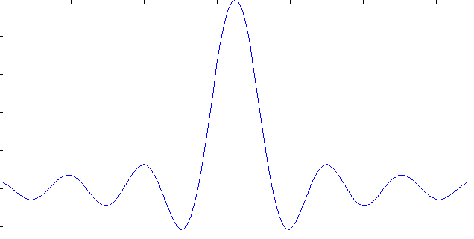
0
1
2
3
4
5
6
7

Slide 3
0
1
2
3
4
5
6
7

Slide 4
0
1
2
3
4
5
6
7

Slide 5
0
1
2
3
4
5
6
7

Slide 6
0
1
2
3
4
5
6
7

Slide 7
0
1
2
3
4
5
6
7

Slide 8
0
1
2
3
4
5
6
7

Slide 9
0
1
2
3
4
5
6
7

Slide 10
0
1
2
3
4
5
6
7

Slide 11
Frequencies not aligning with the bins
0
1
2
3
4
5
6
7

Slide 12
Frequencies not aligning with the bins
0
1
2
3
4
5
6
7

Slide 13
Frequencies not aligning with the bins
0
1
2
3
4
5
6
7

Slide 14
Frequencies not aligning with the bins
0
1
2
3
4
5
6
7

Slide 15
Frequencies not aligning with the bins
0
1
2
3
4
5
6
7

Slide 16
Frequencies not aligning with the bins
0
1
2
3
4
5
6
7

Slide 17
Frequencies not aligning with the bins
0
1
2
3
4
5
6
7

Slide 18
Frequencies not aligning with the bins
0
1
2
3
4
5
6
7

Slide 19
Frequencies not aligning with the bins
0
1
2
3
4
5
6
7

Slide 20
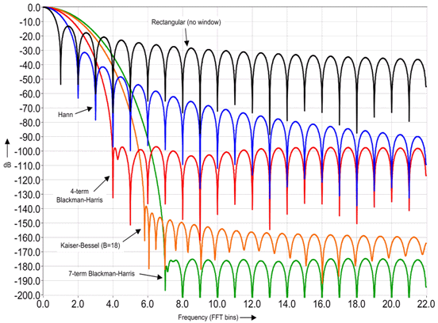
Windows

Slide 21
Smearing occurs if | Φ₁− Φ₂ | < ML / 2
ML
Φ₁
Φ₂

Slide 22
Smearing occurs if | Φ₁− Φ₂ | < ML / 2
ML
Φ₁
Φ₂

Slide 23
SLL interference occurs if
SLL > 20 log10(A₁/A₂) on the window where | Φ₁− Φ₂ |
A₁
A₂
Φ₁
Φ₂

Slide 24
SLL interference occurs if
SLL > 20 log10(A₁/A₂) on the window where | Φ₁− Φ₂ |
A₁
A₂
Φ₁
Φ₂

Slide 25
SLL interference occurs if
SLL > 20 log10(A₁/A₂) on the window where | Φ₁− Φ₂ |
A₁
A₂
Φ₁
Φ₂

