Slide 1
ECE485 Computer Architecture
Lesson 19
Tomasulo Algorithm Supplemental Slides
Adapted from LTC Bob McTasney (AFIT) and primary author:
David Patterson
Electrical Engineering and Computer Sciences
University of California, Berkeley

Slide 2
Advantages of Dynamic Scheduling
Dynamic scheduling - hardware rearranges the instruction execution to reduce stalls while maintaining data flow and exception behavior
It handles cases when dependences unknown at compile time
  it allows the processor to tolerate unpredictable delays such as cache misses, by executing other code while waiting for the miss to resolve
It allows code that compiled for one pipeline to run efficiently on a different pipeline
It simplifies the compiler
Hardware speculation, a technique with significant performance advantages, builds on dynamic scheduling (next lecture)

Slide 3
HW Schemes: Instruction Parallelism
Key idea: Allow instructions behind stall to proceed
DIVD F0,F2,F4
ADDD F10,F0,F8
SUBD F12,F8,F14
Enables out-of-order execution and allows out-of-order completion (e.g., SUBD)
  In a dynamically scheduled pipeline, all instructions still pass through issue stage in order (in-order issue)
Out-of-order completion caused WAW
Out-of-order execution causes WAR

Slide 4
Why Tomasulo Algorithm?
Implemented for the floating point unit of the IBM 360/91
  About 3 years after CDC 6600 (1966)
Goal: High Performance without special compilers
Differences between IBM 360 & CDC 6600 ISA
  IBM has only 2 register specifiers/instruction vs. 3 in CDC 6600
  IBM has 4 FP registers vs. 8 in CDC 6600
  Pipelined rather than multiple functional units (but conceptually viewed as multiple functional units)
    Adder supports 3 instructions
    Multiplier supports 2 instructions
Why Study? lead to Alpha 21264, HP 8000, MIPS 10000, Pentium II, PowerPC 604, i7

Slide 5
Tomasulo Algorithm
Hardware will detect and preserve dependencies (within a limited window of the instruction stream)
Hardware will check for resource availability
Independent instructions will be issued to the correct functional units
Correctness of execution guaranteed by hardware
Independent of compiler optimizations
Backward compatibility
  Software scheduling: different machine configuration necessitate recompilation (or at least rescheduling)

Slide 6
Tomasulo Algorithm
Control & buffers distributed with Function Units (FU)
  FU buffers called “reservation stations”; have pending operands
Registers in instructions replaced by values or pointers to reservation stations(RS); called register renaming ;
  Renaming avoids WAR, WAW hazards
  More reservation stations than registers, so can do optimizations compilers can’t
Results to FU from RS, not through registers, over Common Data Bus that broadcasts results to all FUs
  Avoids RAW hazards by executing an instruction only when its operands are available
Load and Stores treated as FUs with RSs as well
Integer instructions can go past branches (predict taken), allowing FP ops beyond basic block in FP queue

Slide 7
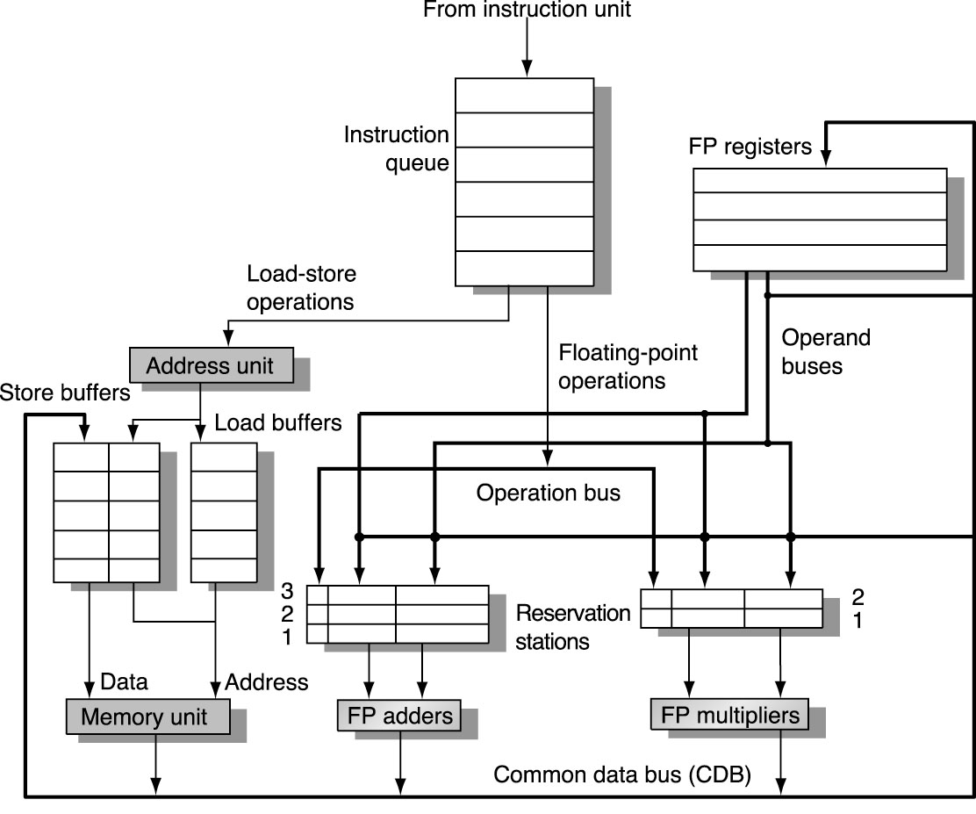
Tomasulo Organization
Notes:
Resolve RAW memory conflict? (address in memory buffers)
Integer unit executes in parallel

Slide 8
Reservation Station Components
Op—Operation to perform in the unit (e.g., + or –) on S1 and S2
Vj, Vk—Value of source operands
  Either V or Q is valid for each operand
Qj, Qk—Reservation stations producing source registers (value to be written)
  Note: No ready flags as in Scoreboard; Qj, Qk=0 => ready
  Store buffers only have Qi for RS producing result
Busy—Indicates reservation station or FU is busy
Register result status—Indicates which functional unit (Qi) will write each register, if one exists. Blank when no pending instructions that will write that register.

Slide 9
Three Stages of Tomasulo Algorithm
1. Issue—get instruction from FP Op Queue
  If reservation station free (no structural hazard),
  control issues instruction & sends operands (renames registers).
2. Execution—operate on operands (EX)
  When both operands ready then execute;
  if not ready, watch Common Data Bus for result
3. Write result—finish execution (WB)
  Write on Common Data Bus to all awaiting units;
  mark reservation station available
Normal data bus: data + destination (“go to” bus)
Common data bus: data + source (“come from” bus)
  Does the broadcast
  64 bits of data + 4 bits of Functional Unit source address
  FU snags value on CDB if matches expected FU (produces result)
Notes:
For Issue: Note that remaining registers avoids name dependencies (anti-WAR and output-WAW)
For Execution, RAW eliminated since result is directly pulled off the bus and stored in the associated reservation station.

Slide 10
Detailed Tomasulo Pipeline Control
Instruction status
Wait until
Bookkeeping
Issue
Station or
buffer empty
if (RegisterStat[‘S1’].Qi ≠ 0)
{RS[r].Qj ← RegisterStat[‘S1’].Qi}
else {RS[r].Vj ← S1; RS[r].Qj ← 0}
if (RegisterStat[‘S2’].Qi ≠ 0)
{RS[r].Qk ← RegisterStat[‘S2’].Qi}
else {RS[r].Vk ← S2; RS[r].Qk ← 0}
RS[r].Busy ← yes;
RegisterStat[‘D’].Qi ← r;
Execute
(RS[r].Qj=0) and
(RS[r].Qk=0)
None — operands are in Vj and Vk
Write result
Execution completed
at r
and CDB available
∀x(if (RegisterStat[x].Qi=r)
{Regs[x] ← result; RegisterStat[x].Qi ← 0});
∀x(if (RS[x].Qj=r) {RS[x].Vj ← result; RS[x].Qj ← 0});
∀x(if (RS[x].Qk=r) {RS[x].Vk ← result; RS[x].Qk ← 0});
RS[r].Busy ← No
r = RS instruction is assigned

Slide 11
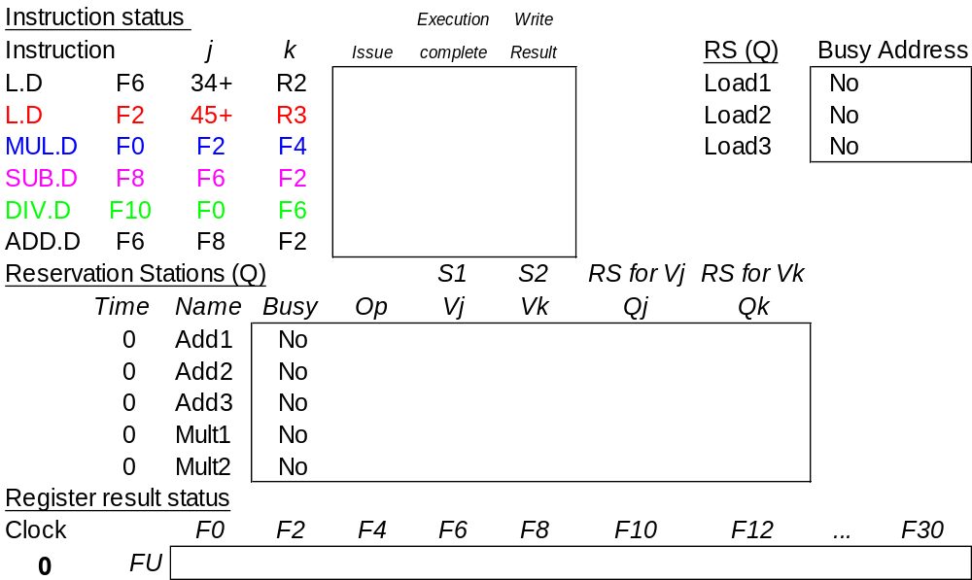
Tomasulo Example Cycle 0
3 Load/Buffers
3 FP Adder R.S.
2 FP Mult R.S.
Qi
ASSUME ‘EX’ CC’s: Load-2, Add-2, Mult-10, Div-40

Slide 12
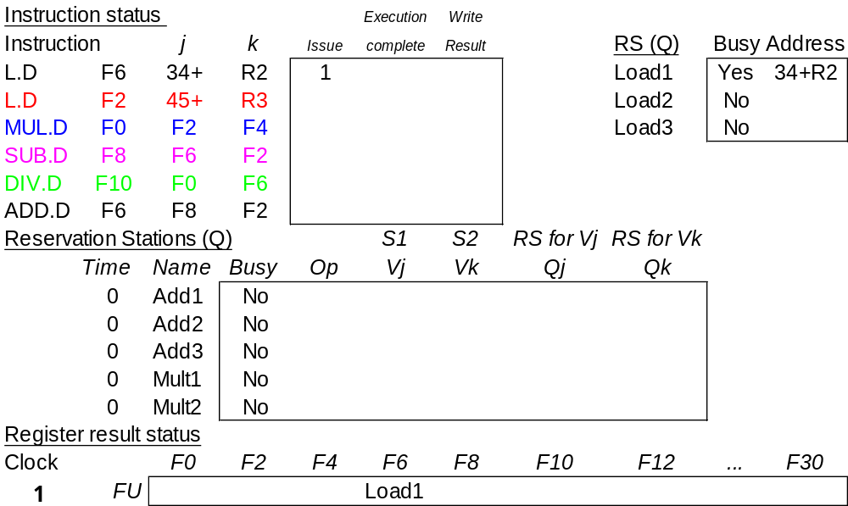
Tomasulo Example Cycle 1

Slide 13
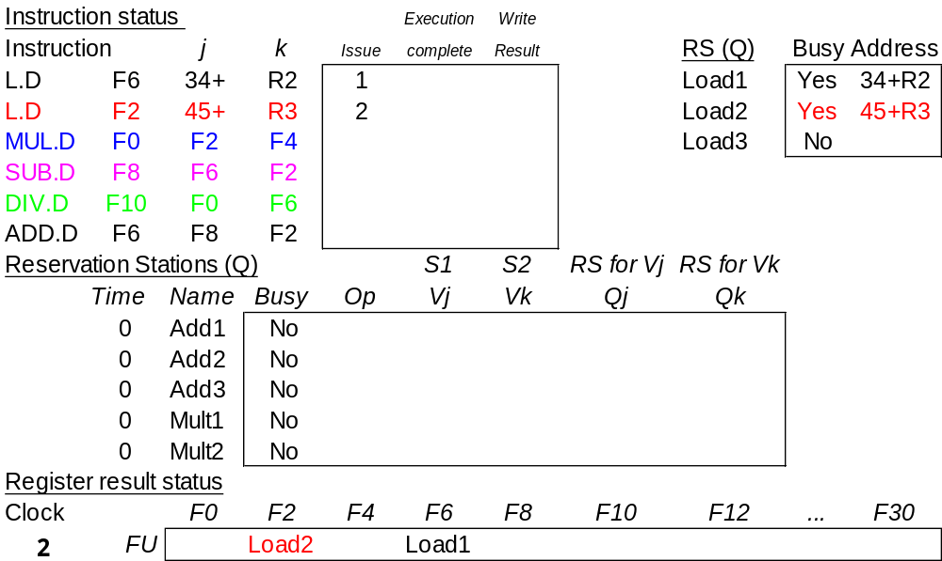
Tomasulo Example Cycle 2
Note: Unlike 6600, can have multiple loads outstanding

Slide 14
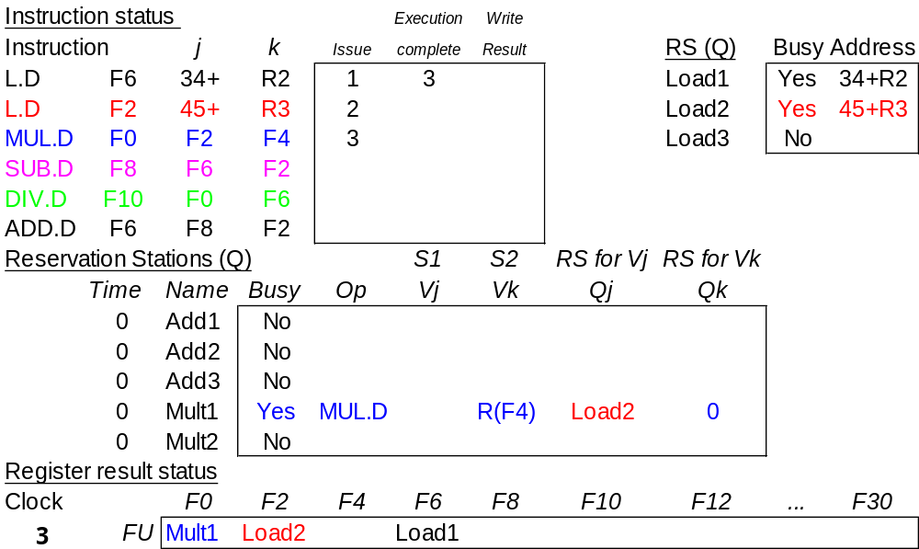
Tomasulo Example Cycle 3
Note: register names are removed (“renamed”) in Reservation Stations; MULT issued vs. scoreboard
Load1 completing

Slide 15
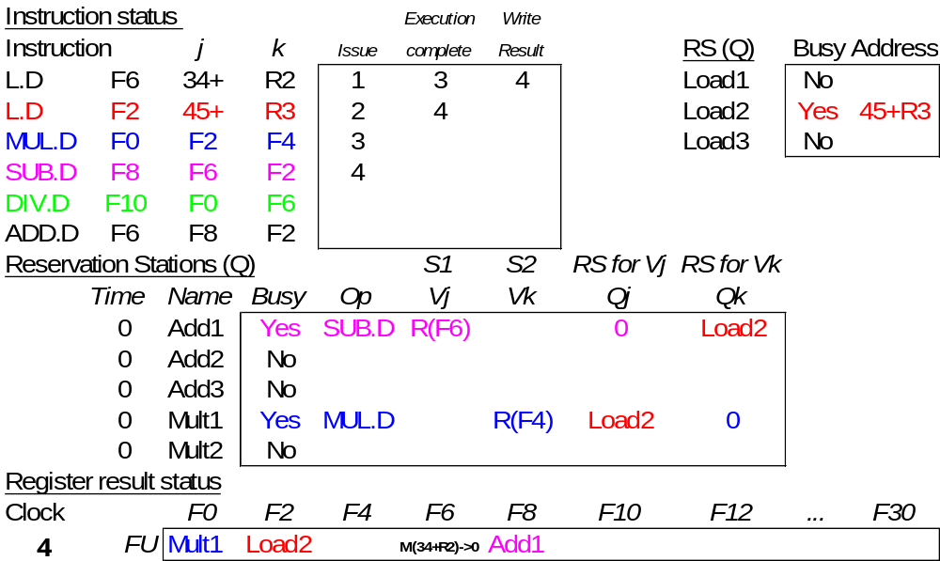
Tomasulo Example Cycle 4
Load2 completing; what is waiting for it?

Slide 16
Tomasulo Example Cycle 5
Instruction status
Execution
Write
Instruction
j
k
Issue
complete
Result
RS (Q)
Busy
Address
L.D
F6
34+
R2
1
3
4
Load1
No
L.D
F2
45+
R3
2
4
5
Load2
No
MUL.D
F0
F2
F4
3
Load3
No
SUB.D
F8
F6
F2
4
DIV.D
F10
F0
F6
5
ADD.D
F6
F8
F2
Reservation Stations (Q)
S1
S2
RS for Vj
RS for Vk
Time
Name
Busy
Op
Vj
Vk
Qj
Qk
2
Add1
Yes
SUB.D
R(F6)
M(45+R3)
0
0
0
Add2
No
0
Add3
No
10
Mult1
Yes
MUL.D
M(45+R3)
R(F4)
0
0
0
Mult2
Yes
DIV.D
R(F6)
Mult1
0
Register result status
Clock
F0
F2
F4
F6
F8
F10
F12
...
F30
5
FU
Mult1
M(45+R3)->0
Add1
Mult2

Slide 17
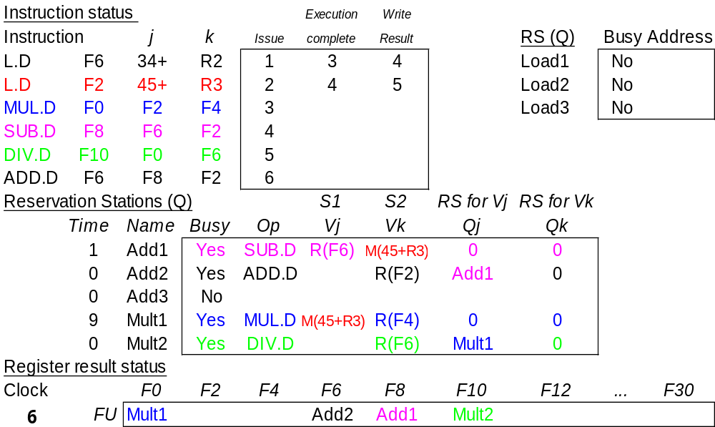
Tomasulo Example Cycle 6
Issue ADD.D here vs. scoreboard?

Slide 18
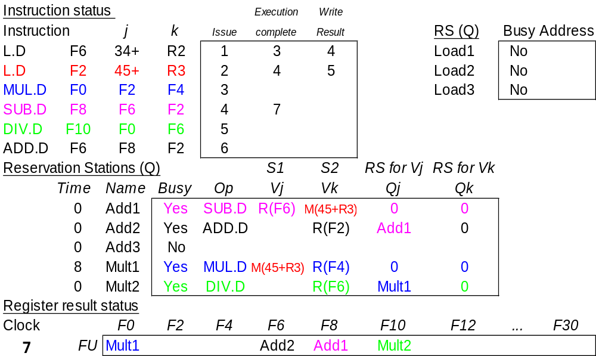
Tomasulo Example Cycle 7
Add1 completing; what is waiting for it?

Slide 19
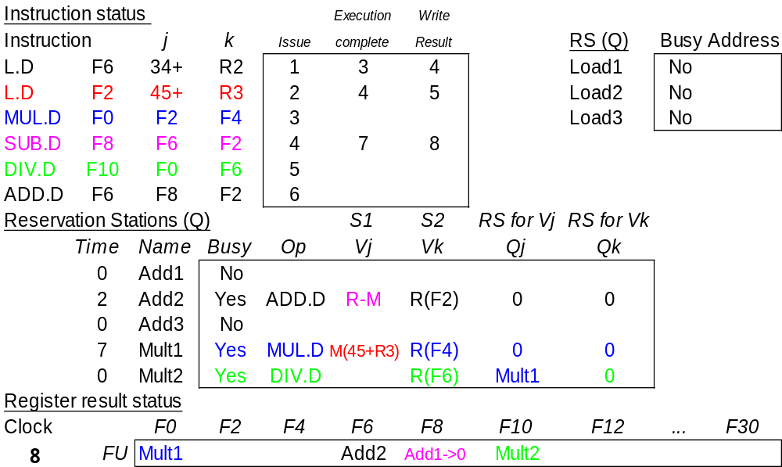
Tomasulo Example Cycle 8

Slide 20
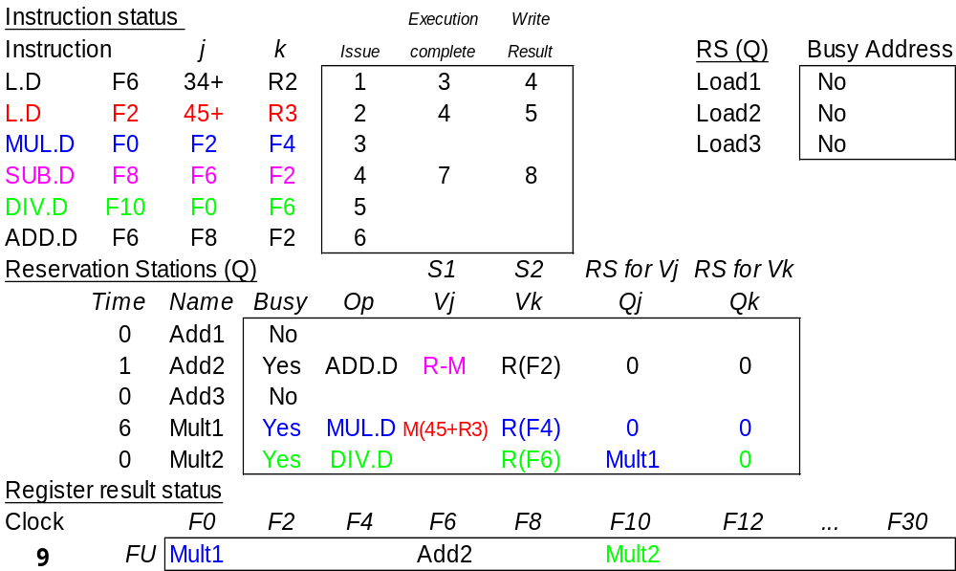
Tomasulo Example Cycle 9

Slide 21
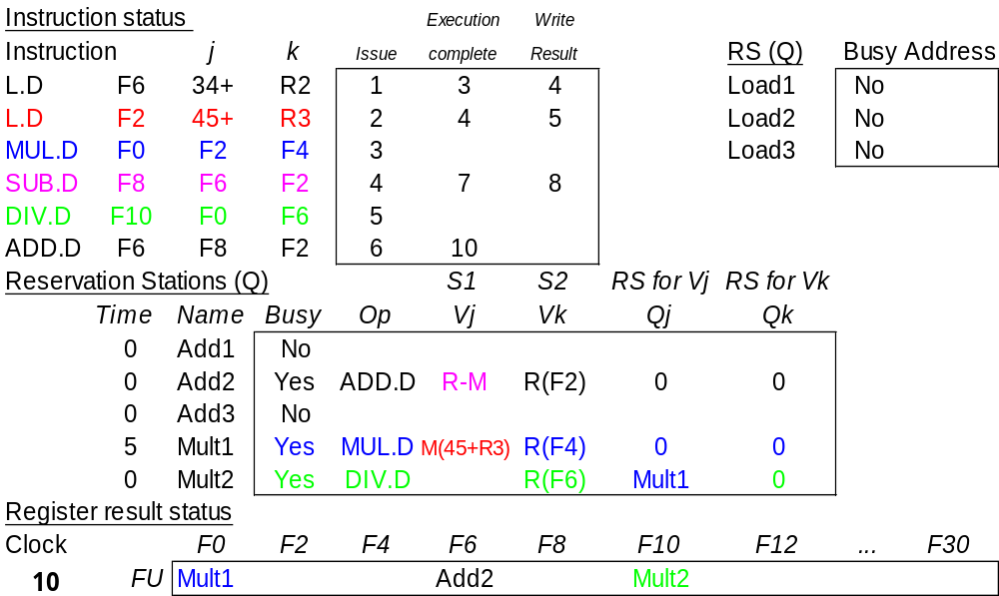
Tomasulo Example Cycle 10
Add2 completing; what is waiting for it?

Slide 22
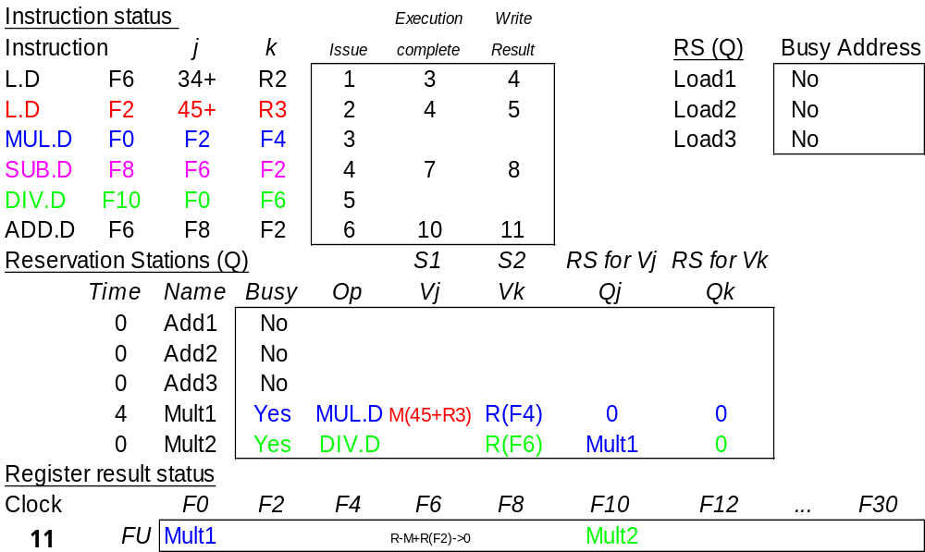
Tomasulo Example Cycle 11
Write result of ADD.D here vs. scoreboard?
Notes:
No WAR on DIV.D since DIV has value directly stored in Vk (as opposed to having to wait and read the register).

Slide 23
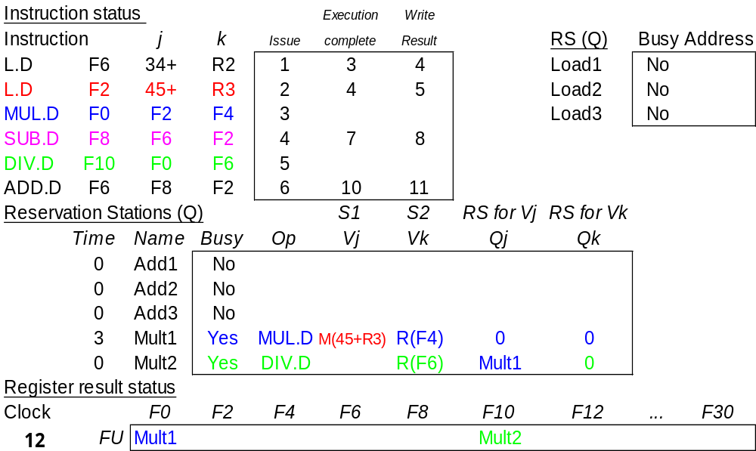
Tomasulo Example Cycle 12
Note: all quick instructions complete already

Slide 24
Tomasulo Example Cycle 13
Instruction status
Execution
Write
Instruction
j
k
Issue
complete
Result
RS (Q)
Busy
Address
L.D
F6
34+
R2
1
3
4
Load1
No
L.D
F2
45+
R3
2
4
5
Load2
No
MUL.D
F0
F2
F4
3
Load3
No
SUB.D
F8
F6
F2
4
7
8
DIV.D
F10
F0
F6
5
ADD.D
F6
F8
F2
6
10
11
Reservation Stations (Q)
S1
S2
RS for Vj
RS for Vk
Time
Name
Busy
Op
Vj
Vk
Qj
Qk
0
Add1
No
0
Add2
No
0
Add3
No
2
Mult1
Yes
MUL.D
M(45+R3)
R(F4)
0
0
0
Mult2
Yes
DIV.D
R(F6)
Mult1
0
Register result status
Clock
F0
F2
F4
F6
F8
F10
F12
...
F30
13
FU
Mult1
Mult2

Slide 25

Tomasulo Example Cycle 14

Slide 26
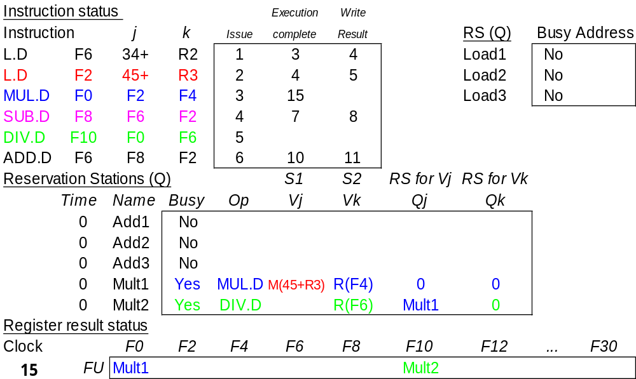
Tomasulo Example Cycle 15
Mult1 completing; what is waiting for it?
Tomasulo Algorithm CSCE 692 – Computer Architecture

Slide 27
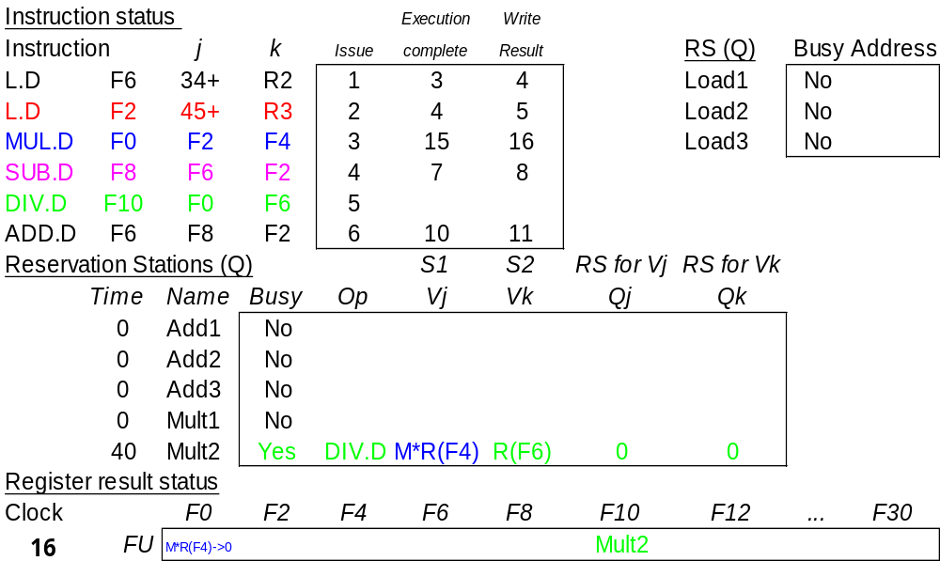
Tomasulo Example Cycle 16
Note: Just waiting for divide
Tomasulo Algorithm CSCE 692 – Computer Architecture

Slide 28
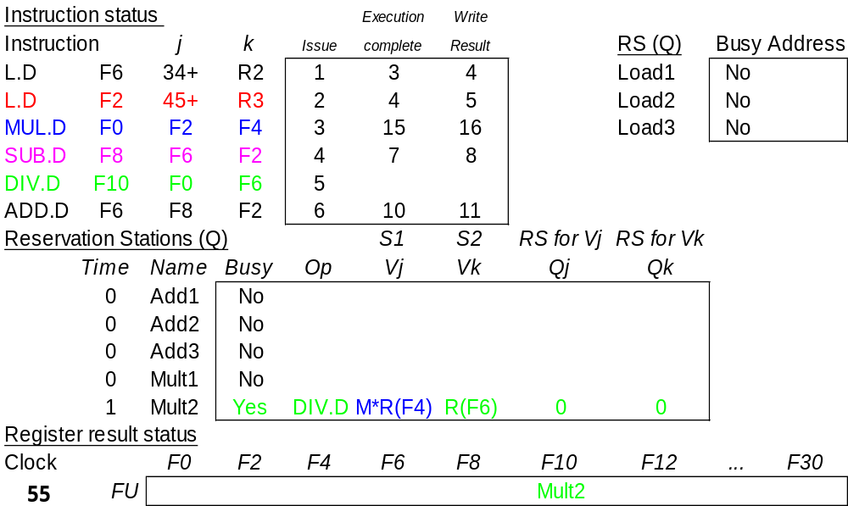
Tomasulo Example Cycle 55 – TIME Warp!!

Slide 29
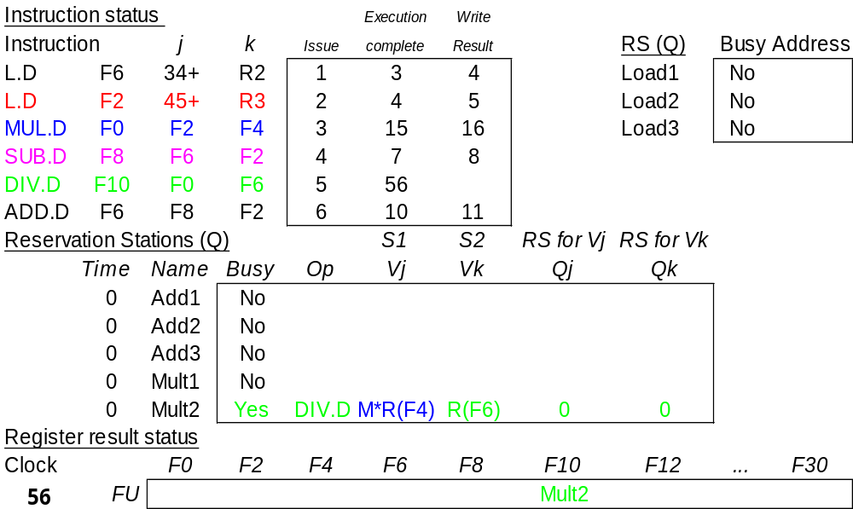
Tomasulo Example Cycle 56
Mult 2 completing; what is waiting for it?

Slide 30
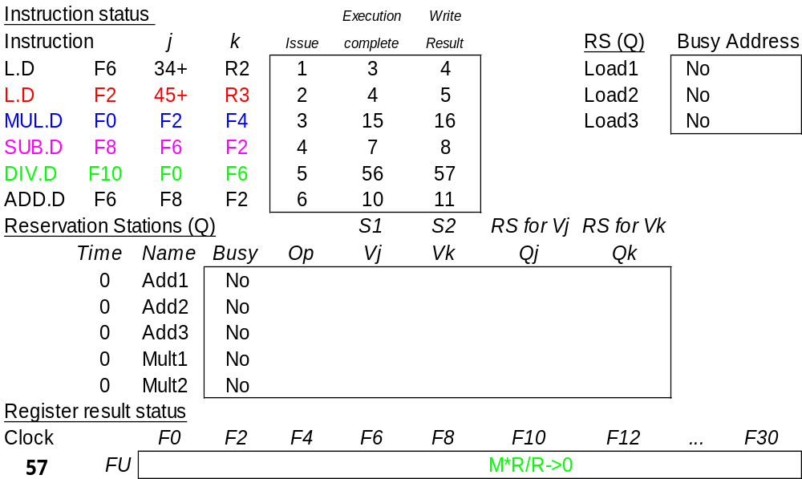
Tomasulo Example Cycle 57
Again, in-order issue,
out-of-order execution, completion

Slide 31
Compare to Scoreboard Cycle 62
Instruction status
Read
Execution
Write
Instruction
j
k
Issue
operands
complete
Result
L.D
F6
34+
R2
1
2
3
4
L.D
F2
45+
R3
5
6
7
8
MUL.D
F0
F2
F4
6
9
19
20
SUB.D
F8
F6
F2
7
9
11
12
DIV.D
F10
F0
F6
8
21
61
62
ADD.D
F6
F8
F2
13
14
16
22
Functional unit status
dest
S1
S2
FU for j
FU for k
Fj?
Fk?
Time
Name
Busy
Op
Fi
Fj
Fk
Qj
Qk
Rj
Rk
Integer
No
Mult1
No
Mult2
No
Add
No
0
Divide
No
Register result status
Clock
F0
F2
F4
F6
F8
F10
F12
...
F30
62
FU
Why does it take longer on Scoreboard/6600?

Slide 32
Tomasulo vs. Scoreboard
(IBM 360/91 vs. CDC 6600)
Pipelined Functional Units Multiple Functional Units
(6 load, 3 store, 3 +, 2 x/÷) (1 load/store, 1 + , 2 x, 1 ÷)
window size: ≤ 14 instructions ≤ 5 instructions
No issue on structural hazard same
WAR: renaming avoids stall completion
WAW: renaming avoids stall completion
Broadcast results from FU Write/read registers
Control: reservation stations central scoreboard

Slide 33
Tomasulo Drawbacks
Complexity
Many associative writebacks (CDB) at high speed
  Big load for a single bus
  Can only writeback one result per clock
Performance limited by Common Data Bus
  Multiple CDBs => more FU logic for parallel assoc writebacks

Slide 34
Tomasulo Loop Example
Loop: L.D F0 0 R1
MUL.D F4 F0 F2
S.D F4 0 R1
DADDI R1 R1 -8
BNEZ R1 Loop
Assume Multiply takes 4 clocks
Assume first load takes 8 clocks (cache miss?), second load takes 4 clocks (hit)
Assume stores take 4 clocks
To be clear, will show clocks for DADDI, BNEZ
Assume branch predicted “taken” and DADDI issue, execution, forwarding and write-back is done in one cycle (done to simplify this example).
Notes:
Note that times are from execute-to-ExecuteComplete

Slide 35
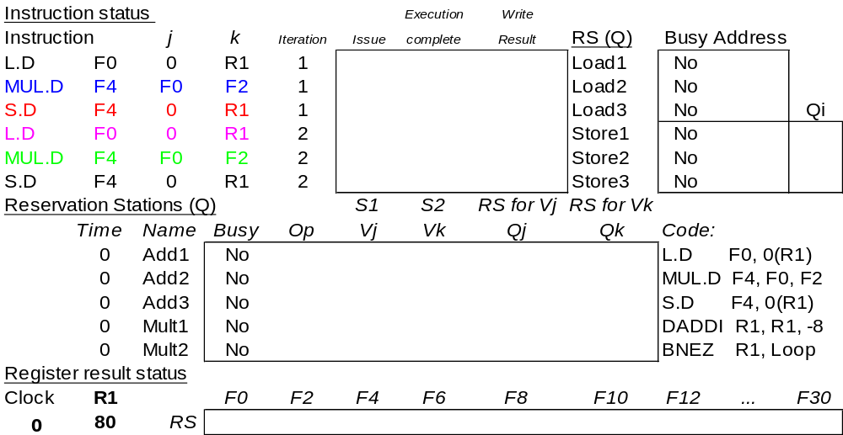
Loop Example Cycle 0
Notes:
2 iterations are “unrolled”
Assume
Predict taken
Int ALU ignored (except for issue time)

Slide 36
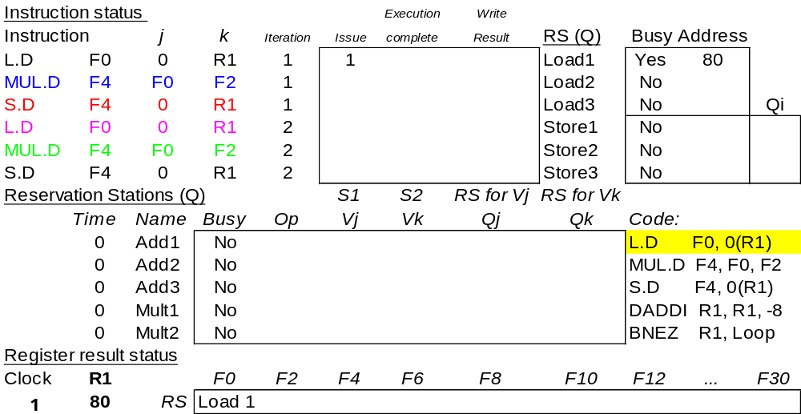
Loop Example Cycle 1

Slide 37
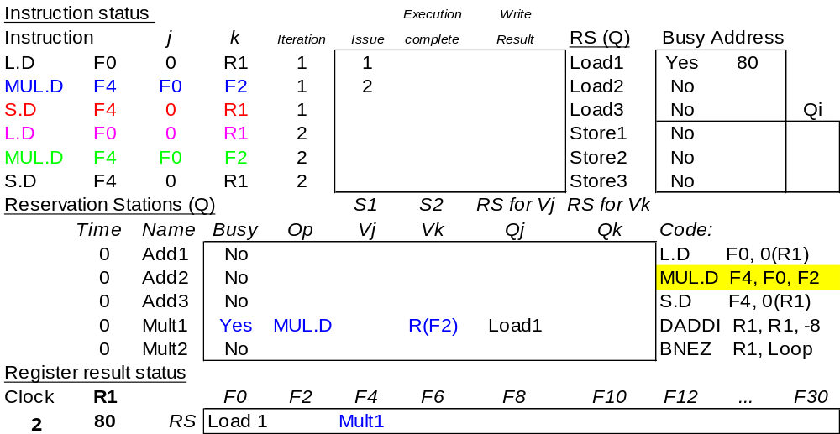
Loop Example Cycle 2

Slide 38
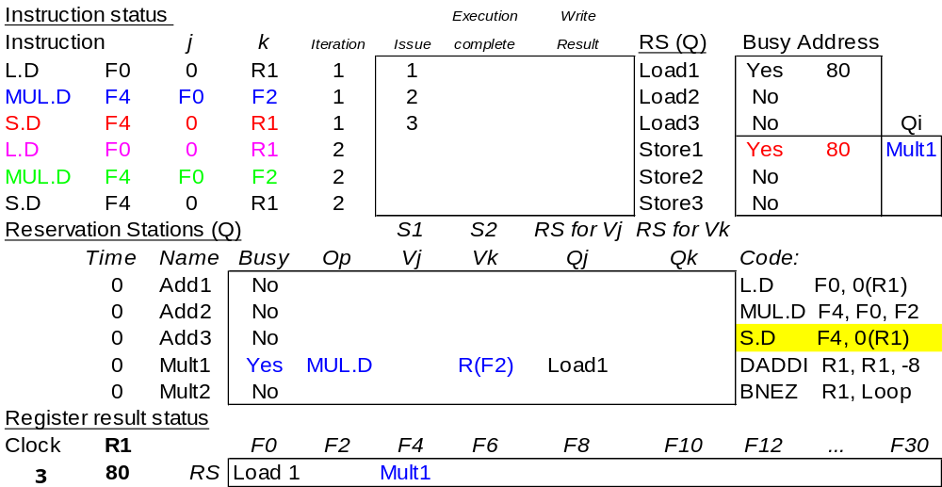
Loop Example Cycle 3

Slide 39
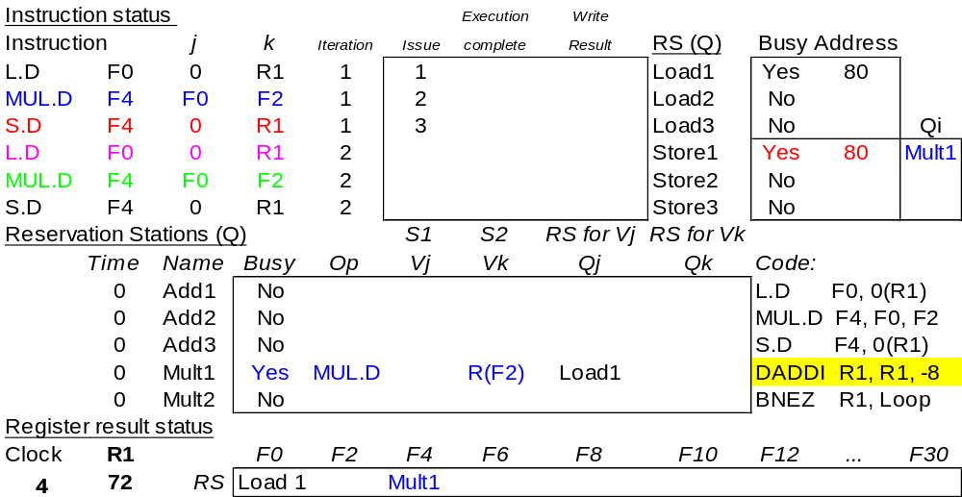
Loop Example Cycle 4

Slide 40
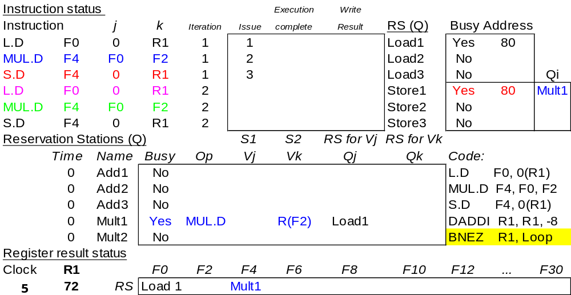
Loop Example Cycle 5

Slide 41
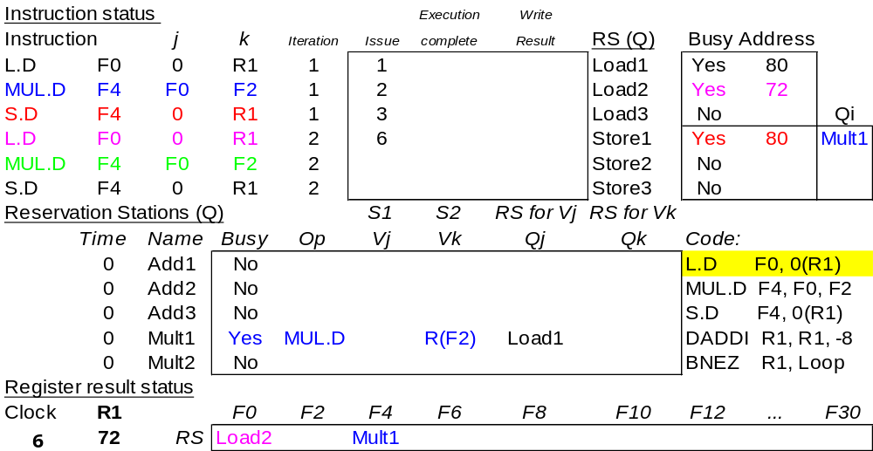
Loop Example Cycle 6
Note: F0 never sees Load1 result

Slide 42
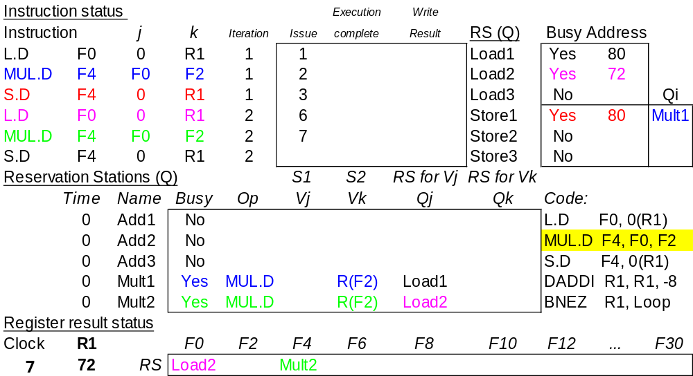
Loop Example Cycle 7

Slide 43
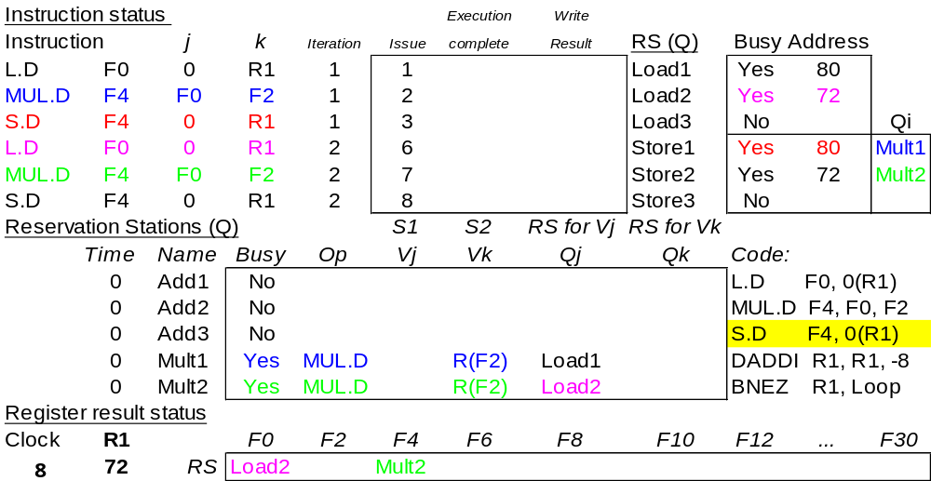
Loop Example Cycle 8

Slide 44
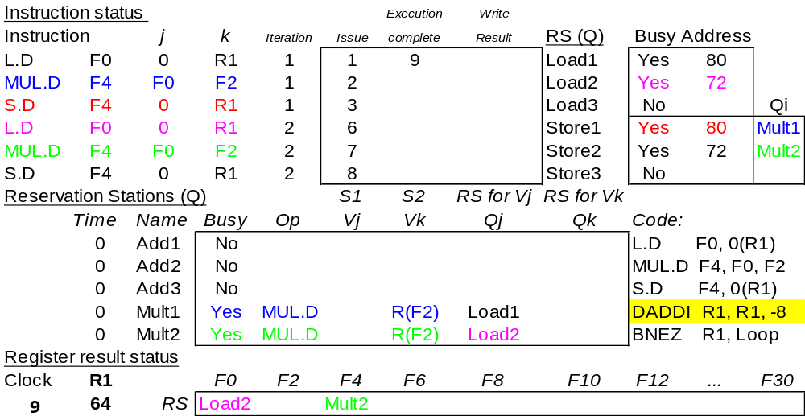
Loop Example Cycle 9
Load1 completing; what is waiting for it?

Slide 45
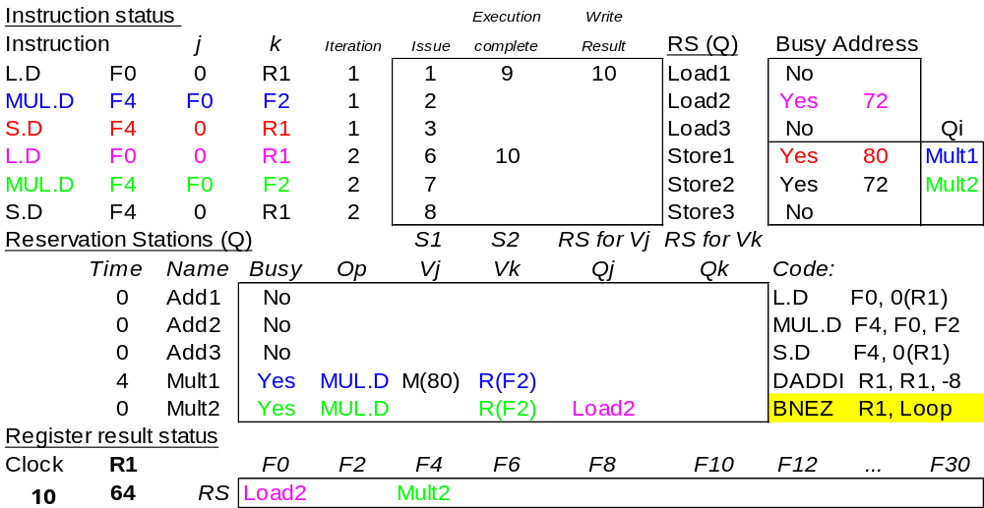
Loop Example Cycle 10
Load2 completing; what is waiting for it?

Slide 46
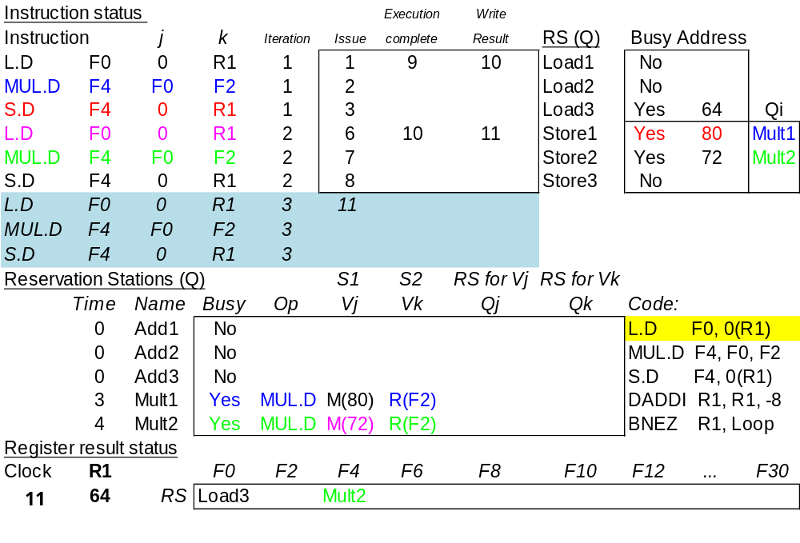
Loop Example Cycle 11
Notes:
Iteration 3 stalls on MUL.D as no reservation station is available.

Slide 47

Loop Example Cycle 12
Notes:
Iteration 3 stalls on MUL.D as no reservation station is available.

Slide 48

Loop Example Cycle 13
Notes:
Iteration 3 stalls on MUL.D as no reservation station is available.

Slide 49

Loop Example Cycle 14
Mult1 completing; what is waiting for it?
Notes:
Iteration 3 stalls on MUL.D as no reservation station is available.

Slide 50
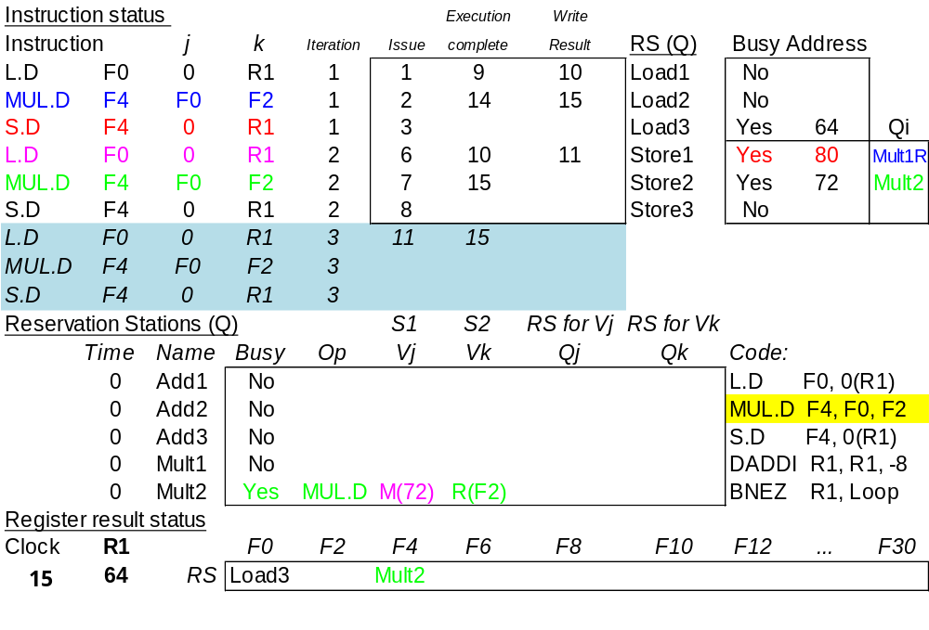
Loop Example Cycle 15 (corrected)
Mult2 completing; what is waiting for it?

Slide 51
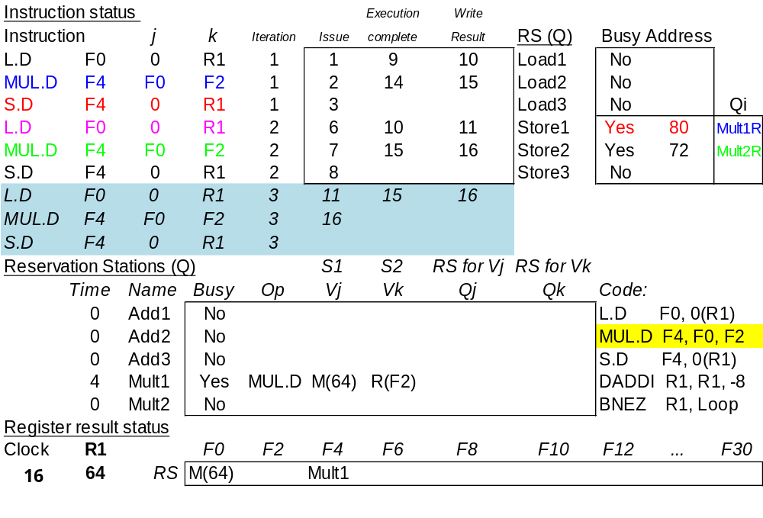
Loop Example Cycle 16 (corrected)
Much going on here. Can you tell what happened?

Slide 52
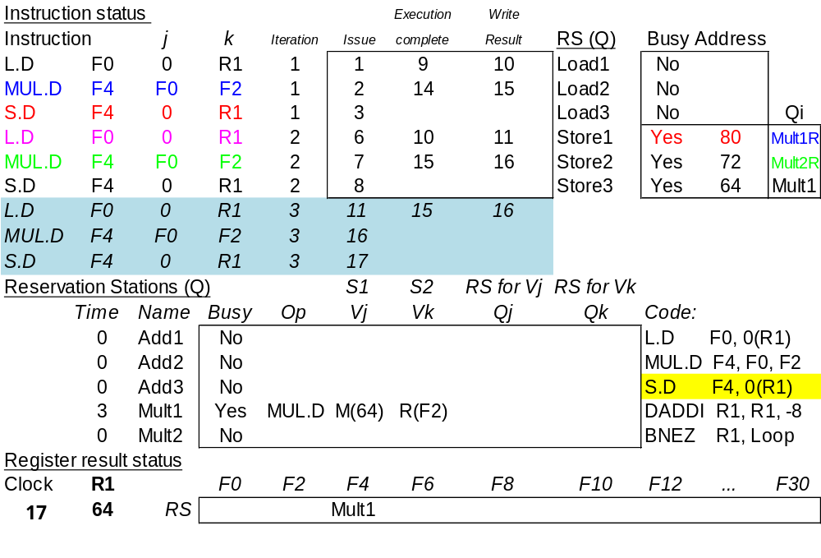
Loop Example Cycle 17 (corrected)

Slide 53
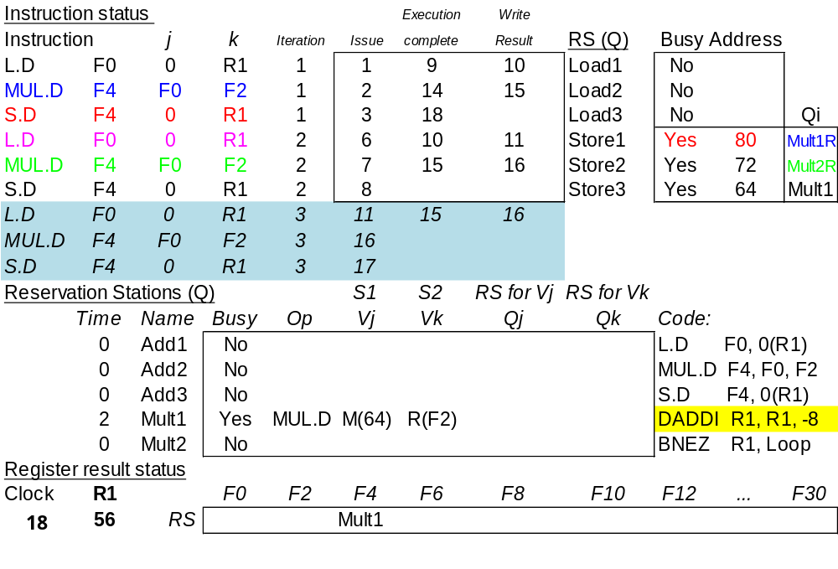
Loop Example Cycle 18 (corrected)

Slide 54
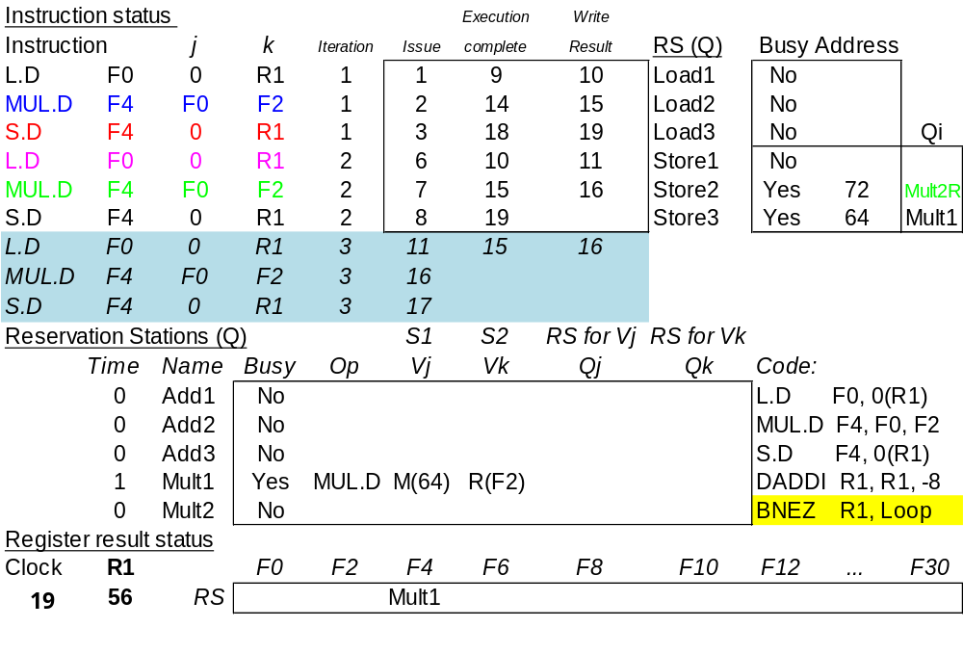
Loop Example Cycle 19 (corrected)

Slide 55
Tomasulo Summary
Reservations stations: renaming to larger set of registers + buffering source operands
  Prevents registers as bottleneck
  Avoids WAR, WAW hazards of Scoreboard
  Allows loop unrolling in HW
Not limited to basic blocks
(integer units gets ahead, beyond branches)
Lasting Contributions
  Dynamic scheduling
  Register renaming
  Load/store disambiguation
360/91 descendants are Pentium II; PowerPC 604; MIPS R10000; HP-PA 8000; Alpha 21264

Slide 56
ILP Summary (up to now)
Leverage Implicit Parallelism for Performance: Instruction Level Parallelism
Loop unrolling by compiler to increase ILP
Branch prediction to increase ILP
Dynamic HW exploiting ILP
  Works when can’t know dependence at compile time
  Can hide L1 cache misses
  Code for one machine runs well on another

