Slide 1
<AgencyName> SME Training: Phone Interview
<insert date>

Slide 2
<Delete THIS SLIDE BEFORE PRESENTING>
PREPARE THE FOLLOWING AHEAD OF TIME – 1 PRINTED COPY OF EACH PER ATTENDEE
Phone interview rating template customized with your questions and proficiency levels
Optional: copies of SME Background Info Sheet if they haven’t all submitted them already

Slide 3
Agenda for this session
Review interview guide
Conduct mock interview
How to rate applicants
Notes:
Most of the time in this training will be spent reviewing the phone interview rating template which contains the questions you created during Job Analysis.
SMEs will also learn how to write a transcript of the phone interviews and we will practice how to conduct the interviews.

Slide 4
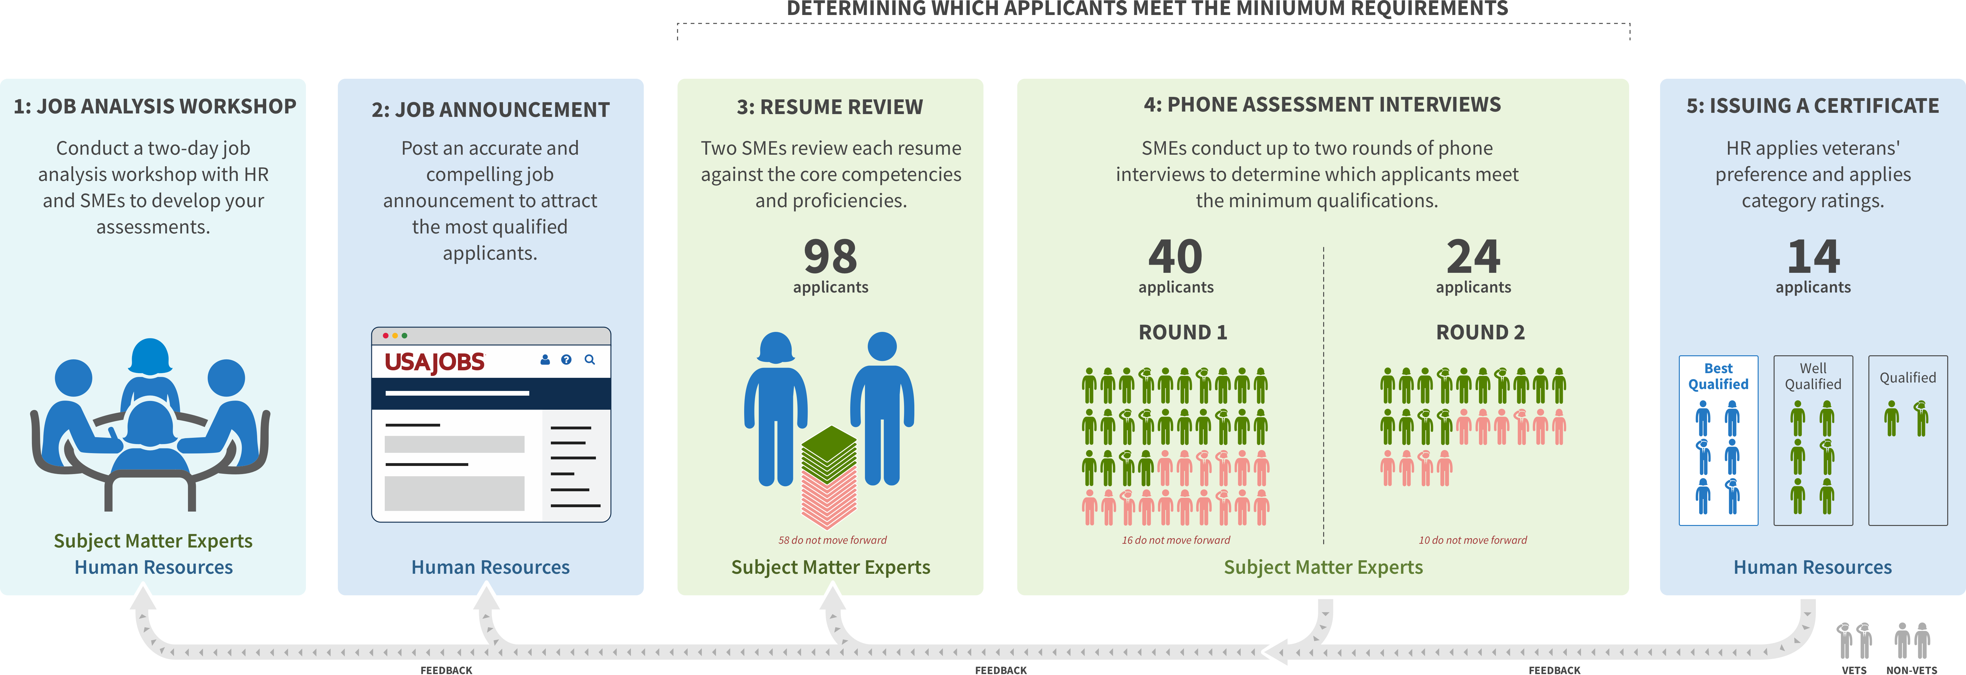
Multi-Hurdle SME Assessment Process
WE ARE HERE
Notes:
Reminder of the overall hiring process and where we are now
Job analysis workshop and Job Announcement already done. Resume Review stage is complete.
We are now preparing for Phone Interview (1 or 2) stage
One SME will conduct a phone interview for every applicant phase 1. Not every applicant will have a second phone interview.

Slide 5
This is an examination. You are testing their knowledge of, and expertise in, the pre-defined competencies.

Slide 6
Prohibited Personnel Practices 5 U.S.C. 2302(b)
Giving an unauthorized preference or advantage to improve or injure the prospects of any particular person for employment (also, don’t promise anyone they’re going to get this job--you don’t know that!)
Engaging in nepotism
Discriminating (including discrimination based on marital status and political affiliation)
Considering employment based on factors other than personal knowledge or records of job-related abilities
Influencing any person to withdraw from job competition
Notes:
Reminder of relevant legal requirements around personnel practices
Cannot discriminate for or against vets
Cannot bias for or against internal applicants or internal contractors

Slide 7
OVERVIEW: Briefly review the Interview Guide
Notes:
This should take about 5 min.

Slide 8
ACTIVITY: Group-based mock interview
Notes:
Split the group in two. One asks questions and the other answers. Take turns asking/answering the question.
No one should be put on the spot
Go through the whole process from start to finish – everything from script to analysis
Have the SMEs read the “expected good responses” to answer the questions
Get on the same page about what the questions are asking for

Slide 9
Review interview questions
Half the team read questions, the other half answers. Take turns
Get on the same page about:
Questions and follow-ups
Proficiency levels
Sample responses
Notes:
Reference the competency/target proficiency after reviewing *each* question.
Talking point: cannot deviate from probe questions to be fair to all applicants.

Slide 10
During the interview, you can’t change questions, but you can repeat and clarify questions if needed.

Slide 11
Take advantage of probe questions
Notes:
You can ask questions like “tell me more about that” more than once

Slide 12
DURING THE INTERVIEW: Transcribing responses

Slide 13
Writing a Transcript
Transcript should be detailed enough so that if one SME were to review another SME's assessment, they would arrive at the same proficiency level.
Transcript does not have to be a verbatim transcription, but do it to the best of your ability.
Notes:
Example:
If the transcript shows a poor response, you can’t give them a “meets”

Slide 14
Good or bad Transcript: Example 1
Question (Communication and Collaboration):
Tell me about a time you worked with a team to solve a technical issue? How was the problem identified and how did your group communicate your findings?
Transcript:
Able to give a detailed description of an issue and its resolution
Describes that they played an active role in finding and mitigating the risk (vs watching their team find and solve the problem)
Candidate identified size and scope of risk and how it would affect users
Candidate mentioned informing stakeholders
Notes:
This is not a good example. Reasons:
- Transcription with details? no -- the notes are high-level and overly summarized.
- Analysis at the end? yes
- Can another SME make a determination? no, not without details

Slide 15
Good or bad Transcript: Example 2
Question (Active Directory):
How does DNS resolution work?
Transcript:
User makes a request to a URL
DNS caches along the way
Local machine, network, and ISP have them
There are DNS lookup providers out there
Essentially what they are doing is mapping the domain name that you put in with the correct IP address that you're trying to go to.
Impression: Covers basics, but lacks details
Notes:
This is a good example. Reasons:
Transcription with details? Yes, this is a transcription
Analysis: yes. Short but separate
Can another SME make a determination? yes, because details are provided

Slide 16
Good or bad Transcript: Example 3
Question:
How is the cloud secure? How would you get data on the cloud securely?
Transcript:
Im speaking from amazon, because this is what I'm most familiar with. Security is a first class citizen. There are always VPCs or virtual subnets that are closed by default. You have to provision security groups and network ACLs to make them accessible from outside the VPC.
Storage systems can be encrypted via private key that you provide. You can encrypt at rest, or as you're writing to the storage systems.
Amazon load balancers designed to resist DDoS attacks, several ways to get things onto the cloud securely.
There are secure gateways that let you create T1 or T3 connections, a direct encrypted pipe, allows you to secure anything (machine on prem in government office, EBS storage). Encrypted E2E.
Amazon stuff can be certified -- I forget the organization that lets you certify as secure (health or PII).
Notes:
This is a good example. Reasons:
Transcription with details? Yes, this is a transcription
Analysis: yes. Short but separate
Can another SME make a determination? yes, because details are provided

Slide 17
AFTER THE INTERVIEW: Rating applicant responses

Slide 18
Ratings: - Does not meet - Meets - Exceeds
Notes:
If the applicant does not meet the proficiency level, you *must* give them a Does not Meet. Each interview is its own filter step.
If an applicant does not do well, do not pass them along to be filtered later
An applicant that gets one or more “exceeds” in an interview will be placed in a higher rating category compared to an applicant that just got “meets” across the board

Slide 19
There is no quota for how many applicants should pass.
Notes:
If no one meets the bar, no one should pass.
If everyone meets the bar, everyone should pass.

Slide 20
AFTER THE INTERVIEW: Writing your analysis

Slide 21
Example Interview Analysis
“The applicant has done full-stack work ranging from cloud to front-end. Their implementation of agile, both at previous orgs and in their own startup (albeit a single-person org), shows they knows how to prioritize user needs during development. Seems like well-rounded individual contributor and a strong communicator.
Minor concern: Knowledge on networking is on the weaker end.”

Slide 22
AFTER THE INTERVIEW: Email your docs to: <insert HR Specialist(s) email>
Notes:
Insert HR specialist(s) email addresses here

Slide 23
Problems with the interviews
If the applicant is a no-show, try calling again (give them 10 minutes).
If the interview doesn’t occur, in the Interview Analysis box, write “No-show” and submit the template to HR and the schedulers and make a note in the email body that it’s a no-show.
If the applicant is late or verbose, you must make the determination in the allotted time.
If you have a technical issue and you start late, and you can’t get to every question, go over the allotted time or work with the schedulers to make up the time difference.

Slide 24
Timeline and Hours Required – {NUMBER} interviews
{NUMBER} SMEs will be doing {NUMBER} interviews each between {DATES}
Interviews will be scheduled for up to 1 hour.
Email docs to HR by end of day of that interview.
Make sure you block off the 4 time slots/day you provided to schedulers.
Schedule 60 minutes per interview for yourself to set up/fill out/submit feedback that same day.
Notes:
Replace variables on this slide with your details.
Details on this slide may change depending on request from HR.

Slide 25
Submit interview guides within 1 business day.

Slide 26
The End

