Slide 1

Movie Flix
Your Ultimate Movie Booking Destination
"Book Your Seat to the Story."

Slide 2
What We Will Cover
01
02
03
04
05
Introduction & Vision
Index
Navbar
Footer
Home Page
06
07
08
09
10
Faq’s Page
About Us page
Movies & Movies
Details page
Blog & Blog details
page
Contact page
11
12
13
14
Ticket page
Logout & login sign up
page’s
Admin Panel (Deshboard)
Responsiveness
Ye humari poori website ka shuta sa overview hay jisna ho sakay humnay describe kia or humari poori website database kay saath connect hay with desboard
admin panel kay saath or fully animated & hover effect say bhari hoi hay ismay ap movies ticket book ker saktay hay or movies blogs tickets login sign in logout
contect etc sab databses say connect hay or admin panel pr sab show hota hay user ki dari details end alert animation hover java html css php sql database
etc etc ka user kia hay humnay

Slide 3
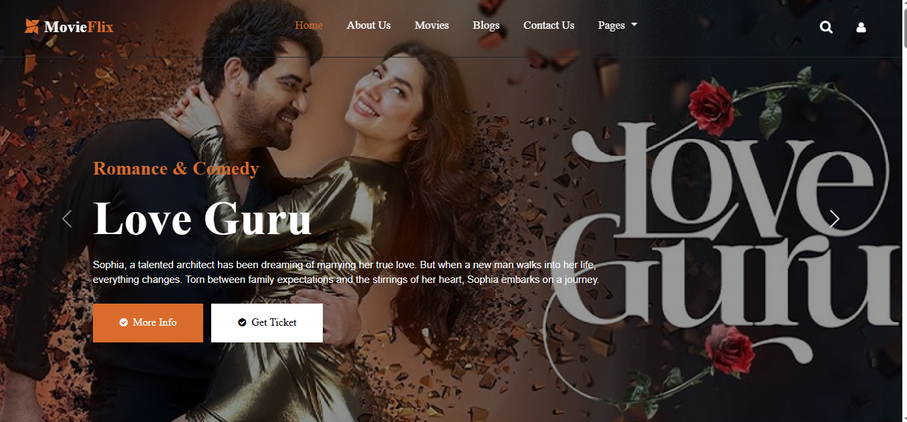
e
Navbar
Ye humara navbar hay ismay 8 pages hay or logout bhi hay her ek cheez navbar pr di gai work kerti hay hover or animation kay saath
or her ek pages data bse say connected hay or pages me droptown hay or uskay under 2 pages hay ticket or faqs kay search pr click
kernay say search bar khulta hay jese niche pic me hay or bandy pr click kernay say logout ka option ata hay or logout pr click kernay
say logout hojata hay or ye her page say connect hay her page pr show hoga
Pages > Faqs - Ticket
Search Bar
logout

Slide 4
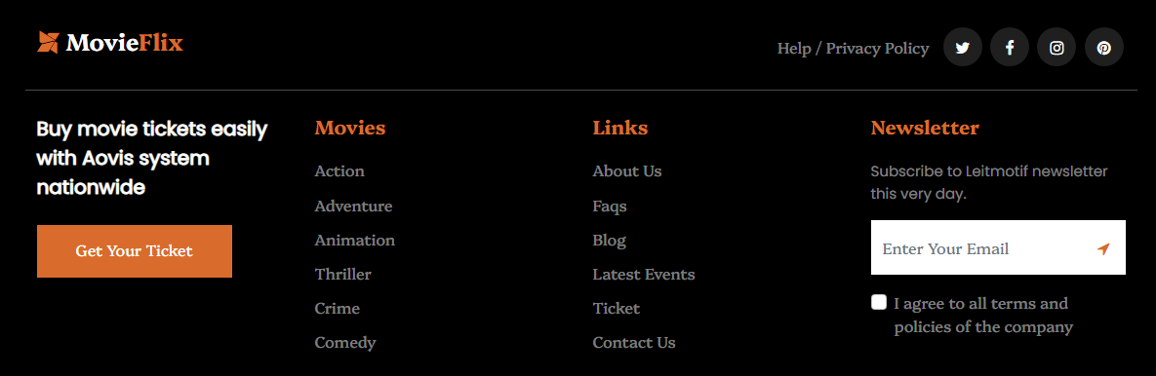
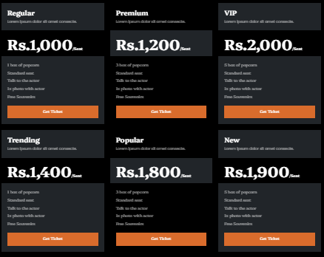
e
Footer
ye humara footer hay ismay diye gaye saray button work kertay hay or functionlaty provide kertay hay ismay bhi hover effects wagera sab add hay
or ye her page say connect hay her page pr ye footer show hoga or work karay ga e

Slide 5
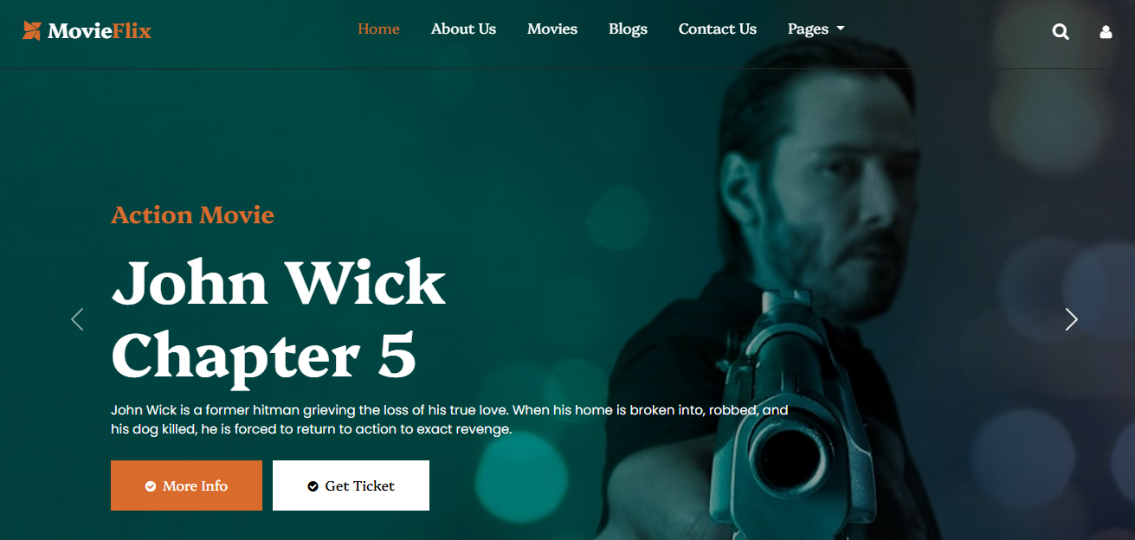
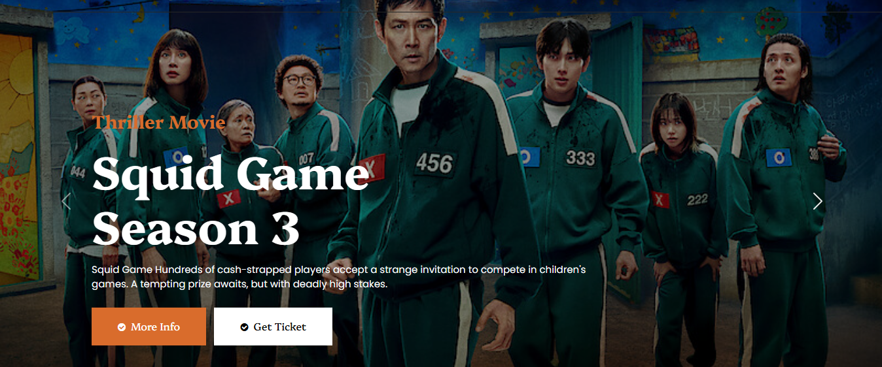
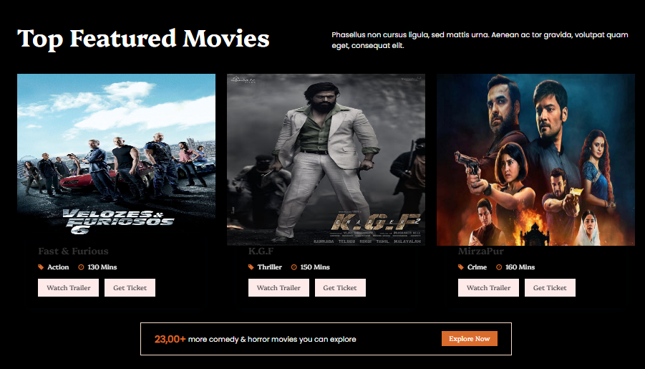
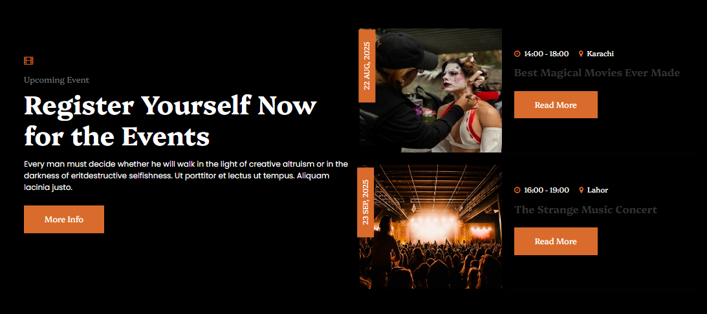
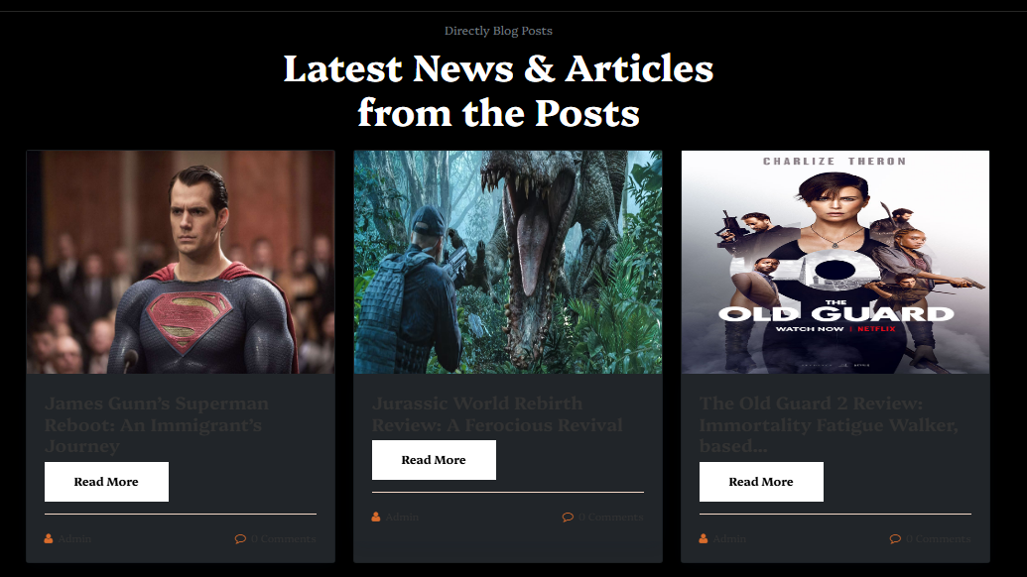

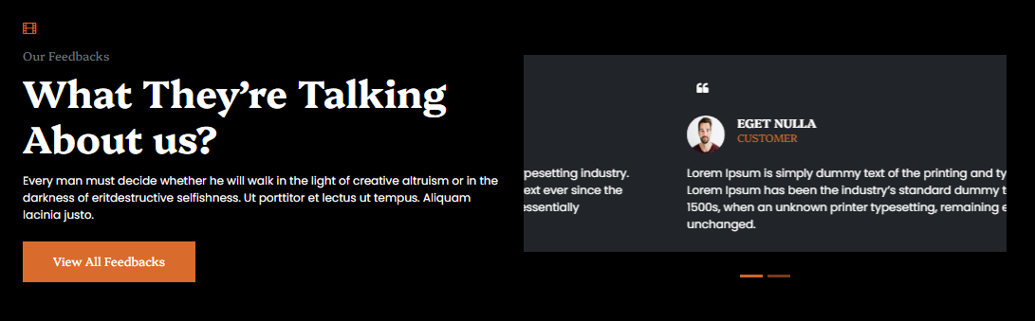
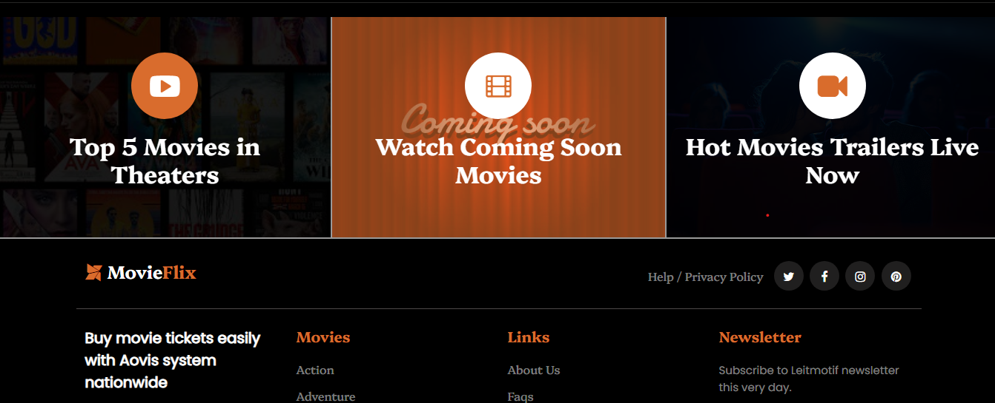

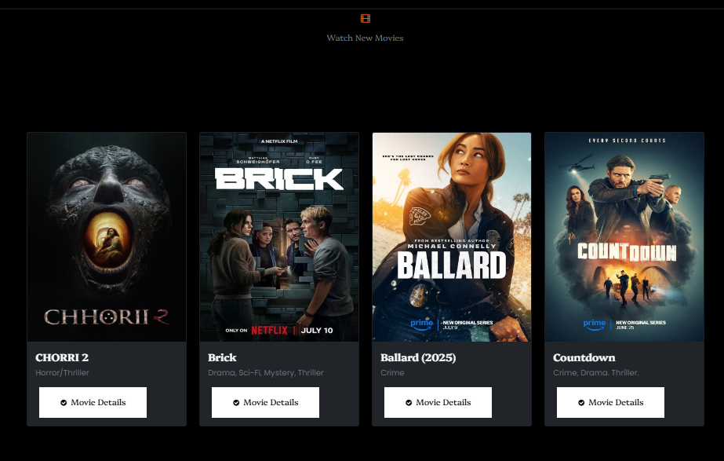
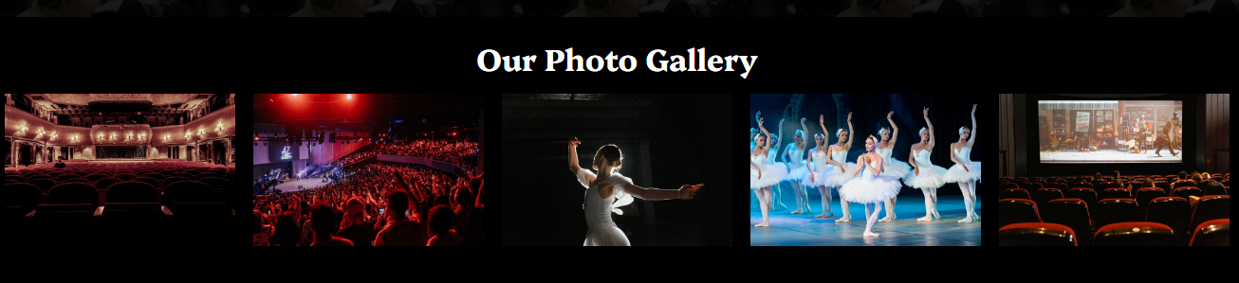
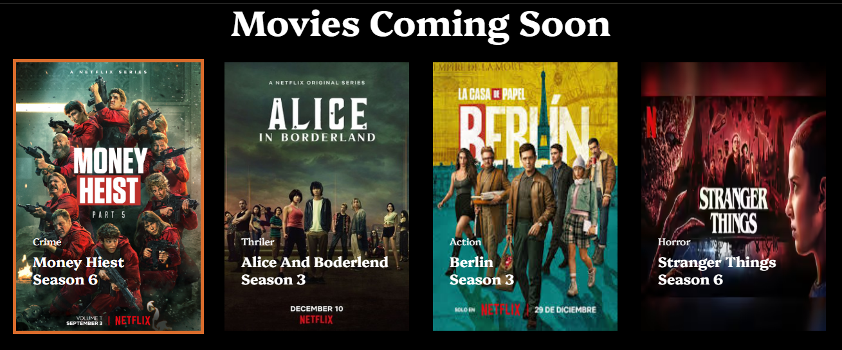
Home
Ye humara home page hay ismay jo miveis show ho rahi hay wo sab database say connected hay or sab functions provide kerti hay
movie pr click kernay say movie ki details khulay gi movie kay trailer bhi show hoga or blog pr click kernay say blog bhi shor hongay
or wo sab bhi databse base say connected hay or her cheez pr animation hay or hover effect bhi hay or get ticket pr click kernay say
ticket ka page khul jaye ga or waha say ap ticket book ker saktay hay or jo ticket book hogi wo bhi database pr show hogi
CRUSAL

Slide 6
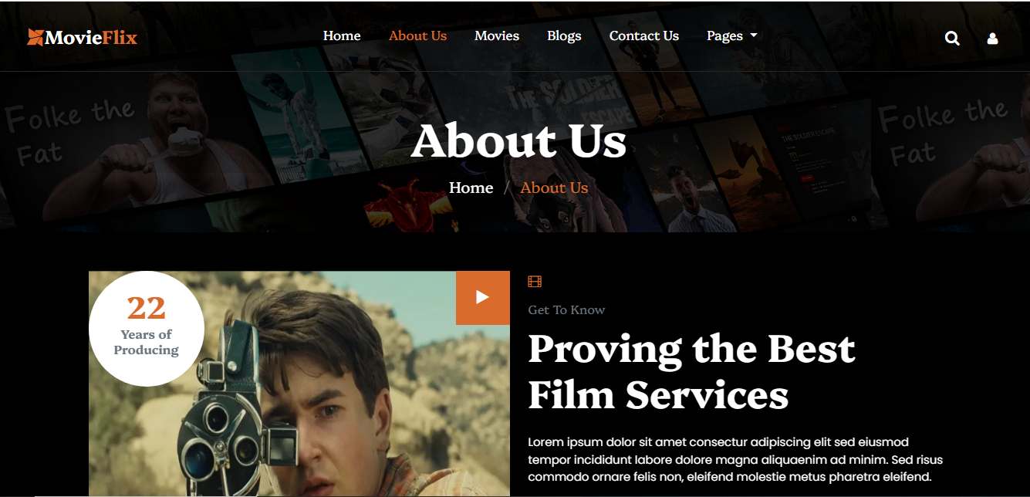




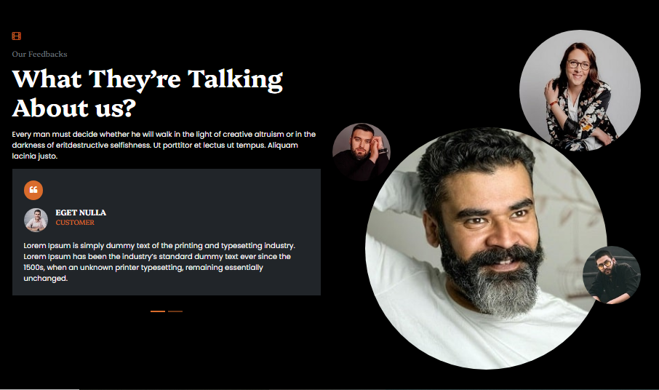
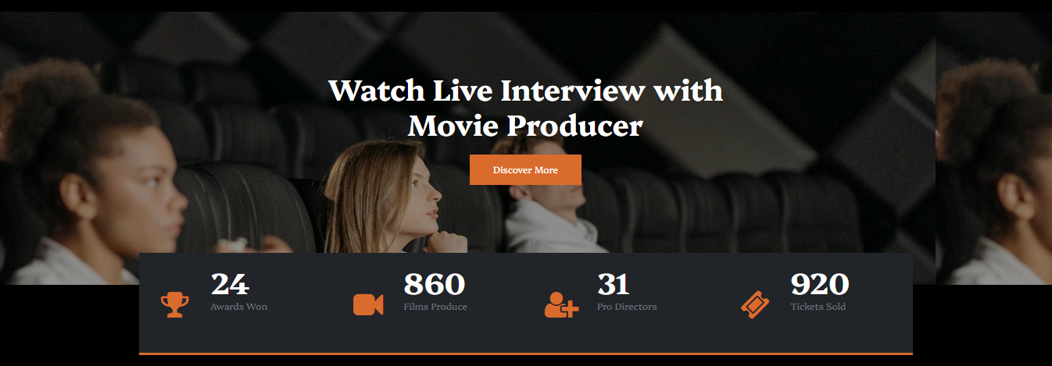
About Us
Ye humara about us ka page hay ismay hover effect hay or enimation hay or ye takriban static hay or ismay discover kay button pr antertake hay
or wohi normal navber or footer bhi hay

Slide 7
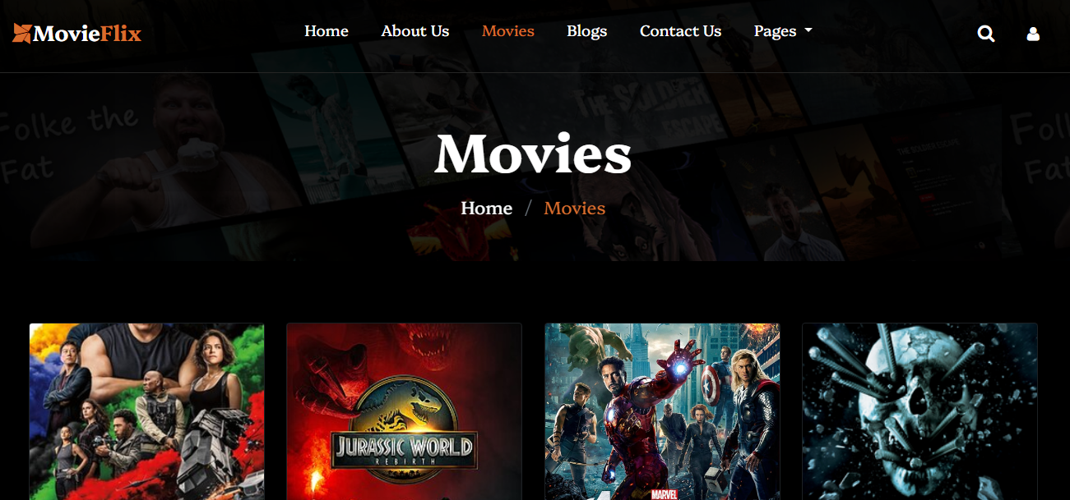
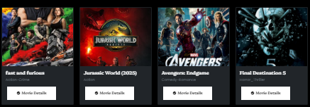
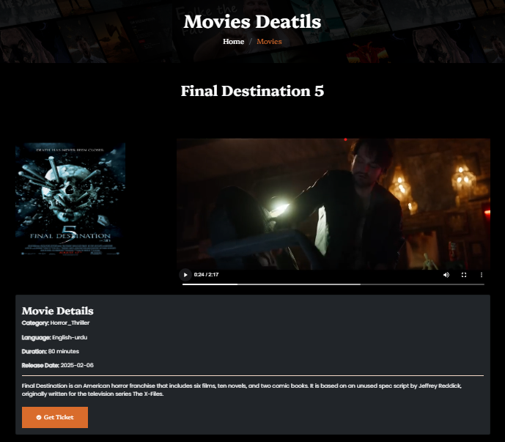
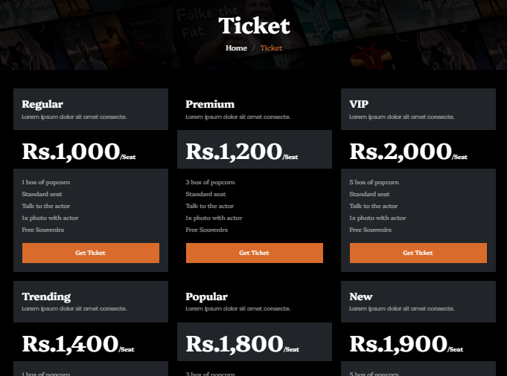
Movies
Ye Humara movies ka pages hay ismay jitni movies hay wo sab database say a rhi hay or uski details trailer sab database say a rha hay ismay may bhi
animation or hover effext wagera sab hay movies details pr click krkay movies details ka pages khulay ga or usmay di gai saari details data base say
connect hay or movie detail me jakr get ticket pr click kero gay to tickicket ka page khul gaye ga or jo ticket book karo gay wo databs me show hogi

Slide 8
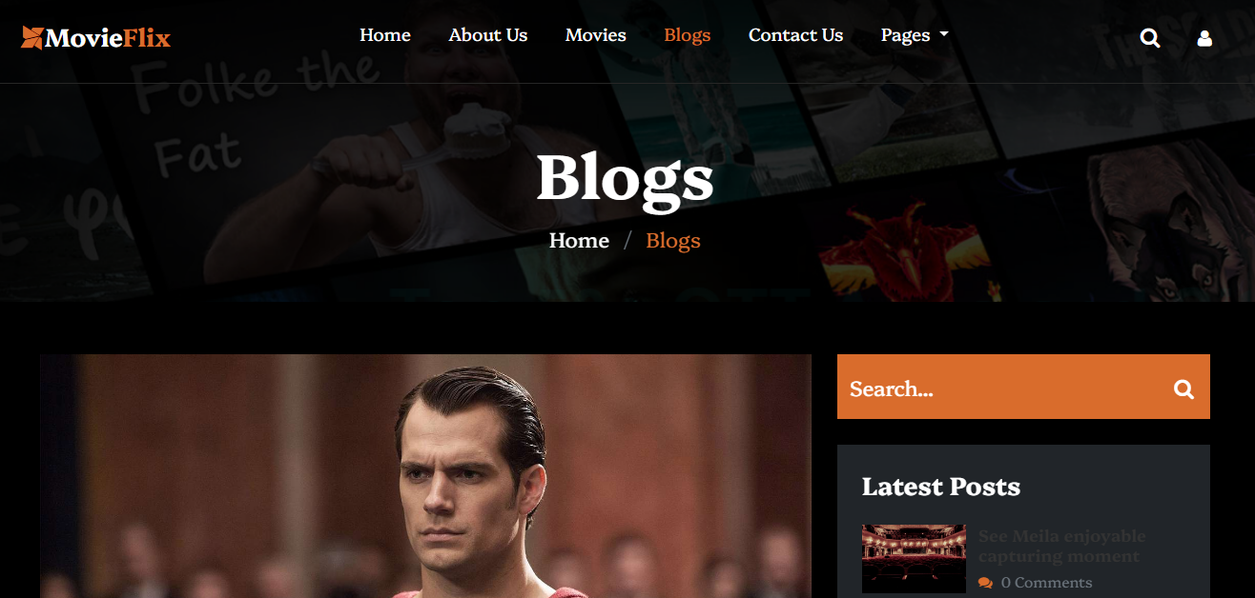
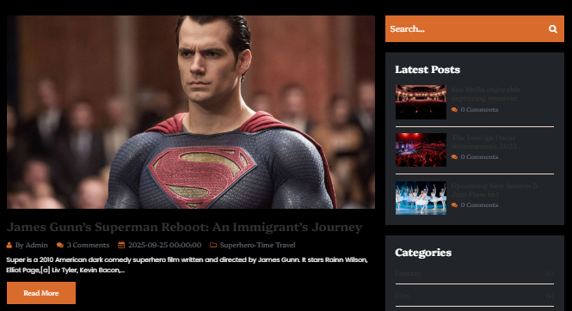
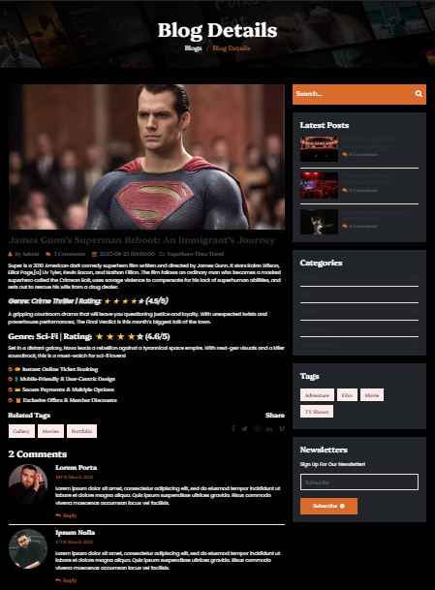

Blogs
Ye humara blog page hay ismay bhi animation or hover effect hay or saray blog database say a rhay hay or her ek ki details bhi database
say connected hay kissi bhi blog ki details ya picture ya button pr click kernay say uski details a jaye gi

Slide 9
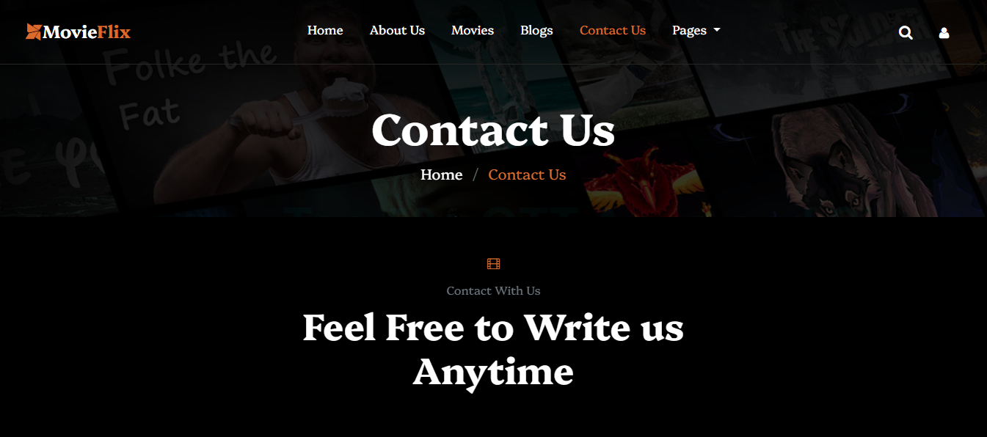
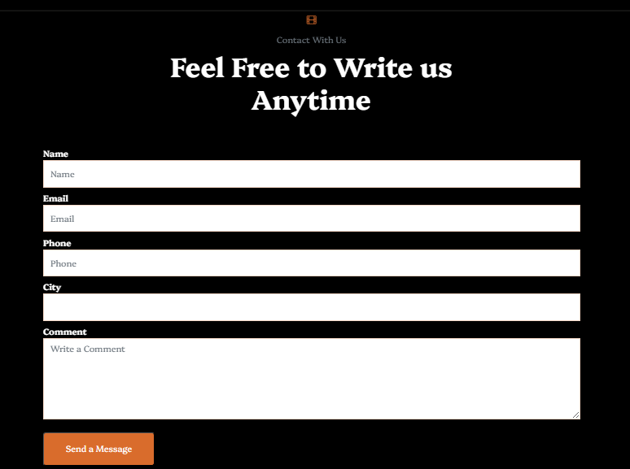
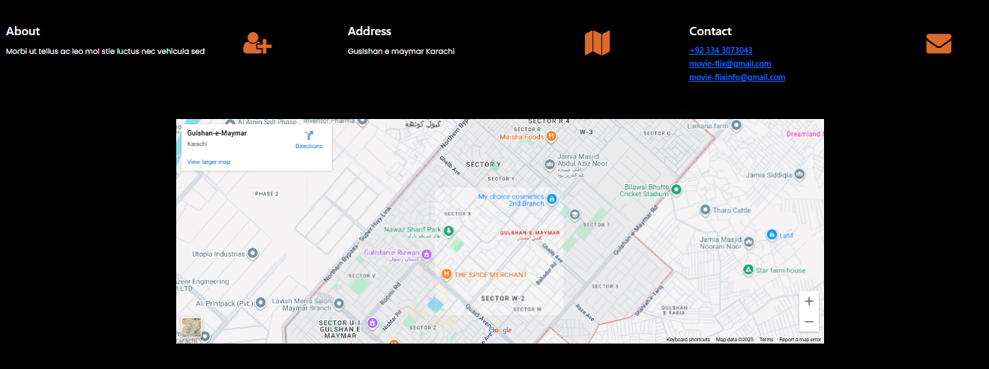

Contact
Ye humara contact us ka page hay ismay bhi animatio n or hover alert wagera sab hay simay user diye gaya form fill karay ga to sweet alert shot hoga
or sari details database pr shor hongi or ismay ek map bhi hay jo kay live google map hay

Slide 10
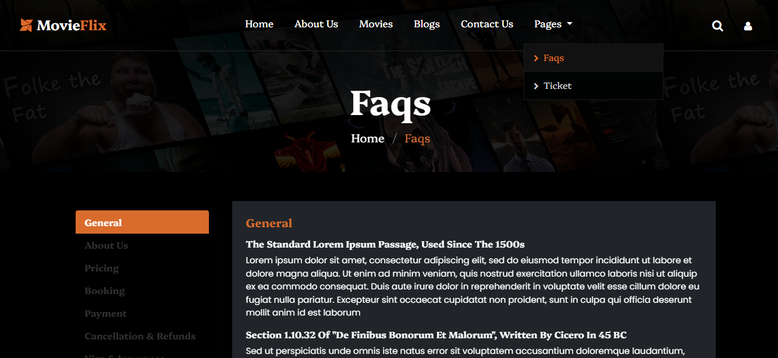
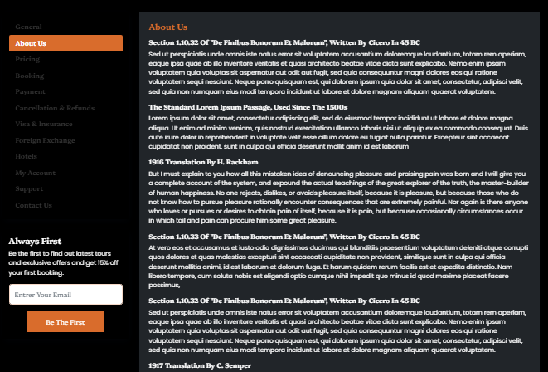
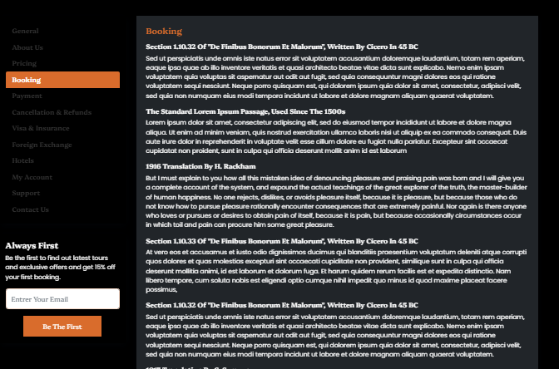
Faqs
Ye humara Faqs ka page hay ismay faqs describe kiya hay ismay bhi animation or hiver effects hay but ye ek static page hay lekin iskay actertake
hver animatio nbarpoor hay

Slide 11
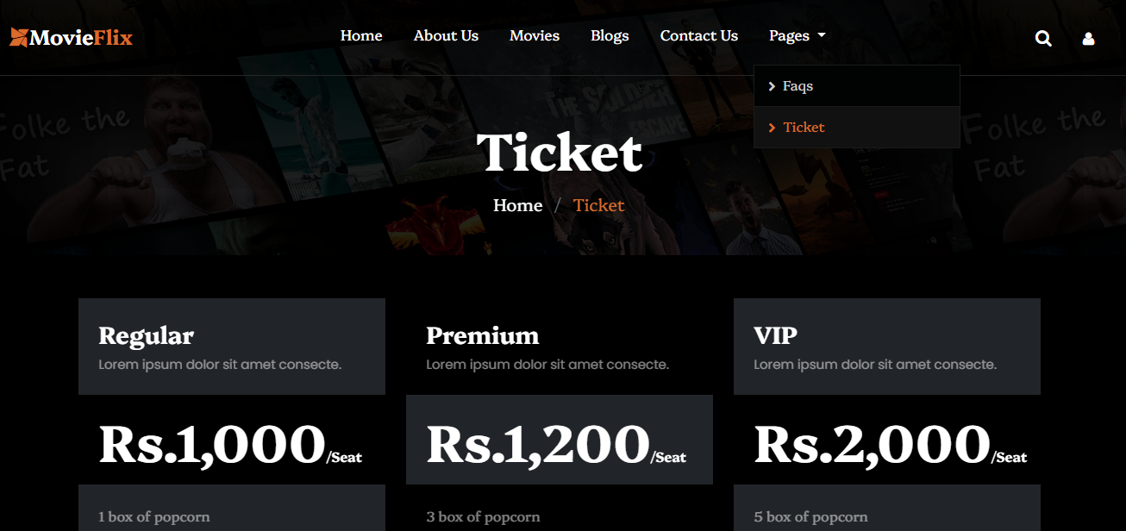
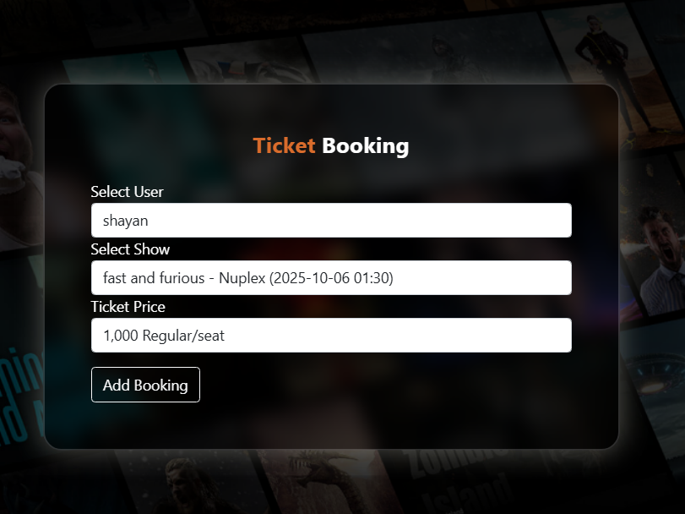

Ticket
Ye humara ticket ka page hay ismay bhi animation hover alert wagera sab hay ismay bhi jo user ticket book karay ga wo database me show hoga or
ismay wo wo movies ki ticket book hongi shot database me hay or wo yeha show ho rahi hay

Slide 12
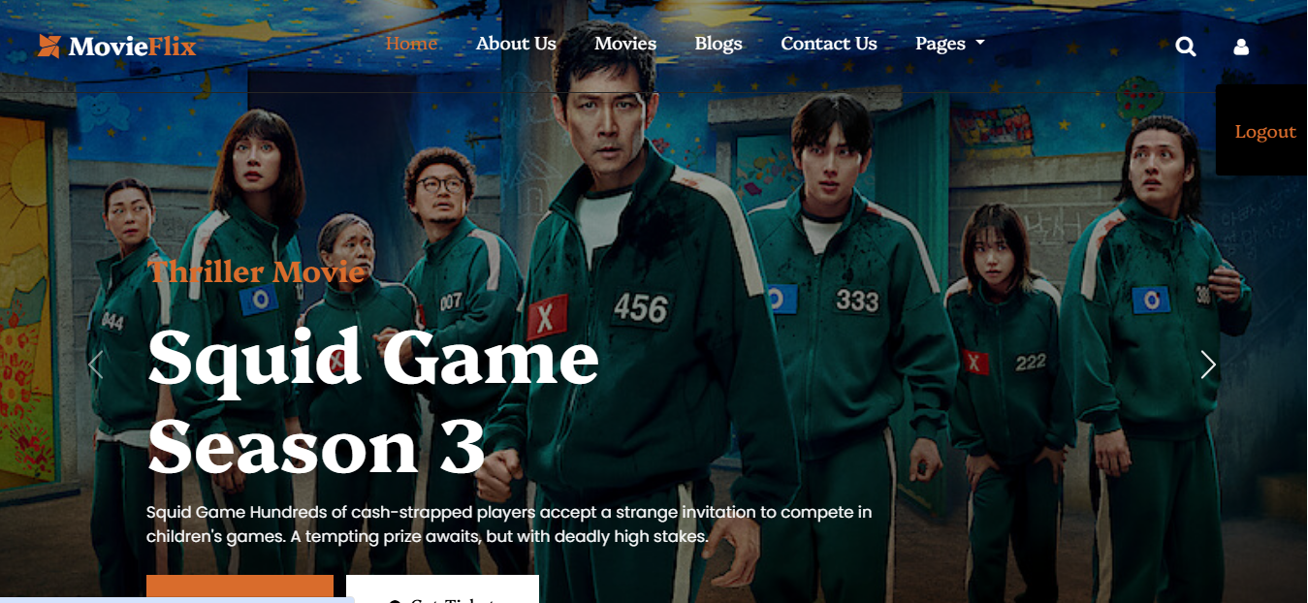
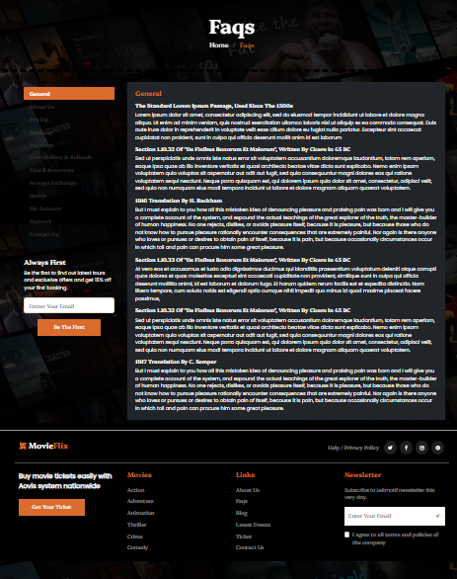
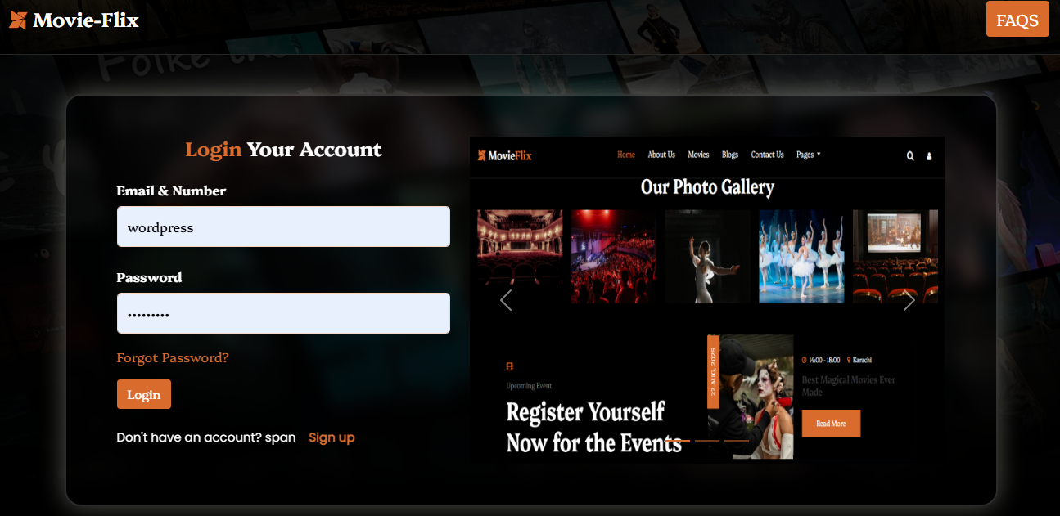
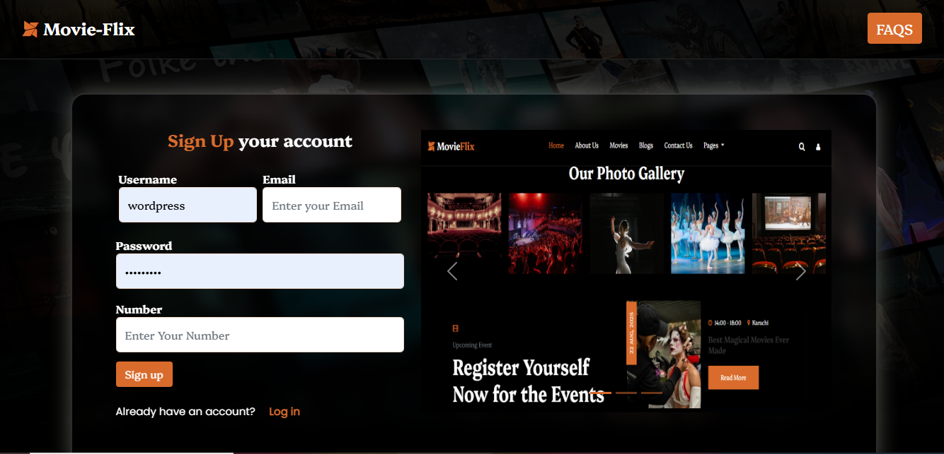

Logout
Ye logout or sign up login hay jismay proper logout hota hay sign up hota hay or login hota hay tamam user ki details database me show hoti hay
or her button function provide kerta hay ismay her tarha ki animation or hover effect bhi hay or crusel bhi hay or login user direct home page pr
re direct hota hay
Log In
Sign Up

