Slide 1
无人机组会
龚畅阳
2019/3/14

Slide 2
目录 Contents
1
回顾已确定的做法
2
新的一个验证做法

Slide 3
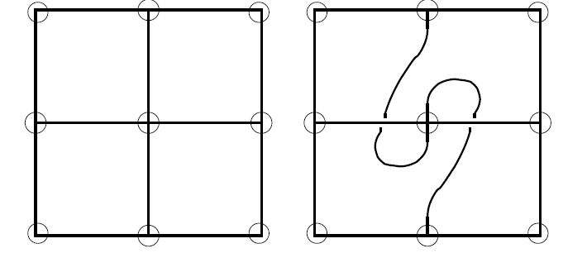
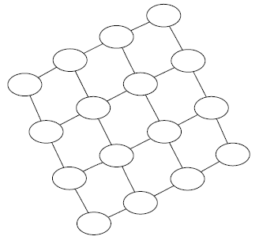
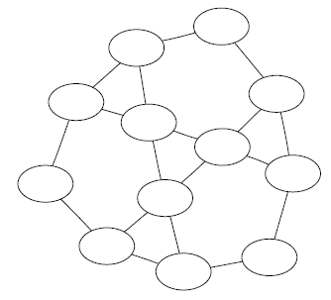
Topological SLAM

Slide 4
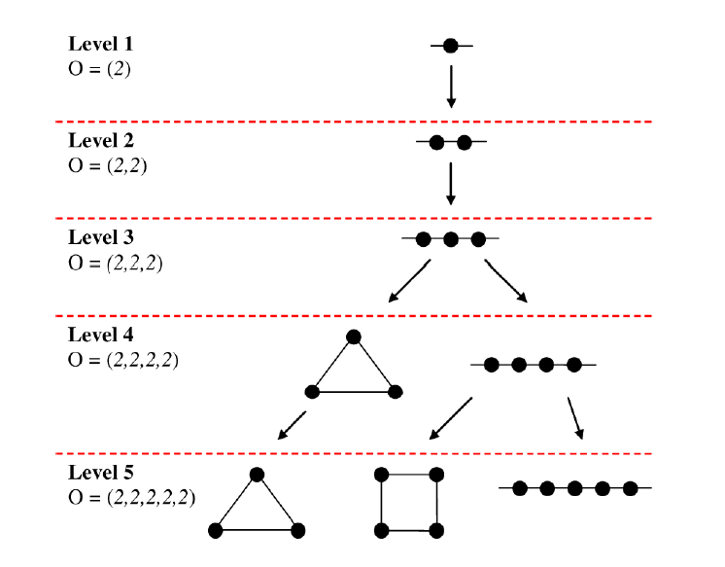
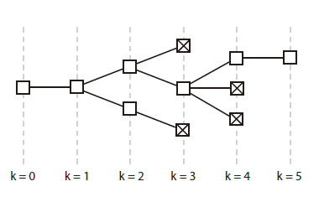
The Growth of hypothesis tree
Map Candidates (hypothesis)

Slide 5
The Growth of hypothesis tree
Experience
From —— To
Map Candidates (hypothesis)
Step 0
Step 1
Step 2
Step k

Slide 6
Separated storage of hypothesis
Topo Node
Topo Edge
Map Candidate
Map Collection
Node Instance x3(real experience)
Node Collection

Slide 7
Separated storage of hypothesis
Robot
Node details are stored in node instances, the usage and references are connected to each other
1
2
3

Slide 8
Separated storage of hypothesis
New Instance!
4
At first consider it to be a brand new node
If it conflicts with the hypothesis, this map will be deleted
1
2
3

Slide 9
Separated storage of hypothesis
Check the usage in the map if it is possible
New Instance!
Find similar nodes
4
1
2
3

Slide 10
Separated storage of hypothesis
Clone the map with possible loop close
New Instance!
Find similar nodes
4
1
2
3

Slide 11
Separated storage of hypothesis
Modify it to be a loop closed one
New Instance!
Find similar nodes
4
1
2
3

Slide 12
Separated storage of hypothesis
Add the instance into node collection
New Instance!
Find similar nodes
4
1
2
3
4

Slide 13
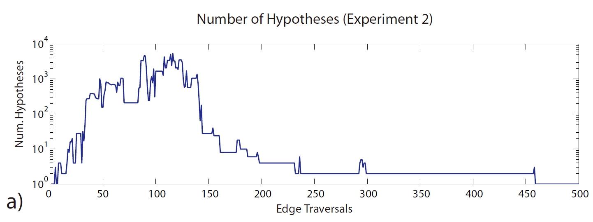
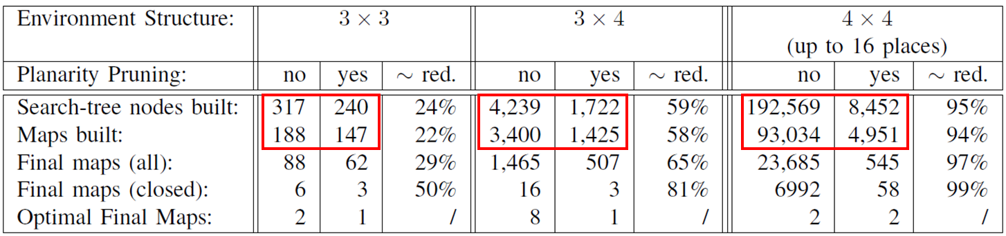
Hyper exponential growth

Slide 14

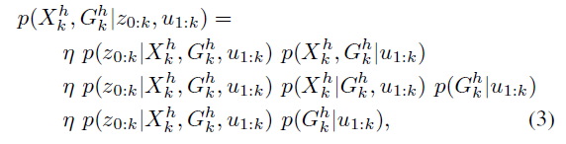
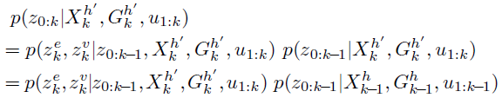
A bayesian framework
k: k steps in the map, from 0 to k
u: motions, move through which gate
z: measurements, odom, semantic
G: the map hypothesis
X: robot state, where it is
The robot always move as expected
=1
can be computed recursively

Slide 15
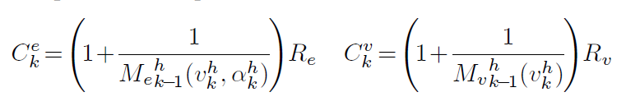
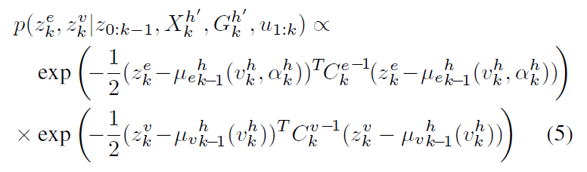
A bayesian framework
k: k steps in the map, from 0 to k
u: motions, move through which gate
z: measurements, odom, semantic
G: the map hypothesis
X: robot state, where it is
C conv with measure times
Indicates that the influence will be greater after serval measures
μ the average of the measurements

Slide 16

A bayesian framework
k: k steps in the map, from 0 to k
u: motions, move through which gate
z: measurements, odom, semantic
G: the map hypothesis
X: robot state, where it is
Adding a fractor
C conv with measure times
Indicates that the influence will be greater after serval measures
μ the average of the measurements

