Slide 1
Twitter Topic Map
A graduation project by
Brett Nelson
Advisor:

Slide 2
Questions to Answer
When determining what subjects people are most interested in, how much does geographical position matter?
Can public Twitter data be used to draw predictions on public opinions before more traditional surveys publish results?

Slide 3
Objectives
Process fast moving twitter data in a scalable way
Expose results of processing in a publically facing website
Store processed twitter data for fixed amount of time for historical analysis
Answer questions on previous slide

Slide 4
Design
There will be two main projects, the Frontend and the Backend
FrontEnd
The webapplication that users will utilize to display the twitter data
Will implement a MVC architecture using Spring
Mybatis will be used to decouple data access objects from Database logic
Backend
Contains retrieval, processing, and storing of twitter data form Twitter API
These two components will be executing on two separate machines ideally.

Slide 5
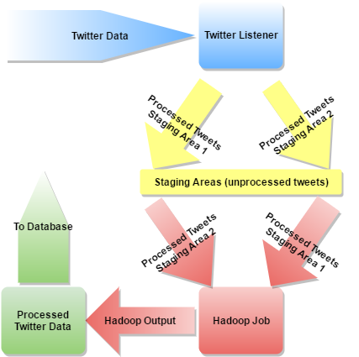
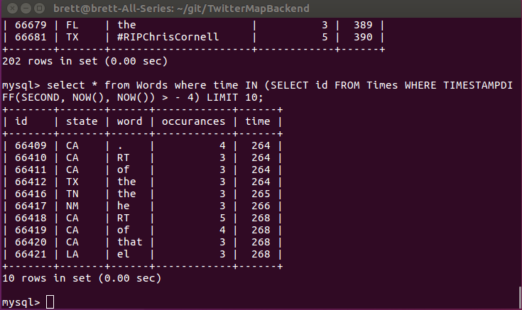
Implementation - Backend
Hadoop was chosen to process the mass amount of data retrieved from the Twitter API
The architecture was designed to eliminate all I/O, Database, or Hadoop bottlenecks
When the tweet data is being stored in staging area 1, Hadoop is accessing the staging area 2 data to process, and visa-versa
Once the data has been processed, it is uploaded to a MySQL database with a timestamp. This is then used by the website to display the data
Each word is associated with a time bucket, which dictates what timeslice the word was retrieved on.

Slide 6
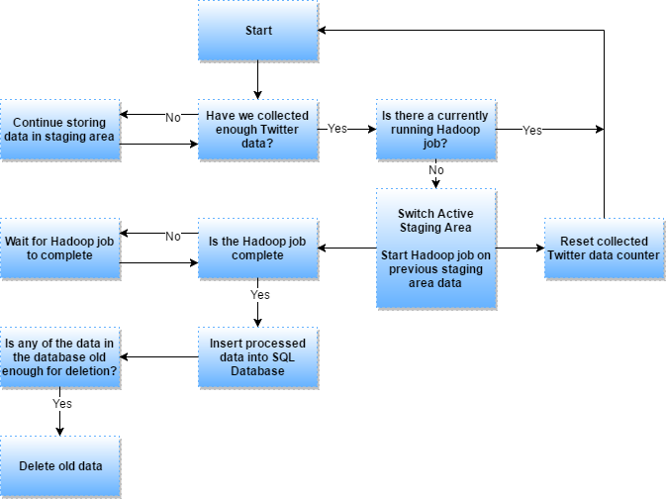
Backend - Flow

Slide 7
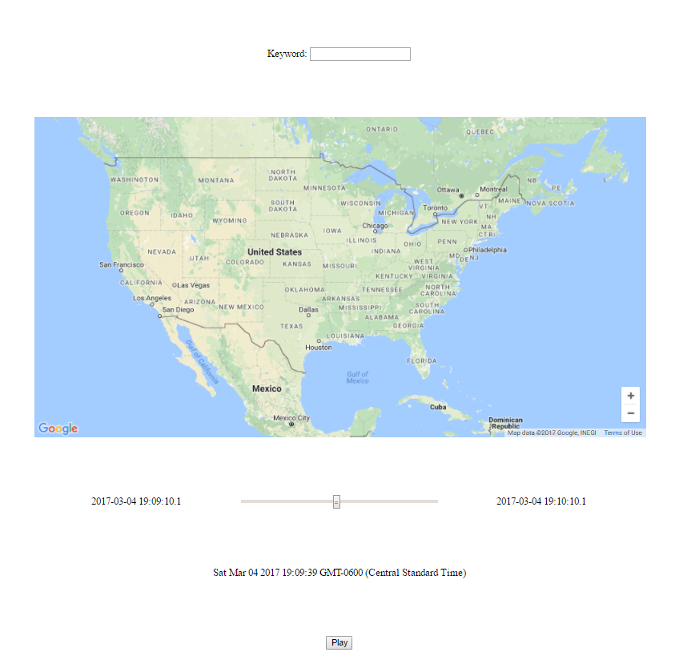
Implementation - Frontend
The UI is minimally designed, with only essential functions exposed.
The Google API was chosen to draw the map and markers, as well as handle zooming and positioning
Time modifiers are in design to slow down or speed up viewing time.

Slide 8
Frontend usage
First, the user enters a search term
Then, the user can select “play” and the map displays where tweets mention the topic
The user can adjust the time they are viewing, as well as pause the playback at anytime

Slide 9
End

