Slide 1
Fusion3D Viewer
Advanced Features
Highlighting Vertical Obstructions

Slide 2
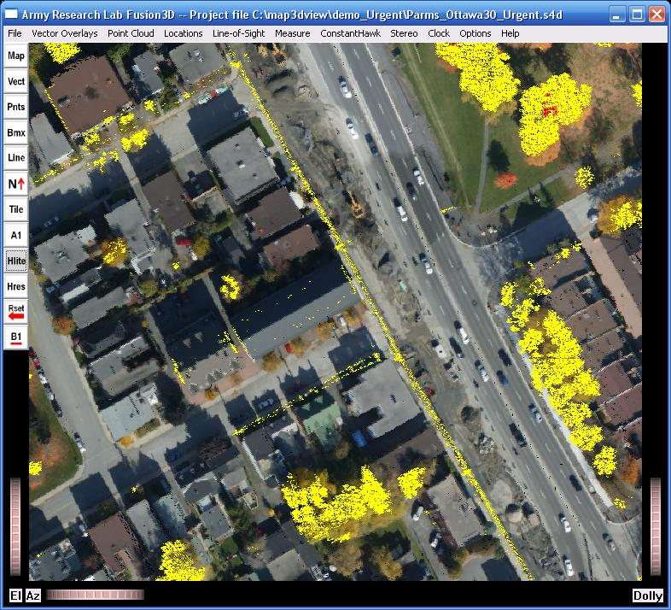
Highlighting Vertical Obstructions
Highlight all objects that are significantly above the local ground plane
Highlighting toggled on and off using button
All points 20m or more above are shown in red
All points 10m-20m above shown in yellow
Thresholds can be changed thru menu item ‘Highlight Elevation Thresholds’ under ‘Measure’ menu
Restrictions
Only when both first-hit and last-hit DEMs available like BuckEye (uses differences between ‘a2’ and ‘a1’ DEMs)

